Slide 1
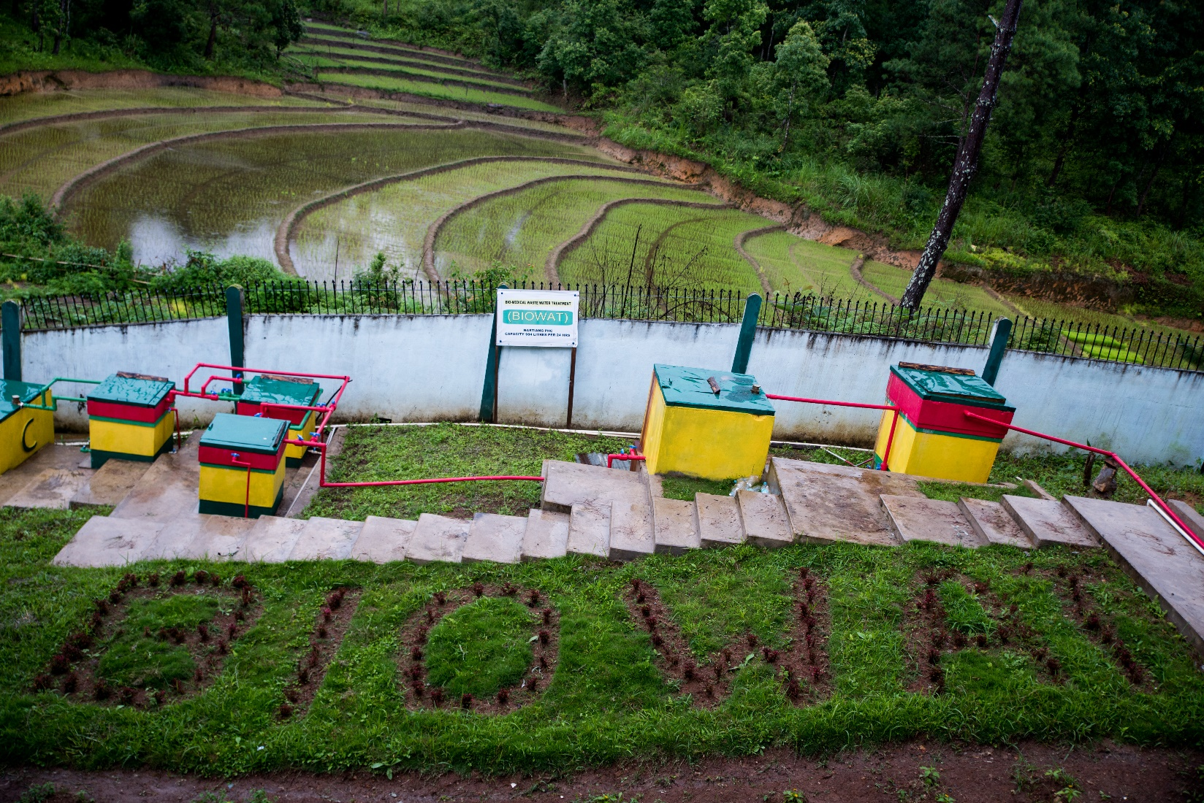
The BIOWAT

Slide 2
Problem Statement

Slide 3
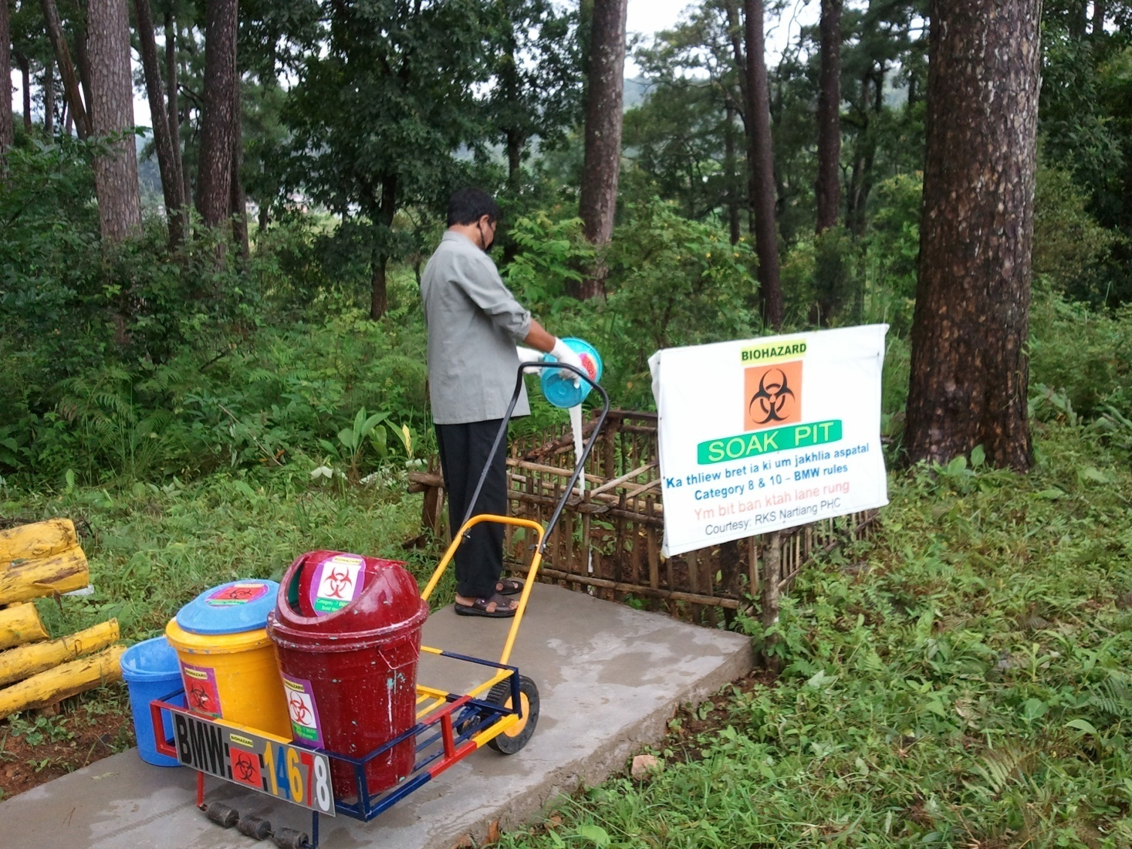
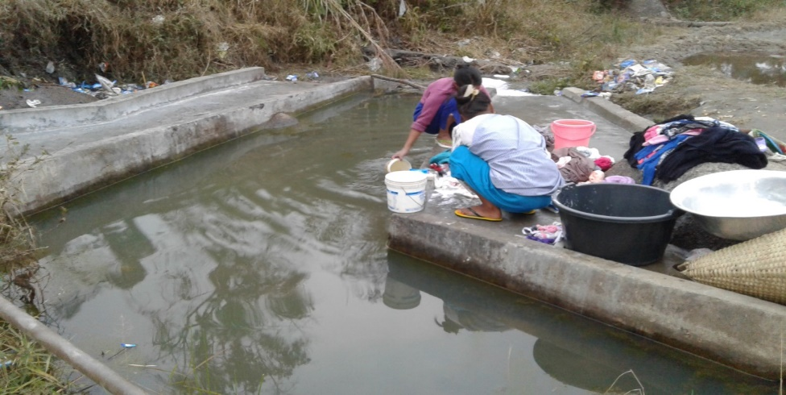
(Environmental Issues)

Slide 4
Description
BIOWAT- short for Biomedical Waste Water Treatment
An improvised facility for the treatment & disposal of liquid waste (Biomedical waste water) generated at Primary Health Center, Nartiang West Jaintia Hills Meghalaya.
At BIOWAT, following a simple primary, liquid waste undergoes four stages of treatment before disposal viz.,
Intermittent/Demand operated Slow sand filtration
Chlorine Disinfection
Carbon Adsorption
De-chlorination with Vitamin-C(ascorbic acid)

Slide 5
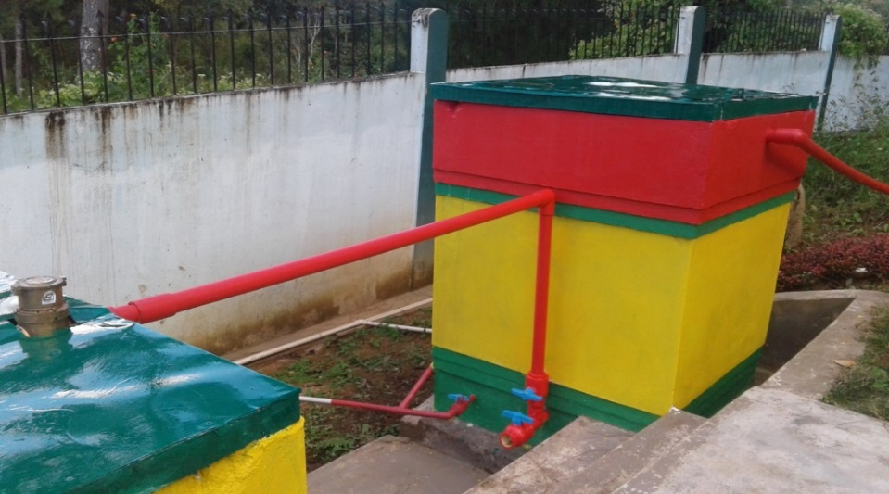
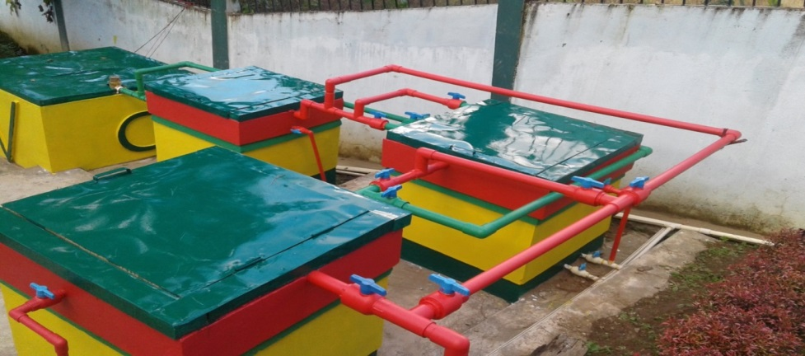
SSF (Demand Operated)
GAC Bed-3
GAC Bed-2
Flow Meter-1
GAC Bed-1
Chlorine contact Tank

Slide 6
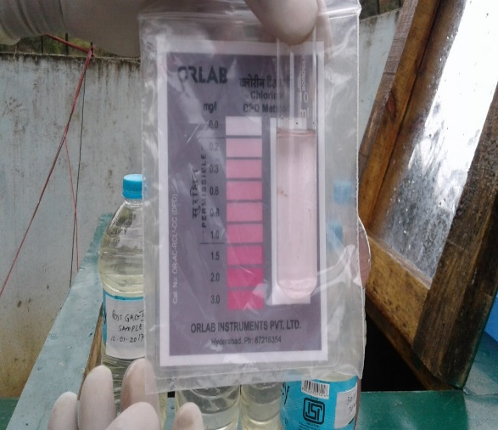
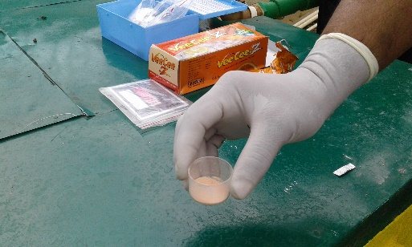
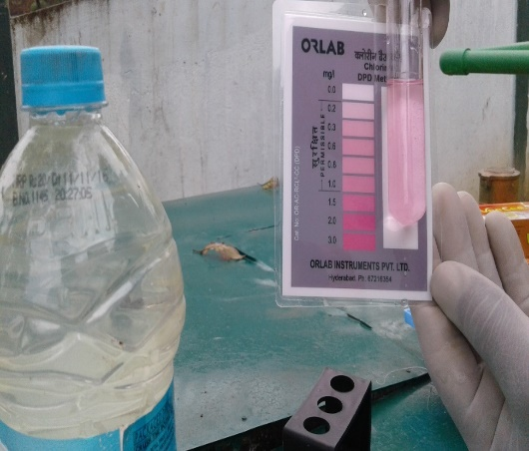
At BIOWAT, dechlorination with Vitamin-C(ascorbic acid) is the final stage of treatment of biomedical waste water. Free residual chlorine is neutralized based upon a reaction by M.W.Tikkanen et al., in 2001.

Slide 7
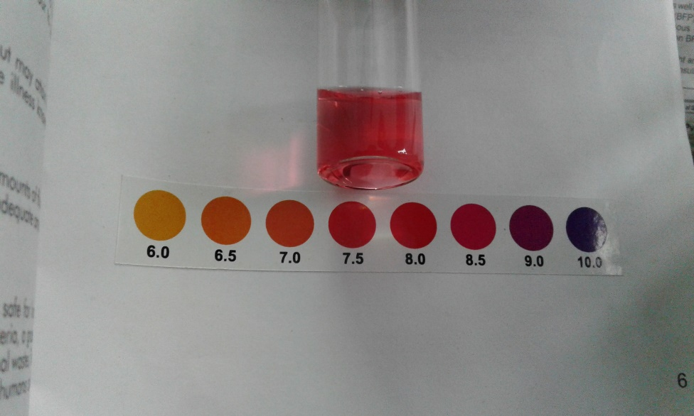
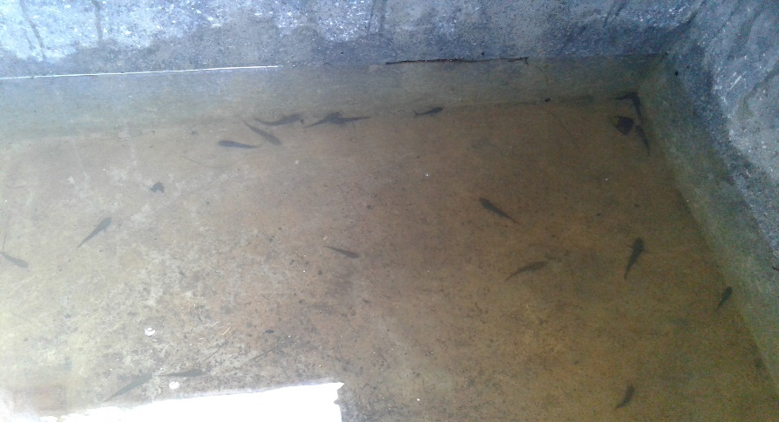
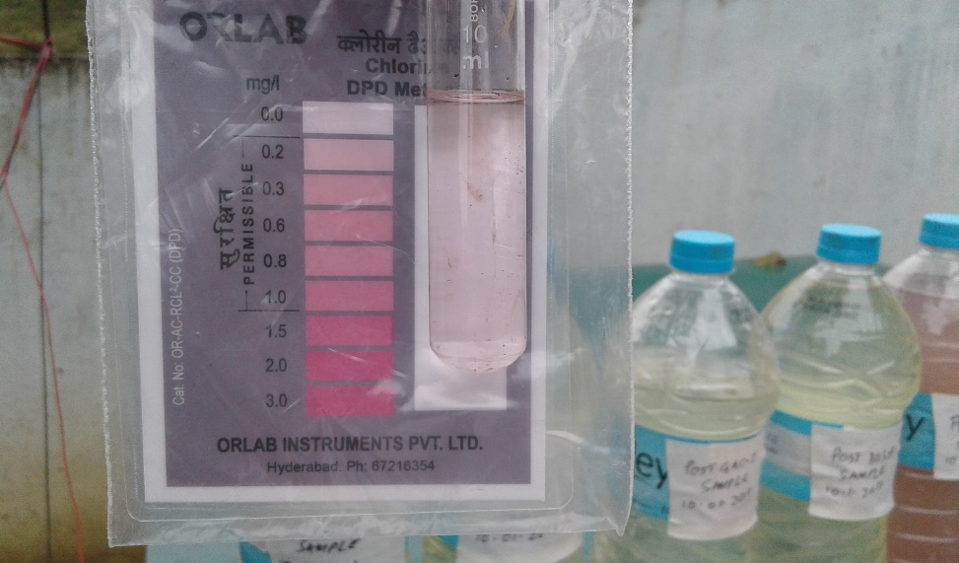
Outcome
(Discharge parameters of effluent)
Free Chlorine : 0mg/L
pH: 7-7.5
Fish survival 100%>96hrs
Turbidity: < 5NTU

Slide 8
Estimated cost:
Initial Start cost: Rs.200000/- (rupees two lac only).
Daily running (logistic support)cost:Rs.20/-(rupees twenty only)
Annual (cost of GAC): Rs.10000(rupees ten thousand only)
Partners:
Health Engineering wing

Slide 9
Benefits:
Simple operation and maintenance
Efficient removal of chlorine
Zero energy consumption for daily operation
Low cost – start up and running
Scalability:
Health Department in the process of replication at PHCs & CHCs

Slide 10
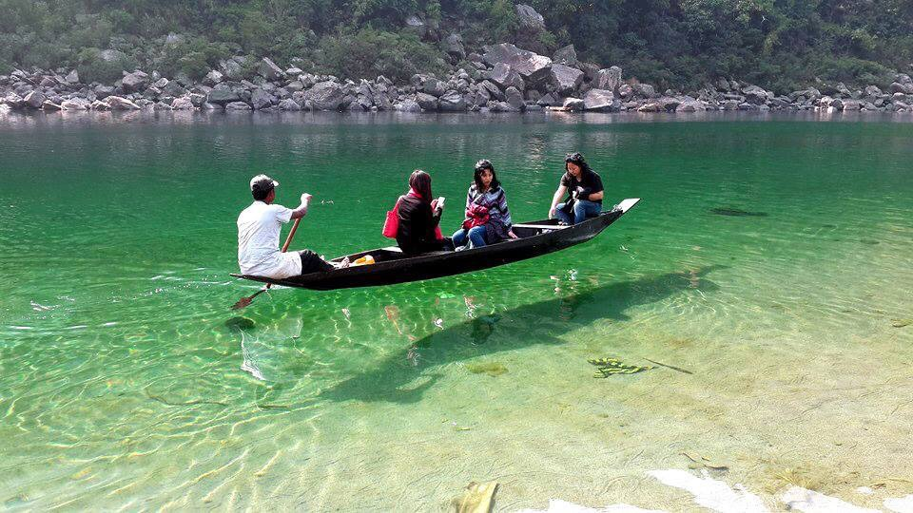
THANK YOU

