Slide 1
Engaging Chemists to Strengthen TB Notification

Slide 2
Background
46% TB patients not known to National Programme
> 80% of initial care-seeking is in private sector
Based on prescriptions from informal health care providers anti-TB drugs was available over-the-counter
Inspite of TB being a Notifiable Disease NOT all private practitioners are notifying
Plos One 2011; 6(9): e24160
Plos One 2012; August 6

Slide 3
Opportunity
Government Notifies Schedule H1 drugs Over-the-counter sale of 46 drugs restricted from March 1, 2014
The list includes 11 anti-TB
Drugs will carry a Boxed Label Warning that
should not be sold without a prescription issued by Registered Medical Practitioner
self-medication of the drug preparation can be dangerous.
The new rule mandates the chemists and druggists
To maintain sales register and
To retain the physician’s prescription copy as a proof of drug sales.

Slide 4
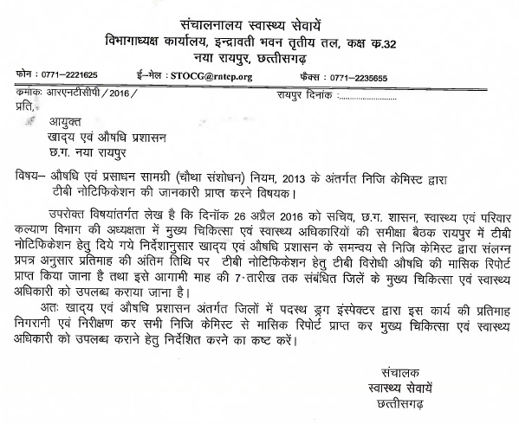
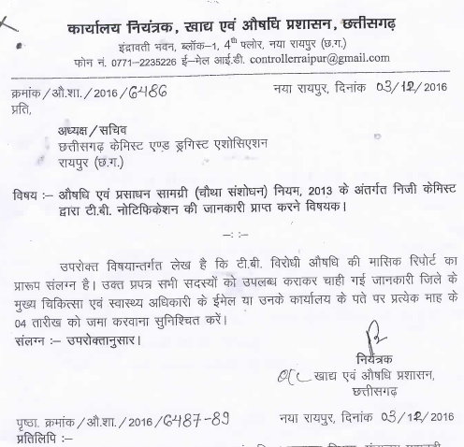
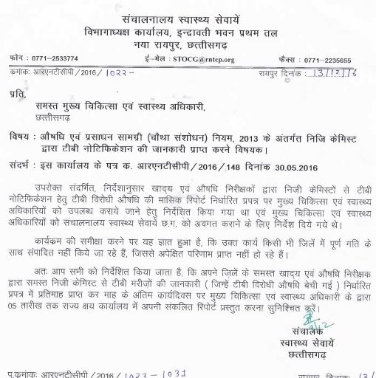

Administrative Actions
DHS letter to Commissioner FDA
Commissioner FDA to Chemist Associations
DHS letter to CMHOs

Slide 5
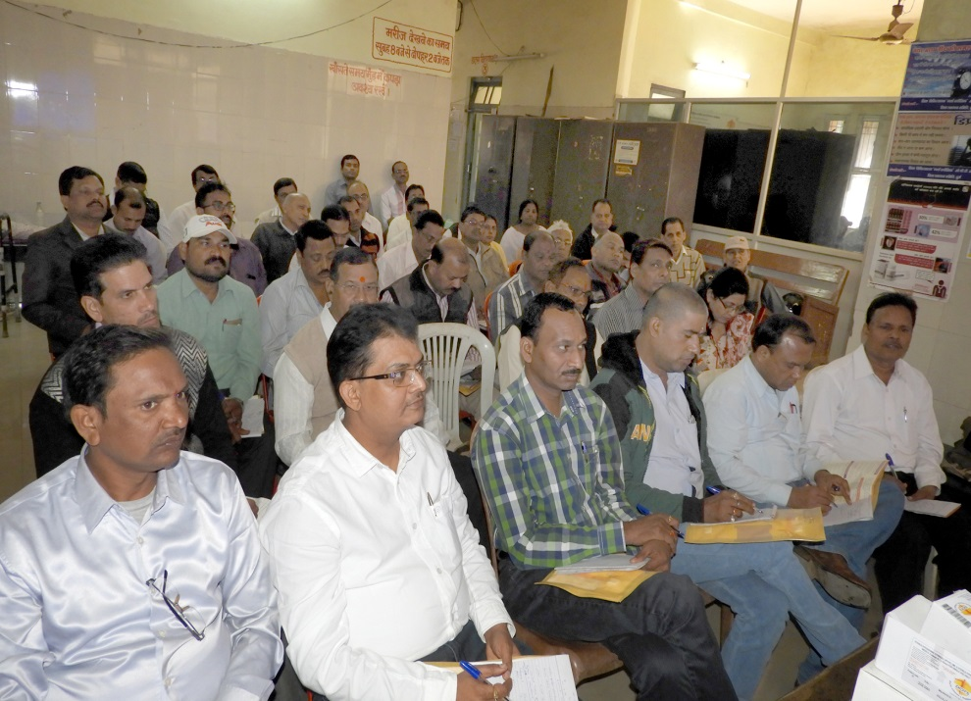
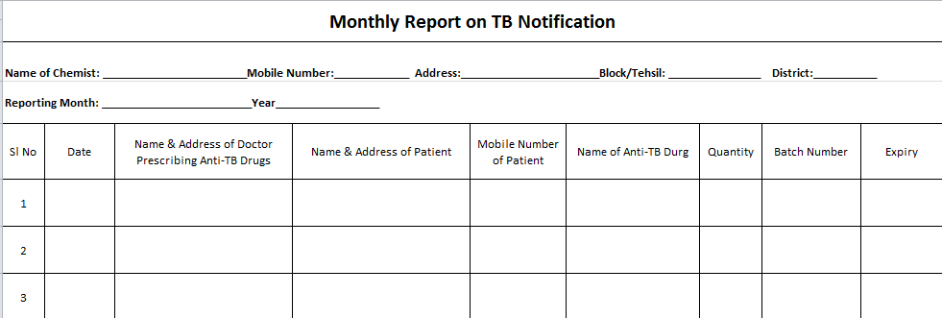
District Preparedness & Actions
Sensitization workshop of Chemists by the districts
Monthly Coordination Meeting of Drug Inspectors with RNTCP staff
Drug Inspectors collect notification information from Chemists in a structured format.

Slide 6
Outcome of Efforts
TB patients notified from Chemists

Slide 7
TB Notification from Chemist - Tool to Strengthen Private Partnership
TB Notification information from Chemists is being utilized to track back those private practitioners NOT notifying TB cases
State-wide baseline information now available that 41% chemists sell anti-TB drugs
Policy being developed to partner with Chemists for providing FREE anti-TB drugs under RNTCP

Slide 8
Impact on TB Case Notification Public & Private Sector (per lac population)
142/lac
126/lac
128/lac
104/lac

Slide 9
50% TB patients treated in Private Sector
Bilaspur
Raipur
TB in Public Sector
TB in Private Sector

Slide 10
Way Forward….
De-duplication of TB Notification from Private Practitioners & Chemists to generate accurate information
Plan to Keep FREE Anti-TB Medicines at Selected Chemists & Private Practitioners
Drug Sales data from chemists can be utilized for estimating privately treated TB cases
Anti-TB prescription practices of private sector – is there a need to regulate wrong treatment practices??

Slide 11
Undernutrition and Tb In chhattisgarh
40000 new patients every year
Undernutrition is a much bigger problem than MDR Tb
90% of our people with tuberculosis are malnourished, 55% have severe undernutrition
average weights of adults with tuberculosis are (PLOS One 2013, JSS study)
33 kg in women and
39 kg in men.

Slide 12
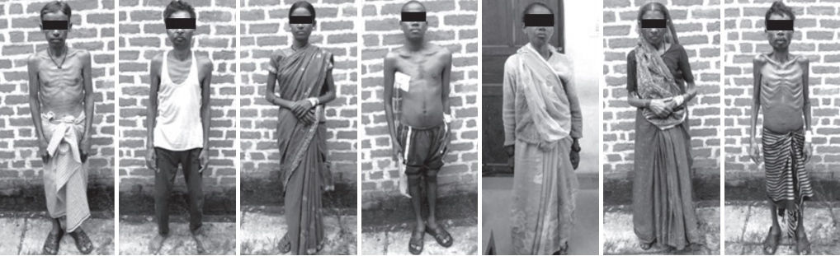

Slide 13
What can Supplemental food do to Tuberculosis care
Deaths reduced by two thirds
Improved compliance: food , less side effects
Improved weight gains
Return to work
Possibly less relapses

Slide 14
Mukhyamantri Kshay Poshan Yojana
1 kg milk powder, 1.5 kg shelled groundnuts and 1 kg soyabean oil each month for all Tb patients for entire course
First state in India to do this: trailblazer
Budgetted in the state budget.

