Slide 1


4th National Summit on Good and Replicable Practices and Innovations in Public Healthcare Systems
6th – 8th JULY, 2017
HM & FW Department, Govt. of Andhra PradesH
IT system for screening and follow-up
of NCD Patients (MMHC)

Slide 2
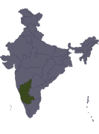
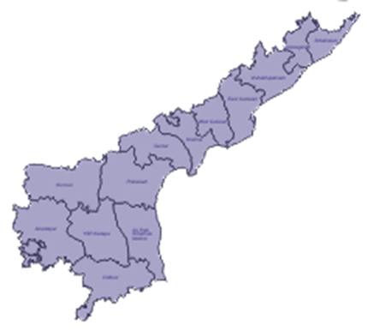
MMHC - Andhra Pradesh State 2016
(Mahila Master Health Checkup)
Partners
Coverage
Health Services
Solution
7 Conditions - Oral, breast and cervical cancers, hypertension, diabetes, hormonal disorders and vision disorders
6 Million Rural Women between 30-60 years.
HM&FW Program - NCD Screening & Treatment
Citizen Health Records (Aadhaar), Mobile Apps
Health Platform, Web apps, Dashboards
11,850 ANMs, 450+ doctors, 100+ Health Officials
Tata Trusts – Deployment Partner
Dell-EMC – Technology Partner

Slide 3




MMHC Program Flow
Continuity of Care
Patient referred up
11 Tertiary Hospitals
Screening & Treatment
by Specialist Doctors
Patient referred up
57 Secondary Hospitals
Screening & Treatment
by Specialist Doctors
1075 PHCs, 277 MMUs
7617 Subcenters
Follow up
Initial screening by ANM & MOs
10 women / week
Follow up
Woman goes home with booklet

Slide 4
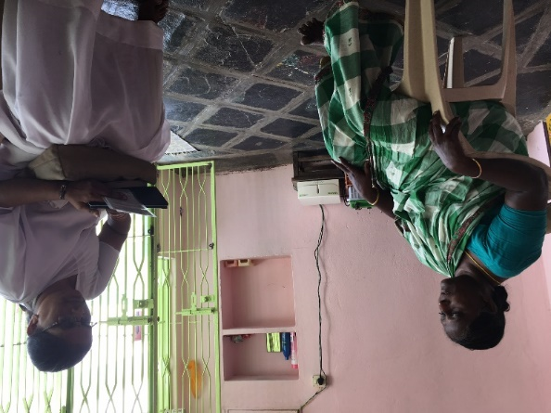
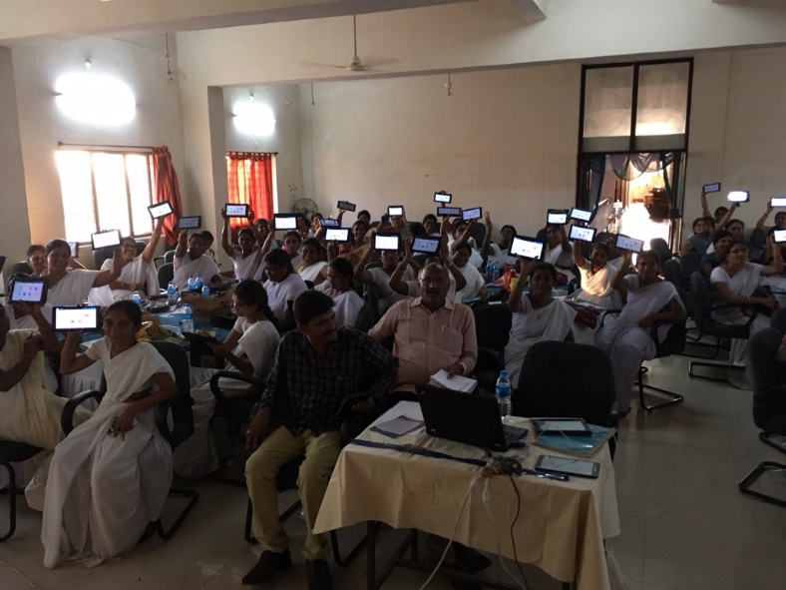
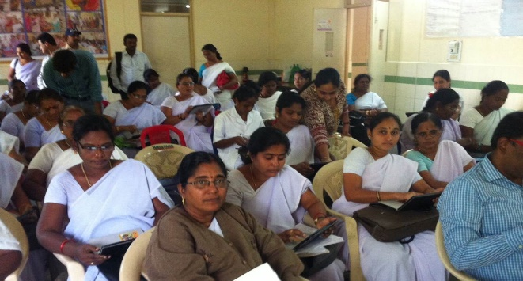
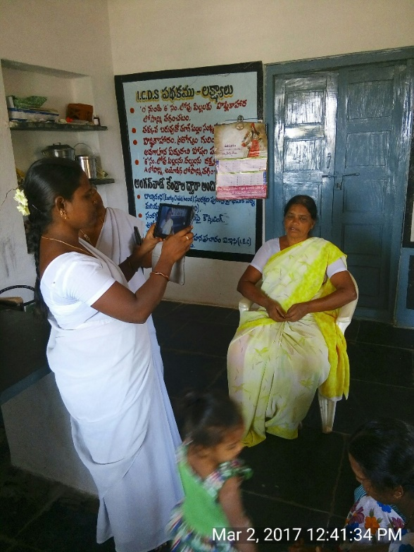
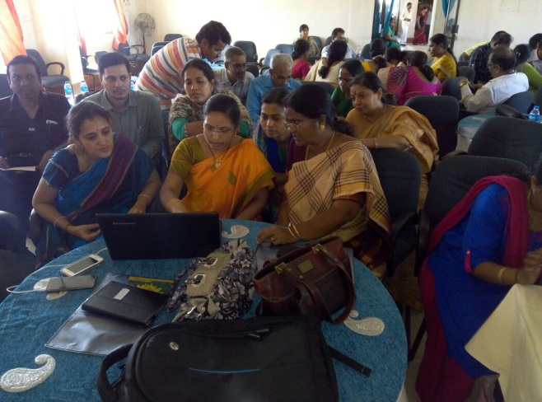
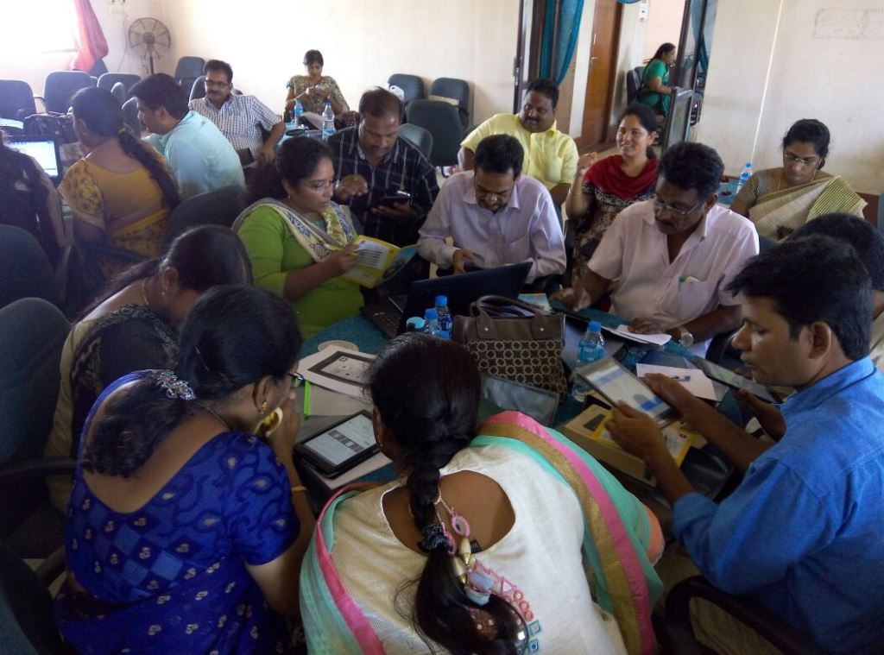
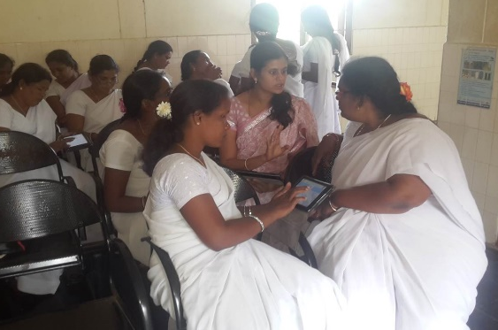
6,78,086 women screened; 11850 Health workers, 350+ Doctors Trained

Slide 5

Increased Stakeholder Value
Stakeholder | Benefits
Citizen – Improved Access | Health records with Unique-ID
Health worker – Improved Efficiency | NCD screening, enrolment, patient history. Pictorial UI, Telugu, simple dashboard, help audio/video Reduced paperwork. Intelligent Sync
Doctor – Improved Efficiency | Comprehensive patient history Easy management of patient info. Examination, lab tests, diagnosis, treatment and referral
Health Department – Improved Administration | Real-time tracking of program progress with drill-down Administrative monitoring of personnel performance
Policy Makers – Improved Coverage, Indicators | Monitoring health indicators, performance Improved planning, resource allocation

Slide 6
Challenges Faced
Tablet challenges
Capacity Issues
Referral Tracking
Doctors
Low Awareness
Program Design
Tablet not working, given for another program.
Tablets in poor condition. Login-related issues.
ANM moved, deputed to other center. Connectivity issues
ANMs don’t sync regularly; don’t upgrade. Failed sync.
ANMs uninstall app, clear data.
Improper, incomplete data entry. Partial screening. Duplicate enrolments.
Referred women don’t go to hospital or go to non-assigned hospitals.
Health records not retrieved and updated in hospital.
Too many people referred to hospitals.
Doctors not able to do data entry while seeing patients. Asking for DEOs.
Women hesitant to get screened especially breast and cervical screening.
Identifying the exact forms, getting clarity on workflow, requirements takes time

Slide 7
Lessons Learnt
Close simple cases of hypertension, diabetes and vision at MMU and PHC
Program should have heavy publicity and sustained attention & pressure from all levels
ANMs support is critical. Must collect and address their field issues.
Multiple high-quality, hands-on trainings needed.
Aadhaar ID for patient tracking between primary, secondary & tertiary
Give health card for women. Give choice for patients of which hospital to go to.
Dashboards and Data provide great value in bringing quality, and tracking issues.

Slide 8
Best Practices
Adapt program to address ground issues. MMUs for common conditions. Health card for patients
Strict program management and quality control. Monthly reviews with Minister, Prl Secy
Deployment support team. Extensive, direct user training and re-training
User-friendly UI, local language, AV help. Visual feedback. Created with inputs from users
Weekly status calls District Nodal officer, Core Support Group on dashboard data
Technical PMU, data analysts for user support and progress monitoring

Slide 9
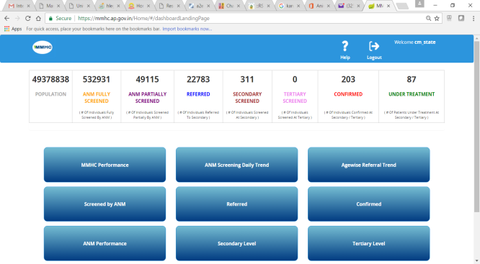
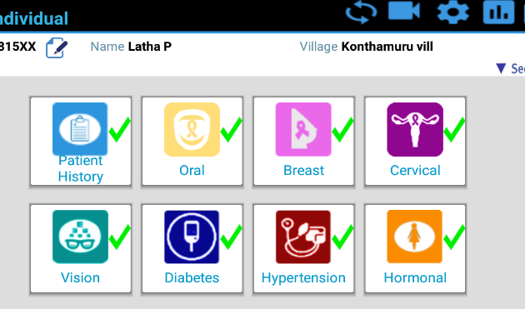
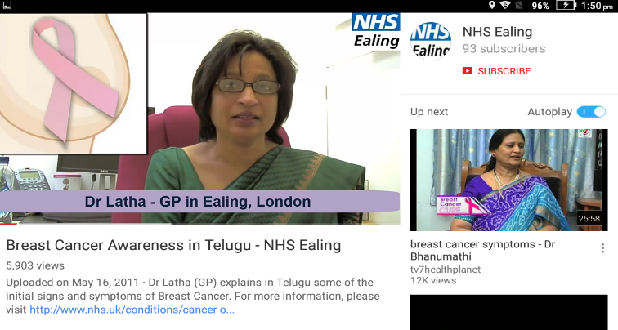
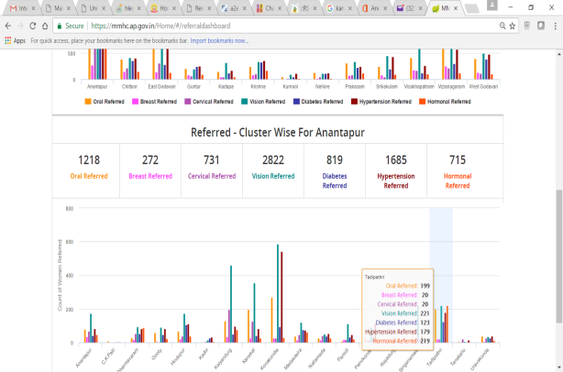
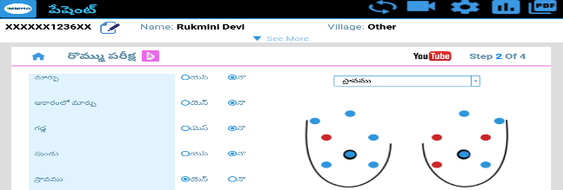
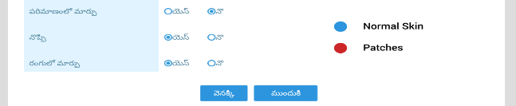
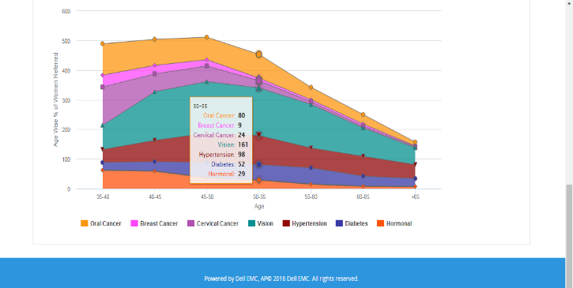
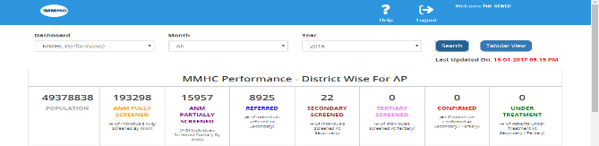
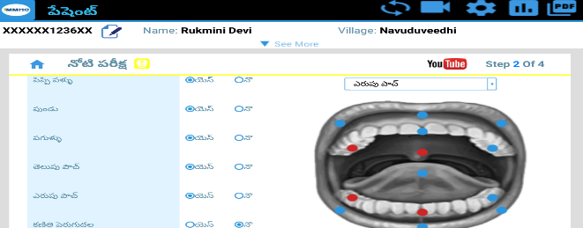
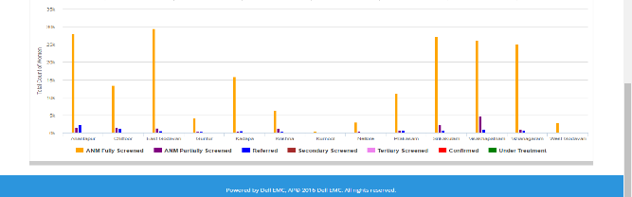
Screenshots
Dashboard Link

Slide 10
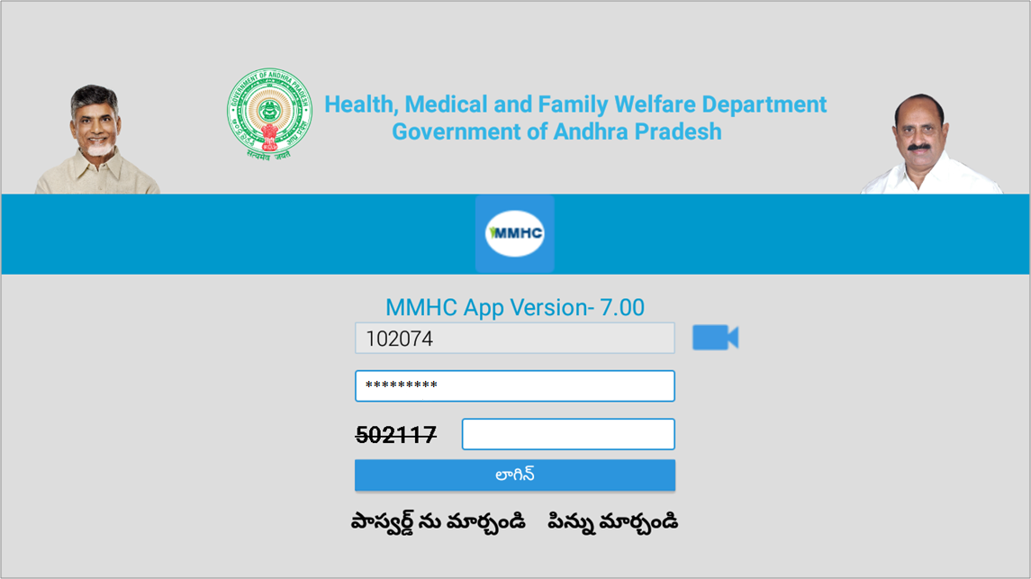
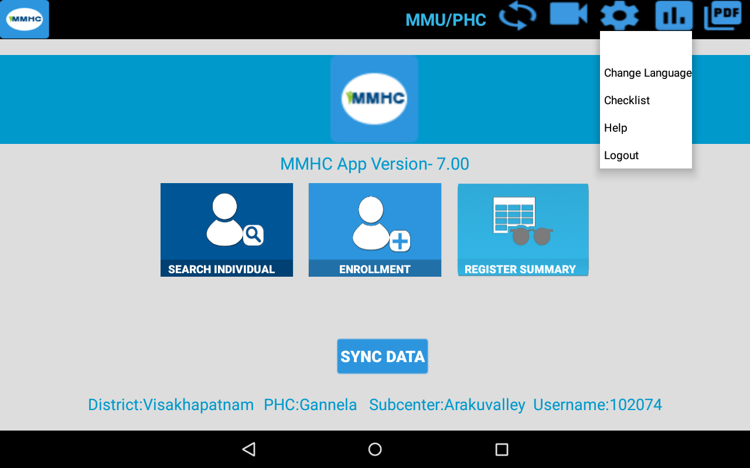
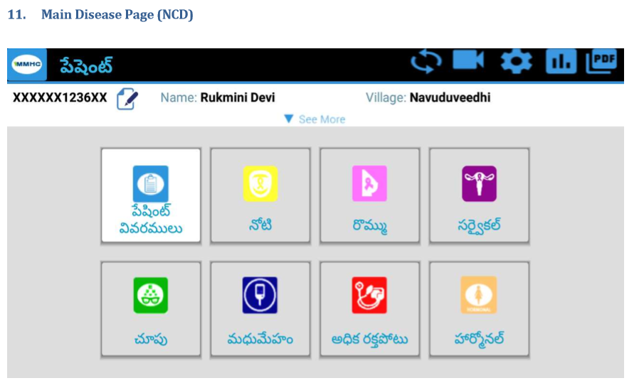
Screenshots of Android App

Slide 11
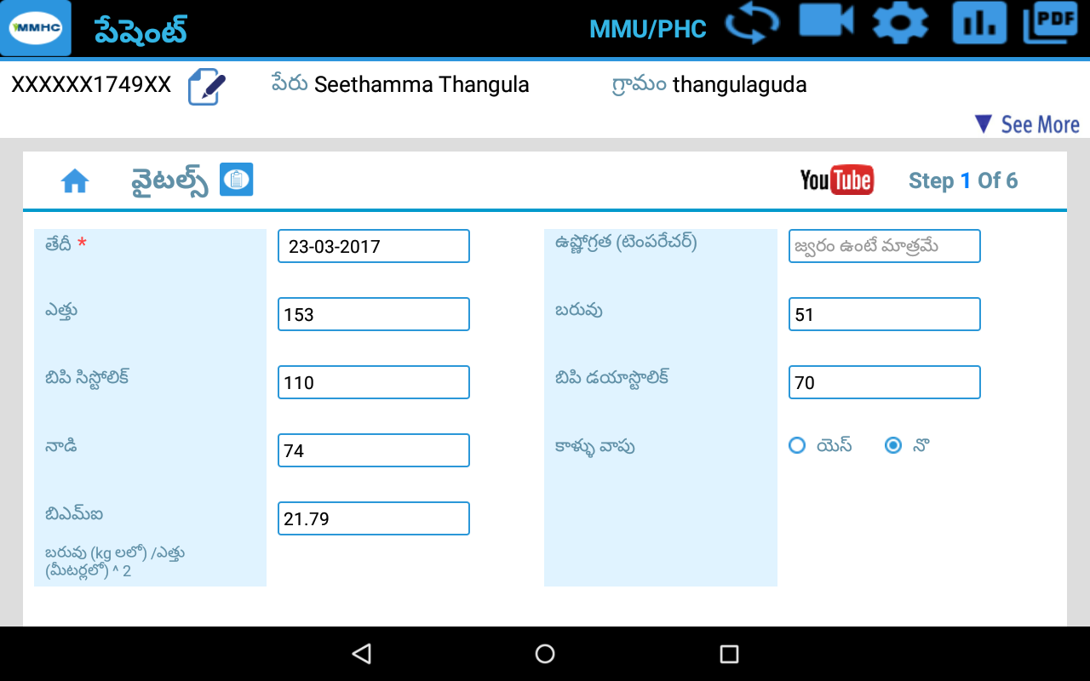
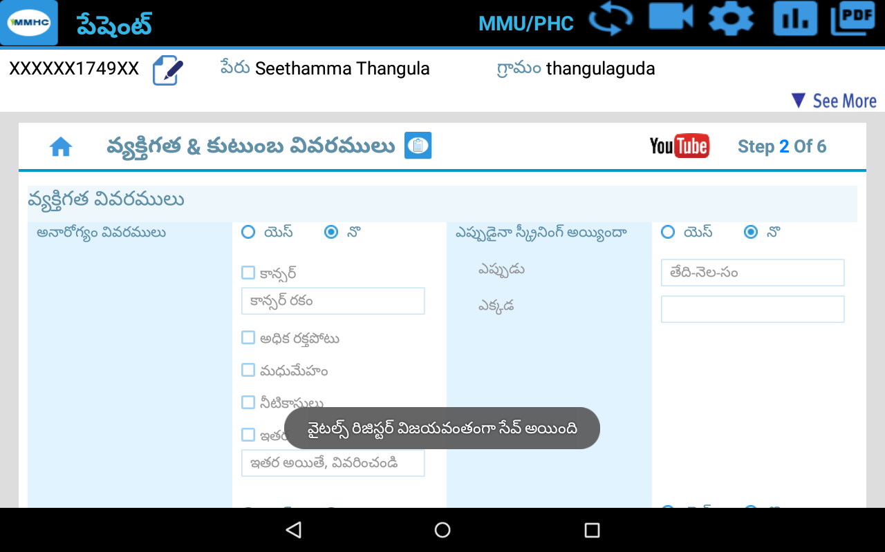
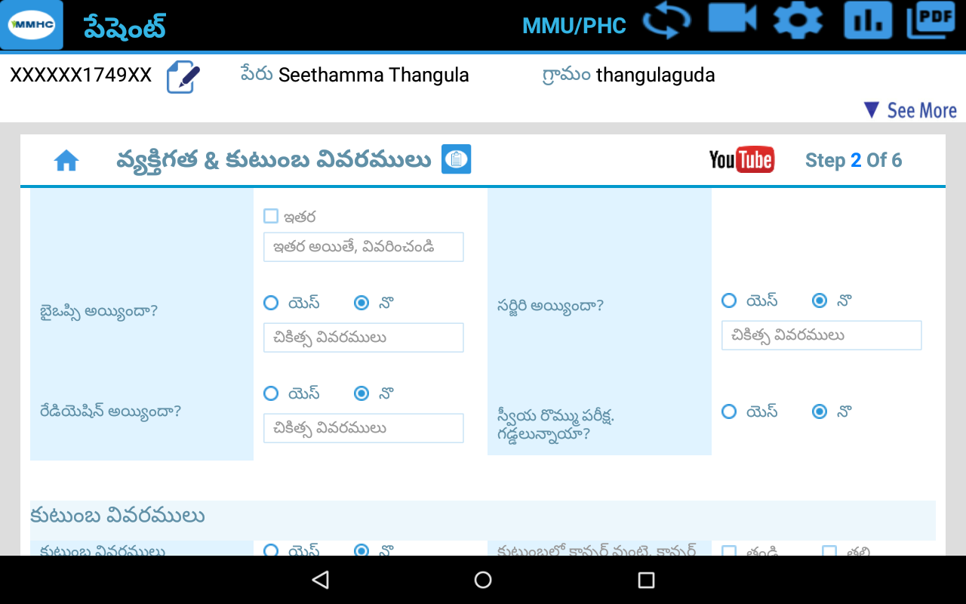
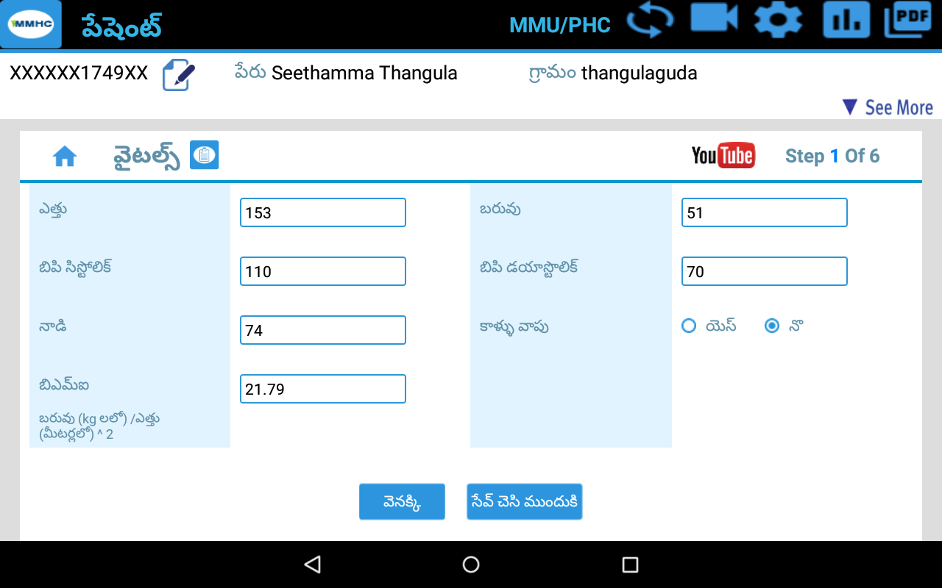
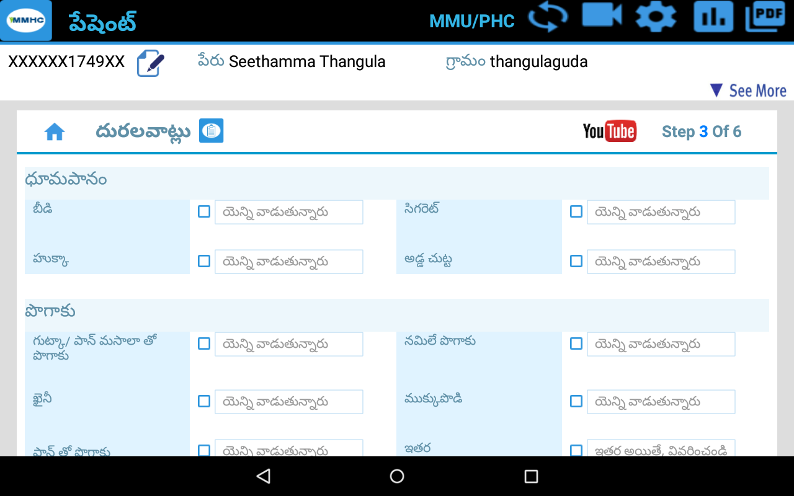
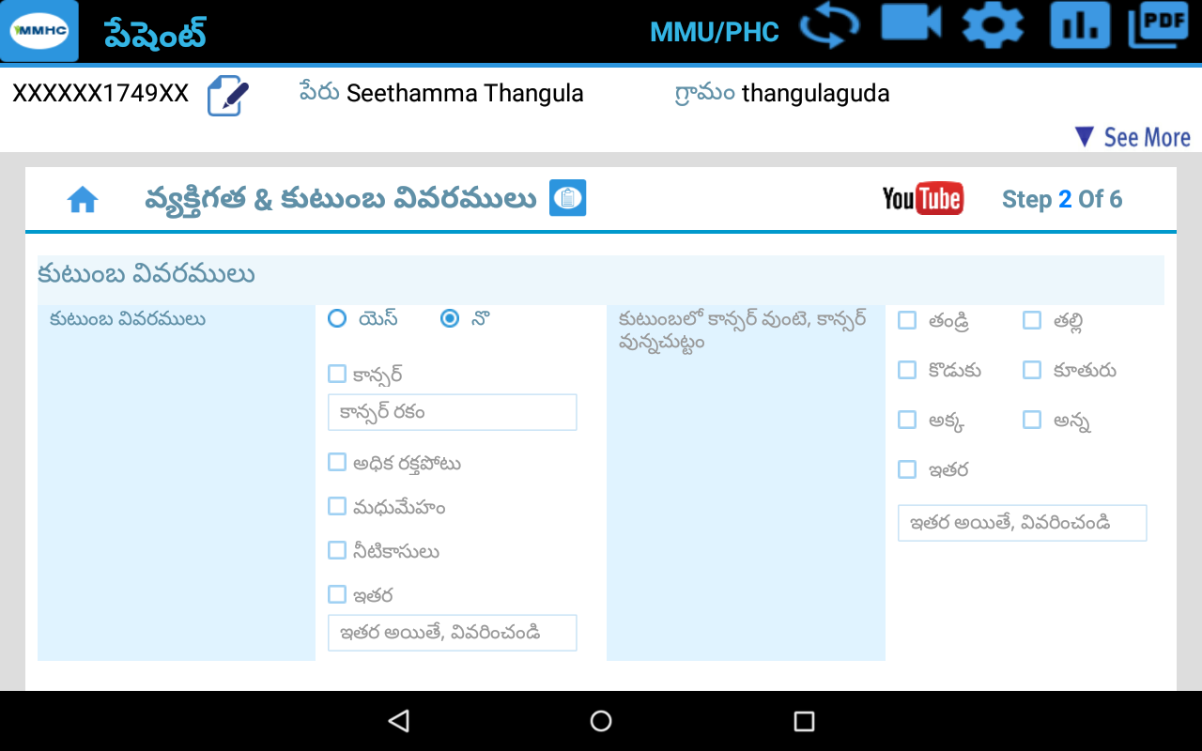
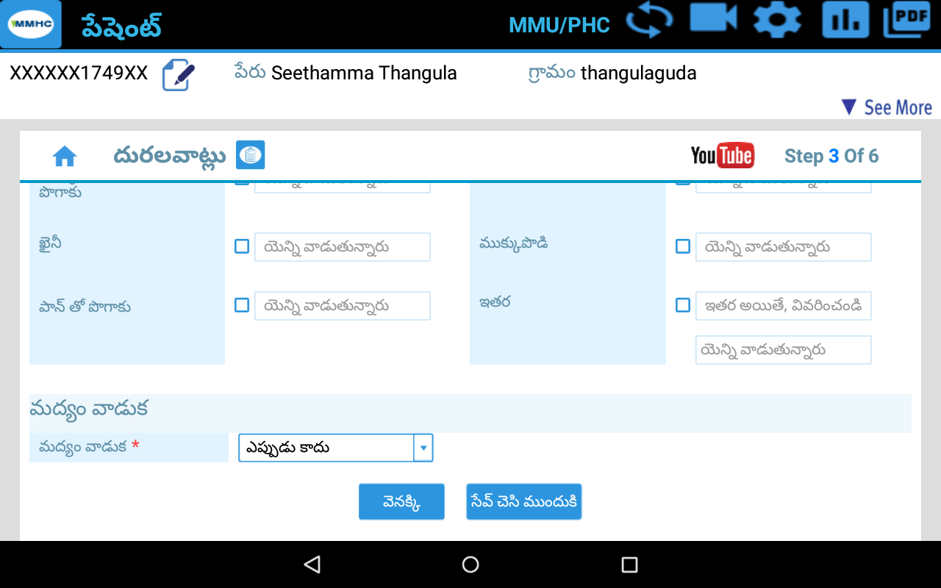

Slide 12
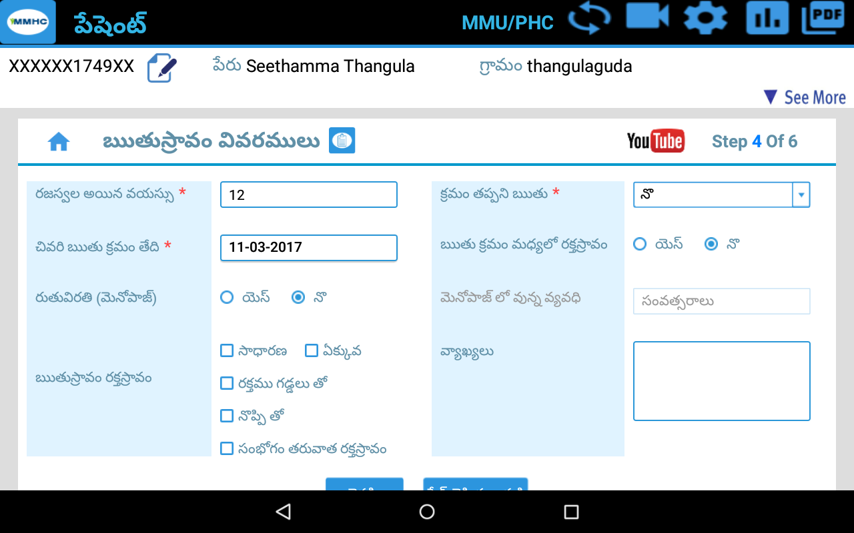
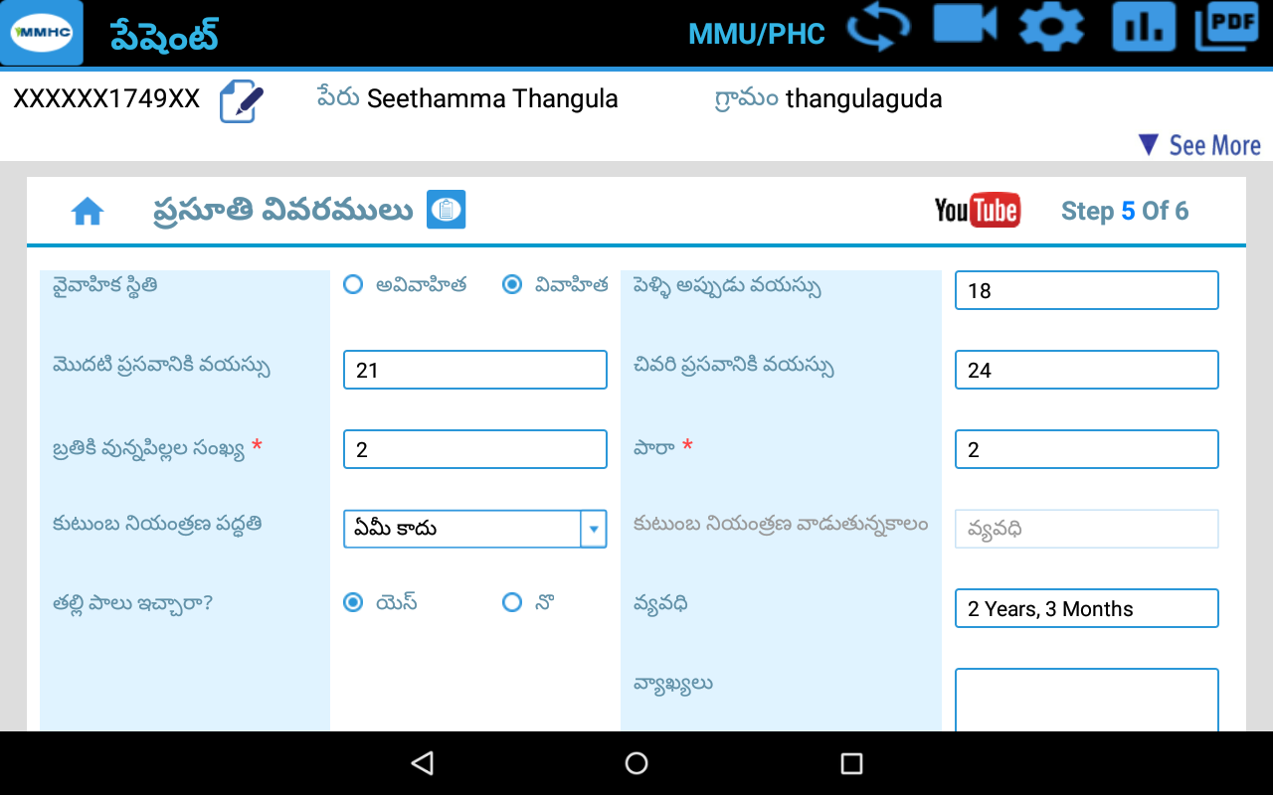
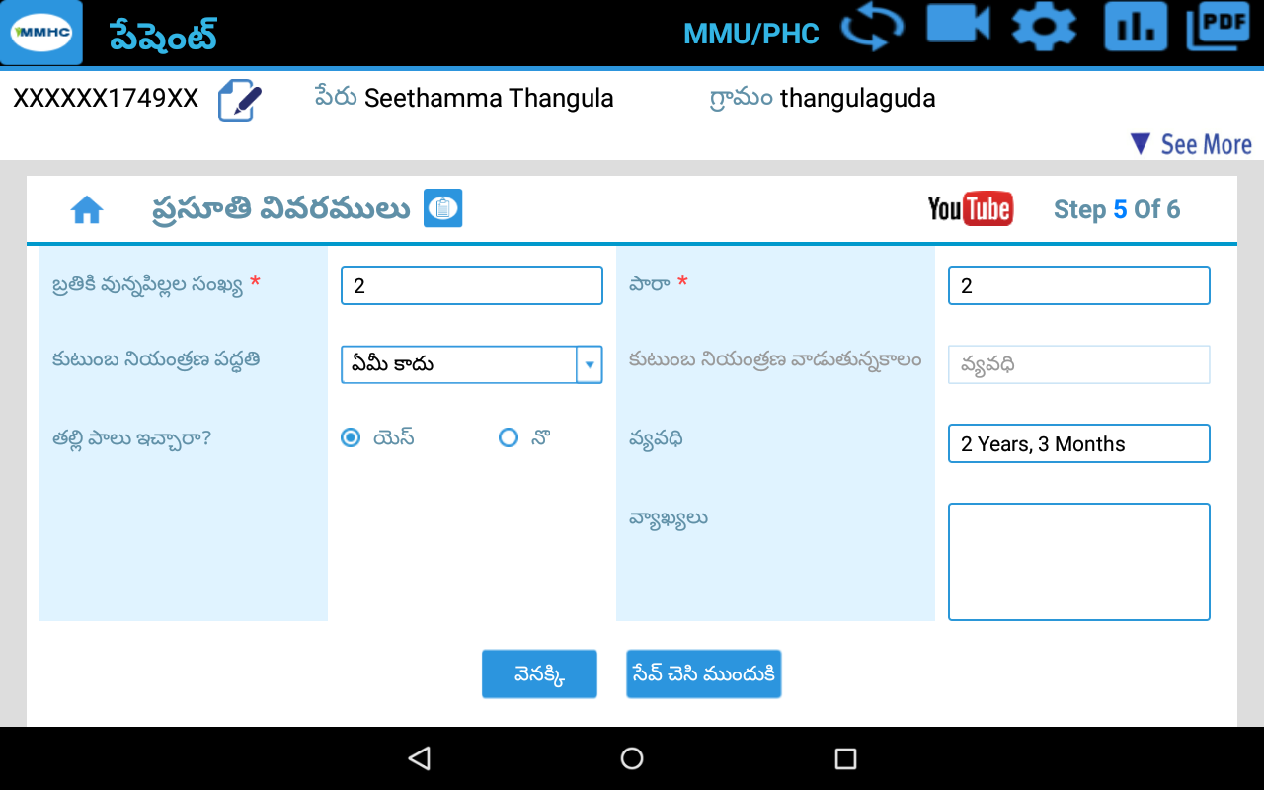
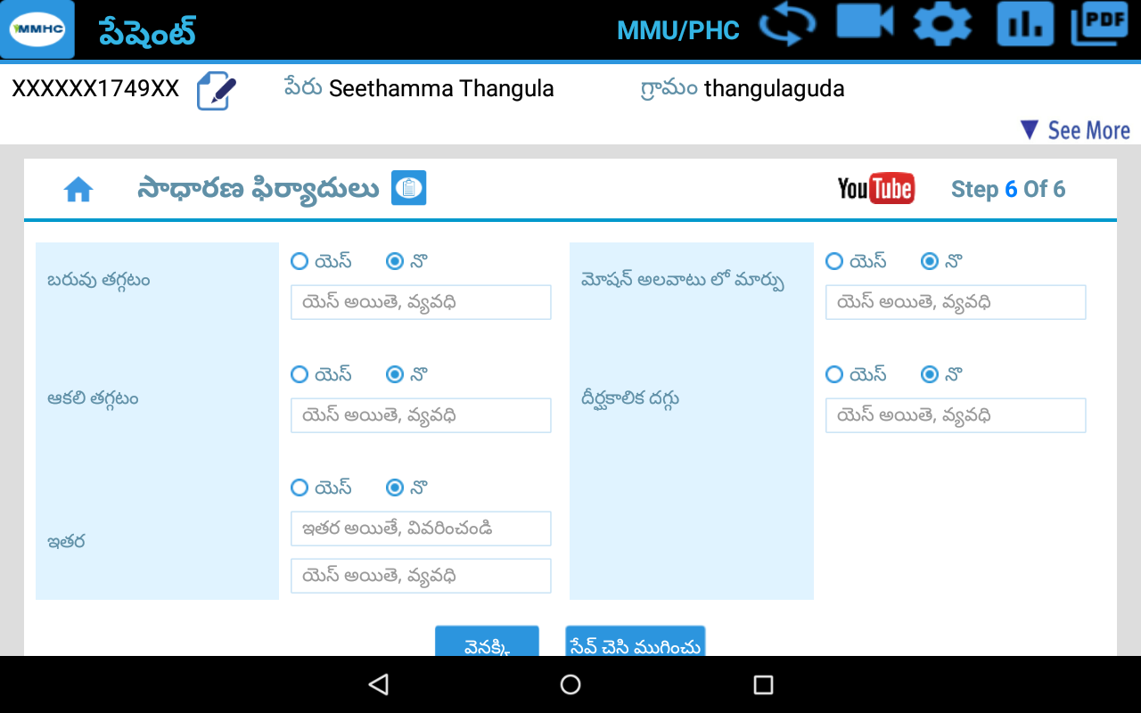
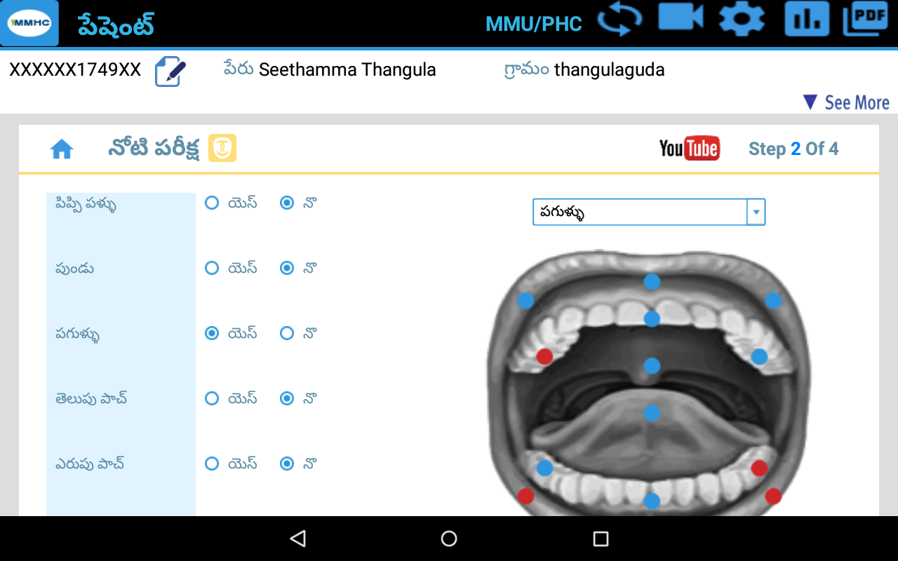
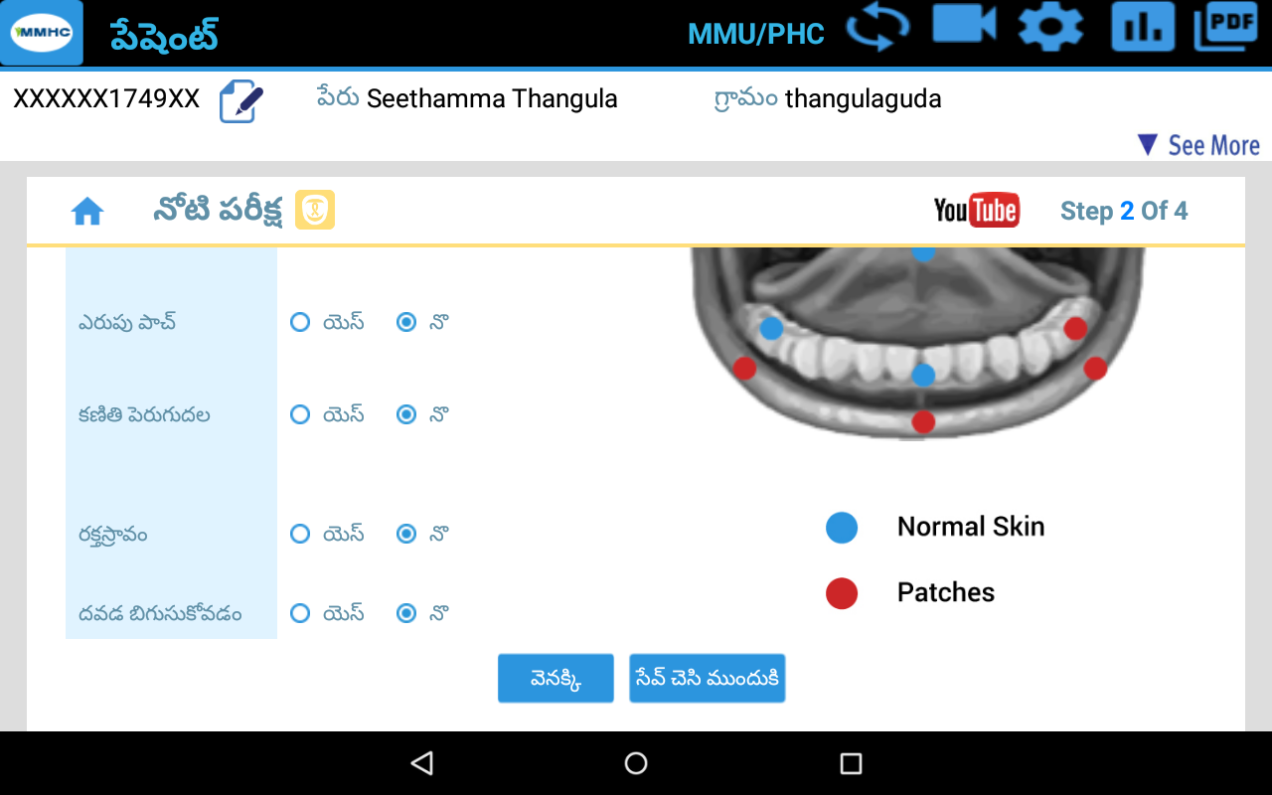

Slide 13
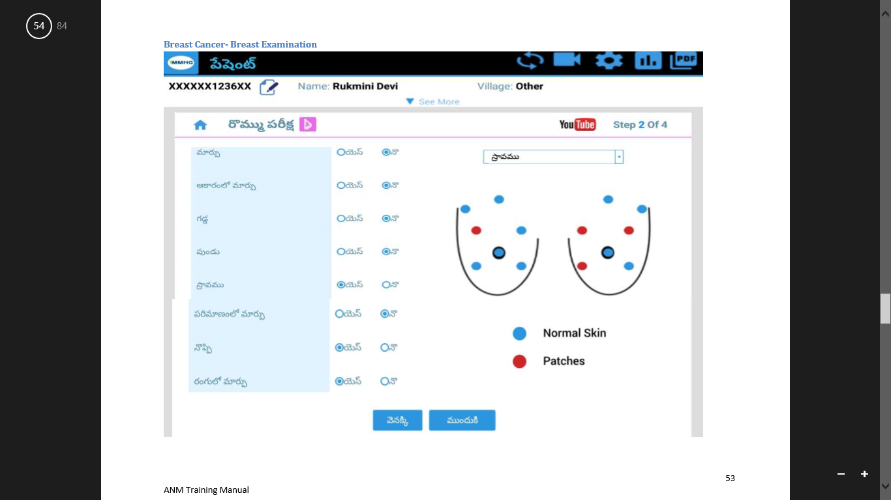
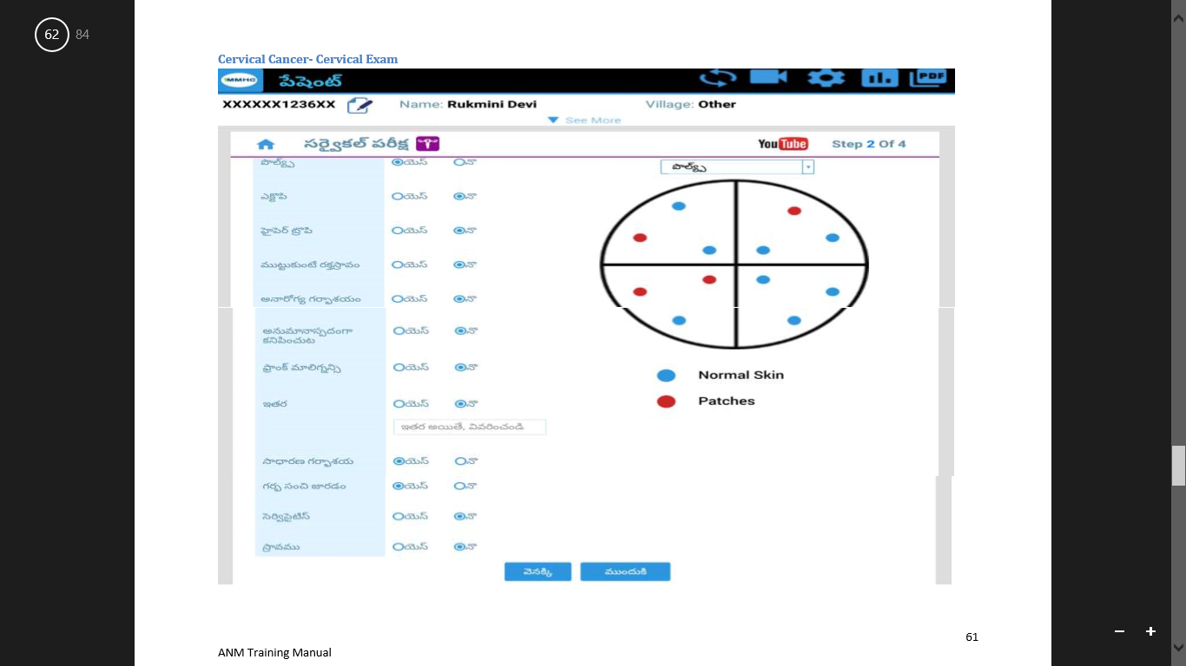
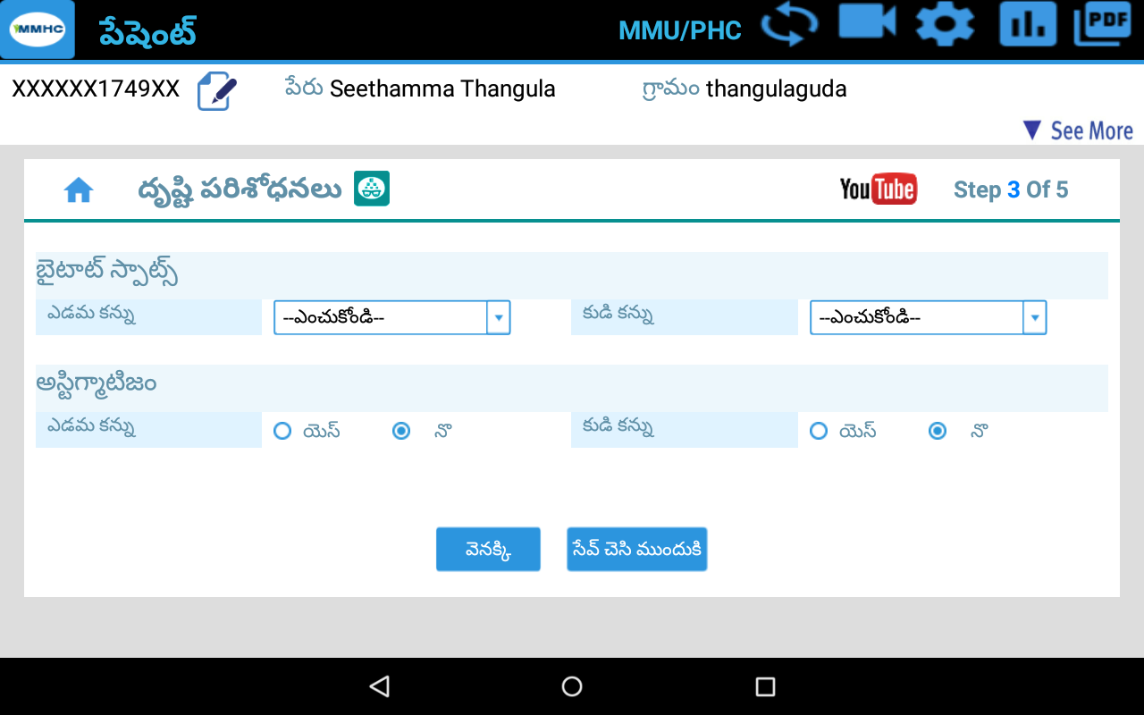
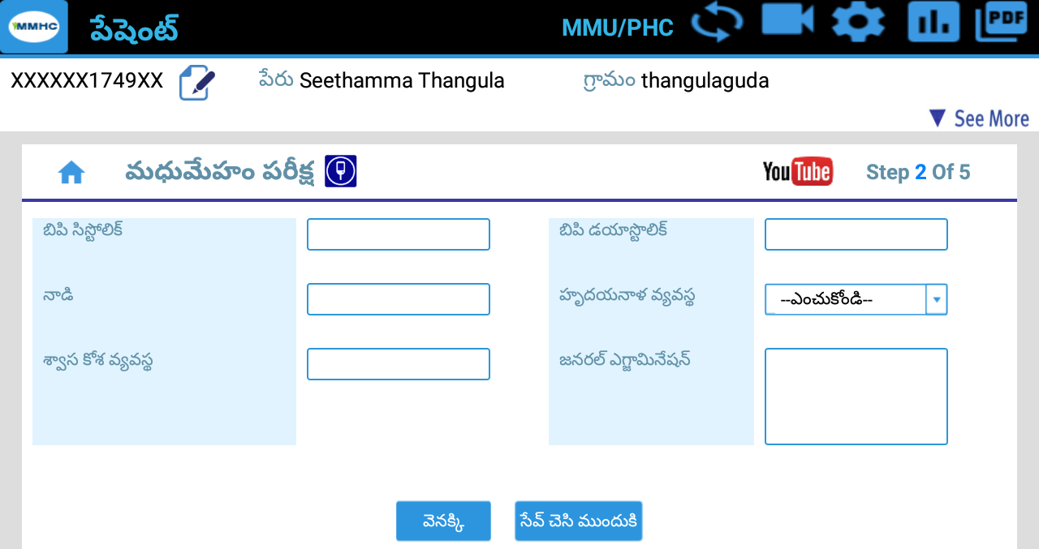
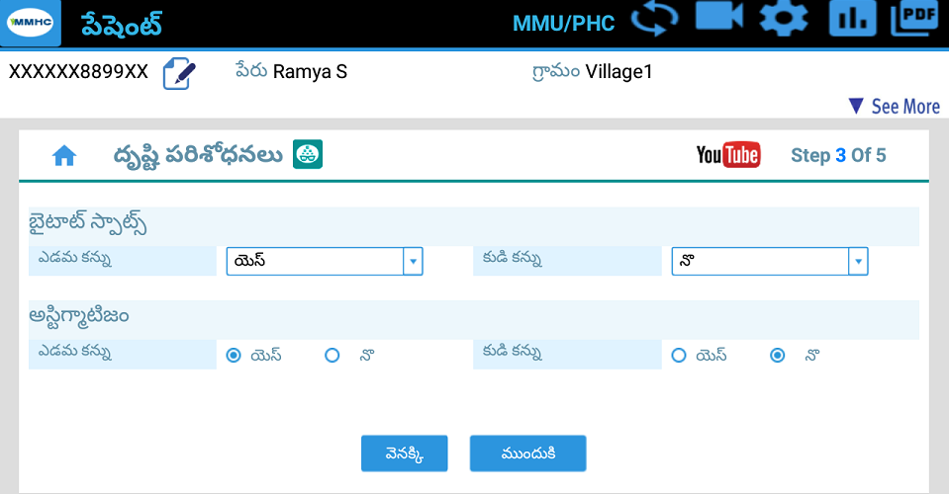

Slide 14
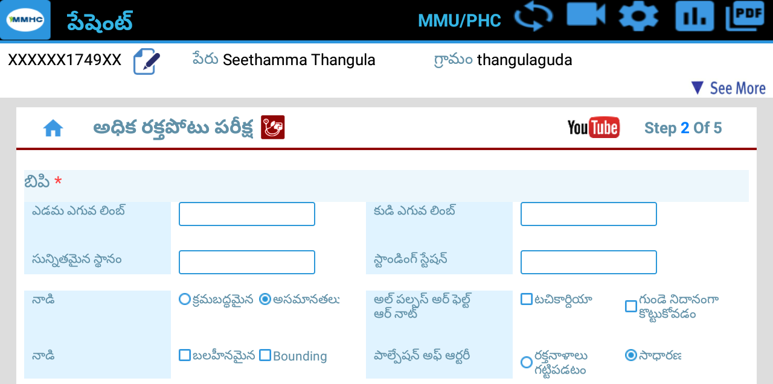
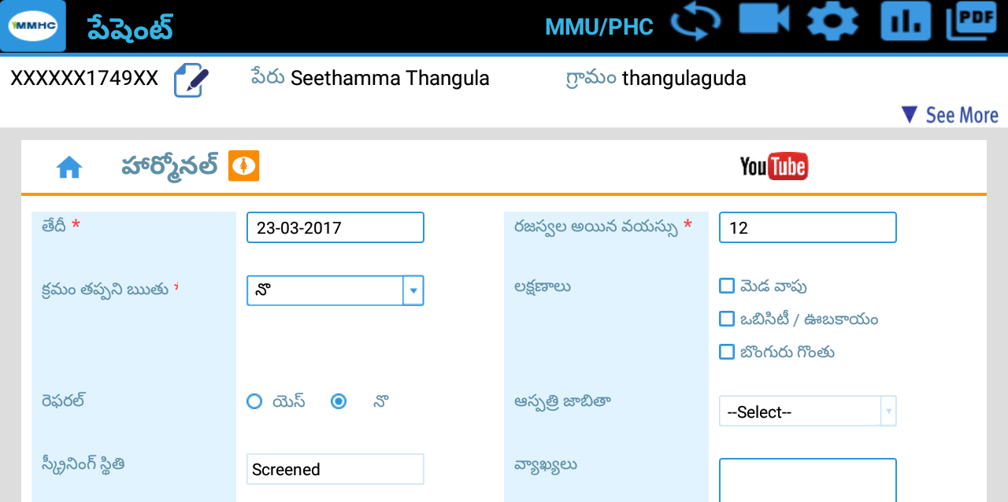
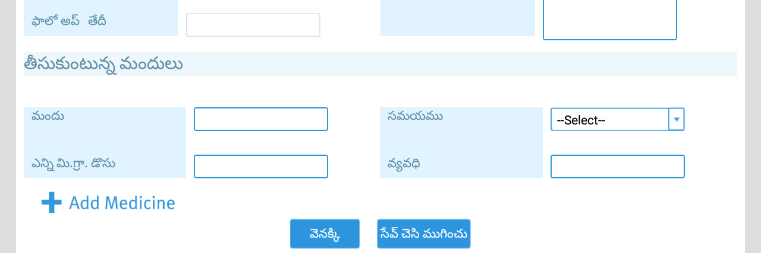
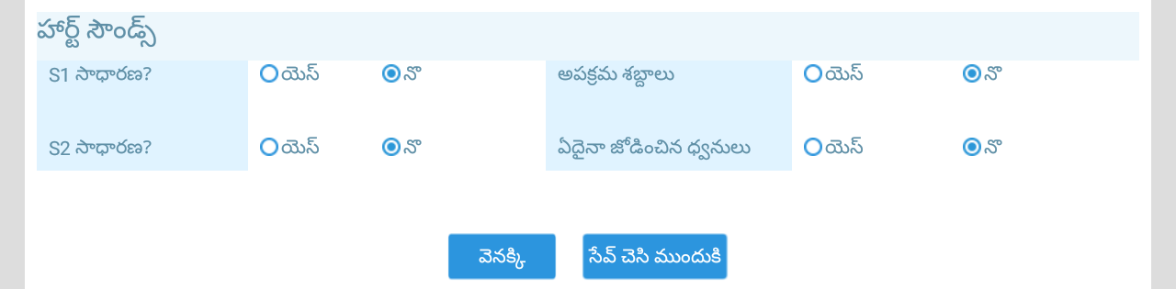
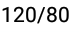
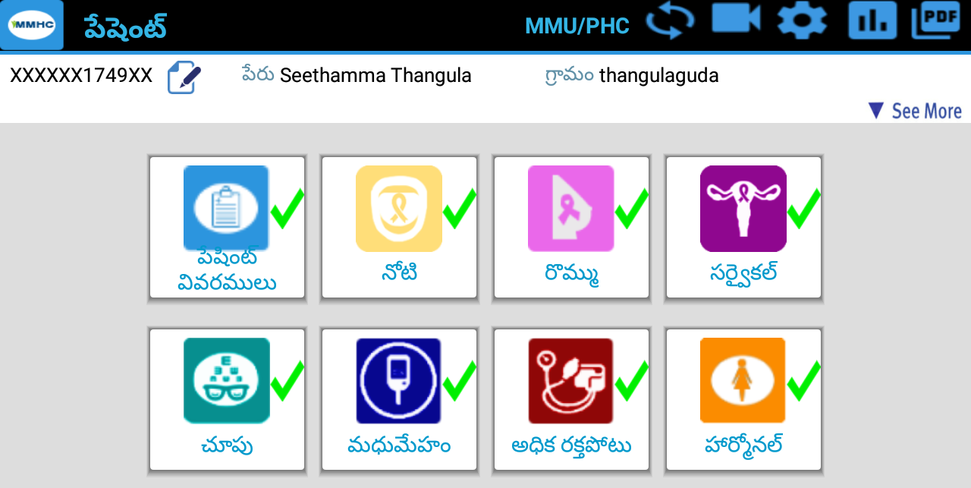

Slide 15
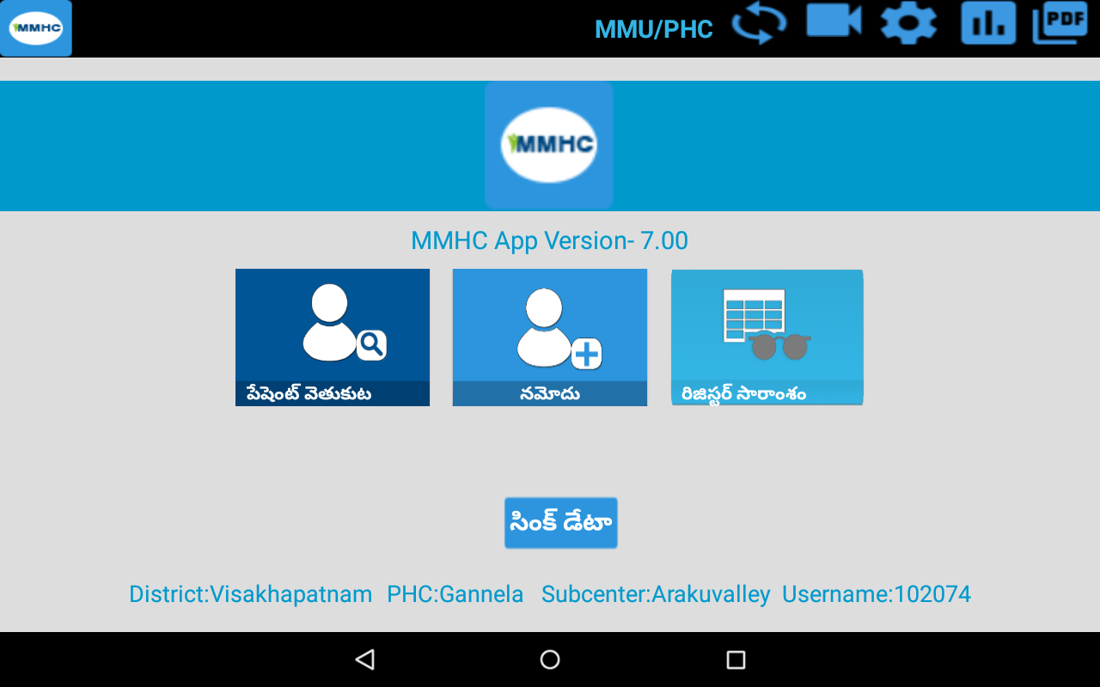
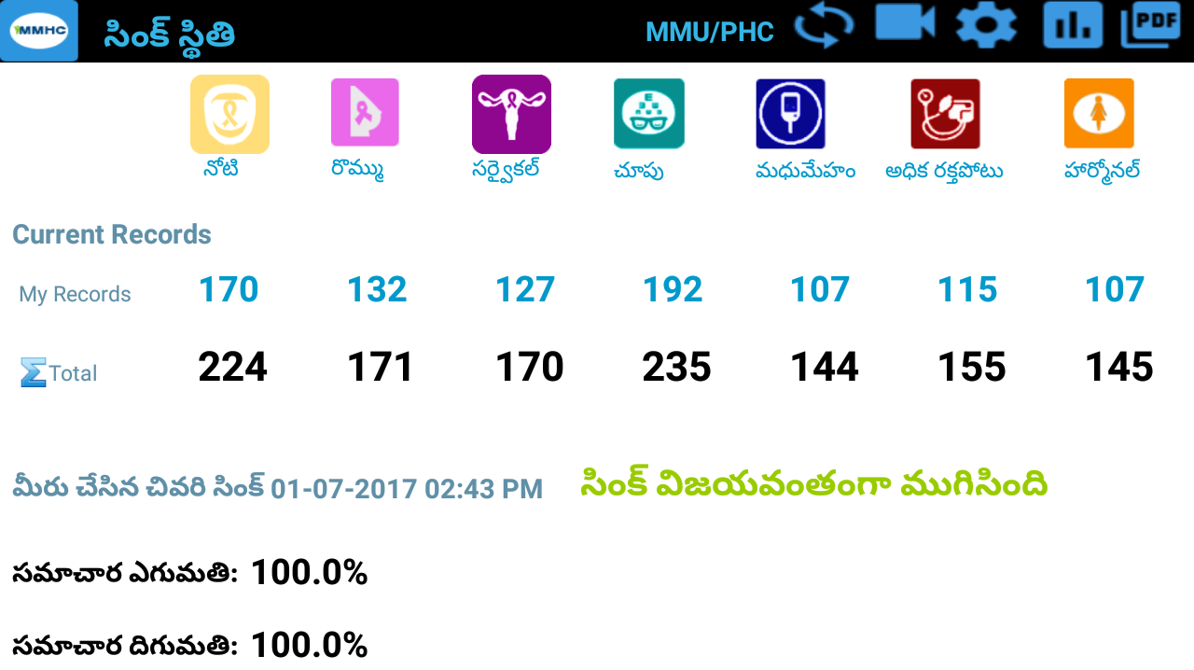
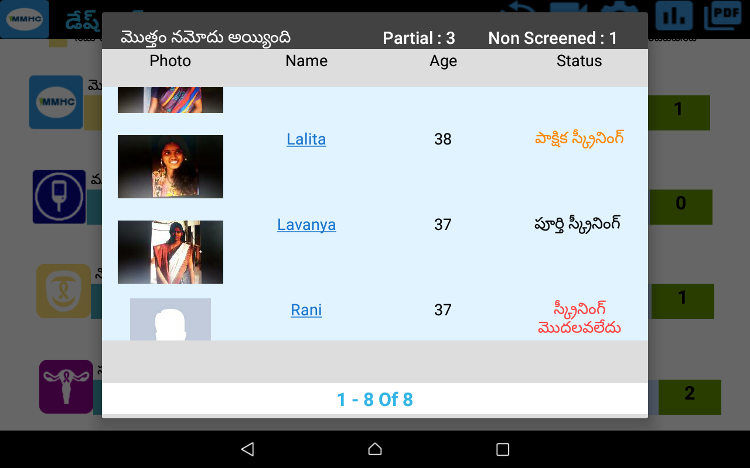

Slide 16












LifeCare NCD – Android App Features
50 NCD screens
  All 7 disease screenings
  Examination, Symptoms
Individual Enrolment
  Aadhaar ID, QR Code reader
  Personal info, photo
User-friendly UI
  Visual feedback, Warnings, prompts
  Pictorial, touch, select
Login
  2-step authentication. Password, Code
Register Summary
  Searchable list of all registers
  All individuals entered
Refer, Search Individual
Doctor’s feedback
Social Media Links
  Awareness videos
  In Telugu, for each disease
Patient History
  Vitals, Medical , family, history, social habits and complaints
Offline with Sync
  Intelligent & fast
  Works with multiple users
Tablet Dashboards
  Counts for all diseases
  Filter by dates, village
Audio-Video help
  Telugu instructions – every screen
  Training Manual
Telugu & English
  Select language for screens
A

Slide 17










LifeCare NCD – Web App & Dashboards Features
Broad NCD coverage
All 7 diseases
18 webpages
Patient Record
Visible to Secondary and Tertiary
With history, vitals
Screen Patient
Examination, symptoms
Procedures, Investigations
ANM summary report
Confirm & Treat
5 rounds of treatment
Can refer mid-way
Login, Search
Captcha; Accounts for 5 specialists
Search by ID, Name, Disease
Refer Patient
Between secondary and tertiary hospitals
Laboratory Tests
63 Standard tests
Standard result options
Sync to Cloud
Intelligent & fast
Works with multiple users
User-friendly UI, Help
Pictorial, select
Training manual & Help screens
Dashboards
Screen, confirm, treat
ANM, Secondary, Tertiary
Linked to AP CM Core
Performance Charts
Program, Disease counts
Staff performance counts
Agewise & Weekly trends
Dynamic Graphs
Drill-down - District to village
Switch numbers or charts

Slide 18
Thank you

