Slide 1





Family Health Centre Approach for Universal Health Care
Dr. Manu M.S.
Consultant SHSRC- Kerala

Slide 2
Kerala Model of Health Today
Indicator |  | Kerala | India
Birth Rate |  | 14.7 | 21.4
Crude Death Rate | All | 6.9 | 7
 | Male | 7.9 | 7.5
 | Female | 6 | 6.4
Under 5 mortality Rate |  | 14 | 69
Maternal Mortality Ratio |  | 66 | 178
Expectancy of Life at Birth | Male | 71.4 | 62.6
 | Female | 76.3 | 64.2
Economic review 2015. State Planning board

Slide 3
Challenges
Double burden of diseases
High out of pocket expenditure
Demographic and Epidemiological Transition
Marginalized populations
Accidents and trauma Management
Mental Health including Suicides
Human resource in the health sector

Slide 4

Moving Forward – Nava Kerala Mission

Slide 5

AARDRAM MISSION
Quality improvement (Primary, Secondary and Tertiary)
Raising resources (financial and human)
Addressing inequity in health care provision
Strengthening Primary Health Care

Slide 6
Principles of FHC
Universality
Family based
Equitable & non-discriminative
Comprehensive
Ensuring financial protection
Quality
Rationality
Portability & continuity of care
Protection of patient rights
Community participation
Accountability
Responsiveness

Slide 7
Service Provision
Institution based (FHC & Sub Centre)
Curative services,
Counselling & Health Education,
Maternal and Child health
Medico-legal services,
Pharmacy and Laboratory Services
Geriatric Care
Implementation of National Programs
Field based
Outreach activities
Routine services by JPHN, JHI, ASHA and AWW.
Work place related services
Community Participation
All services will include preventive, promotive, curative, rehabilitative and palliative care.

Slide 8
Health Care Service Delivery Plan
Family health registers on E-Health platform updated yearly
Family Health Register
Individual Health Plan
Family Health Care Service Delivery Plan
Ward health plan
Grama Panchayat health plan
Social Determinants
Notes:
Variables listed in eHealth
demographic details, medical history,risk behaviors, anthropometry, blood sugar, blood pressure, environmental parameters of the household,
occupational details

Slide 9
Service Packages
Risk reduction
Obesity
Diabetic care
Hypertensive care
COPD
CAD
Depression
ANC
Postnatal
New born package
Immunization
TB
Accidents and Injury

Slide 10
LSGs & FHC
FHCs are Health care delivery service institutions of LSG
LSGs ensures the smooth functioning and management of these centres by
Providing infrastructure,
Human resources
Other logistic support as and when required.
Community Partnership and Participation.
Health will have to be the focal point of all development activities of the LSG.
Based on the Annual Health Status Report
Based on the Panchayat specific SDG targets
Based on inter department convergence mechanism
Notes:
Local governments will bring in different development sectors together FHC will work with other social development sectors like
Social Justice, Education, Agriculture, Water Supply, SC/ST development etc.

Slide 11
Community Participation
Social Structures
Ayal Sabha,
Ward Sabha,
Grama Sabha,
Local NGOs
Kudumbasree
Oorukoottam
Other Community Organization
Arogya Sena
LSG level Convergence of Missions such as
“Harithakeralam”,
“Life”
“Pothuvidyabhyasa samrakshana yagnam”
Notes:
Health volunteerism in community 20 per ward 500 per Panchayat will work along side the existing social structures.

Slide 12
Monitoring and Evaluation
Process monitoring by Department of health services and NHM
Social monitoring by different social structures
Social audit will be facilitated by LSG
Evaluation at regular intervals for mid course corrections

Slide 13
Differences
Individual care plan and responsibility mapping
Quality standards
Quantity of service
Financial protection
Universality

Slide 14

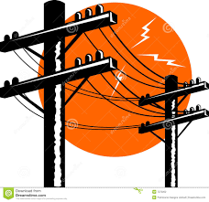

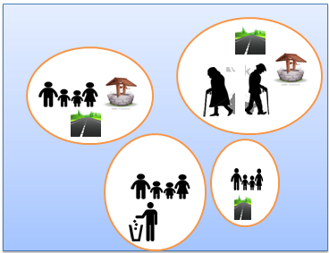


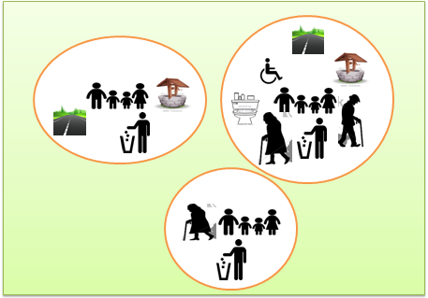
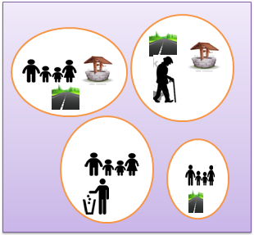




Slide 15


