Slide 1

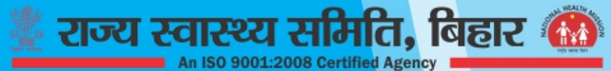
104 CALL CENTRE(TOLL FREE) WITH MEDICAL HELPLINE IN BIHAR

Slide 2

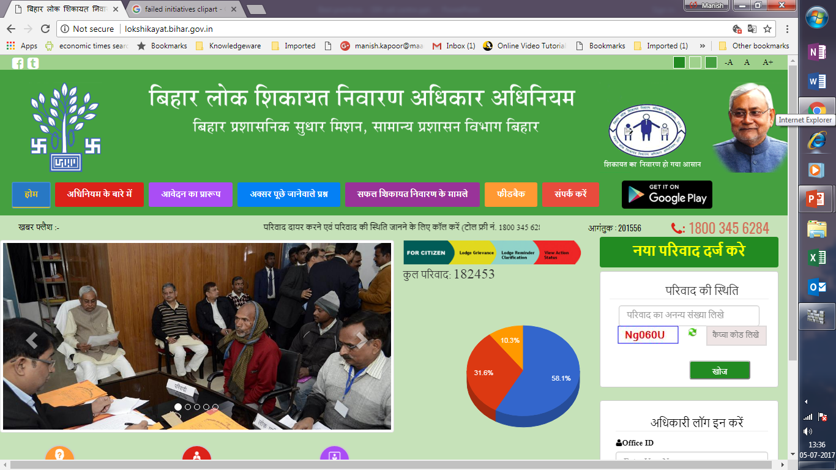
PROBLEM STATEMENT
Grievance Redressal is a proven strategy for strengthening of any public service delivery system.
Since 2008, after the implementation of National Rural Health Mission(NRHM), the State Health Society Bihar(SHSB) has initiated several mechanisms to address the grievances related to public health. However, these mechanism could not meet the growing needs of healthcare, by providing time bound resolution.
The State Health Society, Bihar(SHSB) took a new strategy to resolve public grievances of health delivery system under the umbrella of “Lok Shikayat Nivaran Adhikar Adhiniyam 2015”.

Slide 3

PROGRAMME DESCRIPTION - INTRODUCTION (1/5)
Bihar Assembly had passed an Act on Public Grievance Redressal in the year 2015, “Lok Shikayat Nivaran Adhikar Adhiniyam 2015”.
This act has given legal power to community to complain about any public service provision to respective authority.
The authority should then ensure time bound compliance of all grievances.
The State Health Society, Bihar (SHSB) established and is running a 5-seater 104 call center at the state level, for grievance redressal under the umbrella of this Act, since March 2016(30th March,2016) on a pilot basis, at its office.
THE RESPONSE OF THIS INITIATIVE HAS BEEN OVERWHELMING IN THE FIRST YEAR ITSELF.

Slide 4
PROGRAMME DESCRIPTION - ORGANIZATION STRUCTURE (2/5)
Executive Director, SHSB
Nodal Officer (B.A.S)*
104 Call Centre
Shift First (06:00 AM to 02:00 PM)
Shift Nodal Officer (Senior Dr. Add. Director Level)
Shift 2nd (02:00 PM to 10:00 PM)
Shift Nodal Officer (Senior Dr. Add. Director Level)
Shift First (10:00 PM to 06:00 AM)
Shift Nodal Officer (Senior Dr. Add. Director Level)
Shift Supervisor
Shift Supervisor
Shift Supervisor
5 Operators
5 Operators
3 Operators
* - Bihar Administrative Services

Slide 5
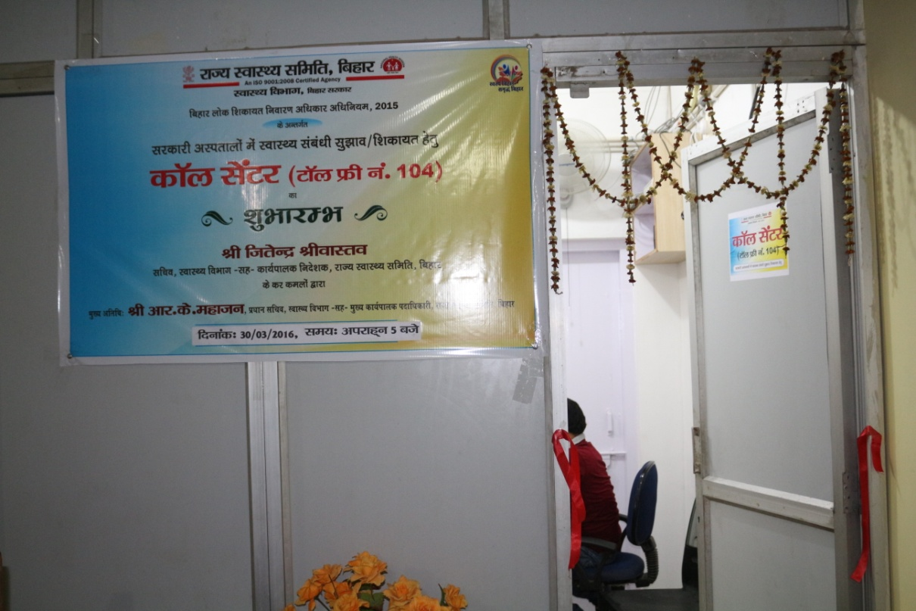
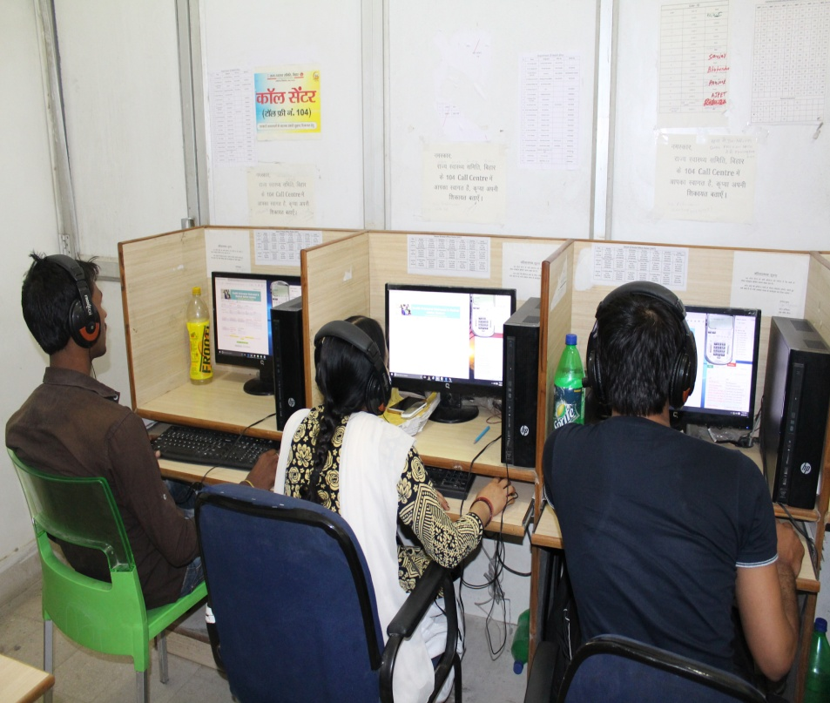
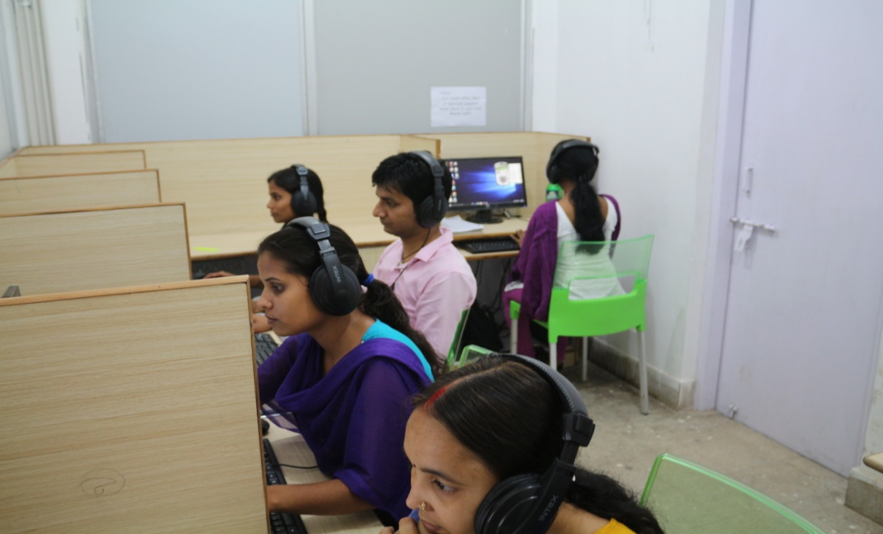
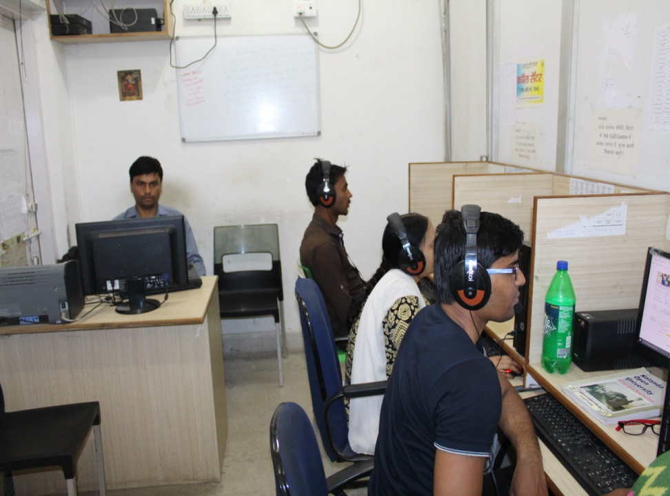
PROGRAMME DESCRIPTION - FACILITY (3/5)

Slide 6
PROGRAMME DESCRIPTION - GRIEVANCE REDRESSAL PROCESS FLOW DIAGRAM (4/5)
Yes
Close the grievance
LEVEL 1
Resolved by operator
No
Forward to supervisor (Level 2)
Grievance Registered
Yes
Close the grievance
LEVEL 2
Resolved by Supervisor
No
Forward to Addl. Director (Shift Nodal) (Level 3)
If medical advice, call transfer to shift medical officer.
Yes
Close the grievance
LEVEL 3
Resolved by Add;. Director (Shift Nodal Officer)
No
Forward to Nodal Officer (Level 4)
Yes
Close the grievance
LEVEL 4
Resolved by Nodal Officer
(104 call centre)
No
Forward to Executive Director
Conference:- Call operator /supervisor/nodal officer resolve the grievance with conference among related hospital/district officials, complainant and itself, if required.

Slide 7
PROGRAMME DESCRIPTION - GRIEVANCE REDRESSAL PROCESS FLOW DIAGRAM (5/5)
Call operator receives a call.
The operator asks and notes the details of the caller ( Name, age, sex, location, grievance details) in the Interactive Voice Response System (IVRS)software.
The software creates a unique ID number for this grievance and sends it to complainer’s/callers, registered mobile no. by SMS.
The call operator segregates the grievances accordingly to the nature (Medical advice, Directory services, Grievances etc.) and tries to resolve the issue. For example, if the caller needs medical advice, operator connects the call to the medical officer designated for the shift.
START
Has the shift supervisor, been able to resolve the grievance?
The shift supervisor facilitates conference between the complainant/caller and the facility or district officials to resolve the grievances.
If the operator, is unable to resolve the grievance on its own, then the same gets transferred to his shift supervisor
Has the call operator, been able to resolve the grievance?
No
No
Yes
Yes
Feedback is taken from the complainant/caller & complaint/query is closed.
Yes
Yes
END
The complaint is forwarded to the shift nodal officer
Has the shift Nodal officer , been able to resolve the grievance?
The complaint is forwarded to the Nodal officer (104 call centre), who then resolves the complaint.
Has the shift Nodal officer (104 call centre), been able to resolve the grievance?
No
The complaint is forwarded to Executive Director(SHSB), who then resolves the complaint.
No

Slide 8
PROGRAMME OUTCOME
Months | Accident | Admission of Patient in Health Centre | Blood Bank Related | De addiction | Medical Advice | Presence of Doctor/Staffs | Supply of Drugs | Natural Disaster | Epidemic | Miscellaneous/others | Total Relevant Call
Apr-16 | 2 | 7 | 30 | 1580 | 217 | 58 | 55 | 0 | 0 | 833 | 2782
May-16 | 3 | 3 | 62 | 154 | 608 | 17 | 15 | 0 | 0 | 2312 | 3174
Jun-16 | 2 | 5 | 43 | 80 | 456 | 19 | 12 | 0 | 0 | 2673 | 3290
Jul-16 | 0 | 3 | 43 | 66 | 591 | 14 | 9 | 0 | 0 | 2472 | 3198
Aug-16 | 1 | 6 | 55 | 56 | 796 | 30 | 18 | 89 | 3 | 1989 | 3043
Sep-16 | 1 | 6 | 66 | 47 | 824 | 20 | 16 | 38 | 7 | 1702 | 2727
Oct-16 | 2 | 2 | 31 | 35 | 817 | 22 | 24 | 2 | 1 | 1737 | 2673
Nov-16 | 0 | 4 | 35 | 34 | 688 | 17 | 13 | 0 | 4 | 1969 | 2764
Dec-16 | 0 | 5 | 24 | 30 | 564 | 19 | 11 | 0 | 1 | 1868 | 2522
Jan-17 | 0 | 5 | 18 | 33 | 520 | 18 | 18 | 0 | 0 | 1823 | 2435
Feb-17 | 3 | 3 | 19 | 19 | 431 | 40 | 19 | 0 | 1 | 1515 | 2050
Mar-17 | 2 | 6 | 15 | 14 | 410 | 24 | 19 | 0 | 1 | 1375 | 1866
Apr-17 | 0 | 1 | 115 | 13 | 380 | 35 | 4 | 0 | 0 | 1309 | 1857
May-17 | 1 | 8 | 70 | 77 | 536 | 39 | 14 | 0 | 0 | 1733 | 2478
Total | 17 | 64 | 626 | 2238 | 7838 | 372 | 247 | 129 | 18 | 25310 | 36859
2016
2017

Slide 9
ANALYSIS OF ONE YEAR OF OPERATIONS (APRIL,2016 – MARCH,2017)
Type | Total Cases (Nx) | Solved (Ny) | Not Solved (Ns = Nx- Ny) | Percentage(%) of total resolved cases (Ny/Nx)
(A) Grievance Issue | 3427 | 3328 | 99 | 97.11
(B) Blood Related Issues | 626 | 573 | 53 | 91.53
(C) Enquiry related to 104 Call Centre | 24309 | 24292 | 17 | 99.93
(D) Medical Advice | 7838 | 7198 | 540 | 91.83

Slide 10
FINANCIAL IMPLICATIONS (HR & INFRASTRUCTURE INCLUDING TOLL FREE & PRI LINE BILL)
This call center is managed by total 19 persons (15 operators and 4 supervisors), human resource with the support of 5 nodal officers and one state level administrative officer.
The total annual cost of running of the call center is around 30 lakhs per annum and are able to resolve 95% grievances in time. The data of 104 call center has been used for ensuring services related to de-addiction center, referral transport, drugs and blood related issues etc.

Slide 11
SCALABILITY
Based on the overwhelming response and growing healthcare needs, the state has decided to scale up this initiative as per GoI guideline.
Below are some learning points:
Regular IEC of 104 call center up to the village level is very important, to increase higher utilization of services.
Grievance redressal(GRS) mechanism should be time bound and having escalation matrix in place.
Work towards bringing Front Line Workers (FLWs), like ASHA(s), MAMTA(s) within the framework of grievance redressal system(GRS), by addressing their grievances and queries directly, at the state level.
The call centre should have at least one female doctor during day time, to address the grievance of female beneficiaries.
Link the Grievances redressal system with the provision of “Lok Shikayat Nivaran Adhiniyam 2015”.

Slide 12
THANK YOU

