Slide 1
Improving Hospital Building Designs to Improve Quality of Care
A Govt. Of Madhya Pradesh Initiative

Slide 2
Why Focus on Hospital Design
Prophylaxis is better than cure
From where it all started (Problem in shifting)
Different from Conventional Buildings
Patient Convenience
Eternal shortage of resources (HR, Equipment and upkeep)
Till now we have focused mainly on HR and Equipment (Mainly in terms of Quantity)
Impact on Health Service Delivery
Infection Control and Quality Assurance Parameter

Slide 3
Problem Description
BROWN Field
GREEN Field

Slide 4
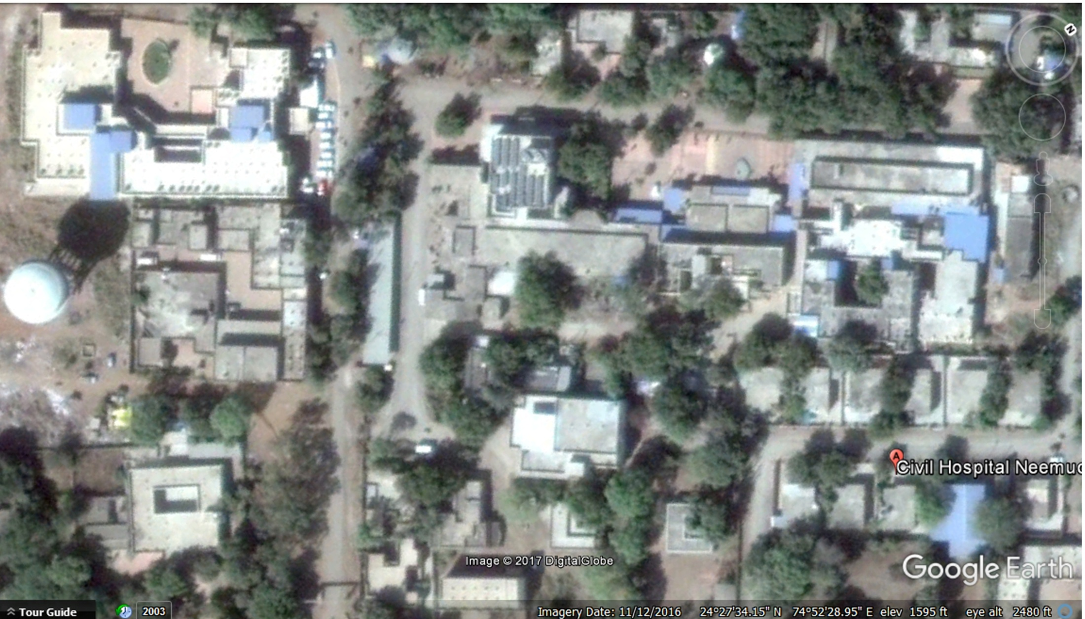
Maternity
180 M
Trauma
General Ward
New Block
Maternity
Approach Road
Old Hospital Building
EXISTING DISTRICT HOSPITAL AT NEEMUCH

Slide 5
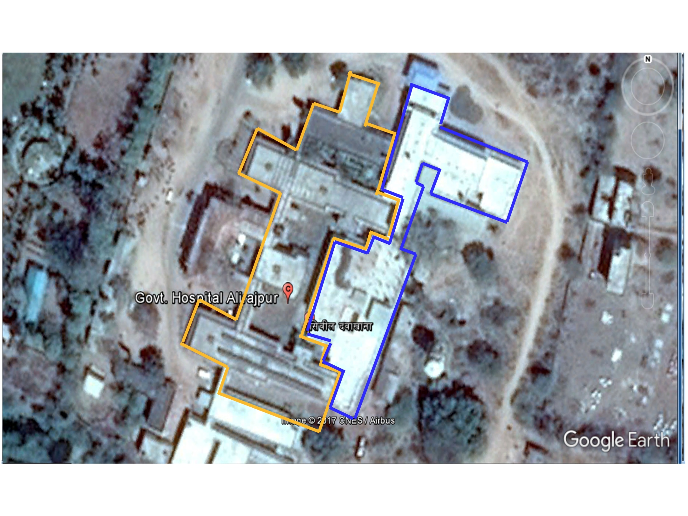
OLD HOSPITAL BUILDING
NEW HOSPITAL BUILDING
EXISTING HOSPITAL AT ALIRAJPUR

Slide 6
BROWN FIELD
  Irregular augmentation of existing health facilities
New structures are generally duplication or stand alone rather than complementary
Trauma and Surgical Ward
Inter departmental co-ordination.
Maternity and SNCU
Fate of existing facilities.

Slide 7
GREEN Field - New Design
For a Sick Patient, Every Walking Step Matters.
Limited Staff of Interdependent Departments
Anaesthesiologist in Trauma, ICU and OT.
X- Ray Rooms in Casualty and OPD.
Over/Under Construction
Trauma Centre Triage/ Receiving Area
CSSD

Slide 8
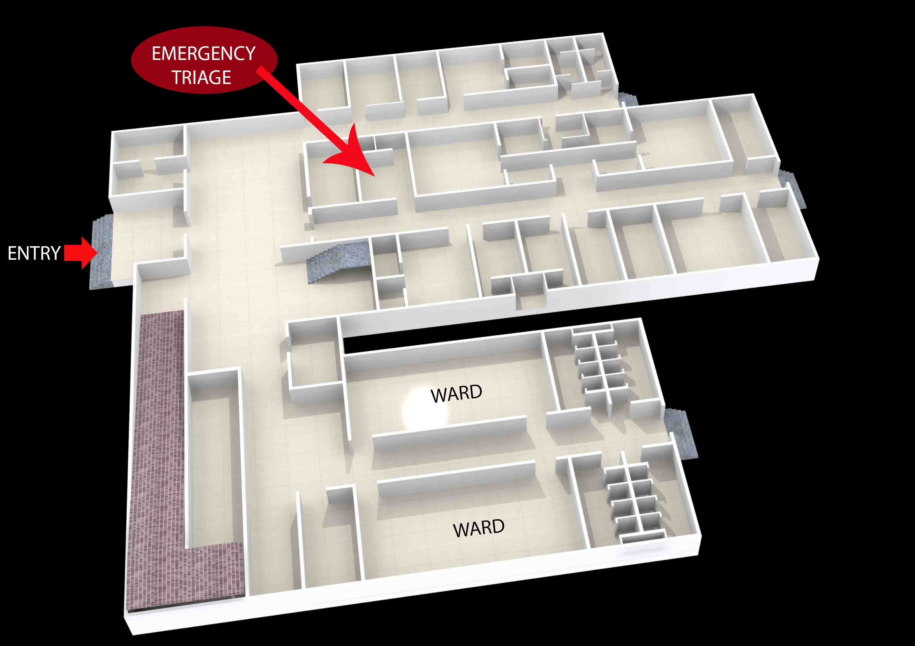
Trauma Unit DH Khandwa : Before

Slide 9
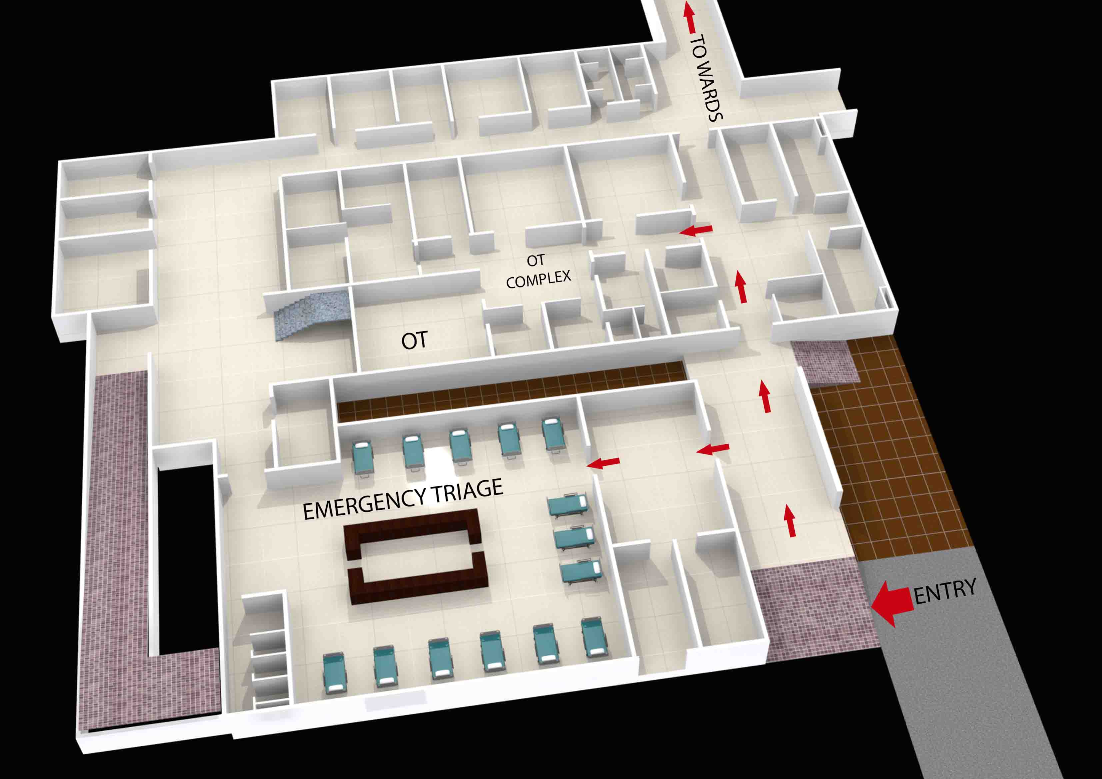
Trauma Unit DH Khandwa : After

Slide 10
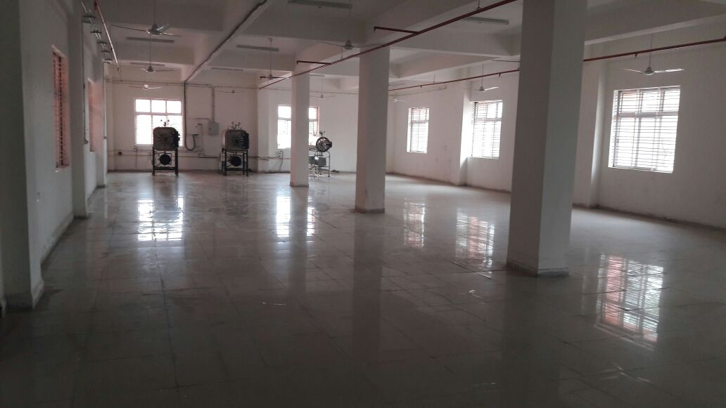
CSSD DH Ujjain

Slide 11
GREEN Field - New Design…contd.
Micro Detailing of Service level Drawings
Radiation Protocol
Plumbing
Electrical Fittings
Impact on Quality
Infection Control (Zoning/Seamless Floors/ No Recesses and Niches)
Natural Light and Ventilations
Accreditation Protocols

Slide 12
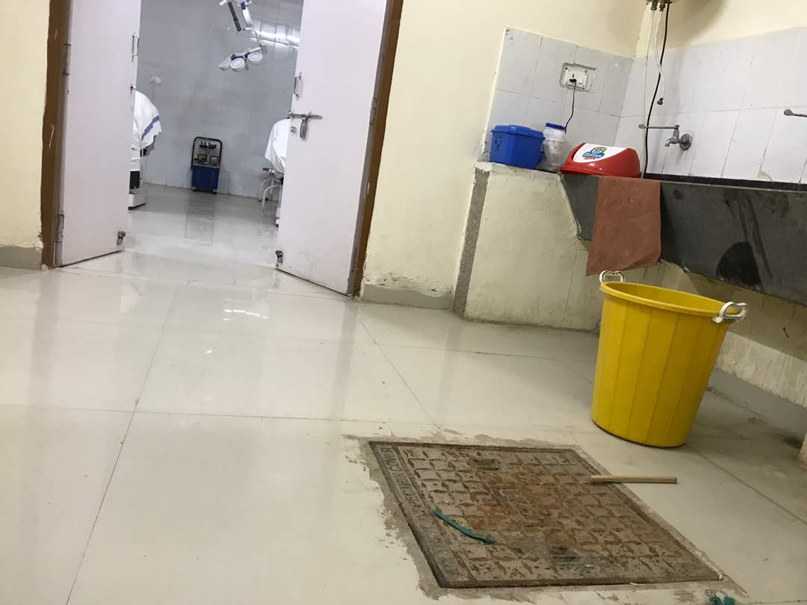
OT Complex (flaws in service detailing)

Slide 13
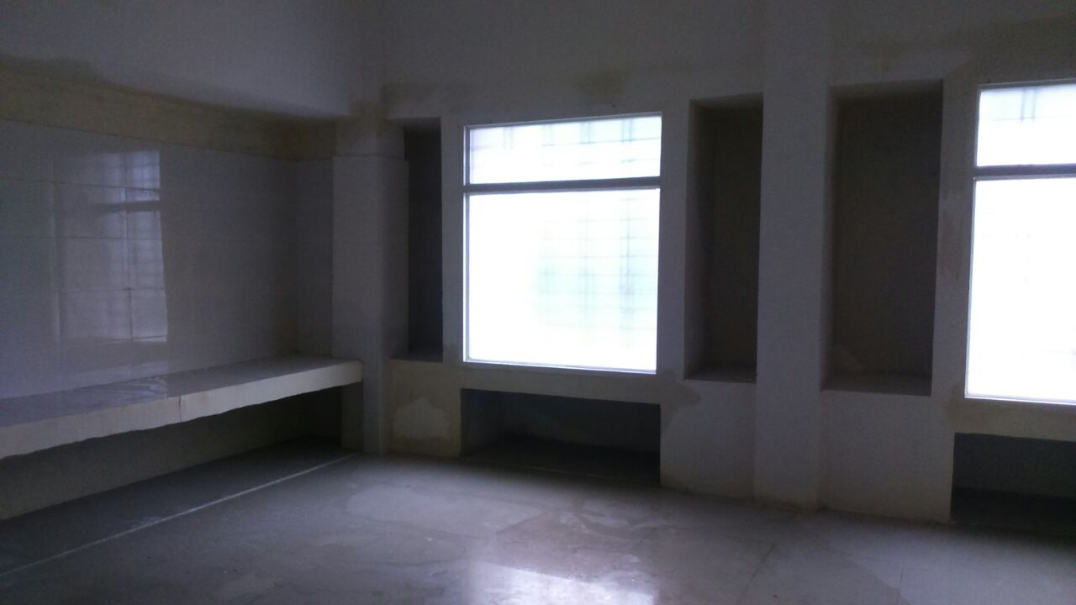
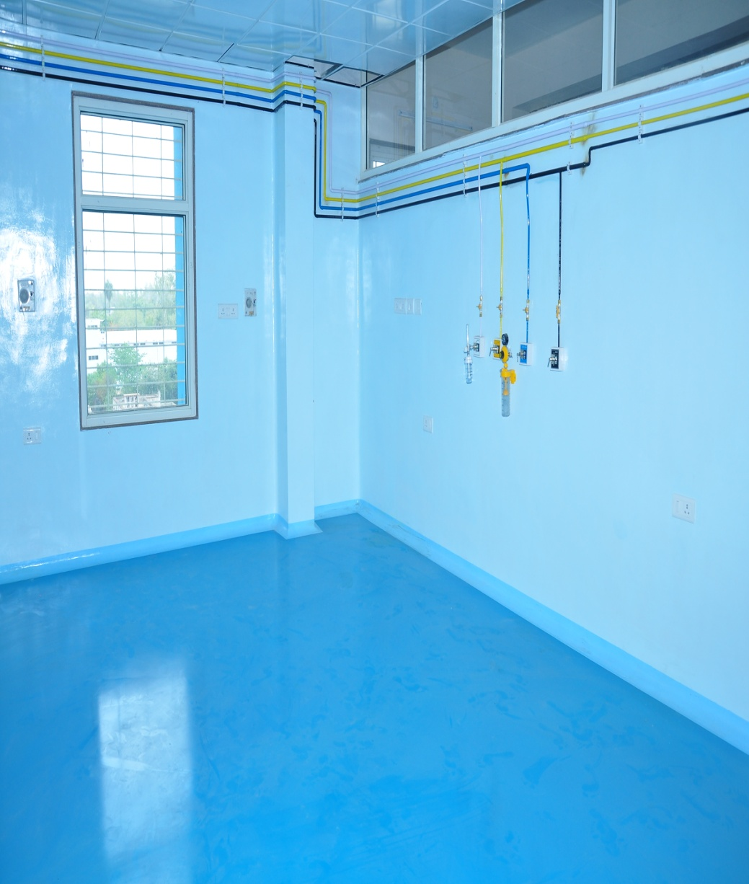
Operation Theatre
Before | After

Slide 14
OUR APPROACH
Sensitisation within the Department
NSHRC Workshop
Convinced about the root cause of problem
Capacity building of professionals
Sensitisation at the level of government
Convincing the works department
Engagement of hospital planning consultant
Institutionalizing the process by getting RFP changed by the works department.
Infrastructure Audit/Perspective Planning.

Slide 15
RESULTS/OUTCOMES
Qualitative
Patient convenience
Improved Quality of Services
Increased efficiency of Service providers
Quantitative
Reduction capital cost
Reduce operational and maintenance cost

Slide 16
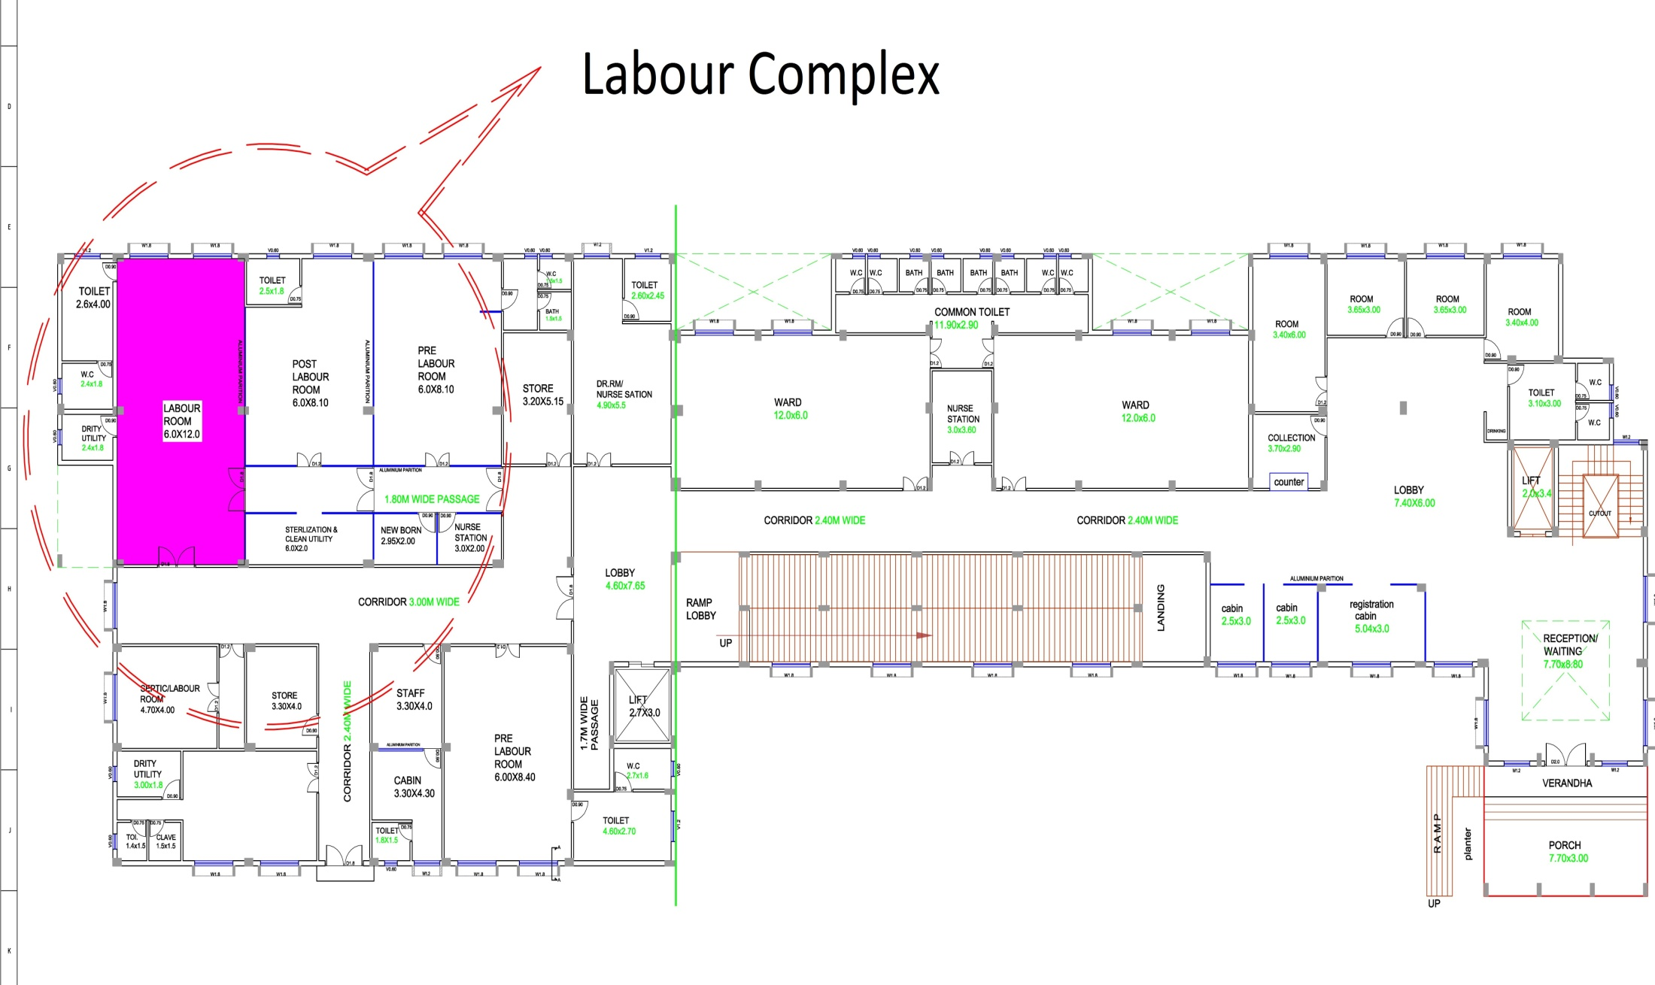
Labour Complex : MCH Sehore (Before)

Slide 17
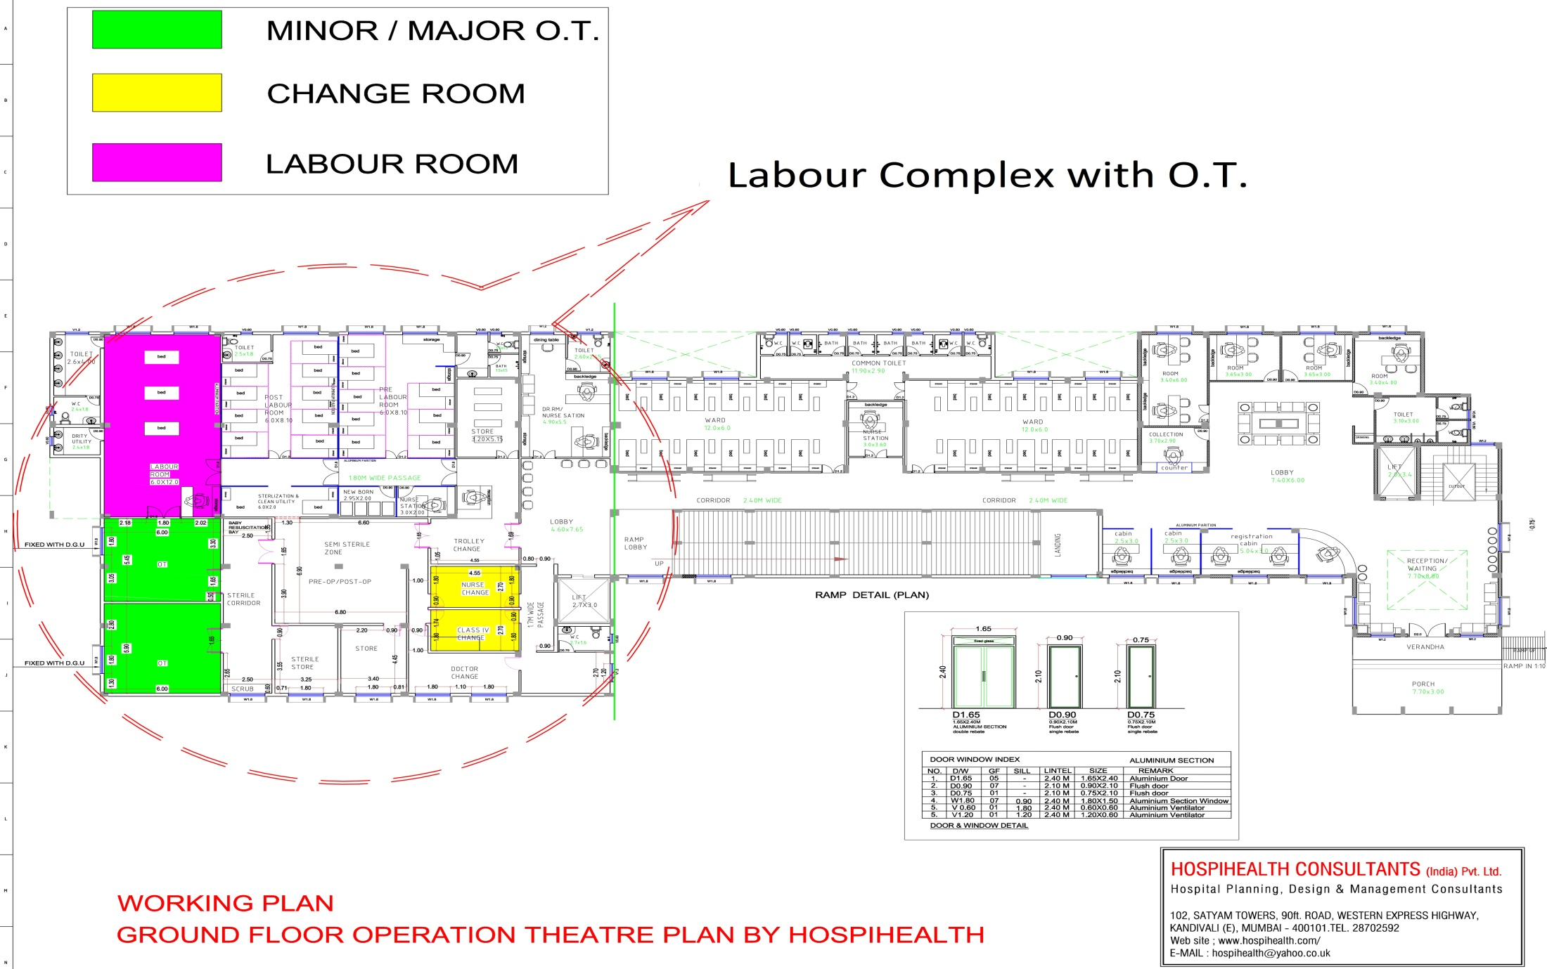
Labour Complex : MCH Sehore (After)

Slide 18
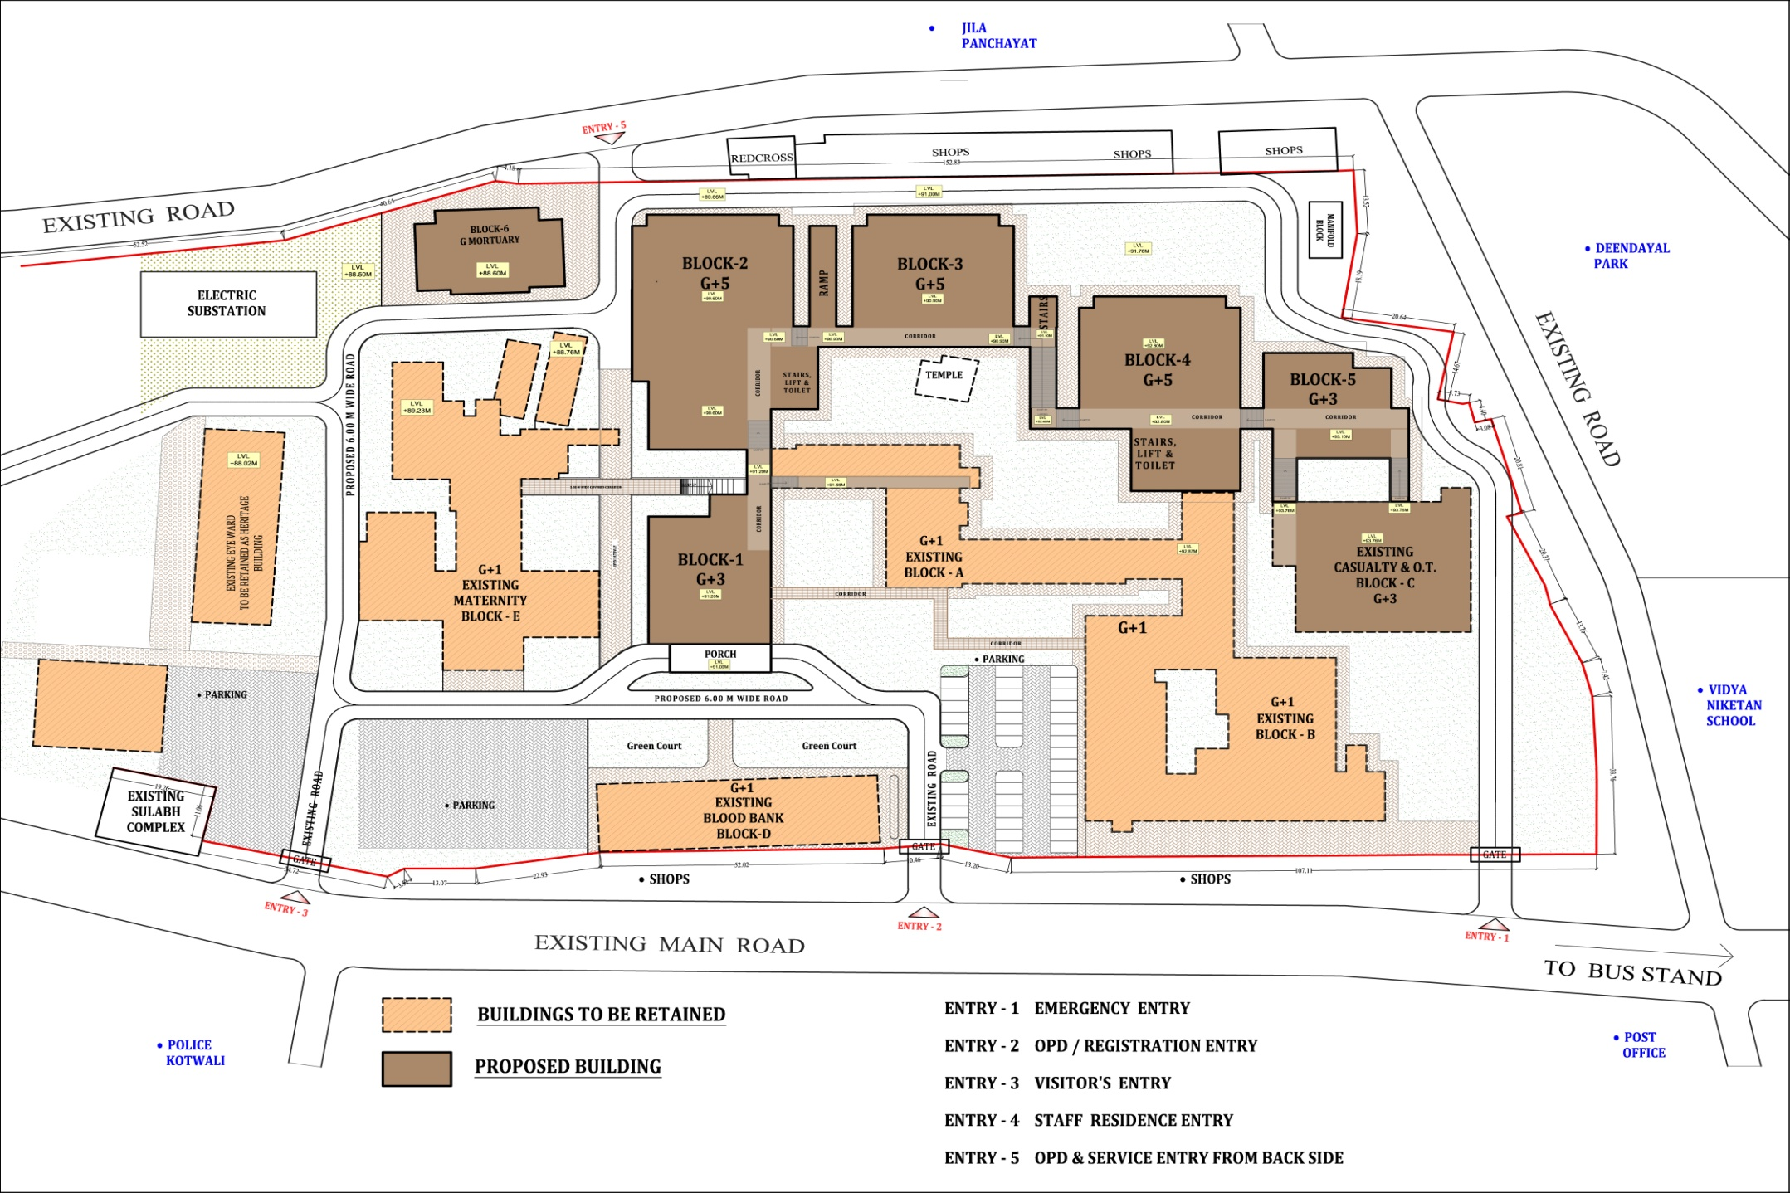
DH Chhindwara : Development Plan (Before)

Slide 19
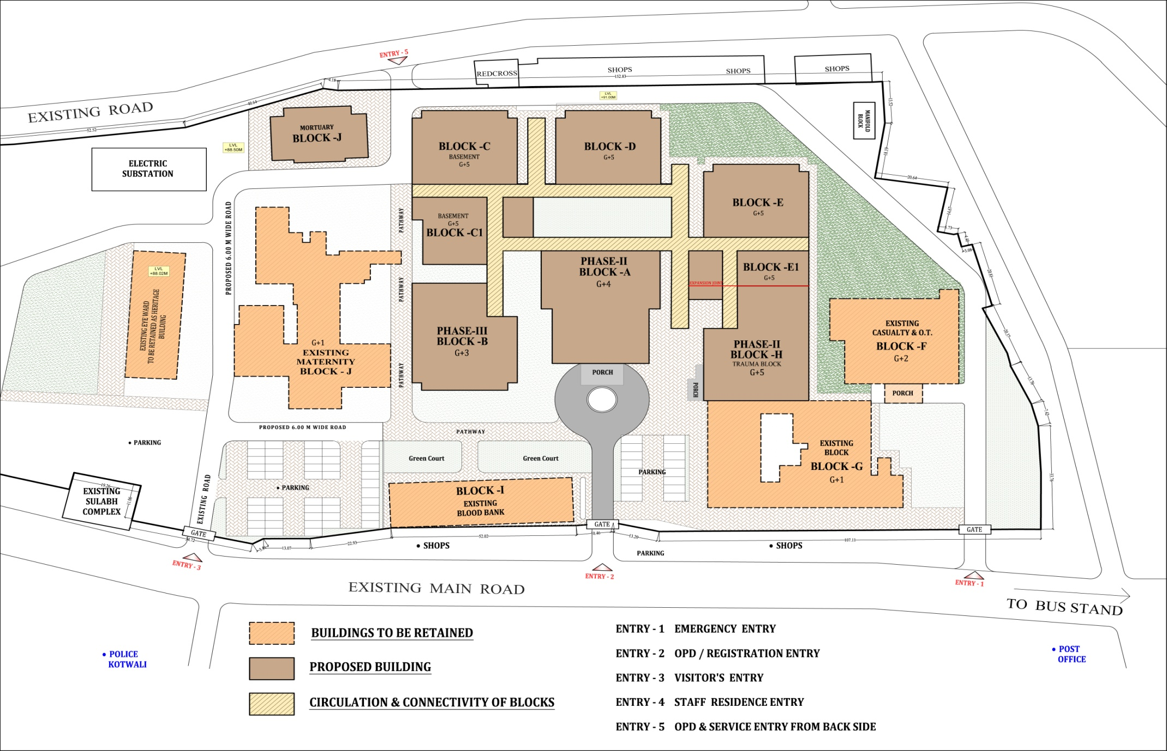
DH Chhindwara : Development Plan (After)

Slide 20
Thank You
“It’s a beginning & not an end”

