Slide 1
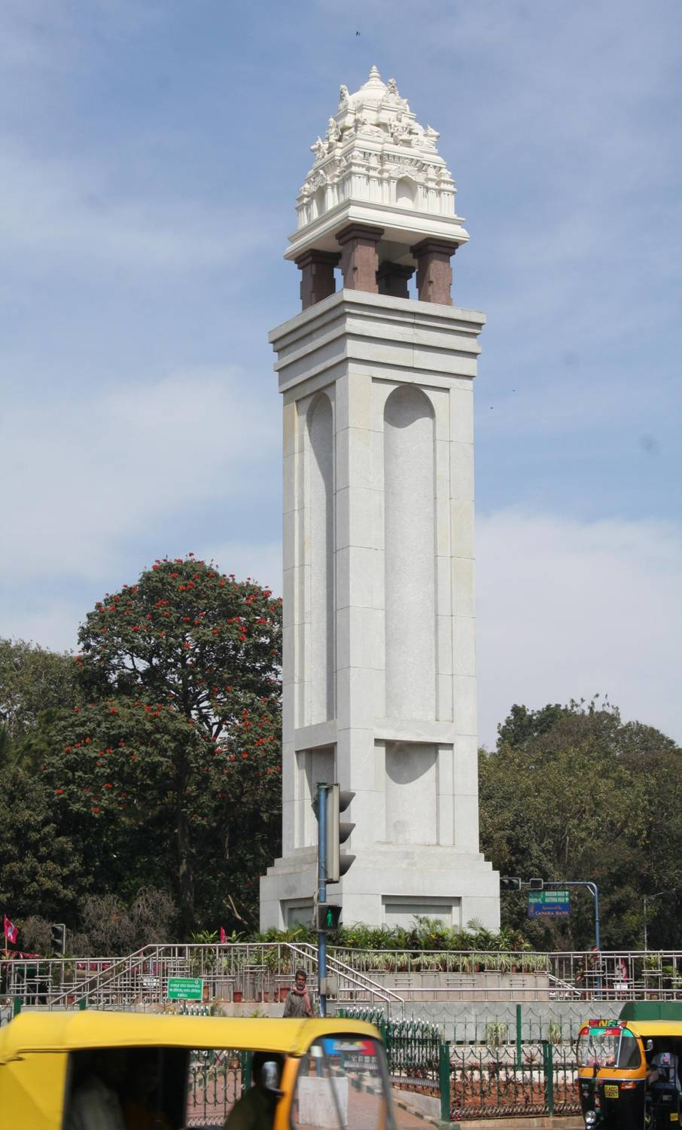

BBMP- Public Health Information and Epidemiological Cell in BBMP (PHIEC), Bangalore, Karnataka

Slide 2
Features Summary
Data collection online
Data collection from Govt & Private Hospitals
Line Listing of Patients with GIS location
SMS/email Alerts to MOH for Confirmed Cases
Update from Rapid Response Teams at the field
Weekly reporting and Emergency reporting
Data on Non-Communicable Diseases & S Forms
Outbreak/Media Alerts, VPD Alerts
Reports for MOH, Reports for Epidemiologists
Reports, Charts, on Map

Slide 3
Current Status
Hospitals are GIS mapped
Zone boundary and MOH boundaries on GIS define jurisdiction
Over 600 Private Hospitals given access to the application
KMC Act and KPME Act
Working with PHANA
Online system, Training
Compliance of Private hospitals >70%.
Thank you email, Reminder SMS
PHIEC Team assisting and monitoring for sustenance
MOH & HOs have access to dashboards
ANMs and Health Inspectors trained to update at the field for control and preventive actions

Slide 4
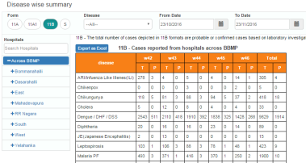
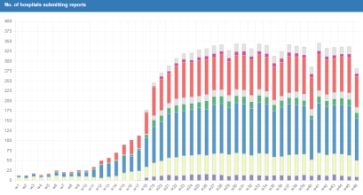
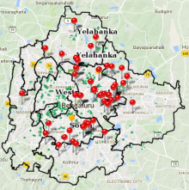
Features Summary
Hospitals
Web Application
Accessible at Hospitals
3 Forms - one time per week
With submission History
Email acknowledgement on submission
Reminder SMS
High Alert for emergency reporting
Works on smart phones
Govt. Hospitals
Forms
11A
11A(1)
11B
Private Hospitals
Submit weekly
Registered Users
PHIEC System
SMS
Health Officers
Dashboard for Health Officers
View by zone or MOH filters
Alerts for Confirmed cases
Update & follow up preventive actions
Receive Outbreak Alerts
email
Reports
Charts
Map
PHIEC Cell
Data analysis – Trend detection
Provide data for effective Public Health Planning
Monitor and follow up on weekly Reporting
Drive to increase the coverage of Hospitals

Slide 5


Detection to Actions – Process Flow
Hospitals
Govt. Hospitals
Report Lab Tests data
positive cases and confirmed cases
ex: Tests ELISA -NS1,ELISA -IgM(MAC)
Line listing of Patient Details
Name, location Details
Forms
11B
Private Hospitals
Patients
Submit weekly
Registered Users
PHIEC System
email
SMS
Health Officers
Gets SMS on Confirmed cases
Gets SMS on high Alerts
Dashboard lists for follow up actions
Health Center updates control actions
Health Inspectors update preventive Actions
Update at the location with Photos
PHIEC Cell Monitors reporting & Actions

Slide 6
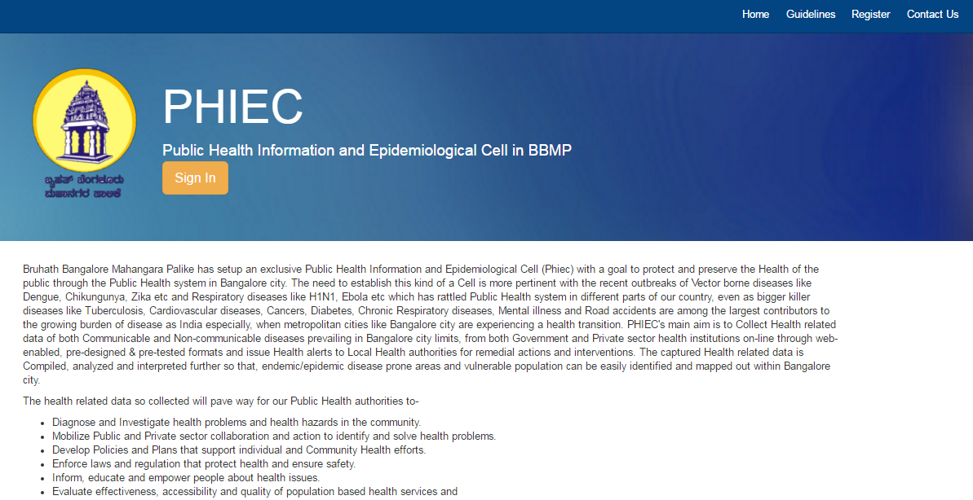
BBMP PHIEC - Application

Slide 7
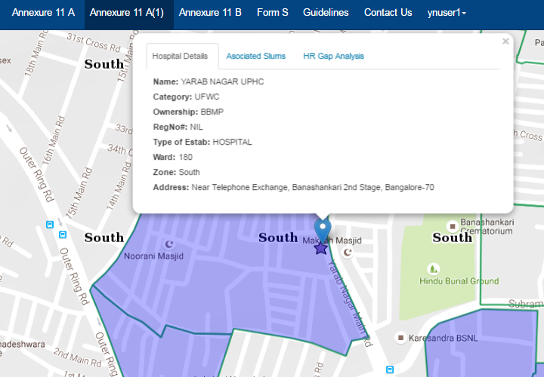
Hospital User Login
Hospital detail shown on map
To access menu 11A, 11A(1), 11B, S ( UPHCs only)
For UPHCs – map shows associated slum areas covered

Slide 8
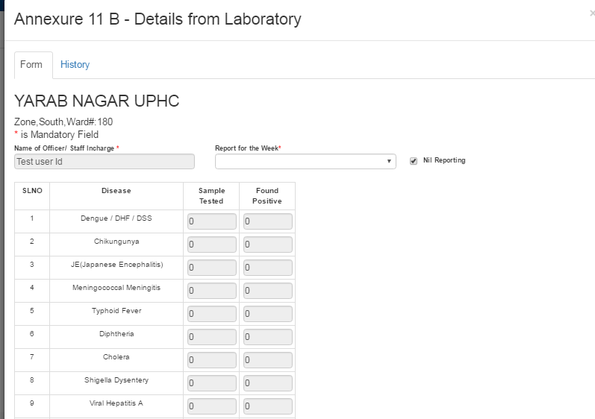
Weekly Reporting – Form 11B
11B – Laboratory confirmed cases reporting
Option to submit a null report – if no cases to be reported for a week

Slide 9
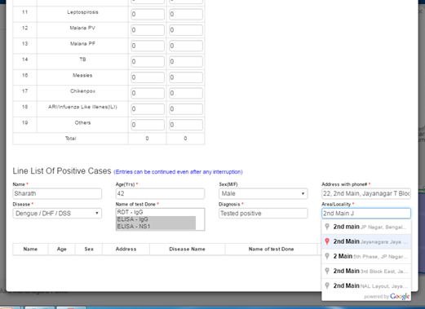
Form 11B Line listing
11B Line listing should tally to the number of positive cases
Patients contact details and Google aided locality captured

Slide 10
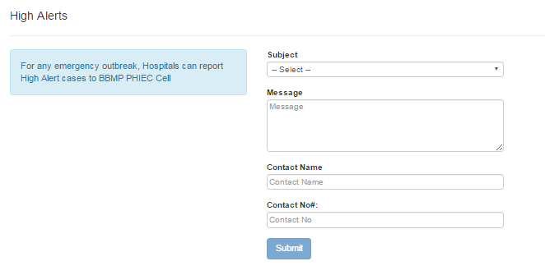
Emergency reporting – High Alerts
Hospital can post emergency reporting if needed during the week
SMS sent to MOH and PHIEC Cells on such reporting.

Slide 11
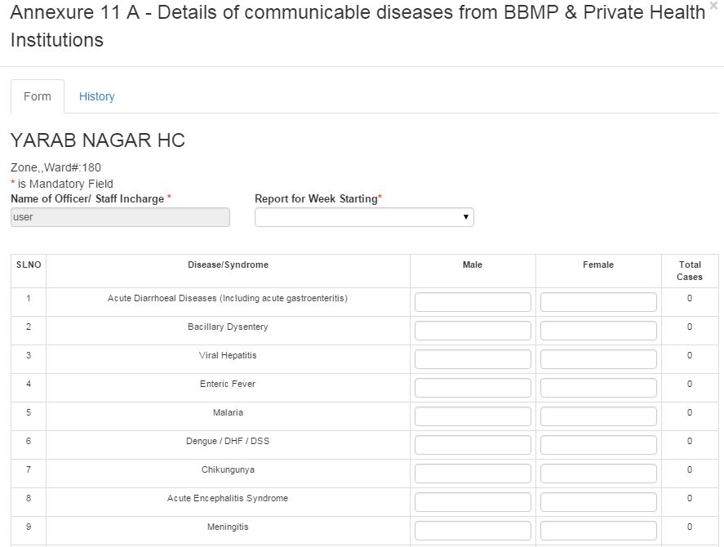
Weekly Reporting –Form 11A
Report for previous week ( Monday to Sunday).
Weekly one time to be reported.
Expected to submit report on Monday, if not latest by Tuesday

Slide 12
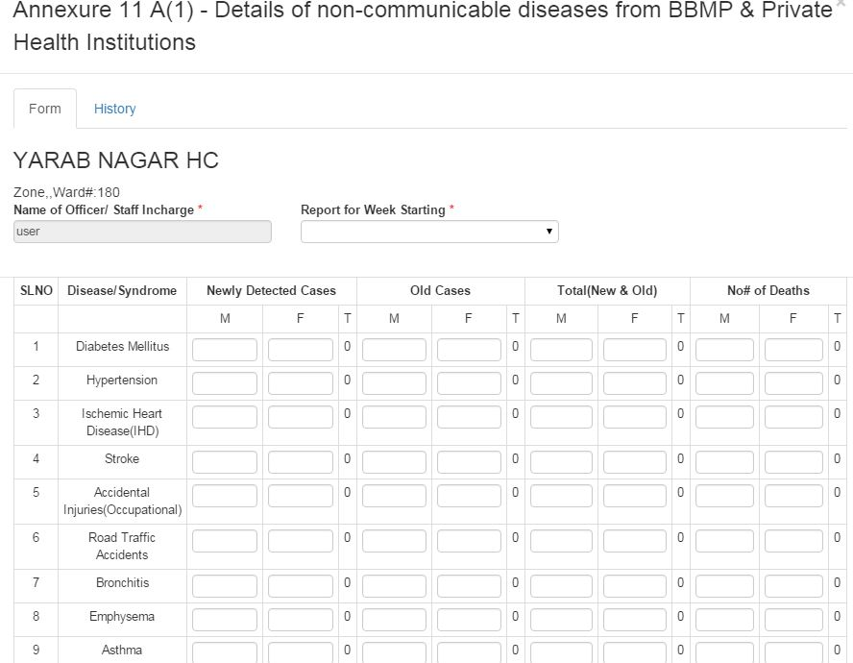
Weekly Reporting – Form 11A1
11A1 – seeking details of new cases, old cases and death cases
Previous week submission can be viewed, printed and filed at Hospital

Slide 13
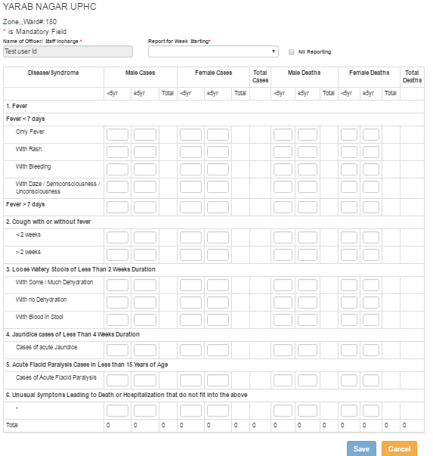
Weekly Reporting – Form S
Form S – introduced a month back
Submission by Officer at UPHCs

Slide 14
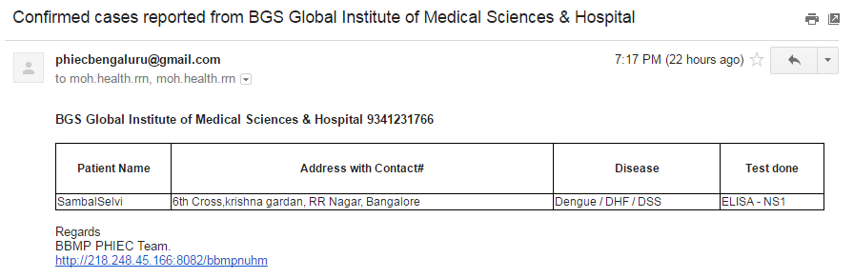
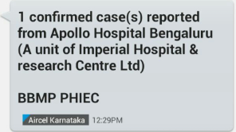
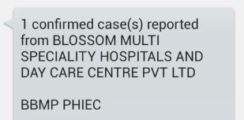
Confirmed Cases - Alerts Email and SMS
SMS

Slide 15
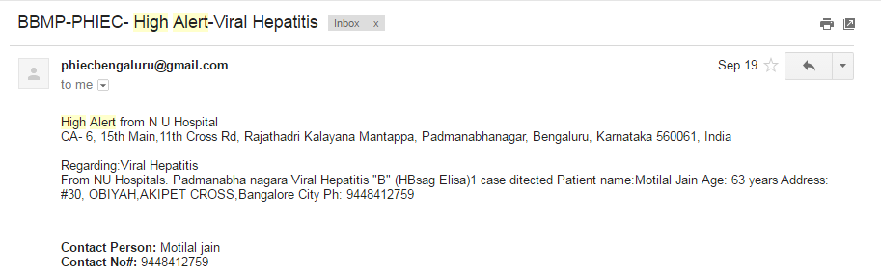
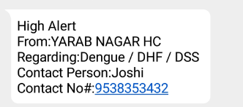
High Alerts - Alerts Email and SMS
SMS

Slide 16
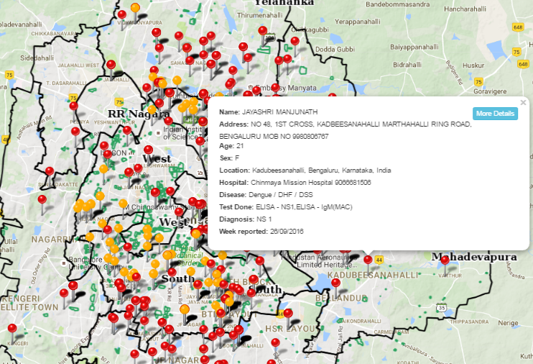
Confirmed Cases – with Patient locality
Confirmed cases – spread by locality of patients
Indicators to show actions taken or not

Slide 17
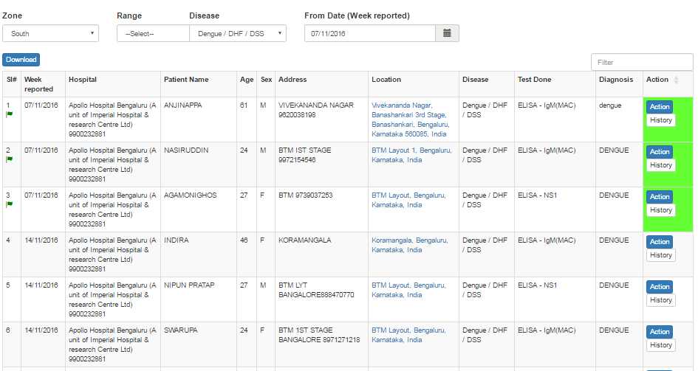
11B – Confirmed Cases Listing
MOH to view new cases and cases with action history
MOH can optionally transfer case to another range for any wrong reporting

Slide 18
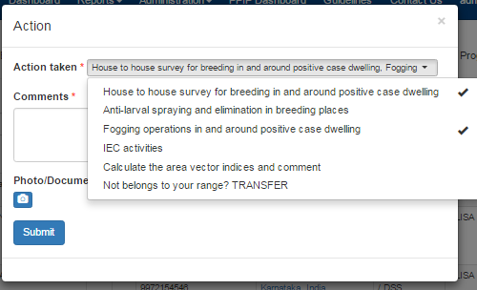
Update Preventive Actions
Health Inspectors take action and update at the field.
Location of action captured
Photo of action captured

Slide 19
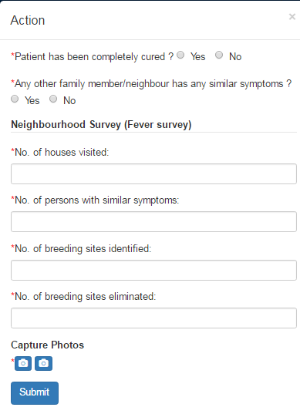
Update Control actions
ANMs from concerned Health centers update actions taken
Update about the patient & family
Update about neighbourhood survey

Slide 20
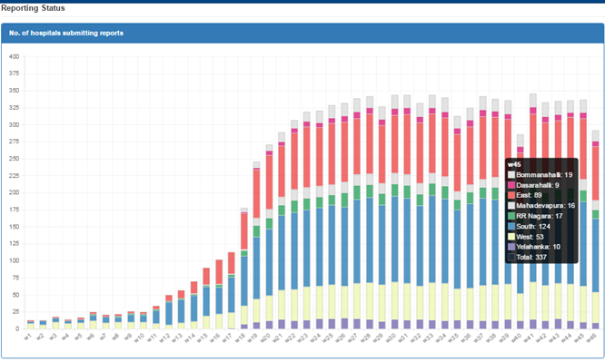
Dashboard – Reporting Status
Chart showing number of Hospitals submitting reports – week wise
Essential to monitor and sustain the reporting

Slide 21
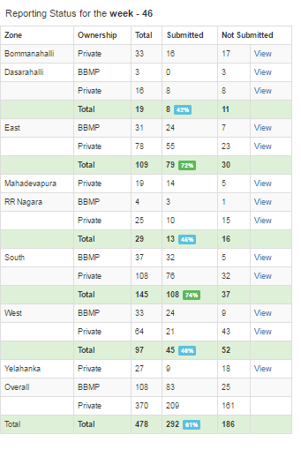
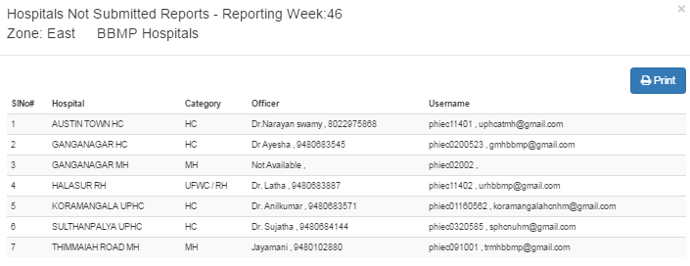
Report on non submissions
Zone wise , range wise breakup of submission status
View non-submission list with ready contact details for follow ups

Slide 22
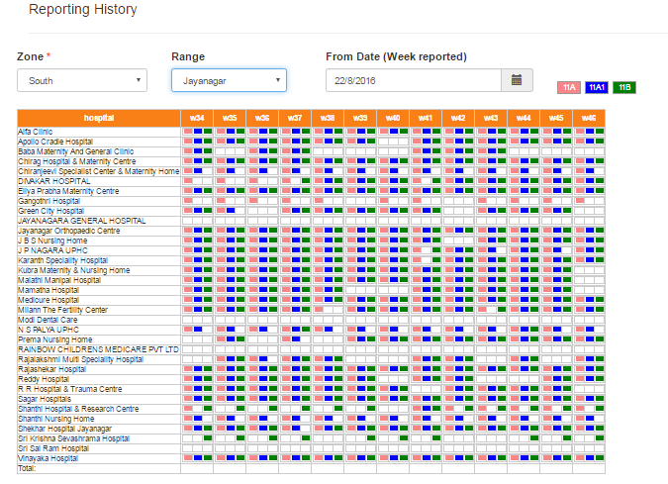
Reporting History – Hospital wise
Hospital wise status of submission for all the Forms
Review for consistent reporting

Slide 23
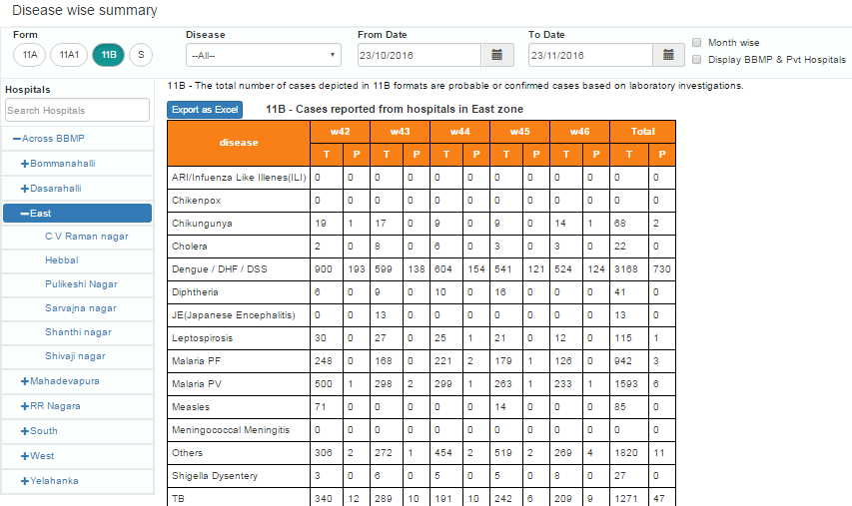
Disease Reporting summary
Disease reporting with maximum combination filters
Form wise, Disease wise , for any given date range
Area coverage wise – across BBMP, zone wise, range wise, or by a hospital

Slide 24
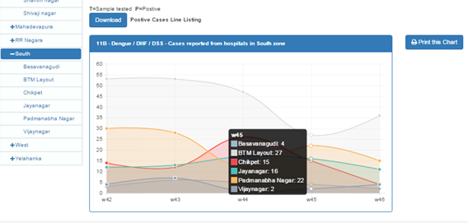
Disease reporting summary – Charts
Dengue case reporting by Range wise for 5 weeks in South Zone
Line Listing available for download as Excel for tracking follow up actions

Slide 25
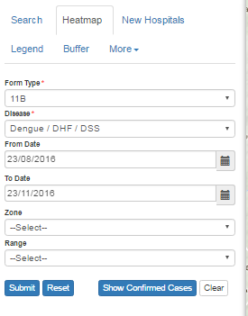
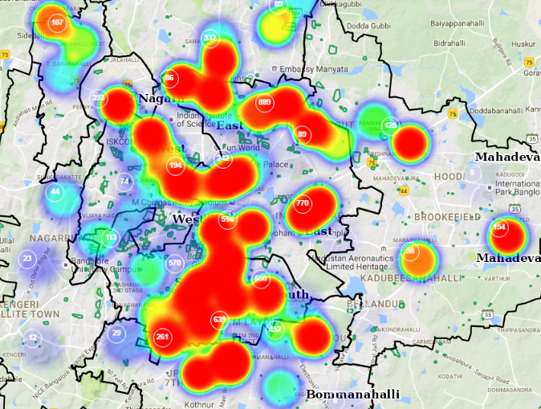
Disease summary – Heat Map
Heat map for Dengue reporting for 3 months duration
Drill down from clustered view to individual hospital

Slide 26
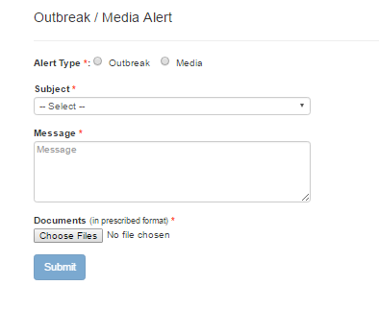
Outbreak and Media Alerts
All MOHs alerted for any outbreak or media alerts.
Prescribed alert document to be attached
Alerts can be viewed at email or at the PHIEC system.

Slide 27
Way Forward
Monitor and drive preventive action at the field level
Get action update through a Mobile App
GEO Location, Time of Action, with Photos.
Drive further for Hospital Coverage
Leverage NUHM data on Urban Slums – for action plan
Use Facilities and Equipment Inventory at Govt. Hospitals to manage emergency situations
Availability of Ventilators across Hospitals
Beds Availability and staff availability

Slide 28
Thank You

