Slide 1


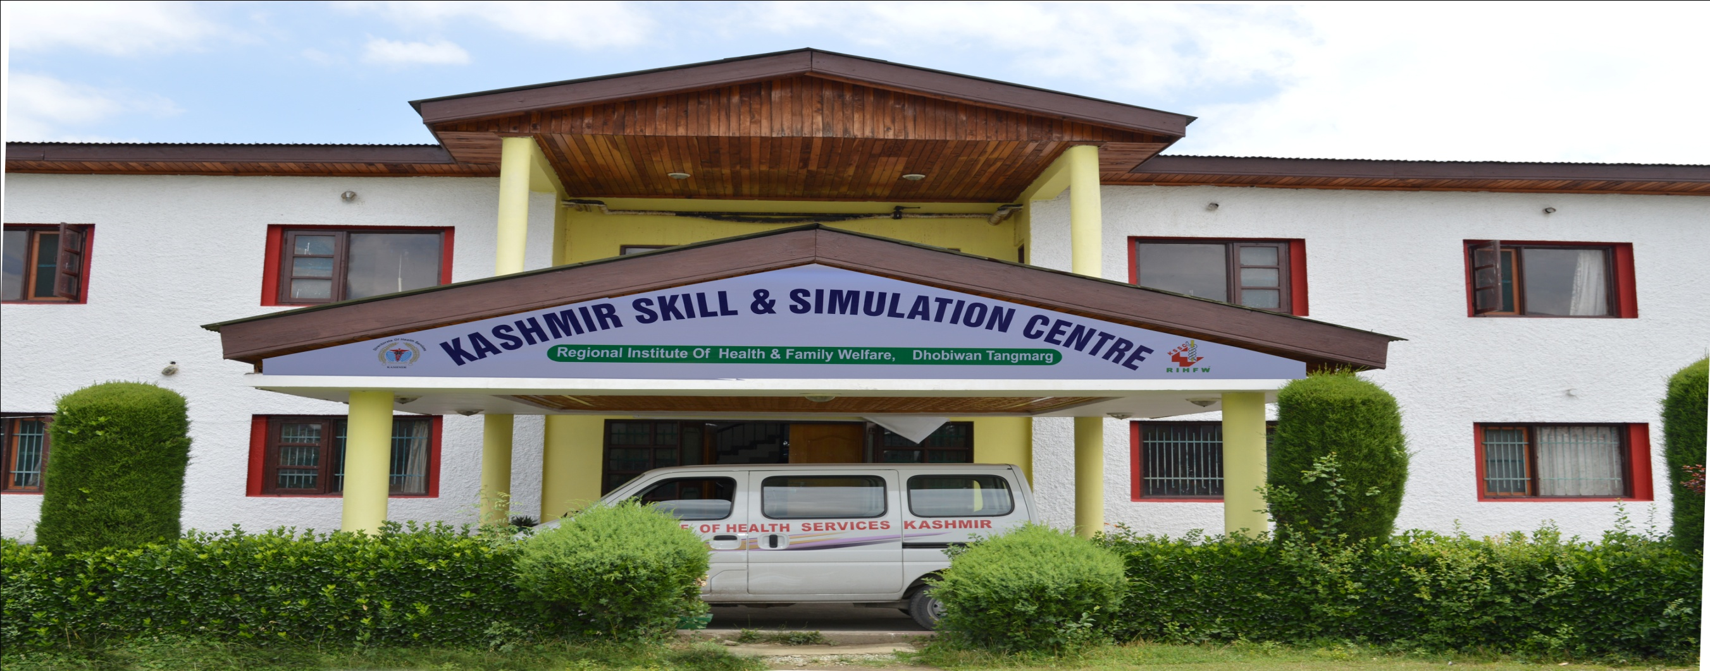
Directorate of Health Services, Kashmir
Kashmir Skills & Simulation Center
Regional Institute of Health & Family Welfare, Dhobiwan, Kashmir.

Slide 2
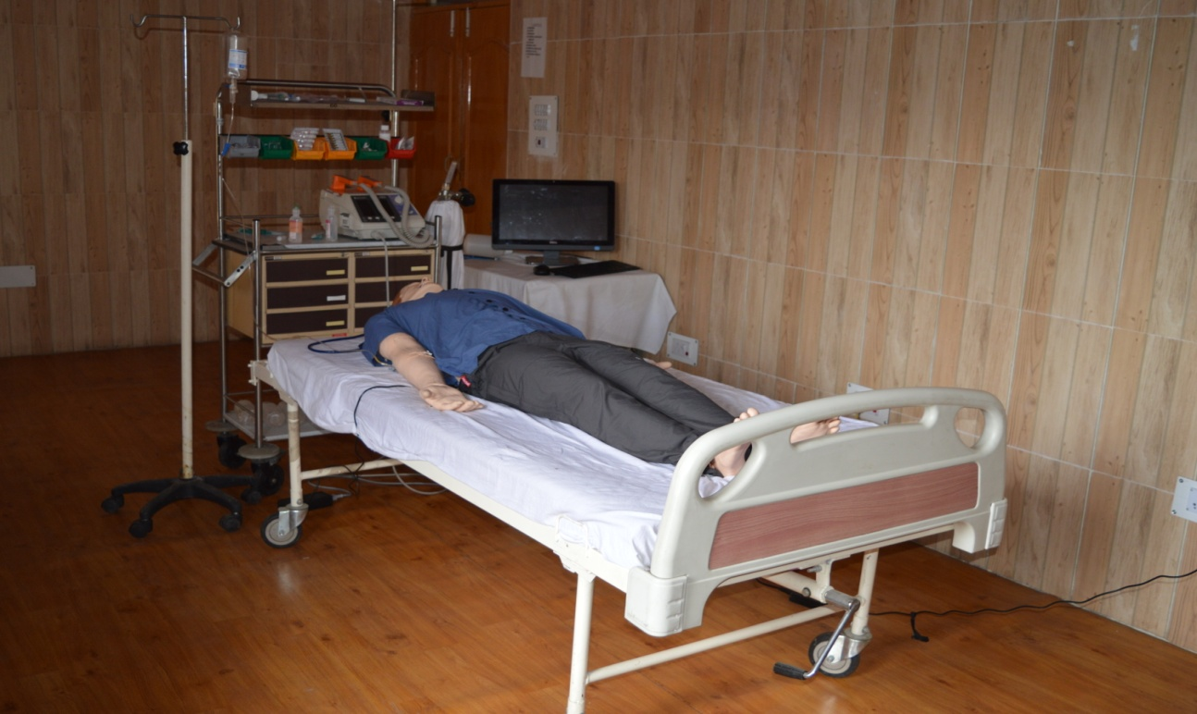
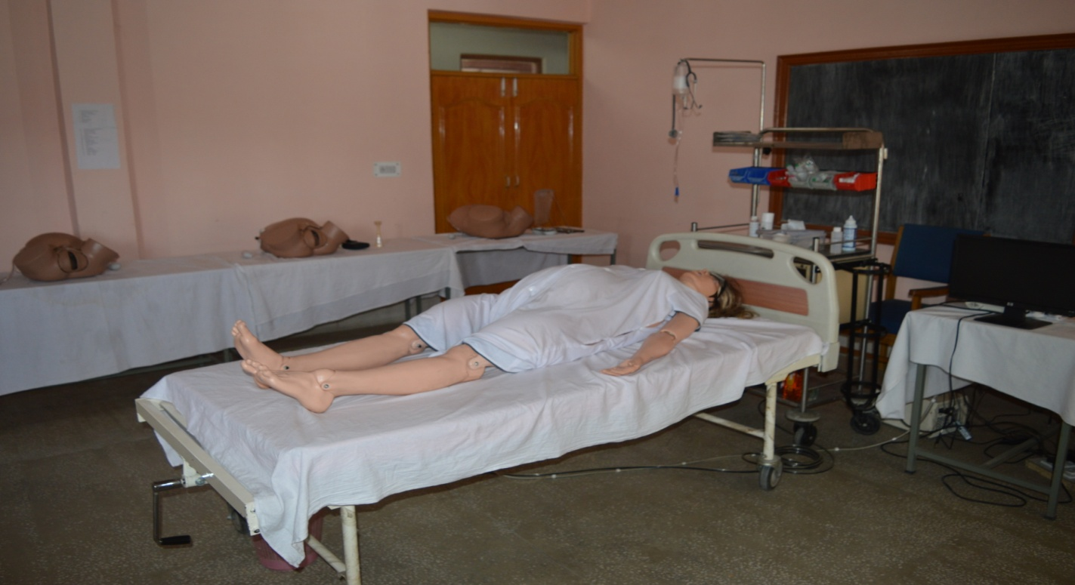
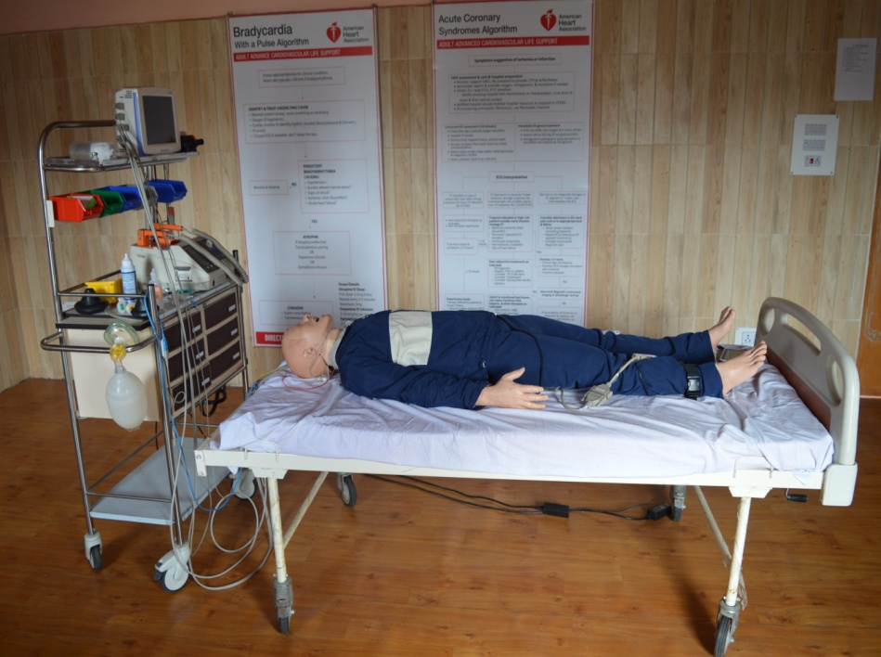
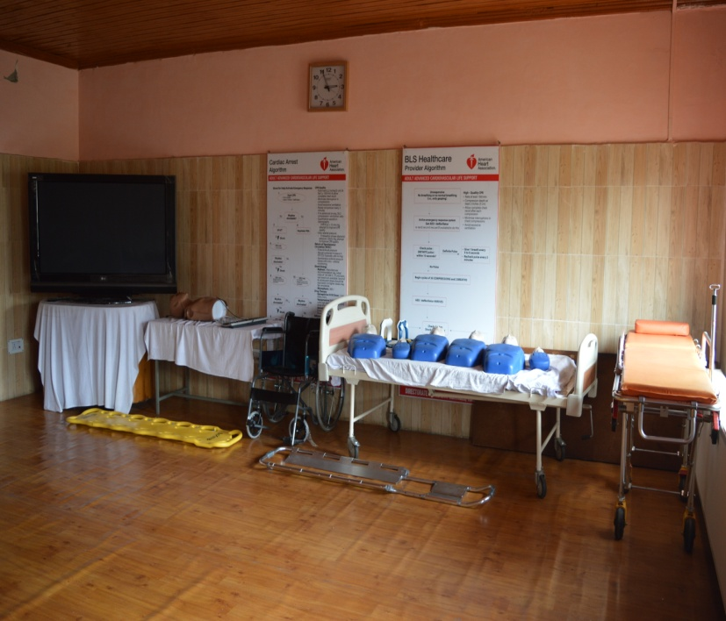
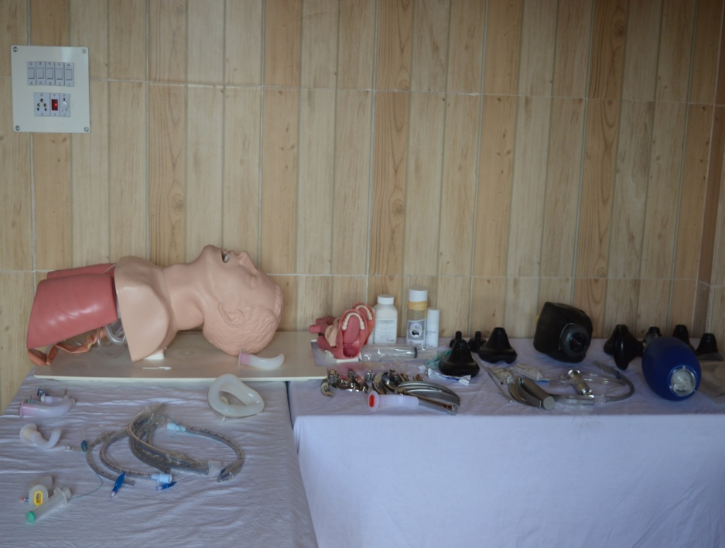
Different Training labs at KSSC, RIHFW Dhobiwan
Clockwise: 1. SIM MAN Lab 2. SIM MOM Lab. 3. Mega Code Kelly Lab. 4. BLS Lab. 5. Airway Management Lab
Where all the trainings are conducted

Slide 3
Background
How it all started
Over the years, the Directorate of Health Services, Kashmir has been successful in reaching out to the population by way of establishment of new Community Health Centers (CHCs), Primary Health Centers (PHCs), and Sub Centers catering to all the geographical locations. Lack of skill upgradation trainings has been a challenge in recent times and the quality of trainings in the Medical, paramedical and nursing colleges has not been focused upon, as a result, semi-trained and semi-skilled health professionals without proper expertise are working in the system. Even the curriculum of the Medical Colleges has left out the skill based competencies of the pass outs who are being posted to serve in our health institutions.
An effort in analyzing the gaps in skills of health personnel and the hospital infrastructure with respect to handling of institutional deliveries and emergency/trauma patients in the institutions under the Directorate of Health Services, Kashmir was under undertaken in 2011 by the Directorate and it was found that increasing the skills of healthcare professionals as per the modern protocols of skill enhancement in key areas related to Mother & Child Healthcare (MCH), Basic Life Support and Management of trauma/cardiac care will lead to improvements in outcomes.

Slide 4
Gap Analysis 2011
Sequence of events that followed in establishment of KSSC - Flowchart
Constitution of EMS Task force at Directorate level 2011
Constitution of Future training faculty 2011
Constitution of Trauma Management team 2012
BLS ToT in collaboration with ICRC 2011
Kashmir Skills & Simulation Center
(KSSC)
Establishment of ER Rooms in all DHs and select SDHs 2013 till date
SIM Mom/SBA ToT 2013
ERTC ToT Phase 1 in collaboration with ICRC 2013
ACLS ToT in collaboration with American Heart Association 2014
Constitution of Medical Emergency Audit team for ER Rooms and Critical Care Ambulances 2013 & 2017 respectively
ERTC ToT Phase 2 & Phase 3 in collaboration with ICRC 2014 & 2015

Slide 5
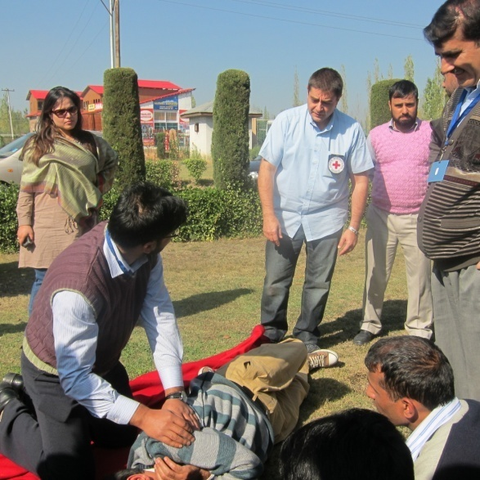
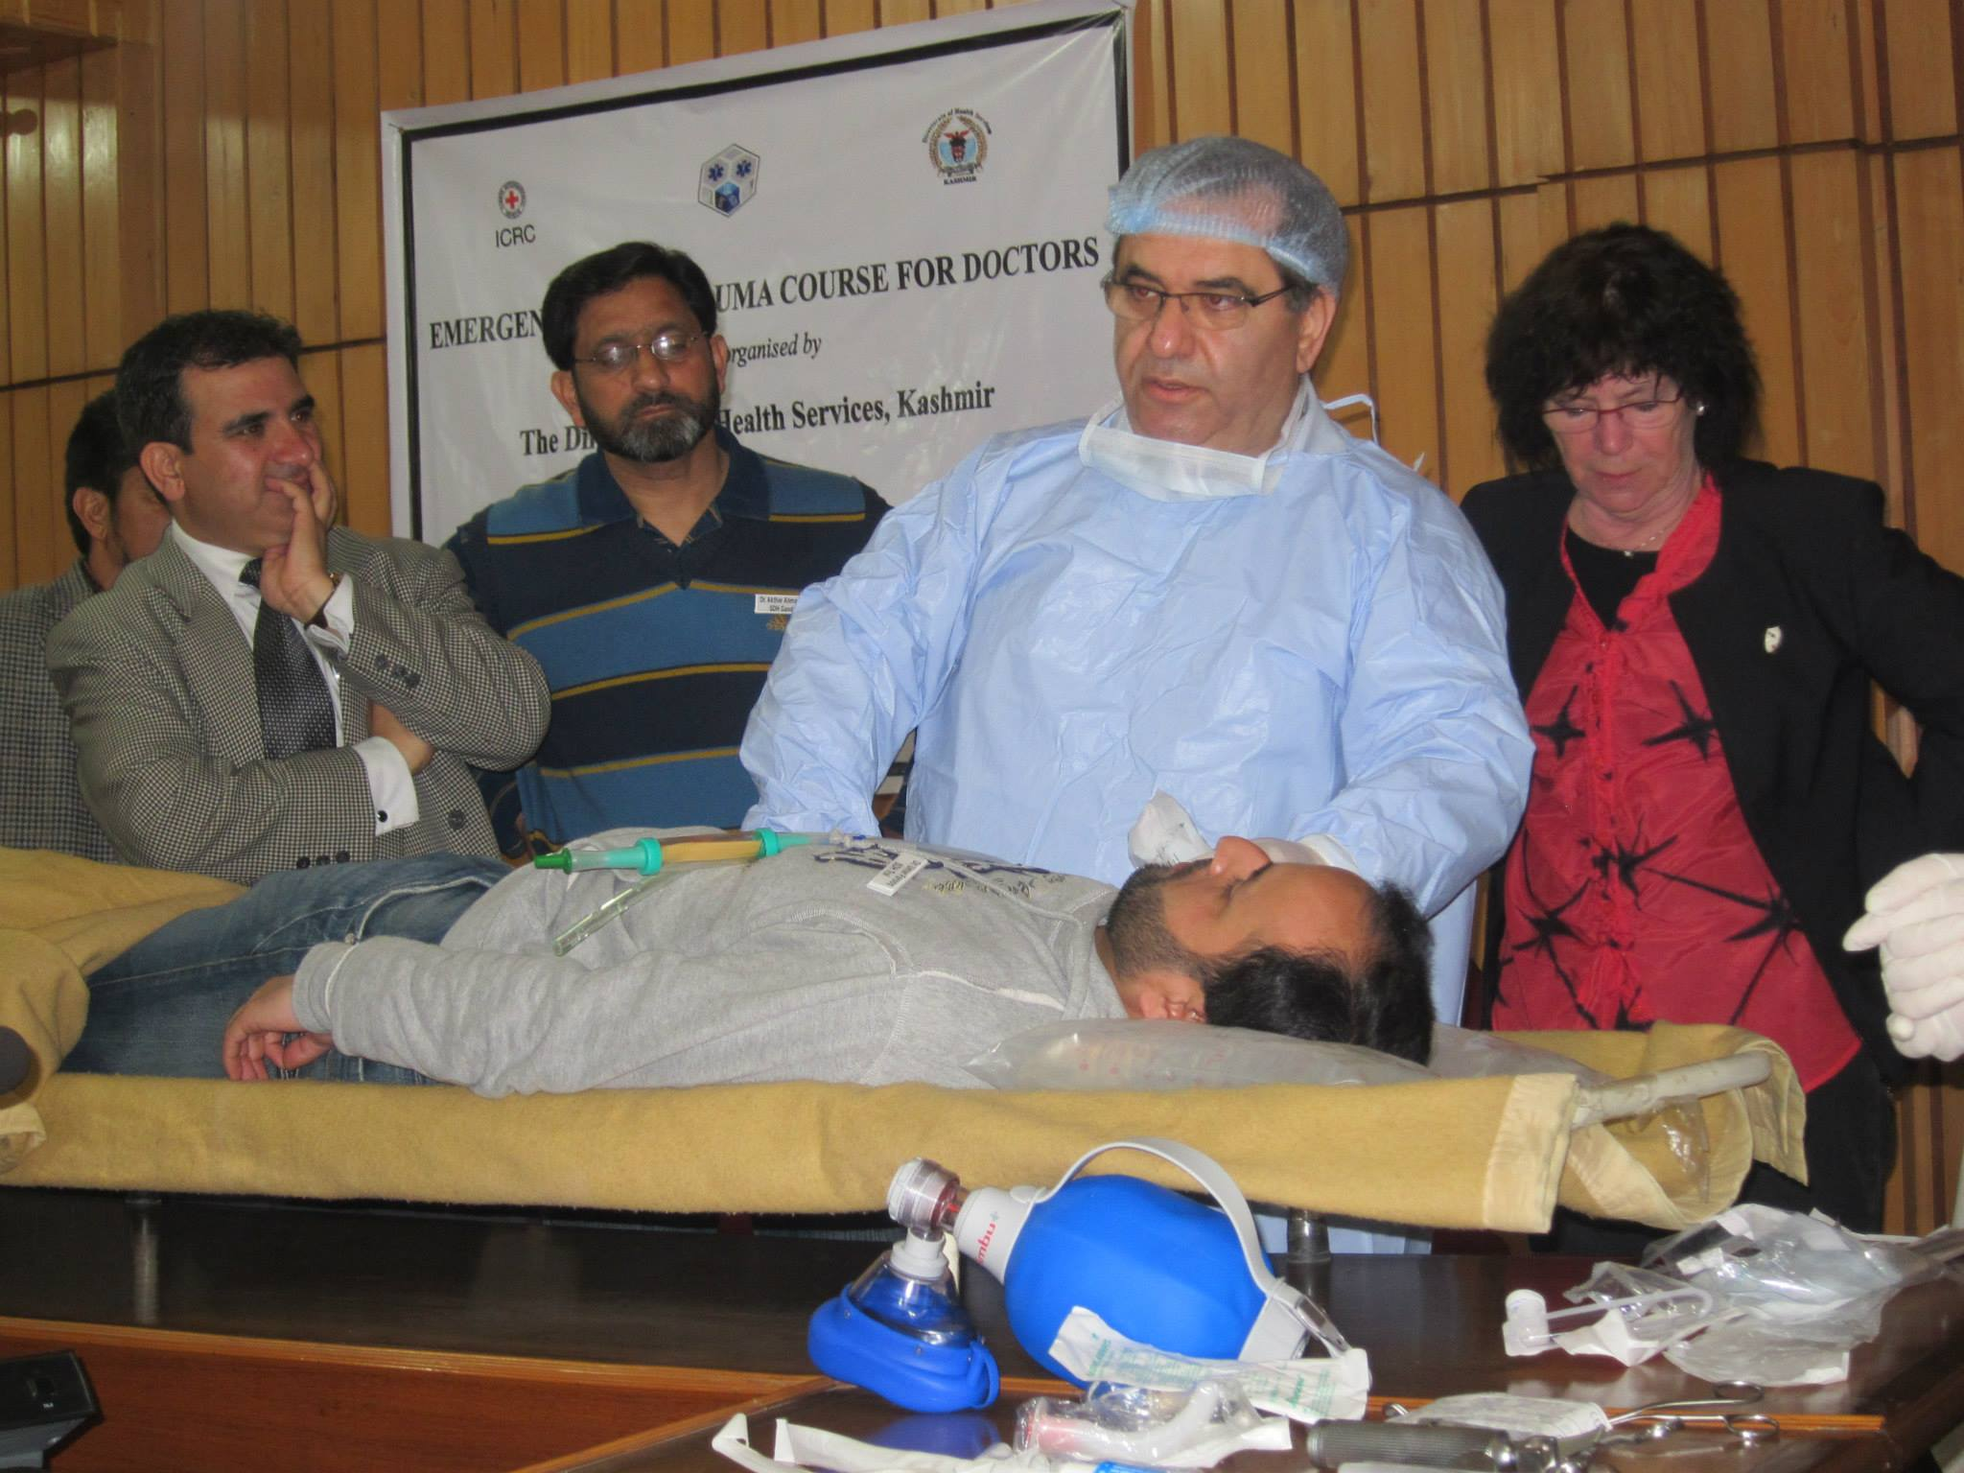
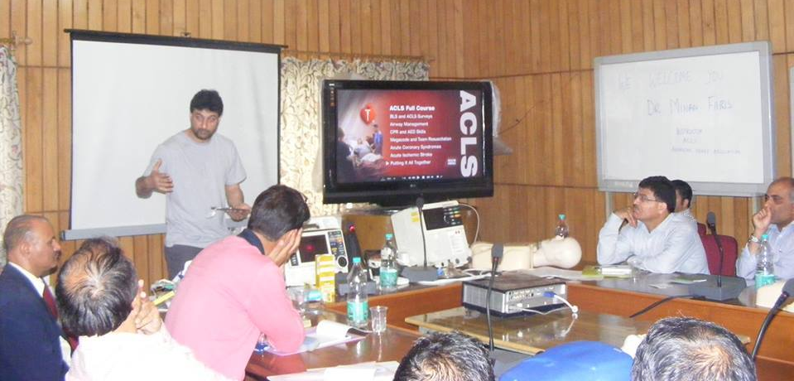
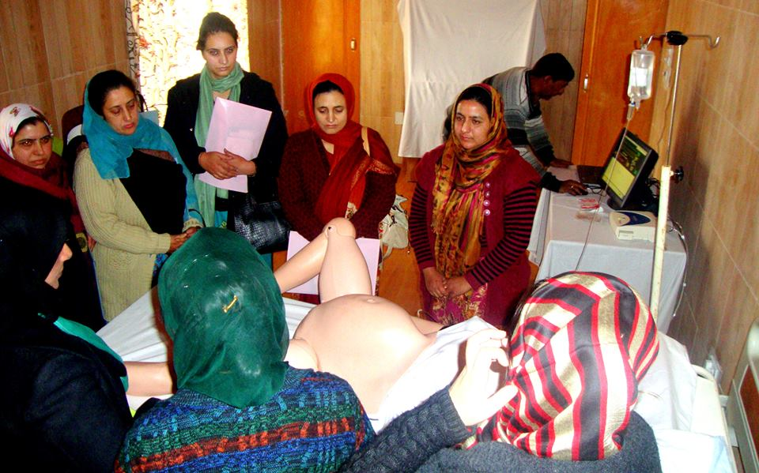
Clockwise: 1. BLS ToT in collaboration with ICRC 2. ERTC ToT in collaboration with ICRC. 3. ACLS ToT in collaboration with American Heart Association. 4. Skill Birth Attendance ToT
ToT Trainings in collaboration with various International organizations

Slide 6
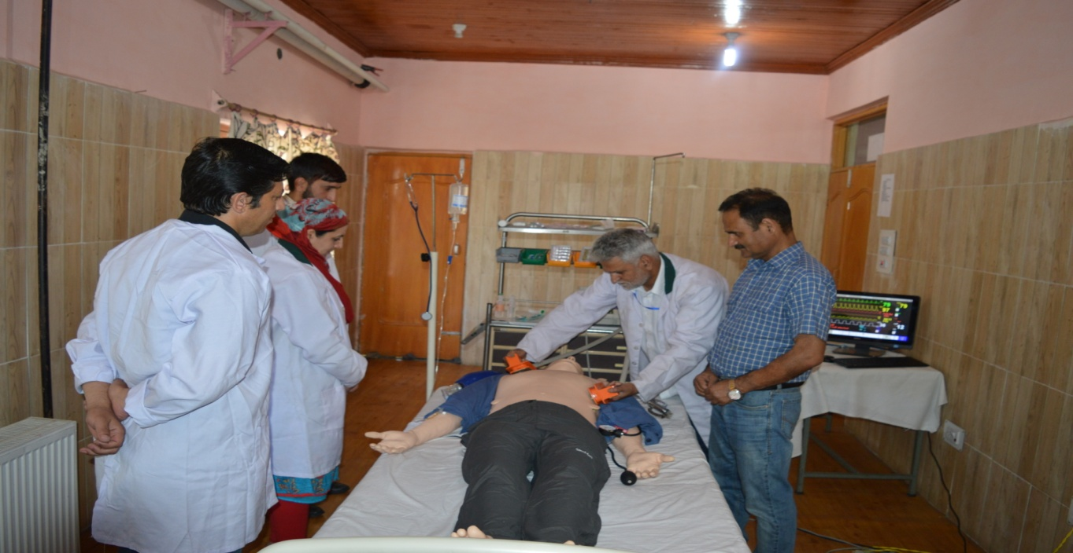
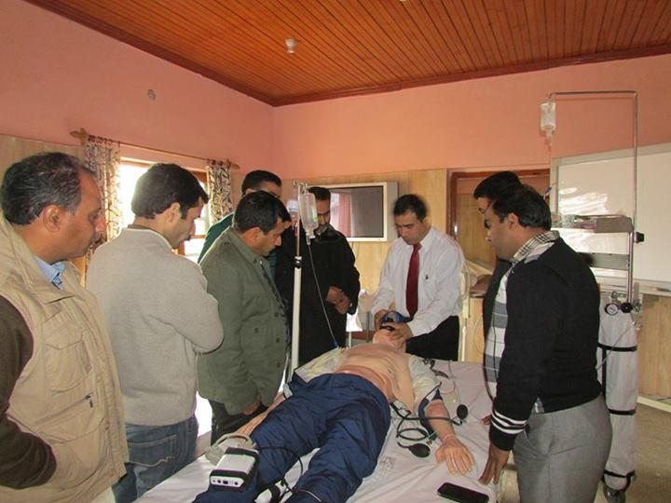
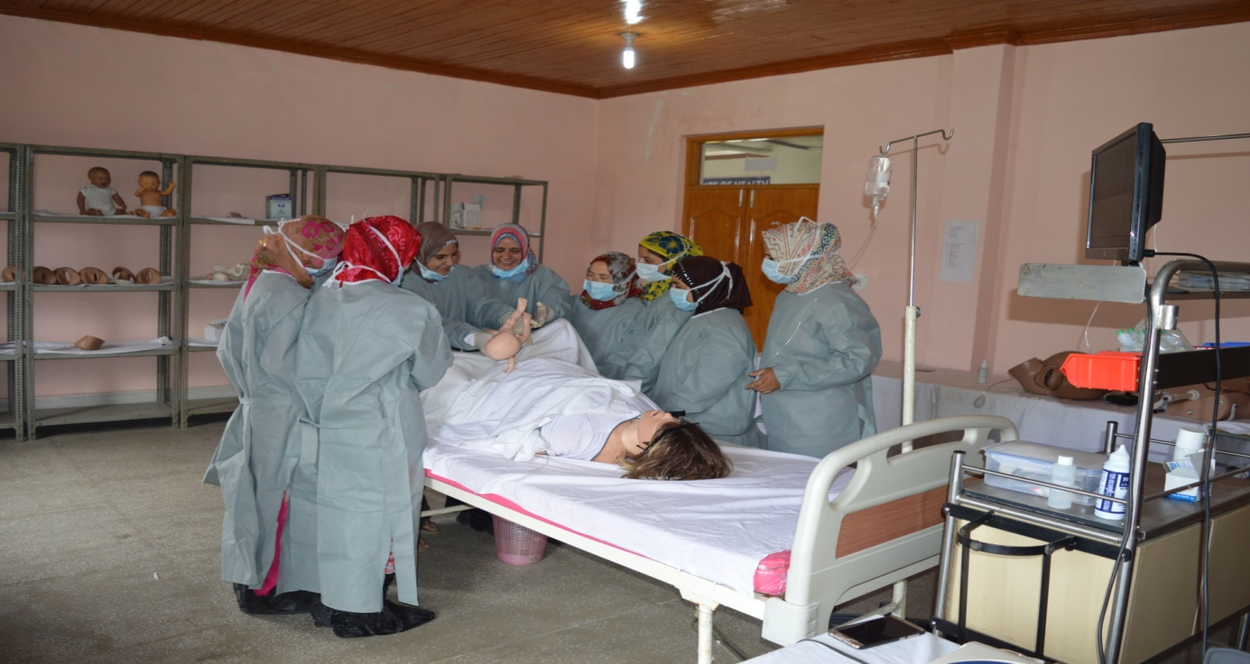
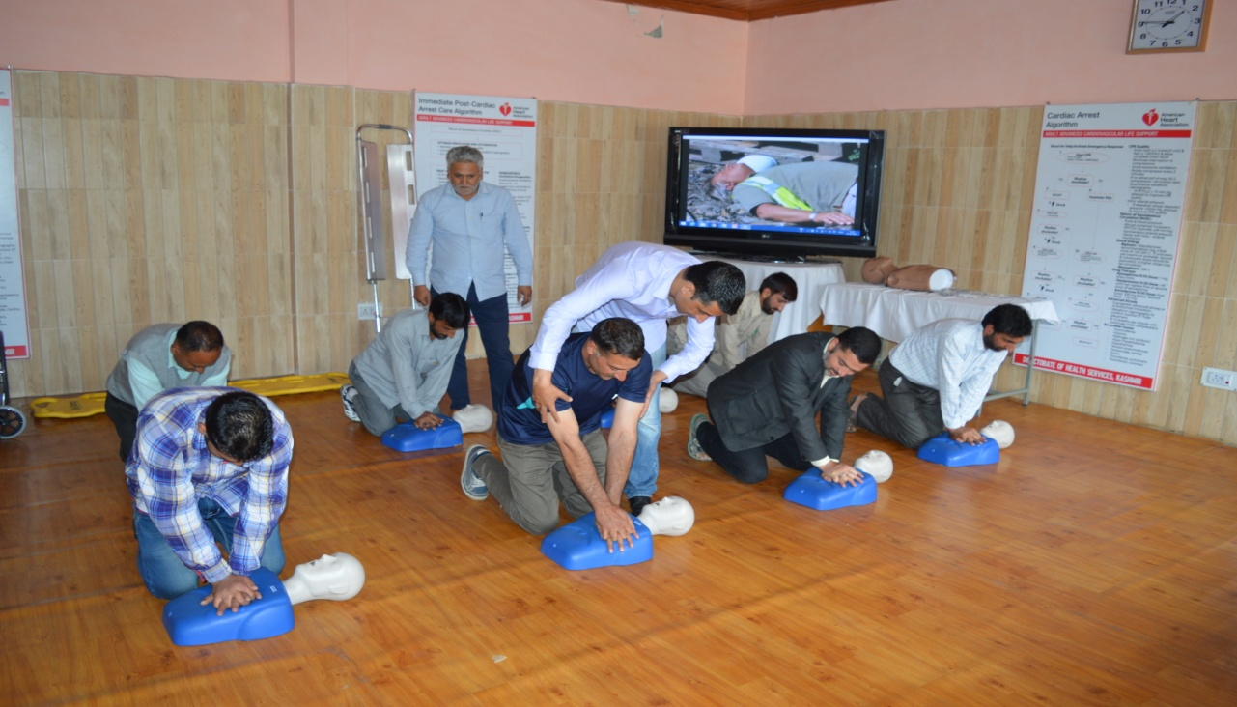
Clockwise: Master Trainers of DHSK imparting ERTC, ACLS, OST and BLS trainings down the line to the health personnel
Current Training modules at KSSC, RIFHW Dhobiwan

Slide 7
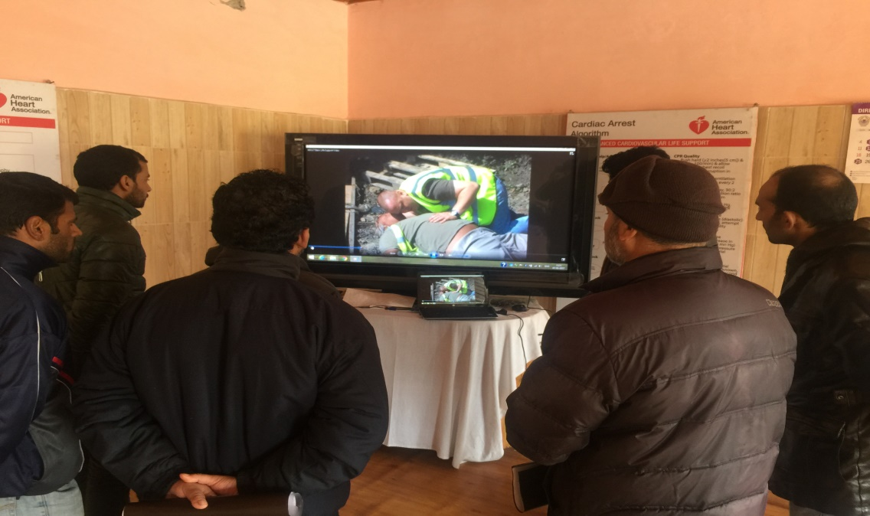
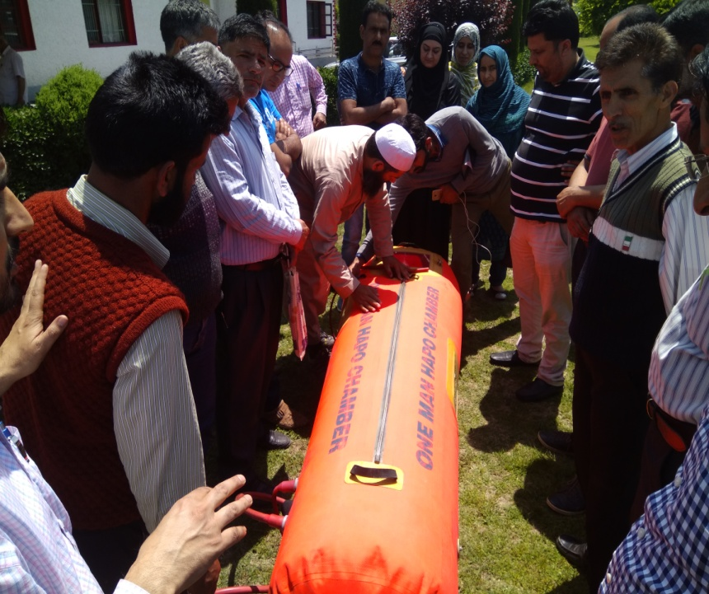
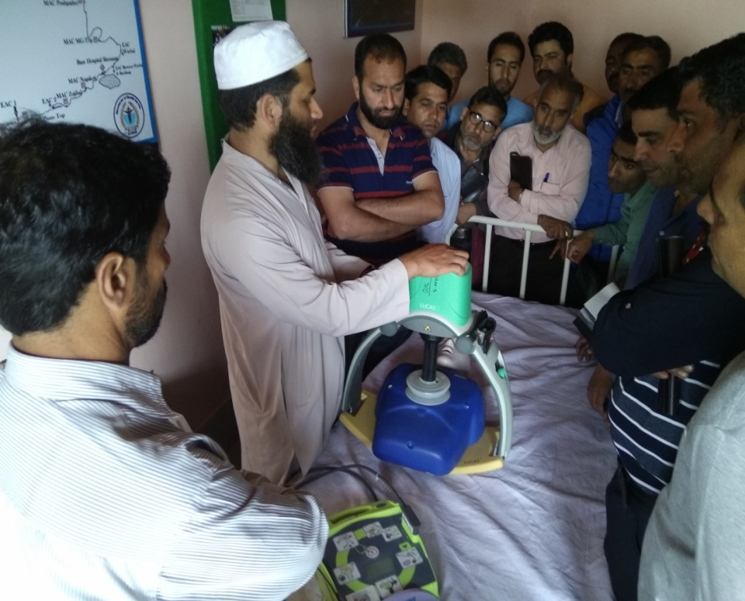
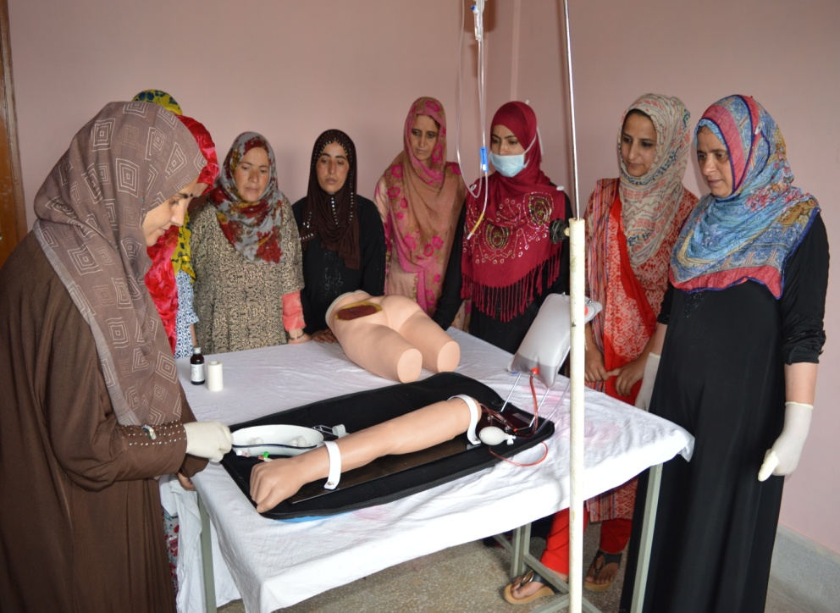
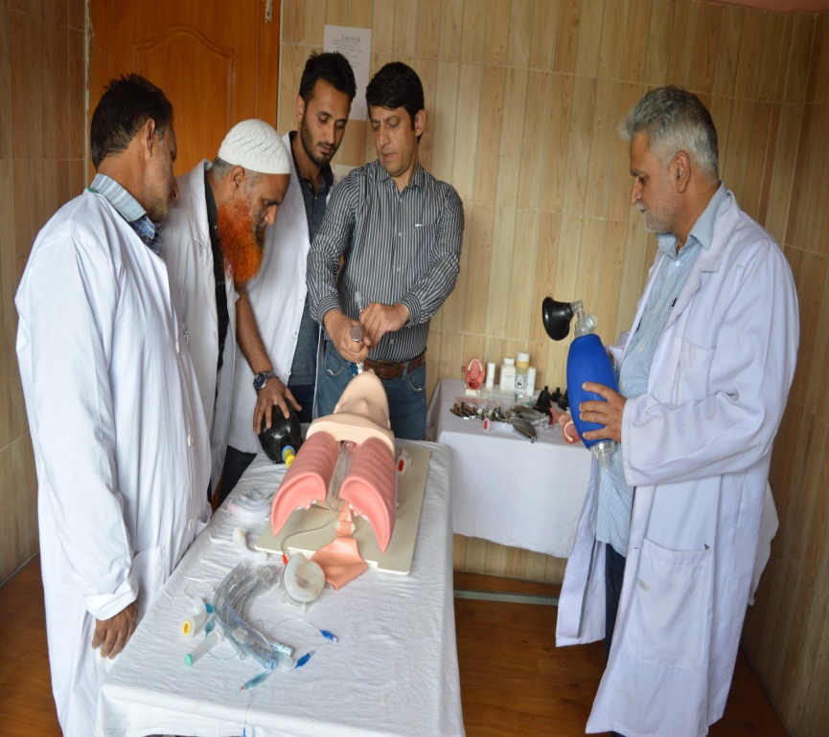
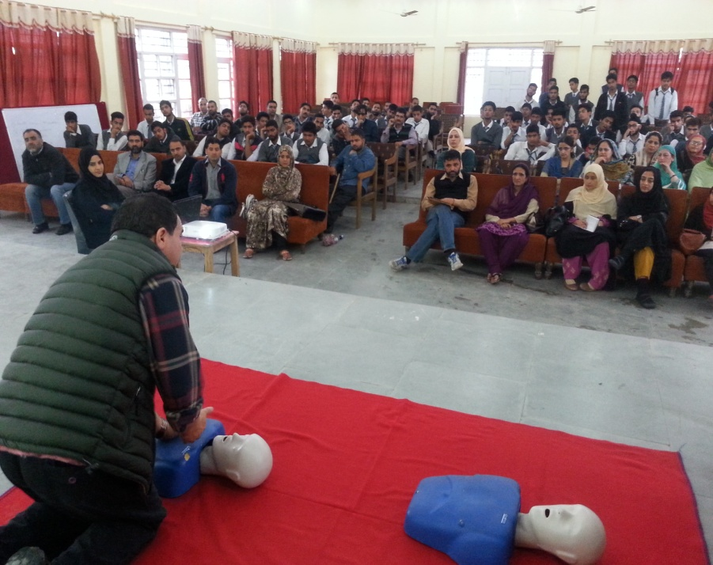
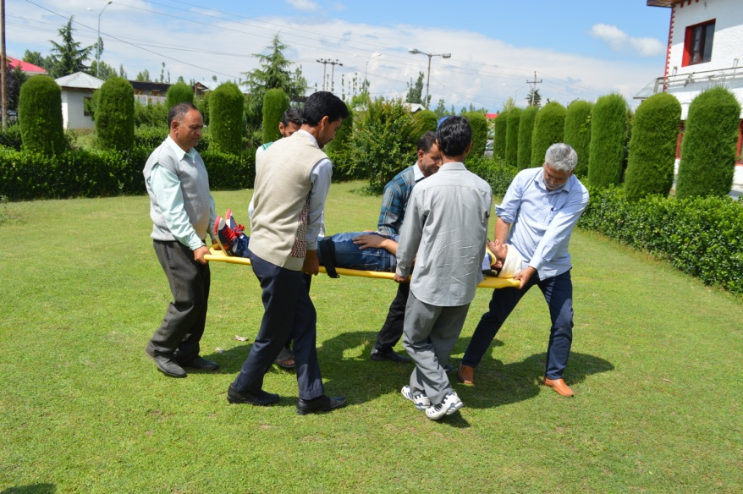
Clockwise: 1. Audio – visual session of various trainings. 2. High Altitude Medical Emergency training. 3. Automatic CPR training. 4. IM/IV training. 5. Airway management training. 6. BLS training in School.
Current Training modules at KSSC, RIFHW Dhobiwan

Slide 8
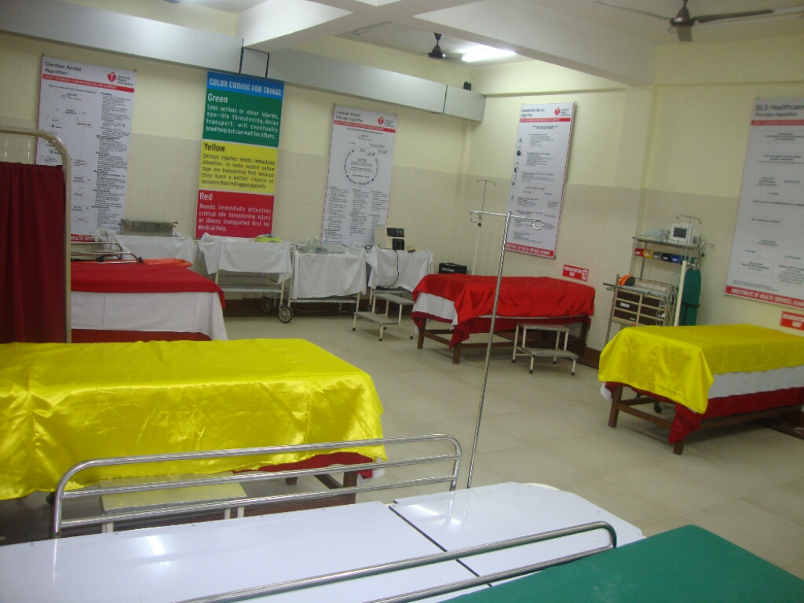
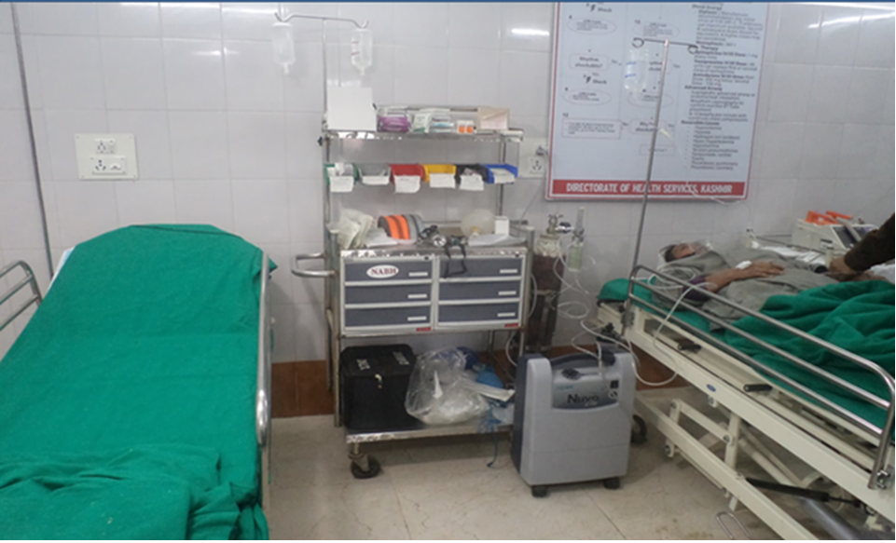
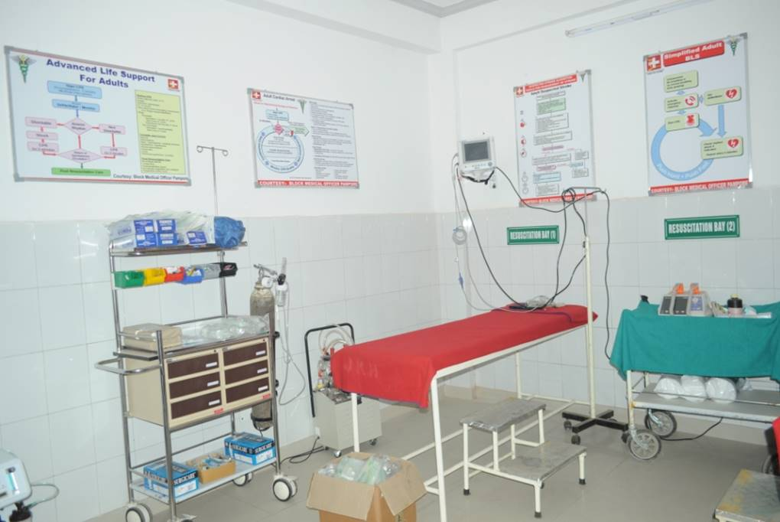
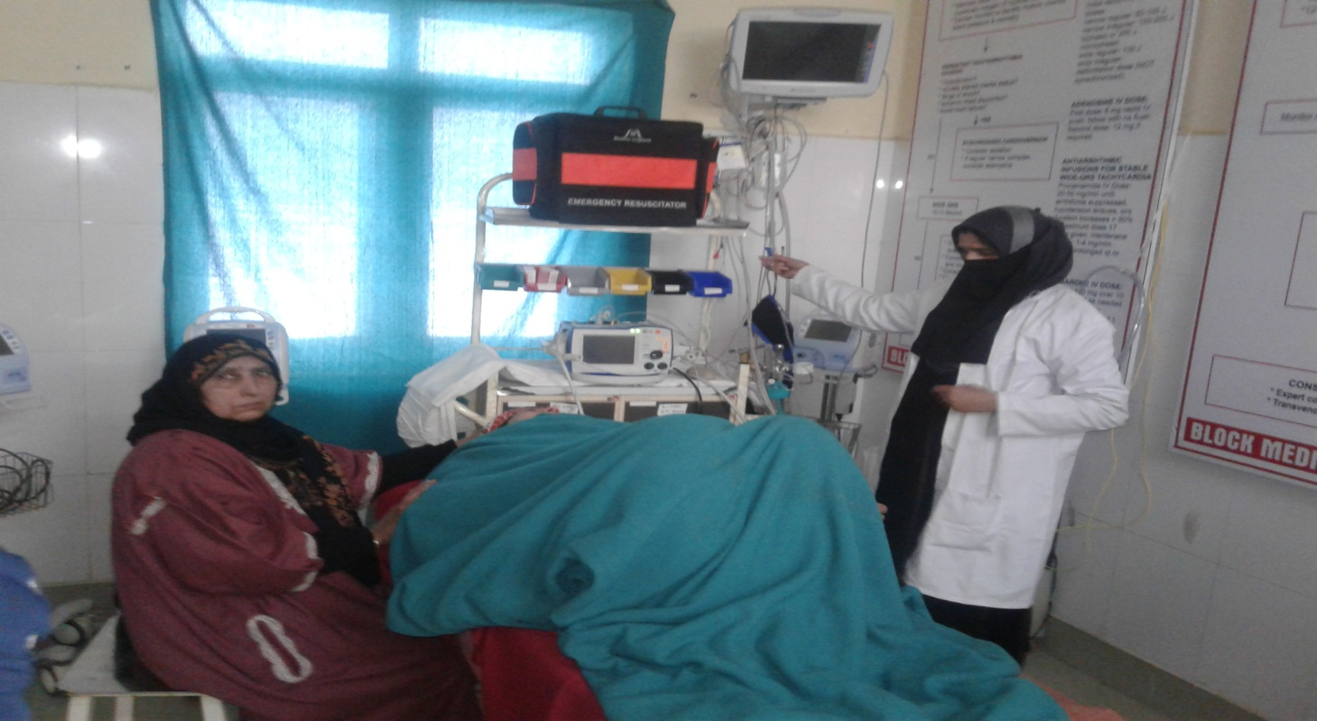
Emergency Rooms established at various District Hospital and selected Sub District Hospitals
ER Rooms came into existence with focus on Emergency Medical Services
ER Room at DH Pulwama
ER Room at DH Anantnag
ER Room SDH Pampore
ER Room at SDH Magam

Slide 9
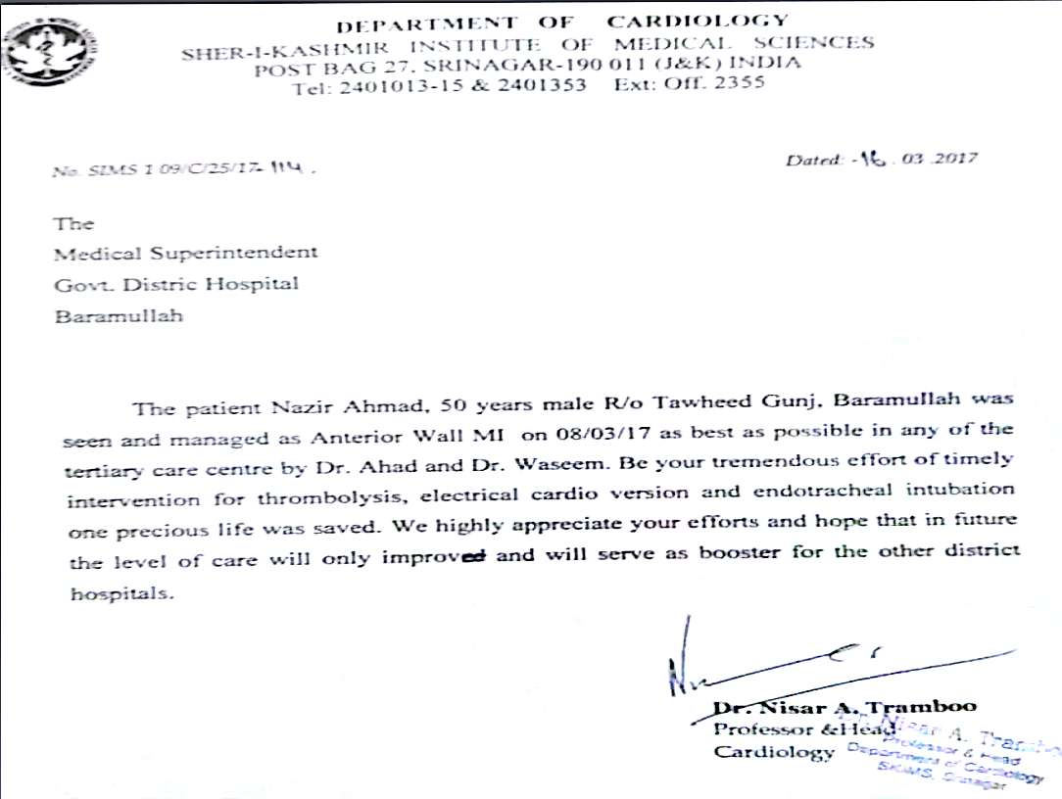
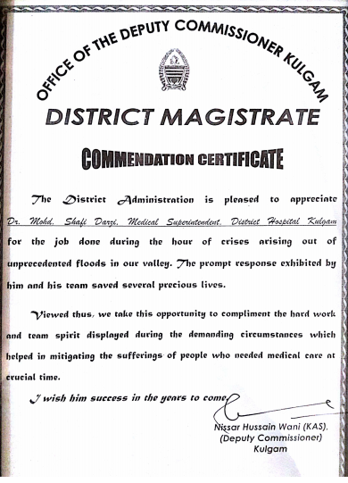
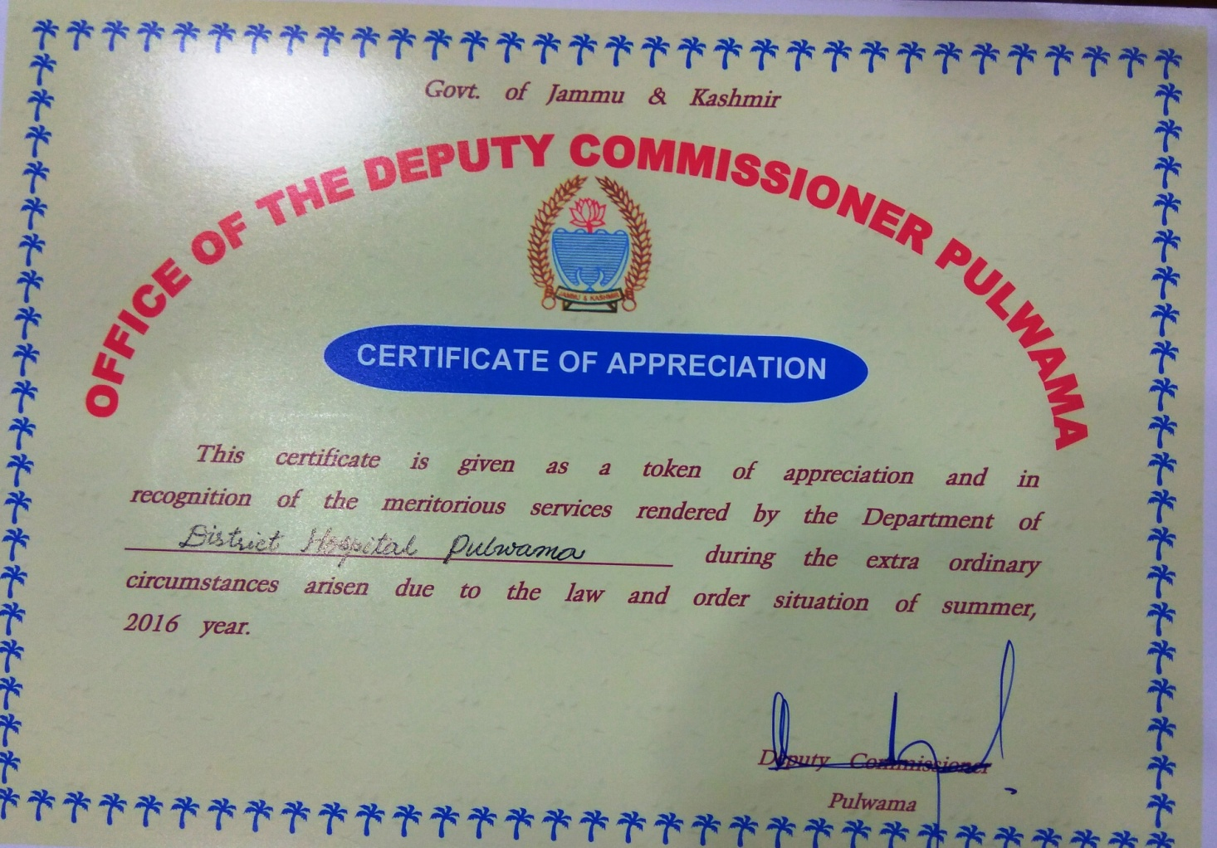
Recognition of the Emergency healthcare services delivery output by various authorities of the State
What Government functionaries have to say

Slide 10
Outcome/Results
The impact that matters
All the trainings conducted on these mannequins and simulators are being continuously monitored and regular feedback from the trainees is being analyzed. In addition, impact assessment studies are being regularly conducted in the institutions where the trained staff is being deployed. Considering the feedback, this institution and the skill based interventions are providing huge dividends to the Department which can seen in terms of pre-hospital care, management of trauma during the golden hour and shifting of critical patients to higher institutions as per EMS protocols and reduction of Infant Mortality Rate which has been acknowledged as a positive indicator of the effectiveness of the Department of Health. Management of disaster in the form of Floods 2014 and management of trauma by the peripheral institutions during the law and order problem in 2016 are two major instances wherein these trainings proved to be beneficial in saving lives. In 2016, 83% on the total injured patients that were received at peripheral health institutions were managed in these institutions while as only 13% were referred to tertiary care hospitals. The referral rate during similar situation in 2010 was around 40%.
This initiative of having a high end simulation center in other states will improve the healthcare delivery system in those states. For replication, acknowledgement of this initiative of the Directorate of Health Services, Kashmir by the Union Ministry of Health is imperative as it will motivate the other States to follow this practice.

Slide 11
Work Done - KSSC
Trained manpower
Total number of Health personnel/other stakeholders trained in Kashmir Skills & Simulation Center, Regional Institute of Health & Family Welfare, Dhobiwan till date:
Name of the training | Number of trainees/health personnel trained till date
Basic Life Support (BLS) | >7000
Emergency Room Trauma Course (ERTC) / Advanced Cardiac Life Support (ACLS) | 651
Obstetrics & Skill Trainings | 423
High Altitude Medical Emergency Training | 465
In addition to training on simulation methodology, the KSSC routinely conduct District & Divisional level CMEs, Capacity Building & Orientation programmes, Skill Development Workshops, etc in a bid to enhance the academic knowledge of the health personnel.

Slide 12
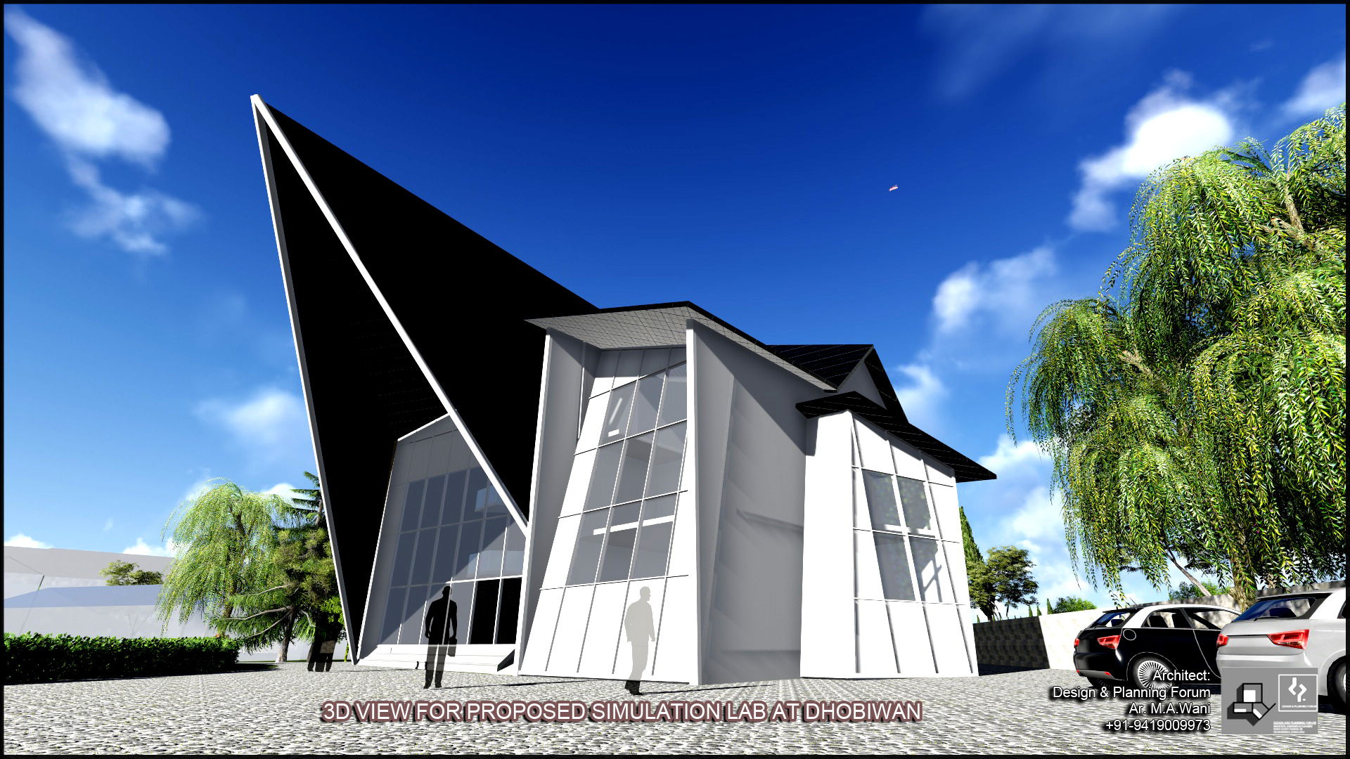
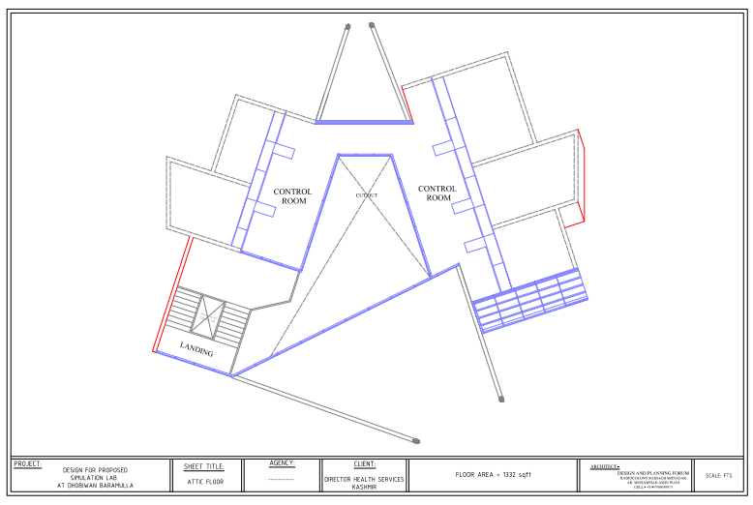
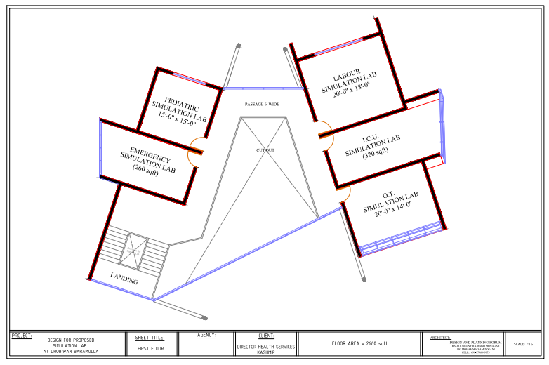
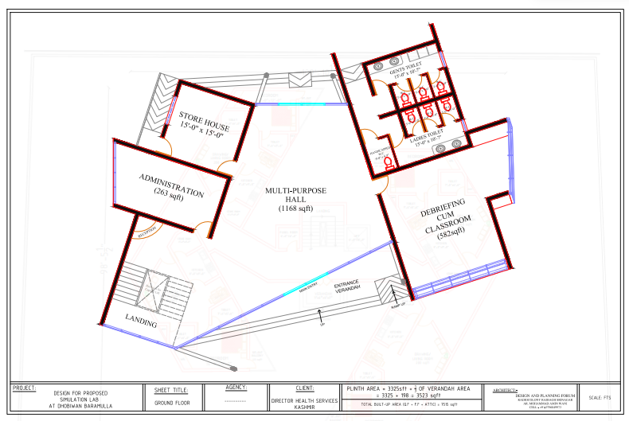
Proposed expansion of Kashmir Skills & Simulation Center on modern protocols
Envisaged taking the simulation trainings to the next level

Slide 13
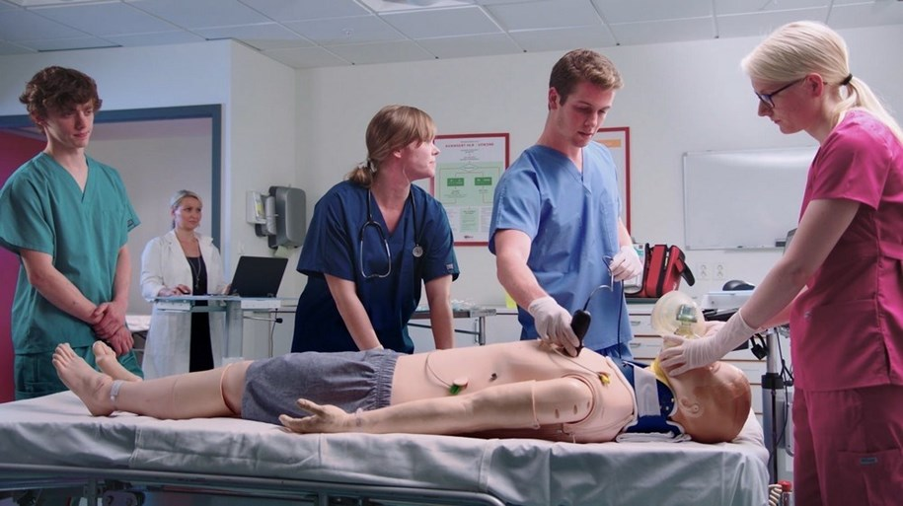
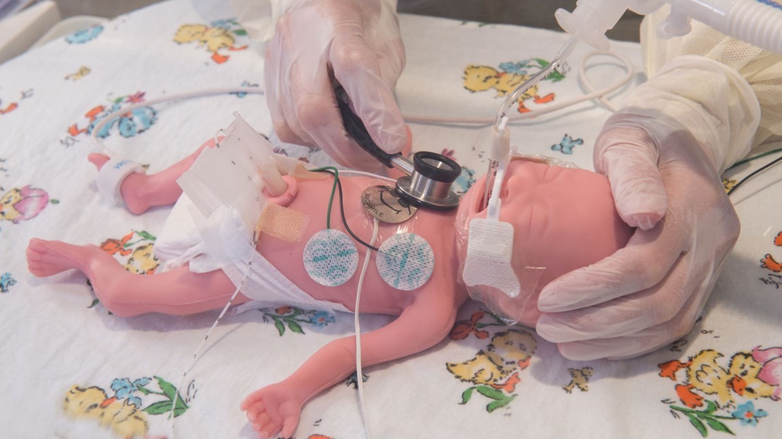
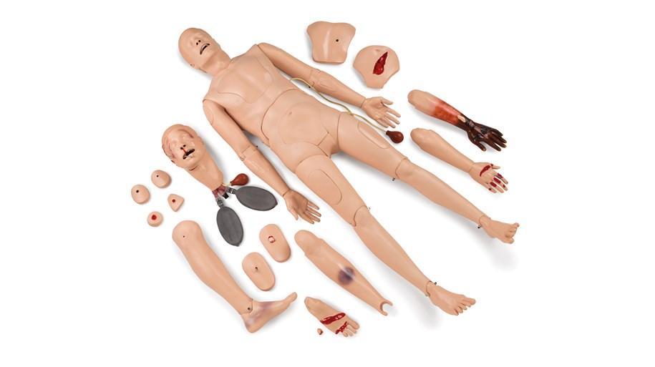
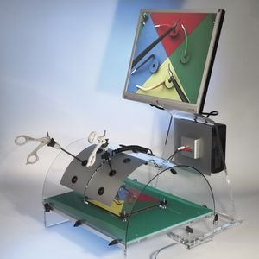
Some of the planned future simulators in pipeline
What next – way forwrd

Slide 14

I request all the esteemed dignitaries to personally visit the Kashmir Skills and Simulation Center and have a feel of simulation trainings on modern scientific protocols and at the same time cherish the picturesque beauty of Kashmir.
Thank you

