Slide 1
Human resources in health
Making comprehensive primary health care possible
JSS, Chhattisgarh

Slide 2
The problem
Doctors are not going to go to rural areas in any significant proportions, despite measures to do so. And even if they do….
The complexity of problems are such that they require many specialized knowledge.
Clinical problems even at a population of 100,000 require knowledge of at least 20 clinical specialties.
Our system does not allow non doctors to heal - the drugs and cosmetics act, the strong IMA, no public health cadre, no recognition of mid level Health Worker

Slide 3
comprehensive primary health care
Mid level Health workers
Patient support groups
Health and wellness centres

Slide 4
The solution at JSS
Train VHWs as much as possible in different skills , with appropriate pedagogy and supportive technology.
Focus on mid level health workers
Train specialists as generalists- DNB family medicine
Mentor MBBS physicians as all competent rural GPs
On job training and mentoring in quality of care

Slide 5
The mid level health worker
While the infections and MCH can be managed through institutions and communitized somewhat, the NCDs need a model of community management. The compliance rates with treatment in most NCDs are below 50% .
Cadre of Senior Health workers
Nurse Practitioners
Nursing Assistants, OTAs, Lab Assistants
ANMs & GNMs
Diplomate National Board (DNB) for Family Medicine to work as ‘generalists’

Slide 6
The nurse as mid level HW
a well trained ANM
GNM or BSc Nurse who has done bridge course, and why not an ANM?
Nurse practitioner – in midwifery, in Primary health care, and in Intensive care

Slide 7
Functions of the Mid level HW
Knowledge and attitude skills
When to treat, and when to refer
If to refer, planning referral
Emergency management and abandonment management
Chronic disease and follow up care
Home based care
Disease based patient groups

Slide 8
Training of Mid level HW
Pedagogy: More pictorial, many times, in small bites
Use of IT in training and supportive supervision
online platform for learning modular courses
Follow up training , at least once a month along with supportive supervision
The monthly meeting is an important strategy
WhatsApp and google groups for continued interaction, mentoring and training.
STG are guidance and don’t lend them into automated plans

Slide 9

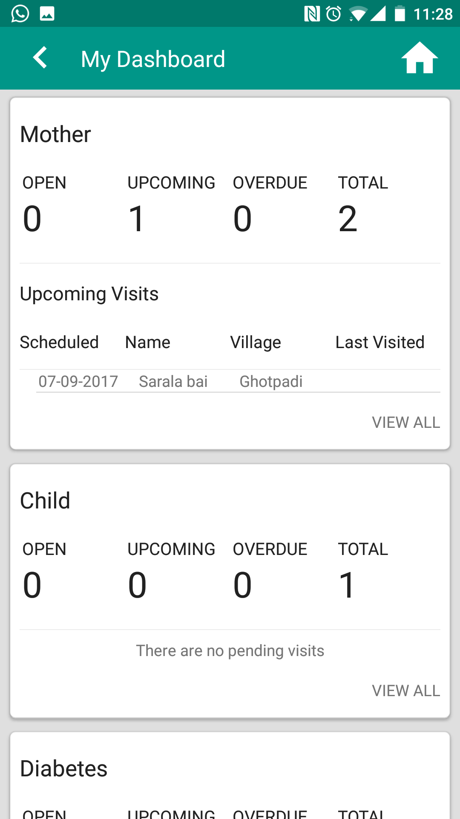
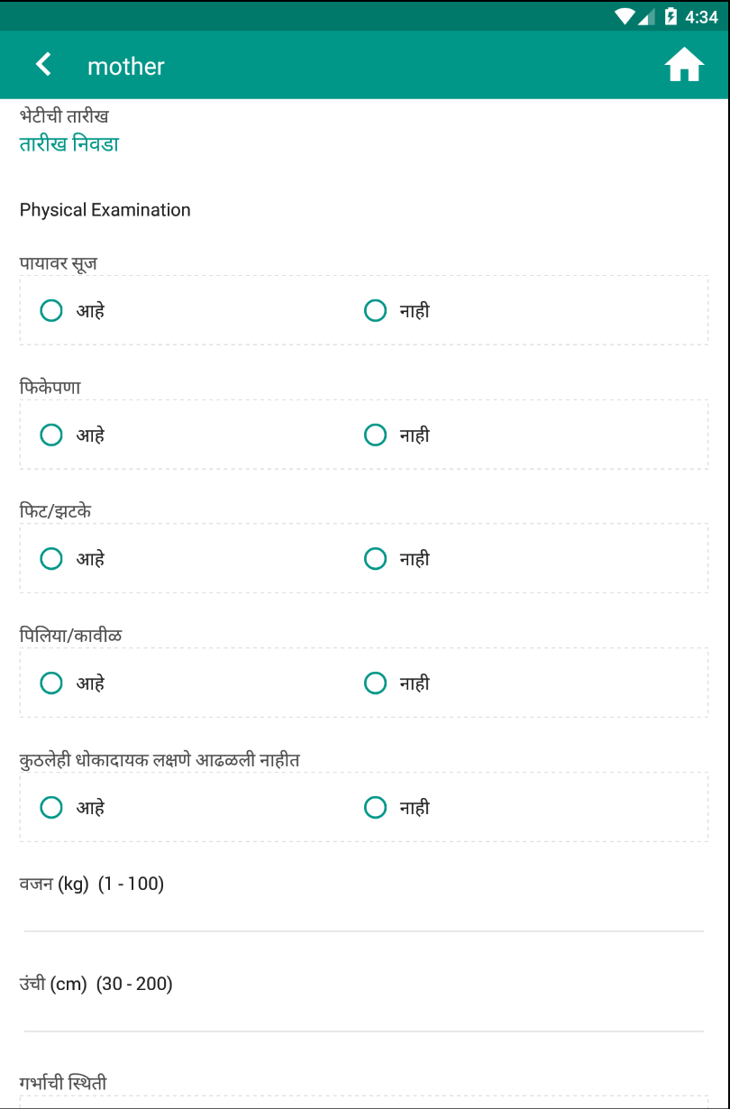
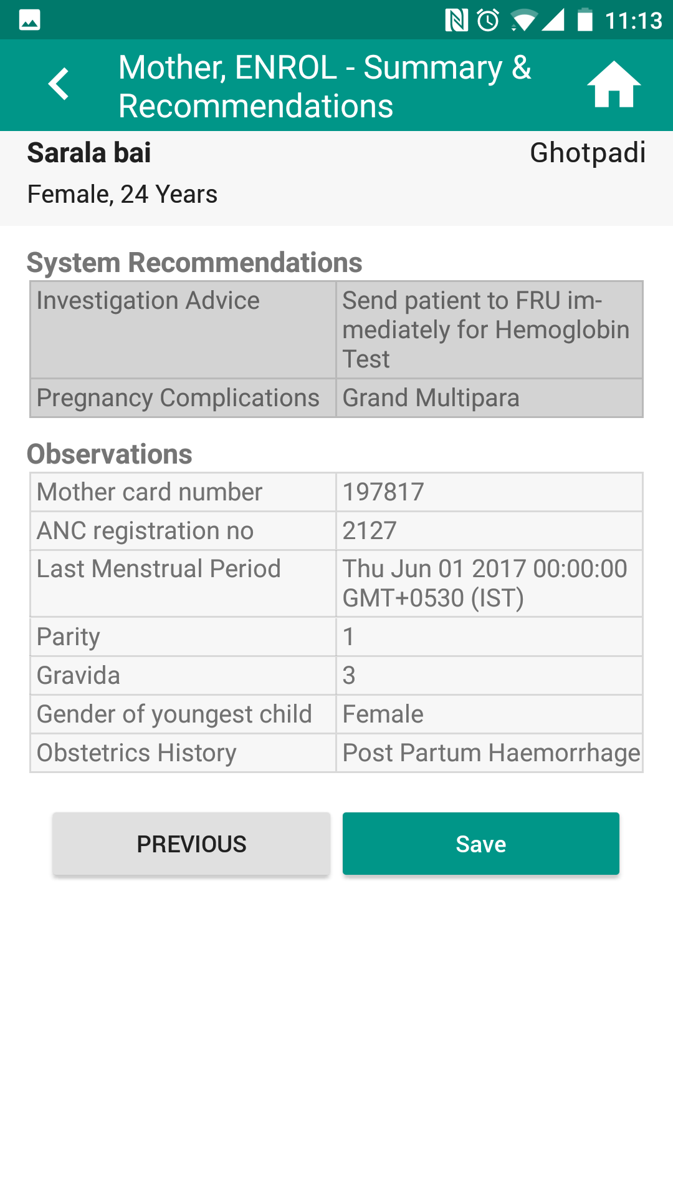
Program-wise schedule management
System recommendations E.g. High Risk pregnancies, Treatment Advice, Referral Advice, Investigation Advice
Protocolised questionnaire and schedules, Local Language support
Notes:
First pic - Workers can be reminded of upcoming visits and plan their schedule according to system generated or manual reminders
Second pic - Easy visualisation using charts can point out immediate problems
Third pic - Easy glance of vaccination schedules
Fourth pic - System recommendations based on data collected during current and previous encounters

Slide 10
Supportive Supervision
Both Administrative and Clinical, and through on job training
  Coordinator for RCH: Antenatal clinics, postpartum care, newborns and under 3 kids, and cancer screening for Breast and Cervical cancer –
  Cluster coordinator: NCD care along with the SHW –
  Asha/referral centre coordinator: supporting village based care/ malaria
  Monthly meeting is the strategic pathway

Slide 11



Slide 12
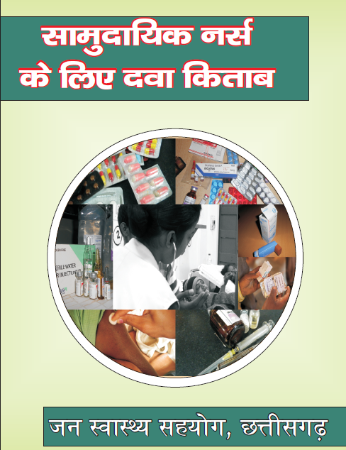


Slide 13
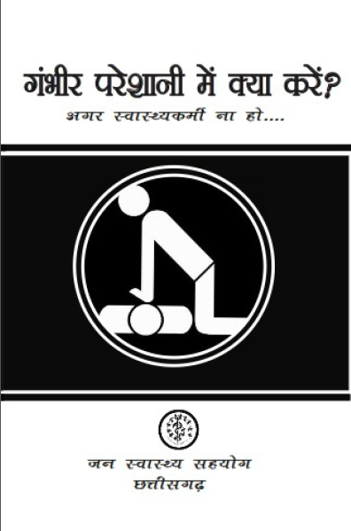
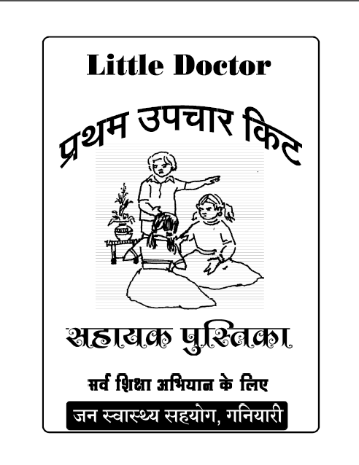

Slide 14
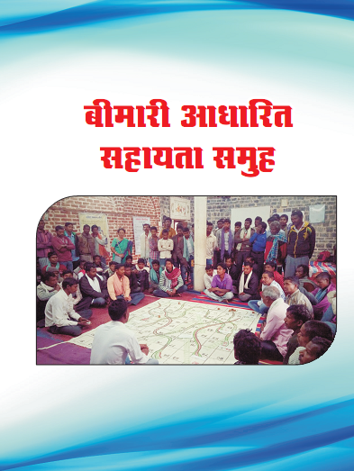
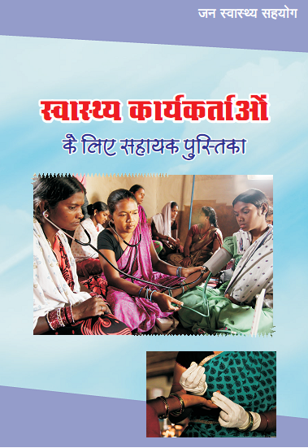

Slide 15
Human Resources in Health: whither doctors?
Not over dependent on a doctor, but not without a doctor
HWC supported by a team of a doctor, a lab tech , a pharmacist and a record keeper on a fixed periodic day
The key person still is the mid level health worker
Can’t trivialise primary care; plus legality ensured

Slide 16
Challenges for the health system doctoring the system
Drugs and cosmetics Act: schedule K, standing orders, prescribe and dispense
Clinical establishment act: Non physician health facilities
Employment and integration into the system:
Licensing and certification : risk of litigation
Trainers and training materials and sites for training/mentoring them

Slide 17
The specialist generalist
Knowledge of how many specialists is needed at one lac population?
‘Kishore kumar’ type of physician
Family medicine

Slide 18
Motivation : is it not possible in public facilities?
It is the leadership level at the district and the state that determines this for the peripheral level through
  – Content –
  Formats of interaction –
  Devolution of power –
  Training as a tool of hand holding

Slide 19
Future plans and hopes
The B Sc.( Community Health) is taken up by states.
Bridge course succeeds.
An online platform for learning modular courses for mid level HW is up and running
A clutch of apps for diagnosis and follow up of chronic illnesses and MCH problems are available on tablets for use by mid level HW and by VHW.
Scale up the concept of Disease patient support groups and Mid level HW and Asha facilitate these groups for chronic illnesses.
The health and wellness centres becomes the infrastructural locus for these mid level health care providers and becomes a vibrant place.

