Slide 1
‘SAMPOORNA MANASIKAROGYAM’ (Mental Health for all) DMHP Thiruvananthapuram model of Comprehensive mental health care
Dr Kiran.P.S
State Nodal Officer
Mental Health
Kerala

Slide 2
The delivery of mental health services through primary health care system as a policy for developing countries was recommended by WHO, as the burden of mental disorders is 10-12% and treatment gap is 80% for mental disorders.
Needed an implementation model to detect the case burden in the community, to enable access to mental health care system and to close the treatment gap.
DMHP Tvpm had become the first district to attain mental health integration into primary care in 2014, where weekly mental health clinics are being conducted in all PHCs & CHCs by trained doctors, and patients are getting Mental Health treatment & medicines from their nearest PHC.
It is in this scenario that DMHP Tvpm has devised and put into action its new endeavor of Sampoorna manasikarogyam with the objective of :-
Finding the undetected case burden in the community by interventions & camps.
Involving community level workers in detection, management and follow up of cases in their community
Integration of newly detected cases to primary care health system

Slide 3
The protocol is as follows.
Sensitization of members of Block panchayath and Gramapanchayath on mental health.
Sensitisation of CHC & PHC staff- Health workers(JPHN,JHI)
Training of grass root level workers-ASHAs( or Health Volunteers) on Mental Health awareness creation, Stigma Reduction & Screening with Case detection Forms
CASE DETECTION CAMPAIGNS
ASHAs visit Every Household in the panchayath, give brief mental health awareness class with leaflets,& Screens with structured DMHP case detection forms. Information on camp date given
Case detection forms evaluated by DMHP team. Families with detected cases are intimated to attend camp at nearby PHC by ASHA workers.
Mental health camp in concerned PHC involving DMHP team,& PHC Staff.
Three review camps in following successive months to cover the entire cases detected by repeated intimation by ASHA, and follow ups of newly diagnosed cases
Stable cases are transferred to PHC Medical Officer who will conduct weekly/monthly(depending upon the number of patients) Mental Health Clinics in the PHC.
Medical Officer, Pharmacist, Staff nurses and Health workers are trained by DMHP TVPM, and they support the management, drug dispensing and records keeping in the PHC.
Follow up plans for rehabilitation units in the community, involving Health workers & LSG Members
DMHP team directly conducts review camps every 6 months.
Evaluation of data and analysis

Slide 4
Expenditure split up
Sl.NO | Activities | Amount in Rs
1 | Sensitization of LSG Members, PHC Staff | 2000
2 | Training of ASHAs (Half day training) | 3000
3 | House visit Remuneration for ASHAs Rs 150/day x 10days x 15 wards(avg) | 22,500
4 | Medical camp | 3000
5 | 3 review camps | 4500(1500x3)
6 | Printing of awareness leaflets, posters, questionnaire | 4000
7 | Awareness classes in local schools, kudumbasree units, ICDS units and other institutions in the panchayath | 4000
 | Total | 43000/-(Forty three thousand )
Funds are provided by Gramapanchayaths for which DMHP gives Proposal through the PHC Medical Officer.
PHC is the Implementing agency for the funds received.

Slide 5
Comparative data of the programme in 3 selected panchayaths
Grama panchayaths | Kallikkad | Cherunniyoor | Kuttichal
population | 14,724 | 22,138 | 18,750
Houses visited | 5002 | 5519 | 5249
wards | 13 | 14 | 13
Mental health awareness classes | 1.PHC Staff 2.ASHA workers 3.Health Volunteers 4.Panchayath members 5.School teachers (60 members) | 1.PHC Staff 2.ASHA workers 3.Panchayath members (60 members) | 1.PHC Staff 2.ASHA workers 3.Panchayath Members 4.School teachers (65 members)
Duration of case detection campaign | 8 days | 8 days | 7days
Screened Cases | 322 | 384 | 546
Medical camp Review camps | 1 3 reviews | 1 3 reviews | 1 3 reviews
New cases detected | 89 | 93 | 128

Slide 6
Data Analysis
The clinics conducted by DMHP are 22 per month(in CHCs) and one ‘Sampoorna Manasikarogyam’ once in a month. The mean average of new cases detected in the DMHP clinics in a month and in the case detection campaign once a month were evaluated.
RESULT
New cases detected through campaigns are more than twice the number of cases that directly seek a DMHP Clinic. The three case detection campaigns covered a population of 55612 through 15770 houses, screened 1277 prospective cases of which 310 cases diagnosed with psychiatric morbidity, were treated in mental health camps and integrated to primary health care. Cases detected per campaign through this model are twice (2.15 : 1) that through monthly DMHP clinics.
DMHP | Number/month | NEW CASES (direct) | MEAN
Clinics (CHC) | 22/month | 415 | 46 cases/month
Sampoorna Manasikarogyam(PHC) | 1/month | 310 | 103cases/campaign/month

Slide 7
Data Analysis
RESULT
More than 10 times increase in number of patients through case detection in the community by screening, than the direct seeking of psychiatric care system by patients.
Panchayath | Kallikad | Cherunniyoor | Kuttichal (Tribal area) | Total
DMHP Clinics (in Block CHCs) Prior to the progrm | 9 | 11 | 8 | 28
Sampoorna Manasikarogyam | 89 | 93 | 128 | 310

Slide 8
At the rate of one camp per month 12 GramaPanchayaths can be successfully completed a year with collaborative work between DMHP, Grama Panchayath & PHC
Cost effectiveness-as the already existing health machinery is being used
Fund allocation from local Panchayath.
LSG members become aware of the problems faced, and welfare schemes available for mental patients, so becomes more involved
Extending similar activities to areas where specialist care is inadequate. One time manpower assortment can meet the needs of the camp and the follow up through primary care integration would maintain the sustainability of provision of care.
Training activities to be two parallel process of top down for primary care doctors for successful integration through clinics and bottom up from the community for identifying the major part of undetected case burden.
Secondary level activities of community based rehabilitation, establishment of Day Care Centres and other targeted interventions like school mental health in the community are facilitated.
It is an effective way of detecting case load at one go. The program can be adapted to the needs and availability of resources in other areas.
ASHAs become grassroot level workers for Mental Health in the Gramapanchayath. They are approached by the people for clearing doubts and seeking modes of treatment for newly developed cases.They also help to ensure regular follow ups and reduce Treatment Dropouts

Slide 9
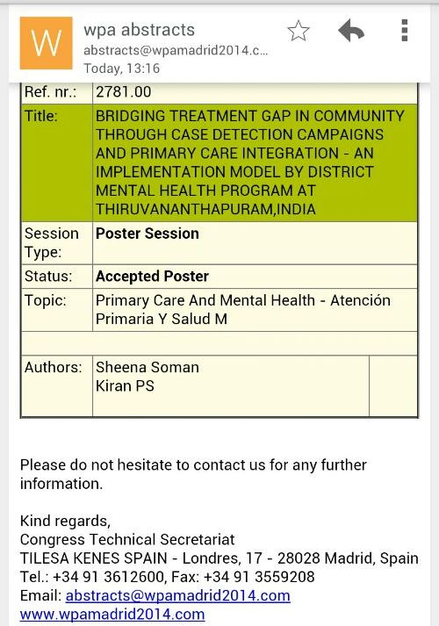

Slide 10
Conclusion
Programme has already been successfully implemented in 13 Gramapanchayats, and is being planned to be scaled to 171 Gramapanchayats as part of ARDRAM Mission, and later to all Gramapanchayats and Municipal- Corporation wards in the state.
Average expenditure for a Gramapanchayat is about Rs 40,000/- which makes the programme economically feasible and sustainable.
Sampoorna Manasikarogyam is a comprehensive model of sensitization, mental health training, case detection campaigns and camps, enabling detection of the unidentified case burden in the community. Their integration to primary care clinics enables follow ups, overcomes treatment gap and improves access to mental health care.
THANK YOU

