Slide 1
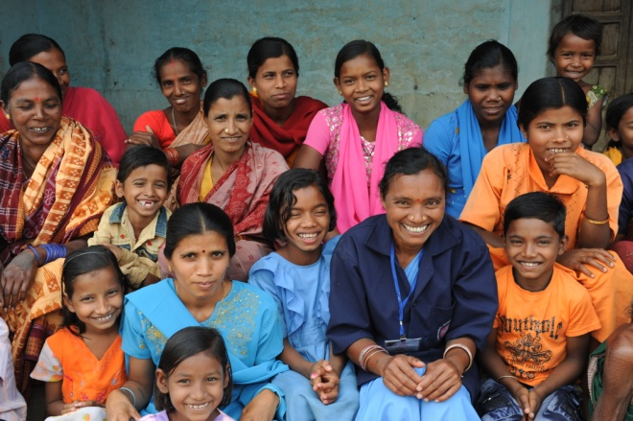
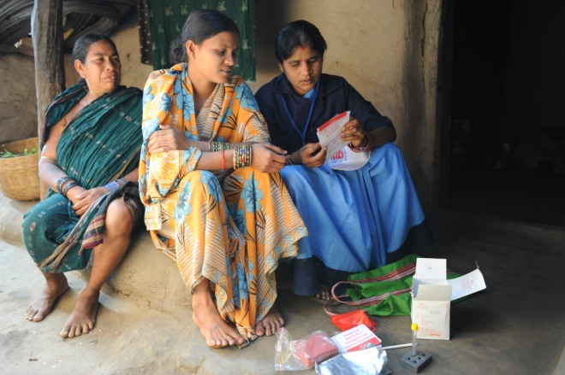
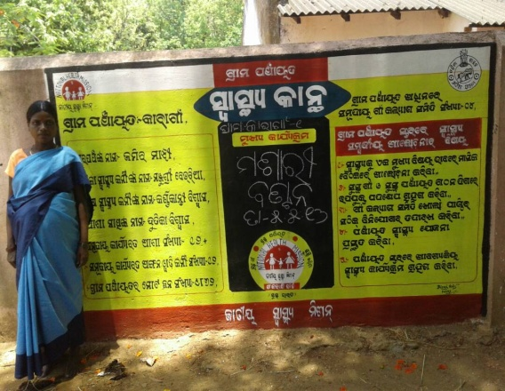
ODISHA
Improving access to malaria control services at community level through the community volunteers :
Accredited Social Health Activist (ASHA) & Others
Presentation by:
Dr M M Pradhan
Jt. Director, NVBDCP, Odisha

Slide 2
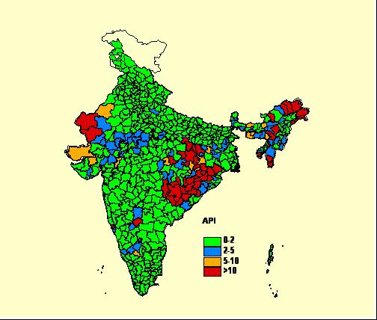
Odisha- at a glance
  Area:
  156,000 sq. km. (4% of India’s land area)
  34% forest areas
  Diverse ecology
  Rapid urbanization & industrialization
  Population:
  44 million (3% of India’s total population)
  Rural- 82%; Urban- 18%
  ST- 22%; SC- 16 %
  Reported malaria cases:
  0.4 million (26% of the country)

Slide 3
Health Infrastructure in Odisha
32 Districts- 30 DHs & 2 Capital Hospitals
314 Blocks- 377 CHCs
PHCs- 1236
SCs- 6688
51,000 villages (no. of ASHAs- 47294; 45230 ASHAs are trained in malaria)
Odisha- Medical Colleges-9
29 SDH

Slide 4
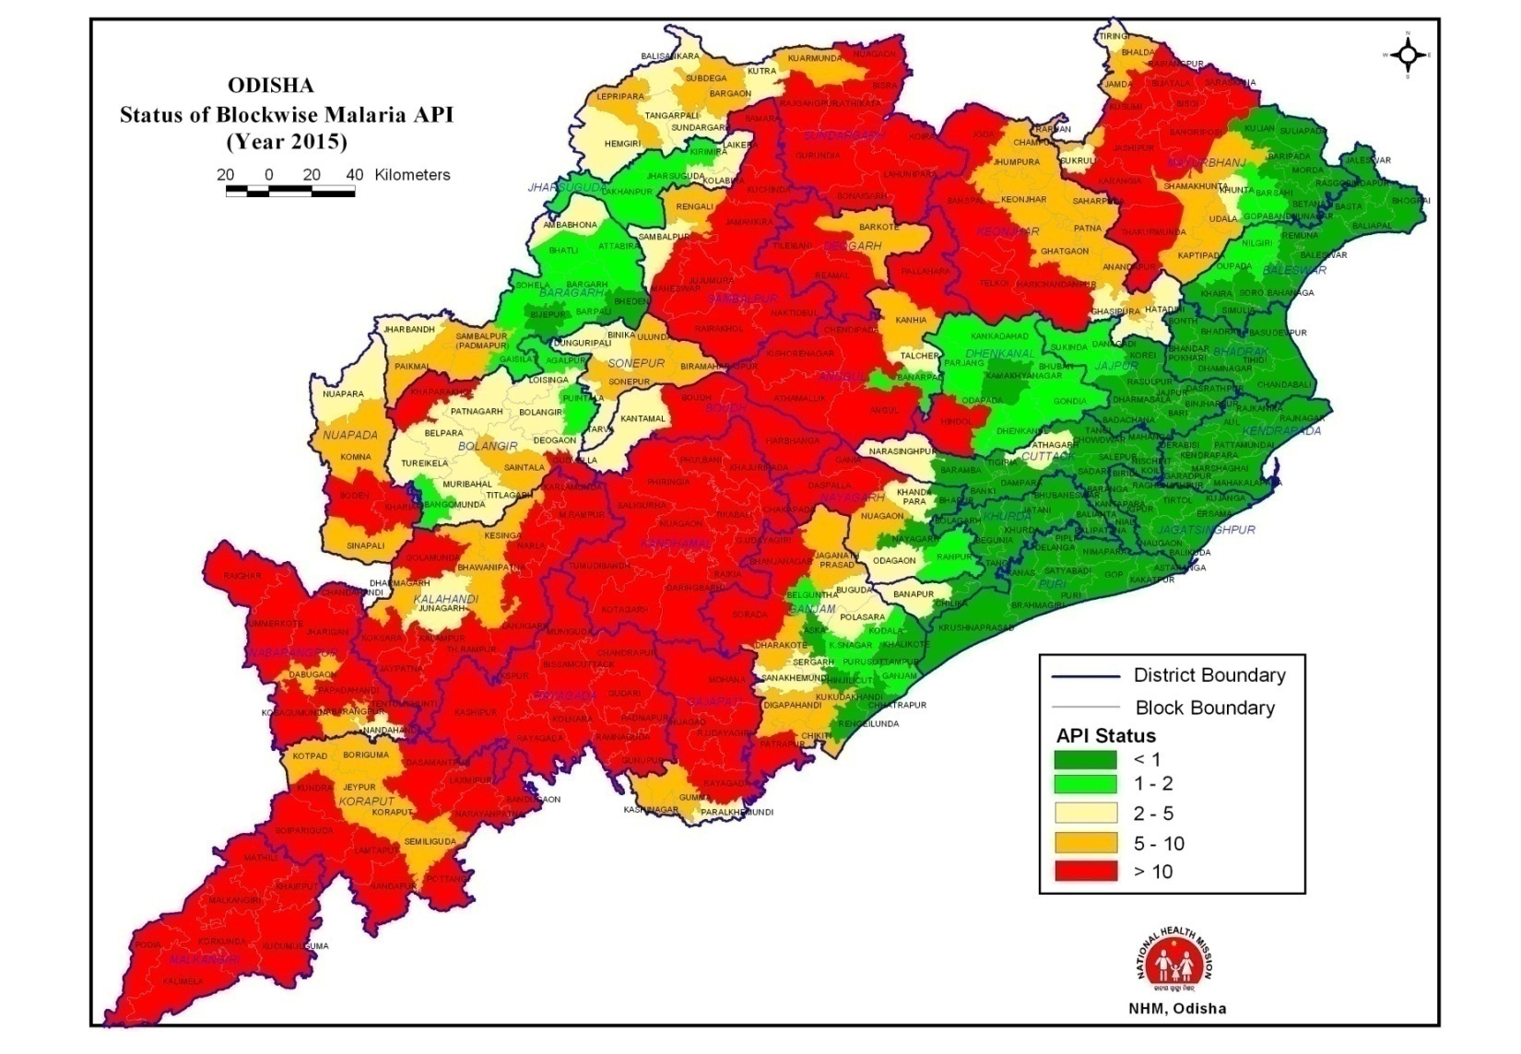
Malaria Problem
Hilly, forest, forest fringed areas
Favourable climate and geo-ecotypes,
Complex vector bionomic and High falciparum proportion ( >90%)

Slide 5
Stratification of districts-based on API, 2016
Malaria burden | No. of Dists |  | No. of CHCs
 | 2015 | 2016 | 2015 | 2016
API ≥ 10 | 14 | 13 | 105 | 122
API 5-<10 | 3 | 4 | 33 | 48
API 2- <5 | 5 | 4 | 55 | 47
API 1- <2 | 0 | 1 | 49 | 29
API < 1 | 8 | 8 | 122 | 121
8 coastal districts are very low endemic (API<0.5).
Population- 27% of state’s pop. (1.12 crore)
Source: Epidemiological data of Odisha , 2016

Slide 6
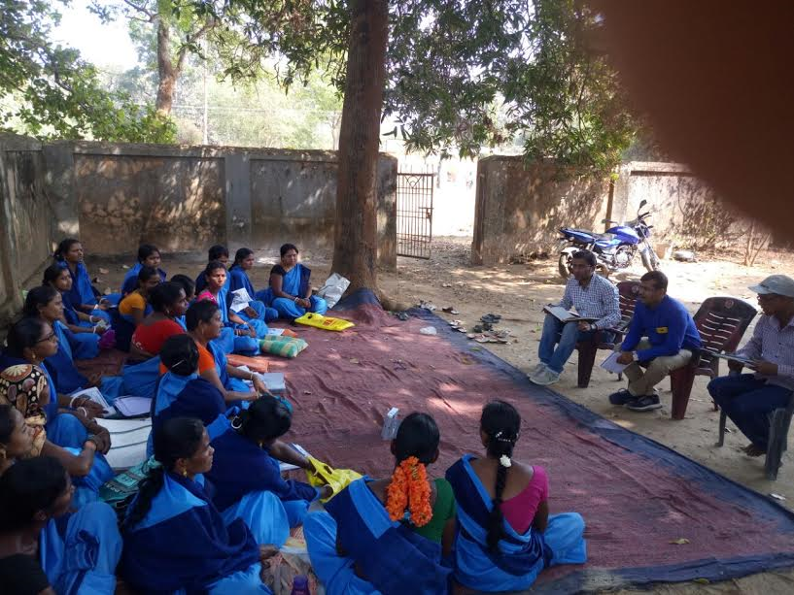
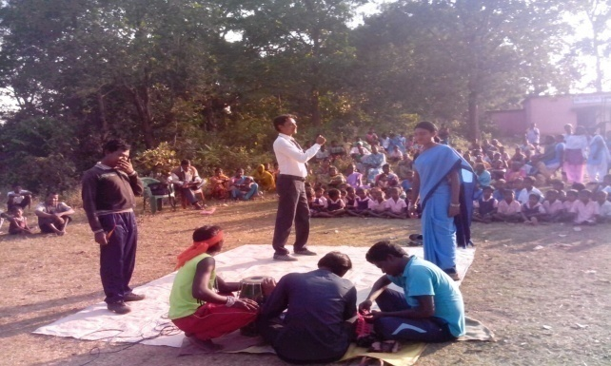
Function of community volunteers (ASHA and others) in Malaria control activities
Under NVBDCP (central sponsored under NHM)
  Early Diagnosis and Complete treatment (EDCT)
  Vector Control Interventions (Long Lasting Insecticidal Net (LLIN and Indoor Residual Spray)
  IEC/ BCC/ IPC
State specific
  DAMaN – Special activities in inaccessible villages
  Special IEC – BCC campaign (under MDD) and LLIN specific (Nidhi Ratha campaign)

Slide 7
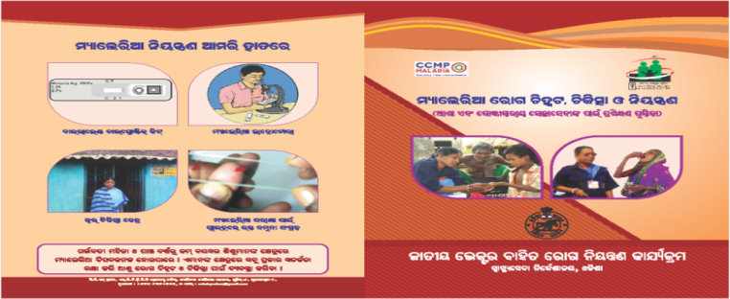
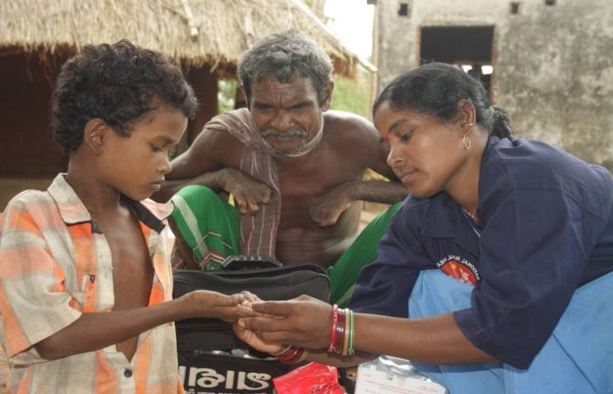
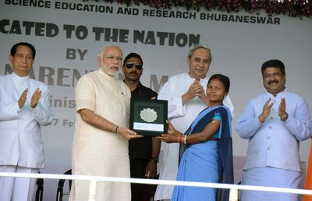
Capacity Building of ASHAs by the State
2007: ASHAs were trained as Fever Treatment Depot (FTD) for diagnosis and treatment of malaria cases with Appropriate Anti-malaria drugs
In 2007 around 30000 ASHAs and 2016 more than 45, 000 ASHAs are trained and engaged as FTD
2010- Started with Mono-valent RDT and shifted to use bivalent RDT for use at point of contact in community.
Strict alignment to National guidelines (for drug, diagnosis, and record keeping) for capacity building of ASHAs
ASHA conducting RDT
Champion ASHA appraised by Hon’ble PM

Slide 8
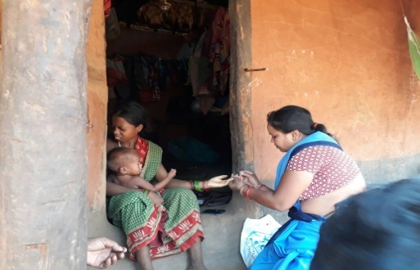
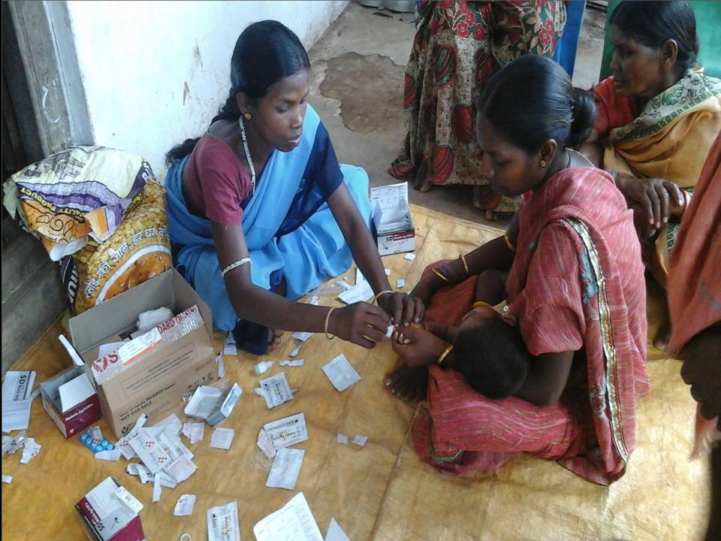
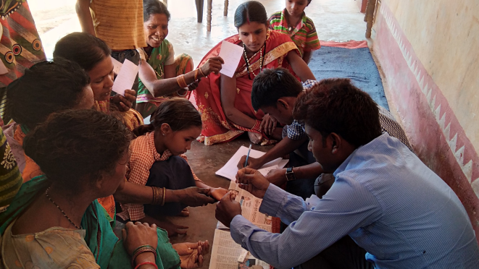
EDCT by ASHA & Community Volunteers at far-off hamlets
ASHA- the first point of contact for malaria diagnosis and treatment at the village level.
ASHA is involved in the community platform (Gaon Kalyan Samiti /Village Health Sanitation and Nutrition Committee) for malaria programme related and other activities.
ASHA links with AWW and non-ASHA volunteers engaged for malaria service in remote areas.
Approximately 3000 Non-ASHA community volunteers trained in EDCT in hard-to-reach areas– supported by respective ASHA.
Non ASHA volunteers are supported by the programme (incentive based) and by CARITAS India consortium and TATA Trust

Slide 9
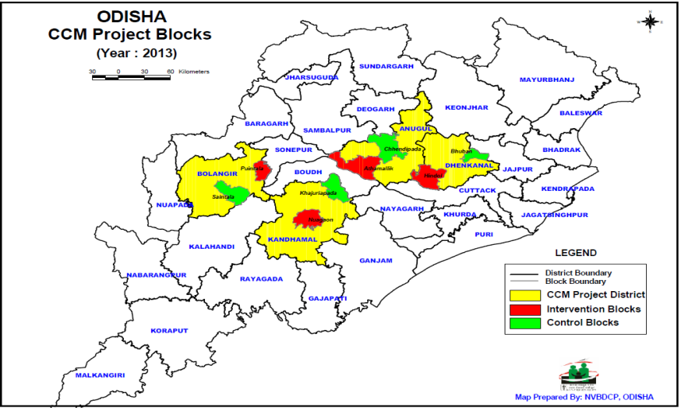
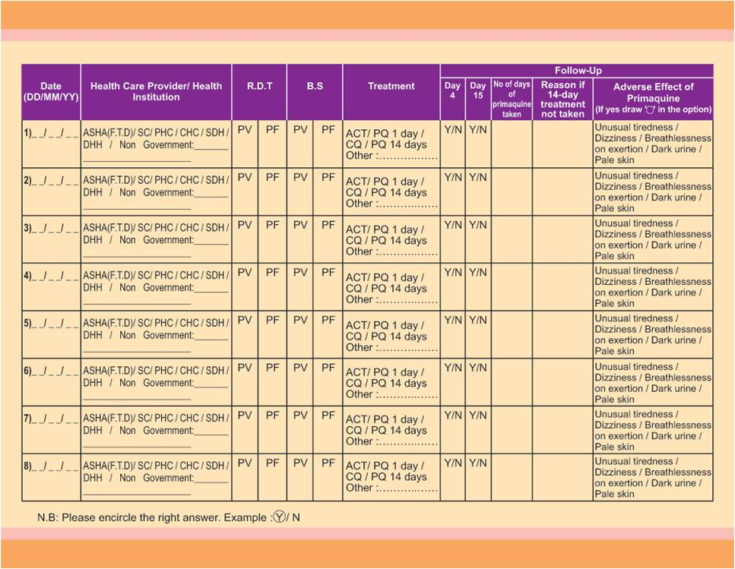
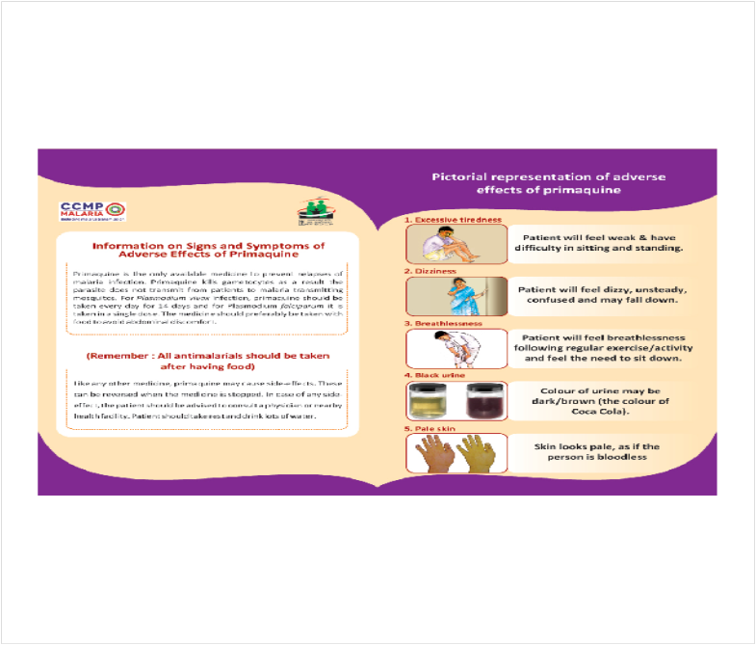
Comprehensive Case Management Project (CCMP) in Odisha
Improved access to 3Ts: test, treat, & track
Principal investigators: NIMR, NVBDCP – Odisha
Support: MMV&WHO
Project areas :4 intervention and 4 control blocks each in four districts of different malaria endemicity
Diagnosis and treatment by ASHA (473) alternative volunteers (239) in all villages
ASHA ensure completion of treatment by following up patients diagnosed by her as well as by other higher facility
ASHAs are trained to identify PQ-related haemolytic adverse events

Slide 10
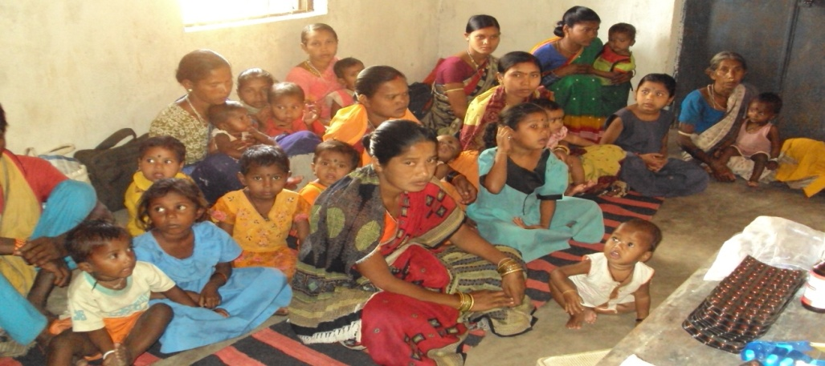
Addressing Malaria in VHND sessions
Guidelines have been rolled out by state to address Malaria in vulnerable population groups (pregnant mothers and under-5 children) in monthly Village Health & Nutrition Day (VHND) sessions.
VHND is conducted at Anganwadi Centre.
VHND - once in a month (TUESDAY or FRIDAY)
  Malaria screening is being done in VHND sessions by bivalent RDT.
  Malaria positive cases are treated with appropriate Antimalarials.
  Counseling for regular use of LLIN/ITN
HW(F), ASHA, AWW play crucial role
  In 2015-16, a total 3067411 PW attended VHND sessions and 178294 with fever have been tested for malaria (58%)
  Malaria positive rate : <3%.

Slide 11
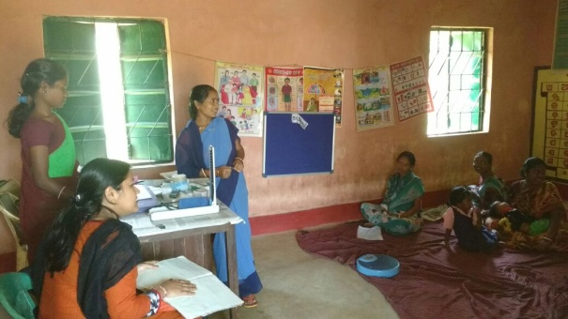
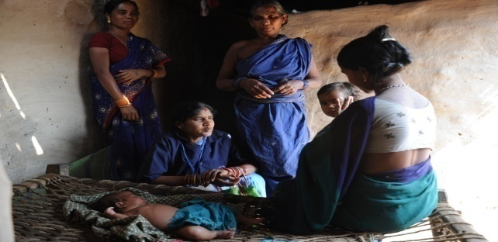
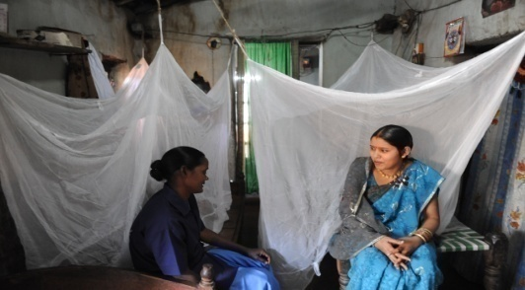
Role of ASHA in VHND Sessions For Malaria Prevention & Management
Role of ASHA
  Mobilizing pregnant women, lactating mothers and under-5 children to VHND session
  Conducting mandatory malaria screening using bi-valent RDT.
  Treatment of positive cases as per national guideline.
  Follow up for treatment adherence & any complication.
  Counseling for better acceptance & utilization of vector control interventions

Slide 12
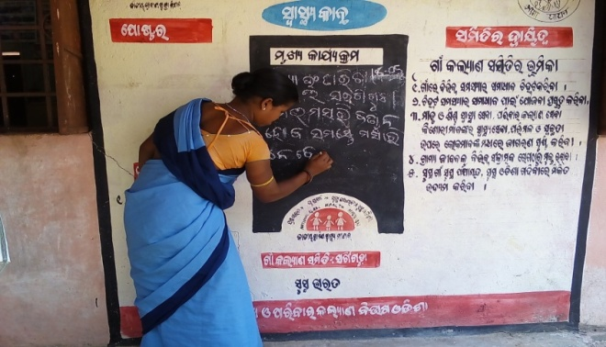
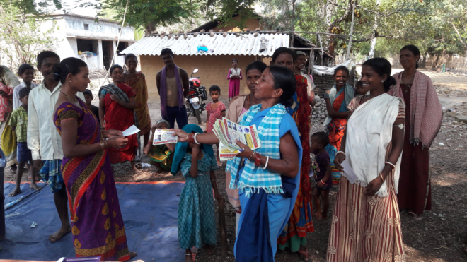
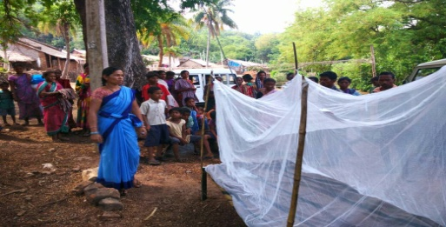
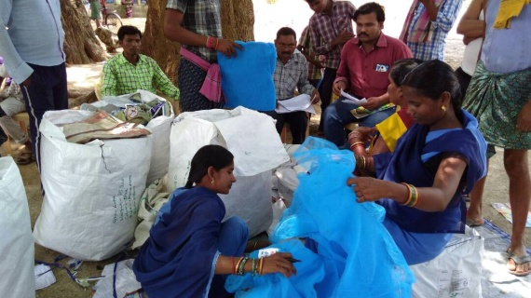
Role of ASHA in LLIN Distribution In Community
Engages through GKS platform
Conducts Household survey
Distributes advance information slip
During distribution along with AWW and ward member conducts coding
Demonstrate how to use LLIN at distribution venue
Maintains LLIN register
Writes on the village health wall bulletin (“Swasthy Kanth”)

Slide 13
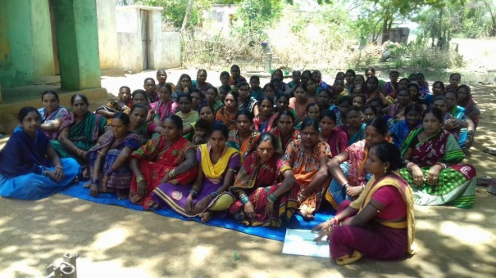
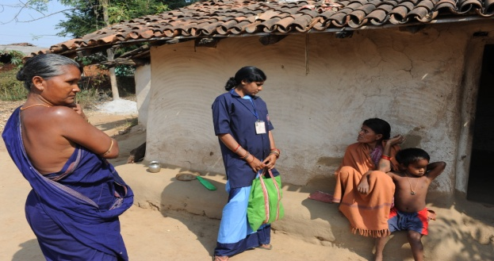
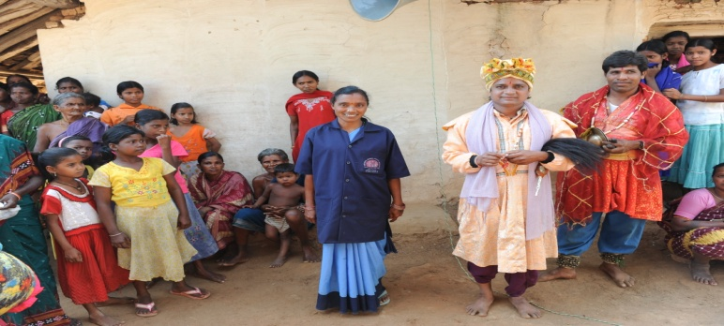
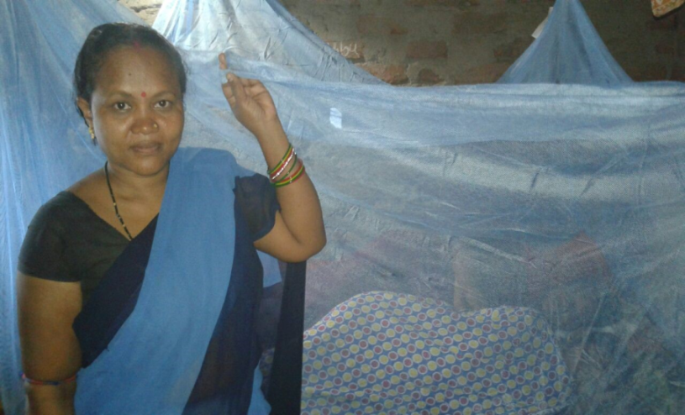
Role of ASHA in scaling-up the use of LLIN
Organizing meetings for the villagers on LLIN distribution and use
Folk arts and different IEC & BCC activities
Counseling to increase use
Night time monitoring

Slide 14
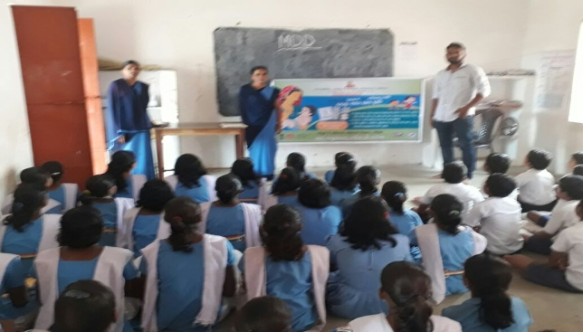
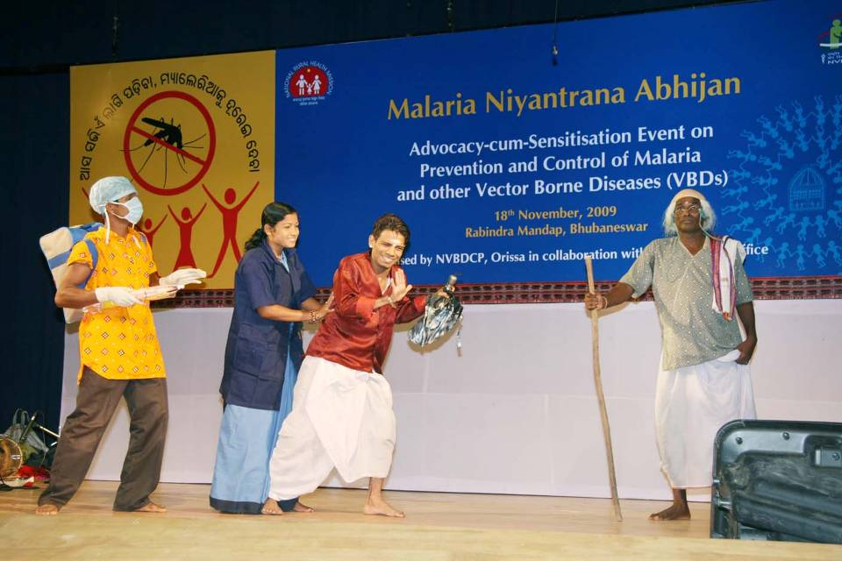
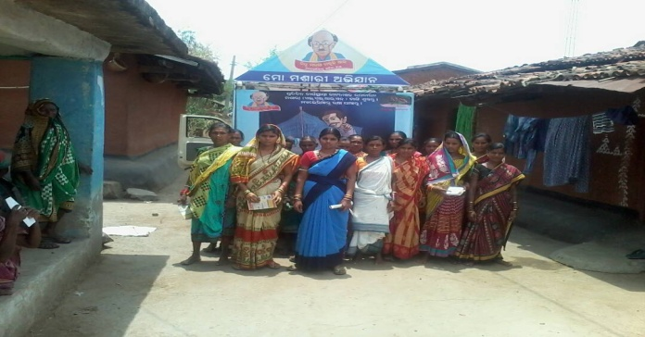
Role of ASHA in Malaria, Dengue and Diarrhoea (MDD) Campaign
MDD is state funded activity to create awareness on outbreak prone monsoon influenced diseases- Malaria Dengue and Diarrhoea.
Role of ASHA
Coordination with School
Delivering awareness messages
Engaging in Different IEC activities, e.g. Nidhi Rath Campaign
Mobilizing community and increasing participation of children

Slide 15
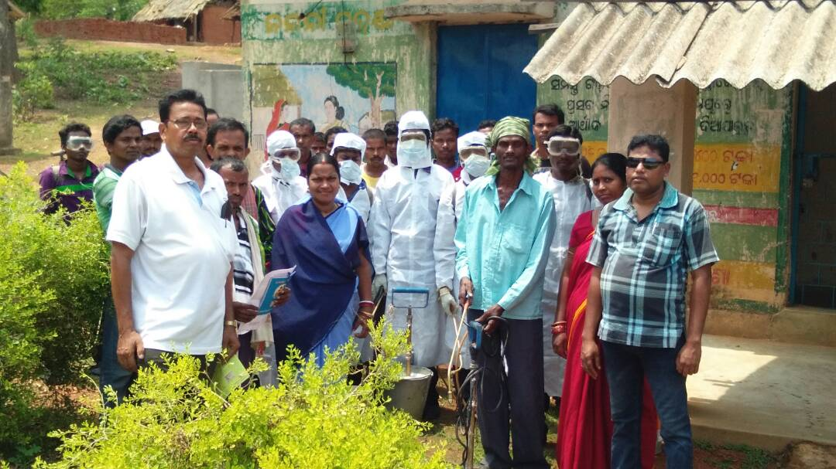
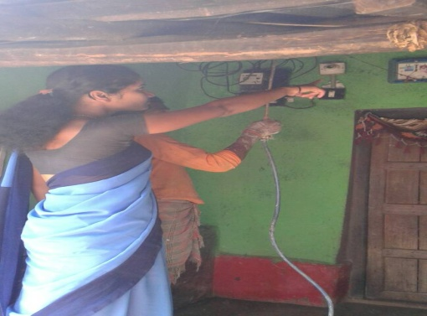
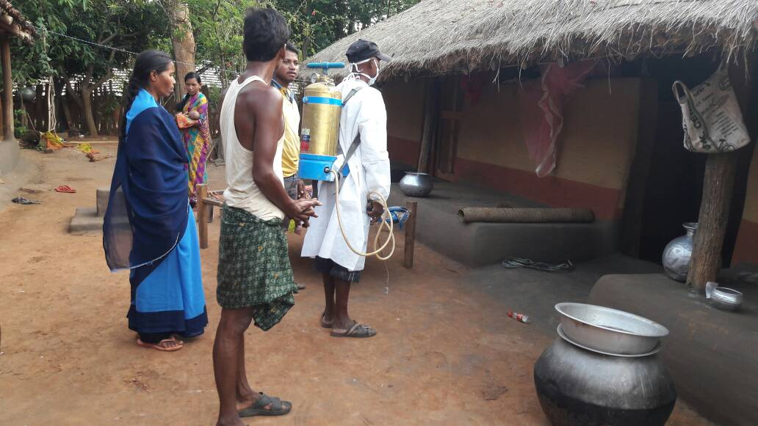
Role of ASHA in implementation of Indoor Residual Spray (IRS)
Advance intimation to the households regarding date and time of spray
Counselling to increase community acceptance
Accompanying the spray squad during spray operation
Addressing the refusal cases
Household counselling on Do’s and Don’ts regarding IRS

Slide 16
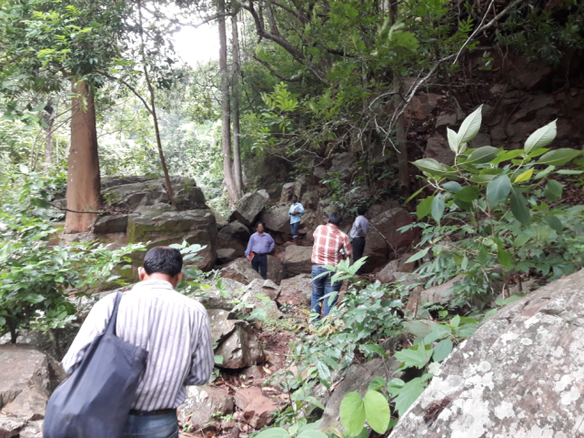
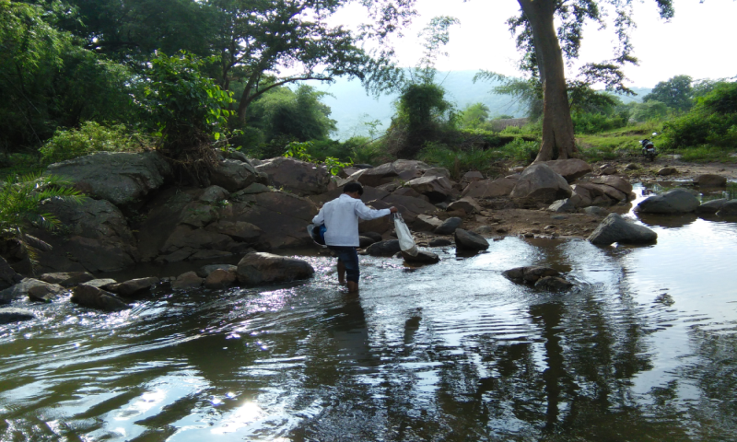
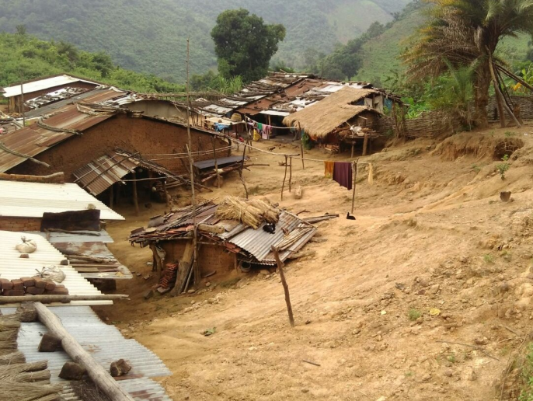
Problem of Inaccessibility in Hard-to-reach Areas
Inaccessible especially during transmission season in monsoon hindering service delivery when it is most needed.
Non-availability of modern transport mechanism throughout the year hindering referral.
Community is mostly tribal, marginalized and have poor literacy rate- challenges of poverty, treatment seeking from informal healers, low malaria awareness.
It is observed that in theses areas, around 20% of malaria cases in these areas are asymptomatic.

Slide 17
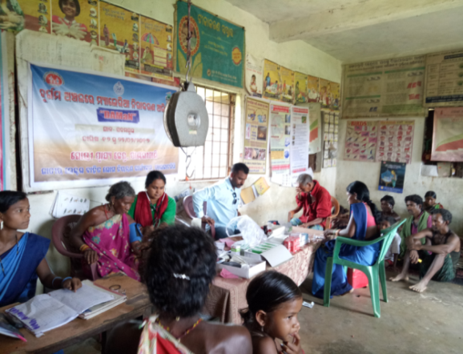
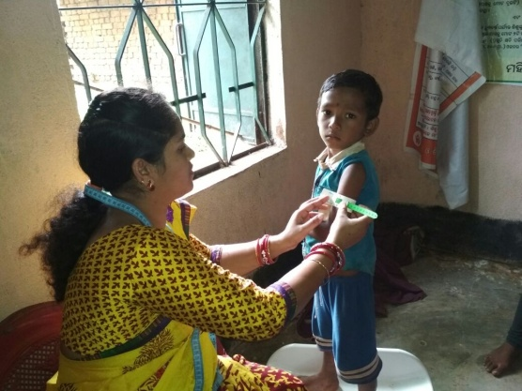
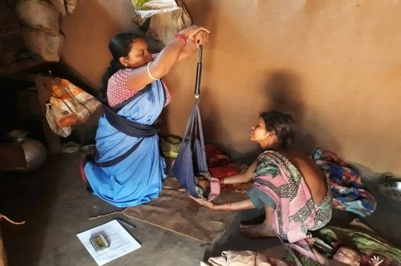
DAMaN – Access the Inaccessible
Model initiative by the State of Odisha from 2017. FIRST OF ITS KIND IN INDIA.
Implementation through camp approach - two rounds annually.
Vulnerable centric approach.
ASHA, AWW and other community volunteers and PRI members are involved.
Package of activities:
Mass malaria screening (both symptomatic and asymptomatic).
Treating of all malaria positive cases.
Haemoglobin estimation of
Pregnant & lactating mothers
Growth assessment of
under-5 children.
Inaccessible villages / hamlets
Accessible villages/
hamlets

Slide 18
Impact of Different Malaria Control Interventions
New inputs : RDT & LLIN
Bivalent RDT & 2nd Phase LLIN
Increased surveillance and complete treatment.
Proportionately, Case fatality rate is at lower level.

Slide 19
Program Outcome due to ASHA involvement
Increase in Passive Surveillance- ABER increase from 12.24% in 2007 to 16.37% in 2016
Deaths reduced by 187% in 2016 compared to 2007 in spite of increase in case detection.
Around 40 lakh LLINs could be distributed smoothly through ASHAs- GKS mechanism during 2010-2012 . This resulted reduction of malaria incidence and deaths by 73.54 % and 268.7% respectively in 2013 compared to 2010.
Early diagnosis and complete treatment, mass screening in hard to reach areas and Tribal Residential Schools averted outbreaks
In 2017, >11.34 million LLINs are being distributed under GFATM support - already 7 million have been distributed through ASHA- GKS mechanism within 2 months and most difficult pockets have been protected before cut off by rains.

Slide 20
Scalability and Opportunity
Capacity Building: With enhanced capacity building and increased nos. of ASHAs/ other community volunteers in remote villages/ hamlets, surveillance and EDCT services can be further improved.
Inclusive Approach: Health NGOs and other players can support community volunteers in remote inaccessible hamlets and service delivery can be scaled up through inclusive approach.
Scale up of best practices: The mass screening and simultaneous vector control under DAMaN can avert deaths and lower malaria transmission rate.
Inter-sectoral Coordination: Convergence with other sectors, including sanitation, tribal affairs, rural development, women & child development etc. can add value to DAMaN efforts for alleviation of the problems of malaria and malnutrition

Slide 21
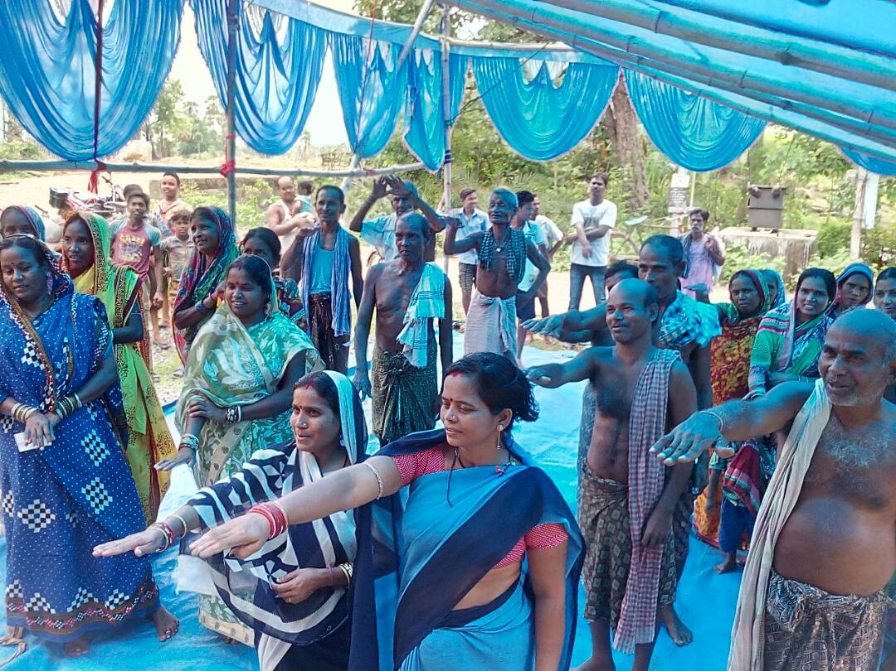
Community Volunteers
remains critical in malaria control/elimination
THANK YOU FOR KIND ATTENTION
“End Malaria for Good”

