Slide 1


4th National Summit on Good and Replicable Practices and Innovations in Public Healthcare Systems 6th – 8th JULY, 2017
HM & FW Department, Govt. of Andhra PradesH
SWASTHYA VIDYA VAHINI
Video

Slide 2
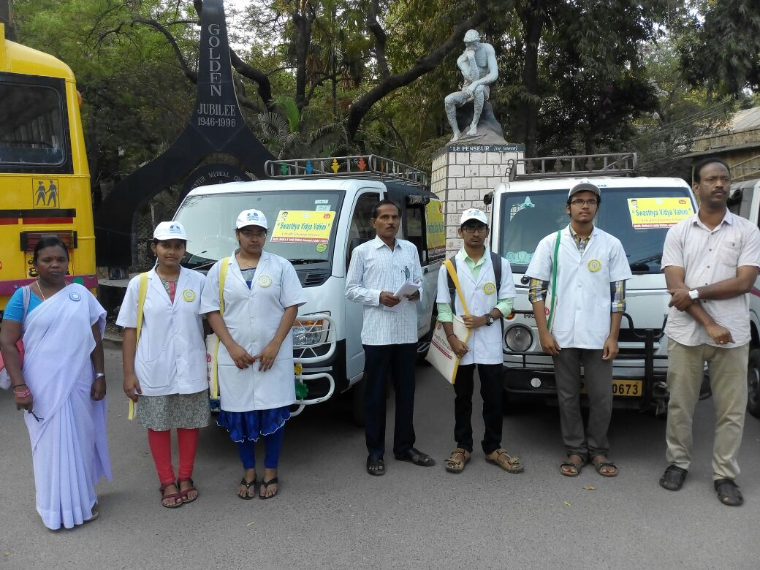
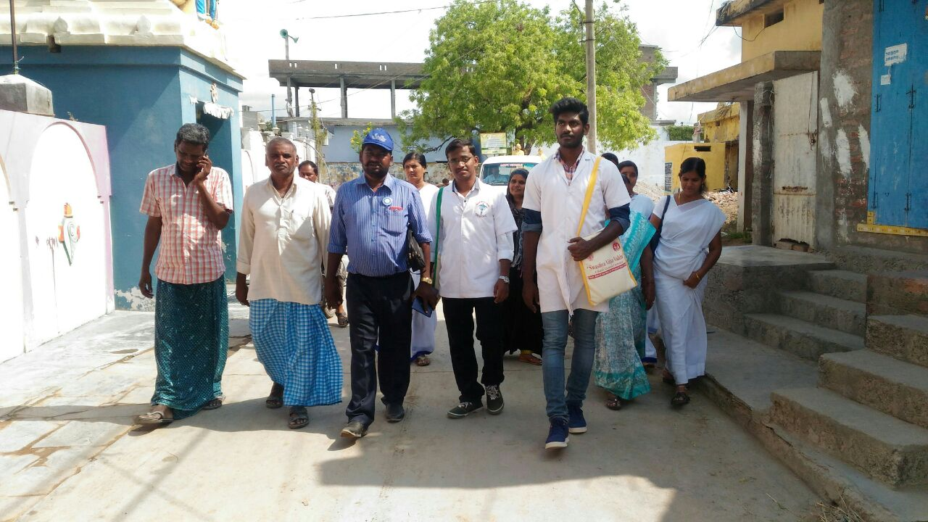
Swasthya Vidya Vahini (SVV) programme structure
Health Education programme through Medical & Para Medical Students
Student teams of two each are allocated to each village.
The colleges trains the students and forms teams in consultation with student representatives.

Slide 3
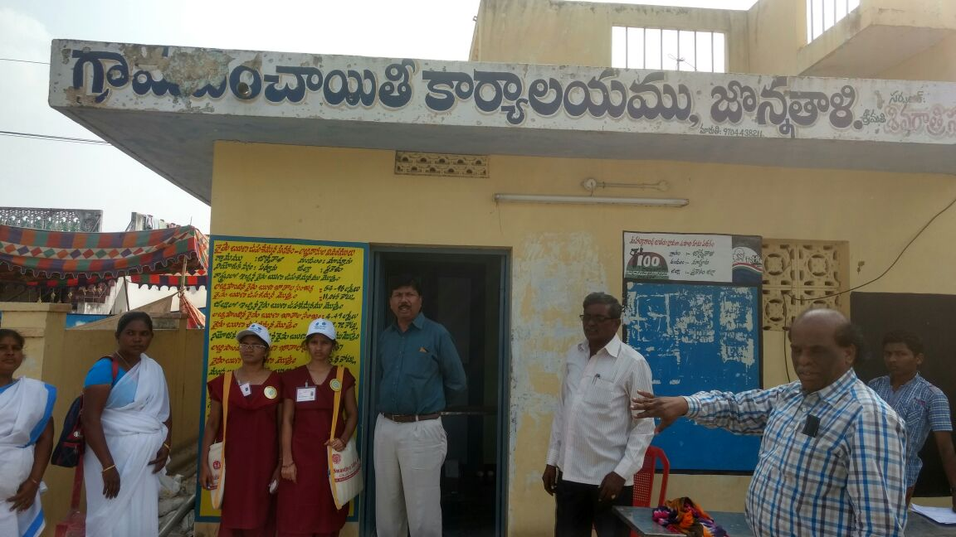
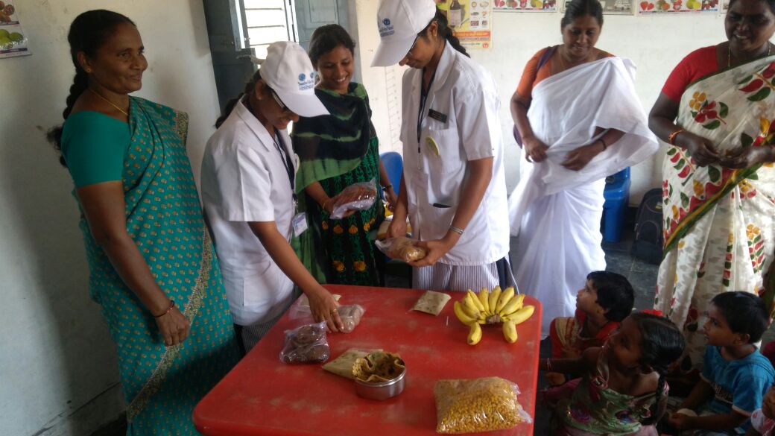
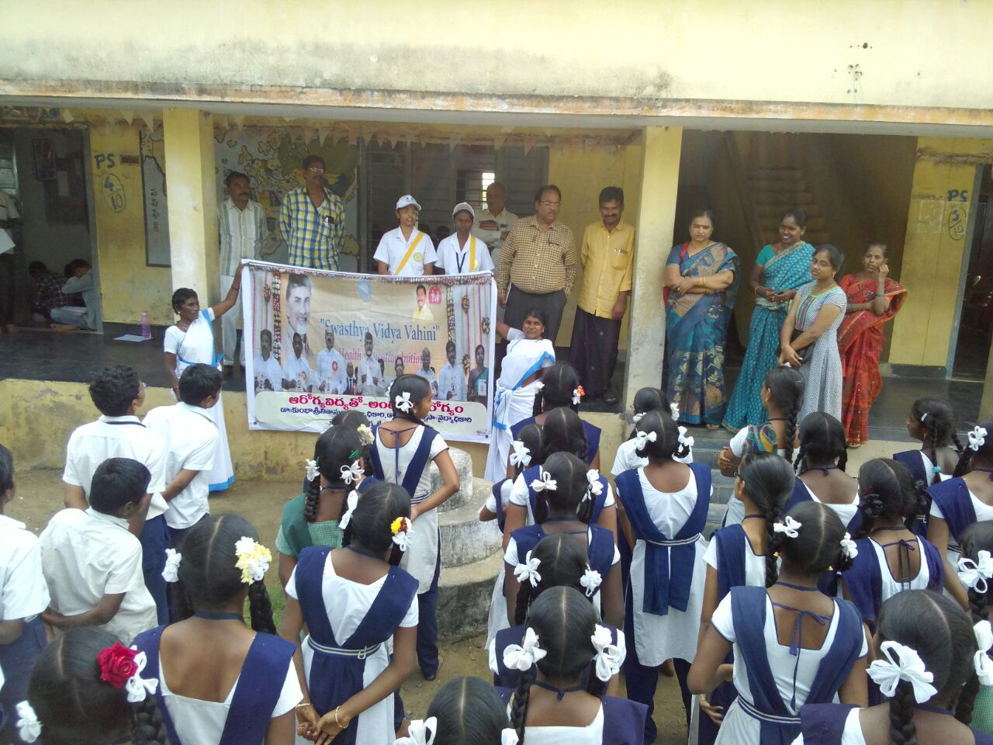
Collaborating departments for SVV
Panchayat Raj
WCD&SC
Education
The Village Secretary and the Sarpanch are responsible for safety of the students when they are in GP villages / habitations.
They accompany the team in the Transect walk
Anganwadi Centre: The Anganwadi teacher arranges a meeting with the mothers/ pregnant women.
She will also provide the required data to the students
The Physical Education Teacher of the school accompany the team to the school.
He/She will also arrange a meeting of the team with the teachers of the school

Slide 4
The process of SVV programme
Two teams of students in their allotted vehicle will join the Chandranna Sanchar Chikitsa (Mobile Medical Unit) at their allocated village by 10 am, along with the Health supervisor.
One team gets down and the other team will proceed to the next scheduled village of MMU and complete part of the field activities before the MMU arrives in the afternoon.
Each team will visit the allocated village one day once in a month for 10 months in a year and submit a project report on the village status.
The students will complete the field visit and return back to their respective colleges in the same vehicle.
The Health supervisors accompany the students teams from their colleges to the field and back to their colleges again, ensuring their safety throughout the visit.

Slide 5
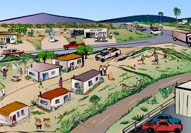
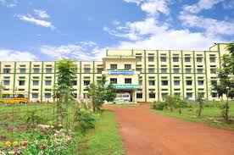
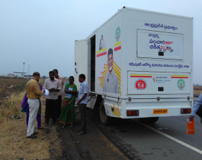
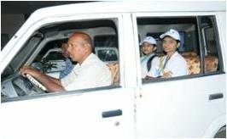
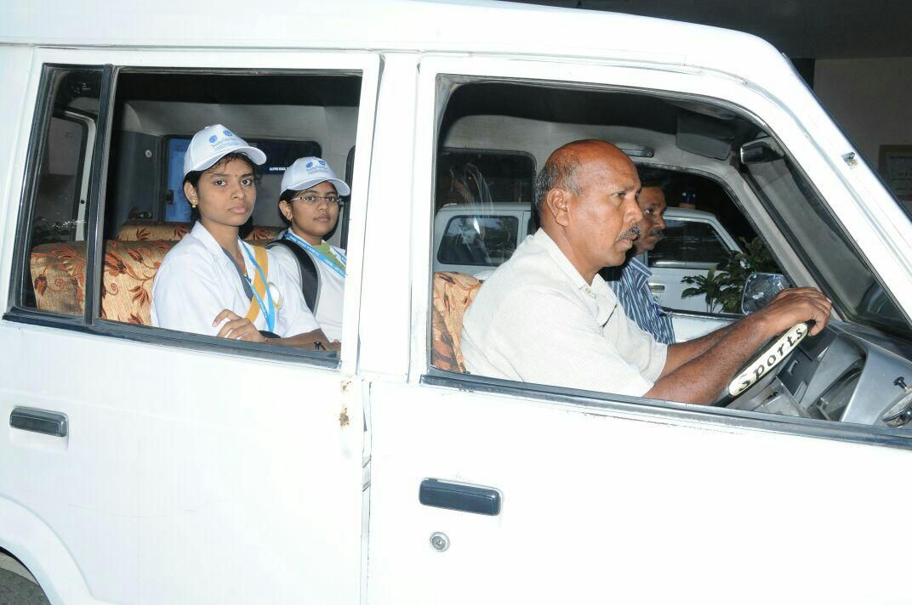

The process of field visit
Village A
MMU
Two teams in
one vehicle will
Follow MMU
College
Village B

Slide 6
Field activities
The team is received at the village by the Sarpanch, Panchayat secretary, and ASHA of the village.
Activities in the village are: A transect walk in the village will be followed by visits to the institutions
AWC- interact with the Mothers at AWC.
Panchayat Office
Schools: If there is more than one school in the village, all the Schools are visited, one every month.
Lunch for the students is arranged at AWC or Schools.
House visits to five houses prioritized by the AWW according to the presence of pregnant women, infants and under five children initially

Slide 7
Monthly Themes
446 teams / day
Substance abuse
Dec
WASH
Jan
Physical literacy
Oct
NCD
Nov
Nutrition
Sep
ENV.hygiene
Feb
RCH
Aug
Commdiseases
Mar
Anemia
Jul
Pers.hygiene
Jun

Slide 8
Monitoring of SVV & Recording the observations
Data entry of the observations and feedback on the same day into the software application developed for the purpose.
The issues observed are brought to the notice of the concerned departments for corrective measures.
End of 10 months, the students will prepare a project report that will be allocated points in the internal assessment of the student and the best project is rewarded.
Monitoring in SVV will be done through
Android App - Used by Health Supervisor for marking of attendance.
Web Application – Used by Colleges for Registration & Scheduling of Students and Students for filling of Checklists

Slide 9
Issues of Concern
Out of 5520 batches/month of students feedback - following issues have been identified
Keeping of peri-domestic animals (cows/buffaloes) inside the houses - 2437
Disease outbreaks/ disaster in the past 1 year - 251
Hot spot for any disease - 229
Villages nearby mines - 251
Presence of Open defecation Sites - 1482
Presence of Garbage dumps near houses – 1410
Villages with unsafe drinking water -
Villages having Electrification issues – 1069

Slide 10
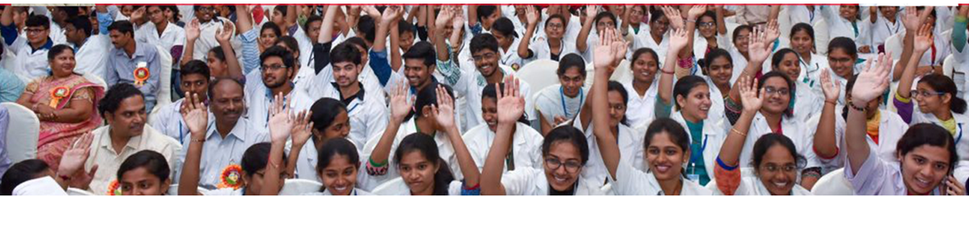
THANK YOU

