Slide 1



National Health Mission- Tamil Nadu
COMMENCEMENT OF DIPLOMATE OF NATIONAL BOARD COURSES IN DISTRICT HEAD QUARTERS HOSPITALS
Dr.Darez Ahamed IAS
Mission Director NHM Tamil Nadu
07.07.2017

Slide 2
PROBLEM STATEMENT
District Hospitals cater to public approaching health facilities and serves as a bridge between Medical College & Primary Health Centre.
Though the services provided are on par with Tertiary care Hospitals in many specialities, the potential has not ben tapped to train human resource for health. DH services cater to significant population and case load is heavy in almost all the facilities.
In Tamilnadu context NHM’s flagship program of strengthening DH is crucial to provide HR requirement of Universal Health care and prevention of catastrophic expenditure.

Slide 3
WHY DNB IN SECONDARY CARE HOSPITALS?
Secondary care hospitals share 34% of Out Patient services, 41 % of In patient Services and 44% of Family Planning services through 29 District Head quarters Hospitals and 274 Sub District hospitals per day
CEMONC Centers in Secondary Care Hospitals contribute to nearly 49% (1.5 lakh) deliveries in CEMONC on par with 22 Medical colleges.
42 SNCUs in Secondary Care Hospitals contribute to 40% of total admissions of sick newborns.

Slide 4
Benefits of Commencing DNB courses
Secondary care hospital strengthening with DNB courses will indirectly help to commence following paramedical courses
Speciality nursing courses like Neo-natal nursing, Midwifery nursing, O.T room nursing, Orthopedic & Rehabilitation nursing;
Para-medical courses like MLT, X-ray/CT technicians, Renal dialysis technician, OT technician, Ophthalmic assistant etc.

Slide 5
Work Flow
Identifying District Hospital with required Bed strength (200 beds) & HR
Signing of MoU with Directorate of Medical Education
Payment of Prescribed Fees & Filling up Application for the District Hospital proposed to start the course as per norms
Inspection by Team of Officials from National Board of Examinations to the selected District Hospitals
Accreditation by National Board of Examinations to commence Courses

Slide 6
PROGRAMME DESCRIPTION
PG teacher from Medical College in the specialty concerned.
Tie-up for Ethical Committee to review research & Thesis work
Library Services
Rotational Posting in different modalities / departments / OT so that exposure as prescribed in the DNB curriculum is met
Training in the area of Basic Sciences specialties
Hands on training provision

Slide 7
PROGRAMME DESCRIPTION
Teaching Faculty Needed :
One PG teacher above the level of Assistant Professor or Assistant prof with 5 years of post-graduate teaching – from DME
One Senior Consultant with minimum 8 years experience post MD/MS.
One Junior Consultant with minimum 5 years experience post MD/MS.
Two Senior Residents with PG degree / diploma with more than 2 years experience (as per NBE).
One whole time Resident, MO with or without PG qualification

Slide 8
Mandatory Supportive Documents
Certified copies of mandatory regulatory / licensing approval and all statutory requirement / clearances from the local authority / Government for running such establishment is required to be submitted to NBE as under:
Approval for Clinical / Teaching establishment
Fire Safety Certificate from State Fire Department
Building Complex / Occupancy
Local Authority / Municipal Clearance
Certificate of Incorporation

Slide 9
STATUS OF DNB COURSES IN SECONDARY CARE HOSPITALS
Secondary care Hospitals
48 seats in 8 DHQ hospitals and 3 SDH
S.N | Name of the Specialty | No. of seats
 |  | Proposed
1 | Obstetrics and Gynecology | 14
2 | Pediatrics | 8
3 | Ortho | 6
4 | General Surgery | 5
5 | General Medicine | 5
6 | Emergency Medicine | 8
7 | Ophthalmology | 2
 | Total | 48
* Other seats are under inspection

Slide 10
List of Institutions
District | S No | Secondary Care Hospital | Identified Course | No. of Primary Seats | No of Secondary seats
Cuddalore | 1 | Cuddalore | Medicine | 1 | -
 |  |  | O&G | 1 | 1
 |  |  | Ophthalmology | 1 | 1
 |  |  | Orthopaedics | 2 | 2
 |  |  | Paediatrics | 1 | 1
 | 2 | Chidambaram | Paediatrics | 1 | 1
Dindigul | 3 | Dindigul | O&G | 1 | 1
 |  |  | Surgery | 2 | -
Erode | 4 | Erode | Medicine | 1 | -
 |  |  | O&G | 2 | 1
 |  |  | Paediatrics | 1 | 2
 |  |  | Surgery | 1 | -
Kancheepuram | 5 | Kancheepuram | O&G | 1 | 1
Ramnathapuram | 6 | Ramnathapuram | O&G | 1 | 1
 |  |  | Orthopaedics | 1 | 1
 |  |  | Surgery | 1 | -
Thanjavur | 7 | Pattukottai | Surgery | 1 | -
Tiruppur | 8 | Tiruppur | Medicine | 1 | -
Virudhunagar | 9 | Virudhunagar | Medicine | 1 | -
 |  |  | Paediatrics | 1 | 1
Thoothukudi
 | 10 | Kovilpatti | O&G | 1 | 1
 |  |  |  | 24 | 15

Slide 11
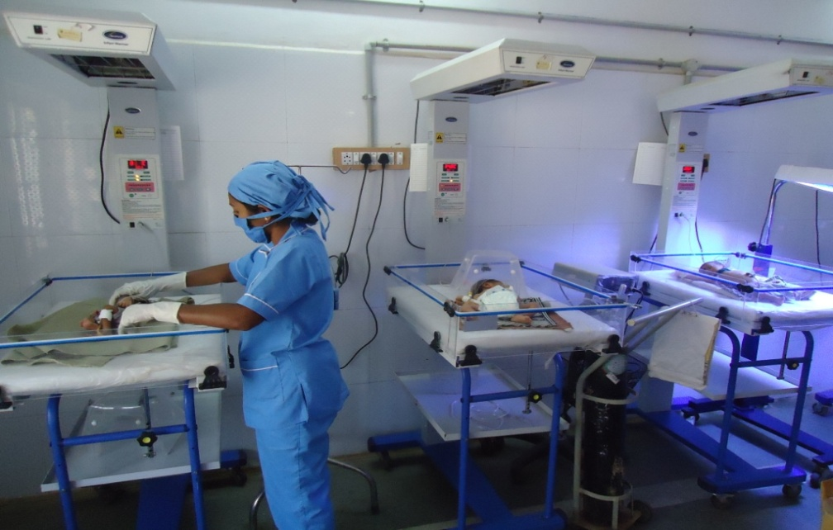
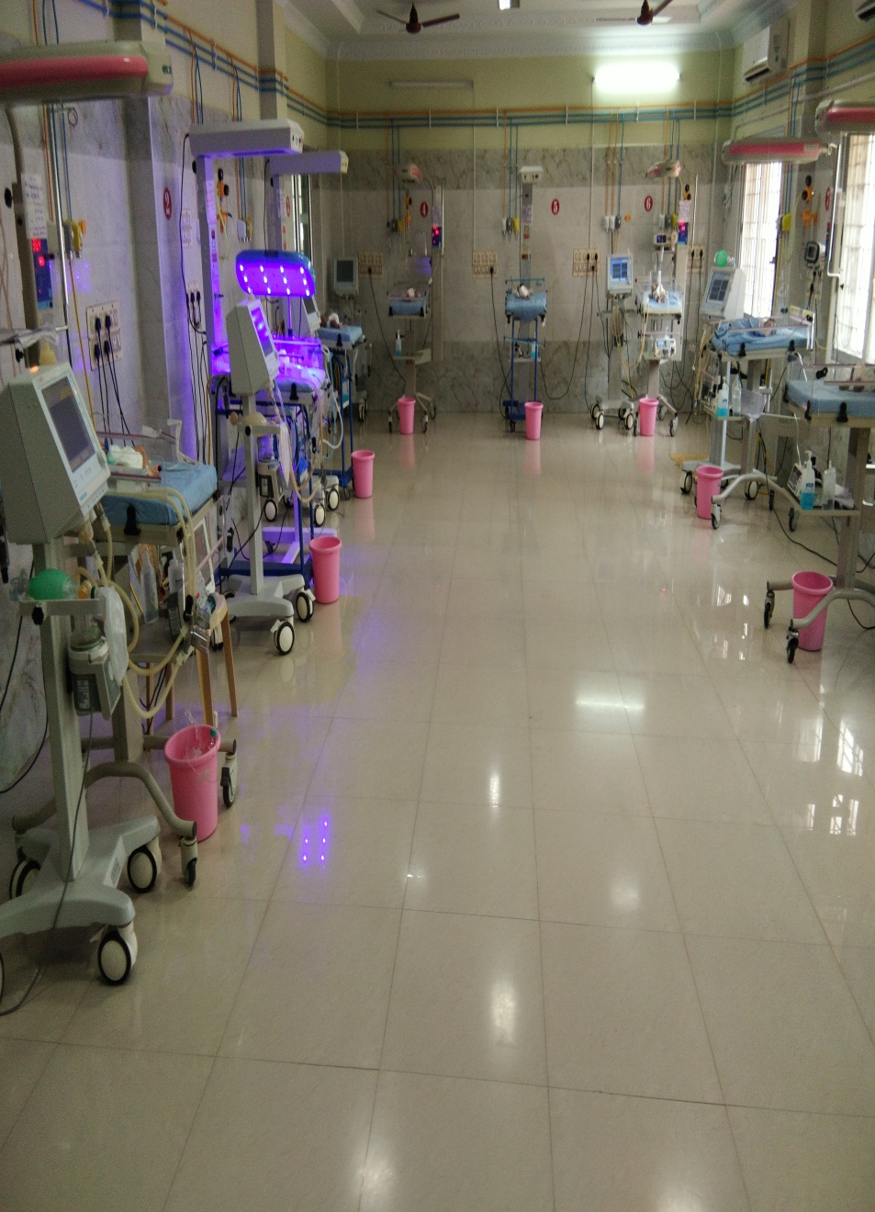
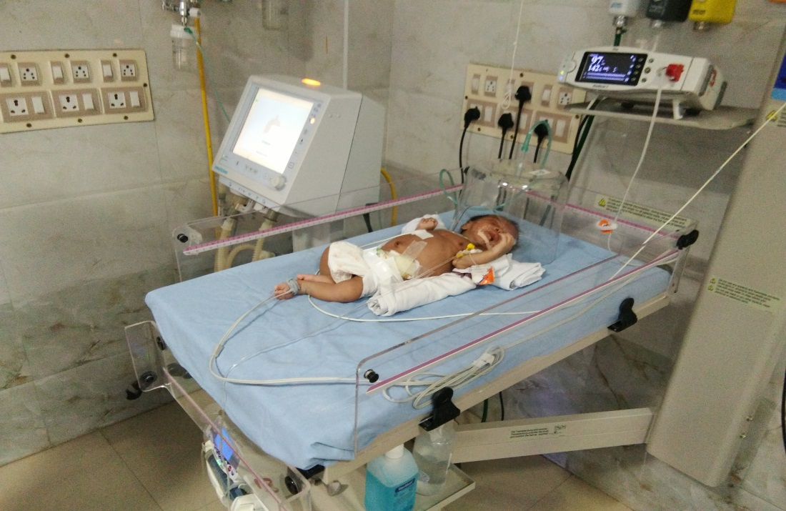
CUDDALORE DHQ-PEDIATRICS DEPARTMENT

Slide 12
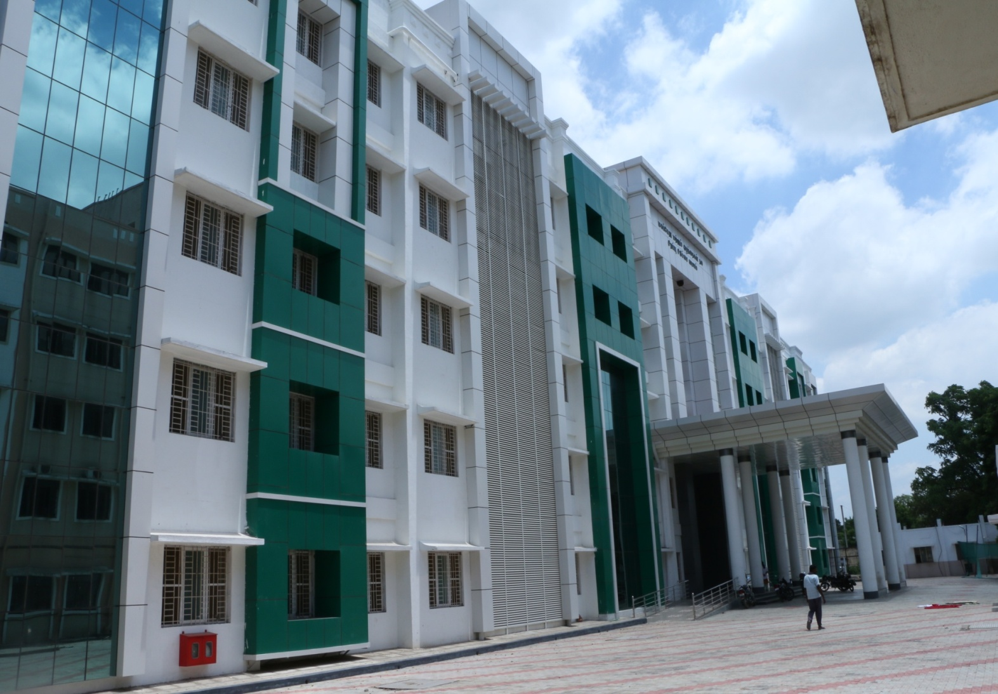
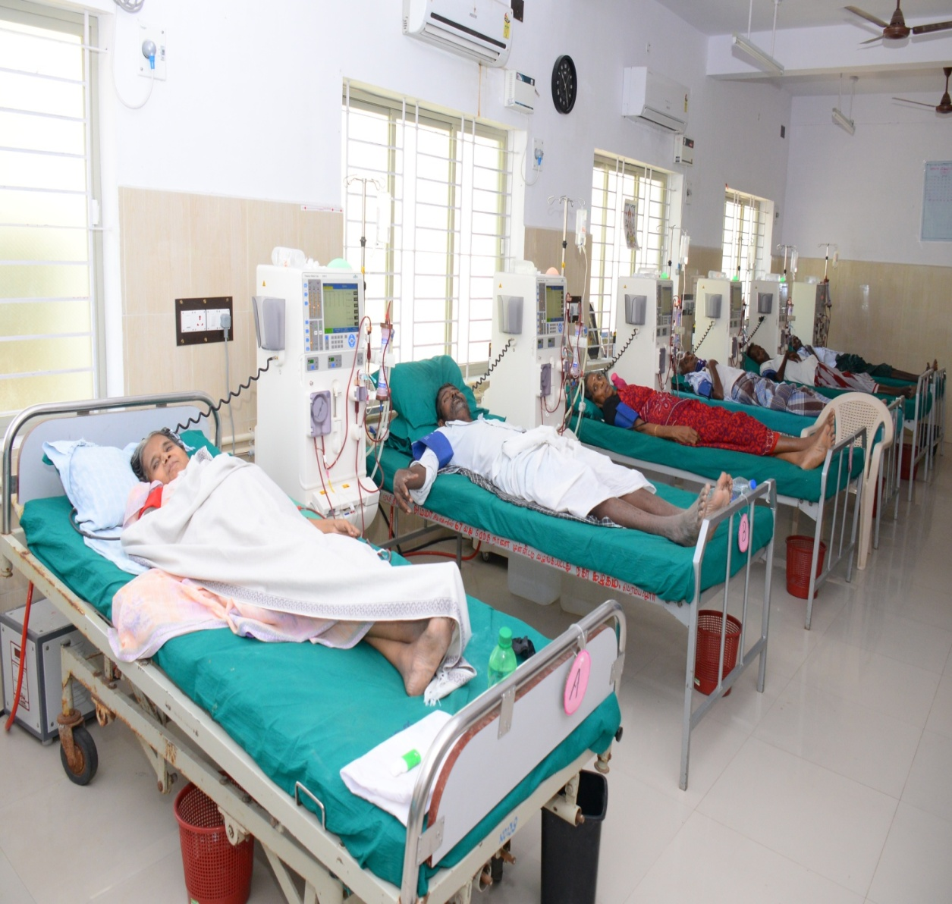
DISTRICT HEAD QUARTERS HOSPITAL

Slide 13
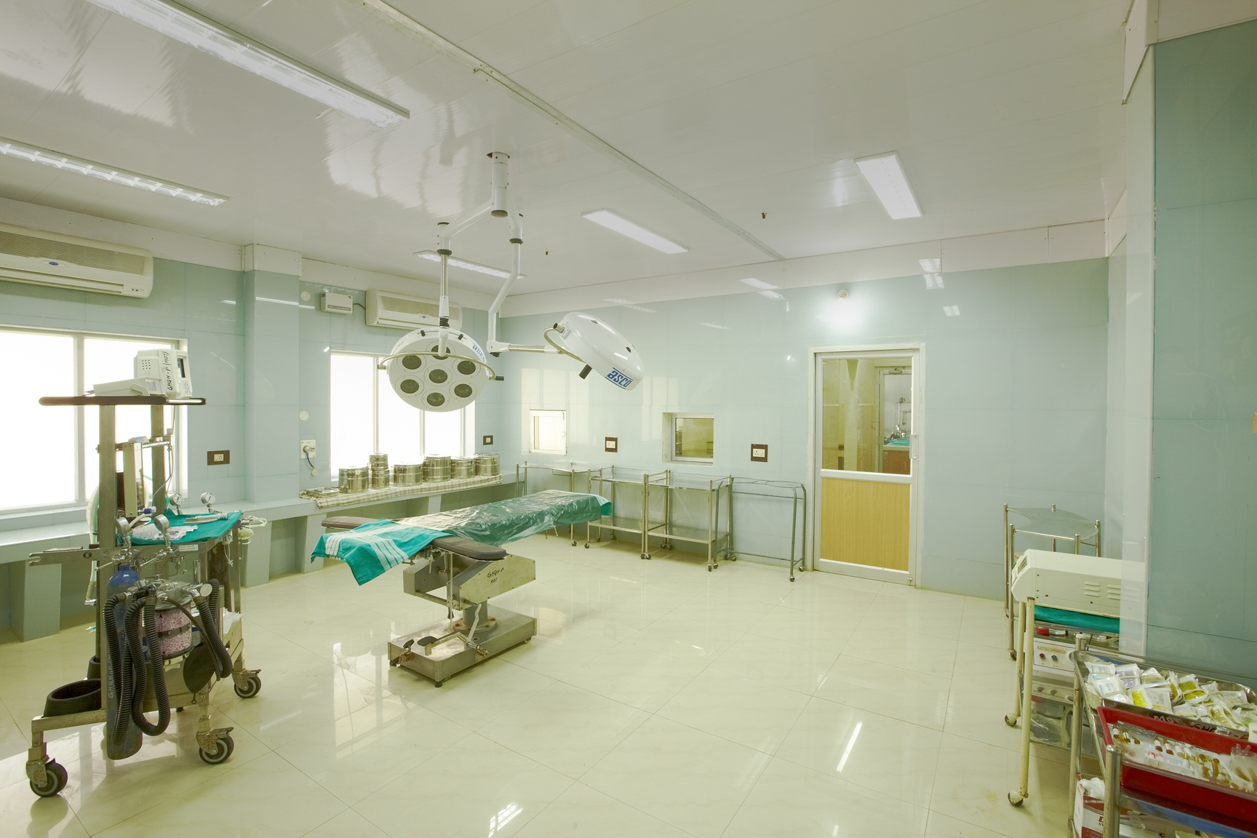
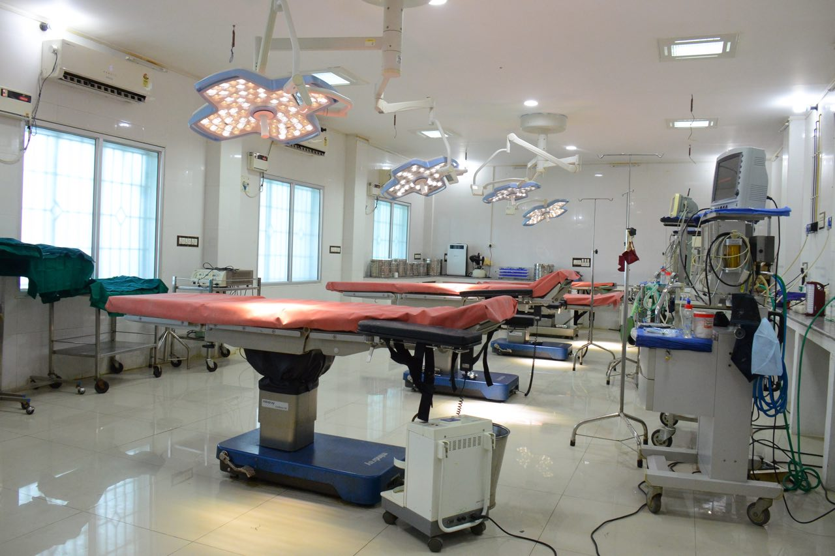
CEMONC OPERATION THEATRE AT DISTRICT HEAD QUARTERS HOSPITAL

Slide 14
DNB Seat Matrix
Secondary Care Hospital | Identified Course | No. of Primary Seats
Cuddalore | Emergency Medicine | 1
Dindigul | Emergency Medicine | 1
Erode | Emergency Medicine | 1
Mayiladuthurai | Emergency Medicine | 1
Ramnathapuram | Emergency Medicine | 2
Tiruppur | Emergency Medicine | 1
Virudhunagar | Emergency Medicine | 2
 |  | 9

Slide 15
Name of Departments & Annexed Medical Colleges
District | Secondary Care Hospital | Identified Course | No. of Seats | Name of the Department | No. of Faculty | Annexed Medical Institution
Cuddalore | Cuddalore | Medicine | 1 | Medicine | 1 | Villupuram Medical College
 |  | O&G | 1 | O&G | 1
 |  | Ophthal | 1 | Ophthal | 1
 |  | Ortho | 2 | Orthopaedics | 1
 |  | Paediatrics | 1 | Paediatrics | 1
 | Chidambaram | Paediatrics | 1
 | Cuddalore | Emergency Medicine | 1 | Anaesthesia | 1

Slide 16
Name of Departments & Annexed Medical Colleges
District | Secondary Care Hospital | Identified Course | No. of Seats | Name of the Department | No. of Faculty | Annexed Medical Institution
Dindigul | Dindigul | O&G | 1 | O&G | 1 | Madurai Medical College
 |  | Surgery | 2 | Surgery | 1
 |  | EM | 1 | Anaesthesia | 1
Ramnathapuram | Ramnathapuram | O&G | 1 | O&G
 |  | Ortho | 1 | Orthopaedics | 1
 |  | Surgery | 1 | Surgery | 1
 |  | EM | 2 | Anaesthesia | 1
Virudhunagar | Virudhunagar | Medicine | 1 | Medicine | 1
 |  | Paediatrics | 1 | Paediatrics | 1
 |  | Emergency Medicine | 2 | Anaesthesia

Slide 17
District | Secondary Care Hospital | Identified Course | No. of Seats | Name of the Department | No. of faculty | Annexed Medical Institution
Erode | Erode | Medicine | 1 | Medicine | 1 | Salem Medical College
 |  | O&G | 2 | O&G | 1
 |  | Paediatrics | 1 | Paediatrics | 1
 |  | Surgery | 1 | Surgery | 1
 |  | EM | 1 | Anaesthesia | 1
Tiruppur | Tiruppur | Medicine | 1 | Medicine
 |  | EM | 1 | Anaesthesia
Thoothukudi | Kovilpatti | O&G | 1 | Anaesthesia | 1 | Tirunelveli Medical College

Slide 18
District | Secondary Care Hospital | Identified Course | No. of Seats | Name of the Department | No. of faculty | Annexed Medical Institution
Thanjavur | Pattukottai | Surgery | 1 | Surgery | 1 | Thanjavur Medical College
Nagapattinam | Mayiladuthurai | EM | 1 | Anaesthesia | 1
Kancheepuram | Kancheepuram | O&G | 1 | O&G | 1 | Chengalpet Medical College

Slide 19
Approved Seats

Slide 20
FINANCIAL IMPLICATIONS
Name of Activity | Unit cost | Number of hospitals | Amount in Rs
1. Non recurring Expenditure
Library with standard text | 7,50,000 | 11 | 82,50,000
Classroom & Demo Room | 25,00,000 | 11 | 2,75,00,000
Hostel facilities | 15,00,000 x | 11 | 1,65,00,000
DNB Admin Cell at DMS |  |  | 10,00,000
TOTAL |  |  | 5, 32, 50,000

Slide 21
Name of Activity | Unit cost | Number of hospitals | Amount in Rs
2. Recurrent Expenditure
Fresh Accreditation fees for one specialty application + Bulletin cost (28 specialty application forms in 11 hospitals) | 2, 03,000 | 28 | 56, 84,000
33 students for 12 months (Primary) Stipend for DNB candidates 1st year | Rs 25,000 |  | Rs.99,00,000
Other HR |  |  | Rs 32,76000
Others (contingency, hiring vehicle ) |  |  | Rs 45,30,000
TOTAL |  |  | Rs 2,82,50,000
GRAND TOTAL |  |  | Rs 81500000

Slide 22
Way Forward
Current status | Overall Target | Target to be achieved by 30.9.17 | Target by 31.3.18
Accreditation & Assessment of 48 seats (33 primary & 15 secondary ) in 11 Government Hospitals. | Creation of 300 DNB seats | 100 DNB seats | 200 DNB seats

Slide 23
THANK YOU

