Slide 1

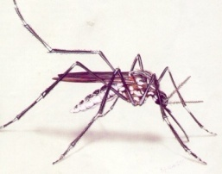

Innovations towards Malaria Elimination
In
Navi Mumbai Municipal Corporation
Dr. Ujjwala Oturkar
Programme Officer (NVBDCP, CD & NCD)

Slide 2
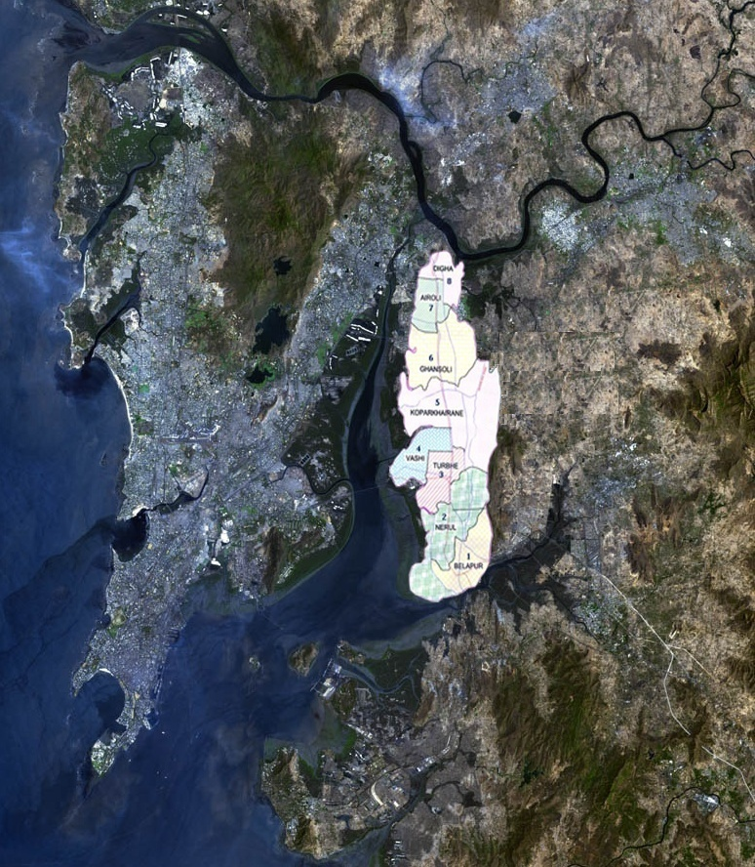

Slide 3
Navi Mumbai Municipal Corporation Area – 108.638 Sq. Km.
Total Population - 1506981
(Population as per 2011 Census- 1119477)
Slum Area population -
Human resource
  Health Supervisor - 02
  Health Assistant - 22
  Insect Collector - 01
  MPW - 43

Slide 4
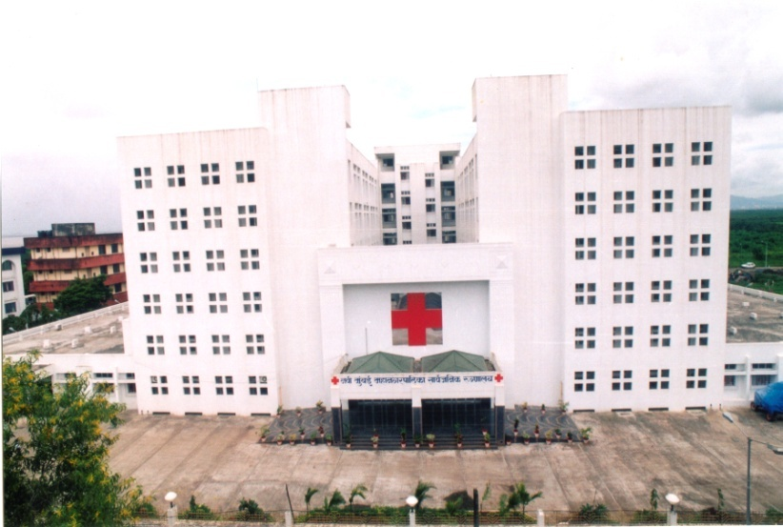
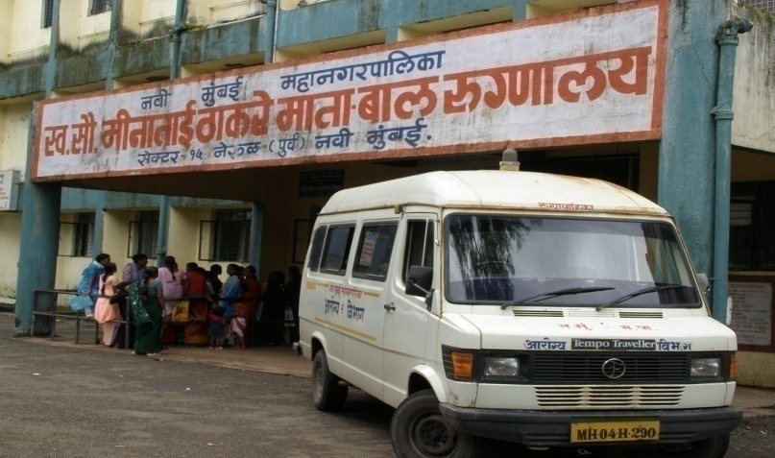
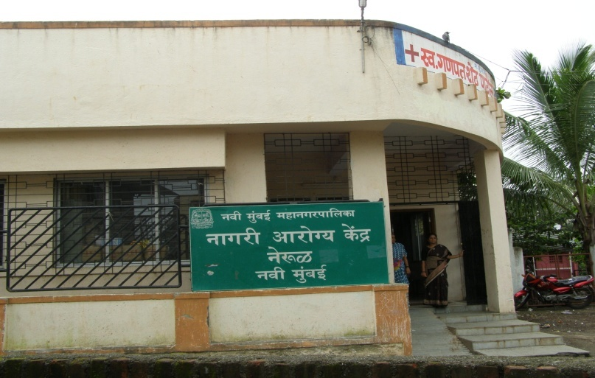
Health Infrastructure
Super Specialty Hospital
3 General Hospital
1 Maternity & Child Hospitals
22 Urban Health Posts
One Mobile Clinic

Slide 5
Activities under NVBDCP
UPHC wise Area wise Weekly schedule Anti Larval spraying activities
UPHC wise Area wise Weekly schedule Fogging activities
Biological Methods (Guppy Fish)
Indoor Breeding Crosscheck
Case investigation activities
Surveillance activity - Active & Passive
Weekly Construction site visit.
Information, Education & Communication
- Awareness of Secondary School Children, School Rally &
Various Competitions.
- Senior Citizen Awareness Campaign.
- Mahila Mandal , C.B.O. Awareness.
- Awareness of School & College Principals.
- Sensitization of General Practitioners .
- Street Plays all over NMMC Area.
- Handbills, Posters, Banners, Hoardings, Exhibition set.
- Special Anti-Malaria month &Anti-Dengue Preventive month
- Festive Season Awareness Campaign- Ganapati , Navratri .
- Appeal to citizens of Navi Mumbai through News Papers.
Mosquito Abatement Committee

Slide 6
STATEMENT SHOWING B.S. COLLECTION & MALARIA POSITIVES
Year | BS | PV | PF | MIX | TOTAL | PF% | SPR | API
1998 | 144195 | 4383 | 2157 | 53 | 6593 | 32.7 | 4.57 | 11.59
1999 | 118895 | 576 | 1078 | 40 | 3694 | 29 | 3.11 | 5.59
2000 | 110566 | 1760 | 1033 | 30 | 2823 | 36.5 | 2.55 | 4.00
2005 | 150776 | 1290 | 304 | 31 | 1625 | 20.61 | 1.07 | 1.75
2010 | 202905 | 1032 | 84 | 22 | 1138 | 9.31 | 0.56 | 0.82
2011 | 197425 | 717 | 43 | 15 | 775 | 7.48 | 0.39 | 0.54
2012 | 171686 | 478 | 28 | 7 | 513 | 6.82 | 0.30 | 0.35
2013 | 170470 | 383 | 12 | 1 | 396 | 3.28 | 0.23 | 0.27
2014 | 162238 | 344 | 12 | 0 | 356 | 3.38 | 0.22 | 0.24
2015 | 163281 | 312 | 2 | 0 | 314 | 0.64 | 0.19 | 0.21
2016 | 155872 | 239 | 3 | 1 | 243 | 1.65 | 0.19 | 0.16
2017 June | 47273 | 51 | 1 | 0 | 52 | 1.96 | 0.10

Slide 8

Distribution of City/Town by API
API | UHP Nos. | Population ‘000 | %
Less than 0.5 | 19 | 13,39,492 | 88.00
0.5 – 1 | 2 | 1,12,089 | 7.43
1 – 2 | -- | -- | --
2 – 5 | -- | -- | --
More than 5 | -- | -- | --
Total | 2 | 1506981 | --

Slide 9
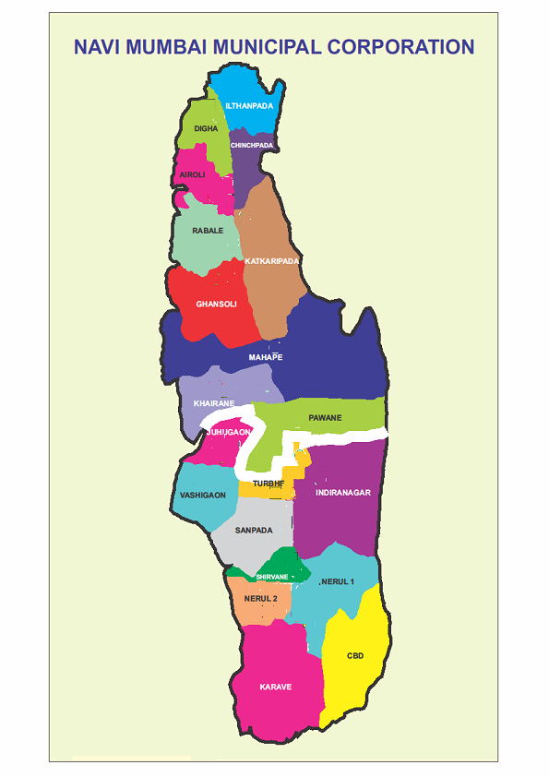
UHP wise Malaria Cases in Year wise
UHP | 2015 | 2016 | 2017
C.B.D | 32 | 13 | 2
Karave | 34 | 23 | 3
Nerul I | 14 | 11 | 2
Nerul II | 20 | 5 | 1
Shirvane | 19 | 10 | 2
Sanpada | 13 | 11 | 1
Turbhe | 18 | 23 | 8
Pawna | 20 | 20 | 5
Idiranagar | 30 | 41 | 7
Juhugao | 3 | 1 | 0
Vashigao | 4 | 2 | 0
Khairne | 19 | 14 | 4
Mahape | 6 | 7 | 1
Ghansoli | 19 | 13 | 1
Rabada | 4 | 6 | 5
K.pada | 11 | 6 | 2
Airoli | 10 | 5 | 2
Chinchpada | 7 | 4 | 2
Digha | 9 | 7 | 1
IlthanPada | 12 | 12 | 2
NocilNaka | 9 | 9 | 1
Total | 314 | 243 | 52

Slide 10
P. FALCIPARUM CASES
YEAR | Total BS | Total Malaria Cases | PF | Death
2010 | 202905 | 1138 | 84 | 0
2011 | 197425 | 775 | 43 | 0
2012 | 171686 | 513 | 28 | 0
2013 | 170470 | 396 | 12 | 0
2014 | 162238 | 356 | 12 | 0
2015 | 163281 | 312 | 2 | 0
2016 | 155872 | 239 | 4 | 0
2017 | 47273 | 52 | 1 | 0

Slide 11
DENGUE CASES
YEAR | SUSPECTED | CONFIRMED | DEATH
2010 | 139 | 27 | 0
2011 | 93 | 22 | 0
2012 | 177 | 39 | 0
2013 | 94 | 24 | 0
2014 | 78 | 2 | 0
2015 | 76 | 2 | 0
2016 | 54 | 21 | 0
2017 | 0 | 0 | 0

Slide 12
DETAILS OF TOTAL BREEDING SPOTS & GUPPY FISH SPOTS
YEAR | Total Breeding spots |  |  | Guppy Fish spots
 | Permanent | Temporary | Total | Temporary | Permanent | Total | Guppy Hatchery
2010 | 204575 | 129990 | 334565 | 1096 | 5721 | 6817 | 30
2011 | 140917 | 353668 | 494585 | 2111 | 6072 | 8183 | 42
2012 | 162582 | 383316 | 545898 | 2314 | 8070 | 10384 | 56
2013 | 131017 | 347698 | 478715 | 1916 | 6626 | 8542 | 56
2014 | 143102 | 366986 | 510088 | 1467 | 6879 | 8346 | 56
2015 | 163420 | 388635 | 552055 | 6814 | 1585 | 8399 | 56
2016 | 326939 | 218558 | 545497 | 1008 | 6184 | 7192 | 56
2017 | 251984 | 351795 | 603779 | 1707 | 7082 | 8789 | 56

Slide 13
Construction site activity
Sr. No. | UHP | No. Construction site | Breeding spots | No. Of Guppy Fish spots | No. of Labours
1 | C.B.D | 51 | 666 | 22 | 568
2 | Karawe | 77 | 563 | 35 | 1128
3 | Nerul-I | 13 | 925 | 26 | 387
4 | Nerul-II | 11 | 1894 | 18 | 132
5 | Shiravane | 6 | 1247 | 23 | 595
6 | Sanpada | 44 | 708 | 26 | 1742
7 | Turbhe | 8 | 356 | 3 | 0
8 | Pawna | 28 | 1865 | 30 | 2071
9 | Indiranagar | 6 | 706 | 4 | 100
10 | Juhugao | 30 | 478 | 1 | 120
11 | Vashigao | 17 | 890 | 13 | 474
12 | Khairne | 5 | 223 | 28 | 412
13 | Mahape | 7 | 1739 | 31 | 772
14 | Ghansoli | 45 | 1565 | 25 | 325
15 | Rabada | 55 | 2358 | 27 | 910
16 | Katkaripada | 20 | 585 | 4 | 200
17 | Airoli | 11 | 745 | 2 | 359
18 | Chinchpada | 3 | 150 | 4 | 450
19 | Digha | 3 | 1426 | 8 | 1676
20 | Ilthanpada | 1 | 3179 | 7 | 130
21 | Nocilnaka | 8 | 460 | 2 | 210
 | Total | 449 | 22728 | 339 | 12761

Slide 14
Mosquito Abatement Committee
Sr. No. | Institute | Problems | Solved Problems | Pending Problems | New Problems | Total Problems
1 | CIDCO | 42 | 22 | 20 | 0 | 20
2 | Collector | 5 | 3 | 2 | 0 | 2
3 | Public Work Dept. | 3 | 0 | 3 | 3 | 6
4 | NMMC | 108 | 32 | 76 | 0 | 76
5 | MTNL | 1 | 0 | 1 | 0 | 1
6 | MSEDCL | 20 | 5 | 15 | 0 | 15
7. | APMC | 3 | 1 | 2 | 0 | 2
8. | Railway | 10 | 2 | 8 | 0 | 8
9 | MIDC | 8 | 0 | 8 | 18 | 26
10 | Private | 3 | 0 | 3 | 1 | 4
11 | Forest | 12 | 6 | 6 | 0 | 6
12 | Salt Commnr | 1 | 0 | 1 | 0 | 1
 | Total | 216 | 71 | 145 | 23 | 168

Slide 15
Indoor Breeding Checking – Special Drive
April- May 2017
Total no of Houses : 482120
Total houses checked : 367310
  Total spots checked : 718186
  Positive Breeding spots : 1740
  Total Tyers destroyed : 395

Slide 16
Innovations
Focus on Migratory Population, Slum Clusters and Construction Sites
Ensuring diagnosis within 24 hrs.
Use of Microscopy
Notification of each malaria case
Case Based Surveillance
Case based supervised treatment
Introduction of treatment card
Case based investigation- Case investigation forms
Case based vector surveillance

Slide 17
Innovations
Reporting from Private Practitioners
Involvement of Residential welfare associations
Special programme for school children
Close collaboration with other sectors
Use of legislative measures- Strict Implementation of Building byelaws
Case based vector intervention- focal/ space spray.
Biological control.
Proper drainage, channelization, minor engineering & deweeding.

Slide 18
Navi Mumbai Municipal Corporation
NATIONAL VECTOR BORNE DISEASE CONTROL PROGRAMME
MALARIA TREATMENT CARD
Urban Primary Health Centre with code: - Case No./year:- ........../......../ 2017
Area:- _______________________
Name of the patient__________________________ Sex: M/ F Age ____________
Permanent Address with Phone No. _____________________________________________
Present Address with Phone No. ________________________________________________
Name and designation of Treatment Provider _____________________________________
Name and Address of Contact Person _____________________________________
Initial Home Visit by (with signature & Date)
1) MPHW - 2) MPHS - 3) MO -
Disease Classification P. Vivax P. falciparum Mix Complication if any (Please specify): | Day | Date | BSC | B.S. No. | Name of Lab. | Smear Result
 |  |  |  |  |  | PV | PF |  | Mix
 |  |  |  |  |  |  | Pfg | Pfrg
 | Initial
 | Follow up 7”
 | Follow up 14”
 | Follow up 28”
I .INTENSIVE PHASE- Prescribed regimen and dosages: (Tab Chloroquine 25mg/Kg b wt for 3 days for P vivax and Mix. ACT for 3 days for P falciparum) Tick ( ) the appropriate Category below P. Vivax P. Falciparum Mix 3days intensive (No. Of Tablets) 3days intensive (No. Of Tablets) 3days intensive (No. Of Tablets) Chloroquine ACT ACT Primaquine Primaquine
Tick (√ ) appropriate date when the drugs have been swallowed under direct observation
Month /year | Date of the month
 | 1 | 2 | 3 | 4 | 5 | 6 | 7 | 8 | 9 | 10 | 11 | 12 | 13 | 14 | 15 | 16 | 17 | 18 | 19 | 20 | 21 | 22 | 23 | 24 | 25 | 26 | 27 | 28 | 29 | 30 | 31
 | 1 | 2 | 3 | 4 | 5 | 6 | 7 | 8 | 9 | 10 | 11 | 12 | 13 | 14 | 15 | 16 | 17 | 18 | 19 | 20 | 21 | 22 | 23 | 24 | 25 | 26 | 27 | 28 | 29 | 30 | 31

Slide 19
RADICAL TREATMENT – MALARIA
II.RADICAL PHASE Prescribed regimen (Tab Primaquine 0.25mg/kg bw per day for 14 days)
P.vivax Mix
Tick (√ ) appropriate date when the Primaquine (Dosage) drugs have been swallowed under direct observation
Month /year | Date of the month
 | 1 | 2 | 3 | 4 | 5 | 6 | 7 | 8 | 9 | 10 | 11 | 12 | 13 | 14 | 15 | 16 | 17 | 18 | 19 | 20 | 21 | 22 | 23 | 24 | 25 | 26 | 27 | 28 | 29 | 30 | 31
 | 1 | 2 | 3 | 4 | 5 | 6 | 7 | 8 | 9 | 10 | 11 | 12 | 13 | 14 | 15 | 16 | 17 | 18 | 19 | 20 | 21 | 22 | 23 | 24 | 25 | 26 | 27 | 28 | 29 | 30 | 31
Treatment out come with date: ________________________ Signature of MO with Date: _________________
1. Cured (Clinically / Microscopy confirm cases) 2. Treatment failure 3. Death
Retrieval actions for missed doses
Date and time | By whom | Whom contacted | Reason for missed doses | Outcome of retrieval
Date and time | By whom | Whom contacted | Reason for missed doses | Outcome of retrieval
Mass Blood Slides (Mass Survey for pv/Pf)
Date | BSC | BSE | Result with the stage
 |  |  | PV | PF | Mix
If positive specify stage
Remarks_______________________________________________________________________________________________________
Medical Officer
UPHC-

Slide 20
Malaria Case Investigation Format
1) Notification/Investigation
a) Date Case Notified:- Notified by:
b) Date Case Investigated by:-Medical Officer/HA
c) Notifying Health Facility-PVT/NMMC/UHP/Others
2) Case Identification
a) Name Of Patient: Age: Sex : M/F
b) Complete address
Permanent:
Temporary:
c) Occupation
d) Working Place/Institution address:
e) Whether high risk area: Yes/No
f) Whether ANC : Yes/No
3) Hospitalization- Yes/No
If Yes:
a) Name Of Hospital:
b) Date Of Hospitalization:
4) Clinical Symptoms-
a) Date of Onset of fever:
b) Type of Fever:
c) Medication if any:
5) Investigation-
PS for MP
a) Date Of Collection:
b) Blood Smear No:
d) Date Of Examination:
e) Diagnosis- PV/PF/MIX : Species-Rare/Mod/Heavy

Slide 21
6) RT given-YES/NO
a) If Yes:
Date Of Starting RT:- Date Of Completion Of RT:-
b) If No:
Specify Reason:
c) Time lag between BS collection and RT:-
d) Follow up:
i)7th day
ii)14th day
iii)21st day
7) Travel history
Travel history of patient 7 days before onset of fever
a)Requires cross notification-Yes/No Place of cross notification
b)Complete Address of Travel:-
8) Surveillance activity
a) Fever survey
Date of visit by MPW to the case:
Total no of Houses Visited:
Total no of Closed houses visited:
Temporary Permanent
Total no of Open Houses visited:
b) Total no of contact smear taken:- Result:
c) Total no of Mass smear taken:- Result:
d) Total no of patient given Tab chloroquine
Adult :
Child:
9) Antilarval activity:-
Activity | Date | Total Houses visited | Total Houses |  |  | Findings
 |  |  | Opened | Closed | Refused
IBC
IRS
FOGGING

