Slide 1


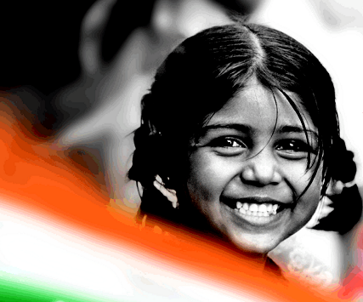
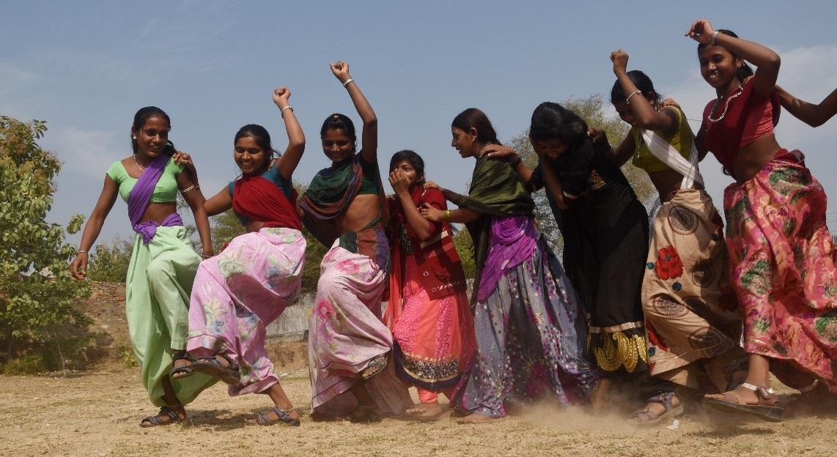
Community Engagement for Saving Daughters in Rajasthan
Naveen Jain, IAS
Secretary & MD, NHM
Chairperson, State Appropriate Authority
,

Slide 2
Key issue of concern - Trends in Child Sex Ratio & Sex Ratio
Major Fall of 38 Points in CSR
Increasing trend in Sex Ratio
The gap indicates towards high sex selective abortion
Diff of 40 point
PCPNDT ACT Implemented in 1994
Due to Non Implementation of Act, Fall of 21 Points

Slide 3
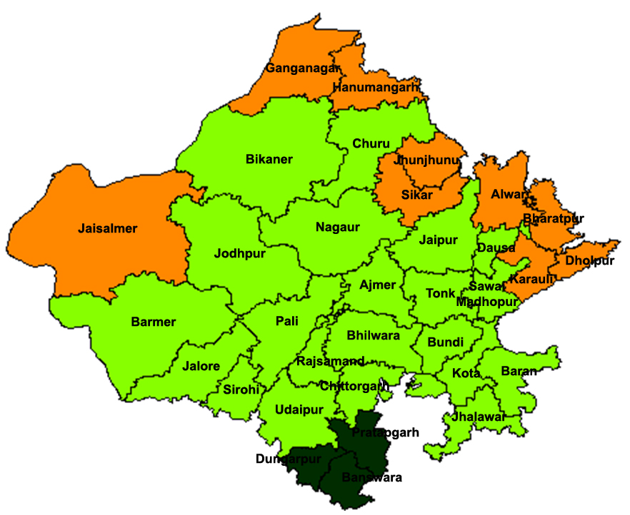
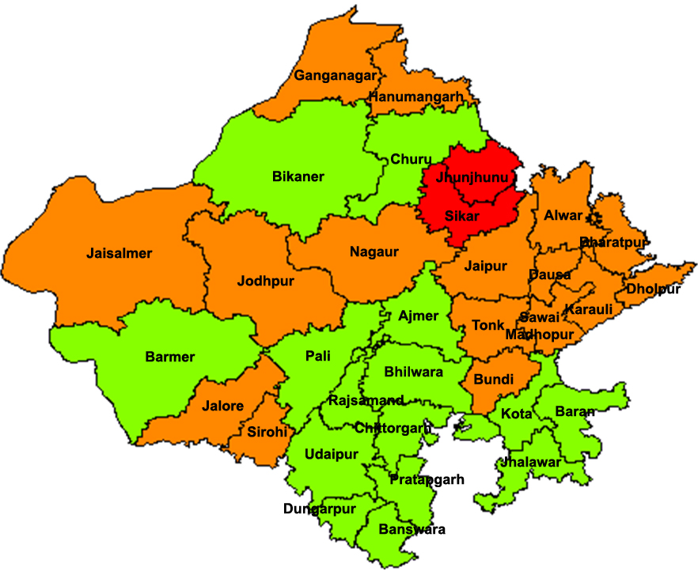
Child Sex Ratio (0-6 years)
2001
2011
Rajasthan - 909
Rajasthan - 888
Less than 850
850 - 899
900 to 949
950 And Above

Slide 4
Issues & Concerns
Sex selection - Practice of determining the sex of an unborn foetus and eliminating it if found to be female. sex selection is also referred to as pre-natal elimination of girls.
Female foeticide - It is defined as aborting a female foetus after sex determination test.
PCPNDT ACT
Pre Natal Diagnostic Techniques Act was passed in 1994, amended in 2003 as Preconception and Prenatal Diagnostic Techniques (Prohibition of Sex Selection) Act
  It Prohibits sex selection before or after conception
  It Regulates use of pre-natal diagnostic techniques
  It Prevents misuse of technology for sex determination

Slide 5
Innovation
Demand
Side
Community Mobilization
Revamped Mukhbir Yojna
Supply
Side
PBI
Beti Janam Badhai Sandesh
104/108 Toll Free Services
Rajshree Yojana
Impact Software
Strict Monitoring of Tracking Devices
Maximum use of technology
Red Alert SMS System

Slide 6
Mutli-Pronged Strategies
Strengthening Act implementation by innovations
Mukhbir Yojna
Decoy Operations
PCPNDT Bureau of Investigation
District PCPNDT
coordinators
Strengthening Monitoring
Regular inspections
F-form analysis
Telephonic follow-up
Research studies
Mobilizing community &
Changing Mindset
Daughters are Precious
Rajshree Yojana
IEC Activities
Involving different
Stakeholders – media,
Civil society, activists
Using Technology
Impact Software
Active Tracker/
Silent Observer
104/108 Helpline

Slide 7
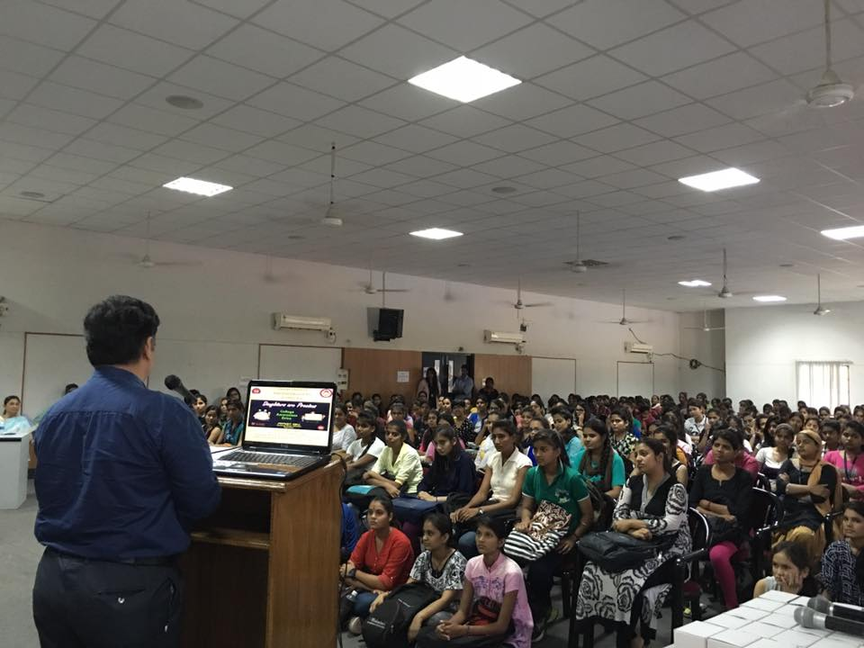
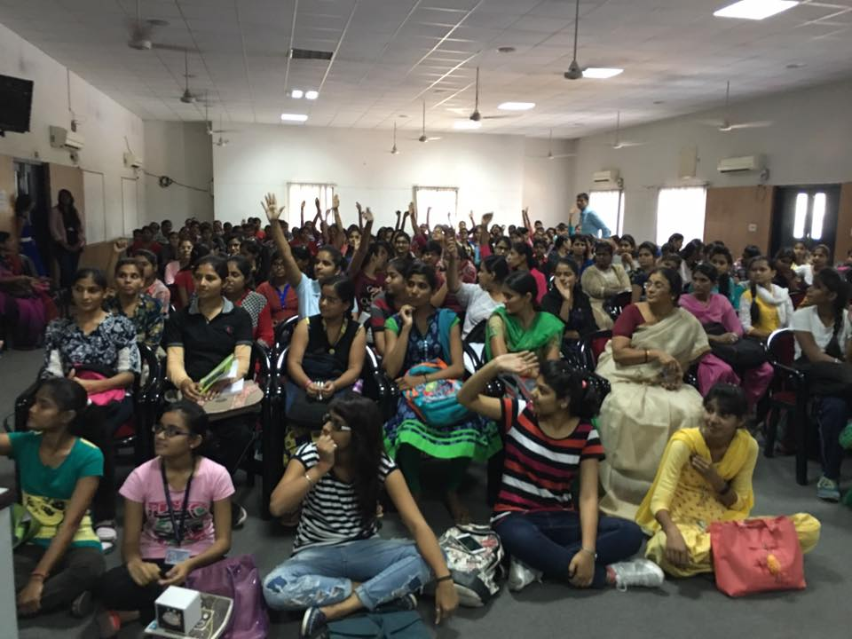
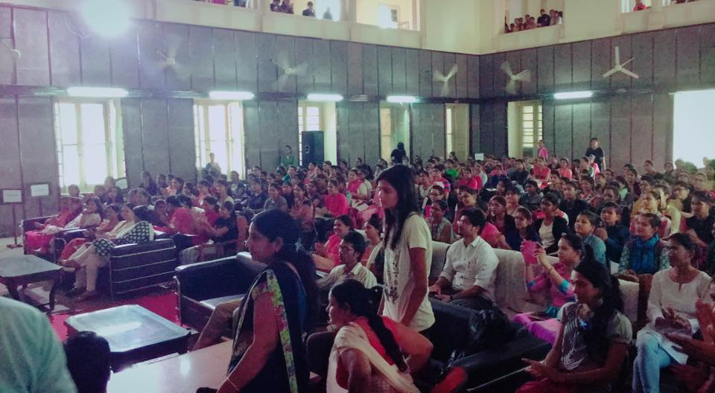
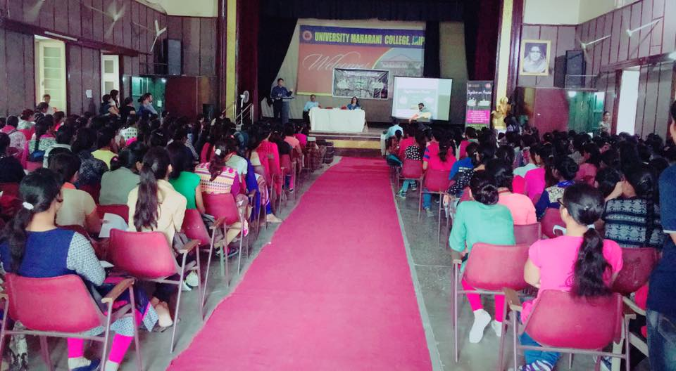
Seminars in Colleges
Community mobilization for reducing demand – Daughters are Precious Campaign
More than 100,000 Youth in 165 colleges were reached through campaign

Slide 8
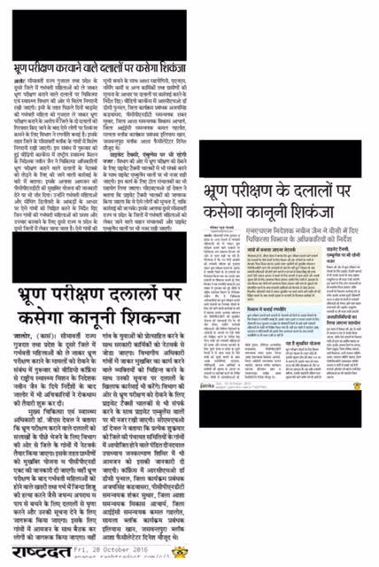
Community mobilization for reducing supply – Mukhbir Yojana
New guideline has been issued for conducting decoy operation
Under the scheme, State Govt. has declared award of Rs. 2,50,000/- to the “Mukhbir” for giving authentic information of sex selection. (
Under this scheme 40% of the award amount is given to informant, other 40% of the award amount is given to pregnant lady and rest 20% is given to the attendant of the pregnant lady
Since 2009, 75 decoy operations including 16 interstate decoy operations were conducted
Increased focus on developing network of Mukhbir in Border Districts

Slide 9
Our speed….increasing year by year

Slide 10
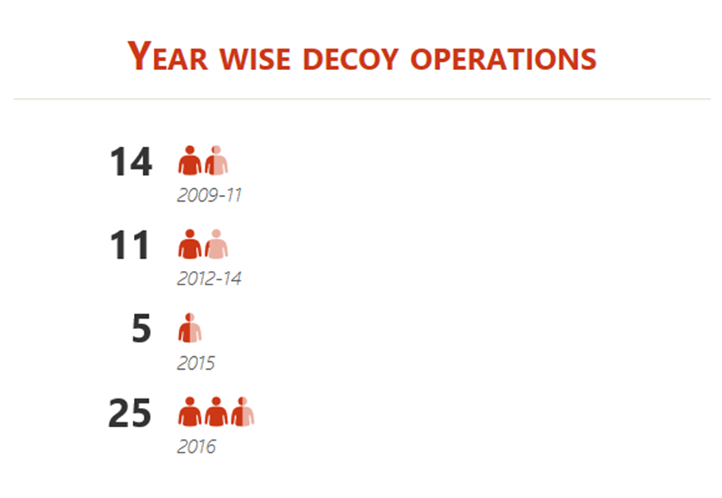
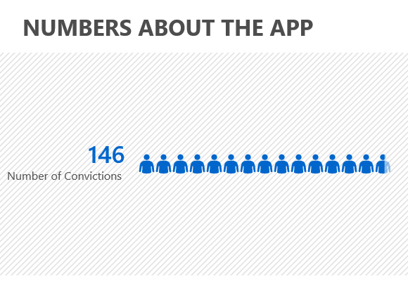
Increase in decoy operations
Year wise Decoy Operations
Inter State Decoy Operations
Gujarat-6
Uttar Pradesh-6
Haryana-1
Punjab-2
Madhya Pradesh-1
Gujarat - 6
Revised Mukhbir Yojana
Haryana - 1
Enhanced IEC
Total Arrested in Decoy Operations - 160
Convictions Till Date

Slide 11
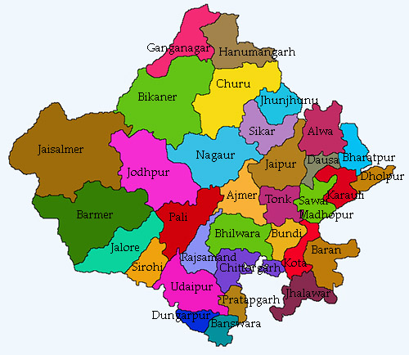
PUNJAB-2
Interstate Decoys
HARYANA-1
UP-6
Gujarat-6
MP-1

Slide 12
In the last 3 calendar years 2014,2015 & 2016 based on 43+Lacs birth now our Sex Ratio at Birth (SRB) increasing continuously...............
It was 927 in 2014 and its 939 in 2016
Finally Some good news????
Year | Sex Ratio at Birth
2014 | 927
2015 | 930
2016 | 939
Increase of 52 Points
If the trend is continued for next 5 years, CSR will become around 940 for the state (in comparison of 888 as per Census 2011)

Slide 13
