Slide 1
Improving Quality of Newborn Care in Rajasthan through State & Regional Resource Centres
National Innovations Summit
Indore, 06-08, July 2017

Slide 2

Context & Genesis
53 SNCUs, 304 NBSUs and 2065 NBCCs across Rajasthan
Significant training load for new-born care packages and retention of newborn care skills
Dependence on existing national & regional collaborative centres for training & mentoring of SNCU personnel in newborn care
No provision for mentoring sub –district providers at delivery points in skills for essential newborn care
Trainings conducted at collaborative centres cost intensive with significant time lag for observership

Slide 3
Rationale
Achieve self - sufficiency in capacity building for newborn care
Support skills acquisition /retention even at sub district level facilities through mentoring
Improve quality of newborn care at district & sub district health facilities
Quality survival of newborns at delivery points & newborn care units
Bring down the cost of trainings & expedite the pace of trainings

Slide 4
NEWBORN RESOURCE CENTRES IN THE STATE OF RAJASTHAN
State Resource Centre at J.K. Lon Hospital,
SMS Medical College, Jaipur in 2013 (with NIPI support)
Pilot in Alwar in 2014 (with NIPI support)
Chittorgarh
Hanumangarh
Seven Regional Resource Centers at identified SNCUs established in 2016-17 (one District SNCU in each Division)
Pali
Beawar
Baran
Bharatpur

Slide 5
Proposed roles of State & Regional Resource Centres
State Resource Centre
Skills based training in FBNC – 4 day classroom training and Two Week Observership for service providers
Regional Resource Centre
Serve as District Training Site/ technical hub at the district level
Initiate Quality Improvement process in NBSU & NBCC
Technical Support to State Newborn Care
Mentoring visits to SNCUs
Review meetings at State level using SNCU Quality of Care Index (SQCI)
Mentoring support to NBSUs & NBCCs
Organize needs based , skills based refresher trainings

Slide 6
Selection of SNCU for the role of Regional Resource Centre
Reasonable Quality of Care (as assessed by using SQCI and Scoring Checklists)
Availability of adequate space (to allow for expansion for training hall/room)
Availability of trained human resources
Willingness of the staff to take on additional role
Potential SNCUs shortlisted and visited to validate their performance and the criteria listed above.

Slide 7
Steps in operationalizing Regional Resource Centres
Allocation of funds
Rs 10 lakhs per centre (Rs 6.5 lakhs- Civil Works, Rs 2.5 lakhs-Furnishing and AV Aids, Rs 1 lakh- Mannequin )
Infrastructure enhancement
Training Hall, Newborn Skill Station
Staff
Nodal Person (Pediatrician)
Nursing Tutors-2 (hired)
Training of RRC personnel
Priority training of the RRC Staff on standard GoI packages on newborn care
Developing a Plan for Mentoring Visits
Developing a detailed travel plan and reviewing progress every quarter

Slide 8
Achievement of State Newborn Care Resource Centre
15 Mentoring Visits of SNCU were conducted using the Standardized Mentoring Tool
S.N. | Type of Training | No. of Batches | No. of Doctors Trained | No. of Nurses Trained | Total Trained
1 | Two Week Observership for SNCU | 14 | 39 | 91 | 130

Slide 9
Mentoring Visits by State Resource Centre to SNCUs in Rajasthan
Score based tools being used for Mentoring visits to SNCUs
15 Mentoring visits provided by State Resource Centre

Slide 10
Achievement of Regional Newborn Care Resource Centre (Up to June 2017)
48 Mentoring visits undertaken to NBSUs and NBCCs using a Standardized Mentoring Tool
S.N. | Type of Training | No. of Batches | No. of Doctors Trained | No. of Nurses Trained | Total Trained
1 | F-IMNCI (Facility based Integrated Management of Neonatal and Childhood Illnesses): 11/5 days | 11 | 45 | 66 | 111
2 | FCC (Family Centred Care: 2days | 12 | 72 | 181 | 253
3 | FBNC (Facility Based Newborn Care): 4 days | 11 | 32 | 126 | 158
4 | NSSK (Navjat Shishu Suraksha Karyakram): 2 days | 1 | 11 | 19 | 30
 | Total |  | 160 | 392 | 552

Slide 11
Improving Quality of Newborn Care through SNCU Quality of Care Index (SQCI)
To assess the optimal (& appropriate) utilisation of services
1.Low Birth Weight Admission Index: Proportion of low birth weight babies (<1800 gms.)
admitted to the unit
2.Rational Admission Index: Proportion of new-borns discharged within 24 hrs.
3.Optimal Bed Utilisation Index: Average number of newborns admitted per bed per month
To identify gaps in skills and /or clinical practices
4.Inborn Birth Asphyxia Index: Proportion of inborn admitted as birth asphyxia
5.Rational use of antibiotics Index: Proportion of new-borns with sepsis received antibiotics
To track those survival/mortality indexes that influence key outcome indicators (such as NMR; IMR)
6.Low Birth Weight Survival Index: Proportion of low birth weight babies (< 1800 gms.)
survived
7.Mortality in normal weight babies: Proportion of deaths that take place in in-born with
birth weight 2500 gms. or more

Slide 12
SNCU Quality of Care Index (SQCI) Two year comparison
Sr No | SNCU, District Hospital | Composite Index 2015-16 | Composite Index 2016-17 | Improvement
1 | Beawar | 0.44 | 0.51 | 0.07
2 | Dungarpur | 0.37 | 0.43 | 0.06
3 | Hanumangarh | 0.37 | 0.48 | 0.11
4 | Jhunjhunu | 0.46 | 0.51 | 0.05
5 | Sirohi | 0.56 | 0.60 | 0.04
BACK

Slide 13
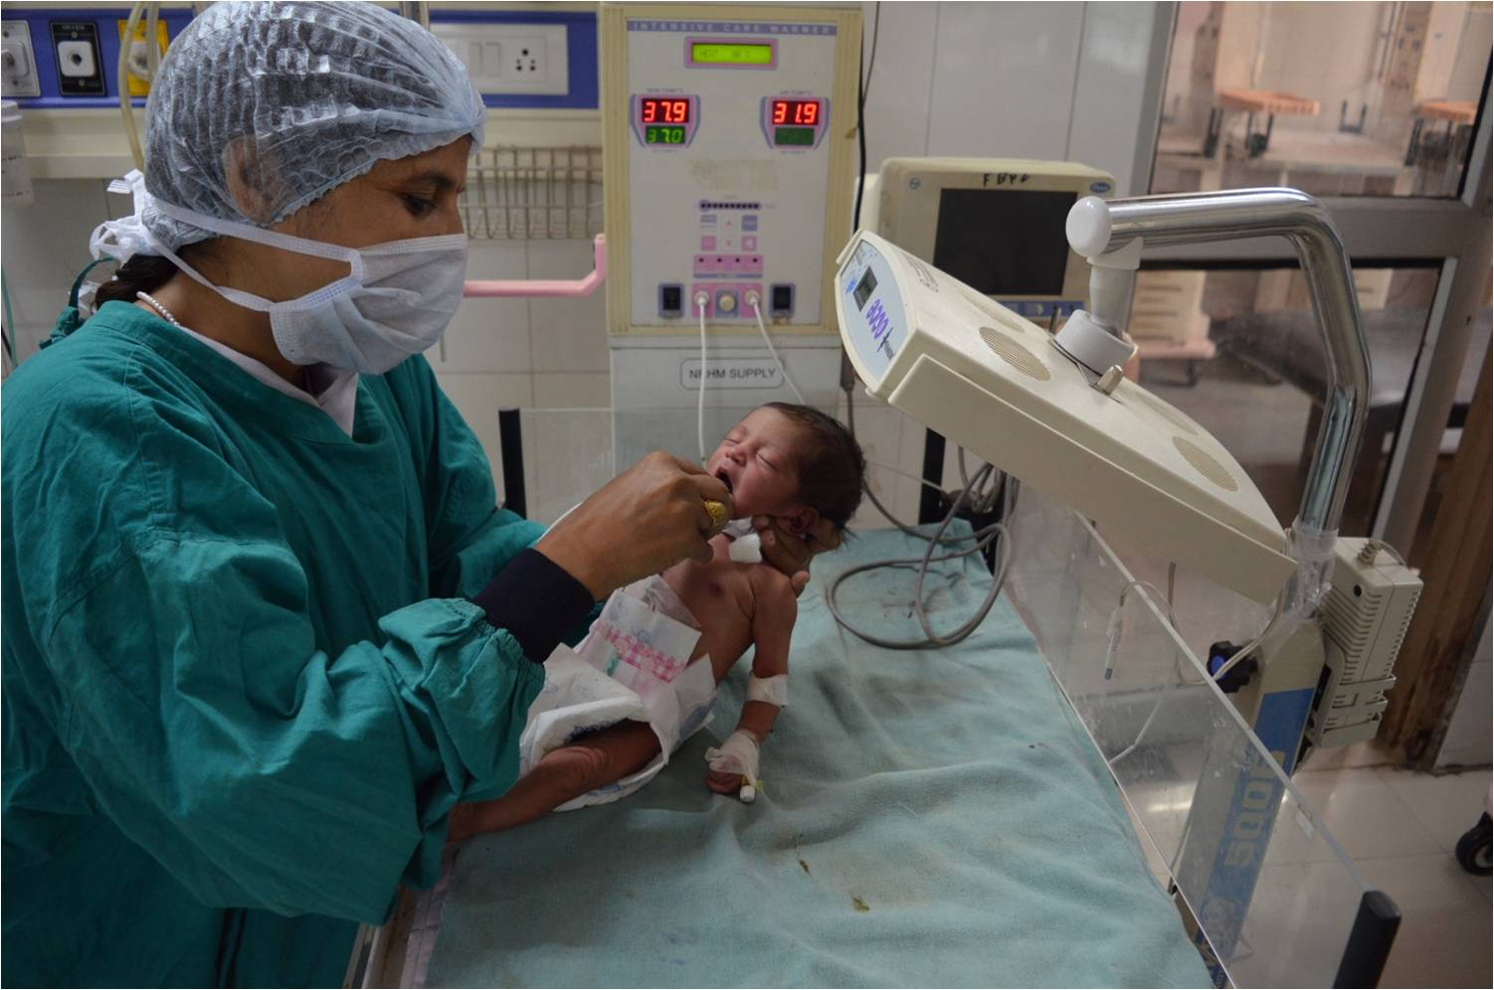
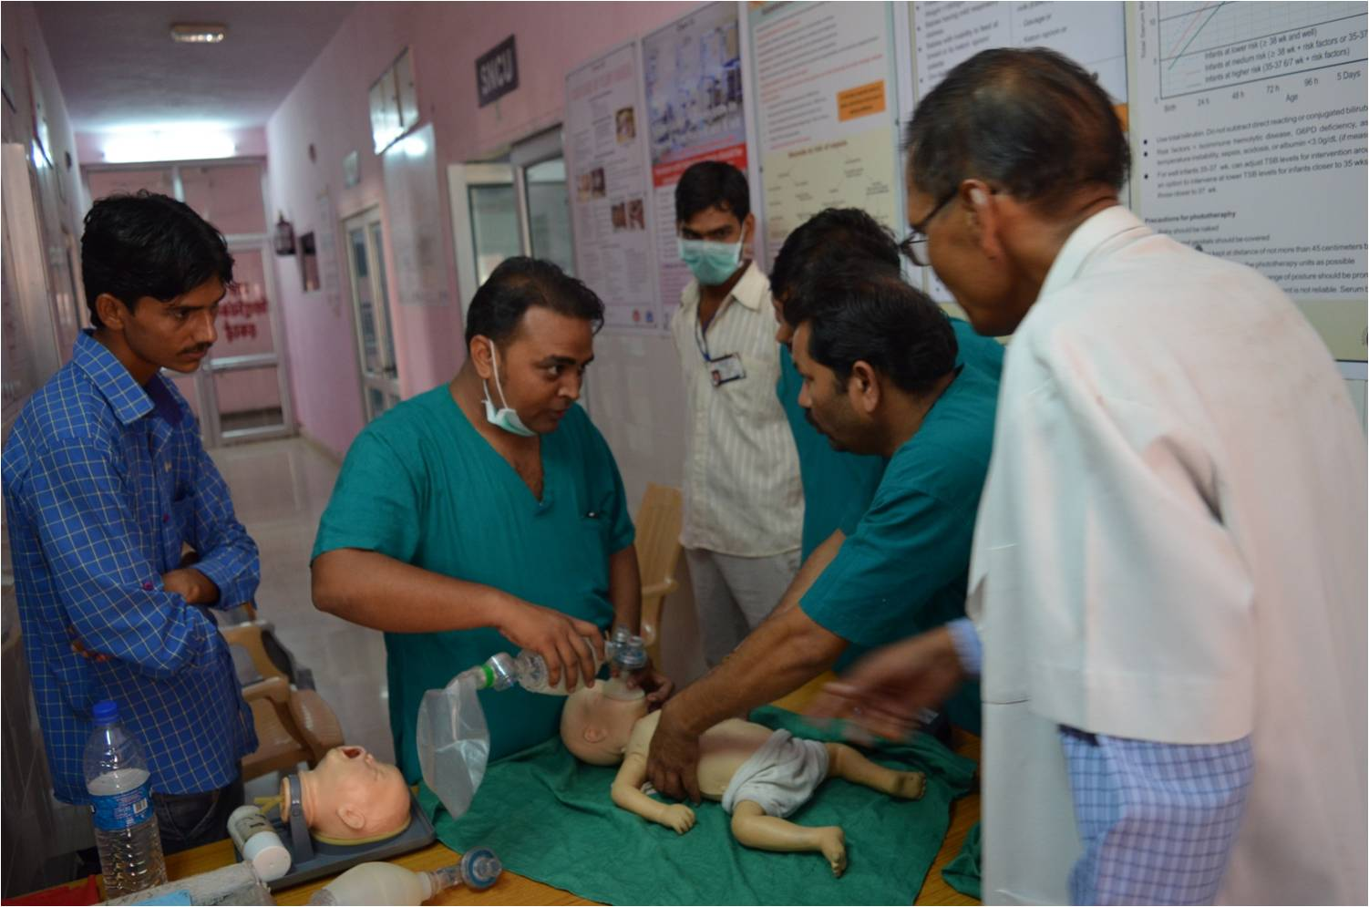
Newborn skills being taught at Newborn Care Resource Centre

Slide 14
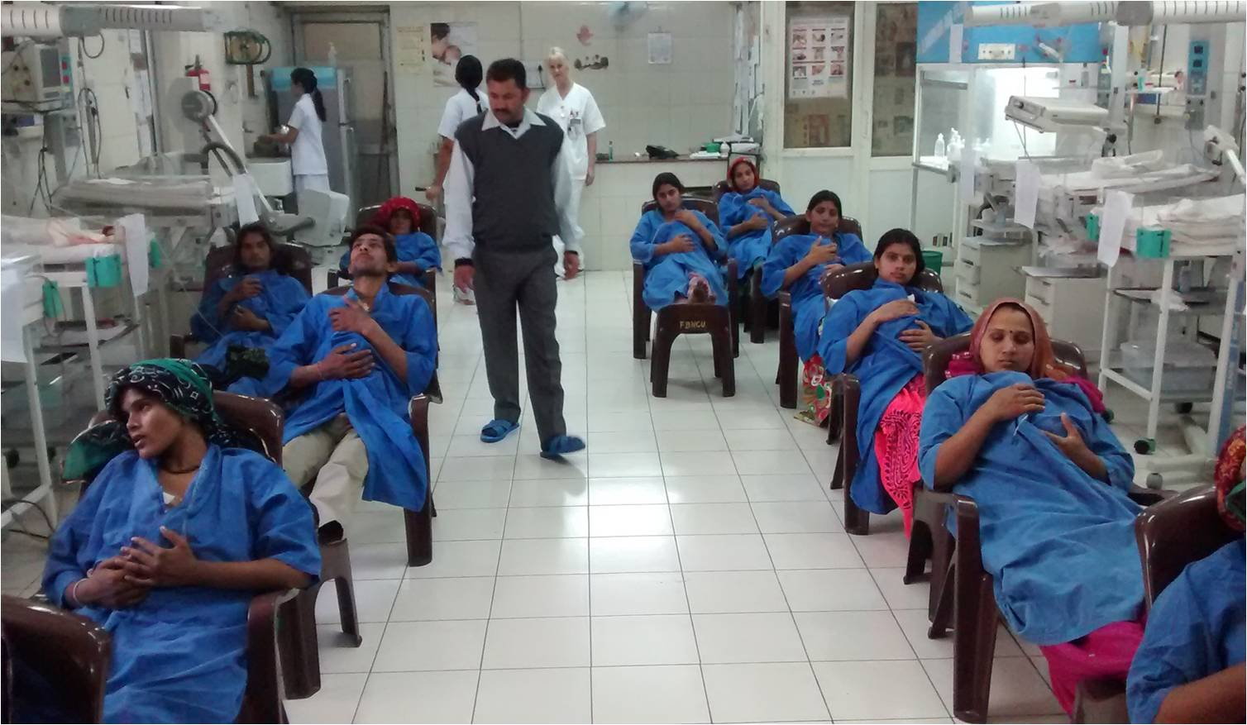
Staff teaching Kangaroo Mother Care (KMC) to mothers in SNCU

