Slide 1


Role of Facility Based Newborn Care in Reducing IMR
NATIONAL HEALTH MISSION, J&K

Slide 2


Jammu & Kashmir at a Glance
Jammu & Kashmir is a State in northern India located in Himalayan Mountains.
State consists of three regions: Jammu, Kashmir Valley and Ladakh.
Population (2017): 1, 42,80,37 (20% SC/ST)
Districts: 22 (06 HPDs).
Most of the districts are far flung having difficult terrain, harsh weather conditions and remain snowbound during winters.
The State is unique in the country as more than 90 % of health care services are being provided by public health facilities.
Significant achievement of 26 points decrease in IMR since the launch of National Health Mission from 52 (SRS 2007) to 26 (SRS 2015).

Slide 3
Problem Statement
Due to lack of infrastructure for FBNC in the peripheral health institutions entire load for managing the sick infants was on the tertiary care institution located in the capital cities of Jammu and Srinagar.
Large no of newborns used to die due to lack of access to FBNC because of difficult terrain, long distances between districts and tertiary care institutions and harsh weather conditions in snow bound areas leading to hypothermia.
Even after introduction of Facility Based Newborn Care (FBNC) & other Maternal and Child Health initiatives under NHM, the annual decrease in IMR was initially slow.
Heightened focus of the state authorities for implementation of FBNC at district level and strengthening of tertiary care institution as referral and training centres led to drastic decrease in IMR in last few years

Slide 4
Status of Facility Based Newborn care Units in J&K
Delivery Points
District Hospital/
Tertiary Care Institutions
24 Special newborn care units (SNCU) & 3 NICUs at GMCs
281 Newborn Care Corners
(NBCCs)
CHC
76 Stabilization units (NBSU)
PHC
Community

Slide 5
Health Indicators as per SRS
Health Indicators | J&K |  | National Average
 | SRS 2014 | SRS 2015 | SRS 2015
Birth Rate | 16.8 | 16.2 | 20.8
Death Rate | 5.1 | 4.9 | 6.5
Total Fertility Rate (TFR) | 1.7 | 1.6 | 2.3
Early Neonatal Mortality Rate (E-NMR) | 22 | 18 | 19
Neonatal Mortality Rate (NMR) | 26 | 20 | 25
Infant Mortality Rate (IMR) | 34 | 26 | 37
Under 5 Mortality Rate (U5MR) | 35 | 28 | 43

Slide 6
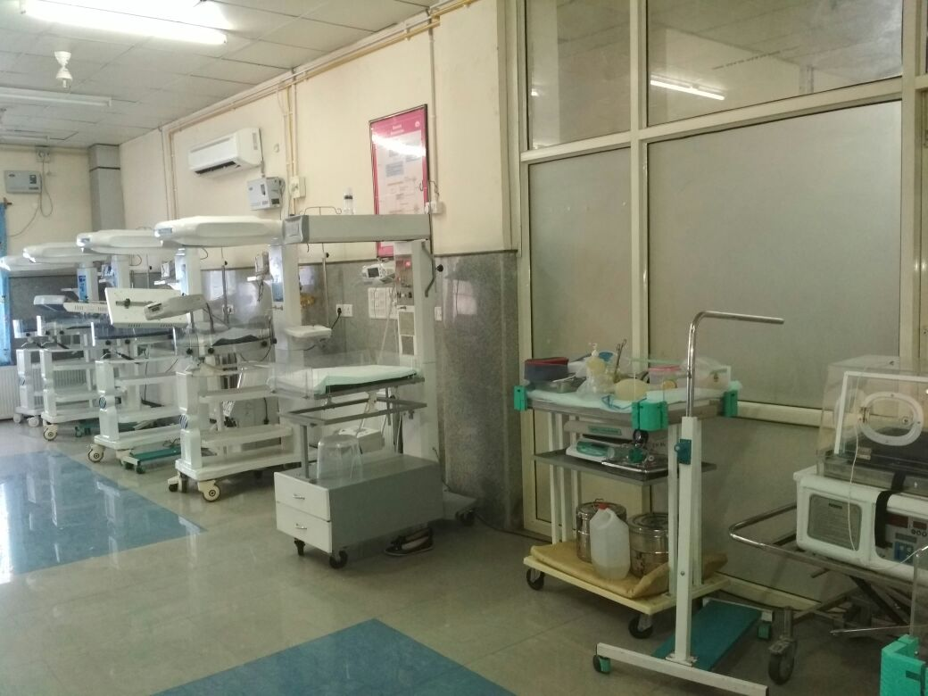
Infant Mortality Rate Trend: India & JK

Slide 7
Infant Mortality Trend in J&K:

Slide 8
Interventions
Strengthening of Labour Rooms & capacity building of SNs
Rationalization of Staff
Monitoring through SNCU Portal
Strengthening of NICUs in GMCs/SKIMS
Training of SNCU Staff at New Delhi & Onsite mentoring by NCC for FBNC team
JSSK; SNCU & labour room Protocols
Roping in of National Collaborative Centre (NCC) for FBNC , New Delhi
High Level Monitoring Committee for reduction of IMR
Involvement of GMCs in Gap assessment , FBNC trainings & supportive supervision
Baseline assessment & Gap Analysis

Slide 9

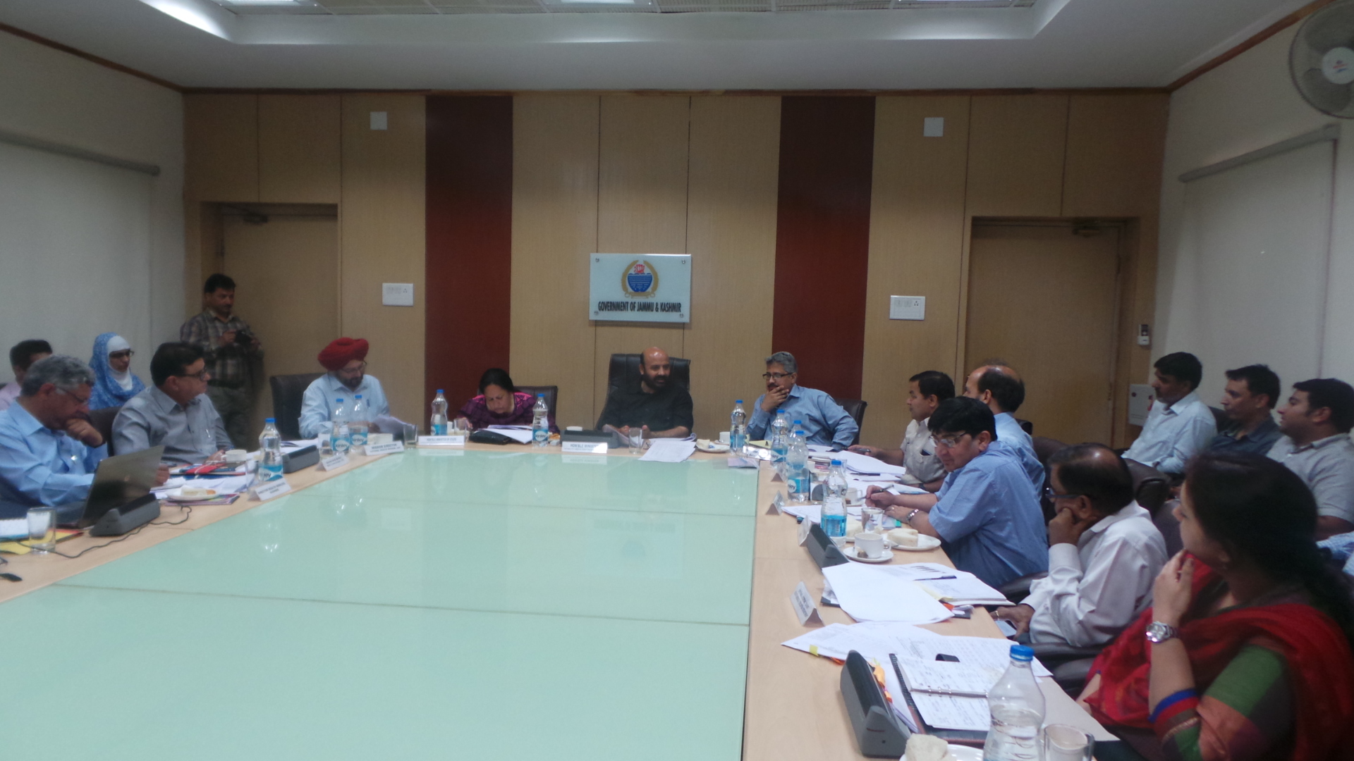
High Level Monitoring Committee for reduction of IMR
State Govt. constituted a High Level Monitoring Committee (HLMC) for reducing IMR in the state during 2011-12 under the Chairmanship of Hon’ble Minister for Health & Medical Education to oversee the implementation of various interventions for reducing IMR in the State on regular basis.

Slide 10
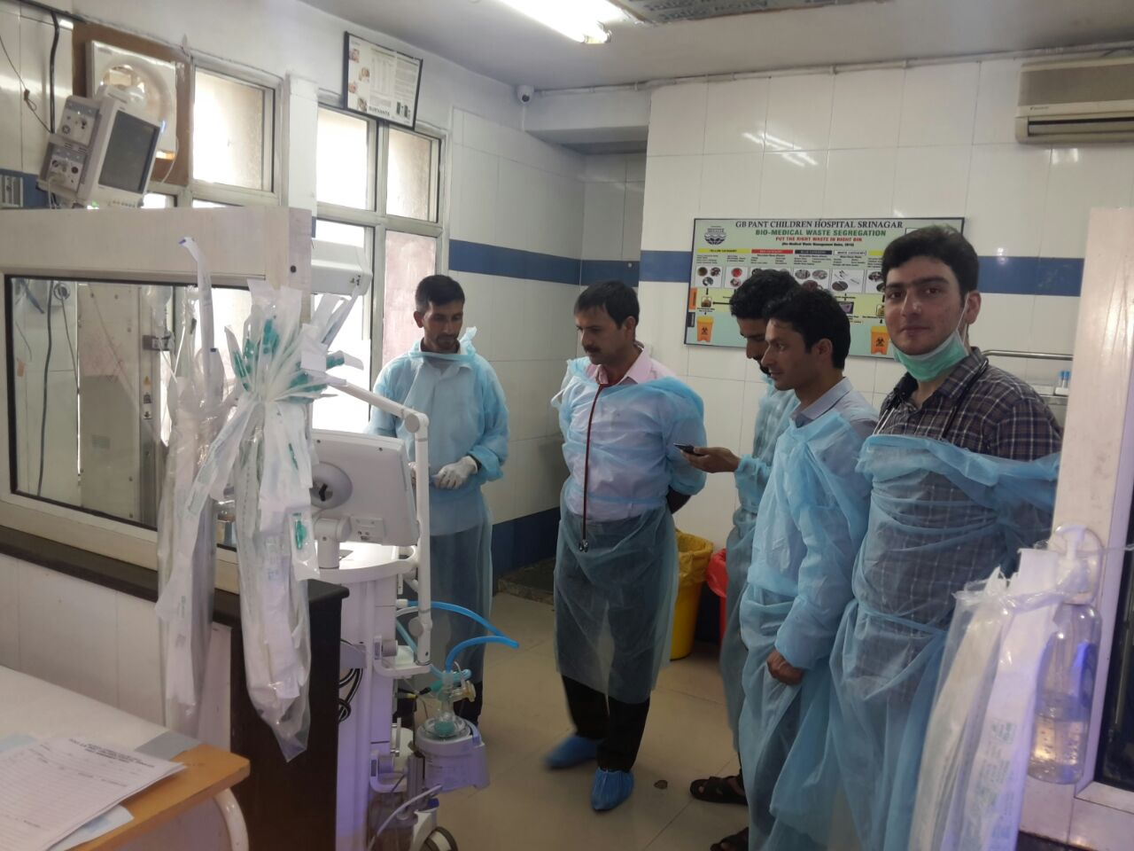
Gap Assessment
As per the directions of HLMC Govt. Medical Colleges of the State were asked to conduct joint monitoring & supportive supervision of FBNC units and also for identification of gaps in functioning of SNCUs, Labour Rooms & OTs in District Hospitals and CHCs.

Slide 11
Roping in of National Collaborative Centre for FBNC, New Delhi for addressing the gaps in terms of training of staff & other programmatic issues
160 Medical Officers & Staff Nurses working in SNCUs at District Hospitals & NICUs in Govt. Medical Colleges were trained in Facility Based Newborn Care programme for capacity building in managing sick neonates.
4 days training is conducted by faculty from NCC for FBNC, New Delhi in GMCs of State followed by 14 days observer ship at Kalawati Saran Children Hospital, New Delhi.
.

Slide 12
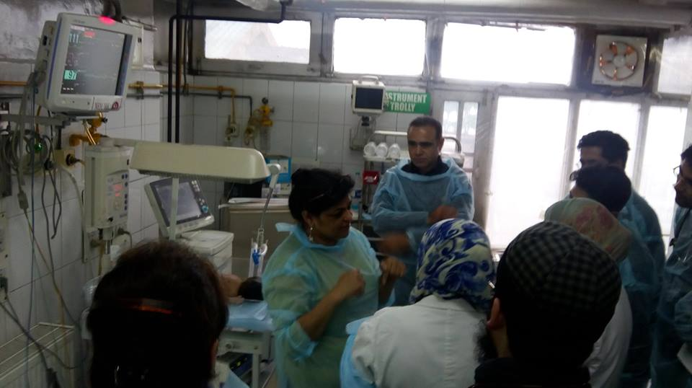
Onsite mentoring & supportive supervision visits by the
team from National Collaborative Centre for FBNC, New
Delhi
Team from the National Collaborative Centre for FBNC, New Delhi has been regularly visiting the State for onsite mentoring and supportive supervision to improve newborn care in J&K. The supportive supervision reports on gaps in infrastructure, functional status of the facilities, equipment, manpower, training and clinical practices are being shared with SNCUs/NICUs for taking necessary corrective actions.

Slide 13
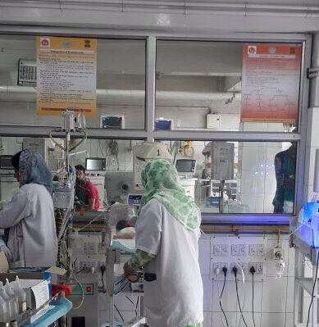
SNCU Protocols
In order to ensure the management of sick neonates as per FBNC guidelines, protocol posters were prepared by State Health Society J&K and provided to all the Special Newborn Care Units of the State. This initiative helped in regulation of admissions, optimum utilization of SNCUs & uniformity in management of sick neonates admitted in SNCUs.

Slide 14
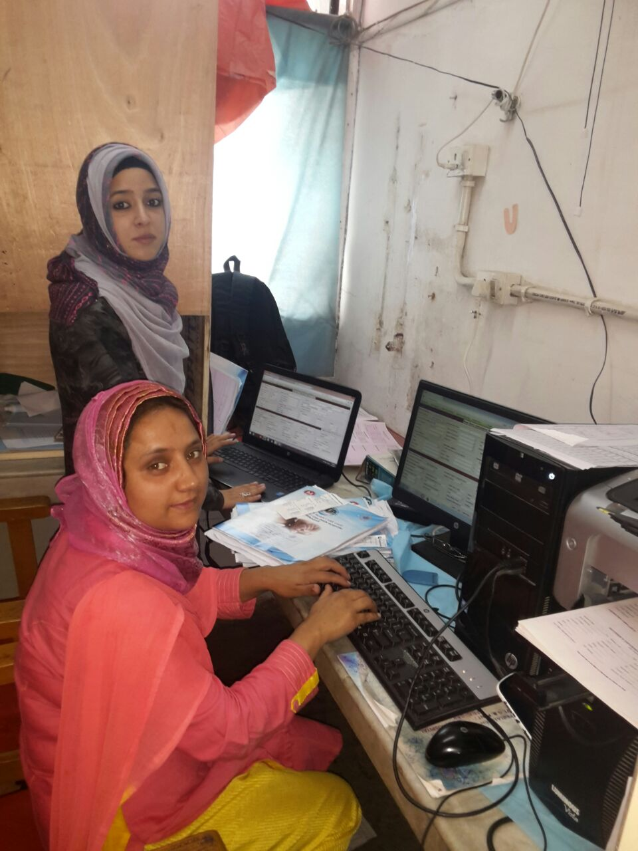
SNCU Online Portal
State adopted the SNCU Online portal of MoH&FW, GoI for monitoring the functionality of SNCUs & NICUs on daily basis. Training & Implementation of SNCU online portal has been conducted with the support of MoH&FW, GoI/UNICEF. After rolling out of this portal quality of care and accountability has improved.

Slide 15
Strengthening of tertiary care institutions to function as referral & training centres.
Because of high workload and being referral / training centres, Rs 5.07 Crores were provided under NHM for Strengthening of the NICUs in SMGS Hospital Jammu, GB Pant and LD Hospital Srinagar during the financial year 2012-13 and 2014-15.
In addition an amount of Rs 13.62 Crores under the award of 13th Finance Commission for reducing IMR in the State were provided to Govt. Medical College Jammu/ Srinagar & SKIMS, Soura for strengthening of NICUs, Labour rooms and Operation Theaters.

Slide 16
Strengthening of Labour Rooms
Facility wise gap assessment in terms of infrastructure, equipment and human resource was done as per the MNH tool kit which was subsequently incorporated in SPIP.
Assessment of skills/practices followed during intrapartum & immediate post-partum care are being done during Supportive Supervision visits.
Staff deployed in Labour Room has been trained in SBA/ NSSK trainings.
Use of Labour Room Protocols & partograph is being emphasised in all the delivery points.
JSSK played an important role by reducing out of pocket expenditure & strengthened the referral linkages.
The initial orientation training of Staff Nurses at State of Art Kashmir Skill & Simulation Lab followed by 21 days SBA training at District Hospitals is providing better results.

Slide 17
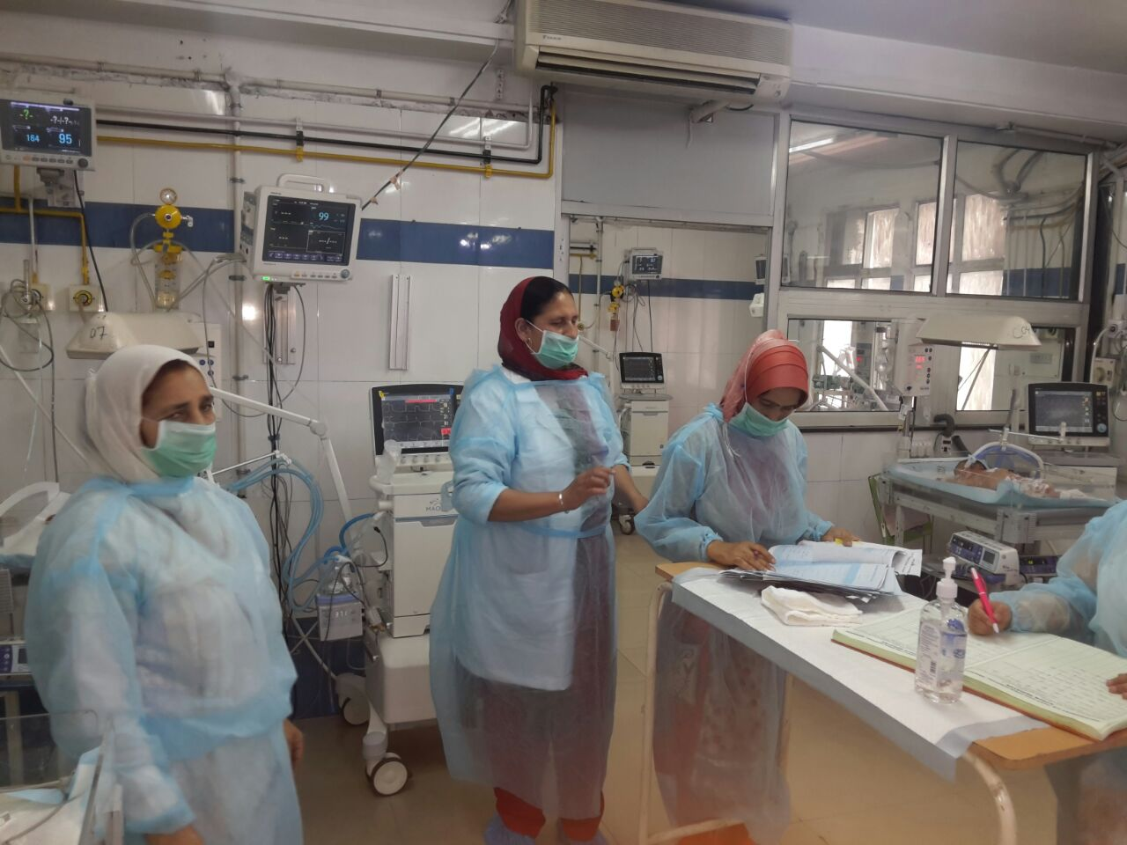
Rational Deployment of Staff
Based on the recommendations of the monitoring teams of NCC for FBNC, New Delhi, additional manpower has been provided to High Workload NICUs in Govt. Medical Colleges & SNCUs in District Hospitals by rationalization of existing staff.

Slide 18

Results
By adopting the above mentioned interventions in last three years the functioning of SNCUs and LRs at district level has improved significantly leading to the drastic decrease in the IMR, NMR and ENMR with a record 8 point decrease of IMR in one year from 34 to 26 (SRS 2015).
Because of improved functionality of SNCUs/ NICUs, labour rooms and OTs the admission rate and quality of care has improved. 87,572 infants have been treated (inborn 55,149) since 2013 and 4406 deaths (5 %) have been reported in SNCUs/NICUs.
It has been observed that the referral of sick infants from peripheral health institutions to district hospitals has increased and referral to tertiary care institutions has significantly decreased.

Slide 19
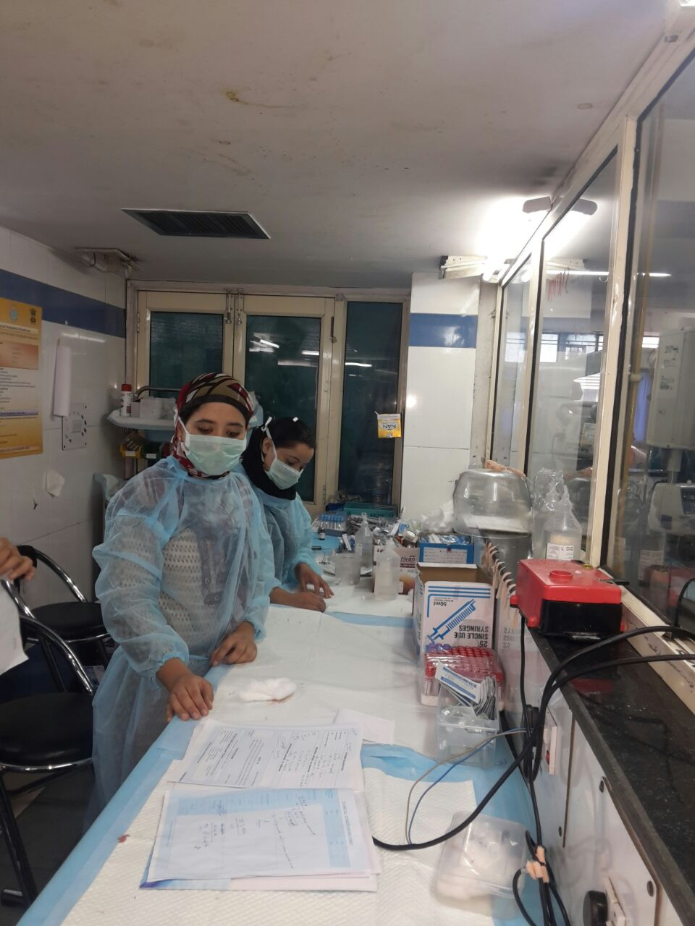
Conclusion & Way forward
Conclusion
In addition to policies & guidelines it needs political will and administrative action to get results.
Way forward to achieve SDG and NHP17 Goals
Continued mentoring & supportive supervision of FBNC Units to improve the quality of care.
Establishment of Family Centred Care (FCC)/ KMC units on pilot basis in 2017-18.
Focus on IYCF practices (MAA Programme)
NRCs and linkages with AWC.
Integration of DEICs with SNCUs for quality of life beyond survival.
More focus on HBNC .
DAKHSTA to strengthen the prenatal care.

Slide 20
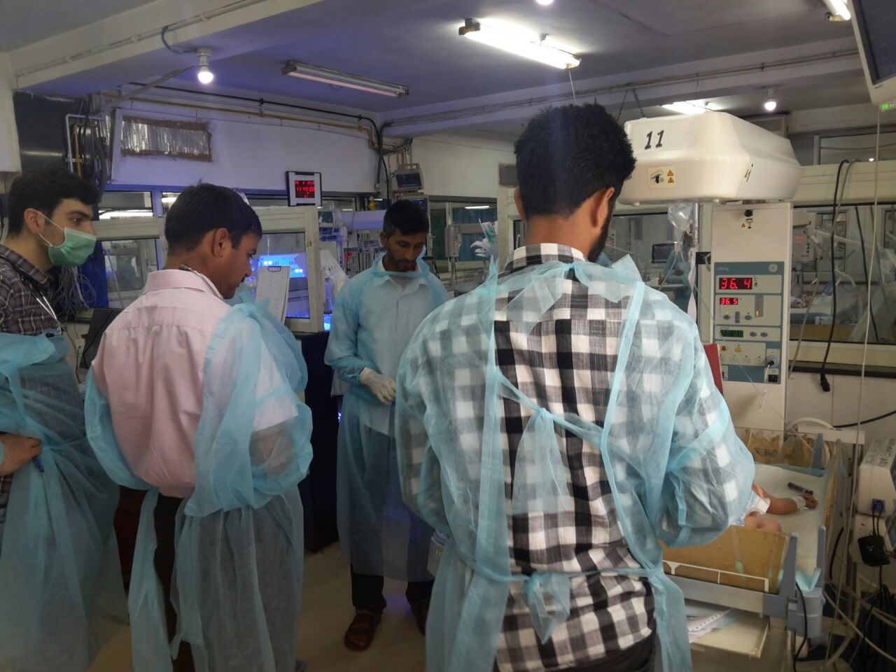
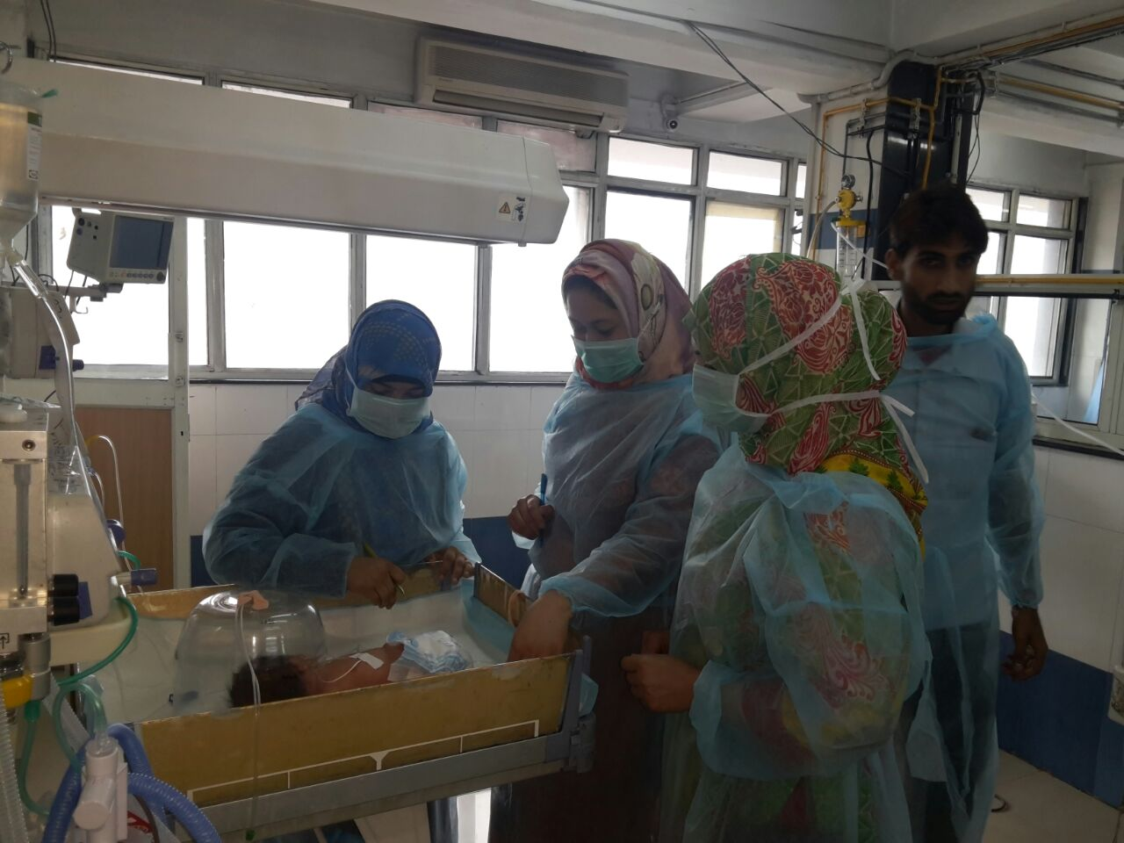
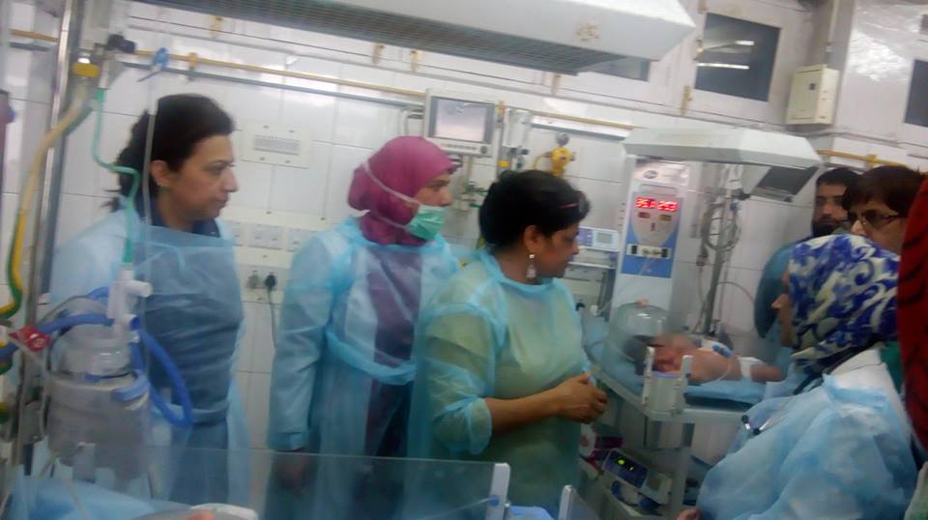
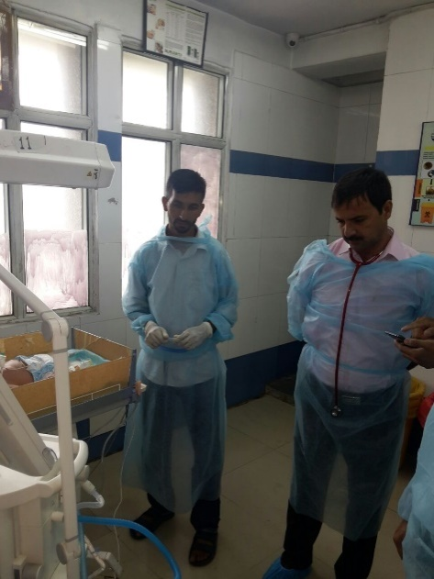
Onsite mentoring & supportive supervision

Slide 21
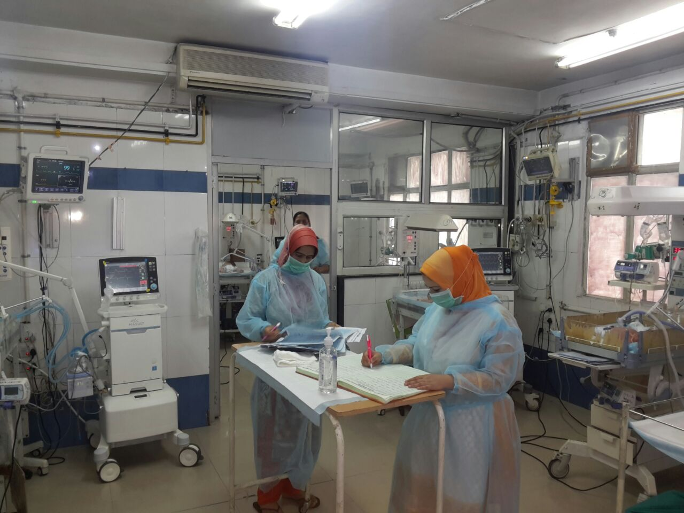
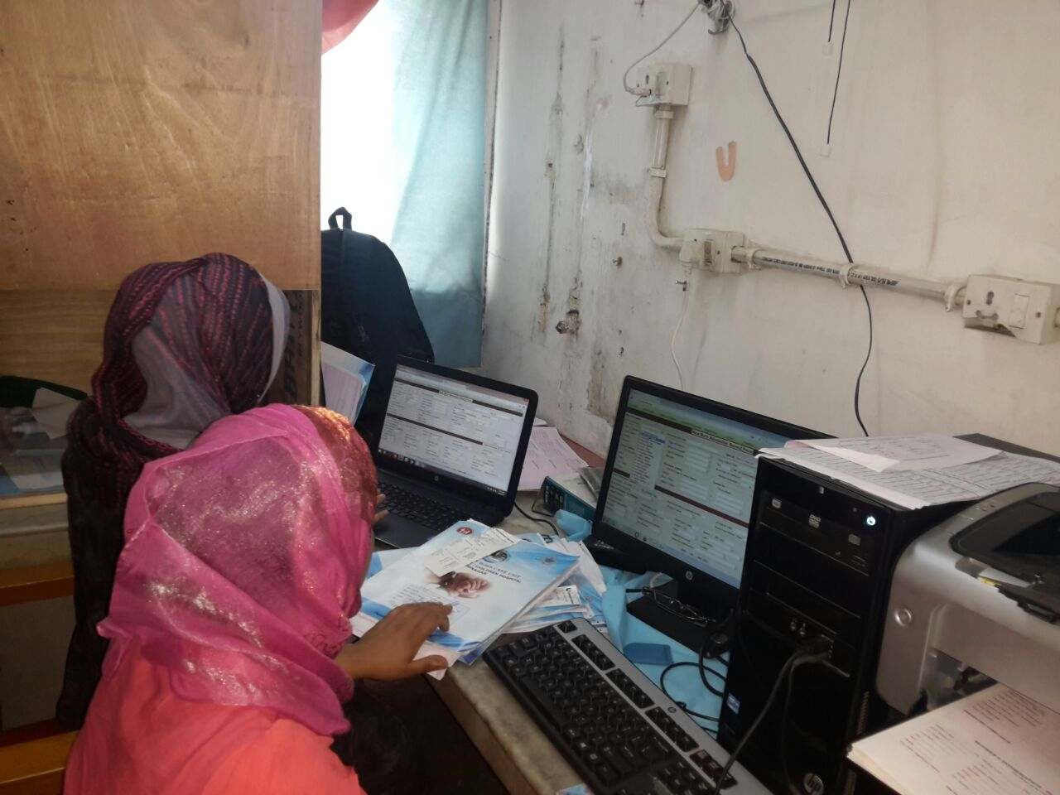
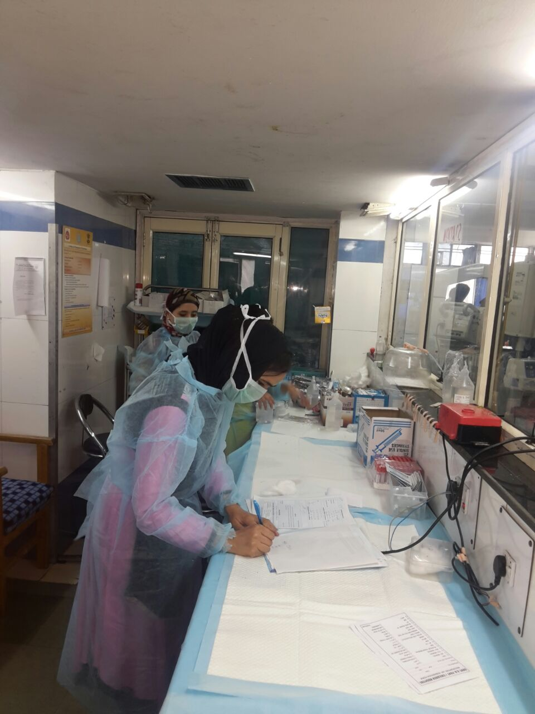
Proper Recording & Reporting

Slide 22
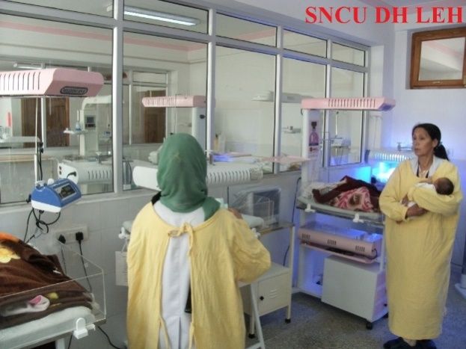
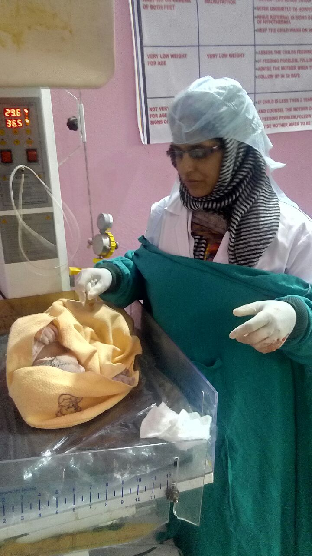

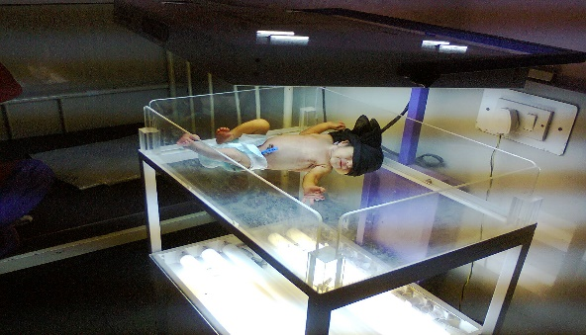
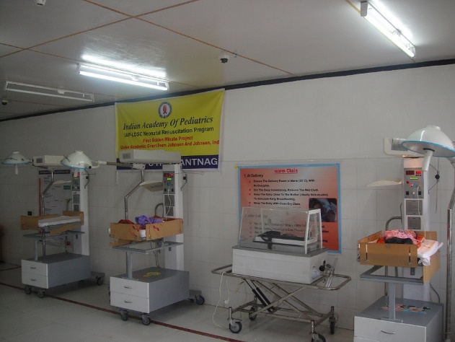
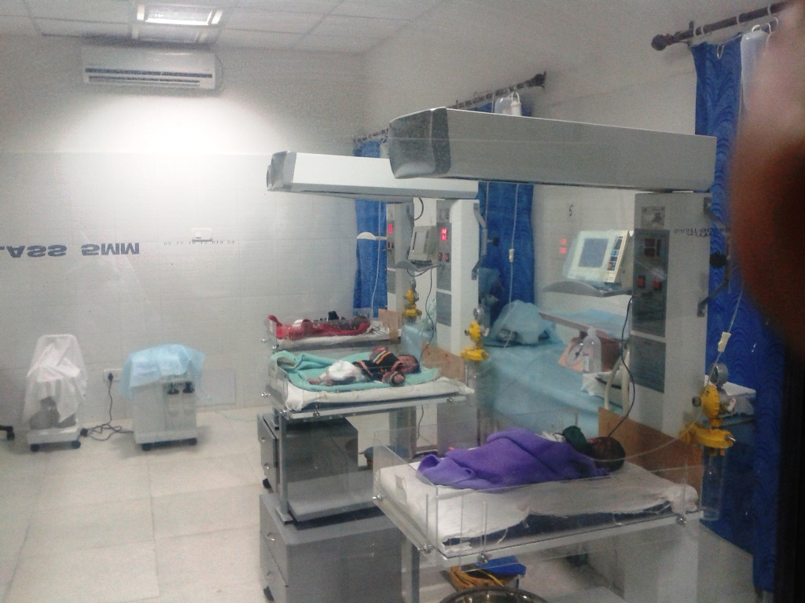
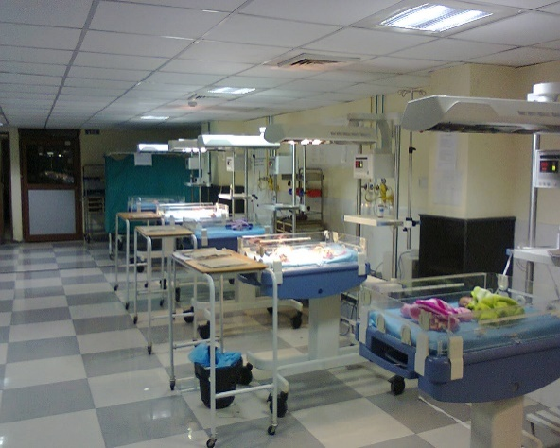
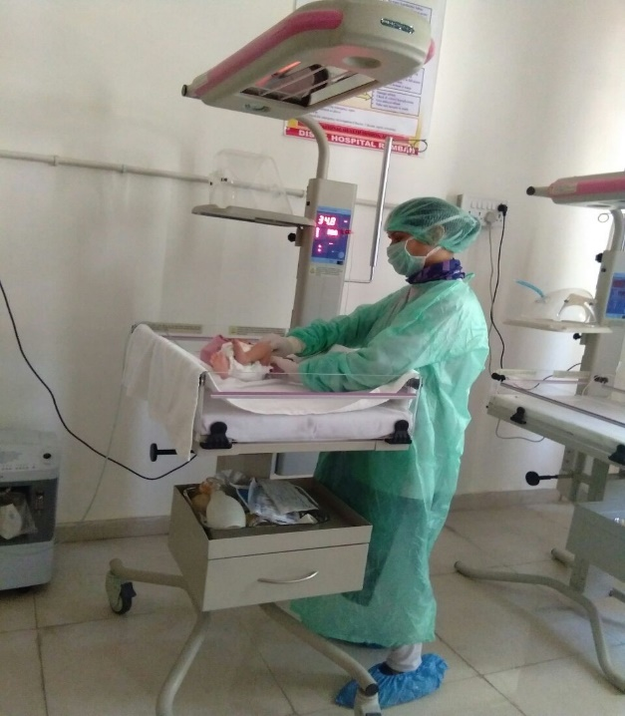
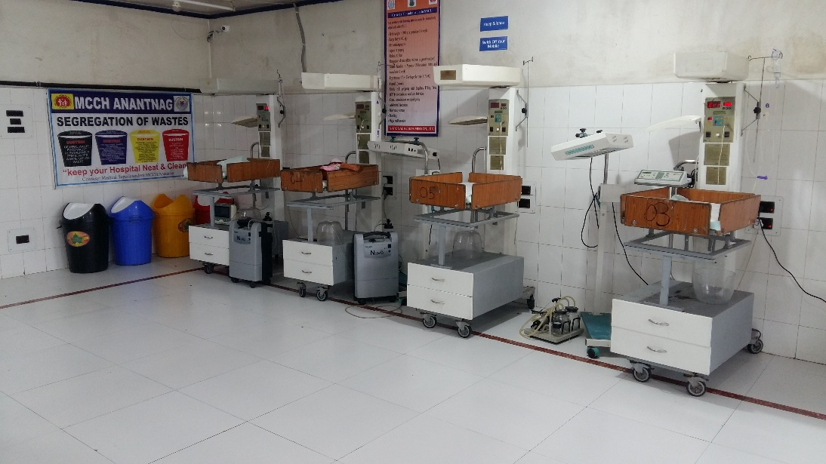
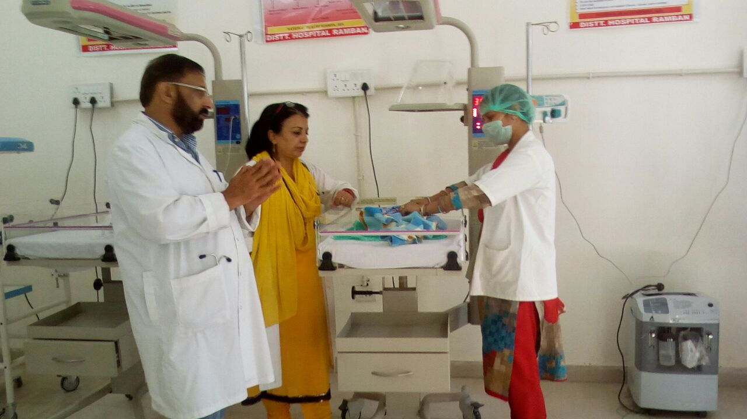
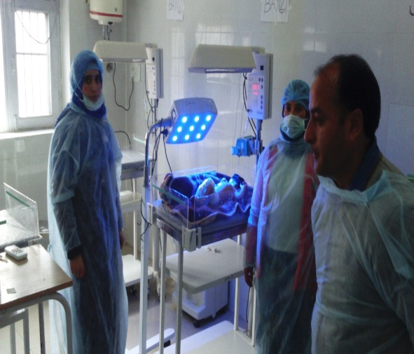
Thank You

