Slide 1


Slide 2

INTENSIVE NCD SCREENING PROGRAM IN URBAN PHCS
Dr.Darez Ahamed IAS
Mission Director NHM Tamil Nadu
06.07.2017

Slide 3
Problem Statement
As per SDG Goals, By 2030 ,’reduce by one third premature mortality from Non Communicable diseases through prevention and treatment and promote mental health and well being” .
Non communicable disease, a high risk burden as per 71st NSSO data, needs screening for population above 30 years of age for Hypertension, Diabetes Mellitus, Carcinoma Cervix, Carcinoma Breast & Oral Cancer. Screened Individuals also need management which includes treatment.

Slide 4
Performance under opportunity screening - TN
Year | Diabetes Mellitus |  | Hypertension |  | Carcinoma Cervix |  | Carcinoma Breast
 | Number Screened | Number found positive | Number Screened | Number found positive | Number Screened | Number found positive | Number Screened | Number found positive
2012 (July-Dec) | 989798 | 46827 | 2034924 | 159908 | 285019 | 12784 | 665846 | 7477
2013 | 6812606 | 325543 | 9446394 | 968543 | 3123492 | 137411 | 4023771 | 52379
2014 | 9663482 | 386745 | 11209121 | 1118794 | 4407657 | 143587 | 5058518 | 62123
2015 | 6929328 | 253330 | 8024345 | 691112 | 2939254 | 72258 | 3364394 | 37822
2016 | 6600292 | 281506 | 7884733 | 672508 | 2383391 | 52429 | 2995361 | 26160
2017 (Jan-May) | 3802510 | 185507 | 4370500 | 380642 | 1410103 | 24383 | 1719685 | 11686
Total | 34798016 | 1479458 | 42970017 | 3991507 | 14548916 | 442852 | 17827575 | 197647

Slide 5
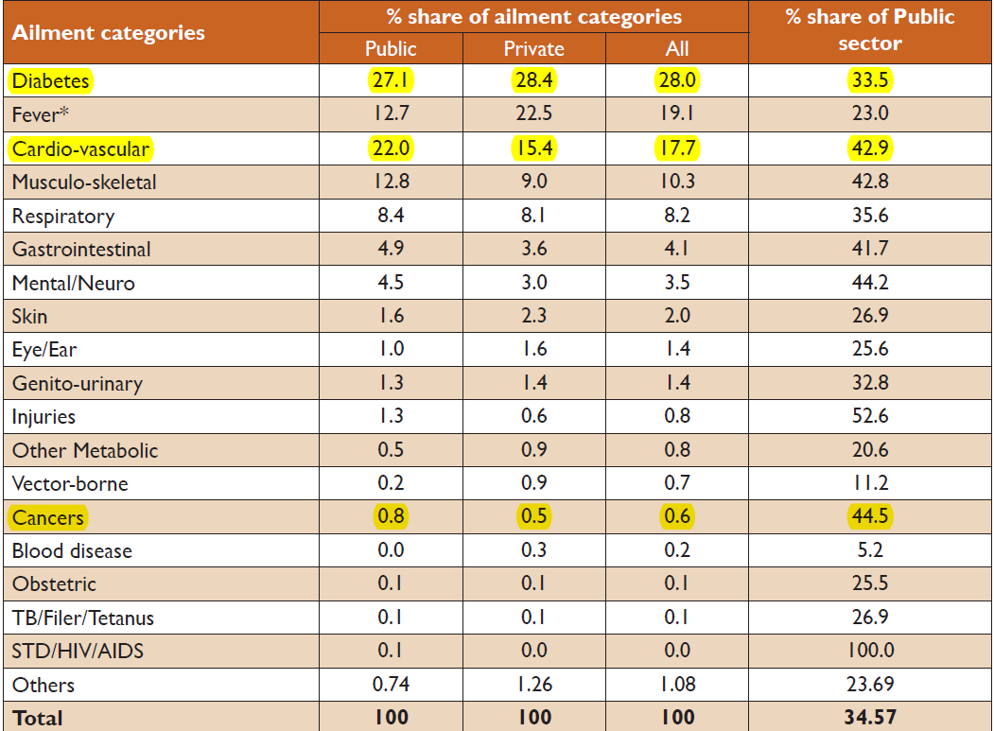
Share of major ailment categories treated in public and private sector as outpatient and share of public sector in the treatment of major ailment categories in Tamil Nadu - 2014
Source : Key indicators of Morbidity Pattern based on NSSO 71st data

Slide 6
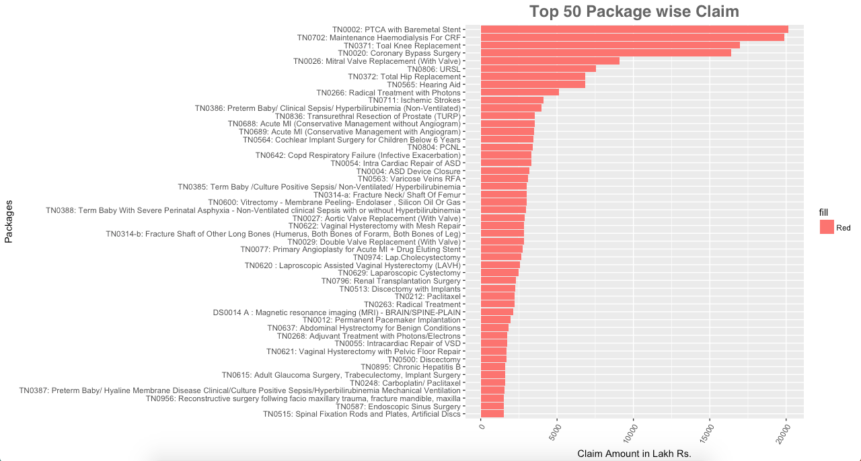
TN - CMCHIS

Slide 7
GOVERNMENT OF TAMILNADU
(Implementation of NPCDCS)
FACILITY BASED SCREENING
POPULATION BASED SCREENING
1736 PHC, 310 GH, 27 Govt Medical College Hospitals,
280 Selected UPHC
293 Dental Units
(262 CHC and 31 GH)
NCD screening in 5 districts & 2 corporations
PHC - 1 Staff Nurse,
GH/MCH - 2 Staff Nurse
CHC- Dentist
Assistant- Door screening
Door survey BP, RBS, CBE
Screening for DM, HT, Cervical and Breast screening for those aged 30 and above
Screening for Oral Cancer all individuals aged 18 and above
Screening for NCD in all individuals aged above 18 yrs

Slide 8
Strategies adopted to intensify screening in Urban PHC
For the first time citizens were invited to attend free Annual wellness checkup a change in strategy from opportunistic screening.
Exclusive institution Team with Medical officer, Staff nurses, Lab technician, Pharmacist, UHNs/ANMs and other staff provided. (Thursday / Friday)
Checking the availability/working condition of the necessary equipment and availability of adequate quantities of lab reagents and other consumables.
Lab equipments procured based on gap analysis / IPHS standard
Persons requiring X-ray referred to nearby Sub District Hospital / District Hospital.

Slide 9
Parameters for screening at Primary Health Care Level
1. Height | 14.Urine-Sugar
2. Weight | 15,Urine-Deposits
3. BMI | 16.Ultrasound Abdomen if needed
4.Blood Pressure | 17.ECG- based on symptoms.
5. Blood –Total Count | 18.X-ray if needed
6.Blood Differential count | 19.Sputum Microscopy(AFB)
7. Hemoglobin | 20.Screening for Ca Cervix
8. Peripheral Smear | 21.Screening for Ca Breast
9. Blood Grouping and Typing | 22.Screening for Oral Cancer
10.Random Blood Sugar | 23.Ophthalmic screening for visual acuity and cataract
11.Blood-Cholesterol | 24.Screening for dermatological conditions
12.Blood- Creatinine | 25.General Examination by the Medical Officer.
13.Urine-Albumin

Slide 10
CLINICAL REPORT – TO THE BENEFICIARY

Slide 11
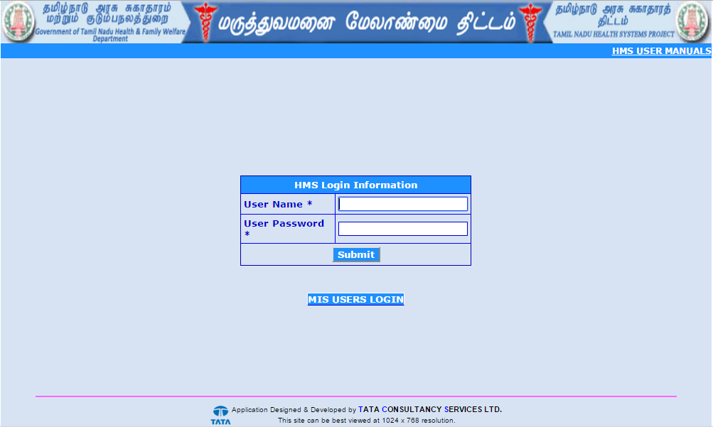
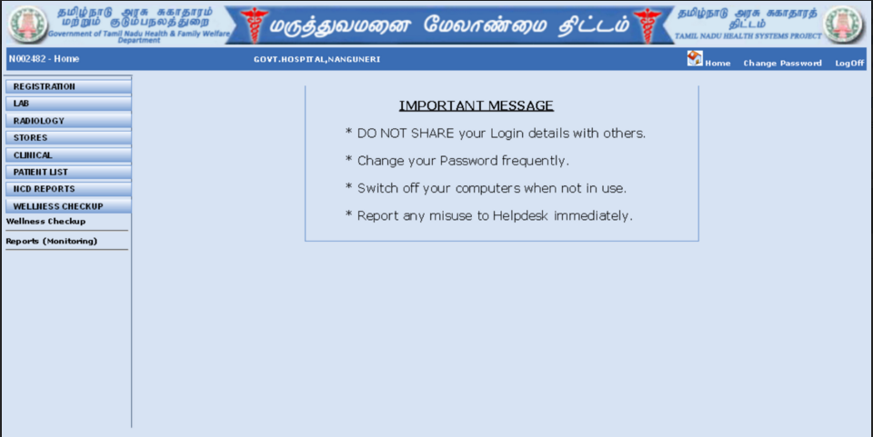
LOGIN SCREEN
Home Page With Tabs For Annual Wellness check up & Reports

Slide 12
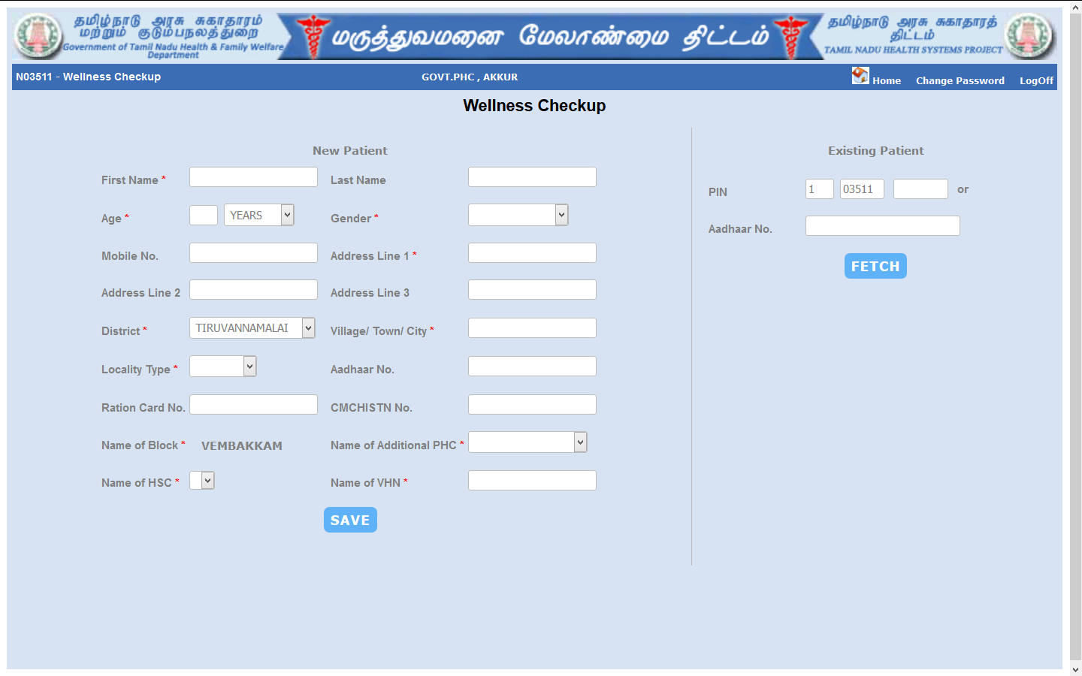
REGISTRATION SCREEN

Slide 13
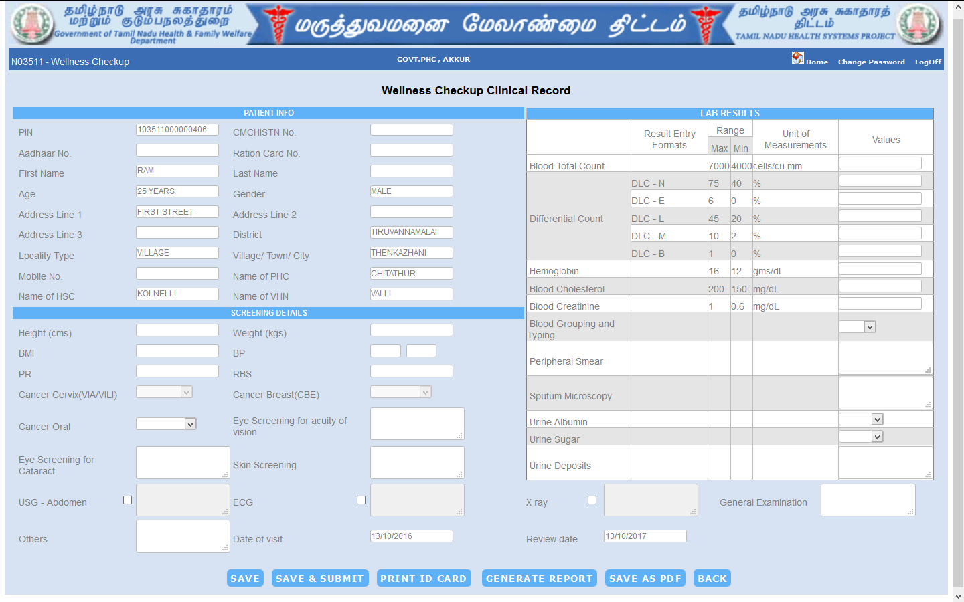
CLINICAL DATA ENTRY SCREEN

Slide 14
Identification of Beneficiaries
Details entered in HMIS web portal by using NCD Staff Nurse User ID.
The ration card & Aadhaar card if available can be updated during registration- to avoid duplication and create a comprehensive EHR for the individual beneficiary
Previous NCD cards, HMIS OP slips if available may be brought along with the above mentioned cards so that their previous medical records can also be included in the EHR.

Slide 15
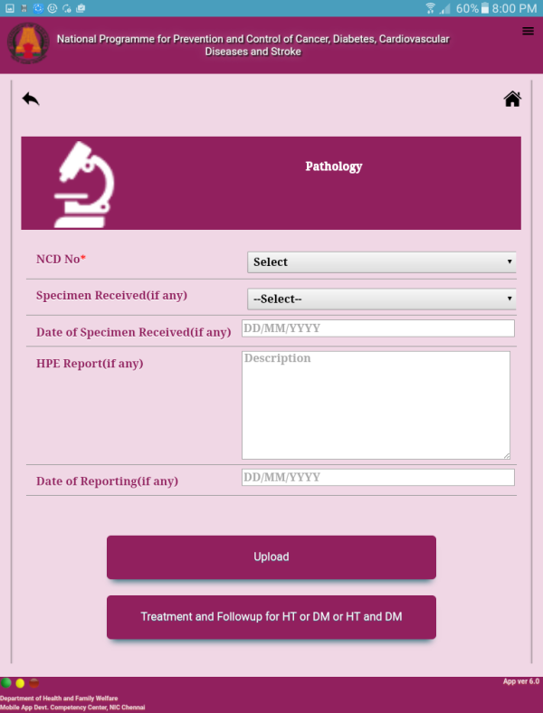
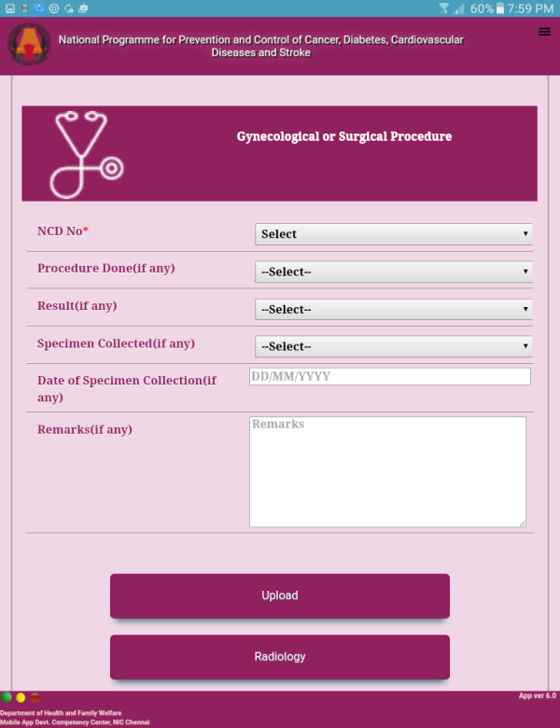
Secondary care level - Assured Follow up
Positive for VIA/VILI and Cancer Breast - Referred to Secondary care level for further investigation.
This is ensured by introduction of NCD App from primary health care level.
Procedures done in secondary care level documented in following tabs
Gynaecological /Surgical Procedures Field : Colposcopy, Colposcopy Guided biopsy
Pathological Field
Treatment and Follow up Field: Complication identified, treatment given, referral made and outcome.
This ensures that all patients suspected are followed up and it can be monitored.
NCD app - screenshots

Slide 16
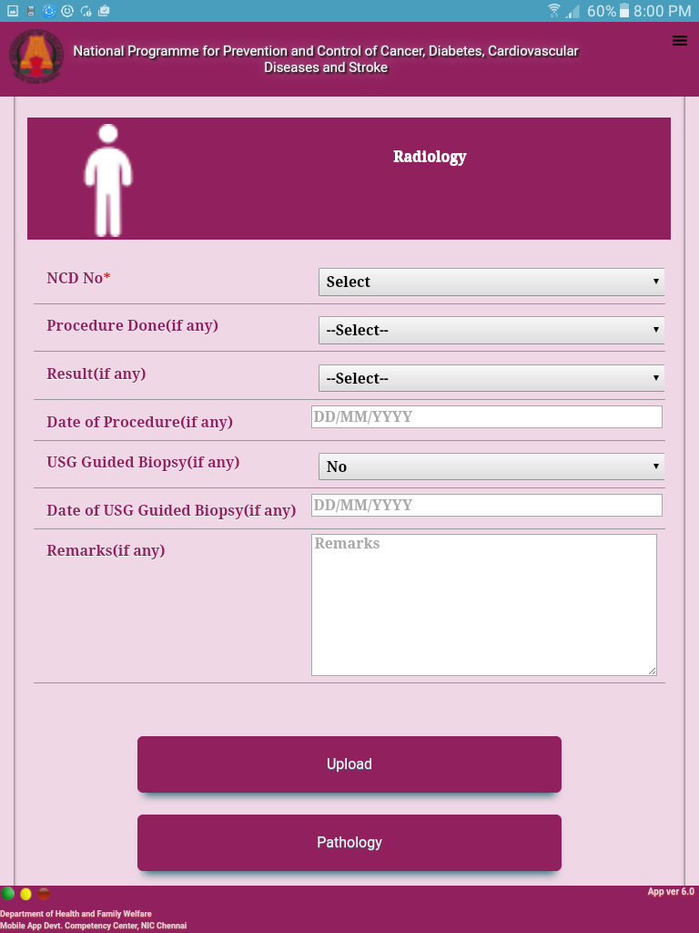
At Tertiary Care Level
Radiology Field
Details of Mammogram and USG guided biopsy
All the details including referral and follow up can be easily viewed by the Health care staff
When a patient misses a referral or follow up can be easily traced by the field health staff and further management can be ensured.

Slide 17
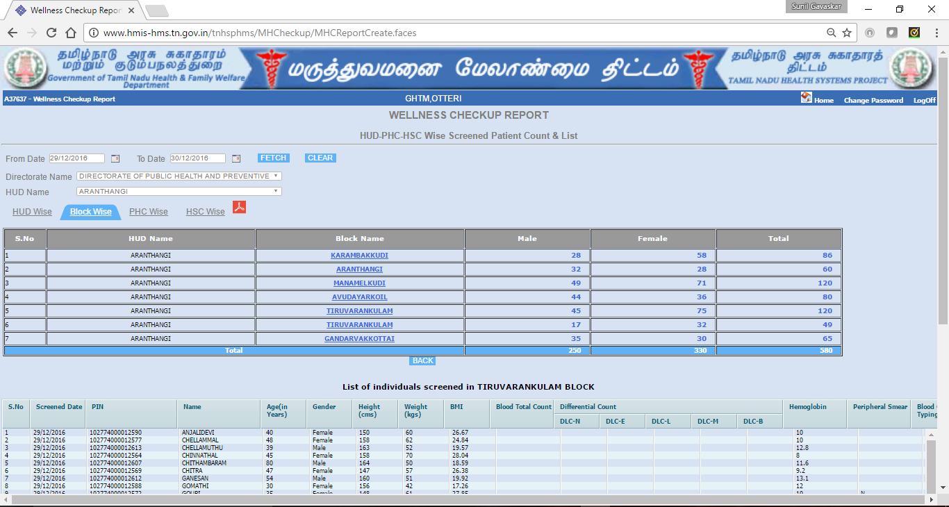
Reports (Monitoring) – Block wise Report with Line Listing

Slide 18
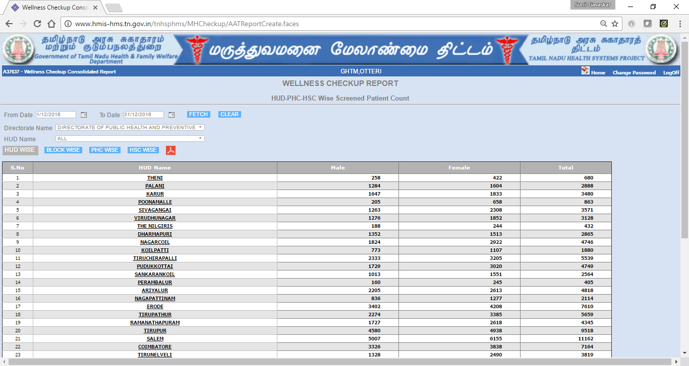
Reports (Monitoring) – District/Institution wise Consolidated report

Slide 19
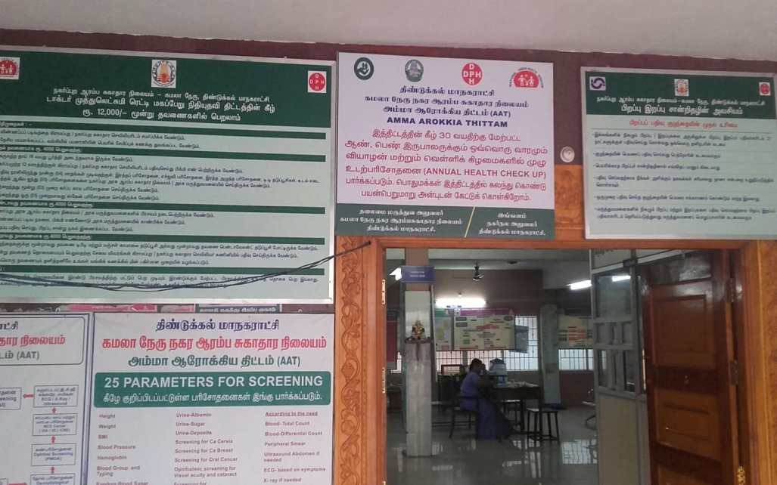
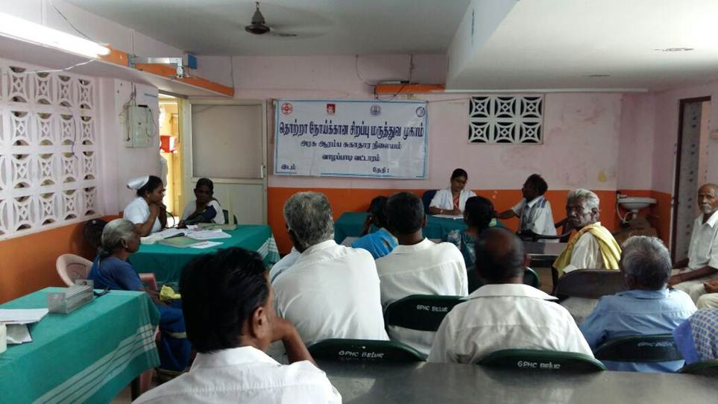
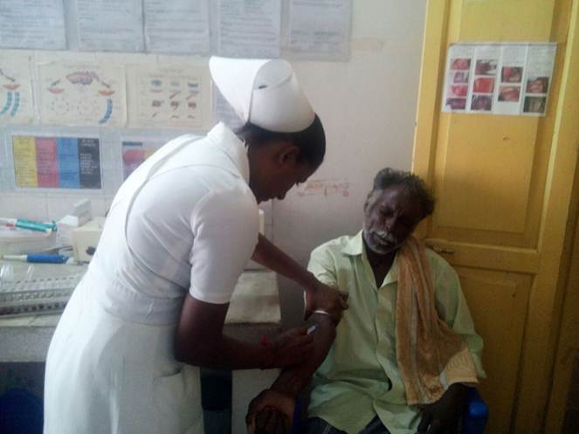
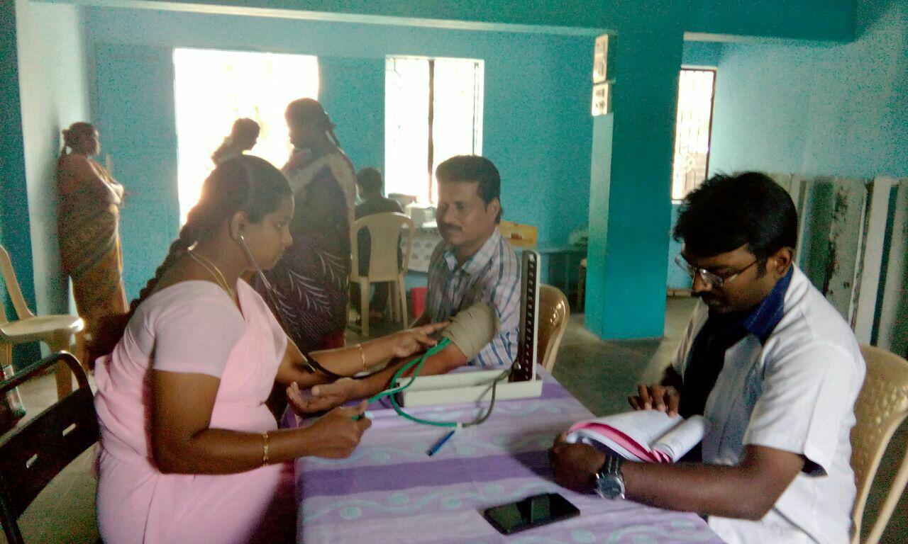
INTENSIVE NCD SCREENING PROGRAM IN URBAN PHCS

Slide 20
Programme Out come- Performance of NCD Screening Programme
Amma Arokiya Thittam (AAT) State performance
Type of facility | Number of facilities | Period | Total screened
PHC – Rural and Urban | 431 | March 2016-May 2017 | 20,94,341
Sub district & District Hospitals | 98 | Commenced in June 2017 *
Total | 529 |  | 20,94,341

Slide 21
Thank You

