Slide 1
Bringing Accountability in Health The Madhya Pradesh Experience
National Health Mission
Madhya Pradesh

Slide 2
Contents
CM Helpline – The Mirror
Accountability in Health
Financial Accountability
Performance Accountability
Political/Democratic Accountability
Way ahead

Slide 3
CM Helpline – A single window for grievance redressal
Number of calls related to health services
  2015-16 : 35,668 2016-17 : 59,638

Slide 4
Accountability in Public Health Services
Essence of Accountability is Answerability*
  Obligation to answer questions regarding actions/decisions
  Transparency in decisions
Performance Accountability
  Performance Measurement
  Service Delivery
Financial Accountability
Political/Democratic Accountability
*Accountability and Health Systems: Overview,Framework, and Strategies, Jan 2003, WHO: http://www.who.int/management/partnerships/accountability/AccountabilityHealthSystemsOverview.pdf

Slide 5
Performance Accountability – MP Experience

Slide 6
Focussed approach of backtracking with rigorous capacity building exercise for ANMs
Identification of poor performing ANMs
Capacity Building
Block
Back tracking at block level meetings
Training in core skills
District
Case listing from Labour room register
Backtracking supervisors
State
Identification of negligent or severe cases
Training at state level
Training supervisors and ANMs
Monitoring by CHAI post training

Slide 7

Results : Key gaps identified and addressed including action on poor performing ANMs
Result of Backtracking
Key Gaps Identified
Capacity building on core skills
Ante Natal Check ups (ANCs)
Training needs analysis
Intensive raining on ANC & HBNC :
Examination and Investigations
Post training evaluation
Data Capturing
Lack of Supervision
# of Cases Back tracked: 216 (200 ANMs) from 20 districts
Lack of Examination
# of Cases where increment withheld after SCN
# of Cases where show cause issued
# of Cases where service terminated:
Lack of Investigation
89
74
4
Lack of Treatment

Slide 8
Performance Accountability – Larger Picture
Benchmarking Performance Levels
  Work Done
  Skill
Measurable targets
Supportive Supervision for improving performance
Transparent evaluation mechanisms
Using IT systems

Slide 9
NHM MP – HRMIS
Complete end to end solution for HR management
Responsibility Matrix (KRA) for each position shared in advance
Online Appraisals for Work done and Skill levels
Online Contract Renewal and Incentive Calculation based on performance
Tracking each NHM employee’s performance and training needs

Slide 10
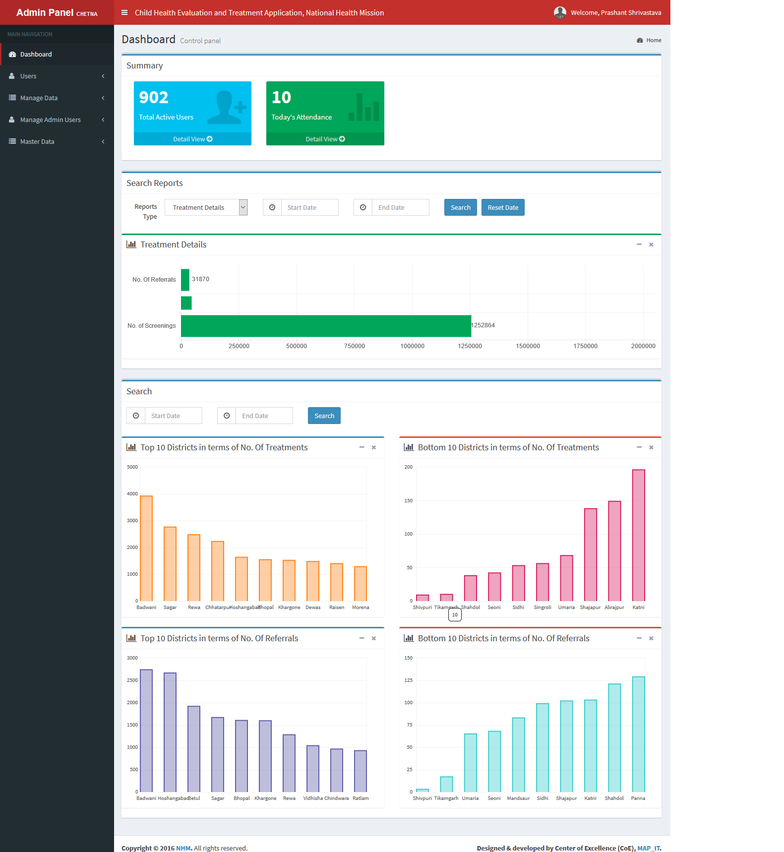
Continuous monitoring and measurement - CHETNA
Ensure timely visits and adequate performance of Mobile Health Teams under RBSK
Two-part system
  Mobile APP
  Web based dashboard
Over 12 lakh children screened
Payment of RBSK teams linked to
work done through CHETNA App

Slide 11
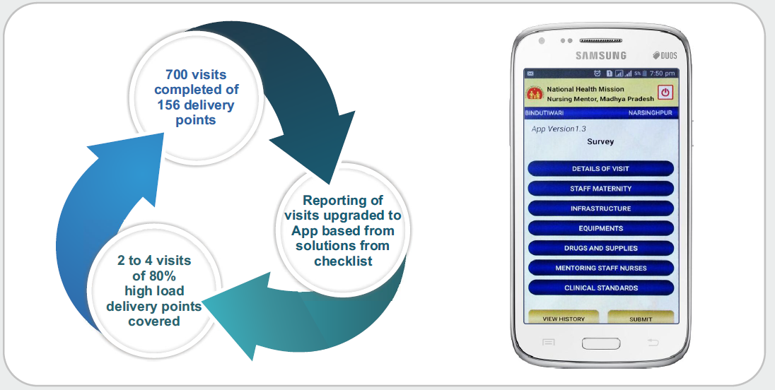
Quality Improvement at Facility - Supportive Supervision at Field Level
Nursing Mentors
  Field level hands on training and supervision by peers
  124 Nursing Mentors across the state
  Incentive per facility Visit
Continuous monitoring through MPWs
ANM Mentors

Slide 12
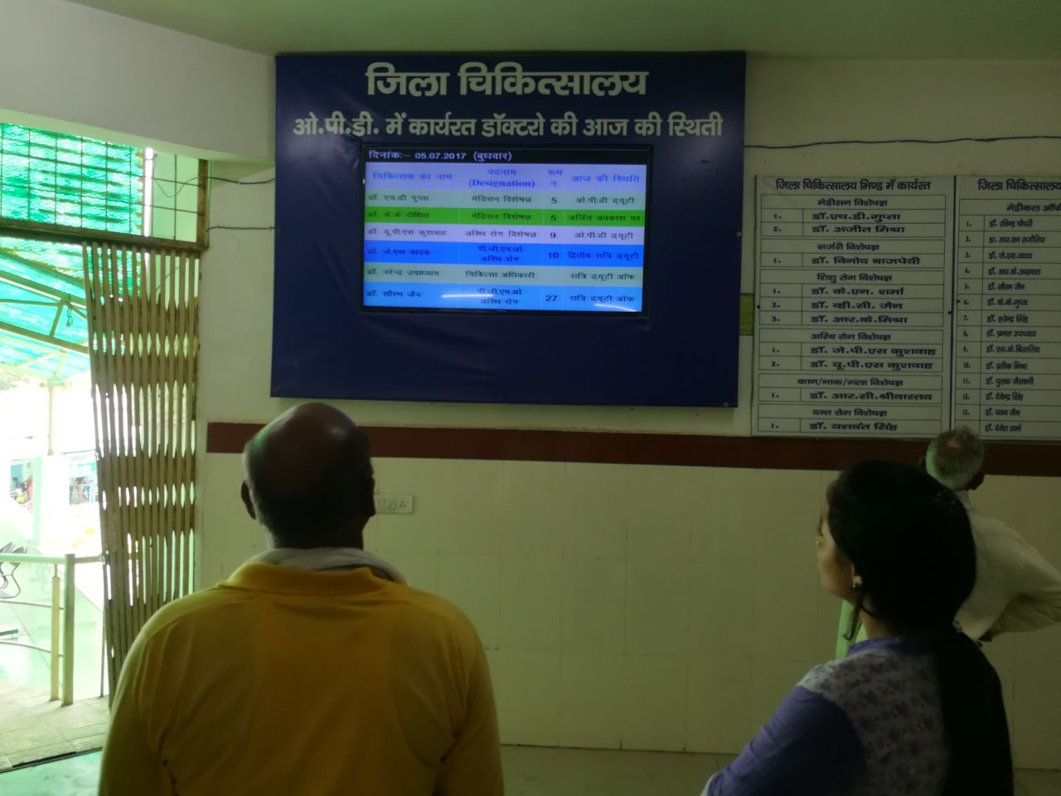

Quality Improvement at Facilities (contd)
Infratructure
  Institutionalised Hospital Planning System
Improvement of Services
1.Proactive Disclosure 2. Patient Feedback

Slide 13
Financial Accountability – MP Experince

Slide 14
MP-Aushadhi
Fully Automated Purchase to Pay System
Integrated Quality Control process
Single Bank account Payment System
Proactive disclosure of medicine stock at all levels of facility
Accountability through set timelines and tasks
Single dashboard view at state level

Slide 15
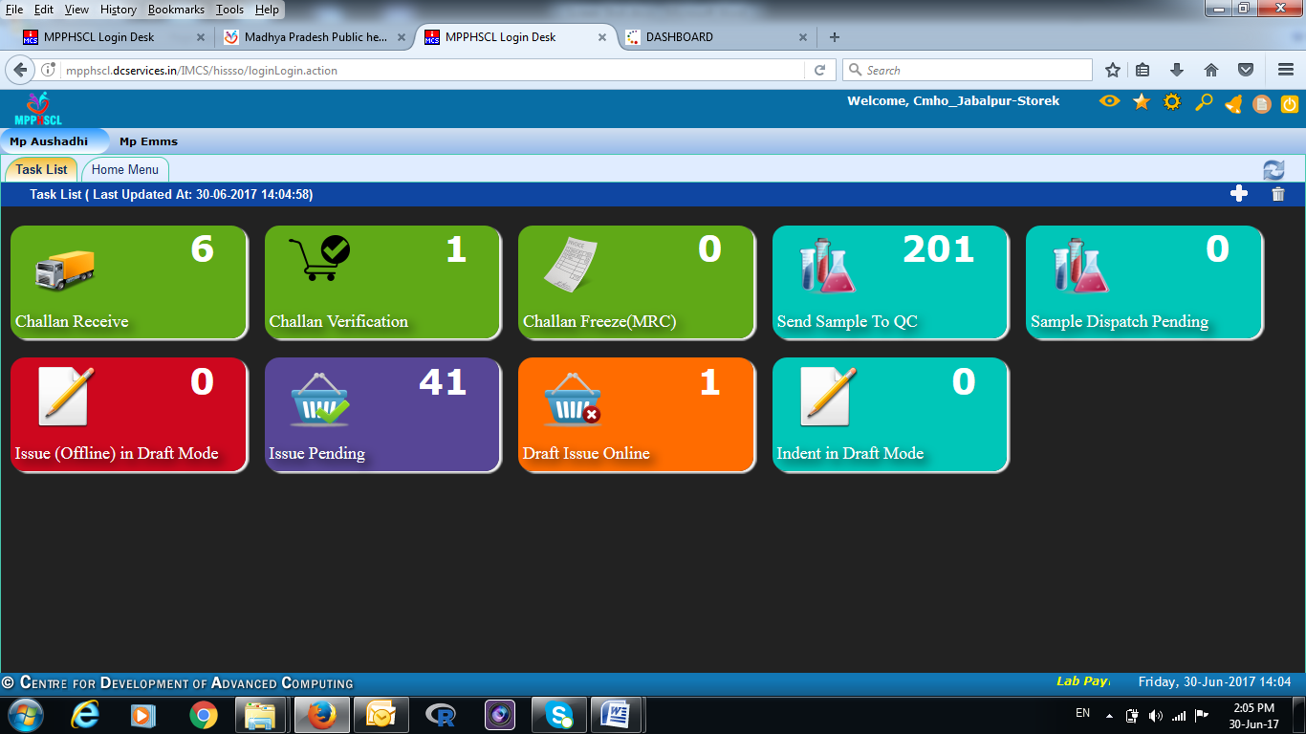
Fixing accountability and timelines through role based pending tasks

Slide 16
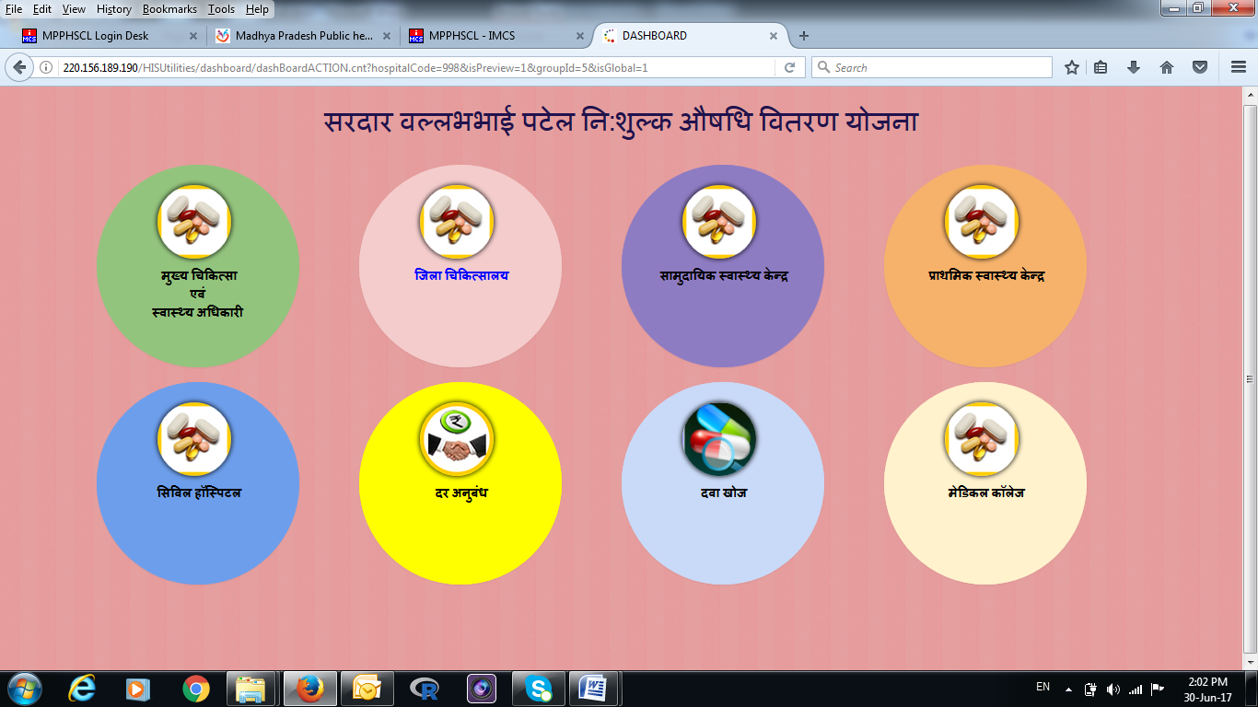
Public portal showing drug availability upto PHC level

Slide 17
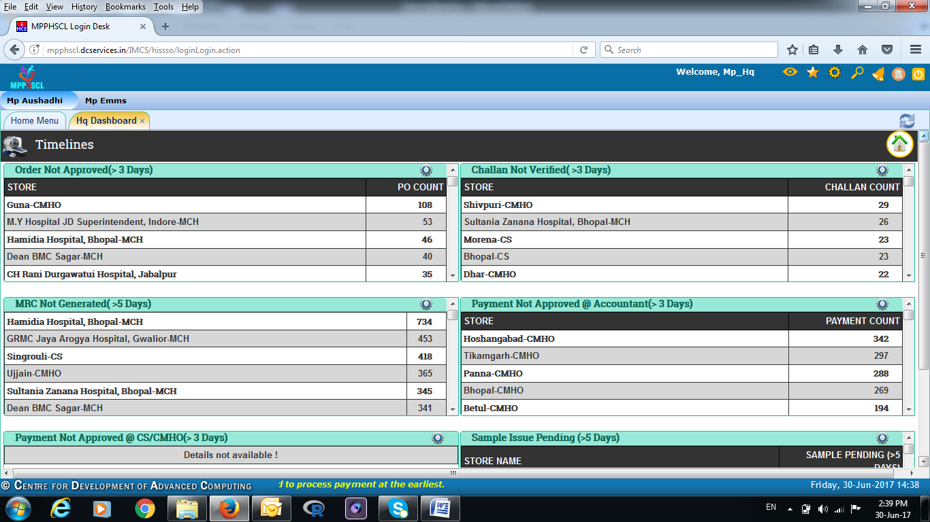
Ageing Analysis of Tasks

Slide 18
Political Accountability – MP Experience

Slide 19
GIS Mapping of Facilities
Identification of
  Underserved areas
  Potential sites for upgradation
Mapping areas of concern such as high home delivery load
Addressing concerns of public representatives in a more holistic manner

Slide 20
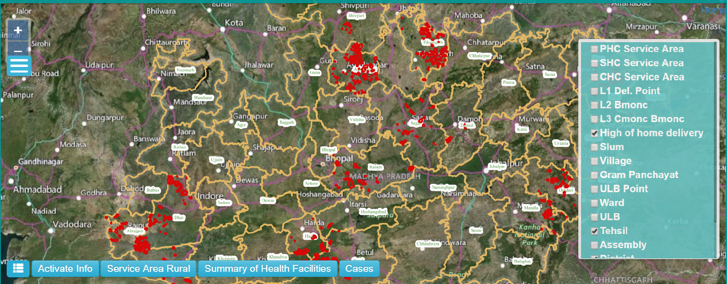
GIS Mapping – High Home Delivery Load

Slide 21
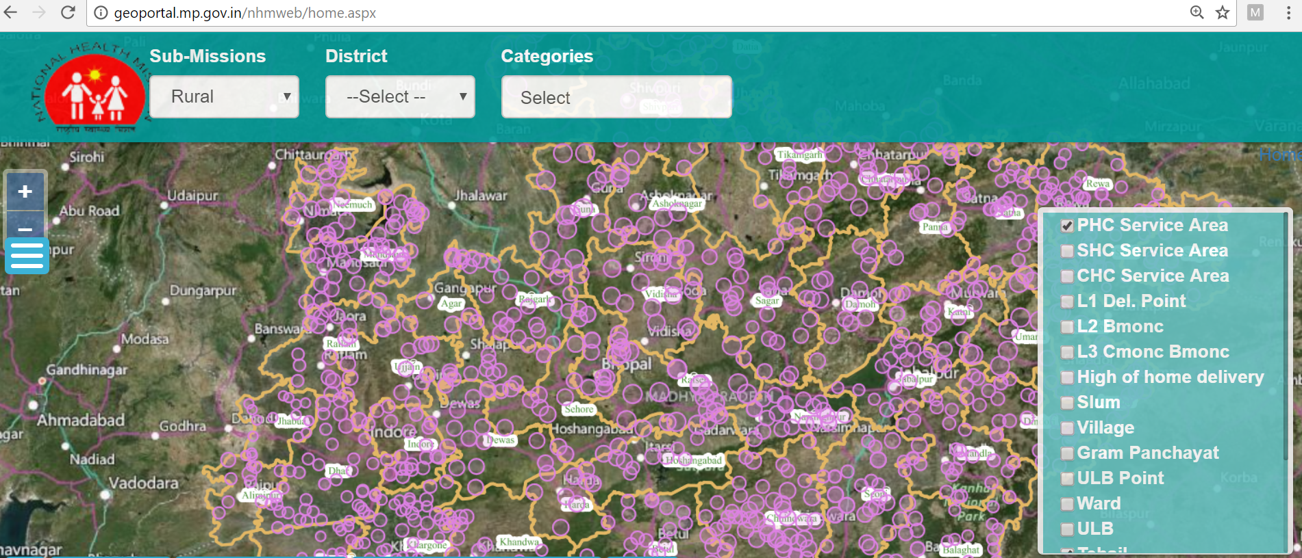
GIS Mapping – Service Area

Slide 22
Way Ahead
Patient Feedback through Mera Aspatal
Biometric attendance linked to salary (both regular and contractual)
Single Account Banking – Full NHM portfolio
Linking work measurement applications such as CHETNA with HRMIS
Enhancing proactive disclosures

Slide 23
Thank you

