Slide 1


Slide 2
Leveraging Community Processes for Urban Slums -
Experience from Chhattisgarh
Prasana R., IAS
Commissioner & Mission Director: Chattisgarh
06.07.2017

Slide 3
Problem Statement
• Infant Mortality declined sharply in rural areas but not in Urban areas despite having more hospitals
• In 2011, Chhattisgarh had the highest Urban Infant Mortality amongst all states of India (Chhattisgarh had urban IMR of 41 per 1000 births against national average of 29 per 1000 in 2011 – SRS)

Slide 4
What our urban slum Baseline Survey pointed out
• Poor Immunization rates
• Poor breastfeeding indicators
• Frequent Diarrhea outbreaks
• Low utilization of family planning services
•Pregnant women accessing ANC check-ups and institutional delivery – but mainly in private sector
• High out of pocket expenditure

Slide 5
Opportunity
• Community Processes was a key strength that Chhattisgarh had due to a decade of experience with Mitanin programme in rural areas
• Introducing Mitanin in urban area without other service provision by ANM, PHC etc was unlikely to be useful
• State decided to launch its own urban health scheme in 2011.

Slide 6
Intervention in Urban Community Process
• 3771 Mitanins were selected by communities of urban slums – cover 20 lakh slum population
• Experienced facilitators of nearby semi-urban/rural area Mitanin were borrowed to facilitate selection and community mobilization
• One round of training was given to Mitanins
• A urban community-process support structure was created by selecting facilitators from Mitanins
• MAS were formed – households covered by one Mitanin, represented one MAS. Thus No. of Mitanin = No. of MAS
• Support structure facilitates MAS as well and spends around 40% of its time on MAS
• 5 rounds of training – 25 days completed for all Mitanins
• 1 Round of training given to MAS
• Since CP is the strength we have, important to leverage it by giving it a wider Role

Slide 7
Mitanin as Service Provider and Link with public health system
Focus on linkage with Public Services:
• Mitanins were able to mobilize 80% of expected deliveries to institutions with 76% of them being in government facilities
• Urban immunisation improved drastically (NFHS-4 reports 96% had measles vaccine, 85% had full immunisation)
Emphasis on HOME VISIT role of Mitanin:
• 82% of newborn received designated home visits from Mitanins and 16% referred to health facilities after identifying signs of sickness
• Improvements in breastfeeding (74% exclusive BF NFHS-4)
• 87% of pregnant women received more than three home visits
• 63% of children under-3 years age received home visits on nutrition and prevention of infections
• Integrated psycho-social development of young children in home visit counseling of Mitanins

Slide 8
ASHA beyond RCH
• 68400 cases of diarrhea given ORS
• More than 120000 other patients treated by Mitanins using drug-kits
• 155 TB suspects per 100000 population screened per quarter and referred for sputum examination pr quarter resulting in 2140 confirmed cases
• 2796 Leprosy suspects screened and referred resulting in 611 confirmed cases
• Identifying diagnosed cases of Sickle Cell Disease and linking them with services

Slide 9
Inter Sector Work of MAS
• Water Testing – Biannual surveys using H2S kits, water points with fecal contamination informed to Urban bodies for necessary repairs.
• Hepatitis E surveillance through Mitanins, combined with water quality survey to identify problems . Followed by discussion with urban bodies for addressing gaps
• MAS monitors a wide variety of urban services – sanitation, Anganwadi, schools, PDS and other social security pensions
• Linking disabled for certification and other rights
• Widespread action on women’s rights by MAS, opposing domestic violence against women

Slide 10
Community surveillance of preventable causes of mortality
• Death registers of MAS – record deaths with community reported causes
• Big improvements in reducing deaths due to diarrhea
• Shows 80% of under-5 deaths are of neonates
• Amongst neonatal deaths, birth asphyxia contributes to 42% deaths
• Post-neonates Pneumonia most common cause
• Sickle cell another important cause
• TB, Accidents and Suicides big causes in adult deaths
• Such community reported data helps in identifying areas to focus on

Slide 11
Urban IMR now reducing faster
 | Average Annual Rate of Reduction in IMR in Chhattisgarh (SRS)
PERIOD | In Rural IMR | In Urban IMR
Before Urban Program (2001-2011) | 4.4% | 2.7%
After Urban program (2011-2015) | 3.1% | 5.5%

Slide 12
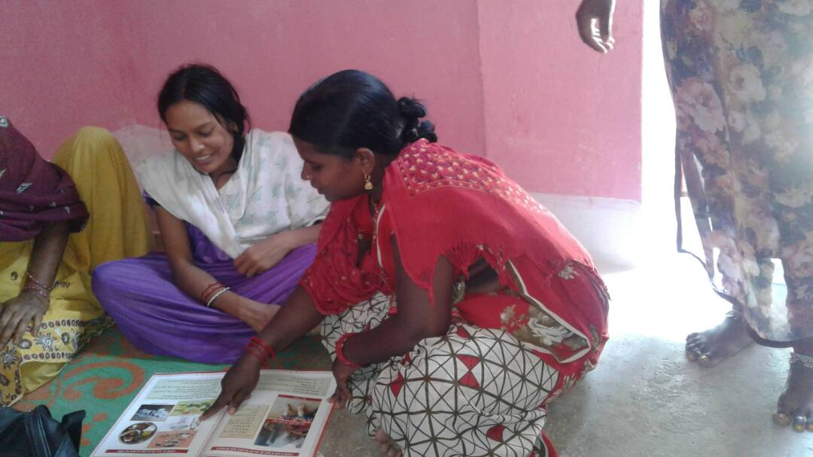
Home Visit by Mitanin

Slide 13
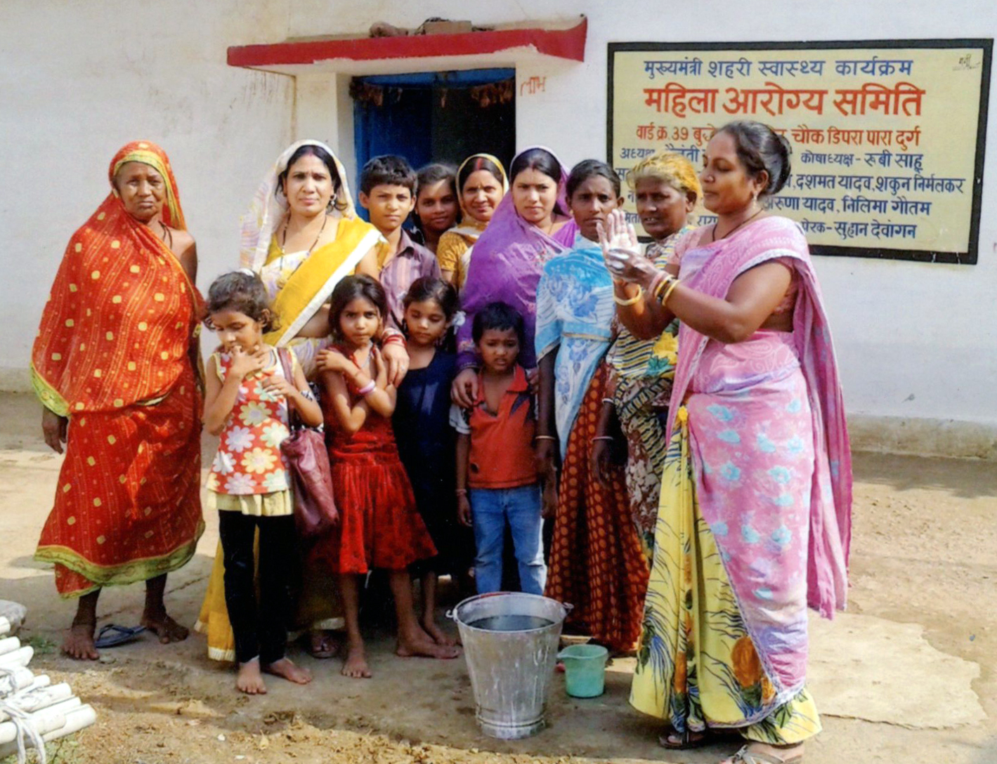
Hand washing in MAS

Slide 14
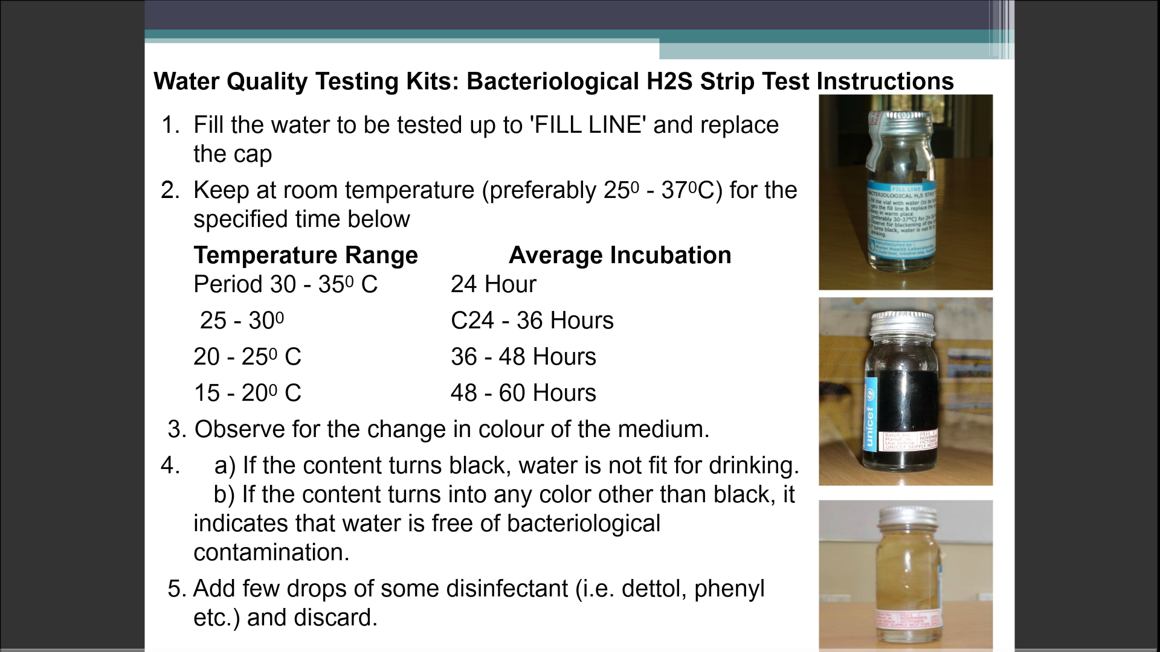
Water Testing by H2S Kits

Slide 15
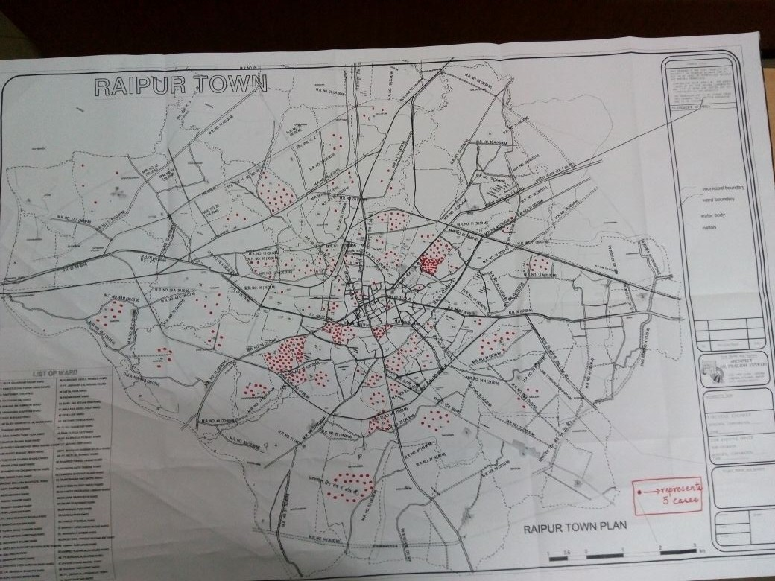
Spot Map: Hepatitis –E Surveillance by Mitanin - Raipur Town

Slide 16
Lessons
• Community Processes can play a big role in success of NUHM
• Introduction of ANMs, Urban PHCs, linkage with District hospitals are vital to success of ASHA
• Urban area slums show wide socio-economic variations, Community Processes should be ready to respond a variety of needs
• Giving a wide role e.g. in home visits, nutrition, disease control, access to safe water, gender equity, community-monitoring of public services can give results
• Investing in a facilitative support-structure is useful in building active MAS and ASHA in urban areas

Slide 17
Thank You

