Slide 1


Slide 2
Inter-Sectoral Convergence with Urban Local Bodies(ULBs) for increasing service Utilization at UPHCs and conducting special Outreach Camps under UPHCs - HARYANA
Ms. Amneet P. Kumar, MD NHM
Dr. Nidhi Sharma, Programme Officer, Urban Health.
National Health Mission, Haryana
06/07/2017

Slide 3
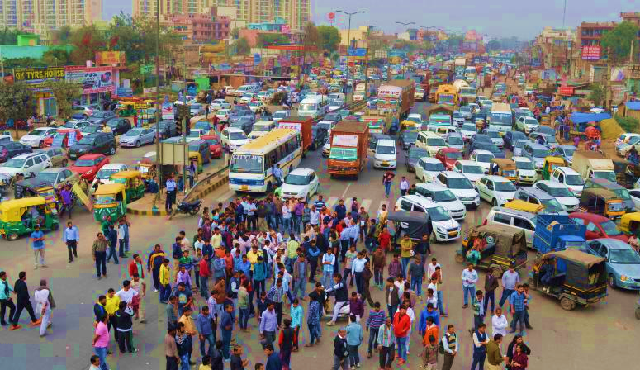
Rapid Urbanization – not just global but local phenomenon
  Urban population of Haryana - 88.21 lacs - 34.8% of the total population
  18.1% of urban population in Haryana is residing in Urban Slums
  By 2026, 46.3% of the total population of Haryana would be living in cities

Slide 4
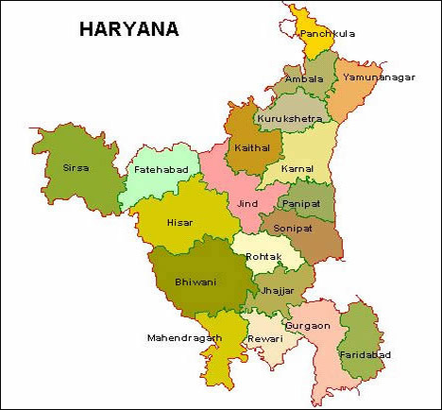
National Urban Health Mission- Haryana
No. Of Districts | 22
Total No. of Cities Covered under NUHM | 28
Million plus cities | 2 ( Gurugram & Faridabad)
Cities(1 lakh to 10 lakh population) | 16
Towns (50000 to 1 lakh population) | 10
No. of UPHCs under NUHM | 95

Slide 5
NUHM envisages provision of primary healthcare services to the slum dwellers and other vulnerable groups with provision of routine fixed services at urban PHCs and targeted outreach services through UHNDs and Special outreach camps.
Objective is to reduce Out of Pocket Expenditure (OOPE) of the Urban poor population.
Cost of Care – Out of Pocket Expenditure in Haryana
Expenditure per hospitalization in Urban
population (excluding child birth) (In Rs.)
Non-hospitalized expenditure in Urban Population (In Rs.)

Slide 6
Special Outreach camps are organized for the identified slum & vulnerable population pockets periodically as per the specific local healthcare needs.
SPECIAL OUTREACH CAMPS
Provide quality health care with provision of Specialists services:
Provide free medicines
Free lab diagnostics (Hb,Blood group and RH factor,HIV,Syphilis,HBsAg
Improved Health Seeking Behavior
Gynecologists, Pediatricians,
Dermatologists, ENT specialists
Dentists, Opthalmologist
Reduce Out of Pocket Expenditure for vulnerable urban population in Haryana

Slide 7
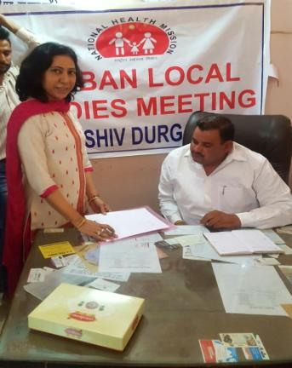
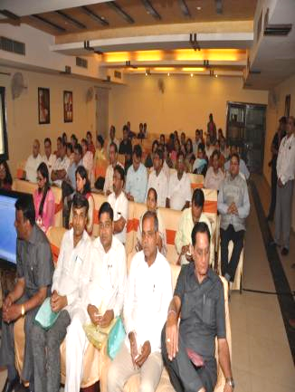
Finding venue for the camp
Mobilizing the slum dwellers at the camp site.
Problem Statement
Under Utilization of services in outreach and at UPHC.
Solution
Inter-sectoral Convergence
District level orientation meetings of ULBs under the chairmanship of Civil Surgeon were organized.
Ward Councilors- included as members of the Swasthya Kalyan Samiti (SKS) in UPHCs
Annual co-ordination meetings with MLAs, MCs, other eminent persons conducted at the U-PHC level.
59 meetings were conducted in FY 2016-17.
Municipal Councilors attending Orientation workshop at UPHC
Municipal Councilors attending Orientation workshop at Faridabad

Slide 8
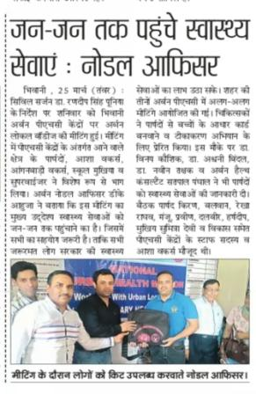
Continued…..
  UPHC level Coordination Meeting
  Model platform to:
  Discuss the area specific issues like sanitation, Provision of potable water supply, waste management etc
  Develop strategies to plan for better public health activities.
  Increase the utilization of services being provided by the UPHC in their catering area.
Convergence Meeting with ULB at U-PHC in District Bhiwani
  Considering the effectiveness and importance - Biannual meeting are planned under each UPHC in FY 2017-18.

Slide 9
Outcome- Outreach Services
Arranging the venue for the camp
Logistics arrangement for staff – tables, chairs.
Logistics for patients – waiting area arrangements; drinking water
Improved branding of NUHM through media coverage
Increase in no. of Special Outreach camps and the OPD attendance at the camps

Slide 10
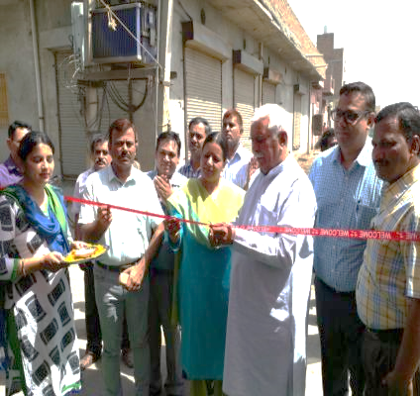
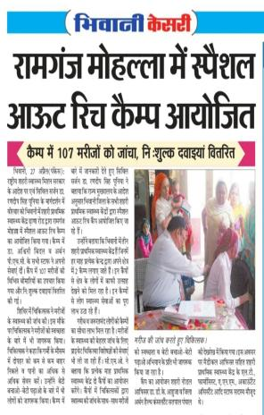
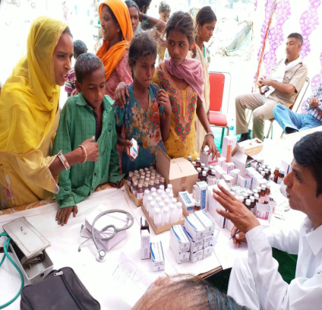
Outreach Activities in Urban Areas
Inauguration of Special Outreach Camp and Mission Indradhanush by Hon’ble Sh. Ramesh Bhatia- Ex- District President BJP Member of State BJP Committee.
Media Coverage
Dispensing of Medicines at Special Outreach Camp under UPHC Gaukaran, Rohtak

Slide 11
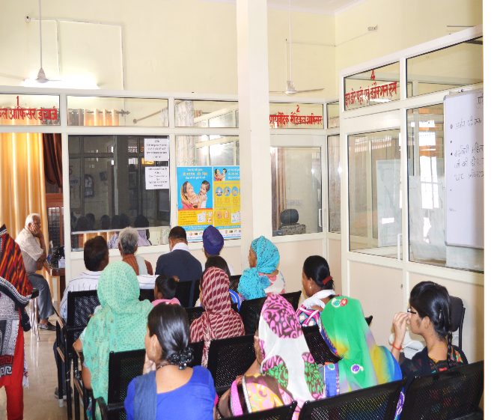
Increase in utilization of UPHC fixed services
Increase in the OPD attendance at the UPHCs
Awareness generation by local leaders in the community
Trust generated among the community due to participation of ULBs in planning of public health activities under the UPHCs.
UPHC management issues pertaining to infrastructure and patient amenities resolved through ULBs
Total OPD attendance at UPHCs has increased by 19% in FY 2016-17

Slide 12
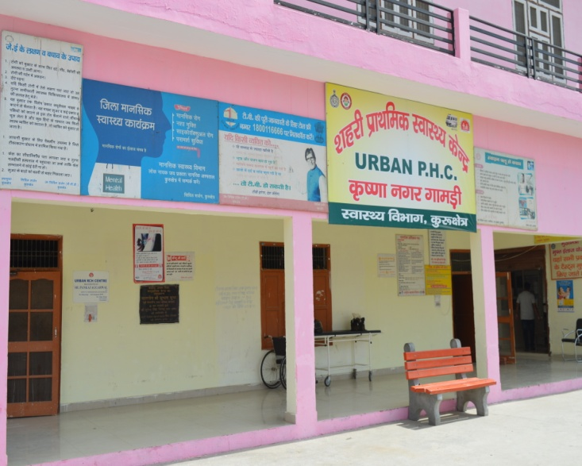
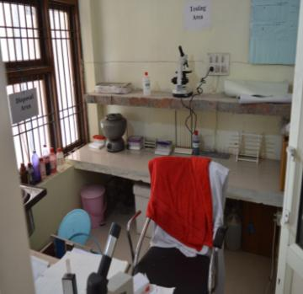
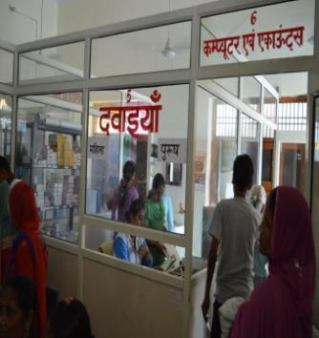
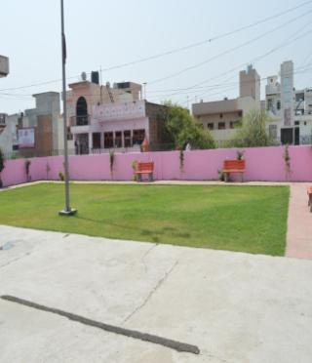
U-PHC at District Kurukshetra
Now shifted to a government building from a rented building provided and maintained by Municipal Councillor, Krishna Nagar Gamri
Park developed in the premises of UPHC Krishna Nagar Gamri maintained by Municipal Councilor of that area.
Laboratory at UPHC Krishna Nagar Gamri
Pharmacy at UPHC Krishna Nagar Gamri

Slide 13
Health Indicators
Total New ANC Registration
No. of Pregnant Women Received 3 ANC
Data Source: HMIS

Slide 14
Conclusion
• Inter-sectoral coordination for shared outcomes results in efficient health service delivery for urban poor.
• Clarity on roles and responsibilities and involvement in both planning and implementation facilitates inter-sectoral co-ordination.
• ULBs can play an important role in mobilization of the community and building credibility of health department in urban poor communities.

Slide 15
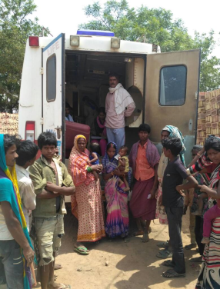
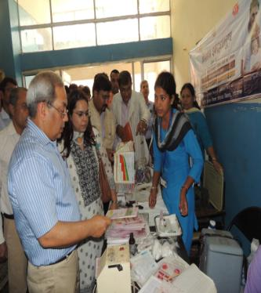
Mission towards improving Urban health…!

Slide 16
Thank You

