Slide 1
Postpartum Family Planning (PPFP) Counselling

Slide 2
Learning Objectives
By the end of this session, learners will be able to:
Define counselling, counselling approach (GATHER) and strategy (BCS), informed choice and informed consent
List out benefits of FP for mother and baby and Healthy Timing and Spacing of Pregnancy (HTSP)
Describe the importance of involving men in FP
Describe the rationale for PPFP, unmet need and return to fertility
Enumerate different PPFP methods with timing of initiation
Describe the myths related to different FP method with clarifications
Demonstrate counselling through role play by using counselling flip book, kit and other job aids according to the steps in counselling checklist

Slide 3
FP for Mother
Benefits if practiced | Risk if not practiced
Reduced risk of complications associated with pregnancies Extra time to take care for her baby Will breastfeed longer, May be more rested and well nourished so as to support the next healthy pregnancy May have more time for herself, children and family More time to prepare for next pregnancy | Increased risk of pregnancy complications Increased risk of miscarriage More likely to induce abortion At greater risk of maternal death
Notes:
Will breastfeed longer, longer duration of breastfeeding is linked to reduced risk of breast and ovarian cancer

Slide 4
FP for Newborn
Benefits if practiced | Risk if not practiced
More likely to be born strong and healthy Breastfed for a longer period, so health and nutritional benefits Enhanced mother-baby bonding by breastfeeding, facilitating child’s overall development Mothers are better able to meet the needs of their newborns | Higher chance of Newborn and infant deaths Greater chance of pre-term low birth weight baby If breastfeeding is stopped before 6 months: the newborn does not experience the health and nutritional benefits of breast milk diminished mother-baby bonding affecting baby’s development
Notes:
Will breastfeed longer, longer duration of breastfeeding is linked to reduced risk of breast and ovarian cancer

Slide 5
Healthy Timing and Spacing of Pregnancy
(HTSP)
Key Messages:
Delay the first pregnancy
For spacing after a live birth: The recommended interval before attempting the next pregnancy is at least 24 months
For pregnancy after an abortion: The recommended interval before attempting the next pregnancy is at least 6 months

Slide 6
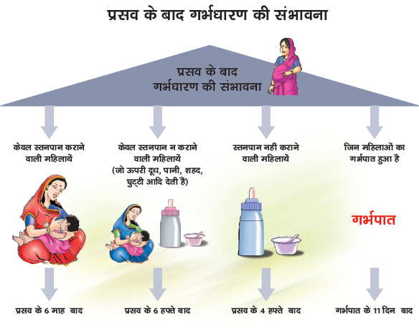
Return to Fertility

Slide 7
Importance of Postpartum Family Planning
High unmet need for family planning in postpartum period
Women are most receptive in these 2 periods
Women come in contact with the health facilities and providers
Inadequate spacing between two pregnancies result in poor maternal and neonatal health outcomes

Slide 8
What is Counselling?
Counselling is a two way communication between a health care worker and a client (or a couple) for the purpose of confirming or facilitating a decision by the client, or helping the client address problems or concerns

Slide 9
GATHER Approach in Counselling
G: Greet
A: Ask
T: Tell
H: Help
E: Explain
R: Return

Slide 10
Balanced Counselling Strategy (BCS)
Step-I: Pre-choice stage:
If the couple has already decided to have the next baby after few years and not early, then
Tell them - to prevent unwanted pregnancy and for good health of mother and baby, they should use any contraceptive method for at least 2 years after childbirth
Ask - If they have thought of using any contraceptive method?
If yes, find out what do they know about the method and provide correct information, remove myths/misconceptions, evaluate her eligibility for the method.

Slide 11
BCS continued
If client has not thought about a particular method, ask following 4 questions and eliminate method/s according to client’s response:
        Do you want more children in the future?
        If yes, do not discuss male and female sterilization
        Are you breastfeeding an infant of less than 6 months old?
        If yes, do not discuss oral contraceptive pills
        Will your partner use condoms?
        If yes, discuss about condoms. Also assess woman’s risk for STIs and HIV and explain that condoms are the only method that can protect from STI and HIV
        Did you have any problem tolerating an FP method in the past?
        If yes, ask which method. Do not discuss the method further if the problem experienced was really related to the method
This strategy will help client to choose a method that matches with her needs

Slide 12
BCS continued
Step-II: Method choice stage:
Give detailed information of the chosen method like:
How does the method act
How effective is the method
What are its benefits
Does it affect breastfeeding or not
Does it protect from sexually transmitted infections
Common side effects of the method and their treatment
When to come for follow-up

Slide 13
BCS continued
Step III: Post-choice stage:
Ask the woman to repeat important information about her chosen method
Respond to her questions and concerns
Schedule the follow-up visit
Record relevant information

Slide 14
Principles of Family Planning Counselling
Maintain privacy
Ensure confidentiality
Be non-judgmental
Use simple, culturally appropriate and easy to understand language
Use good interpersonal communication skills
Be brief, simple and specific with key messages
Encourage the client to ask questions and express any concern
Use AV aids, anatomic models and contraceptive samples
Provide feedback, repeat key information
Always verify what client has understood by having the client repeat the key messages

Slide 15
Counselling and Motivating Men
Why is it important to counsel men on FP or involving men in FP counselling?
Men are final decision makers in many families
Men will know how to protect their health, their wives’ and children’s health
Men have special counselling needs, as
- They need to use or support women’s use of FP methods
- They have less information
- They have serious misconceptions and concerns

Slide 16
FP Methods
For Delaying the first child | For Healthy spacing between two childbirths | For Limiting future pregnancies
Condoms OCPs IUCD EC pills (not to be used as a routine method) | Condoms IUCD OCPs LAM (Needs to be followed up by any other method, before completing 6 months after childbirth) | Female Sterilization Male sterilization/Vasectomy IUCD (after completing the total duration, the old IUCD should be replaced by a new one)

Slide 17
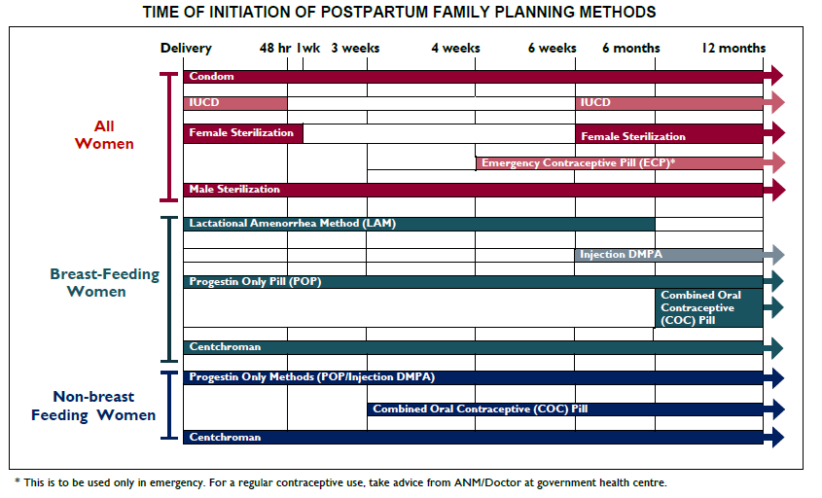
17

Slide 18
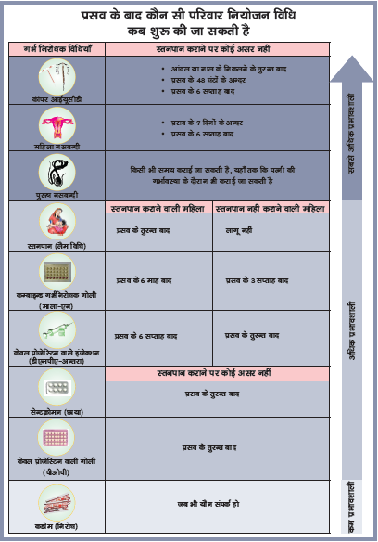

Slide 19

Common Misconceptions about
Contraceptive Methods

Slide 20
Common Misconceptions about OCPs
I need to take the pill when I sleep with my husband
I will face difficulty in getting pregnant again if I use OCPs for long
Pills will make me weak
The pill is dangerous and causes cancer
Pill will cause the birth of twins or triplets in next pregnancy

Slide 21
Common Misconceptions about Condoms
If a condom slips off during sexual intercourse, it might get lost inside woman’s body
There is too much danger of condoms breaking or tearing during intercourse
Two condoms used together give better protection

Slide 22
Common Misconceptions about IUCD
Thread can trap the penis during intercourse
A woman with IUCD cannot do heavy work
The IUCD might travel inside a woman’s body to her heart or her brain
Causes pregnancy outside the uterus
Causes cancer or rotting of the uterus

Slide 23
Common Misconceptions about
Female Sterilization
Woman after sterilization loses desire for having sex
Woman becomes sick and unable to do heavy work
Needs for hospitalization for few days
Shortens the life span of woman and may cause early menopause
Makes the woman fat or obese

Slide 24
Common Misconceptions about
Male Sterilization
Vasectomy is same as castration
Man will not enjoy sex or will not be able to perform sexual activity
Man will become weak
Scrotum will burst with sperms

Slide 25
Key Messages
Unsafe abortions is one of the important causes of maternal deaths and this can be prevented by family planning and safe abortion services
HTSP helps better maternal, neonatal and family health
The high unmet need for FP in postpartum period can be fulfilled through PPFP counselling and adopting an appropriate method
It is important to involve men in FP counselling as they are final decision makers and have special FP needs.

Slide 26
Role-play
Kamla has come to the health centre to get information about family planning methods. Kamla has a 4 year old daughter and is currently pregnant. Her husband has agreed to her using a family planning method after this delivery, but he does not want to use condoms. She is nervous about the safety of family planning; she has heard that it can make it impossible to have more children.

