Slide 1
Organizing Labor Room

Slide 2
Objectives
By the end of this session, learners will be able to:
Describe the importance of organizing labour room for improved quality
Explain the layout to organize LR in a systematic way with all essential equipment and supplies in a functional state

Slide 3
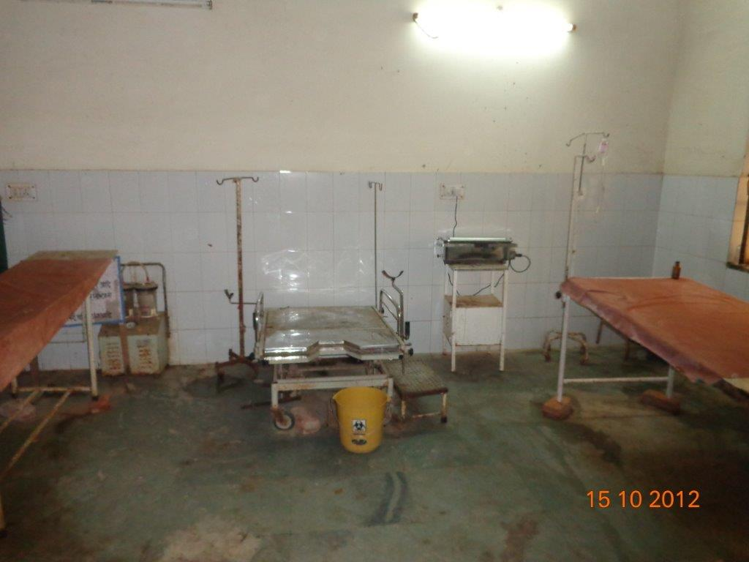
No privacy between two tables
IP items not appropriate
No newborn corner

Slide 4
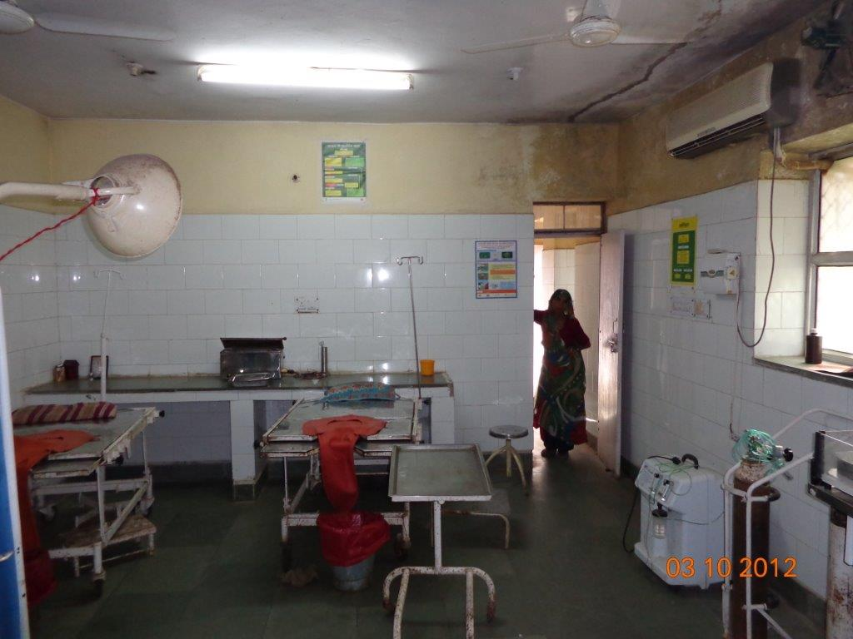
No privacy between two tables and no curtains at entrance
IP items not appropriate
Trays not organized

Slide 5
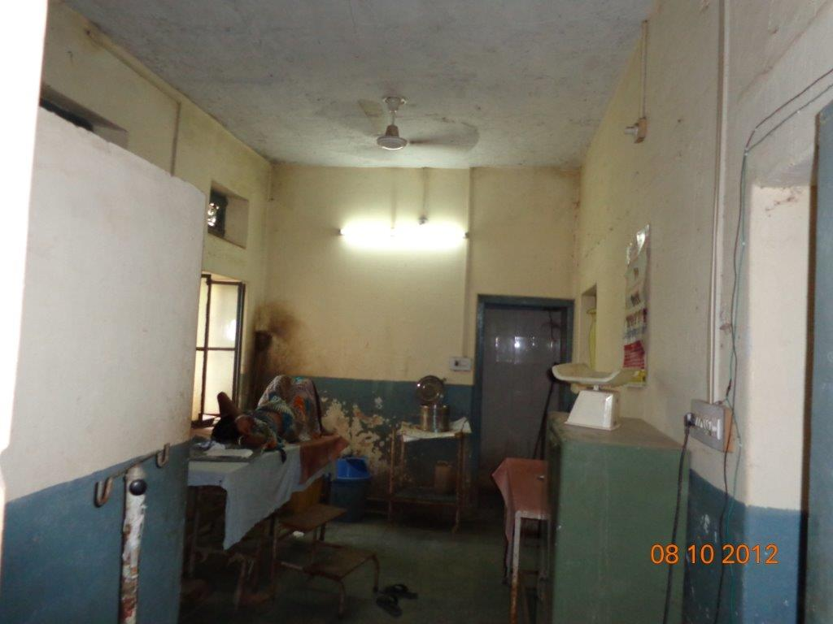
No privacy between two tables and no curtains at entrance
IP items not appropriate
Trays not organized
No newborn corner
Handwashing station?

Slide 6
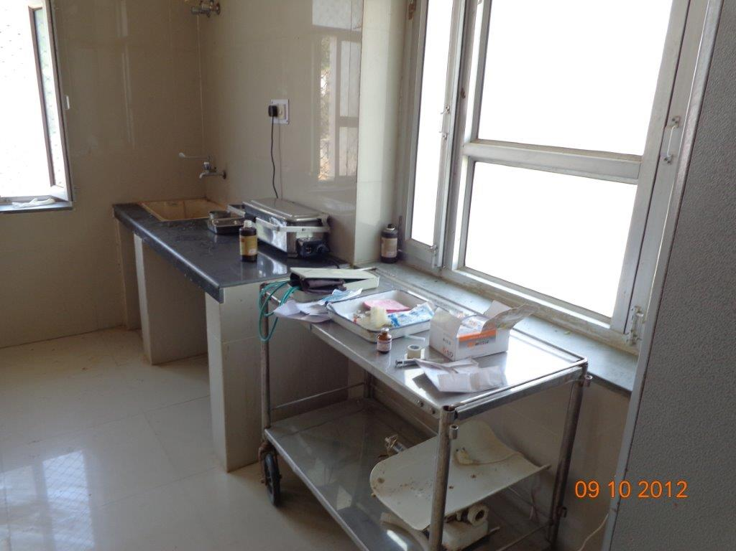
Unorgainzed trays
Weighing scales non usable
Open syringes seen

Slide 7
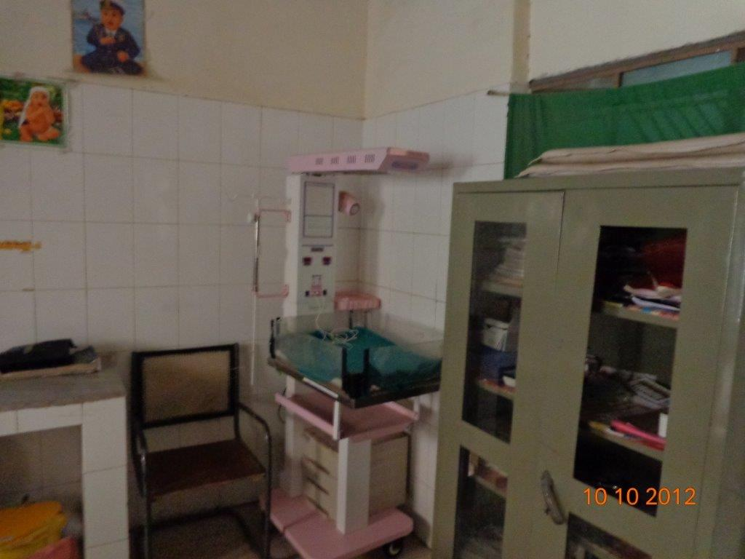
Unnecessary space by chair
Position of the radiant warmer not suitable for newborn resuscitation

Slide 8
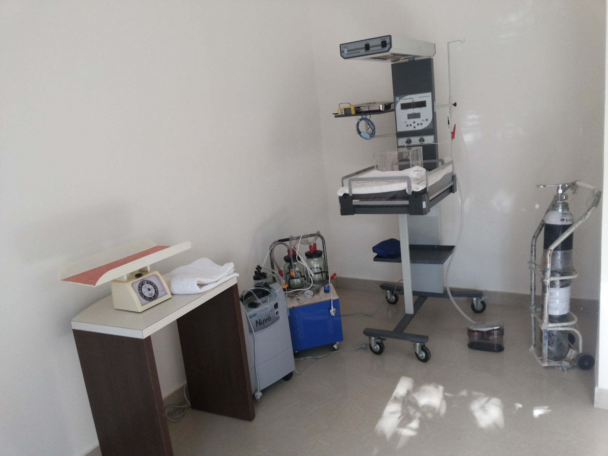
Well organized newborn corner
Radiant warmer position suitable for newborn resuscitation (open on 3 sides)
Mechanical suction seen

Slide 9
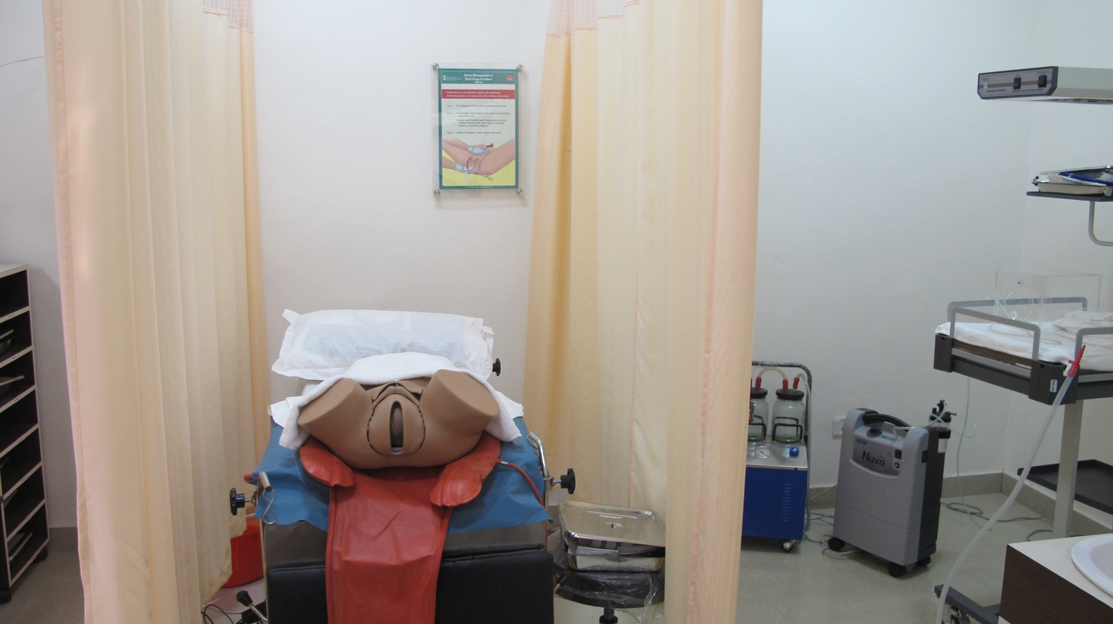
Well organized labor room
Adequate arrangements for privecy
Radiant warmer easily accessible and appropriately placed to use in case NBR is needed
Separate delivery tray for the table
Appropriate protocol poster displayed

Slide 10
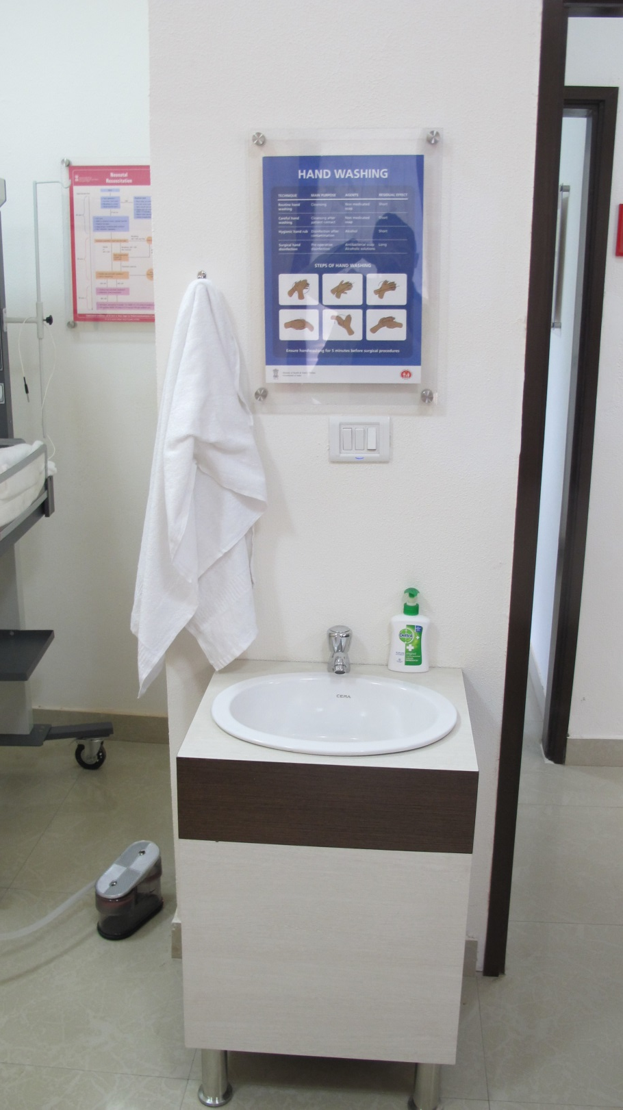
Well organized handwashing station
Appropriate protocol poster displayed

Slide 11
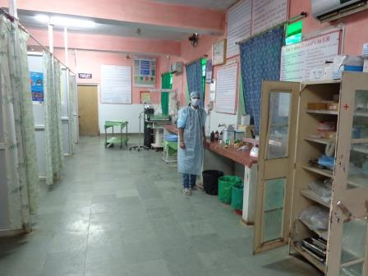
Appropriate space and privacy between labour tables
Newborn corner well placed and easily accessible from all tables
Well organized drug area

