Slide 1
Infection Prevention

Slide 2
Learning Objectives
By the end of this session, learners will be able to:
Describe Sources of infection
Tell the importance of infection prevention
Describe principles of infection prevention
Describe standard precautions
Demonstrate steps of hand washing and preparation of 0.5% chlorine solution
Explain proper handling of contaminated waste
Describe proper disposal of biomedical waste

Slide 3
Sources of Infection
What are the common sources of infection?
Environment : Blood, body fluids, secretions, excretions, placenta, contaminated sharps and other equipment
Other clients and attendants
Health care delivery personnel
People in the community

Slide 4
Principles of Infection Prevention
All objects in contact with the client: Potentially contaminated
Every person: Potentially infectious
If an object is disposable: Discard as waste
If reusable: Prevent infection by decontamination cleaning, disinfecting or sterilizing

Slide 5
Standard Precautions
Hand washing
Use of protective attire (PPE)
Processing of used items
Proper handling and disposal of sharps
Maintaining a clean environment
Biomedical waste disposal

Slide 6
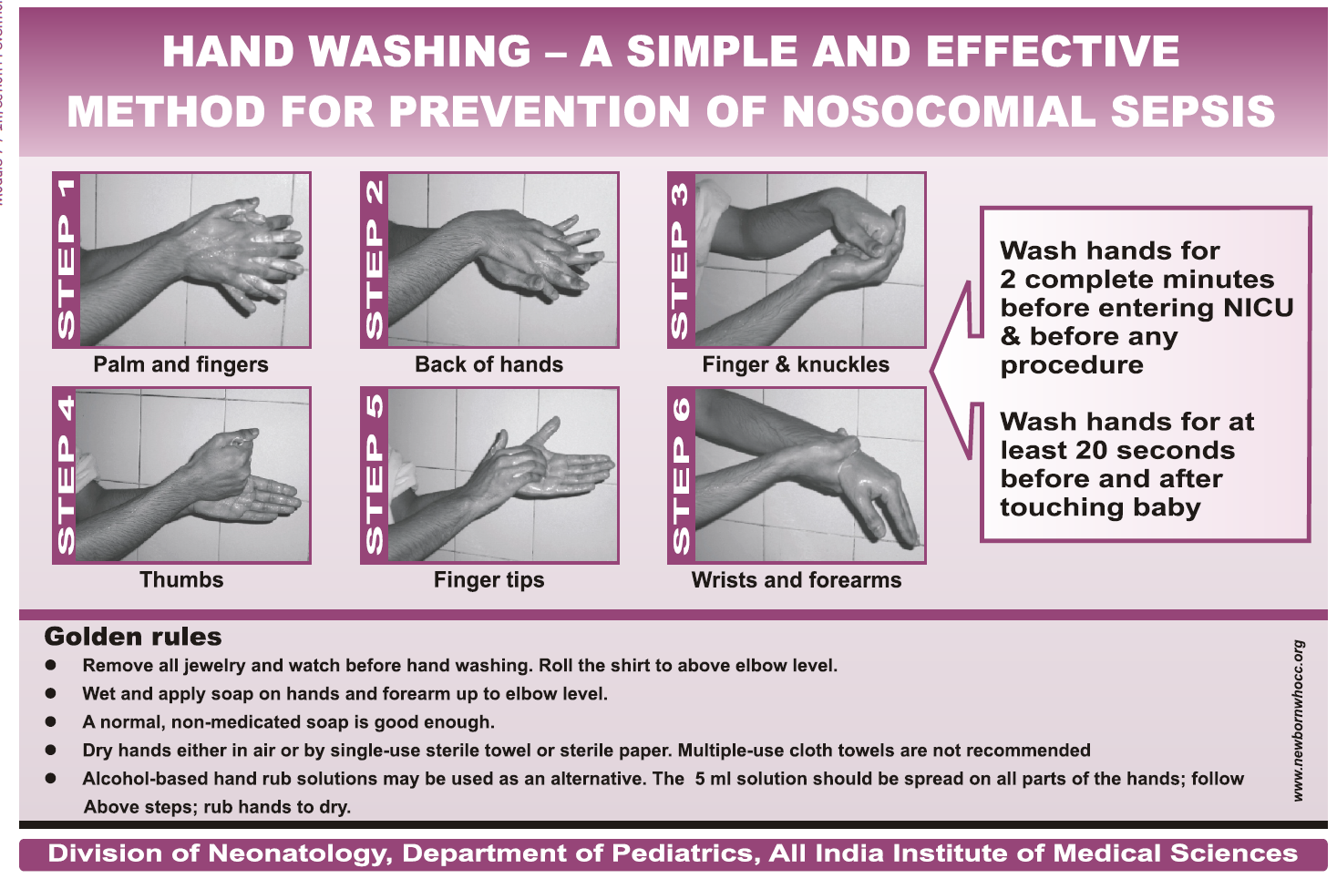
Steps of Hand Washing

Slide 7
2. Standard Precautions: Protective Attire
Gloves
Masks
Eye-covers
Gowns
Caps
Footwear

Slide 8
3. Standard Precautions: Processing of Used Items
A. Decontamination
B. Cleaning
C. Sterilization or high level disinfection (HLD)
D. Storage

Slide 9
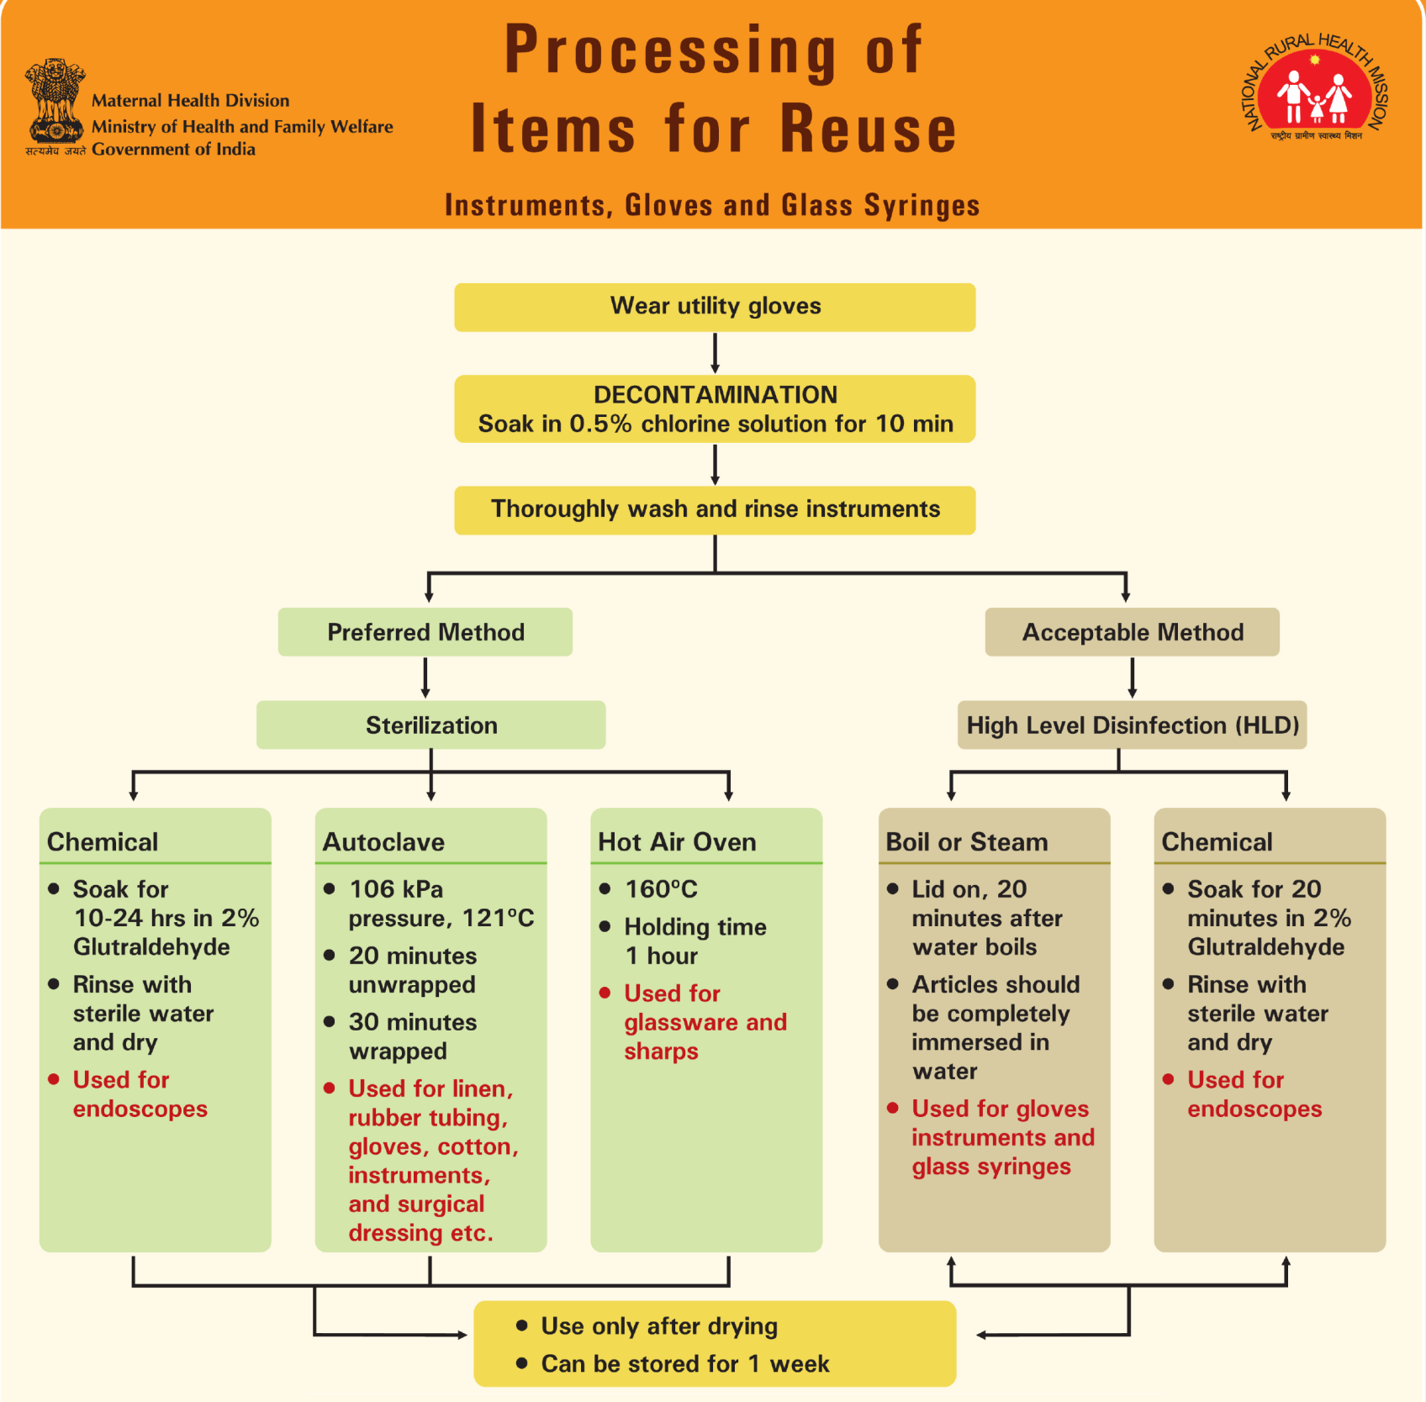

Slide 10
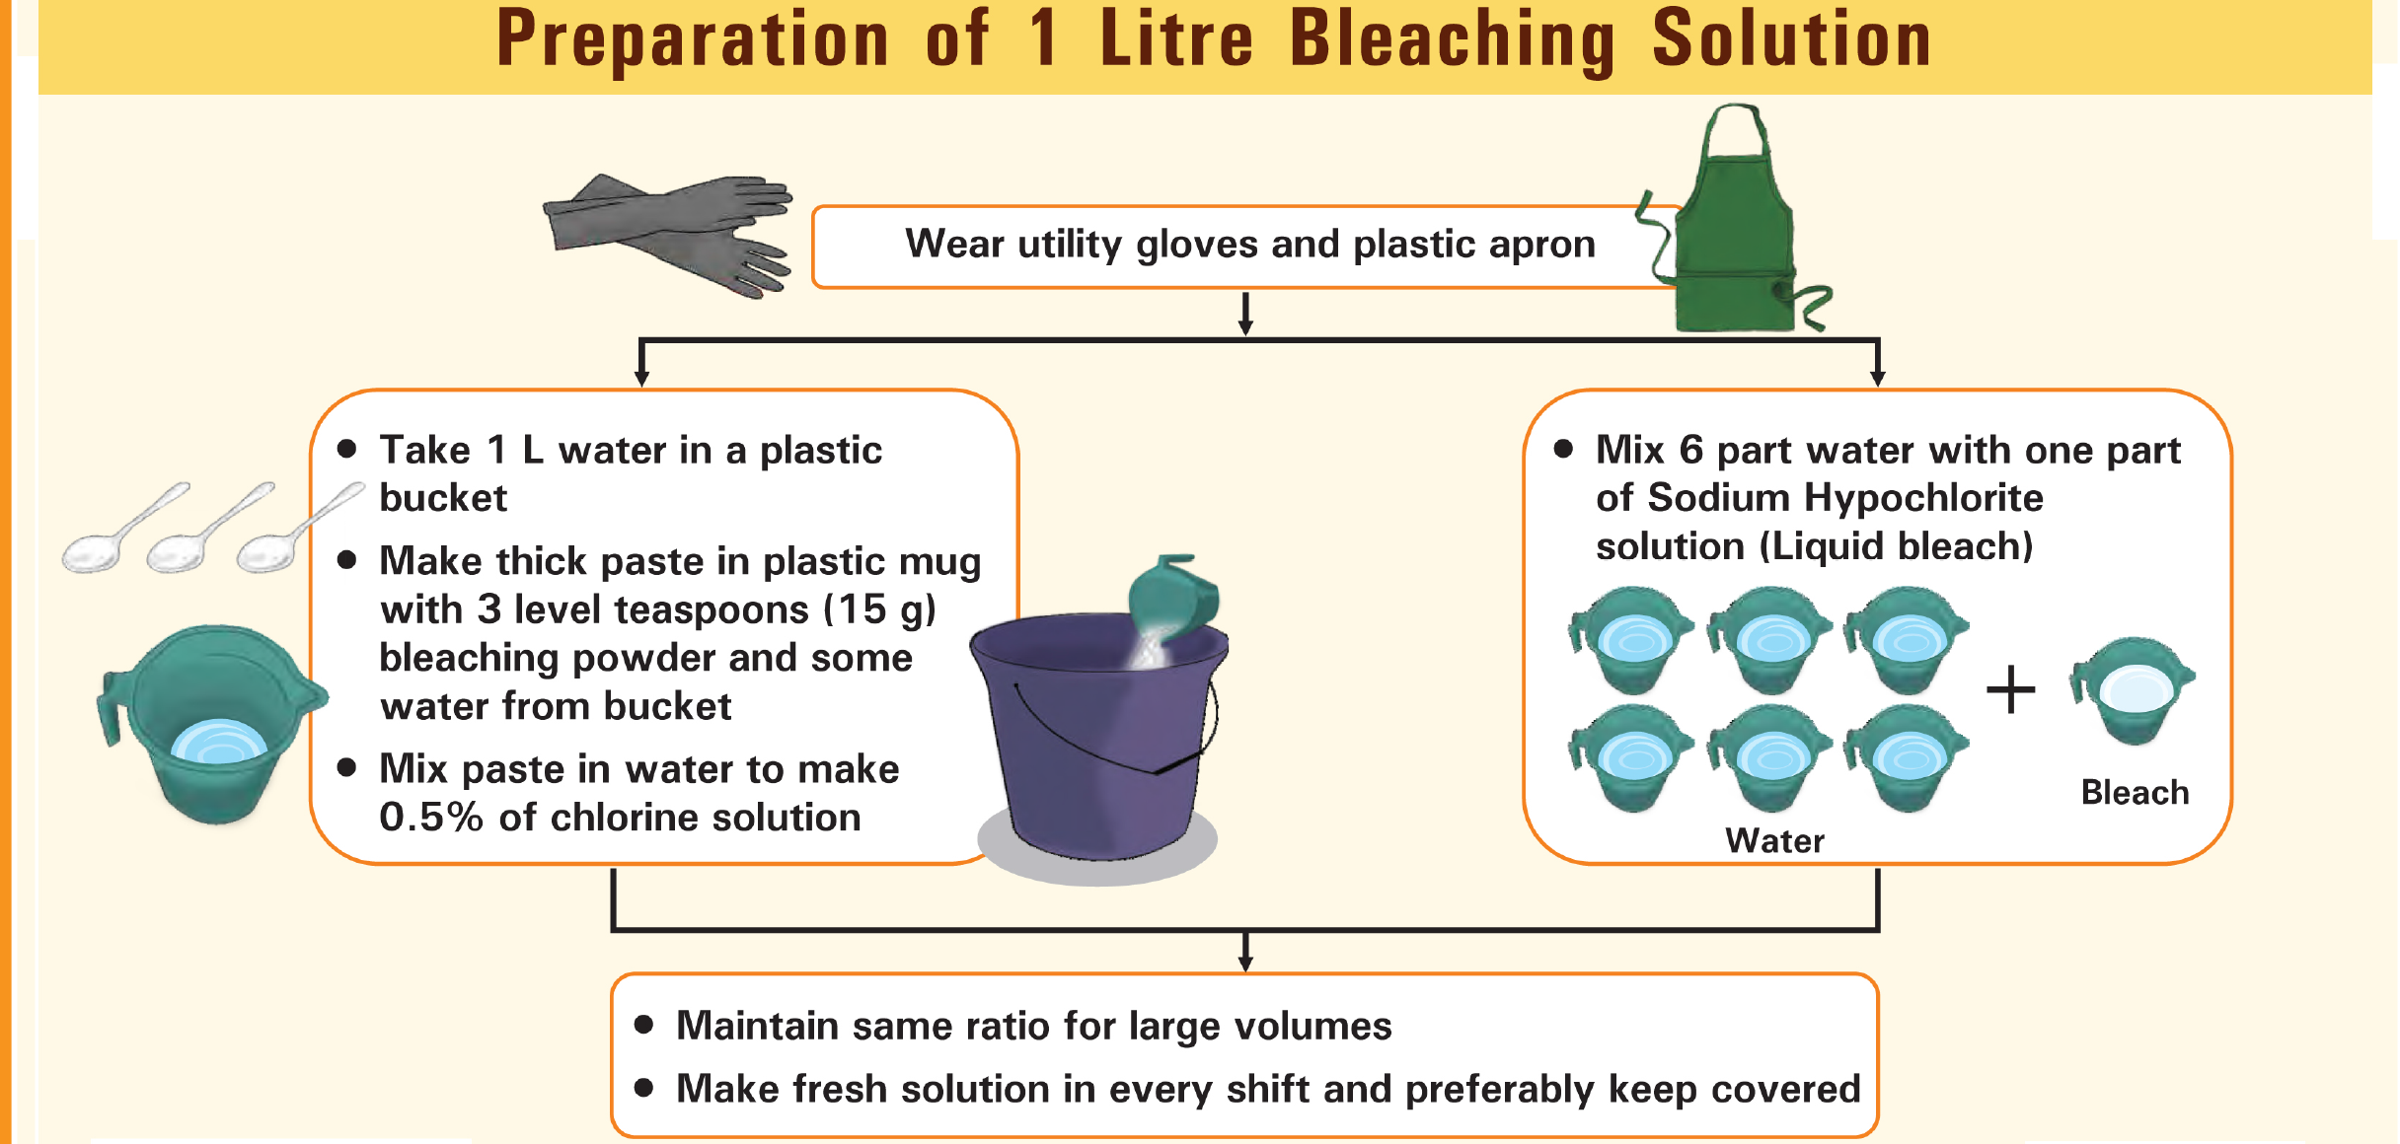

Slide 11
4. Standard Precautions: Proper Handling and Disposal of sharps
Needles and syringes
Use disposable needle and syringe ONLY ONCE
Always wear utility gloves while handling sharps
Do not disassemble the needle and syringe after use
Do not recap, bend or break needles before disposal
Make needles unusable after single use by burning them in a needle destroyer and/or in hub-cutter
Never burn syringes

Slide 12
4. Standard Precautions: Proper Handling and Disposal of sharps
Waste sharps including metals
Dispose off needles, syringes with fixed needles, scalpels, blades etc. in a puncture-proof white (translucent) container
Dispose broken glassware in cardboard boxes with blue coloured marking
PEP (post-exposure prophylaxis)
Wash the exposure site with soap and water immediately
Avoid applying any chemical cleansers
Do NOT attempt to milk or squeeze the wound
PEP should be offered and initiated as early as possible, for all individuals with an exposure that has the potential for HIV transmission, ideally within 72 hours

Slide 13
5. Standard Precautions: Maintaining Clean Environment
Type of cleaning solution
Uses
Plain detergent and water
To remove dirt & organic material such as grease, oil
Disinfectant
0.5 % chlorine solution
To clean up spills of blood or other body fluids
Disinfectant cleaning solution
For cleaning areas – operation theatres, procedure rooms , latrines
Notes:
Show video on cleaning of labour room

Slide 14
6. Standard Precautions: Biomedical Waste Disposal
It is the waste that is generated during diagnosis, treatment or immunization of human beings
Purpose of waste disposal
Minimize/Prevent the spread of infection to hospital personnel who handle waste
Prevent the spread of infection to the local community

Slide 15
6. Standard Precautions: Biomedical Waste Disposal
Steps of waste disposal
A. Segregation
B. Collection and Storage
C. Transportation
D. Treatment and disposal

Slide 16
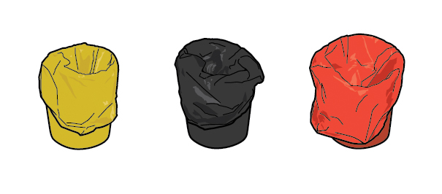
Biomedical Waste Disposal: A. Segregation
Colour Coded Bins
Yellow:
Human and Animal Anatomical Waste, Soiled Waste, Expired or Discarded Medicines, Chemical Waste, Chemical Liquid Waste, Microbiological and Lab Waste, Discarded Contaminated linen and mattresses etc.
Red:
Contaminated Recyclable Waste such as tubing, IV bottles, bags, syringes and gloves
Black:
General waste such as kitchen waste, paper bags, waste paper, disposable glasses & plates, left over food etc.
Puncture proof:
White (translucent)- Waste sharps including metals
Blue- Glassware and metallic body implants

Slide 17
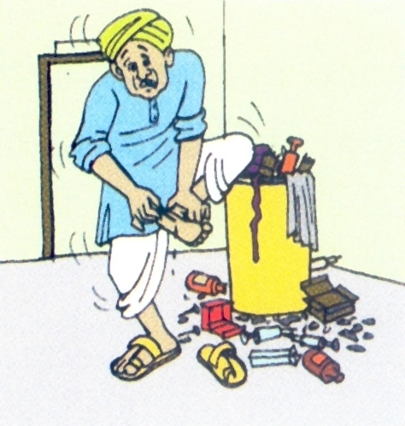
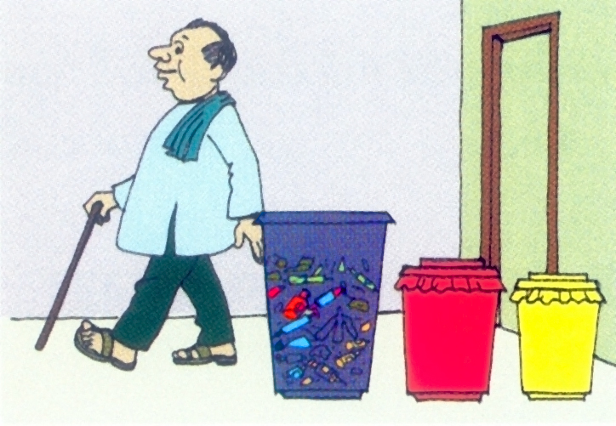
Biomedical Waste Disposal: B. Collection and Storage
Wrong
Correct

Slide 18
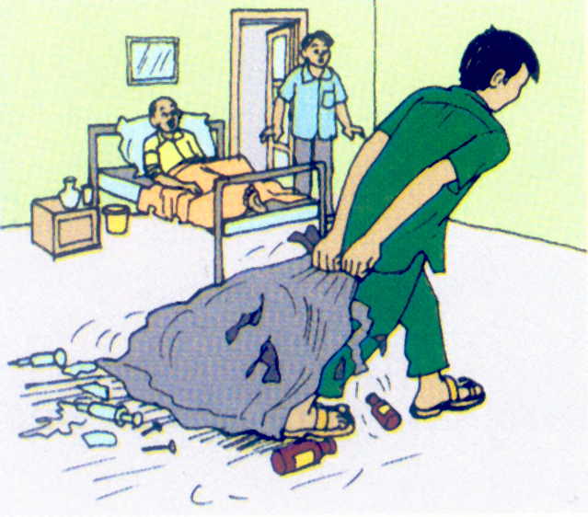
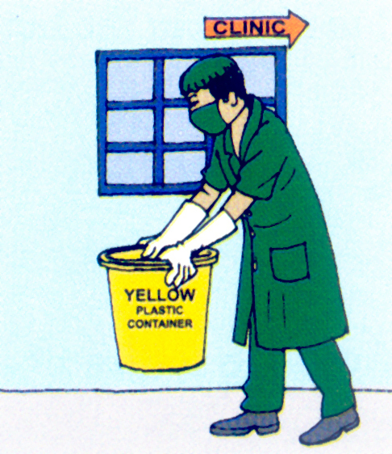
Biomedical Waste Disposal: C. Transportation
Wrong
Correct

Slide 19
Biomedical Waste Disposal: D. Treatment and Disposal
Treatment and disposal options of bio-medical waste as per GoI guideline
There should be no chemical pretreatment before incineration, except for microbiological, lab and highly infectious waste
Disposal by deep burial is permitted only in rural or remote areas where there is no access to common bio-medical waste treatment facility, with prior approval from the prescribed authority
Deep burial facility should be located as per the Central Pollution Control Board provisions
Plastic waste should never be sent to/put in landfills

Slide 20
Key Messages
Consider all objects coming in contact with client and every person as potentially infectious
If an object is disposable, discard as waste, if reusable-prevent infection by decontamination, cleaning, disinfecting or sterilizing and storing appropriately
The first step in processing of used instruments is decontamination i.e. immersing instruments in 0.5% chlorine solution for 10 minutes specifically to kill HIV and Hepatitis B and C viruses and protecting handling staff from infections
In BMWM, the first step is segregation of waste at the source of generation in different colour coded bins

