Slide 1
Prolonged and Obstructed Labour

Slide 2
Learning Objectives
At the end of this session, learners will be able to:
State the definitions of prolonged and obstructed labour in relation to the expected duration of normal labour
Interpret partograph findings to diagnose prolonged and obstructed labour
Discuss symptoms, signs and management of prolonged and obstructed labour

Slide 3
Obstructed labour is One of the Most Important Causes of Maternal Mortality
Mortality and morbidity from prolonged and obstructed labour can be reduced by
Appropriate obstetric examination before and during labour to rule out Cephalo Pelvic Disproportion (CPD) and malpresentations
Proper monitoring of progress of labour through partograph
Timely decision making for interventions

Slide 4
Definitions
PROLONGED LABOUR- After onset of regular, rhythmical painful contractions accompanied by cervical dilation i.e. true labour where labour is longer than 24 hours.
OBSTRUCTED LABOUR- Means in spite of strong uterine contractions, the foetus cannot descend because of mechanical factors due to fetal or maternal reasons; at the inlet, within cavity or outlet.

Slide 5
Factors Influencing Delivery Process- PPP
Power
(Uterine contraction strength)
Weak uterine contractions lead to unsatisfactory progress of labour or prolonged labour
Passenger
(Fetal condition, lie, and presentation)
The Malpositions or malpresentations or any congenital anomaly can lead to prolonged or obstructed labour
Passage
(Pelvic Adequacy)
Inadequate pelvis in relation to presenting part leads to CPD and thus obstructed labour
    Malpositions: are abnormal position of the vertex of the foetal head (with occiput as the reference point) relative to the maternal pelvis.
    Malpresentations: of the fetus are all presentations other than vertex

Slide 6
Complications
Maternal Complications
Maternal death
Uterine rupture
Fistulae
Premature rupture of membranes
Slow dilatation or edema of cervix
Maternal fatigue
Sepsis
Foetal complications
Foetal death
Birth asphyxia and its complications
Caput succedaneum
Excessive moulding of fetal skull
Sepsis

Slide 7
Important Clinical Situations to Understand Prolonged and Obstructed Labour
Prolonged Labour
Woman has been experiencing labour pains for 24 hours or more without delivery
  Prolonged Latent Phase
  Woman is in true labour but her cervical dilatation has not progressed at all or has not reached 4 cm in 8 hours
  Prolonged Active Phase
  Woman is in active phase of labour (> =4 cm dilatation achieved) but cervical dilatation is not occurring at the rate of 1 cm/hour (overall should not last more than 12 hours)
  Prolonged Expulsive Phase
  Woman is in second stage of labour (> 10 cm dilatation achieved) but baby is not delivered for more than 2 hours even after the woman has an urge to push

Slide 8
Important Clinical Situations to Understand Prolonged and Obstructed Labour
Obstructed Labour
Obstructed labour is a clinical diagnosis that can occur at any time during active phase or second stage of labour. Obstructed labour means that uterine activity is good but there is still no descent of foetus.
It can occur due to CPD , malpresentations/malpositions, foetal abnormalities.
Obstructed labour can be prevented by proper obstetric examination and monitoring of progress of labour.
Inadequate uterine activity
Means Less than 3 contractions in 10 minutes, each lasting less than 40 seconds. Can occur anytime during active phase of labour. Can cause prolonged labour.

Slide 9
PARTOGRAPH – CASE STUDY 1
Radha (wife of Gangaram), 26 years of age, third gravida, was admitted at 5:00 am on 11 June 2009 with the complaint of labour pains since 2:00 am. Her membranes had ruptured at 4:00 am. She has two children of the ages of 5 and 2 years. On admission, her cervix was 2 cm dilated.
Plot the following findings on the partograph:
At 09:00 am: • The cervix is dilated 5 cm.
• She had 2 contractions in 10 minutes, each lasting <20 seconds.
• The FHR is 120 beats per minute.
• The membranes have ruptured and the amniotic fluid is clear.
• Her BP is 120/70 mmHg.
• Her temperature is 36.8°C.
• Her pulse is 80 per minute.
9:30 am: FHR 120, contractions 2/10 each <20 seconds, pulse 80/minute, amniotic fluid clear
10:00 am: FHR 136, contractions 2/10 each <20 seconds, pulse 80/minute, amniotic fluid clear
10:30 am: FHR 140, contractions 2/10 each <20 seconds, pulse 88/minute, amniotic fluid clear
11:00 am: FHR 130, contractions 2/10 each <20 seconds, pulse 88/minute, amniotic fluid clear
11:30 am: FHR 136, contractions 2/10 each <20 seconds, pulse 84/minute, amniotic fluid clear
12:00 noon: FHR 140, contractions 2/10 each <20 seconds, pulse 88/minute, amniotic fluid clear
12:30 pm: FHR 130, contractions 2/10 each <20 seconds, pulse 88/minute, amniotic fluid clear
1:00 pm: FHR 140, contractions 2/10 each <20 seconds, pulse 90/minute, temp. 37°C, BP 100/70 , amniotic fluid clear
At 1:00 pm:
• Cervix dilatation 6 cm
• Amniotic fluid clear and BP 100/70 mmHg

Slide 10
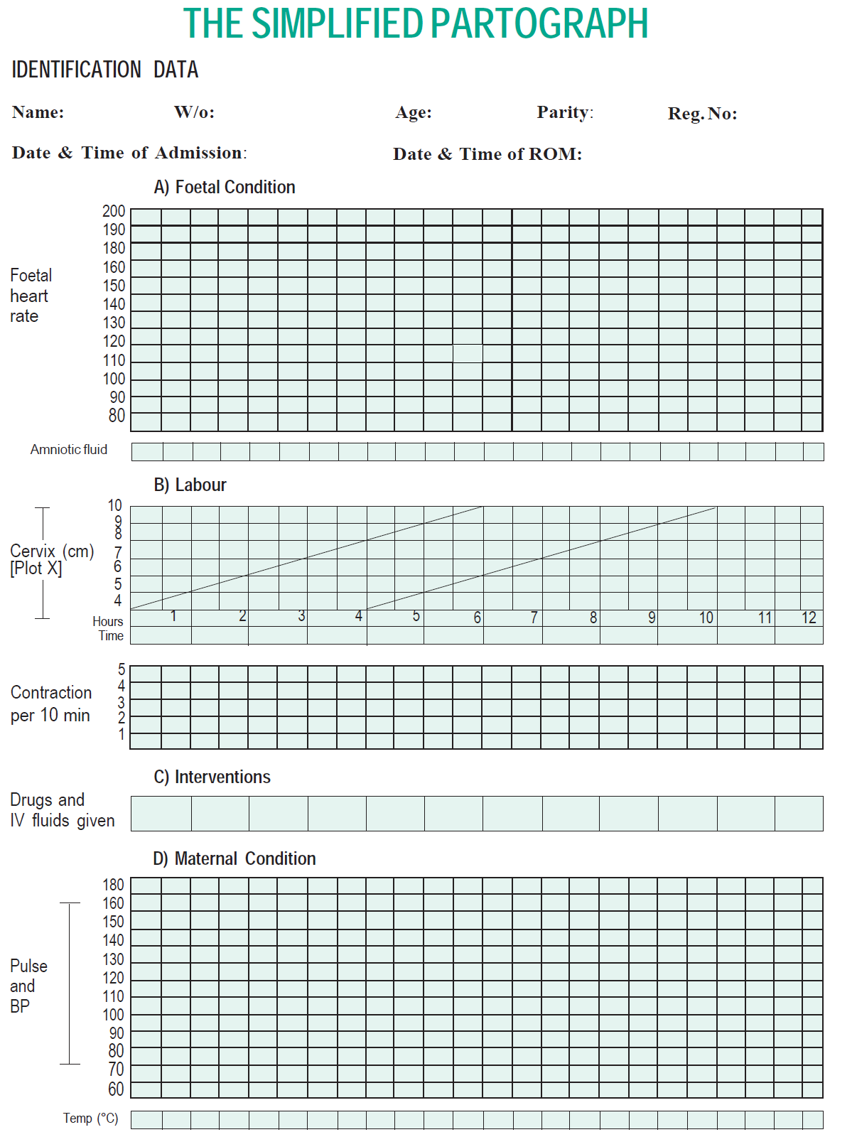
Radha
Gangaram
26 Years
G₃P₂L₂A₀
XYZ1
11/06/09,5:00Hrs
11/06/09, 04:00 Hrs
C
C
C
C
C
C
C
C
C
Cervix dilated = 5cm
9 AM
10 AM
11 AM
12 PM
1 PM
2 CONTRACTION
36.8 C
37 C

Slide 11
Prolonged Labour

Slide 12
Management: Prolonged Latent Phase
Woman is in true labour
Initiate supportive care such as ambulation, maintaining hydration and emotional support by birth companion
If woman does not achieve 4 cm dilatation of cervix within 8 hours even after above mentioned measures
  Call obstetrician/EmONC trained doctor if available to assess the progress of labour and decide the course of action
  Refer the case to a higher center (facility with caesarean section) if obstetrician/EmONC trained doctor is not available

Slide 13
Management: Prolonged Active Phase
Once the woman has achieved dilatation of cervix >=4 cm
Start filling partograph to monitor progress of labour
If the cervical dilatation crosses alert line and/or foetal heart rate shows foetal distress, do the following:
  Call obstetrician/EmONC trained doctor if available to assess the progress of labour and decide the course of action
  Refer the case to a higher center (facility with caesarean section) if obstetrician/EmONC trained doctor is not available

Slide 14
Management: Prolonged Expulsive Phase
Once the woman has achieved full dilatation of cervix
monitor fetal heart rate, contractions and descent of head
If delivery of baby does not happen within two hours of full dilatation of cervix or there are signs of fetal distress, do the following:
  Call obstetrician/EmONC trained doctor if available to assess the progress of labour and decide the course of action
  Refer the case to a higher center (facility with caesarean section) if obstetrician/EmONC trained doctor is not available

Slide 15
PARTOGRAPH – CASE STUDY 2
Radha (wife of Gangaram), 26 years of age, third gravida, was admitted at 5:00 am on 11 June 2009 with the complaint of labour pains since 2:00 am. Her membranes had ruptured at 4:00 am. She has two children of the ages of 5 and 2 years. On admission, her cervix was 2 cm dilated.
Plot the following findings on the partograph:
At 09:00 am: • The cervix is dilated 5 cm.
• She had 3 contractions in 10 minutes, each lasting 20-40seconds.
• The FHR is 120 beats per minute.
• The membranes have ruptured and the amniotic fluid is clear.
• Her BP is 120/70 mmHg.
• Her temperature is 36.8°C.
• Her pulse is 80 per minute.
9:30 am: FHR 120, contractions 3/10 each 20-40 seconds, pulse 80/minute, amniotic fluid clear
10:00 am: FHR 136, contractions 3/10 each 20-40 seconds, pulse 80/minute, amniotic fluid clear
10:30 am: FHR 140, contractions 3/10 each 20-40 seconds, pulse 88/minute, amniotic fluid clear
11:00 am: FHR 130, contractions 3/10 each 20-40 seconds, pulse 88/minute, amniotic fluid meconium stained
11:30 am: FHR 130, contractions 3/10 each 20-40 seconds, pulse 84/minute, amniotic fluid meconium stained
12:00 noon: FHR 140, contractions 4/10 each 45 seconds, pulse 100/minute, amniotic fluid meconium stained
12:30 pm: FHR 100, contractions 4/10 each 45seconds, pulse 100/minute, amniotic fluid meconium stained
1:00 pm: FHR 100, contractions 4/10 each 45 seconds, pulse 110/minute, temp. 37°C, BP 100/70 , amniotic fluid meconium stained
At 1:00 pm:
• Cervix dilatation 6 cm
• Amniotic fluid meconium stained and BP 100/70 mmHg

Slide 16
Radha
Gangaram
26 Years
G₃P₂L₂A₀
XYZ1
11/06/09,5:00Hrs
11/06/09, 04:00 Hrs
C
C
C
C
M
M
M
M
M
Cervix dilated = 5cm
9 AM
10 AM
11 AM
12 PM
1 PM
36.8 C
37 C

Slide 17
Obstructed Labour

Slide 18
Clinical Picture
History, age, parity
Previous operative delivery
Previous still birth
Duration of labour so far
Previous history of babies with developmental anomalies
Progress of labour
Rupture of membranes and their timing

Slide 19
Findings of Clinical Examination
General examination
Physical and mental exhaustion
Dehydration
ketoacidosis
Fever
Shock due to ruptured uterus or sepsis
Foetal condition: try and listen for FHR
Vaginal examination:
Foul smelling meconium may be seen
Amniotic fluid may have already drained away
Edema of the vulva
Vagina hot and dry
Large caput

Slide 20
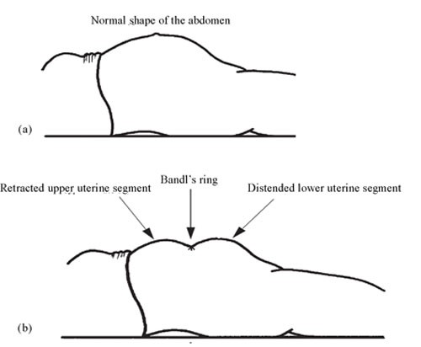
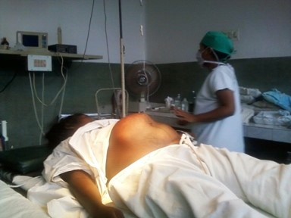
Findings of Clinical Examination (Contd..)
Abdominal Examination
Foetal head above pelvic brim
Women may have frequent & strong contractions or they may have stopped due to uterine inertia or rupture of the uterus.
Bandl’s RING may be seen at:
  Area between upper and lower uterine segments when it becomes visible/ palpable
  Depression across the abdomen at the level of umbilicus.
  Shape of uterus looks like a peanut shell

Slide 21
Management: Obstructed Labour
In ideal situation, complications from obstructed labour can be avoided through timely identification of cephalo-pelvic disproportion and appropriate monitoring of progress of labour
If obstructed labour has been confirmed, do the following:
Rehydrate the patient
Start an i/v line R/L or normal saline @ 25-30 drops/min
Give antibiotics
Inj. Ampicillin 1 gm IV after sensitivity testing
Inj. Gentamicin 80 mg iv
Inj. Metronidazole 500 mg iv
Refer the patient to FRU

Slide 22
Symptoms and Signs: Ruptured Uterus
Symptoms
Shock may be present
Severe abdominal pain
Vaginal bleeding may be present
Signs
Abdominal tenderness
Foetal parts felt superficially
Uterine contour not felt
FHS not heard
It is a life threatening condition
Manage shock and refer immediately

Slide 23
Key Messages
Obstructed labour is one of the important causes of maternal deaths
Partograph helps to identify it and any deviations from normal in foetal and maternal condition and progress of labour early
Prolonged and obstructed labour should be diagnosed early and managed promptly to prevent complications and adverse maternal and foetal outcomes
Augmentation should only be done in indicated cases and at equipped centers under expert medical guidance

