Slide 1
Prevention, Identification and Management of PPH

Slide 2
Learning Objectives
By the end of this session, learners will be able to:
Define PPH and list its causes
Describe the importance of AMTSL and other measures to prevent PPH
Describe ways to identify PPH clinically
Describe ways to identify and manage shock
Describe the cause specific management of PPH
Demonstrate the initial management of retained placenta and atonic PPH including bimanual uterine compression, aortic compression and condom tamponade on model

Slide 3
Prevention of PPH is the Most Important
Part of its Management
PPH can be prevented by:
  Ensuring BPCR, SBA and treatment of anaemia
  Early identification of prolonged and obstructed labour by partograph
  Avoiding unnecessary augmentation, fundal pressure and episiotomies
  Controlled head delivery with perineal support
  Active Management of Third stage of Labour (AMTSL)
  Checking of completeness of placenta after delivery

Slide 4
Identification of PPH
Loss of 500 ml or more of blood during delivery and up to six weeks after delivery (may be less in anemia)
or
Blood loss sufficient to cause signs and symptoms of hypovolemia
or
Woman soaks 1 pad or cloth in <5 min

Slide 5
Causes of PPH
Primary/ Immediate PPH
Secondary/ Delayed PPH
Occurring during delivery till 24 hours postpartum
Tone - Atonic PPH - Most common cause (80-90%)
Tears or trauma
Tissue - retained or incomplete placenta, membranes
Thromboembolic - Coagulopathy
From 24 hours postpartum till 42 days or 6 weeks
Infection in the uterus
Retained placental fragments

Slide 6
Principles of Management of PPH
Call for additional support
Manage shock
Continue uterine massage
Treat specific causes of PPH
    Try medical (uterotonics) and conservative management (such as bimanual compression, aortic compression, balloon tamponade) before conducting surgical procedures
Patient’s condition should be stabilized before any referrals are done
In cases there is need for referral continue fluids, uterotonics and temporizing measures if needed to control the bleeding
Remember that the interval from the onset of PPH to death can be as little as two hours, unless appropriate life-saving steps are taken immediately.

Slide 7
Identification of Shock
Signs of shock:
Tachycardia - Fast, thin thready pulse, >110/minute
Tachypnoea - Fast respiratory rate
Hypotension - Fall in systolic BP, <90 mm of Hg
Hypothermia - Skin cold and clammy
Altered sensorium - Drowsy, semi conscious or unconscious

Slide 8
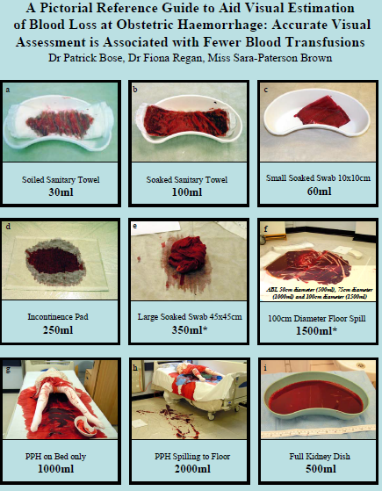

Slide 9
Classification of hypovolemic shock
Signs | Class I | Class II | Class III | Class IV
Blood loss (mL) | 500-1000 15% | 1200-1500 20-25% | 1800-2100 30-35% | > 2400 > 40%
Pulse/min | Normal | 100 | 120 | 140
Systolic BP (mm Hg) | Normal | Normal | 70-80 | 60
Tissue Perfusion | No symptoms or signs |  | Pallor, rapid respiration, restlessness, oliguria, cold skin | Collapse, anuria, Rapid RR (air hunger), cold skin
Mental status | Normal |  | Agitated response | Confused, agitated, aggressive
The blood loss is replaced by IV fluids. IV fluids should be given when losses amount to 700mls Initially give 1 lt in 20 min and decide further fluid requirement based on the vital parameters
Blood Volume 65 ml/Kg

Slide 10
Assessment of Blood Loss
Recognize PPH by correctly assessing the blood loss after childbirth.
Until the woman loses upto 1000 ml of blood her pulse rate, BP, general condition can appear as normal
Pulse 100 /min and BP normal → blood loss can be 1200 ml or more
Pulse 120/min , systolic BP is 80 mm Hg or less, woman is pale, cold, restless and agitated : Blood loss is 1800 – 2000 ml
Woman with low BMI Blood volume is less
Severe PE/Eclampsia
Moderate/severe anaemia

Slide 11
Initial Management of PPH
Shout for Help: Mobilize all available health personnel
Evaluate Vital Signs: Pulse, BP, respiration and temperature
Establish two IV lines with wide bore cannula (16-18 gauge), draw blood for blood grouping and cross matching; catheterize the bladder
Start rapid infusion using cannula number 16 with Normal Saline/ Ringer Lactate, 1L in 15-20 mins
Give Inj. Oxytocin 10 IU I/M (if not already given)
Start Inj. Oxytocin 20 IU in 1000mL RL @ 40-60 drops/min.
Give Oxygen @ 6-8 L per minute by mask
Monitor vital signs and blood loss (every 15 minutes)
Monitor fluid intake and urinary output
Check if placenta has been expelled- manage cause specific PPH

Slide 12
Volume Replacement
I/V Fluids -Give 3 mL of fluid for 1 mL of blood loss. Only crystalloids 5% (Ringer lactate, Hartman’s solution or 0.9% normal saline) should be used, dextrose and colloids are to be avoided. Evidence from RCT does not support the continued use of 5% dextrose and colloid for volume replacement in critically ill patients, the former is inappropriate because (a) only 10% will be maintained in the circulation; (b) it affects the platelet function and compatibility testing.
Blood transfusion is always required where blood loss is in excess of 40% of the patient’s blood volume representing 2000-3000mL.
Fresh frozen plasma, cryoprecipitate and platelet concentrates

Slide 13
Cause Specific Management: Atonic PPH
Massage uterus to stimulate effective uterine contractions
If still uterus is relaxed can give other uterotonics like prostaglandins (misoprostol or carboprostol) or methyl ergometrine or combination of oxytocin and methyl ergometrine
If uterus is still relaxed- examine placenta for completeness, if placenta complete and uterus still relaxed, perform bimanual uterine compression/aortic compression as a temporary measure, perform condom tamponade (at facilities where medical officers available)
Arrange for transportation to FRU where facilities for blood transfusion and surgery available
If bleeding is controlled by drugs- repeat uterine massage every 15 min for first 2 hrs, closely monitor vitals, continue oxytocin (total not exceeding 100 IU in 24 hrs)

Slide 14
Drugs for PPH Management
Drug | Dose and route | Continue dose | Max dose | Precaution and contraindication
Oxytocin | 20IU in 1000ml RL/DNS 60 drops/ min IV infusion | IV infuse 20 IU in 1000ml RL/DNS 40 drops/min IV infusion | Not more than 3L of IV fluids containing Oxytocin | Do not give IV as bolus
Ergometrine | IM or IV (slowly) 0.2 mg | Repeat 0.2. mg after 15 min. If required give 0.2 mg IM/IV slowly every 4 hrs | Five dose (Total 1.0mg) | High BP, PE, Heart disease
15- Methyl prostaglandin F2-alpha | IM o.25 mg | 0.25 mg every 15 min | 8 doses (total 2mg) | Asthma
Misoprostol PGE-1 | 800 micrograms PR/sublingual | Single dose | Single dose | -

Slide 15
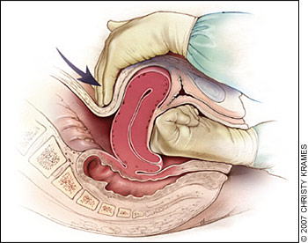
Bimanual Uterine Compression
Empty urinary bladder with Foley’s catheter
Insert gloved hand in vagina, remove any visible clots from vagina
Place fist in anterior vaginal fornix and press against anterior wall of uterus
Place other hand on abdomen behind uterus, pressing against posterior wall of uterus
Maintain compression until bleeding is controlled and uterus contracts

Slide 16
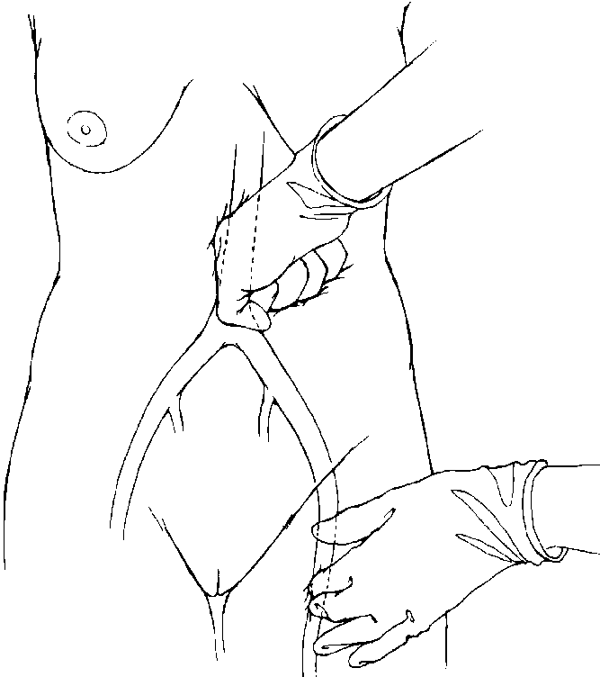
Compression of Abdominal Aorta
Apply downward pressure with closed fist over abdominal aorta directly through abdominal wall
With other hand, palpate femoral pulse to check adequacy of compression
  Pulse palpable = inadequate
  Pulse not palpable = adequate
Maintain compression until bleeding is controlled

Slide 17
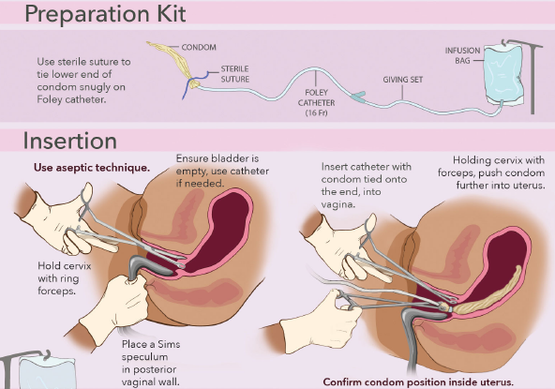
Condom Tamponade
Insertion:
Ensure that the bladder is empty.
Hold cervix with a ring forceps.
Place a Sims speculum in posterior vaginal wall.
Insert catheter with condom tied onto the end (tied using sterile suture), into the vagina.
Holding cervix with forceps, push condom further into uterus.
Source: Jhpiego

Slide 18
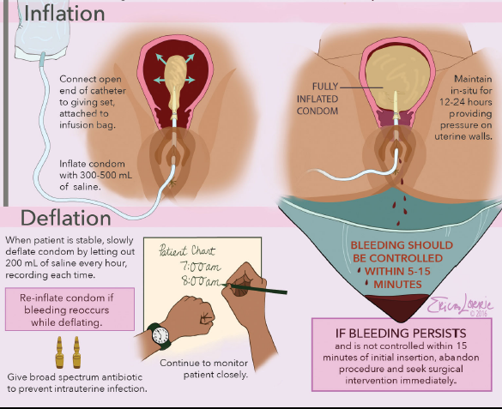
Condom Tamponade
Inflation:
Connect open end of catheter to IV set attached to infusion bag & inflate with 300 to 500 ml saline.
Clamp catheter after inflating.
Maintain in-situ for 12 to 24 hours.
Keep bladder empty by indwelling Foley's, put on woman on prophylactic antibiotics.
Monitor the patient closely.
Source: Jhpiego

Slide 19
Cause Specific Management: Tears or Trauma
Suspect tears in case of contracted uterus with PPH:
Look perineum, cervix and vagina for any tears or laceration
In case of 1st degree perineal tears apply pressure through perineal pads
In case of 2nd, 3rd or 4th degree perineal tears or cervical tears. Cover tear with sterile pad, establish IV line , infuse fluids rapidly, raise foot end of stretcher, keep her warm during transportation and refer woman to higher center for suturing
Notes:
Types of perineal tears:
First degree: Injury to perineal skin only
Second degree: Injury to perineum involving perineal muscles but not involving the anal sphincter.
Third degree: Injury to perineum involving partial or complete disruption of the anal sphincter, which may involve either or both the external (EAS) and internal anal sphincter (IAS) muscles.
Fourth degree: Disruption of the anal sphincter muscles with a breach of the rectal mucosa

Slide 20
Cause Specific Management: PPH due to
Retained Placenta
If placenta is not out with CCT during AMTSL for 30 minutes suspect retained placenta
Give Inj. Oxytocin 10 IU I/M stat if not given during AMTSL
Add 20 IU of oxytocin to 1000 ml of Ringer Lactate or normal saline and infuse at the rate of 40-60 drops/minute
Arrange for blood donor. Arrange for transportation to FRU where facilities for blood transfusion and MRP is available
Give first dose of broad spectrum antibiotics before referral
Do not attempt manual removal of placenta at centers where operative facilities are not available

Slide 21
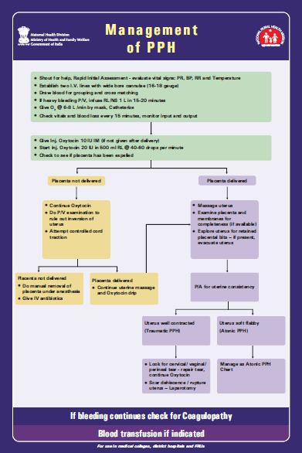

Slide 22
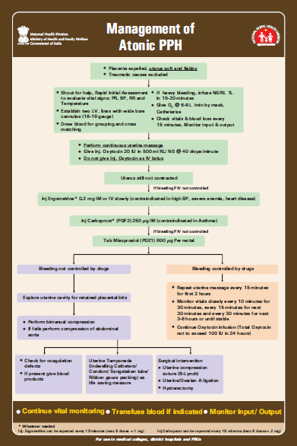

Slide 23
Key Messages
PPH is the most important causes of maternal deaths
70% chances of PPH can be prevented by doing AMTSL for every delivery
Deaths from PPH can occur within 2 hours of its occurrence, so timely identification, management and/or referral is very important
If the woman is in shock, manage it and stabilize her on priority then manage PPH according to the cause
Major cause of PPH is due to atonic uterus which can be prevented by AMTSL and early initiation of breastfeeding
Secondary PPH is mainly due to infection of uterus so apart from PPH management, antibiotics will be required in such cases if the woman has fever and foul smelling lochia

