Slide 1
Second Stage of Labour and AMTSL

Slide 2
Learning Objectives
By the end of this session, learners will be able to:
Describe management of 2nd stage of labour and AMTSL
Describe imminent signs of delivery, controlled delivery of head, shoulders and body
Describe the importance of three steps of AMTSL

Slide 3
What is Second Stage of Labour?
Part of labour beginning with full dilatation of cervix and ends with the expulsion of the foetus
Normally lasts between 1 – 2 hours

Slide 4
Care during Early part of Second Stage
By the time pregnant woman attains full dilatation of cervix, you would have already shifted her to labour room.
Watch for signs of imminent delivery (provide supportive care)
  Gaping of vulva
  Thinning and bulging of perineum
  Pouting of anus
  Head of the baby seen at vulva
  Urge to push
Encourage the woman to push during contractions when she has an urge to do so while taking deep breaths
Notes:
Do,s & Don’’ts
Such as no routine shaving, enema, and augmentation

Slide 5
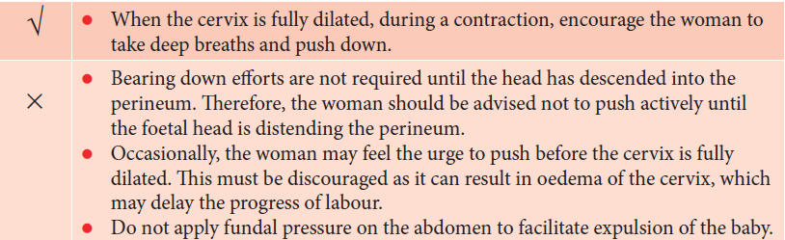
Care during Early part of Second Stage

Slide 6
Supporting Delivery of Head
Clean the perineum with anti-septic solution with strokes of swabs from above downward
Ensure controlled delivery of the head:
  Keep one hand gently on the head as it advances with contractions.
  Support perineum with other hand and cover anus with pad held in position by palm of the hand during delivery.
  Ask the mother to breathe steadily and push only during contraction.
  Encourage rapid breathing with mouth open.
  Allow spontaneous rotation and restitution of head after delivery

Slide 7
Managing Cord Around Neck
Feel gently around the baby’s neck for presence of umbilical cord
If it is loose around the neck, deliver the baby through the loop of the cord, or slip the cord over the baby’s head
If it is tight around the neck, doubly clamp and cut in between

Slide 8
Delivery of Shoulders and Rest of the Body
Wait for the spontaneous rotation and delivery of the shoulders. This usually happens within 1-2 minutes of delivery of head
Apply gentle pressure downwards to deliver the top (anterior) shoulder
Then lift the baby up, towards the mother’s abdomen, to deliver the lower (posterior) shoulder
Rest of the baby’s body follows smoothly
Note the time of birth

Slide 9
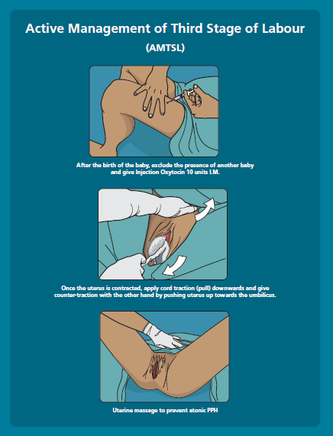
Active Management of Third Stage of Labour (AMTSL)
The three critical steps of AMTSL are:
  Administration of uterotonic drug ( Inj Oxytocin-10IU,IM/ Tab Misoprostol-600mcg,oral)
  Controlled cord traction
  Uterine massage
Approximately 66% cases of PPH can be prevented if AMTSL is done in all cases after delivery
It helps in expulsion of placenta and reduction in blood loss to mother
Notes:
giving uterotonic i.e. inj. Oxytocin 10 IU (drug of choice) or tab misoprostol 3 tablets of 200 mcg each or one tablet of 600 mcg within 1 minute of delivery of baby after ruling out another baby in the uterus

Slide 10
Key Messages
Encourage woman to push down only during contractions and after she feels an urge to push
Ensure delayed cord clamping and cutting (after 1-3 minutes of delivery of baby)
Perform active management of third stage of labour in all cases to help in separation of placenta and prevent PPH:
  Give uterotonic (injection Oxytocin 10 IU IM) immediately after the delivery of baby
  Perform controlled cord traction to help deliver the placenta
  Perform uterine massage
Notes:
Examine the placenta for its completeness:
Maternal surface
Foetal surface
Membranes (hang the placenta by holding the cord)
Cut end of cord (2 arteries, 1 vein)

