Slide 1
Essential New Born Care (ENBC)

Slide 2
Learning Objectives
By the end of this session, learners will be able to:
Describe the importance of newborn care at birth
List the steps of ENBC and their benefits
Describe importance of giving injection Vitamin K to every newborn with route and doses

Slide 3
Importance of Care for Newborn at Birth
Most of the neonatal deaths occur during delivery or on the day of birth
Even for the deaths occurring in the rest of neonatal period, care given at the time of birth is an important influencer
A lot of deaths of newborns due to hypothermia, asphyxia and infection can be prevented by providing essential newborn care to all newborns immediately after birth
Source:: JE Lawn et al.; Every newborn, progress, priorities and potential beyond survival; The Lancet (DOI:10.1016/S0140-6736(14)60496-7).

Slide 4
Essential New Born Care (ENBC)
Call out the time of birth.
Deliver the baby onto a warm, clean and dry towel or cloth and keep on mother’s chest and abdomen (between the breasts).
Assess the baby’s breathing while drying.*
Immediately dry the baby with a warm clean towel or piece of cloth.
Clamp and cut the umbilical cord when cord pulsation stops or in 1-3 minutes (delayed cord clamping).
Leave the baby between the mother’s breasts to start skin-to-skin care.
Place an identity label on the baby.
Cover the baby’s head with a cap. Cover the mother and baby with a warm cloth.
Encourage the initiation of breastfeeding.
Administer inj. Vitamin K intramuscular to baby according to weight
* - if the baby is not crying or breathing well, resuscitation needs to be carried out.

Slide 5
Benefits of Essential Newborn Care
Place on dry and warm towel
Warmth
Immediate drying
Cover baby’s head with cap
Skin to skin contact
Infection prevention
Clean cord cut , cord tie and dry cord stump
ENBC
Mother’s milk
Early initiation of breast feeding
Breathing
Assess while drying
Delayed cord clamping
Prevent neonatal anemia

Slide 6
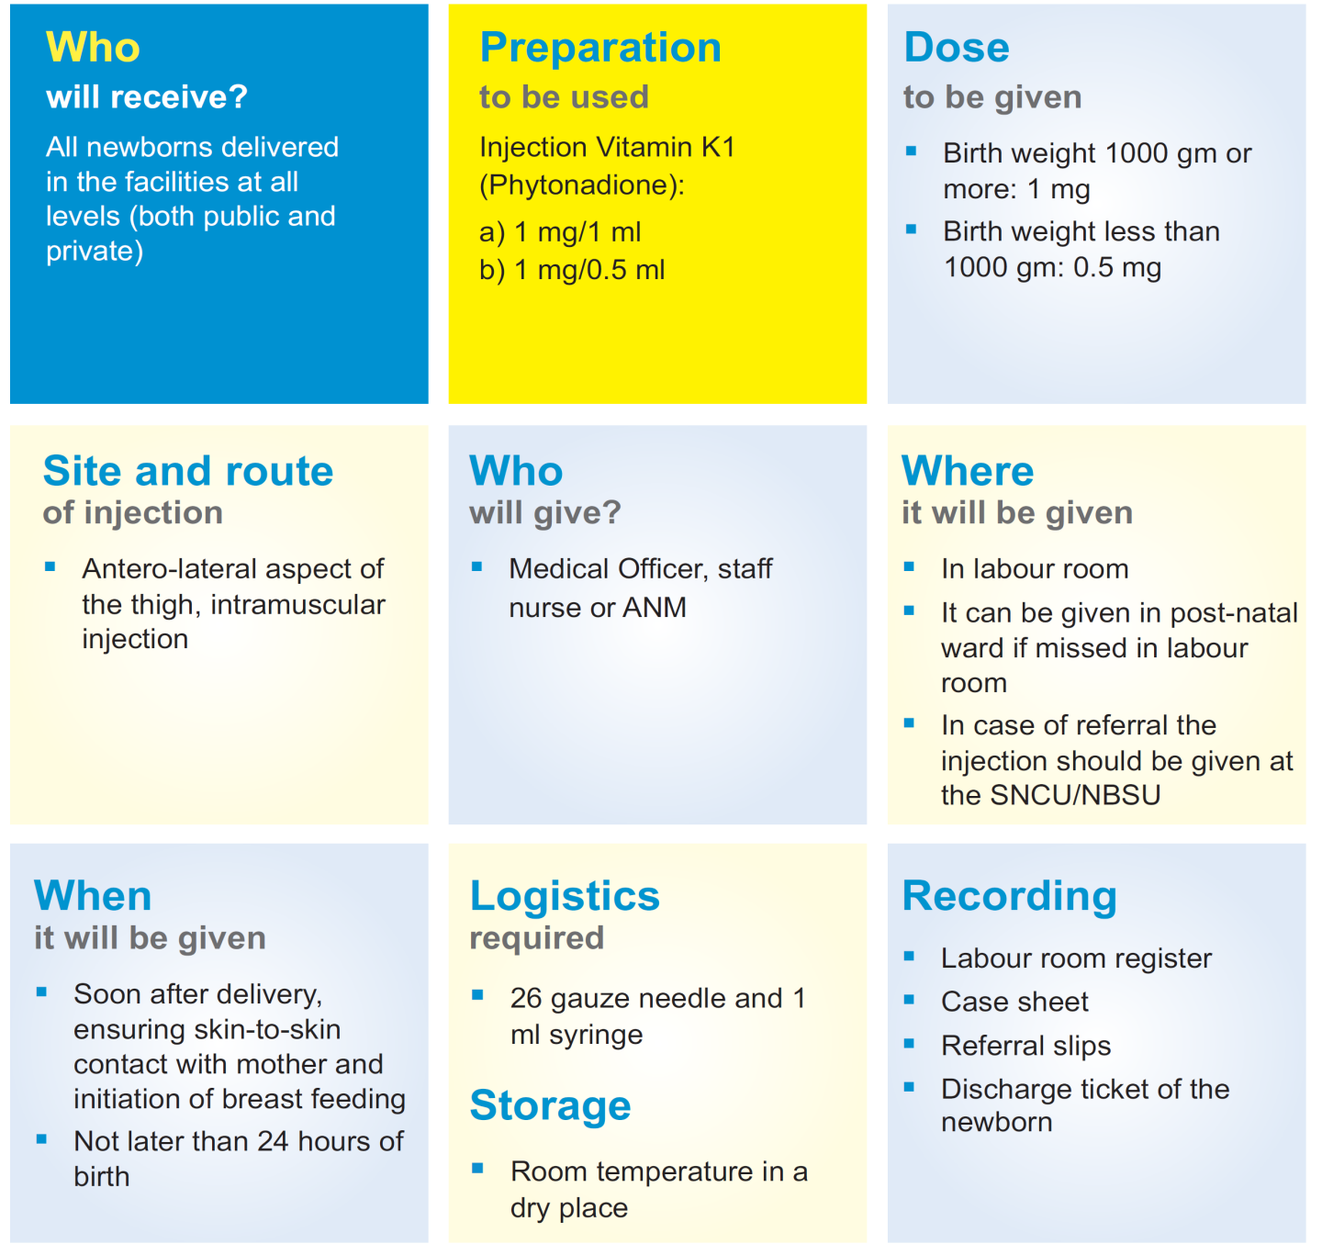
Injection Vitamin K for Newborn
Benefits of Vit K
Prevents hemorrhagic disease of newborn

Slide 7
Key Messages
Most of the neonatal deaths occur during delivery or on the day of birth
Newborn deaths due to hypothermia, asphyxia and infection can be prevented by providing ENBC to all of them immediately after birth
Hypothermia can be prevented by immediate drying and keeping the baby in a dry cloth, skin-to-skin contact with mother and baby covered together and covering baby’s head with cap
Assess baby for breathing to prevent asphyxia and initiate immediate breastfeeding to prevent hypoglycemia
Give injection vitamin K to every baby to prevent haemorragic disease of newborn.

