Slide 1


Institutionalizing Life-saving Practices in Target Facilities
DAKSHATA

Slide 2
Institutionalizing Life-saving Practices
Adherence to life-saving practices
Skill-building
Post-training mentorship
Compliance tools
Enabling environment

Slide 3
Strategic Skill Building- Methodology
For skill building
Use of models
Case-based practice
For knowledge
Interactive PPTs
AV Aids-videos
For hands-on practice
Evening LR visits
Providers need to stay at district

Slide 4
Training Plan
Onsite training for district level facilities (DLF)
Post-training support at DLFs
SCC is used at DLFs
Practice standards are met at DLFs
Staff from sub-district facilities undergo residential training at DLF

Slide 5
Training Human Resource
For District Level Facilities:
District Quality Improvement Mentor
State level trainers
Jhpiego trainers
For Sub-district Level Facilities:
District Quality Improvement Mentor
District master trainers
From existing pool of SBA, NSSK, and skills-labs trainers

Slide 6
Developing Training Plans
Lists all staff involved in childbirth process
Prioritize those currently posted in labor rooms
Prepare name-wise batch micro-plan for the training
Prepare name-wise training plan for each facility
Track training status of staff posted in the district

Slide 7
Developing Training Plans
The goal is to rapidly saturate facilities with trained providers
Create batch in a way that all staff of one facility is trained over 3-4 batches
Plan batches in a way to cover high-delivery load facilities first
Plan facilities in a way that geographic proximity is maintained to facilitate mentorship visits

Slide 8
Developing Training Plans- Example
District A
Batch | Facility
1 | A, B, E
2 | A, B, E
3 | A, B, E
A
D
DLF
E
B
4 | C, D, H, I
5 | C, D, H, I
6 | C, D, H, I
7 | C, D, H, I
C
I
F
G
H
8 | F, G
9 | F, G + remaining

Slide 9
Organizing Trainings
Issue name-wise orders for deployment for training
Issue clear instructions for residential nature of the training
Make arrangement for stay near the DLF
Finalize the name of contact persons for evening shift postings of the trainees
Provide practice observation log for evening shift

Slide 10
Monitoring Trainings
Visits by district nodal person to the training venue and evening posting to check presence
Shift nodal person to sign the practice observation log for each participant
Daily compilation of training attendance sheets
Monthly training report to be submitted to the state level

Slide 11
Guiding Principles for the Trainings
Target all Staff
involved in childbirth
Train more from a few facilities rather than few from many to
Rapidly Saturate Facilities
with trained providers
Monitor Attendance
to ensure participation
Ensure Trainings are Residential
to facilitate evening hands-on practice

Slide 12
Post-training Mentorship and Support
Who?
District Quality Improvement Mentor
When?
First visit within 15 days of completion of training
After that once every 15 days for 2 months
Once in a month for 6 months
Subsequently once every quarter for the next 3-4 quarters
What?
Observation of practices
Review of facility records
Feedback and action planning
District Master Trainers
District level officials
On-the-job handholding and training

Slide 13
Operational Aspects of Mentorship visits
Timely and adequate transportation support (budgeted in PIPs)
Appropriate administrative orders to the facilities
Periodic review of status of mentorship visits to the facilities
Review of mentorship actions during administrative visits

Slide 14
Ensuring Compliance to Safe Care Practices
Institutional Level
Case Level
Performance Standards
Safe Childbirth Checklist
Action plan preparation and follow up
All-staff participation for facility level actions
Handholding on SCC use for each case
Individual staff focus whenever possible

Slide 15
The Safe Childbirth Checklist (SCC)
Is part of the client case-sheet
Focuses on the life-saving practices in line with Dakshata
Helps health workers to remember to perform all essential practices
Needs to be completed in all delivery case in each facility
Use need to be emphasized during each supervision and mentorship visit

Slide 16
The SCC is Organized Around 4Pause Points/Checks?
A Check is a time during the delivery process where the service provider can briefly stop and :
Review the condition of the woman and the newborn baby
Check whether he/she has performed all the essential activities for safe care
Prepare for safe care activities that need to be performed next
On Admission
Just Before and during birth
(or Cesarean)
At Discharge
Soon After Delivery
(within 1 hour)
The Checklist Is Organized Around 4 Pause Points/Checks

Slide 17
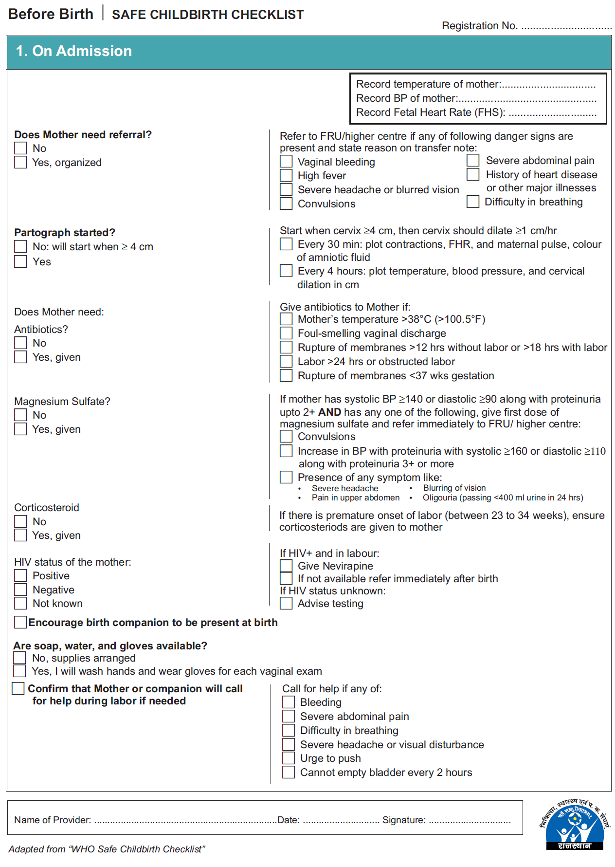
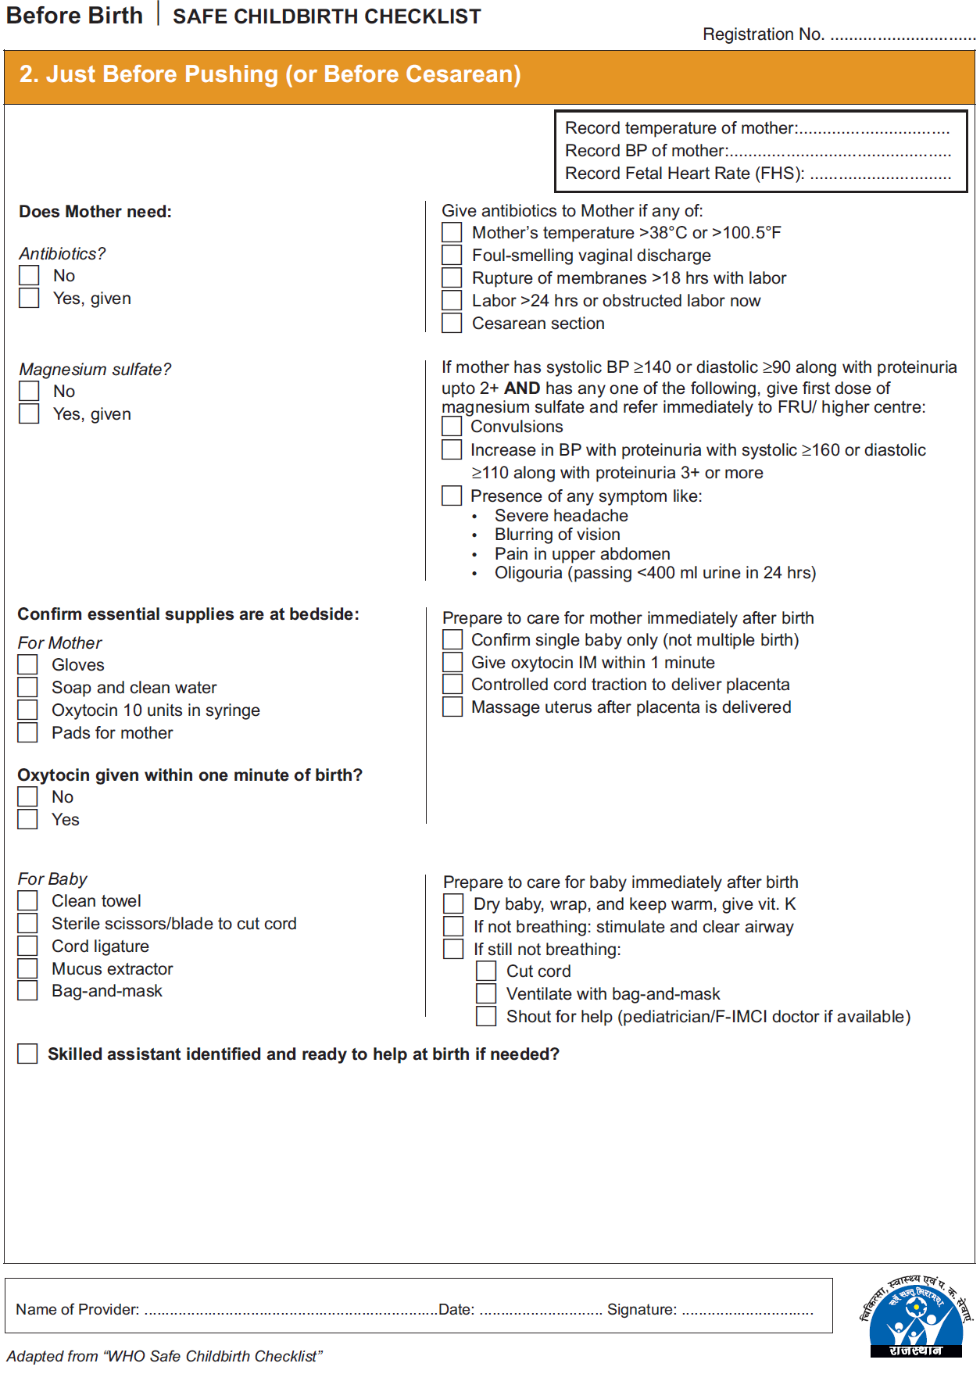
Checks for essential practices
How to do?

Slide 18
How to Use the Checklist ?
A health worker perform activities as he/she routinely does
At each Check, goes through the checklist to check whether he/she has performed everything and in the correct manner
Ticks appropriate responses in the checklist
Uses the guidance given in the checklist to perform activities
If has missed any critical action, performs it, and then checks appropriate response in the checklist

Slide 19
Key Results from SCC Program in Rajasthan
Intervention-all facilities
Practices during & immediately after delivery
Control-all facilities

Slide 20
Key Results from SCC Program in Rajasthan
Intervention-all facilities
Practices soon after Delivery
Control-all facilities

Slide 21
Institutional-level Compliance
Will be ensured through the clinical standards
19 life-saving practices in line with the SCC to be performed during labor and delivery
Organized in the form of an assessment tool
Will be completed by the Quality Improvement Mentor once every quarter
Will help in developing facility specific action plans for improving adherence to practices
Will also provide status of practice of life-saving interventions
District can review facility specific adherence scores to standards periodically

Slide 22
Standards
1 | Provider conducts an appropriate and adequate assessment of clinical condition of pregnant woman and fetus at the time of admission
2 | Provider conducts internal examination appropriately
3 | Provider identifies and manages HIV in pregnant woman and newborn
4 | Provider identifies and manages infection in pregnant woman
5 | Provider identifies conditions leading to preterm delivery and facilitates preventive care
6 | Provider identifies and manages severe Pre-eclampsia/Eclampsia (PE/E)

Slide 23
Standards
7 | Provider monitors progress of labour in every case and adjusts care accordingly correctly fills partograph to monitor progress of labour and timely interprets results for decision
8 | Provider monitors progress of labour in every case and adjusts care accordingly correctly fills partograph to monitor progress of labour and timely interprets results for decision
9 | Provider prepares for safe care during delivery
10 | Provider assists the woman to have a safe and clean birth
11 | Provider conducts a rapid initial assessment and performs immediate newborn care (if baby cried immidiately)
12 | Provider performs newborn resuscitation if baby does not cry immediately after birth

Slide 24
Standards
13 | Provider performs Active Management of Third Stage of Labour (AMTSL)
14 | Provider identifies and manages Post Partum Haemorrhage
15 | Provider assesses condition of mother and baby before shifting them from labour room
16 | Provider ensures exclusive and on demand breastfeeding
17 | Provider ensures care of newborns with small size at birth
18 | Provider counsels mother and family at the time of discharge on postpartum family planning
19 | The facility adheres to universal infection prevention protocols

Slide 25
Creating Quality-enabling Environment at the Facility Levels
Making essential supplies available
Empowering nurses for life-saving practices such as newborn resuscitation, administration of MgSO4, and antenatal corticosteroids, etc.
Non-rotation of trained staff from labor rooms
All-staff meetings to review quality status
Review of dashboard of indicators

Slide 26
Creating Quality-enabling Environment at the District Levels
District level reviews:
Task force/ stand alone review/ part of DHS
Dashboard of indicators
Status of adherence to standards
Labor room upgradation plans:
In line with the MNH toolkit/ labor room guidelines
Well-planned activity
Prioritize high delivery load facilities
Regular sharing of experience between facilities

Slide 27
Creating Quality-enabling Environment
Privacy
Ambience
Lighting & Ventilation
Adequate labor & delivery facility
Better space management
Client facilities
Improved organization of labor rooms

