Slide 1


Slide 2
Process of Budgeting for Standardization of Existing LRs
Calculate future requirement
Review Past Performance
Any future increase in delivery load
Addition of new technology
Deletion of old technology
Delivery load
Short supply of any items
Non- availability of items or equipment
Space or infrastructure requirement for care as per guidelines
Prepare Budget
Include Past performance and future requirement while finalizing
Develop budget worksheet

Slide 3

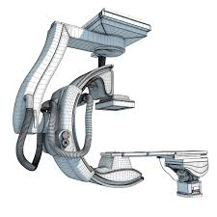

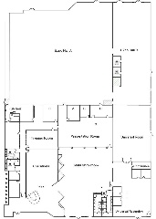

Guidelines Focus on Five Important Areas
Consumables
Equipment and accessories
Human resource
Space and layout
Practices and protocol
Will discuss in detail on three areas:
Space. Equipment and Consumables

Slide 4
Space and Layout: Major Focus areas
Privacy
Ambience
Lighting & Ventilation
Adequate labor & delivery facility
Better space management
Client facilities

Slide 5
Space and Layout: Components for Conventional Labor Room Complex
Waiting/Registration area
Triage/Examination room
Staff room
Labour and delivery area
Newborn care area
Doctor’s duty room
Nursing station
Store
Clean Utility Area
Dirty Utility Area

Slide 6
Suggested Methodology for Budgeting for Standardization of Space and Layout
Prioritize LRs for Standardization
Constitute assessment teams comprising of local facility in-charge, available DP reps, and an architect/ civil engineer contracted for this purpose
Prepare detailed upgradation/renovation layouts for each facility
Add costs for each item and prepare facility-wise cost estimates

Slide 7
Major costs incurred while standardizing space and layout of LRs
Cost of expansion of space (new construction/removal of walls to merge spaces/shifting to new space)
Cost of upgradation of ambience: wall tiles, floors, paint, seepage removal, etc.
Costs of fixing broken windows, doors, partitions, etc.
Costs of upgrading services such as washrooms and utility areas
Costs of adding missing structures such as handwashing station, nursing station, storage areas
Costs of upgrading lighting and ventilation

Slide 8
Example of costs for civil work (approximate costs)
Item | Approximate cost
Partition | 40000 | 10000 per partition, size 8*6, Made up of aluminium and ACC sheet
Shifting of wall to make LR more spacious and convenient for provider | 20000 | (wall size 10*12, 9 inch thick)
Construction of new LR | 1,00,000 | (for a LR of 10*12)
Waiting area with sitting facility | 1,00,000 | (for a area of 10*12)
Building of new toilet in vicinity of LR | 45000 | (size 4*6, tile upto 6 feet, separate septic tank)
Floor of the labor room is constructed of anti-skid vitrified tiles | 18000 | LR size 10*12, 150 rs per sq feet (150*120=18000)
Walls of labor room have wall tiles of white color | 40500 | Upto 6 feet

Slide 9
Example of costs for civil work (approximate costs)
Item | Approximate cost
Main doors has 2 frames, one large (3/5th of width) & another small (2/5th of the width) | 10000 | Size 7*4, made with aluminium and glass
Windows having outside panel fixed & should have half ground glass & half mesh. The second panel should be moving with frosted glass & a lock | 20000 | 5000 per window
Hand washing area A steel sink and Two elbow operated taps with 24*7 running water supply | 5000 | With stainless steel sink
Curtain for privacy | 5000 | For 6 LT, 3 windows and 1 door

Slide 10
Suggested Budgeting for Ensuring Availability of Essential Equipment and Instruments
Step 1 : Calculate the desired number of equipment
As per load and level of facility
See section equipment & accessories, page 32
Use equipment calculator
Step 2: Assess of the number of functional Instrument and equipment in the existing LR
Step 3: Calculate the Gaps (2 - 1)
Step 3 : Request for unit cost from the State Equipment Management Unit (SEMU)/ other similar body
Step 4 : Multiply the gaps with the UNIT cost so as to calculate the total cost estimate

Slide 11
Example: List of equipment-calculated for labor room with approx. 400 deliveries per month
Sl No | Items | Required as per norm | Unit Cost | Cost Estimated
1 | Number of labor tables | 6 | 30000 | 180000
2 | Stepping Ladder for Pregnant Women | 6 | 500 | 3000
3 | McIntosh or disposible draw sheet | 18 | 200/meter | 10800
4 | Kelly's pad | 7 | 500 | 3500
5 | Stainless Steel IV rod | 6 | 1200 | 7200
6 | Yellow biomedical waste bin | 6 | 1300 | 7800
7 | Stool for birth companion | 6 | 500 | 3000
8 | Curtains in LR | 18 | 1800 | 32400
9 | Ceiling mounted lights | 2 | 300000 | 600000
10 | Shadow Less Light | 6 | 21000 | 126000
11 | Fan | 6 | 2000 | 12000
12 | Air Condition | 1 | 42000 | 42000
13 | Refrigerator | 1 | 20000 | 20000
14 | The facility has power back-up | 1 | 600000 | 600000
15 | No. of Functional Radiant Warmer | 2 | 50000 | 100000
16 | Ambu bag for babies(240 ml) with both pre & term mask (size 0,1) | 2 | 1500 | 3000
17 | Functional oxygen cylinder (with wrench) with new born mask | 2 | 5000 | 10000
18 | Doppler/fetoscope in labor room / admission area | 2 | 5000 | 10000
19 | Mucus Extractor (De Lee's) | 14 | 30 | 420
20 | Adult Weighing scale | 1 | 1500 | 1500
21 | Baby weighing machine | 1 | 15000 | 15000
22 | Thermometer (Adult) | 2 | 100 | 200
23 | Thermometer (Baby) | 2 | 1700 | 3400
24 | BP Apparatus | 2 | 550 | 1100
25 | Stethoscope | 2 | 500 | 1000
26 | Suction device | 1 | 3500 | 3500

Slide 12
Sl No | Items | Required as per norm | Unit Cost | Cost Estimated
27 | Wall clock with seconds hand | 2 | 500 | 1000
28 | Examination table with step | 2 | 4000 | 8000
29 | Examination tray | 2 | 1200 | 2400
30 | Measuring tape | 2 | 100 | 200
31 | Delivery trolley | 6 | 8000 | 48000
32 | Delivery tray | 8 | 2000 | 16000
33 | Emergency drug tray | 1 | 50000 | 50000
34 | Sterile scissors | 8 | 500 | 4000
35 | Artery forceps | 16 | 500 | 8000
36 | Sponge holding forceps | 16 | 800 | 12800
37 | Sims Speculum | 8 | 1000 | 8000
39 | Episiotomy scissor | 8 | 1000 | 8000
40 | Allis forceps | 8 | 700 | 5600
41 | Toothed forceps | 8 | 800 | 6400
42 | Needle holder | 8 | 3000 | 24000
43 | Needle (round body and cutting) | 8 | 50 | 400
44 | Thumb forceps | 8 | 500 | 4000
45 | Anterior vaginal wall retractor | 2 | 1000 | 2000
46 | Posterior Vaginal wall retractor | 2 | 1000 | 2000
47 | MVA syringe and cannulas | 2 | 3000 | 6000
48 | MTP cannulas | 2 | 100 | 200
49 | PPIUCD Insertion Forceps | 2 | 2000 | 4000
50 | Autoclave | 1 | 30000 | 30000
51 | Protocol posters | 16 | 1000 | 16000
52 | Wheelchair and/or stretcher | 1 | 6000 | 6000
53 | Table & chair for Service provider | 1 | 10000 | 10000
54 | Communication | 1 | 24000 | 24000
55 | Washbasin | 2 | 5000 | 10000
 | Total Estimated cost |  |  | 2115020

Slide 13
Budgeting for Consumables
Usually non Budgetary Items
Forecast demand for the year and for various months based upon historical trends
Use LR supply calculator
Ensure planning of quantities based upon the perishable nature of the supplies
Budget for supplies based upon the forecasts
Facility to have contingency funds for ensuring 24 X 7 - in case of inadequate supply

Slide 14
Example: List of essential Supplies-calculated for labor room with approx. 400 deliveries per month
Sl No | Items | Required as per norm | Unit Cost | Cost Estimated
1 | Gloves | 1320 | 10 | 158400
2 | Cotton rolls | 42 | 205 | 103320
3 | Gauze (10 Meter) | 33 | 150 | 59400
4 | Sanitary napkins | 660 | 10 | 79200
5 | Sterile pads | 13 |  | 0
6 | Apron | 334 | 50 | 200400
7 | Thread | 33 | 10 | 3960
8 | Towels for receiving new borns | 660 | 140 | 1108800
9 | Chromic Catgut "0" | 165 |  | 0
10 | IV Fluids | 330 | 20 | 79200
11 | IV drip sets | 330 | 50 | 198000
12 | Foleys Catheters | 33 | 125 | 49500
13 | Cord clamp | 330 | 10 | 39600
14 | Disposable Syringes (2 and 5 ml) | 330 | 10 | 39600
15 | Disposable Syringes 10ml | 33 | 7 | 2772
16 | Delivery kit for HIV positive women | 4 |  | 0
17 | Povidone Iodine (500 ml) | 33 | 65 | 25740
18 | Magnesium Sulphate | 476 | 6 | 34272
19 | Antibiotics for mother | 40 | 200 | 96000
20 | Antibiotics for baby | 80 | 500 | 480000

Slide 15
Sl No | Items | Required as per norm | Unit Cost | Cost Estimated
21 | Oxytocin (5/10 IU per ml) | 1320 | 10 | 158400
22 | Vitamin K (1mg/ml or 1 mg/0.5 ml) | 330 |  | 0
23 | Antiretrovirals | 1 |  | 0
24 | Tab Misoprostol | 495 | 6 | 35640
25 | Nevirapine Syp and Tab. | 1 |  | 0
26 | Inj Dexamethasone | 7 | 5 | 420
27 | Uristix for Protienuria and Glucose | 420 | 127 | 640080
28 | Glucometer | 2 | 2000 | 48000
29 | Family Planning options |  |  | 0
30 | Soap and Running water |  |  | 0
31 | Washbasin |  | 2000 | 0
32 | Utility Gloves | 120 | 50 | 72000
33 | Bleaching Powder/Sodium Hypochlorite solution | 350 | 50 | 210000
34 | Plastic tubs for 0.5% Chlorine solution | 6 | 500 | 3000
35 | Coloured bins | 9 | 500 | 4500
36 | Hub cutter | 1 | 150 | 150
37 | Puncture proof container | 3 | 500 | 1500
38 | MCP Card | 330 | 10 | 39600
39 | Safe Motherhood Booklet | 330 | 20 | 79200
40 | Partograph | 330 | 1 | 3960
41 | IUCD client card | 330 | 5 | 19800
 | Total Estimated cost |  |  | 4074414

Slide 16
Thank you

Slide 17
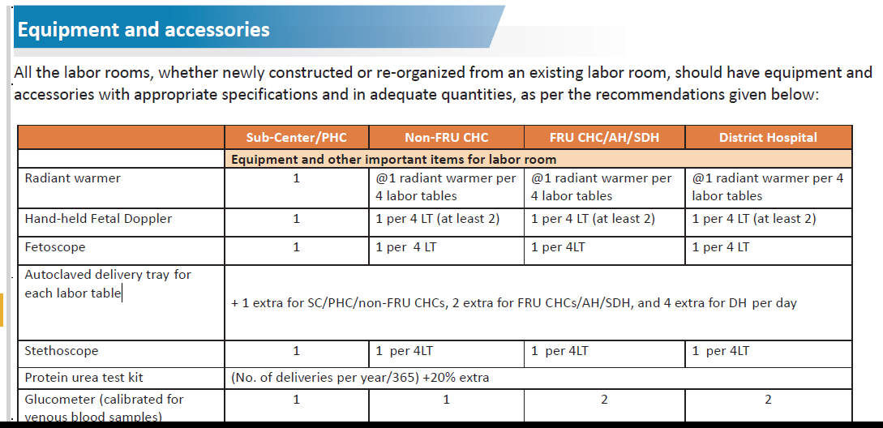
Page 32 onwards of guidelines

