Slide 1

:
सभी के लिए स्वास्थ्य
प्राथमिक स्वास्थ्य सेवाएं: हर व्यक्ति , हर जगह
विश्व स्वास्थ्य दिवस 2019
08 अप्रैल 2019; नई दिल्ली

Slide 2

Case studies on organization of primary healthcare services in Indian states: an overview
Chandrakant Lahariya, MBBS, MD, DNB, MBA, FIPHA
National Professional Officer- Healthcare, Access and Protection
World Health Organization India

Slide 3
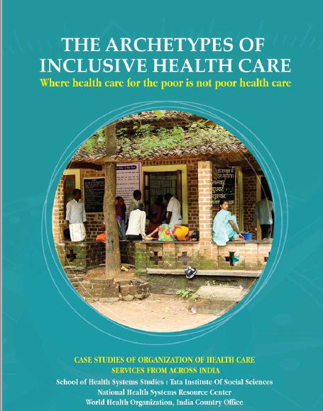
Background
Conducted as a follow up on recommendation of PHC task force (2015)
A compendium of case studies on organizations implementing primary healthcare approaches

Slide 4
Methodology: Comparative case studies
Mixed Methods: Desk review; site visits; interviews & group discussions
Selection Criteria : Purposively selected, Focused on reaching the poor; Potentially replicable to cover entire population; Not focused on maximizing revenue

Slide 5
The case studies included (1/2)
Jan Swasthya Sahyog, Bilaspur, Chhattisgarh
The Healthspring Clinics; Mumbai
Public Private Partnerships in Uttarakhand
Deepak Foundation’s MCH Center, Vadodara, Gujarat
Aravind’s Eye Care, Madurai, Tamilnadu
St. Stephens Community Health Center, Delhi
Mission Hospitals & facilities: Holy Cross Hospital Kunkuri, Jashpur, CG; Duncan Hospital, Ruxaul, Bihar; Christian Fellowship Hospital, Oddanchatram, TN; Good Samaritan Hospital, Amboory, KE

Slide 6
The case studies included (2/2)
Shaheed Hospital, Dilli Rajhara, Chhattisgarh & Peoples Polyclinic Nellore, Andhra Pradesh
JIPMER, Puducherry
King Edwards Memorial Hospital (KEM), Mumbai
Urban Healthcare: Mohalla Clinics of Delhi
District Hospital, Shillong, Meghalaya,
Government Primary Health Centers from 4 states: Meghalaya; Maharashtra, Tamil Nadu, Kerala

Slide 7
Being mindful of limitations
A methodology (comparative case studies) which is ranked lower in hierarchy of evidence
At times, the teams followed variable approaches for documentation
Qualitative focus with limited quantitative data
Mostly documentation focus, with limited analysis
Thus, observations presented need further & detailed examination.

Slide 8
Key observations from 15 case studies

Slide 9
1. Higher utilization of facilities when packages of services were comprehensive
As was the case for all ‘not-for –profit’
That was done through conscious effort to make comprehensive.
PPP models and Govt PHCs were selective
Assured provision (limited gap in intention and provision); a possible explanation for popularity of the provision of primary healthcare at tertiary care facilities

Slide 10
2. Well performing facilities were better harmonized with secondary level of services
A functioning referral system
Functioning mechanisms for ensuring continuity of care
  JSS, specifically for chronic diseases, followed an approach of formulating a treatment plan in consultation with two levels
  Aravind Hospital efficiently used tele-medicine approach to ensure continuity of care
Having strong provision of PHC system but not sufficient services at secondary level does not work

Slide 11
3. Assuring basic level of quality standards improve patient attendance (possibly, satisfaction)
None of the non-govt case studies had a formal quality standard certification including most advanced Aravind eye care system.
Govt PHCs in 4 states, which were considered as best facilities had met some quality standards.
Experience shows that meeting a quality standard for Govt facilities increase patient attendance

Slide 12
4. Innovative & creative approaches to HR gaps
Critical mass & mix of health workers, depending upon type of services, was considered essential.
Except doctors, all other cadres locally recruited and trained or both. Sometimes certified in-house or through a formal system.
Most did innovations to attract and retain right numbers and skill mix – How to attract specialist and how much additional to pay (Deepak Foundation)
Many used a different cadres (i.e. Nurse practitioners) of healthcare providers

Slide 13
5. Under-utilized computer based Health Information system
Most had software and use of technology for billing & diagnostic reports.
A few had customized software for specific purpose. (Aravind eye care)
Many had recognized role of digitization in continuity of care (at two levels) & across time (at same level)
Paper based system?

Slide 14
6. Leadership and motivation at small scale; & ‘political will’ at large scale
Motivation and performance at work was largely dependent upon the vision of the leadership
Reportedly, staff motivation was ensured through selection process by finding motivated individuals
Most created a work culture, where people fulfilled their responsibilities
An extended interpretation could be the need for stronger political will, at larger level and for government health systems

Slide 15
7. Community engagement and participation
Most case studies have reported some form of community partnership and engagement
Role of community in NCD prevention was encouraged by a few facilities.
Community engagement was higher in case studies focusing upon social determinants as well

Slide 16
8. Access & choice of technology & a climate of innovation
Challenge in service delivery were attempted to be tackled through local and frugal innovation.
Specially in case of JSS, there were innovations documented for infection free environment; lowering cost of diagnostics and ICT for continuity of care
Aravind eye care system has done a few technological innovations including indigenously manufactured IOL & eye suture.

Slide 17
Case study on Govt Primary Health Centres in 4 states
10 facilities in 4 states: Kerala, Tamilnadu, Maharashtra and Meghalaya
Purposive selection, in consultation with state official; considered amongst the best by the states
Common features : (a) assured package of (though limited) services with a few additional packages offered; (b) sufficient availability & mix of providers; (c) continuum of care for services available; (d) most had some form of certification in quality standard; (e) stronger local level leadership; & (f) community engagement.

Slide 18
The way forward

Slide 19
A lot more has happened since 2017 onwards
Mohalla Clinics of Delhi, 2015
Innovations; PPP and community engagement
Family Health Centres (FHC), Kerala, 2017
Engagement of PRIs and elected representatives
Basthi Dawakhana, Telangana, 2018
Arguably, the first ULB led community clinics in India
Health & Wellness Centres (HWCs) under Ayushman Bharat
For entire country and both rural and urban areas

Slide 20
The road ahead
There have been attention on specific & detailed documentation of similar case studies (in last 2 years)
Possibly, time for institutional mechanisms for robust documentation and evaluations of models of PHC (both rural & urban)
Possibly for broader health systems research

Slide 21
A case for Institutional mechanism for implementation and health systems research in India
Case studies have underscored many unanswered policy questions on motivation, leadership, HR etc.,
There is strong case for institutional mechanism for implementation research, where policy questions are identified and solutions explored.
Such documentation to be supported by academic rigour of evidence collation, synthesis & analysis for policy solutions.
This need to happen at both national and state level with sufficient opportunities for cross learning and sharing.

Slide 22
In Summary
Case studies gives an overview of the diversity of models for PHC that exists in India. Good and/or popular models have some common characteristics.
For purpose of comparison, conclusions and ongoing learnings; more documentation, HS research & evaluations are needed.
Implementation and health systems research in India may need institutional mechanism supported by all stakeholders.
Might be helpful as India scale up of HWCs.

Slide 23
Acknowledgement
Dr T Sundararaman, Formerly at TISS, Mumbai
All authors of these case studies
Organizations and facilities covered under this study
Dr Rajani Ved and team NHSRC
Dr Hilde De Graeve, WHO India
MoHFW, Govt of India

Slide 24
विश्व स्वास्थ्य दिवस 2019
:
सभी के लिए स्वास्थ्य
प्राथमिक स्वास्थ्य सेवाएं: हर व्यक्ति , हर जगह
Thank you very much

