Slide 1

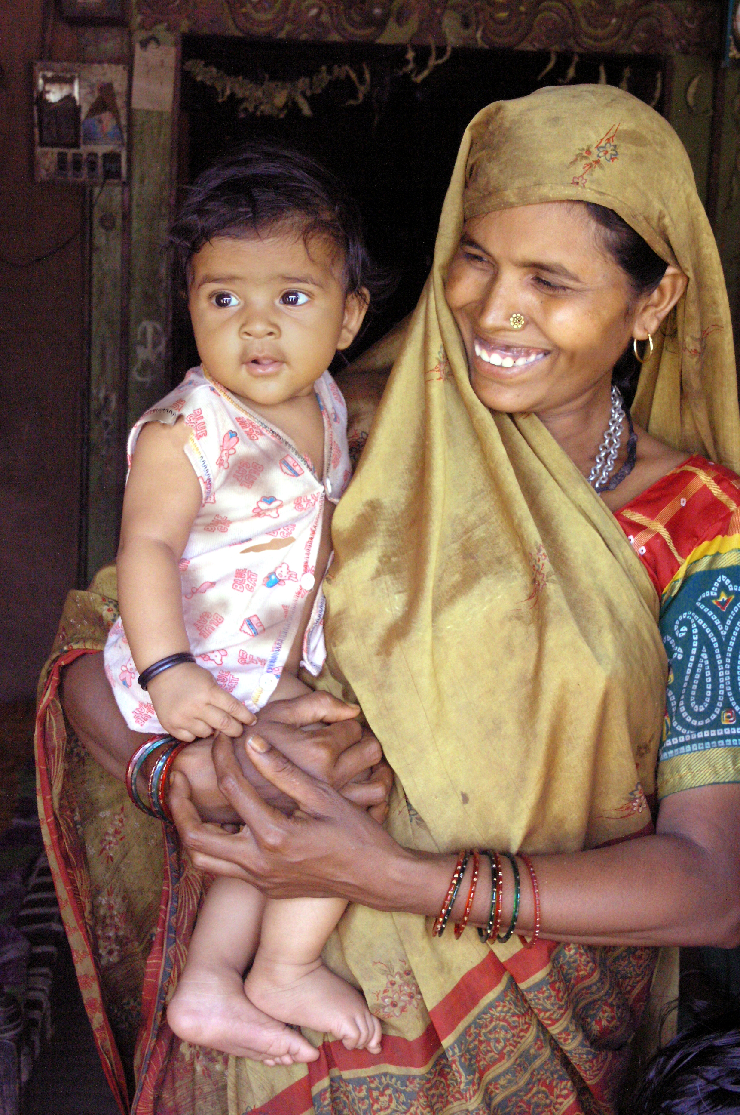
Organizing RMNCH+A Services in Gujarat
Dr. Jayanti S Ravi, IAS
Principal Secretary & Commissioner Health
Government of Gujarat

Slide 2
Overview of the presentation
UHC model for RMNCH+A services
7/11 Approach
Gujarat health indicators
1000 days
Health & Wellness Centres and CHOs
LaQshya and PMJAY
SATCOM & SAPTADHARA
TeCHO+
Midwifery Initiative and Obstetric ICUs

Slide 3
Universal Health Coverage model for RMNCH+A services
Coverage
Services
Innovation
Technology
Communication
Facility Based
Community Based
R M N CH + A
Core Areas
Notes:
UHC cube for RMNCH+A will have three axis primarily
Core Areas (RMNCH+A)
Services (Community based, Facility Based, Communication, Technology & ……..)
Coverage depth of individual interventions
This matrix is developed de novo to better represent RMNCH+A in UHC context.
This matrix is not adopted from any standard source

Slide 4











Comprehensive 7/11 approach for RMNCH+A and beyond
      7 Key focus areas in Health for Gujarat
      4 Additional focus areas
Notes:
First Seven indicators cover all major RMNCH+A Areas

Slide 5
Health Indicators of Gujarat
Indicator | India | Gujarat
Maternal Mortality Ratio (MMR) (SRS 2014-16) | 130 | 91
Institutional deliveries (NFHS-4) | 78.9 | 88.7
Early ANC (NFHS-4) | 58.6 | 73.9
Infant Mortality Rate (SRS 2016) | 34 | 30
Neonatal Mortality Rate (SRS 2016) | 24 | 21
Total Fertility Rate (SRS 2016) | 2.3 | 2.2
TB Case Notification Rate (Nikshay 2018) | 160 | 230

Slide 6
1000 days
in
RMNCH+A
Community based
HWC & CHOs
Facility based
LaQshya
PMJAY
Technology
TeCHO+
Innovation
midwiferyObs ICU
Communication
Saptadhara
SATCOM
Notes:
1000 days approach works at centre of RMNCH+A program in Gujarat. Subsequently one or two best practices are mentioned as pointer towards presentation of best practices in five major domains.
There are many other best practices in each area as follows:
Community Based: Mamta Diwas (VHNDs), Mobile Health & Medical Units (MMU/MHU),
Facility Based: SNCUs, Navjivan Kaksh, MoM (Mothers own Milk), KMC Corners,
Communication: wall painting, Hello Doctor program, IEC material development
Technology: SNCU Online, HMIS, e-Vin, HRMIS, GHMIS
Innovation: 1000 days approach,

Slide 7

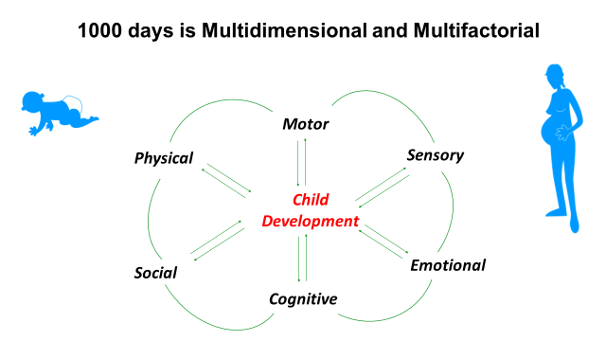
1000 days at a centre of RMNCH+A
First one thousands days are the most crucial in child’s cognitive development
Multiple interventions from MCH are needed to ensure brain development
Every dollar spent yields return of 48 USD
1000 day approach is at centre of any activity being planned in health department
Major components include RMC, stress free environment, flavour bridge, right stimulation to child etc

Slide 8






Health & Wellness Centers
Operationalized 1656 HWCs across state
Includes PHCs, UPHCs and Sub Centres
Plan to reach to 4000 HWCs by Dec-2022
Robust IT backup through TeCHO+
Aarogya Samanvay
Integration of Yoga and Ayurveda in HWC
Pilot tested in Kheda District
Wellness activities such as Pranayam, Dhyan
Kitchen naturopathy & Herbal Garden
21 day module incorporated in CCCH Course
Notes:
Six areas of HWC includes
Maternal health
Child Health
Wellness
Non Communicable Diseases
Elderly Care &
Health Education

Slide 9
Community Health Officers
Certificate Course in Community Health
Expansion to 28 medical college and other institutions
Regular increment as per NHM norms, Performance based incentives and formal grievance redressal mechanism to reduce attrition
800 candidates will finish course by June 2019
Plan to upscale it to 1600 CHOs by February 2020
Notes:
Six areas of HWC includes
Maternal health
Child Health
Wellness
Non Communicable Diseases
Elderly Care &
Health Education

Slide 10
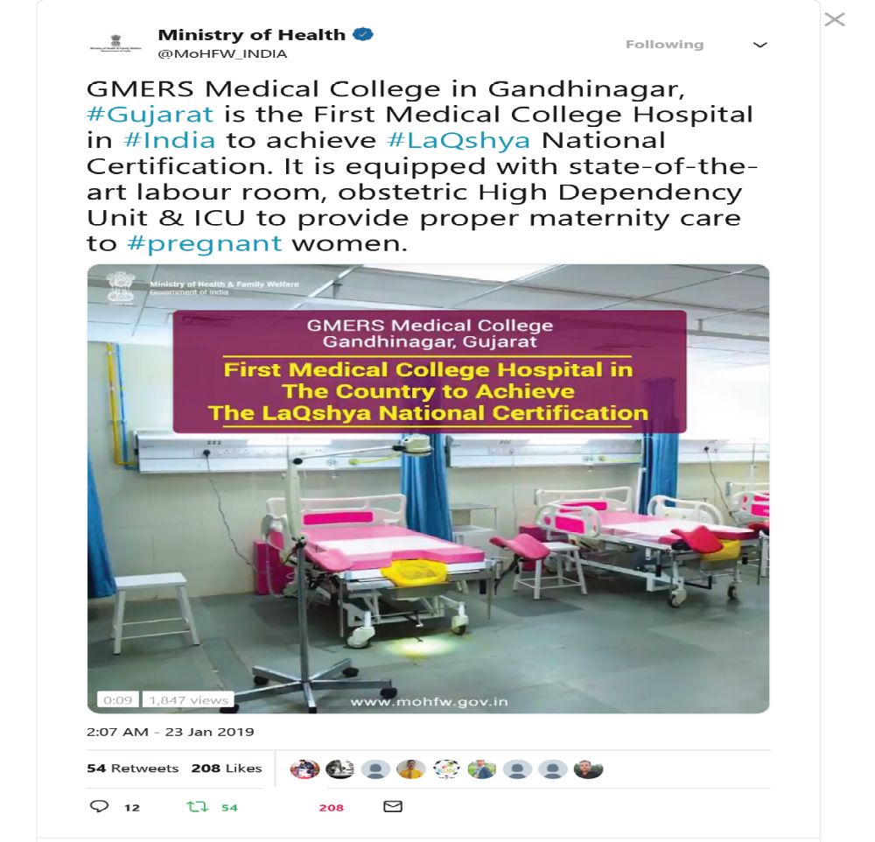
Gujarat leading implementation of LaQshya program
Country’s first LaQshya certified facility GMERS Medical College Gandhinagar.
Highest number of facilities (12 out 54 Labour Rooms & 12 out of 38 Maternity OTs) certified under LaQshya in India.
Highest scoring LaQshya facility in Gujarat is Bardoli CHC with scores 97 & 99 in LR & OT
Very active involvement of facility in-charge from MCH & DH to achieve best results

Slide 11

Gujarat: front runner in AB-PMJAY implementation
Claims- 2nd rank- (2,44,407)
Claim Amount- 1st rank – (358.8 Cr )
Pre Authorization No.- 3rd rank – (3,08,982)
Pre authorization Amount- 1st rank- (452.7 Cr )
Golden Card generated -2nd Rank – (44,84,226)
Hospital empanelled – 3081 (2013 Public + 1068 Private)
Ranking as on 3rd April, 2019

Slide 12
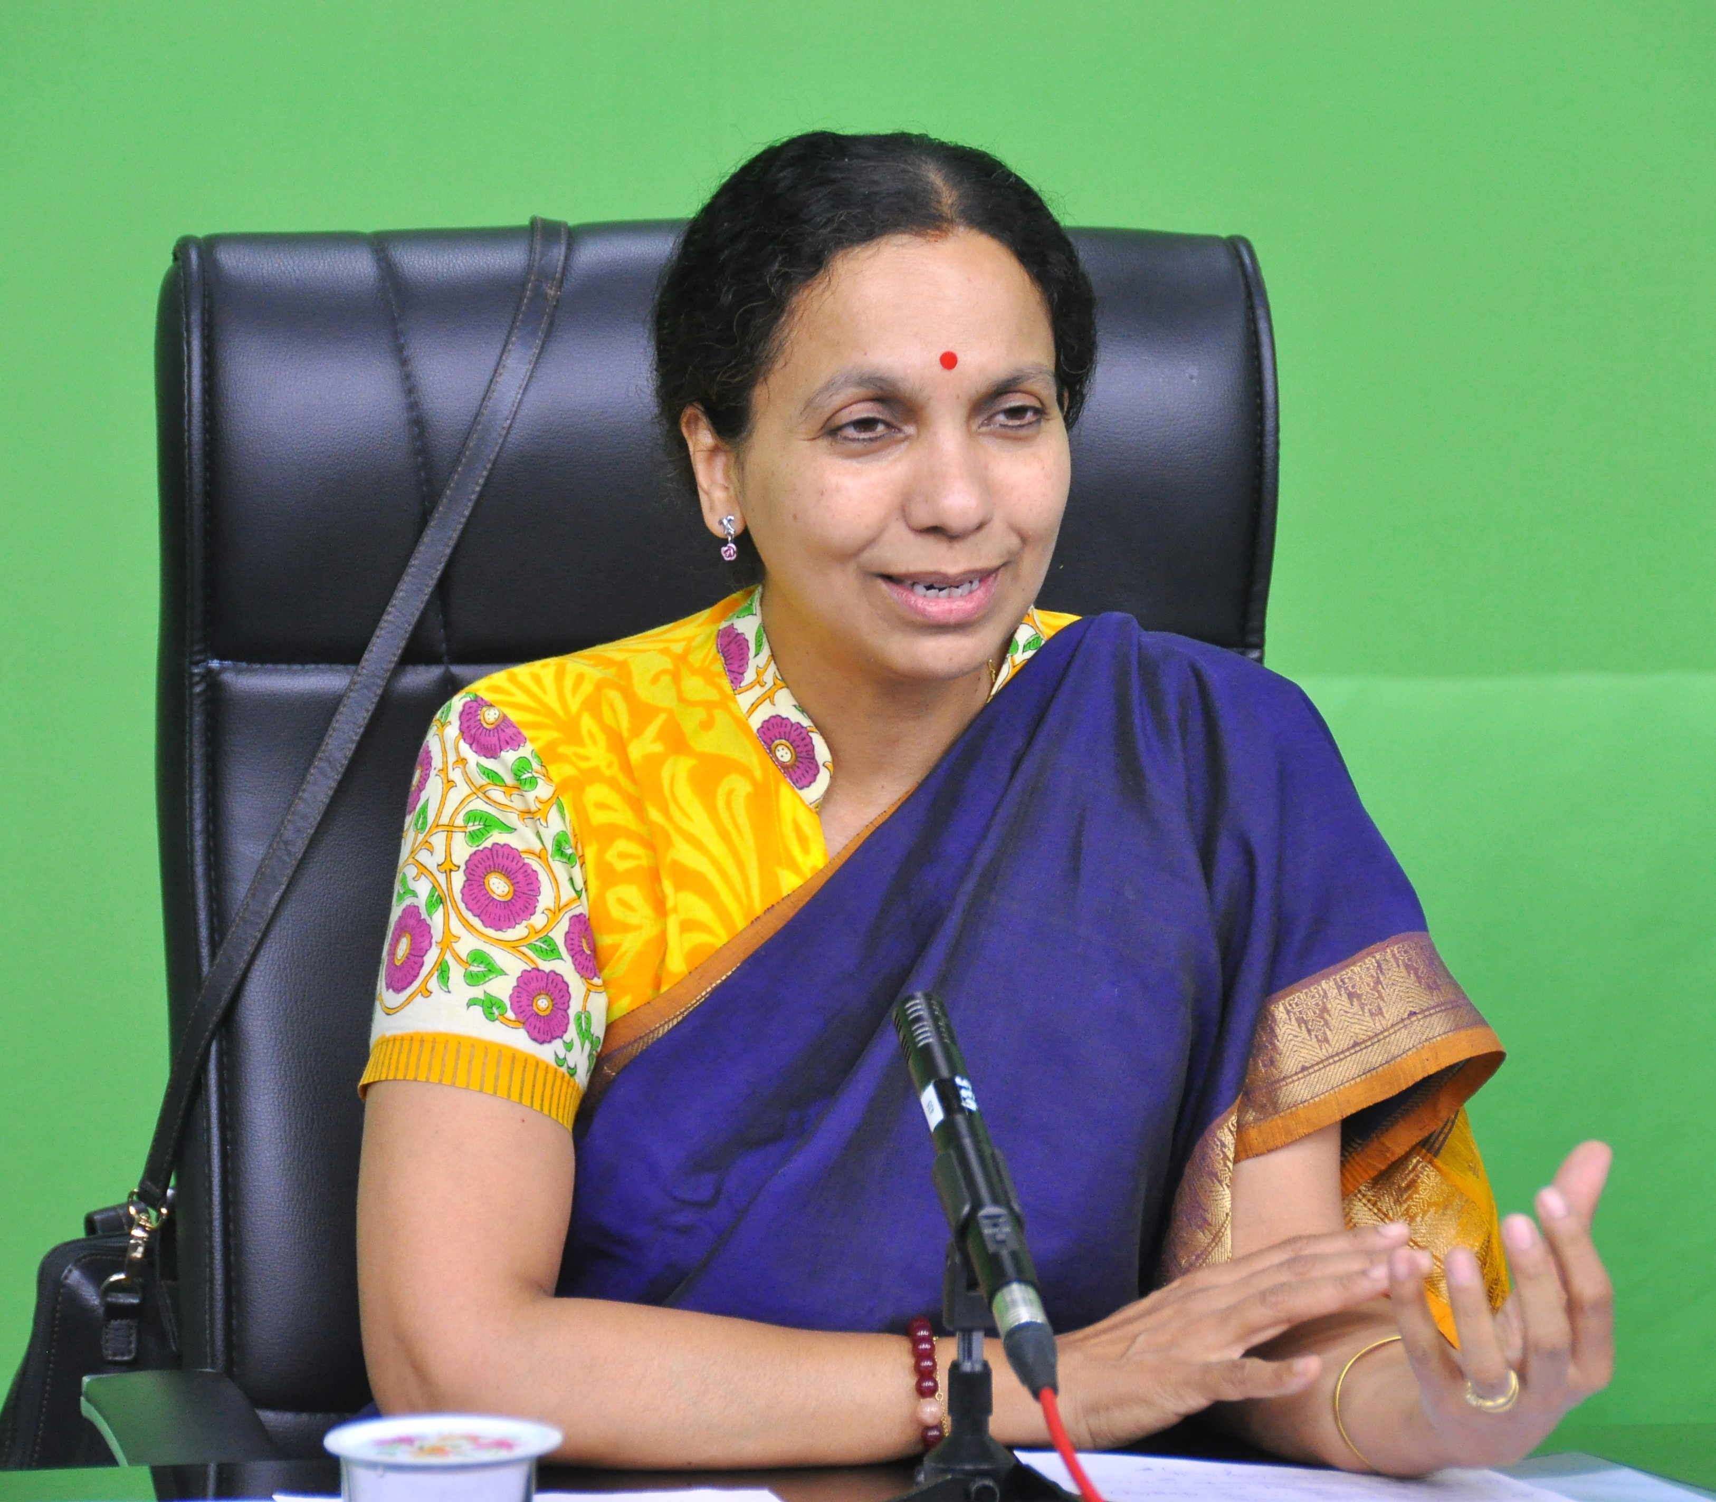
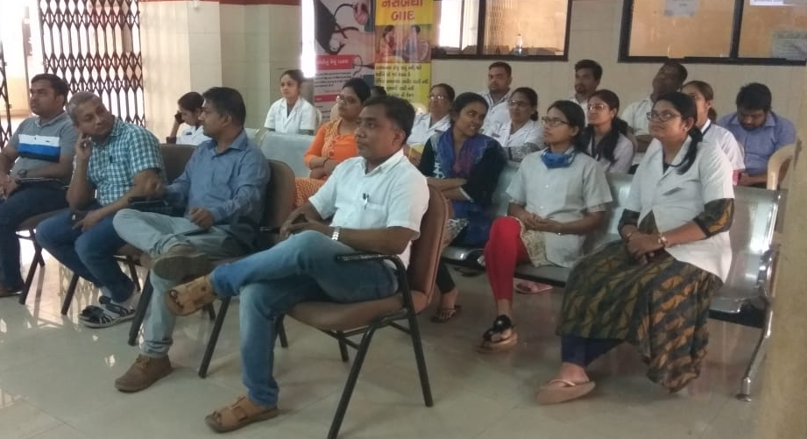
SATCOM: using satellite communication for health
Two dedicated health channel through BISAG
Continued medical education, training, review are organized through SATCOM
Special program ASHA EK CHETNA (52 episodes)
Topics covered through SATCOM
FRU, MDSR, HWC, ICU Staff, SNCU
Special calendar covering all cadres

Slide 13

Saptadhara: seven streams of creativity for health
Using seven streams of creativity (Drawing & Coloring, Creativity, Music, Drama, Dancing, Exercise/Yoga/Meditation and Knowledge to generate community awareness
More than 500 Saptadhara Sadhak are already trained
Existing staff only trained making it very frugal intervention yet highly effective

Slide 14
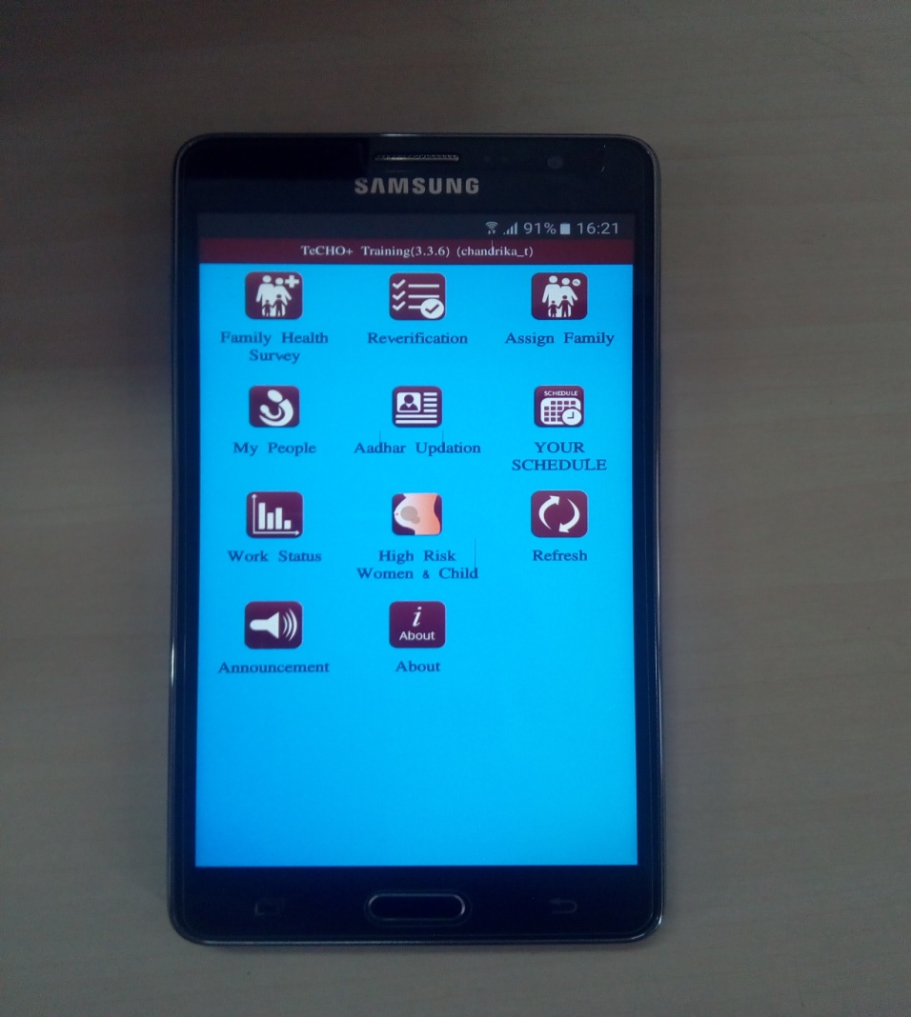
TeCHO+
(Technology enabled Community Health Operations)
TeCHO+ is a third generation health data revolution from paper
to computer to real time mobile based reporting
Currently in use by more than 10,000 FHWs across the state
Covers all areas of RMNCH+A along with NCDs, Mental health and
other areas as well
Contains videos related to various health issues to be shown to
beneficiaries to strengthen interpersonal communication
Real time data entry by=
health care worker providing Service
+ at the time of service delivery
+at the place of service delivery

Slide 15
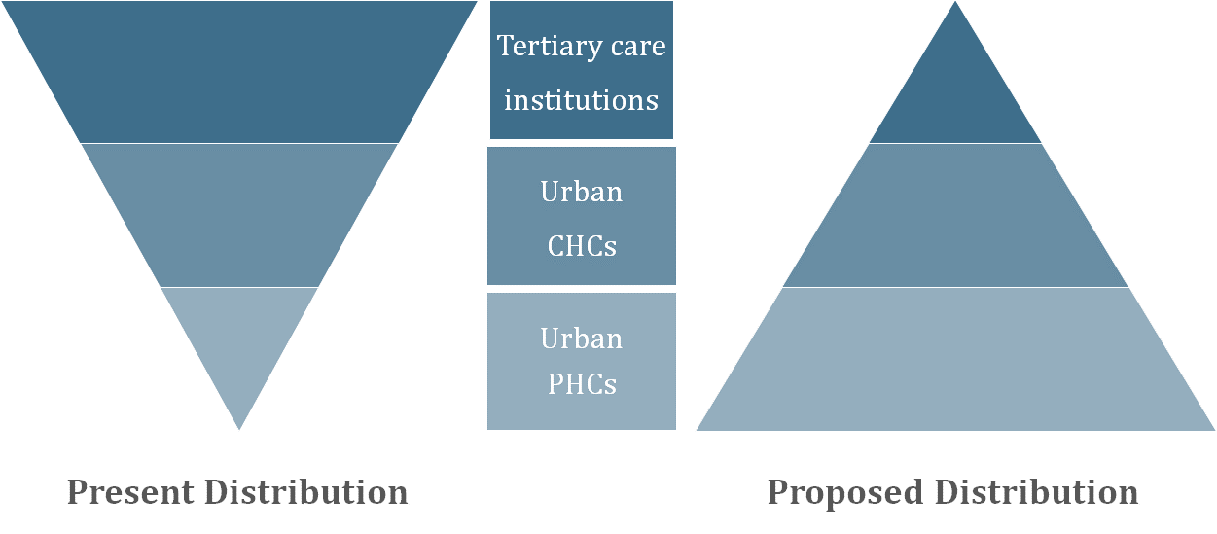
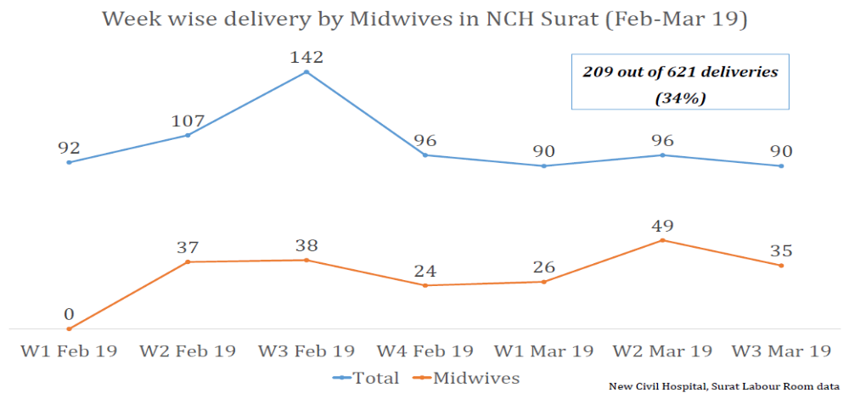
Midwifery : India’s first urban health model for RMNCH+A
First of its kind model addressing maternal health in Urban areas
Midwifery led labour rooms in MCHs and Urban CHCs.
Recruited 150 NPMs
Upscaling midwifery education
Posting of four midwives in separate labour room in medical college has reduced delivery load by 35%

Slide 16
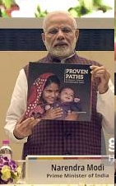
Obstetric ICUs: From Pilot to Scale up (Proven Path)
Obstetric ICUs are developed in all medical colleges of Gujarat with technical support from UNICEF.
These 20 Obstetric ICUs are successfully running for last three years.
Maternal Mortality has shown significant reduction from 3.3% to 0.9%
This initiative is scaled up nationally and has been part of the recently launched national best practice book Proven Paths

Slide 17
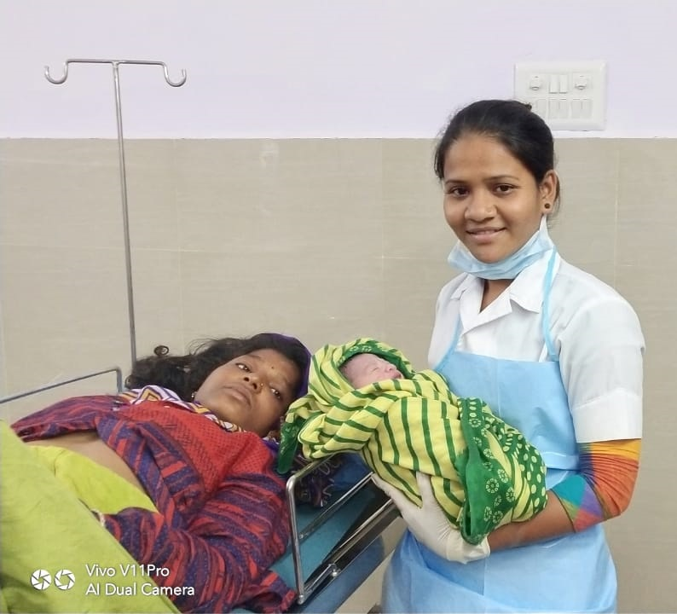
“The best way to find yourself is to lose yourself in the service of Others”\
Mahatma Gandhi

