Slide 1


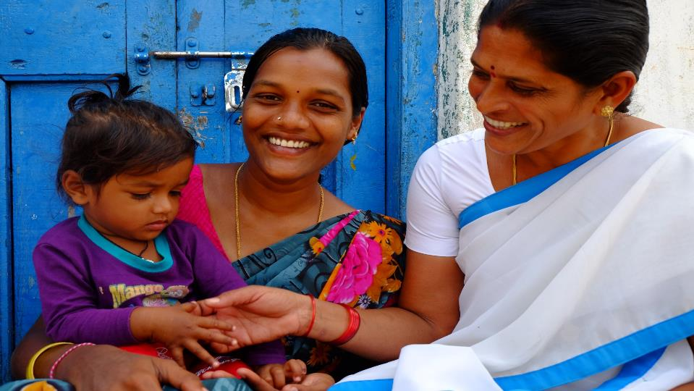
Strengthening RMNCAH +N Services
in
Comprehensive Primary Healthcare
Ministry of Health
& Family Welfare

Slide 2

Outline
Overview
Decoding the Unfinished RMNCAH +N agenda
Strategies
Role of HWCs

Slide 3
Maternal Mortality Ratio
Between 1990 and 2015
India MMR Decline
Global MMR Decline
77%
44%
Compound annual rate of decline increased significantly from
5.8% to 8.01%
Between 2007-09 & 2011-13 to
2011-13 & 2014-16
Notes:
Between 1990 to 2015

Slide 4
Under- 5 Mortality Rate
For the FIRST time
India U5MR = Global U5MR
∝
Share among deaths
Share of births
Notes:
India’s U5MR has equalled the global U5MR
India’s share among deaths is now proportionate to the share of births

Slide 5

We have travelled far…..
But there are miles to go before we reach the unreached!!

Slide 6
CPHC through Health and Wellness centres and POSHAN Abhiyaan present a unique opportunity to complete the unfinished RMNCAH+N agenda
Impossible to achieve UHC targets/ Sustainable Development Goals without achieving RMNCAH targets
RMNCAH interventions lie at the core of all efforts to provide UHC

Slide 7


Target 3.8.1 - Coverage of essential health services
Out of 13 targets under SDG3, three are specifically for RMNCAH
Measured through a composite index of 39 indicators
Of these, 14 indicators cover the spectrum of RMNCAH services

Slide 8

Decoding the Unfinished RMNCAH+N Agenda

Slide 9
RMNCAH+N- At a Glance
Target 100 by 2020
Target 23 by 2025

Slide 10
RMNCAH+N- At a Glance
Source: NFHS 3 & 4

Slide 11
Performance on Key Maternal Health Indicators
% Pregnant women given 180 IFA to total ANC Registration
India | 83%
Bihar | 67
Haryana | 63
Tripura | 56
Punjab | 54
Pudducherry | 52
Delhi | 51
Rajasthan | 46
Arunachal P | 44
J&K | 38
Manipur & Mizoram | 37
Meghalaya | 36
Uttarakhand | 25
Nagaland | 15
Source : HMIS (18-19)

Slide 12
Performance - Postnatal Maternal and Newborn Care
Indicator | National Average (HMIS) | States/UTs Performing worse than the National Average
% Women discharged in less than 48 hours of delivery to Total Reported Deliveries at public institutions | 42% | Uttarakhand (61%), MA (65), A&N (65%), UP (65%), Haryana(67%), Arunachal Pradesh(76%), Nagaland(79%), Jharkhand(82%) and Bihar(84%)
% Newborns breast fed within 1 hour of birth to Total live birth | 89% | Punjab(79%), Lakshadweep(78%), Tamil Nadu(77%), Goa(74%), Delhi(73%), Telangana(69%), Daman & Diu(64%), Chandigarh(63%)
% of newborns received scheduled home visits out of total reported deliveries | 35% | Uttarakhand(33%), Karnataka(31%), Manipur(27%), Delhi(25%), Maharashtra(21%), Rajasthan(21%), Haryana(14%), Arunachal Pradesh(14%), Telangana(13%), Nagaland(12%), Mizoram(11%) and Daman & Diu (1%)

Slide 13
Functional FRUs (HMIS)
Immunization (HMIS)
JAMMU & KASHMIR
FIC (HMIS, April’18 to Feb ‘19)
National: 78.49%
HIMACHAL PRADESH
PUNJAB
CHANDIGARH
UTTARAKHAND
HARYANA
DELHI
ARUNACHAL PR.
UTTAR PRADESH
SIKKIM
RAJASTHAN
ASSAM
NAGALAND
BIHAR
MEGHALAYA
MANIPUR
JHARKHAND
WEST BENGAL
TRIPURA
GUJARAT
MADHYA PRADESH
MIZORAM
CHHATTISGARH
DAMAN & DIU
D&N HAVELI
ODISHA
MAHARASHTRA
TELANGANA
Less than 50%
PONDICHERRY
50%-90%
GOA
ANDHRA PRADESH
More than 90%
KARNATAKA
A&N ISLANDS
KERALA
TAMIL NADU
LAKSHADWEEP

Slide 14
Performance on Key Family Planning Indicators (HMIS)
Source: HMIS 2018-19

Slide 15

Mission Indradhanush
The RMNCAH +N Strategies – Issues and Challenges
ECD
HBYC
MPV
New Contraceptives
New Vaccines
Anemia Mukt Bharat
PMSMA
LaQshya
MAA

Slide 16

Focus on Aspirational Districts
Out of 13 indicators, 8 are on RMNCAH+N
Develop special strategies and formulate annual plans
Ensure all schemes are implemented on priority in these districts
Undertake special visits Monitor ranking on NITI Dashboard
Focus on Intersectoral convergence
Quality ANC and PMSMA
Focus on 1st trimester registration and 4 ANC checkups
Focus on full ANC – screening for HIV, Syphilis, GDM, Hep B etc
Ensure High Risk Pregnancy Tracking and follow -up
Focus on Quality ANC under PMSMA

Slide 17
PMMVY, JSY & JSSK
NITI Aayog findings in a recent field study on PMMVY:
MCP cards not filled properly - cards lacked critical information like date of immunization, ANC check-up etc. causing delays in payments of PMMVY instalments.
At national level only 36% of the registered beneficiaries under PMMVY have received their 3rd and final instalment.
Focus on availability and updation of MCP cards
Raise awareness about entitlements among the beneficiaries
Ensure DBT - expedite data feeding on PMMVY-CAS in respect of JSY beneficiaries.
Clear back logs and ensure prompt payments
Ensure availability of free referral transport, drugs, diagnostics, diet etc
Village Health Sanitation and Nutrition Days
Platform to be strengthened to provide all services & counselling, not only immunization

Slide 18
FOR WOMEN, STILLBIRTHS, NEWBORNS, THE TIME OF HIGHEST RISK IS THE SAME
LaQshya| लक्ष्य
(Labour Room & Maternity OT Quality Improvement Initiative)
Gap filling based on findings from baseline assessment
Ensure State and National certification of facilities at the earliest
Notes:
9.8 lakhs

Slide 19
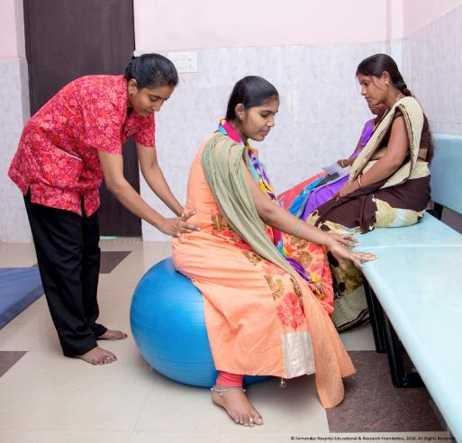
Midwifery Initiative
Cadre of Midwives skilled as per competencies prescribed by International Confederation of Midwives
Revision of current one year NPM Training curriculum to 18 months
Midwifery Led Units in Public health facilities
Career Progression for Midwives
Certification and Regulation by Indian Nursing Council
  To provide access to quality maternal and newborn health services:
  Promote natural birthing by promoting positive child birthing experience
  Ensure respectful care
  Reduce over medicalization
Lancet Series on Midwifery (2014): Safe and effective midwifery care can avert 83% of all maternal deaths, stillbirths and newborn deaths.

Slide 20
Focus on supply chain management for IFA and ensure availability and generate demand
Use Anemia Mukt Bharat Dashboards for monitoring data and initiate test and treatment.
Address non nutritional causes of anemia in endemic pockets eg: Heamoglobinopathies and malaria
Anemia Mukt Bharat
Integrated Diarrhoea Control Fortnight for promotion of ORS and Zinc (28th May – 9th June 2019 – ensure availability and focus on unreached population)
National Deworming Day (NDD) – Focus on private school and out of school participation
IDCF & NDD

Slide 21
Role of PSs and MDs in implementation of IDCF 2019
(28 May – 9 June, 2019)
Review of Stock positioning of ORS/ Zinc and procurement (based on Under 5 Population, estimated diarrhoeal episodes and buffer stock)
Inter-sectoral coordination meeting at State level and Video-conference with district officials on preparation
Review of Capacity building - Stakeholders (AWW, Schools, drinking water & Sanitation, tribal, PRI, IAP –private sector, medical colleges etc.)
Launch of IDCF 2019 campaign and Visibility on Social media platforms
Review of Supportive Supervision plans (State/ Districts) and monitoring by State and District officials during fortnight (At least twice)
Advocacy and awareness generation campaign through local media, SHGs, local religious leaders and local groups (folk dance, nukad natak etc.)
Focus on Aspirational Districts/High Priority Districts- Active engagement Development Partners / Private Providers
Review of preparation, mid-level implementation (corrective measures) and at the end of fortnight

Slide 22
Focus on capacity building of labour room staff for essential newborn care and resuscitation.
Focus on use of SNCU data for ensuring quality care at SNCUs and ensuring follow-up of discharged babies
Promote Mother Newborn Care Unit for developmentally supportive care of Newborn in SNCU
Expedite implementation of HBYC programme
Ensure supportive supervision of frontline functionaries for home visits
New Born Care
Breast Feeding (1st Vaccine)
Although institutional delivery is 78.9%, breastfeeding within one hour of birth is only 41.6%
Capacity building and accreditation on priority
Focus on complementary feeding from 6 months onwards
MAA
Programme

Slide 23

Rashtriya Bal Swasthya Karyakram and Early Childhood Development
Rashtriya Bal Swasthaya Karyakram (RBSK)
Systemic approach for early identification and management of 4Ds - Defects at birth, Deficiency, Diseases at childhood and Developmental Delays for children of 0-18 years
Improve coverage
Ensure referral and management of those identified with 4 Ds
Establish/ strengthen DEICs
Use of MCP card
Promote play and stimulation

Slide 24
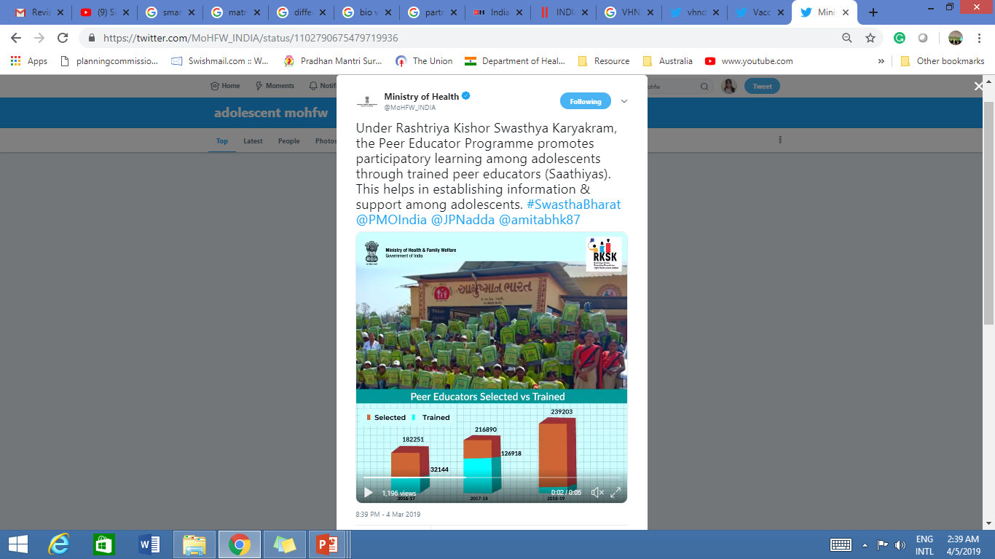

Adolescent Health - RKSK
Focus on revised guidelines for RKSK – Partnerships with NGOs to be prioritized
Reproductive Health
Reposition Family Planning - potential to improve overall maternal and child health outcomes
Most of the states score low in FP Service provision
Expanding the basket of choice: Injectable Contraceptive MPA (Antara Program) & Centchroman pill (Chhaya)
Mission Parivar Vikas- 146 High Fertility Districts & New Family Planning Media Campaign

Slide 25

Immunization
Coverage Improvement- Way Forward
Key Focus Areas
Availability of updated microplans
Regular head count survey and generation of due list
Awareness generation and social mobilization
Supportive Supervision
New Vaccines - Inactivated Polio Vaccine, Rotavirus vaccine, Pneumococcal Conjugate Vaccine, Measles-Rubella (MR) vaccine
State level estimates (CES 2019)
States with FIC < 70%
States with FIC >70%
Entire State will conduct MI
Categorization of districts based on available data sources
Concurrent Monitoring data by partners in sizeable beneficiary survey
IMI Survey
FIC < 70%
Mission
Indradhanush
FIC between 70 - 90%
Intensive Monitoring
Prioritising & focussing
FIC > 90%
Sustain gains

Slide 26

Heath and Wellness Centre: An opportunity to strengthen RMNCAH+N Services
Role of Health & Wellness Centre in augmenting RMNCAH +N Services
Counselling
Service Delivery
Referral and follow up
Supportive Supervision

Slide 27
Services
Pregnancy & Child birth:
Early registration, 4 Antenatal check-up, screening for Anemia, Hypertension, GDM, HIV, Syphilis, Hep B etc
Immunization, IFA and Calcium supplementation
First aid and referral for obstetric emergencies e.g. eclampsia, PPH, Sepsis (Type B SHC)
Neonatal and Child Health:
Identification and management of high risk newborn - low birth weight/ preterm/sick newborn, sepsis
Management of ARI/Diarrhoea and other common illness and minor AEFI
Early detection of growth abnormalities, delays in development and disability & referral
Adolescent Health: Providing adolescent friendly health services.
Family Planning- Provide family planning commodities and services including Injectable MPA, IUCD insertion and removal (at SC and PHC), and Sterilization services (at PHC) .

Slide 28
Counselling, Referral & Follow up
Birth Preparedness and complication readiness- Involve husband and Mother-in-law
Counselling, tracking and follow up of high risk pregnancies
Follow up for SNCU discharged babies, undernourished children, congenital anomalies, developmental delays
Counseling on common AEFI and repeat visits for immunization
Counselling, tracking and follow up of anemia cases
Counselling on basket of choices for family planning
Counseling on Adolescent Health Issues

Slide 29
Monitoring, Reporting and Supportive Supervision
Monitoring of VHSNDs- for antenatal services and immunization Sessions: availability and updation of micro plans and due lists, availability of supplies and logistics (vaccines, commodities for ANC – testing kits, IFA, calcium albendazole), House to house monitoring etc
Records and Reporting - RCH register, entry on RCH portal, immunization- UIP reports, indenting and issuance of stocks through FP-LMIS
  Report Adverse Events Following Immunization (AEFI)
  Report maternal and child deaths – ensure Maternal and Child Death Surveillance and Response – linkage with CRS
Capacity building and support to ANMs and ASHAs on their tasks, including on the job mentoring, and monitoring.
Establish linkages with nearby health facility for management of pregnancy complications, serious AEFIs, severe ARI/ diarrhoea
Facilitate campaigns, awareness generation /intensification activities including inter-sectoral coordination and collaborations with self help groups

Slide 30

Focusing on RMNCAH +N - A direct as well as indirect path to UHC!!
Thank You

