Slide 1
Population Level
Prevention, Screening And Control
Of
Common NCDs
Hypertension, Diabetes And Cancer(breast, Oral, Cervical)
&
NCD Service Delivery
Ayushman Bharat-CPHC
Health And Wellness Centers

Slide 2
Premature mortality among adults age 30-69 years due to NCDs
Four common NCDs –CVDs, Cancers, Diabetes and Chronic Respiratory Diseases accounts for 57% of total mortality in 30-69 age group
Country stands to lose $4.58 trillion between 2012- 2030
NCDs and poverty are interlinked
Notes:
REF: http://www.who.int/healthinfo/global_burden_disease/estimates/en/index1.html

Slide 3
Rationale for Population Based Intervention
Health Policy 2017:
  Integrated approach to NCD
  Health Promotion and Prevention
NCD Service delivery - Ayushman Bharat –CPHC - Health and Wellness Centers
Population Based Screening in 219 districts
Early detection can help in better management of diseases
  Lesser load on tertiary care
Awareness generation on the risk factors: Identifying the population at risk
  Equity and information asymmetry
Follow up and treatment adherence.
Linkages with NPCDCS, RCCs, Tertiary care institutions, SCIs and TCCCs

Slide 4
Workflow
Everyone above 30 years of age is to be covered (about 37%)
Sub Centre/HWC is the nodal unit
Leveraging ASHAs for population enumeration and CBAC through home visits
ANM-CBAC review, supportive supervision and home visits for motivating people for attending the screening

Slide 5
Workflow cont..
Sub Centre/HWC - Weekly- ANM – BP, RBS, referral and follow up
Oral- Breast- Cervical cancer screening at PHC/CHC/DH level
Medical officers, Nurses, Technicians at PHC/CHC for supportive supervision, confirmation, drugs dispensing and follow up
Nurses and LHVs to serve as mentors and trainers and assist in case of staff shortages
Navigation services by ASHA

Slide 6
CPHC – NCD Software Package
Dell is technical partner and Tata Trusts is implementation partner
Tablet App for ANM and Web based module for PHC and above
Tablet for ANM, and PC /Laptop with internet connectivity at PHCs and above for MO and triage Nurse.
Has programmatic and clinical decision support
  Comprehensive CDSS will be incorporated for Hypertension and Diabetes
Inbuilt support for upward/downward referral/ treatment adherence/ drugs inter alia
E Aushadhi will be integrated with the software

Slide 7

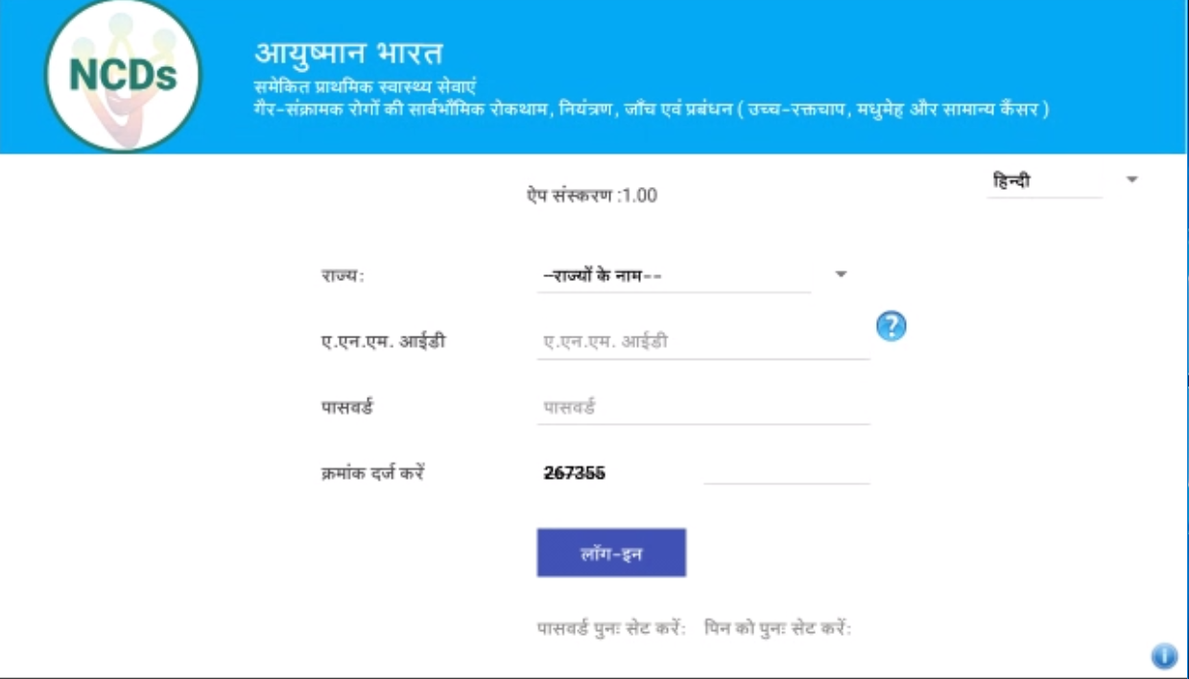
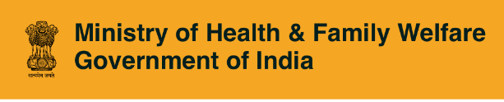
Comprehensive Primary Healthcare
Population-based NCD Screening Program
CPHC-NCD Application

Slide 8
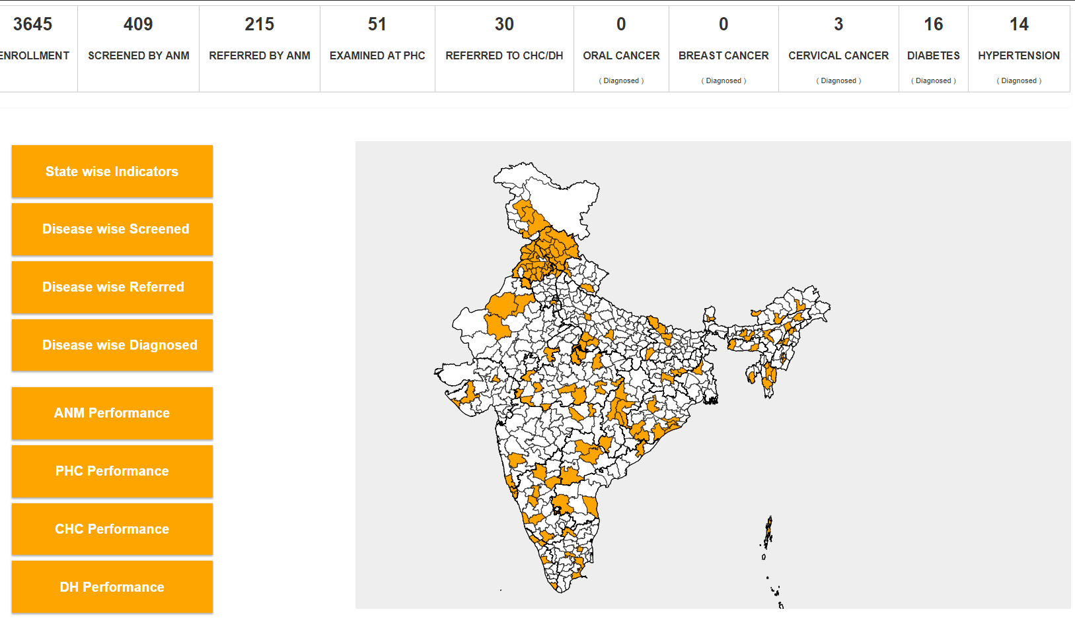
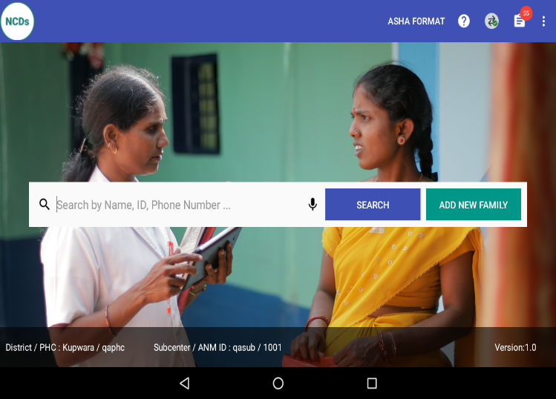
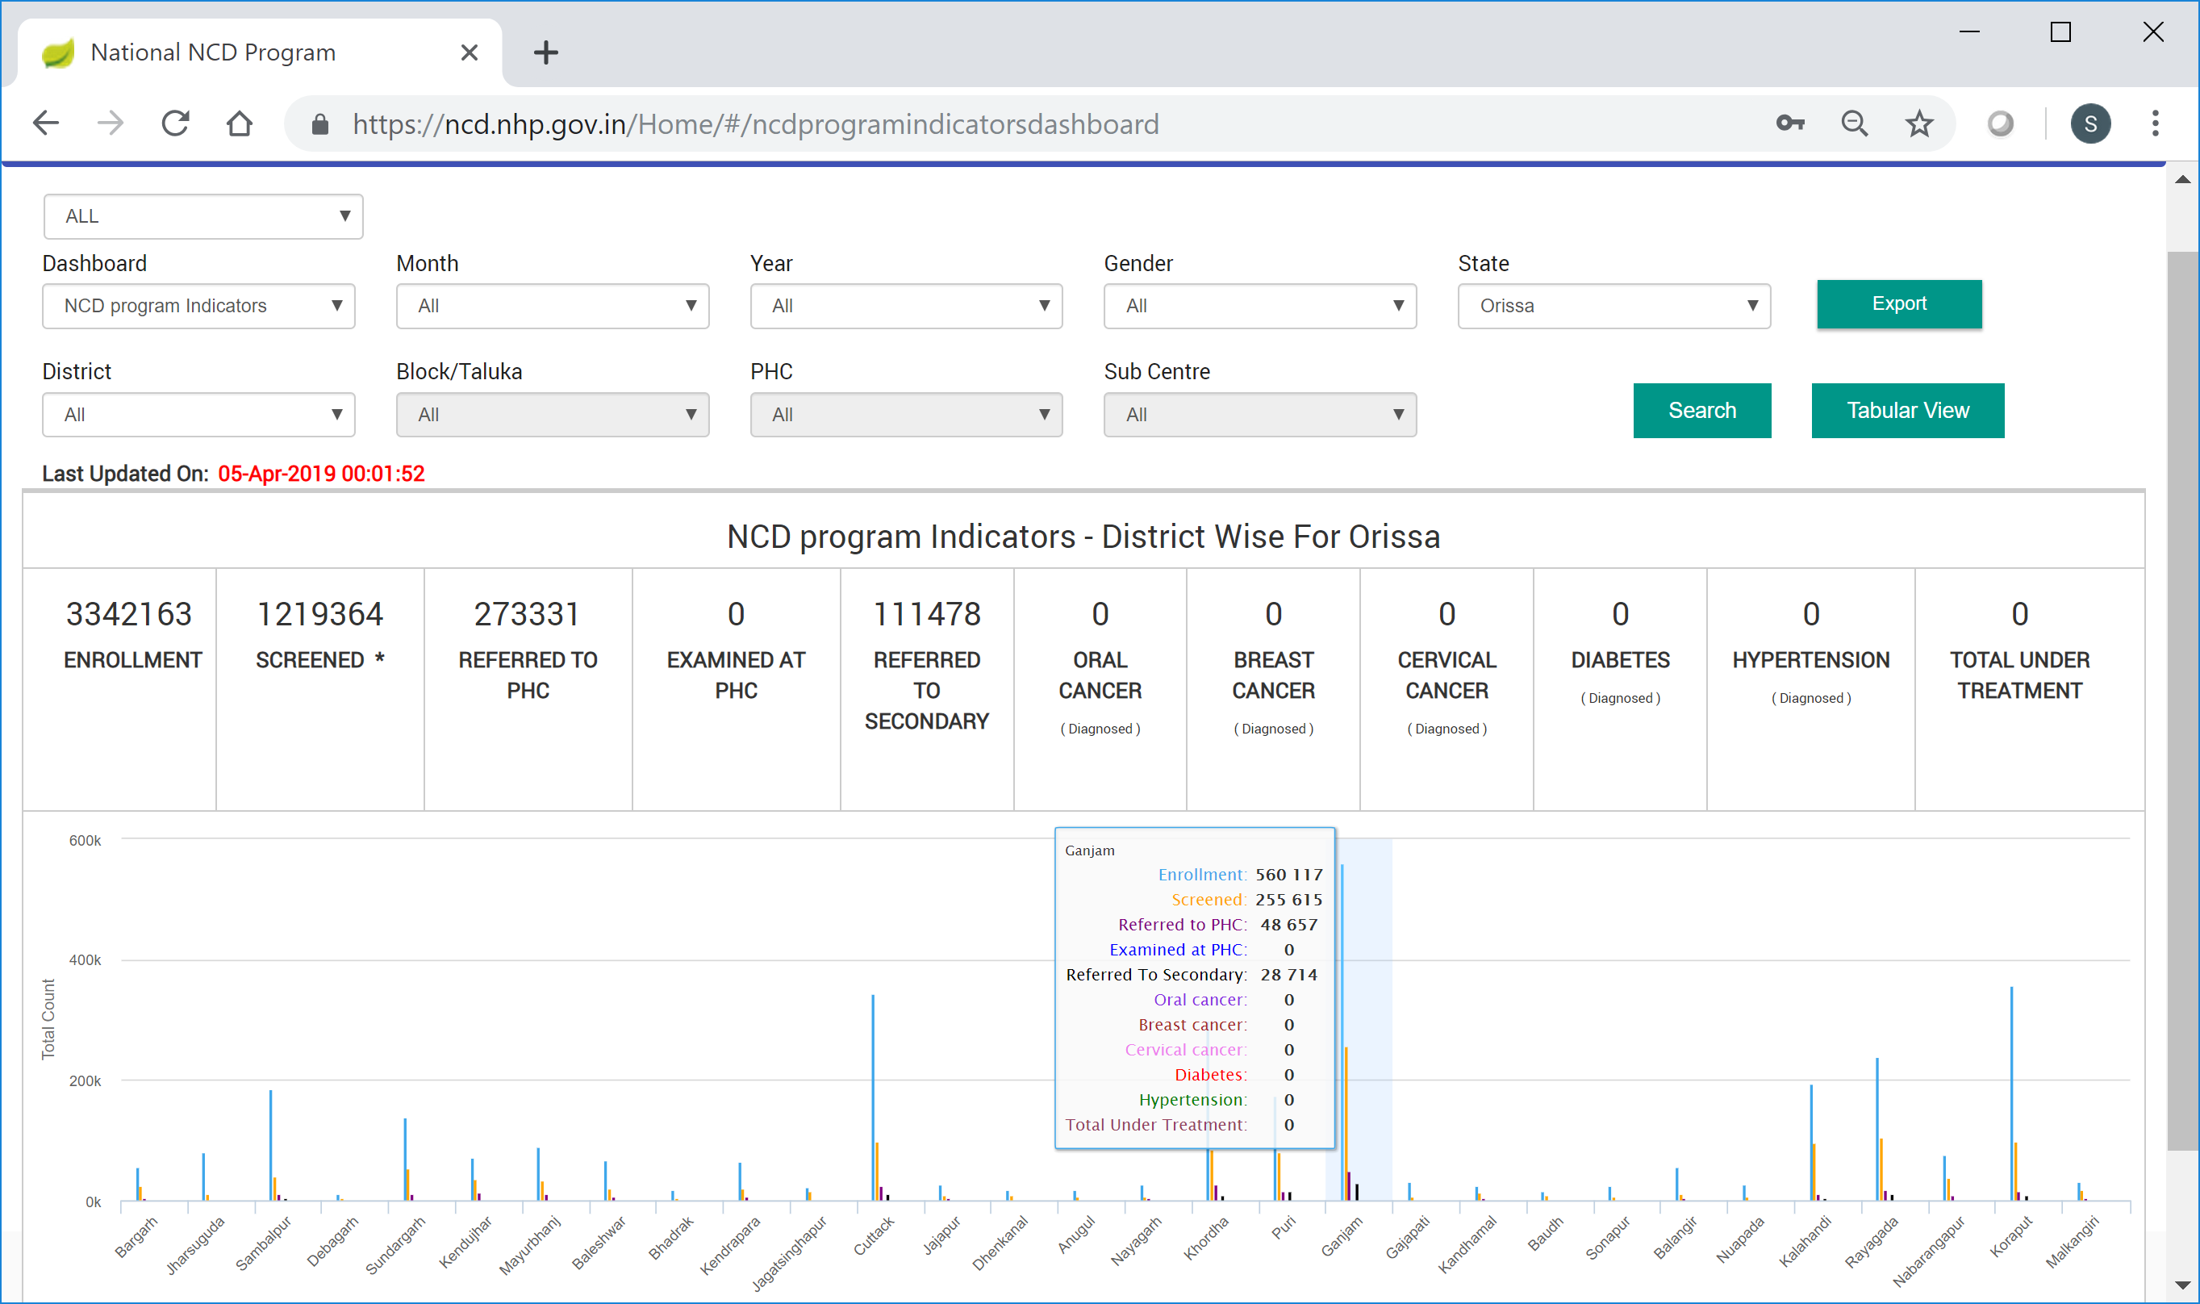
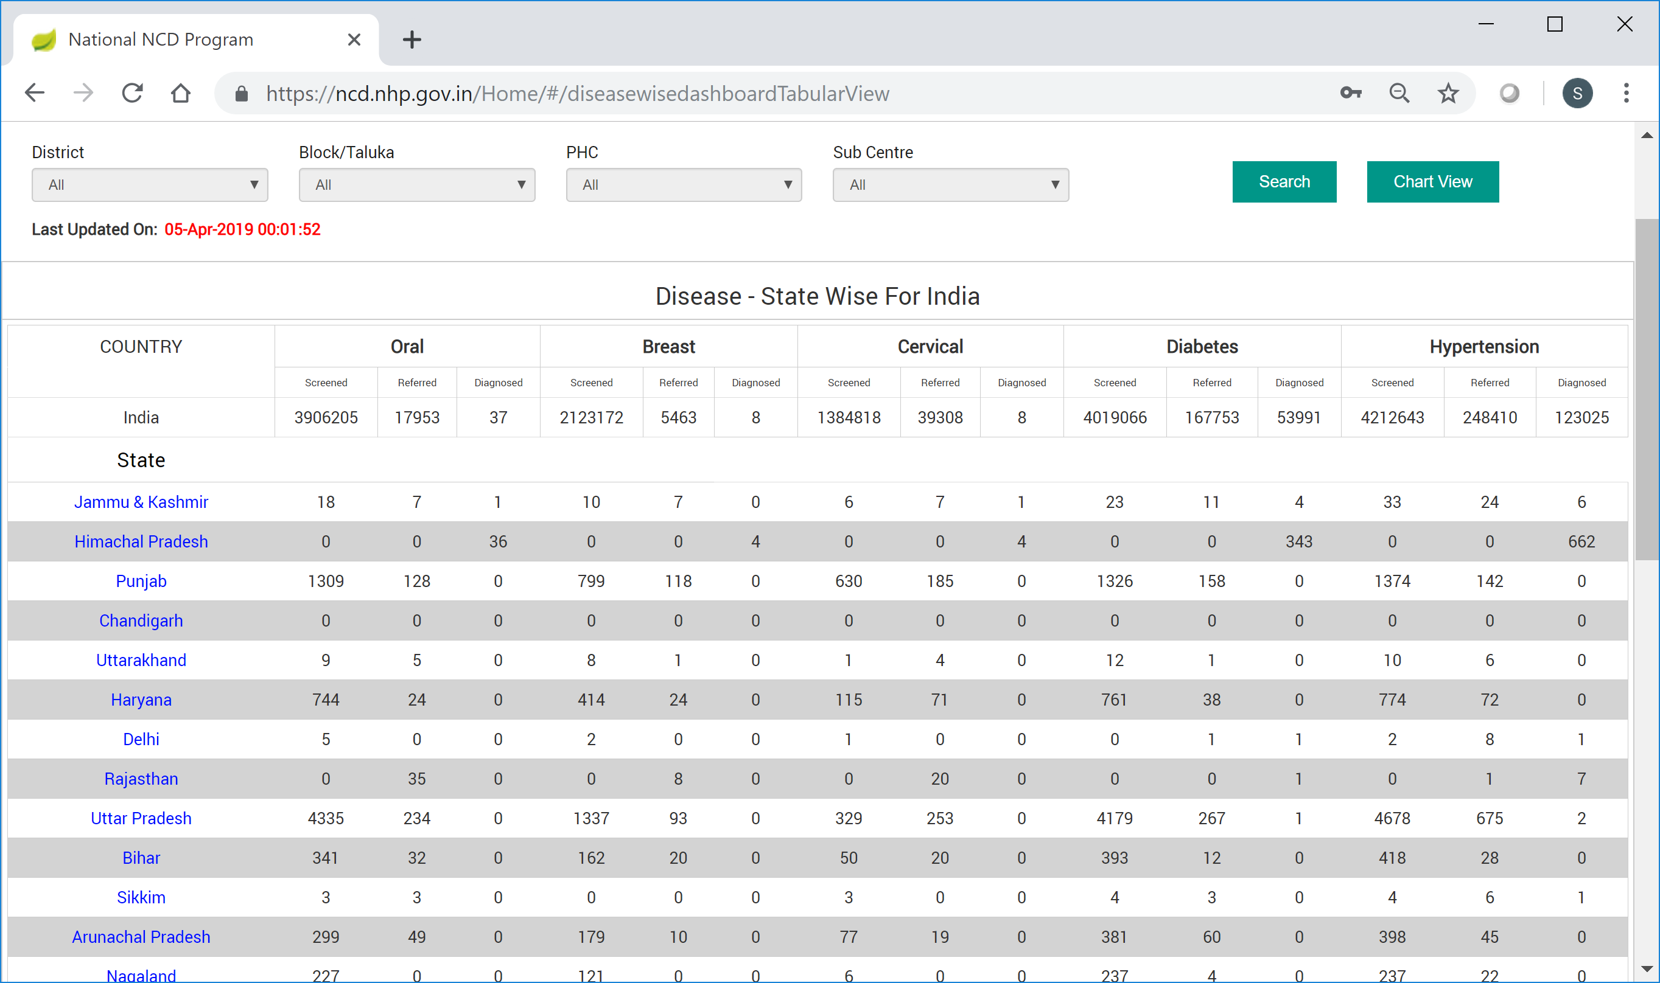
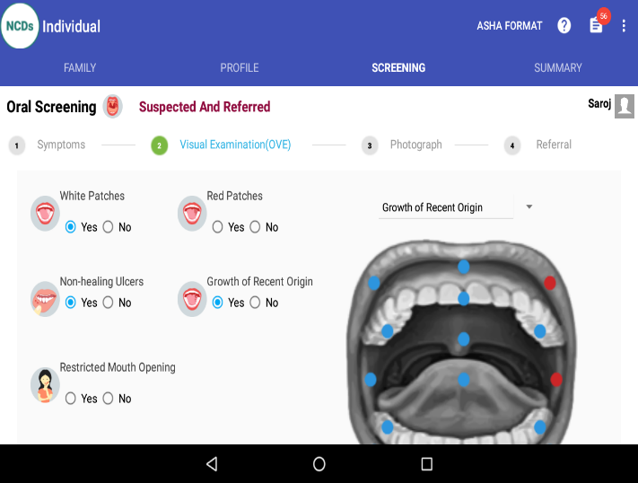
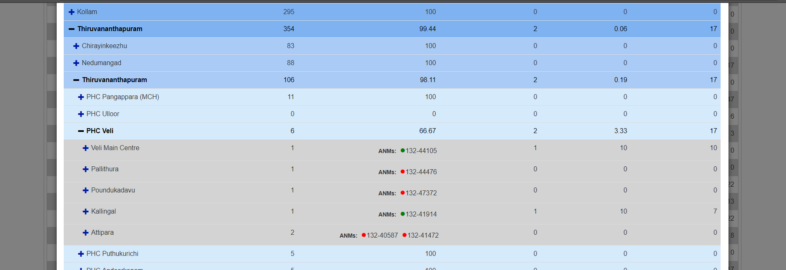
CPHC-NCD Solution Apps
6 Apps which provide Continuum of Care across facilities and locations
* ASHA Mobile App * ANM Tablet App * PHC MO Web Portal
* CHC Portal * Administrator’s Portal * Health Officials Dashboard

Slide 9
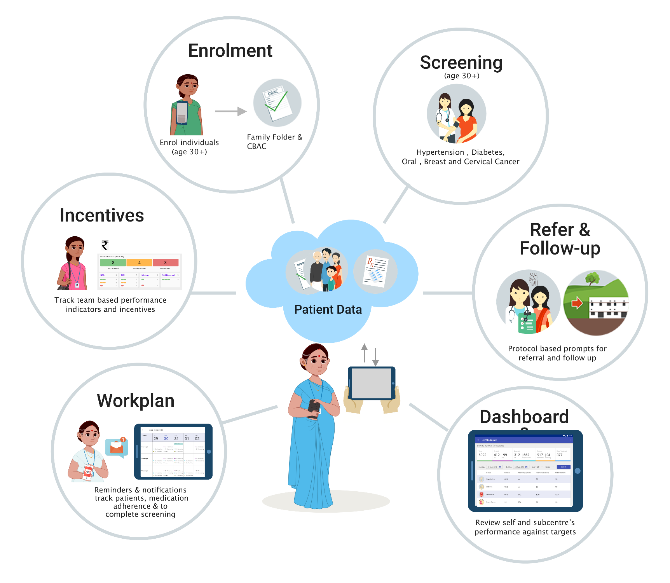
ASHA and ANM Android Apps
Multi Language Support (9 Languages)
Offline Applications
User Friendly UI
Training Manuals, Audio Video Help & IEC Materials
Easy Autoupdate of App
2-step Authentication for Login
Data Entry portal for Enrolment & CBAC
EHR Compliance – HL-7, SNOMED CT, MDDS. First version

Slide 10

NCD Platform Features
Scalability
Performance
Security
Interoperability
Multi Clustered deployment provides High Availability
Rapid Vertical and Horizontal scaling deployment using containers
On demand scalable services based on real-time data load i.e. Metric based scaling
Application Disaster Recovery
Robust incremental 2-way sync for offline capability
Multi clustered, multi zone database for distributed load
Built in Application performance metrics
Elastic Search Stack for lighting fast look up on health ID. i.e. parallel processing
Policy, Identity and Roles Management
Roll based Access Control (RBAC)
Data at REST and In-transit encryption
2-factor authentication
Audit Trail for data update and delete
Unique health identifier
Data interoperability through HL7 standard
Omni channel notification to Citizen and NCD users
Services are based on REST API standard
E.H.R. 2014 Compliance

Slide 11






Unique Health Identifier
For CPHC - Interoperability:
Common Health ID
Common Master Data (Facilities, Users, Locations)
E.H.R. Compliance
  APIs – CREATE, UPDATE, SEARCH
Common HID Registry
Health Program 1
  If Aadhaar given, authenticated with UIDAI server. Aadhaar token stored
  If PAN, Voter or Driver’s license, ID format validated, mobile number verified through OTP
  If no ID-proof is given, photo, parent/spouse name and village needed to resolve duplicates.
  Assurance level attached based on strength of ID
  If none given, rejected
  On success, HID returned
Health Program 2
NCD Server
  Potential duplicates flagged. ANM must manually verify and resolve possible duplicates
  If PAN, Voter or Driver’s license, ID format validated and checked for duplicates
Enrolment by NCD Health Provider
  Sync to NCD server
Check for mandatory fields – NAME, AGE, GENDER. AADHAAR or MOBILE NUMBER
Check if already enrolled, and for duplicates
If Aadhaar, encrypted & stored on tablet
If no ID proof, need photo, parent/spouse name and village
Temp ID generated
  HID sent to Individual by SMS
  Disambiguation of duplicates can be resolved only if online

Slide 12
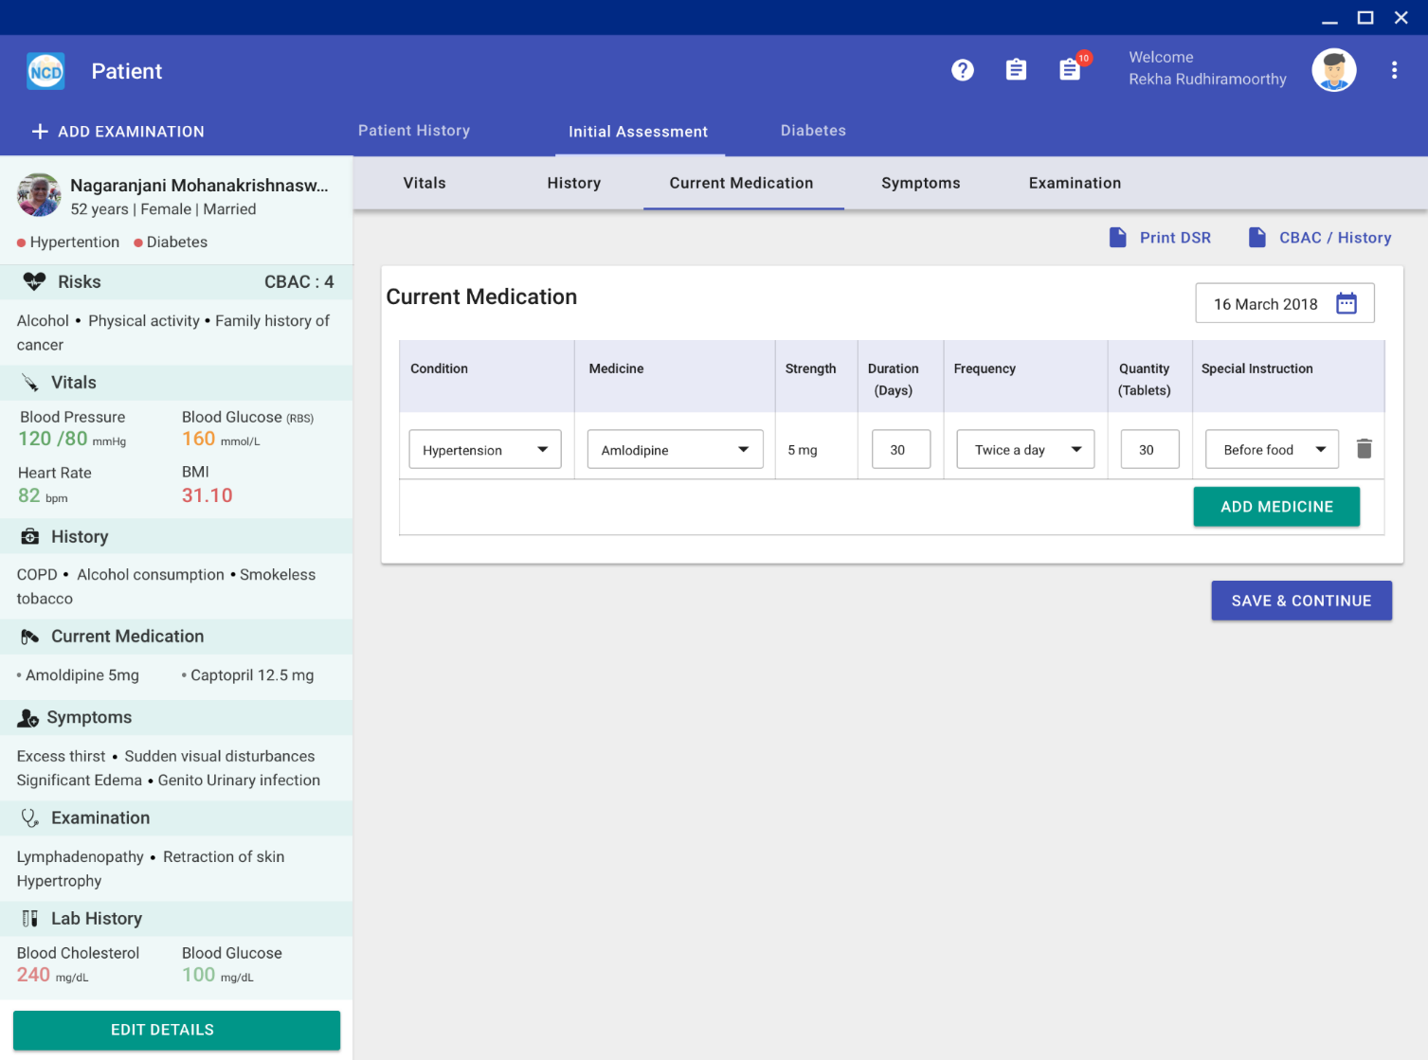
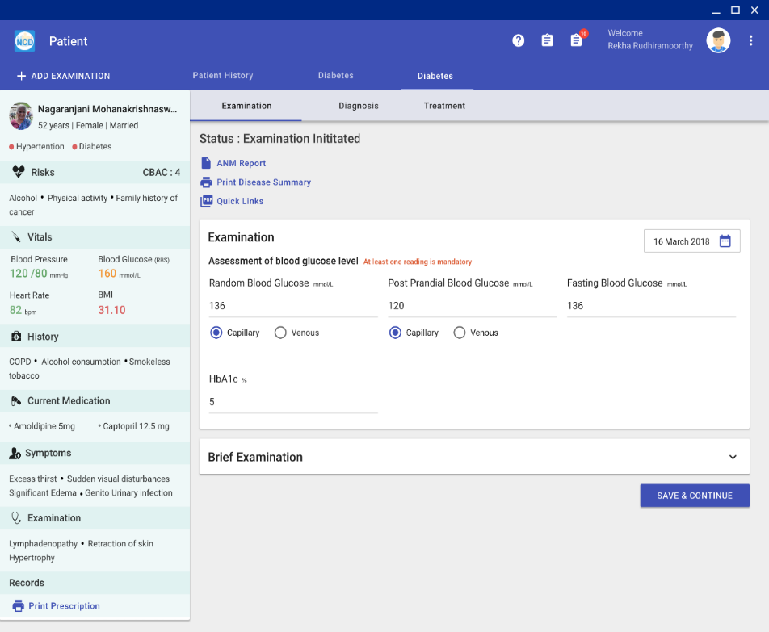
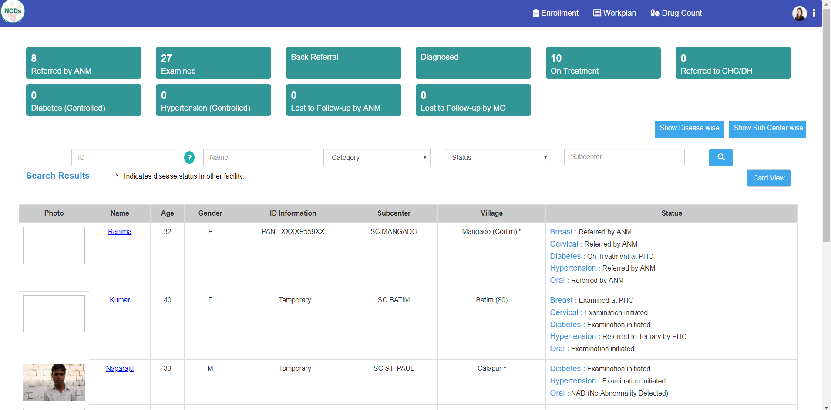
NCD Management – PHC, CHC, DH Portals
Simple User Interface for effective care co-ordination between medical staff at PHC/CHC/DH
Initial Assessment with sub-sections.
  Vitals; Patient History; Current Medication
  Signs & Symptoms; Physical Examination
MO/Doctor screens aligned to GOI protocols
  ANM pre-populated data verified by Nurse
  Disease-specific screens
  Quick data entry by MO; minimum fields
District Level admin portal
  Add - Facilities eg. PHC, SC. VIllages
  Users ANM, MLHP, ASHA, MO, Nurse, Pharmacist, Lab

Slide 13
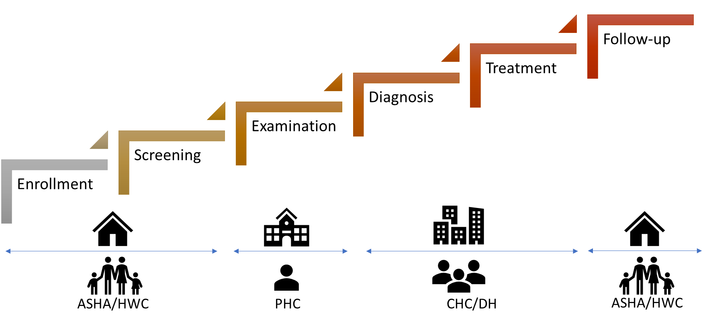





Comprehensive Referral Pathway
Referral pathway - movement of records across various levels of care.
Follow-up instructions available for Doctors to help specify care plan.
A Patient can moves across different statuses across different facilities
Role-based access of health record; Workplans - GOI Protocols and guidelines
Enrolment
Screening
Examination
Treatment
Diagnosis
Refer
Refer
SC/HWC
Follow-up
PHC
Follow-up
CHC/DH

Slide 14
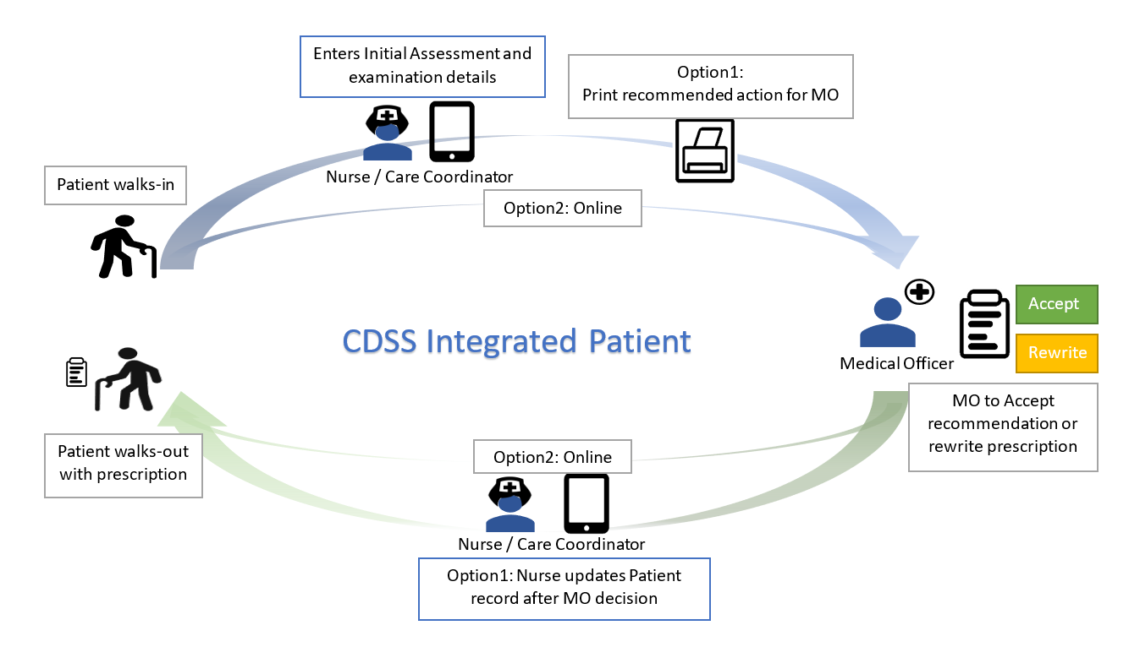
CDSS End to end workflow
Comprehensive Decision Support Solution by AIIMS experts.
Comprises 2000+ rules, validated over 10 years of extensive study.
Caters to Hypertension and Diabetes Mellitus.
Integrated patient workflows
Designed for low-resource settings (Internet connectivity)
Intelligent decision support at different levels of care – PHC/CHC/DH
Integrated Referral and Follow-up pathway for longitudinal record access
Allows customization of rules using an admin module
CDSS Integrated Patient pathway

Slide 15
Training
Cascade model
Training for Population Based Screening (PBS)
  ASHA, ANM, Nurses and MOs
  National ToTs Done – being done by states
Training of NCD Software Application:
  National ToTs done
  Training of Field level functionaries ( ANM, ASHA, MO, Staff Nurse, DEO, DDM) by states
  Tata Trusts is providing training and implementation Support

Slide 16
Training Status ( 2018-19)
Particular | ANM/MPHW | ASHA | Staff Nurse | MO | DEO/DDM/SNO/CHO | Total
On NCD Management | 37584 | 155084 | 10135 | 11024 | 0 | 213827
On NCD Software | 6015 | 838 | 456 | 478 | 3248 | 11035

Slide 17
State Wise Training on GoI CPHC-NCD Application
States | Numbers
Telangana | 2694
Rajasthan | 1547
Haryana | 1181
Odisha | 1146
Madhya Pradesh | 854
Jharkhand | 705
Karnataka | 549
Chhattisgarh | 490
Uttar Pradesh | 363
Puducherry | 300
Maharashtra | 269
Punjab | 230
Bihar | 224
Tripura | 209
States | Numbers
Arunachal Pradesh | 171
Manipur | 146
Assam | 99
Jammu & Kashmir | 98
Meghalaya | 82
Uttarakhand | 78
Goa | 74
Mizoram | 25
Delhi | 20
Nagaland, Sikkim, Daman & Diu, Dadra & Nagar Haveli, Andaman & Nicobar, Chandigarh, Lakshadweep, West Bengal | 0

Slide 18
GoI CPHC- NCD Software usage status
Particulars | State Name
19 States using GoI NCD software | Odisha, Telangana, Madhya Pradesh, Haryana, Rajasthan, Punjab, Karnataka, Chhattisgarh , Uttar Pradesh, Manipur Jharkhand, Tripura, Meghalaya, Arunachal Pradesh, Goa Maharashtra, Assam, Bihar , Jammu & Kashmir
6 States using their own software | Gujarat, Andhra Pradesh, Tamil Nadu, Himachal Pradesh, Kerala, Dadra & Nagar Haveli
11 States yet to start | Puducherry, Uttarakhand, Sikkim, Delhi, Daman & Diu, Dadra & Nagar Haveli, Andaman & Nicobar, Chandigarh, Lakshwadeep , Mizoram, West Bengal

Slide 19
Status of NCD Application Usage ( 2018-19)
States | Enrollment | Screening
GoI NCD Software Application | 45.53 lakh | 23.88 lakh
Data Migrated from state owned NCD software | 4.31 cr | 30.41 lakh
Pan India : Total | 4.77 cr | 54.29 lakh

Slide 20
GoI CPHC-NCD App: Pan India Monthly status

Slide 21
State wise use of GOI CPHC- NCD Application
States | Enrolment | Screening
India | 45.53 lakh | 23.88 lakh
Orissa | 33.42 lakh | 18.74 lakh
Telangana | 7.09 lakh | 4.87 lakh
Madhya Pradesh | 93960 | 880
Haryana | 78715 | 797
Rajasthan | 69769 | 0
Punjab | 44977 | 1393
Karnataka | 39125 | 2452
Chhattisgarh | 32958 | 777
Uttar Pradesh | 31724 | 4629
Manipur | 31323 | 5456
Jharkhand | 24644 | 3589
Tripura | 15909 | 2
Meghalaya | 10401 | 324
Arunachal Pradesh | 6714 | 400
Goa | 6138 | 2797

Slide 22
State wise use of GOI CPHC- NCD Application
States | Enrolment | Screening
Maharashtra | 5453 | 2674
Assam | 5304 | 1226
Bihar | 4314 | 435
Nagaland | 256 | 237
Puducherry | 200 | 190
Jammu & Kashmir | 127 | 40
Uttarakhand | 26 | 13
Sikkim | 25 | 11
Delhi | 19 | 11
Daman & Diu | 5 | 0
Dadra & Nagar Haveli | 1 | 0
Andaman & Nicobar | 0 | 0
Chandigarh | 0 | 0
Lakshadweep | 0 | 0
Mizoram | 0 | 0

Slide 23
Status - States Using their own software Application
States | Enrolment | Screening
Gujarat | 3.76cr | 0
Andhra Pradesh | 22.01 lakh | 13
Telangana* | 15.93 lakh | 15.73 lakh
Tamil Nadu | 7.71 lakh | 7.79 lakh
Himachal Pradesh | 3.98 lakh | 3.98 lakh
Uttar Pradesh | 2.49 lakh | 66
Kerala | 3.02 lakh | 6887
* Telangana was using its own application in 7 districts and data from these districts was migrated.

Slide 24
Tablet & Login Status in GoI CPHC- NCD Application
9854 ANM and 505 MO have Logged in past 30 days -- 103855 Tablets are available
States | Tablets in Hand | ANM Log In | MO Log In
Orissa | 6688 | 3602 | 23
Telangana | 8000 | 3129 | 135
Madhya Pradesh | 6973 | 1739 | 0
Punjab | 3272 | 546 | 0
Chhattisgarh | 273 | 98 | 11
Karnataka | 1500 | 251 | 13
Tripura | 70 | 82 | 0
Jharkhand | 6000 | 33 | 0
Haryana | 2735 | 49 | 0
Maharashtra | 171 | 43 | 4
Arunachal Pradesh | 50 | 39 | 0
Meghalaya | 50 | 39 | 6
Manipur | 220 | 54 | 3
Bihar | 144 | 126 | 0
Goa | 14 | 13 | 2
Assam | 16 | 5 | 2
Uttar Pradesh | 28934 | 84 | 3
Jammu & Kashmir | 200 | 3 | 0
Rajasthan | 0 | 0 | 303

Slide 25
Tablet & Login Status in GoI CPHC- NCD Application
9853 ANM and 505 MO have Logged in past 30 days -- 103855 Tablets are available
States | Tablets in Hand | ANM Log In | MO Log In
Nagaland | 20 | 1 | 0
Puducherry | 9 | 0 | 0
Uttarakhand | 0 | 0 | 0
Sikkim | 0 | 0 | 0
Delhi | 0 | 0 | 0
Daman & Diu | 80 | 0 | 0
Dadra Nagar Haveli | 147 | 0 | 0
Andaman and Nicobar | 0 | 0 | 0
Chandigarh | 71 | 0 | 0
Mizoram | 10 | 0 | 0
West Bengal | 0 | 0 | 0
Gujarat | 14162 | 0 | 0
Andhra Pradesh | 12298 | 0 | 0
Tamil Nadu | 148 | 0 | 0
Himachal Pradesh | 2000 | 0 | 0
Kerala | 9600 | 0 | 0
Lakshadweep | 0 | 0 | 0

Slide 26
Way Forward
Training for Software and Population Based Screening
  Monitoring of schedule and ensure quality
Upward referral and downward follow up linkage
Arrangement of supplies
  IEC, forms, equipment, diagnostics, drugs
Availability of medicines
  Necessary drugs in EDL of the States
  3 months supply
Monitoring mechanism

Slide 27
Way Forward
Tablet Procurement to be completed soon
IT infrastructure to be made ready (Desktop/Laptop, Internet facilities) in PHC, CHC and District hospitals
  PC for MO and Nurse
All the functional HWC to use NCD Application
Medical Officers to start using NCD application so as to bring focus on care continuum

Slide 28
Way Forward
Monitoring of the programme through State and district NCD cells
NCD Division has to take lead
May require coordination with different divisions such as the one dealing with ASHAs.
Action Plan for field training
Cervical cancer screening on field – Action plan
Monitoring of quality of interventions

Slide 29
Thank You

