Slide 1


URBAN HEALTH INITIATIVES
TELANGANA
Dr. Yogita Rana I.A.S

Slide 2
Background
Hyderabad – 5th largest metro in the country.
Challenges in health services delivery in urban areas:
Significant % of daily wagers ; Migrant workers etc.,
Existing UPHCs (149 nos) are too few to cater to a population of approx. 1 crore.
UPHCs are too far from most of the slums and habitations of poor.
Our regular facilities are not open in the evening hours when the working poor could visit the health facility.
Naturally, the poor visit private service providers and incur significant out of pocket expenditure.

Slide 3
  Basti Dawakhana : An initiative to offer quality health services to urban poor.
  One Basti Dawakhana per 5000-10000 population; Located in slums
  Health care facility closer to the people who need it the most
  ONE STOP SERVICE Consultation/Diagnostics/Pharmacy at free of cost.
  Traveling / Waiting time reduced drastically
  Reduced out of pocket expenditure
  Reduced burden on secondary /tertiary facilities
  Platform to converge other National Health programmes in urban areas

Slide 4
Roll out ….Needs convergence…
Municipal corporation (GHMC)
Rent free buildings
Electricity and water connection
Daily house keeping – cleaning ,waste disposal
Repairs etc
Involvement of urban SHGs / MAS
Awareness and mobilisation – platform
Health department
Positioning of medical and para medical staff
Consumables ,medicines, diagnostics etc
Day to day running of the facilities

Slide 5
Collection of samples /bar coding etc and sent to Telangana diagnostics.
Pharmacy - Also dispenses medicines for Non Communicable disesases.
IT initiatives - OPD module
- Diagnostics- Spoke and Hub
- e-aushadi
- Tele medicine ( tele conf)

Slide 6
Sl.No | Facility Name | Functional | Avg OPD/Day | HR | HR Cost per Month | Total HR cost
1 | Basti Dhawakana | 97 | 100 | 1.M.O 2.Staff Nurse 3.Helper | 1) 45 K 2) 21 K 3) 10 K | Rs.76000
2 | SEC (4pm to 8 pm) UPHC | 30 | 50 | 1) Specialist M.O 2) Staff Nurse 3) Helper | 62500 2) 21000 3) 8000 | 91500
3 | Evening Clinics (Part Time) (4-8pm) UPHC | 40 | 50 | 1)M.O 2)Regular ANM 3) Helper | 1) 22000 2) 10,500 3) 8000 | 40500
Human Resource Details

Slide 7
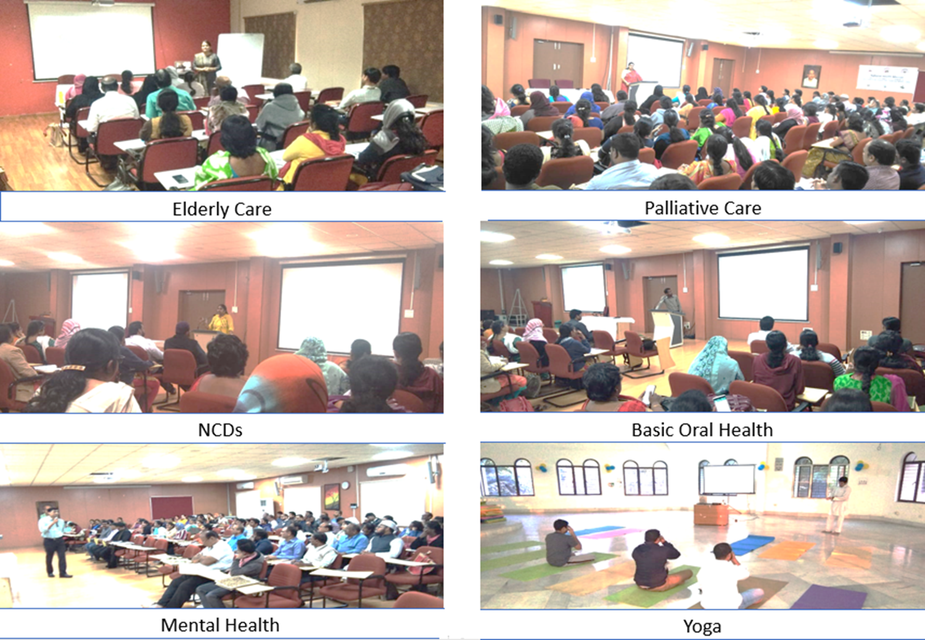
Capacity building

Slide 8
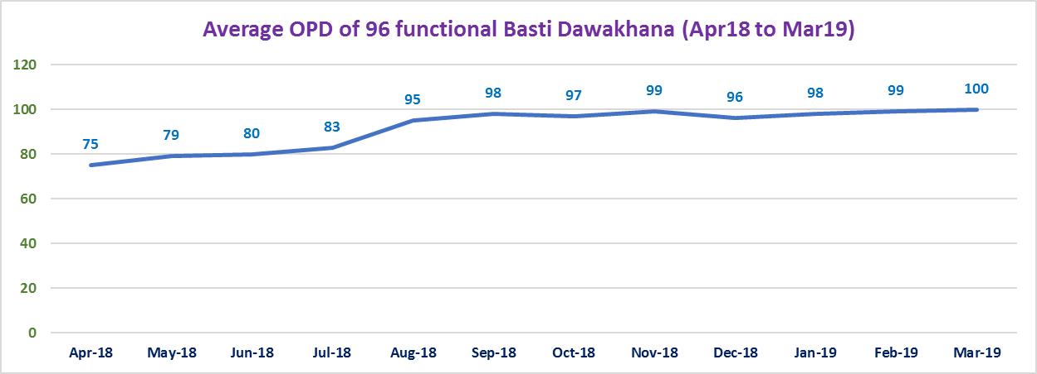
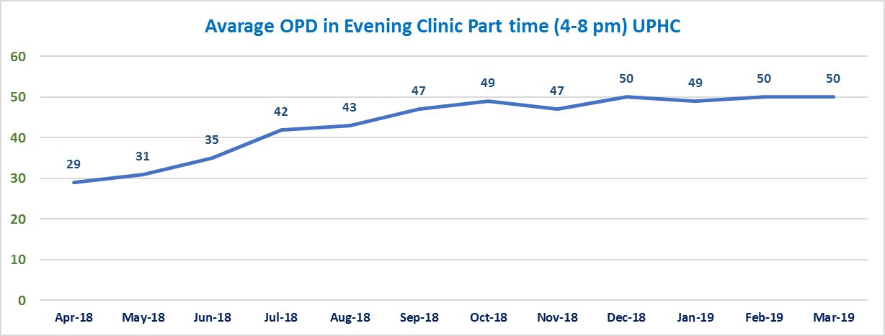
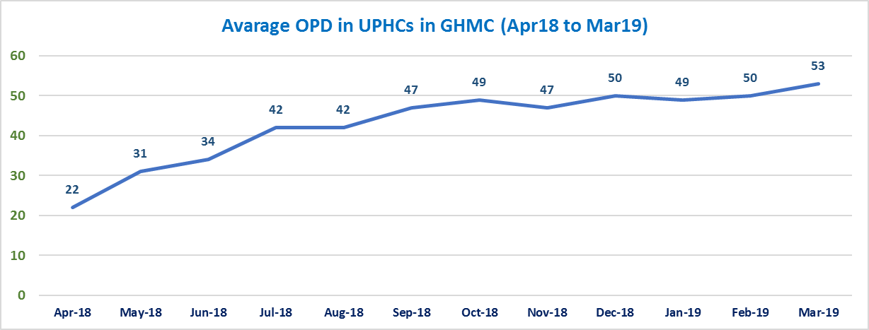

Slide 9
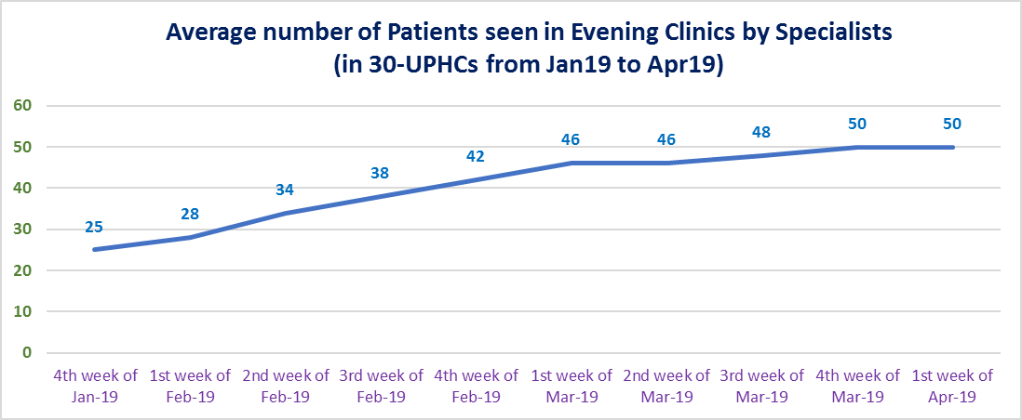
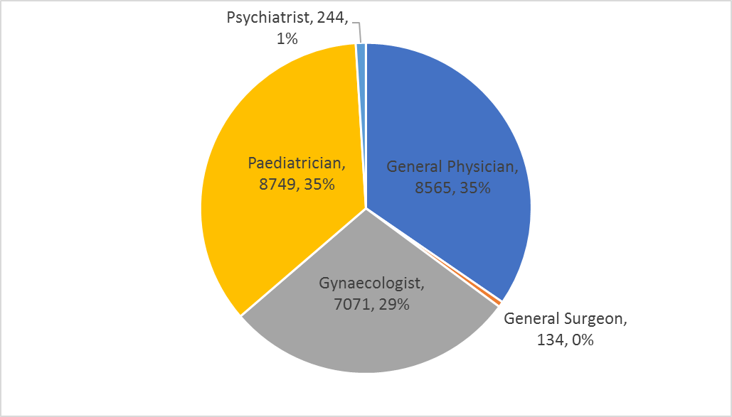

Slide 10
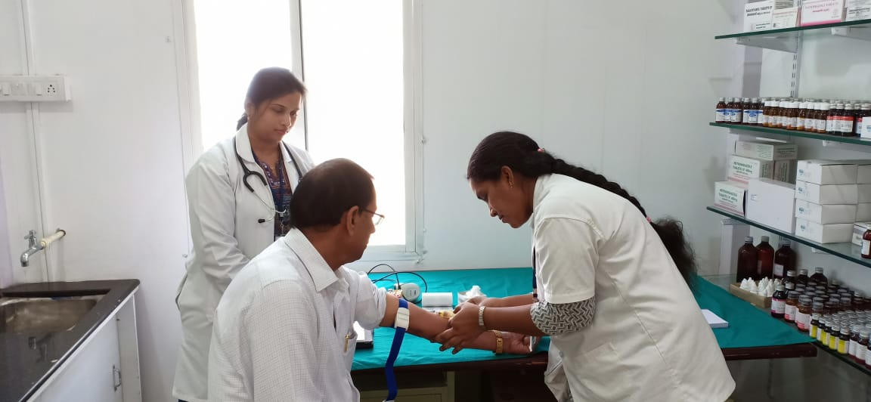
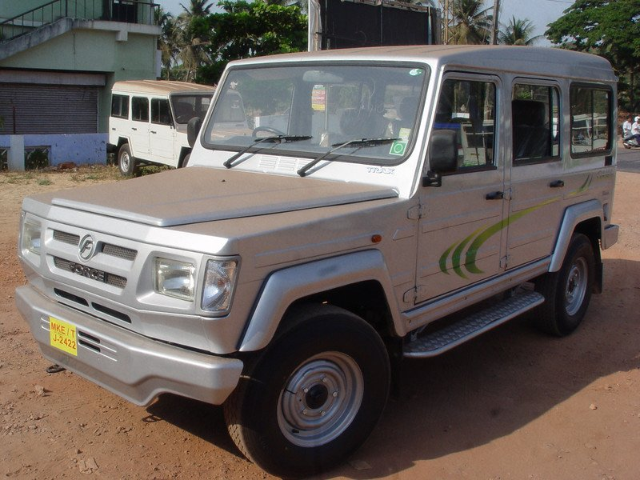
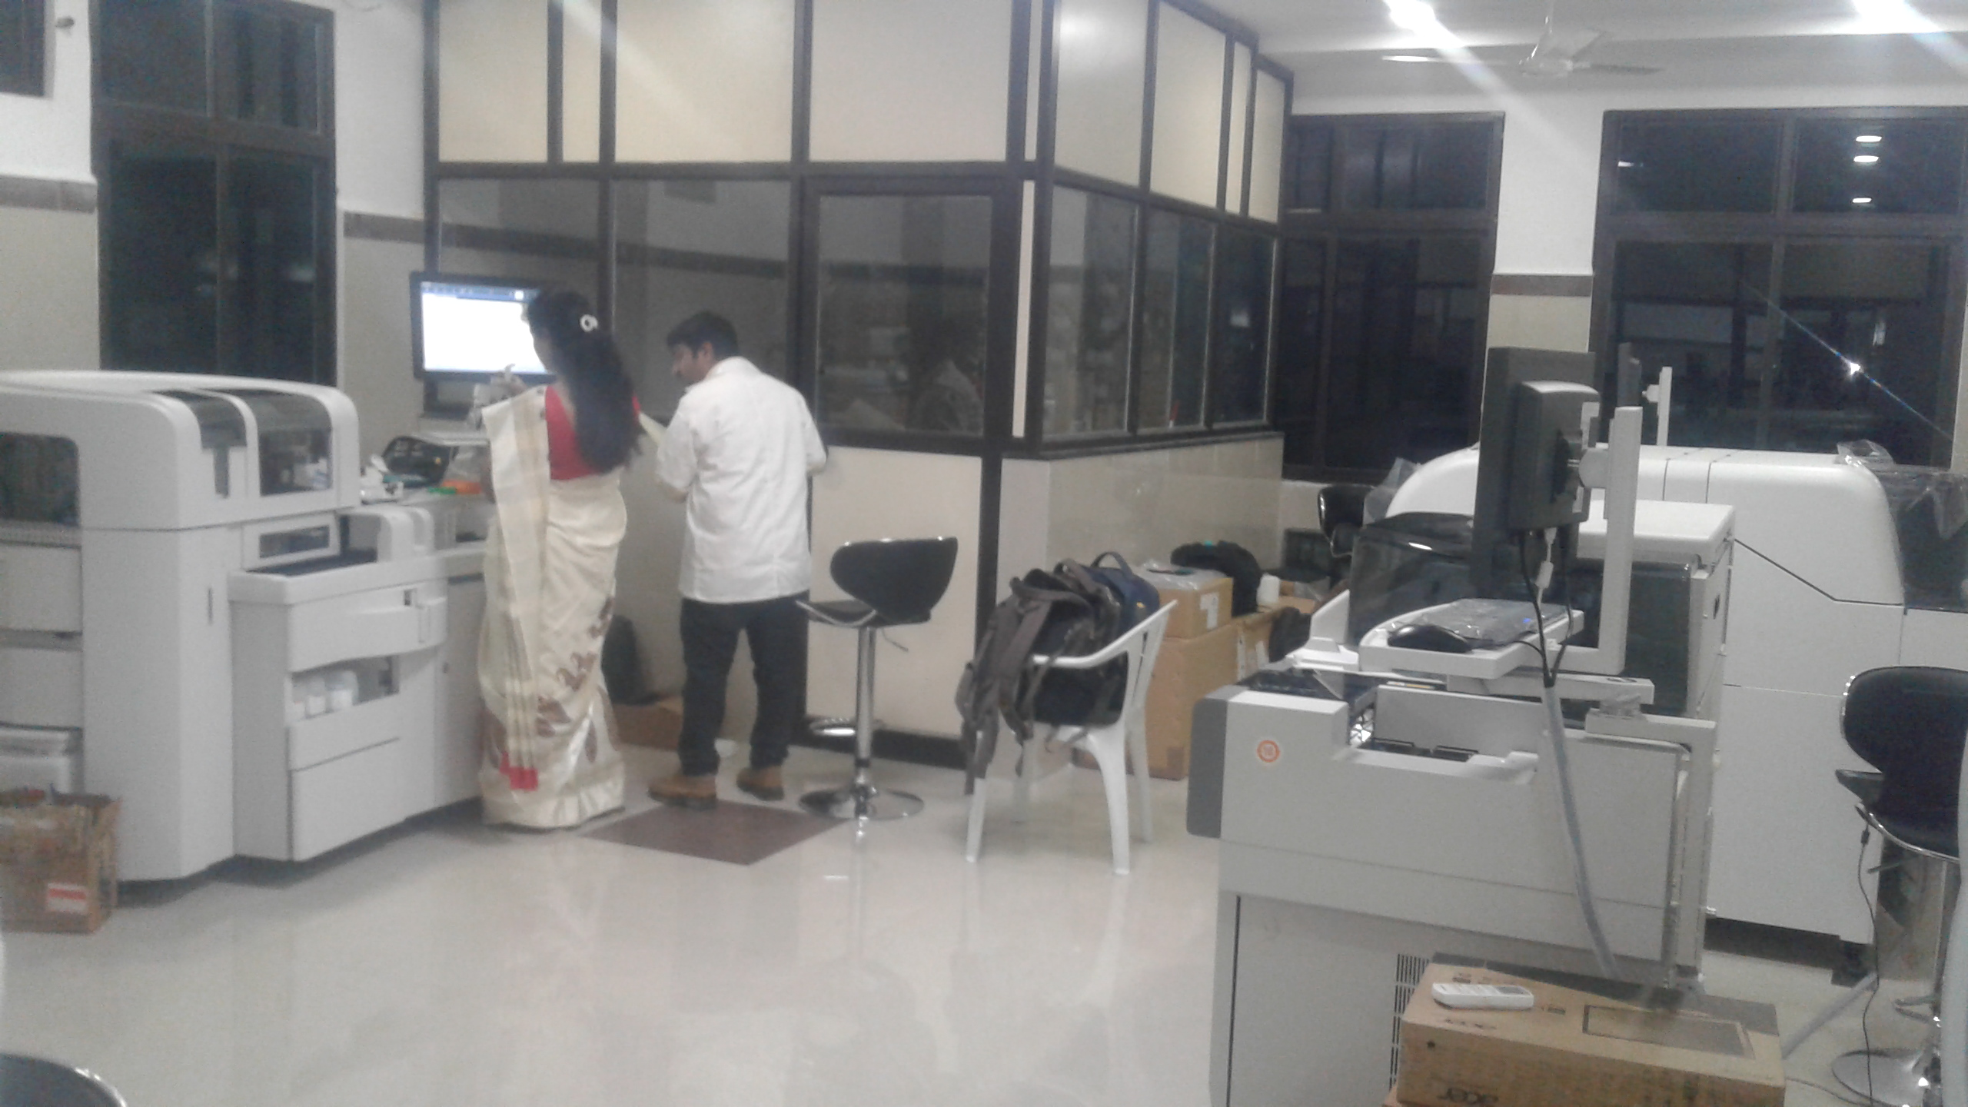
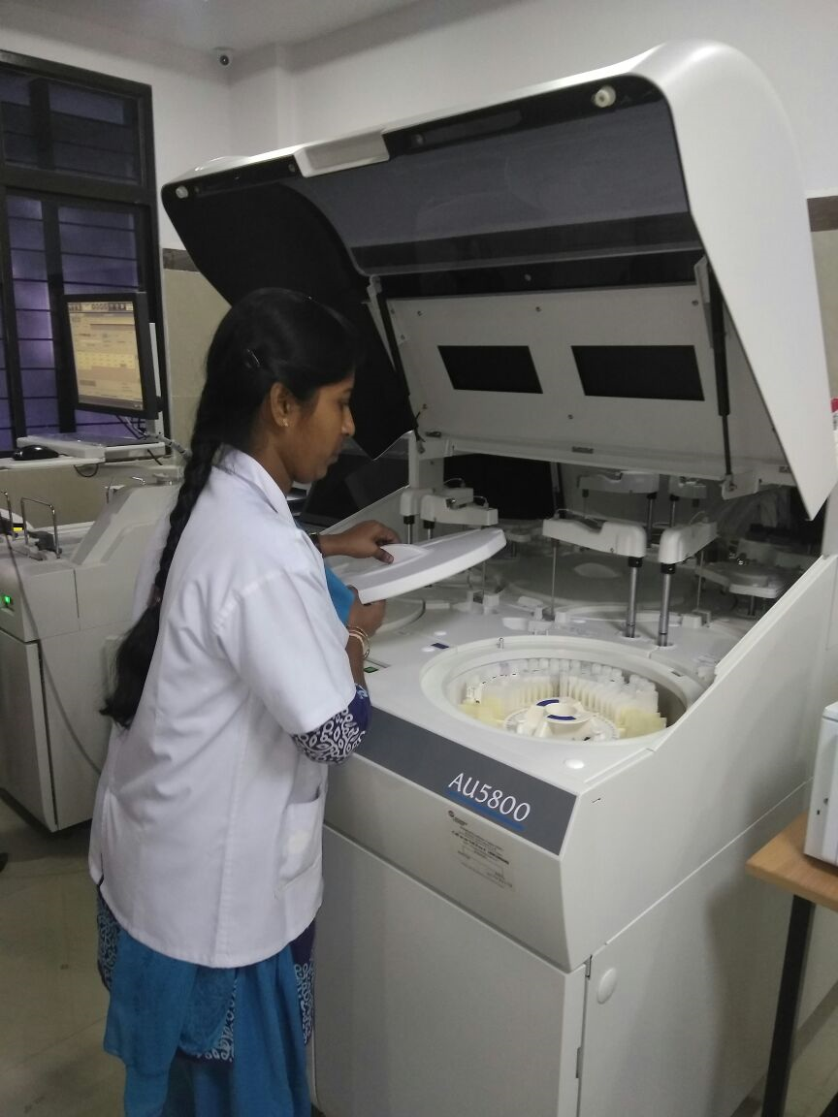
Diagnostics-Work flow
Sample collection at BDK-SPOKE( bar coded )
Samples Transported to Collection point(25)- HUB
Sample Testing at the Hub laboratory
Results transmitted ONLINE

Slide 11
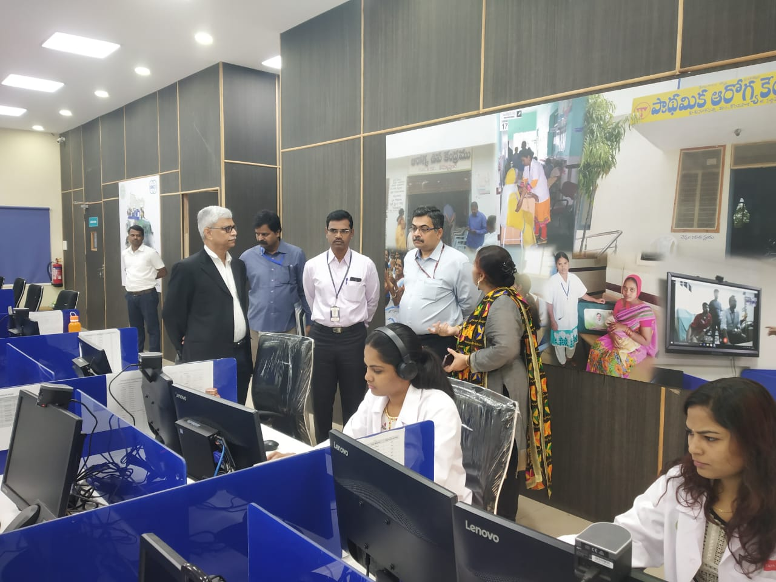
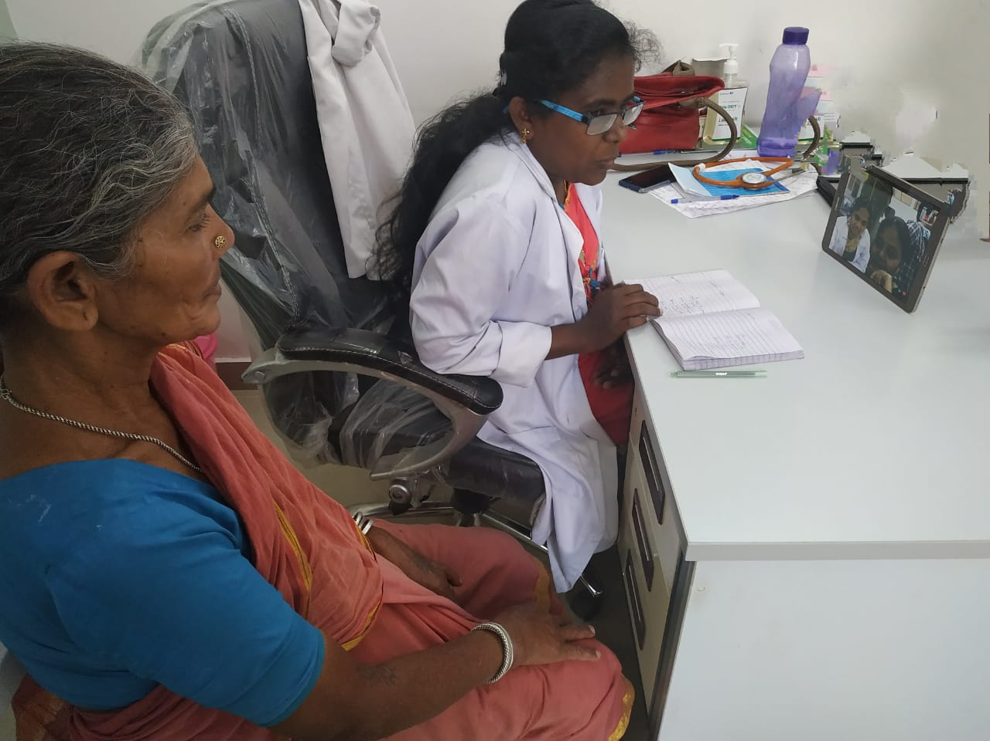
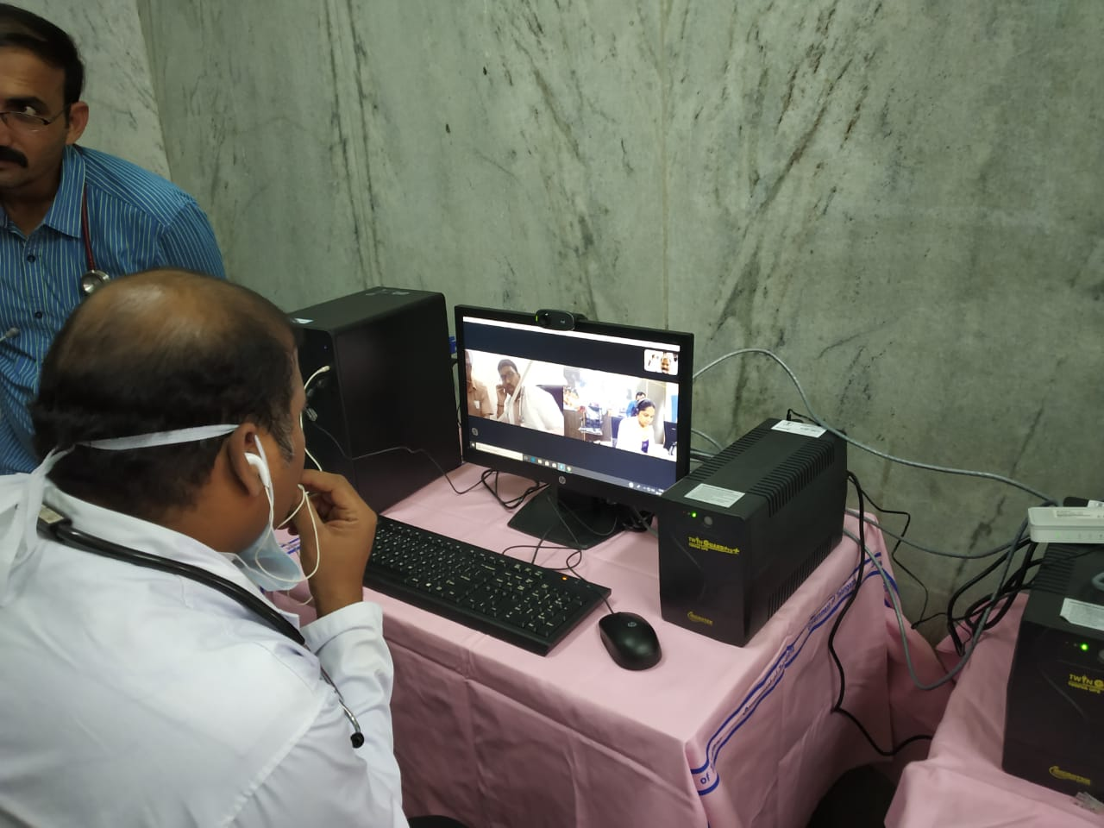
Telemedicine
The UPHCs and Bastidawakhanas are linked to Osmania General Hospital through the Digital Nerve Centre.
Specialists provide teleconsultation on fixed timings
Currently 10 UPHCs/BDs are linked and will be expanded in phased manner
Bastidawakhana
Digital Nerve Centre
Osmania General Hospital

Slide 12
Referral Linkages
Basti Dawakhana
Specialist Evening Clinics in UPHCs
Teaching Hospitals
UCHCs, Area Hospitals, District Hospital

Slide 13
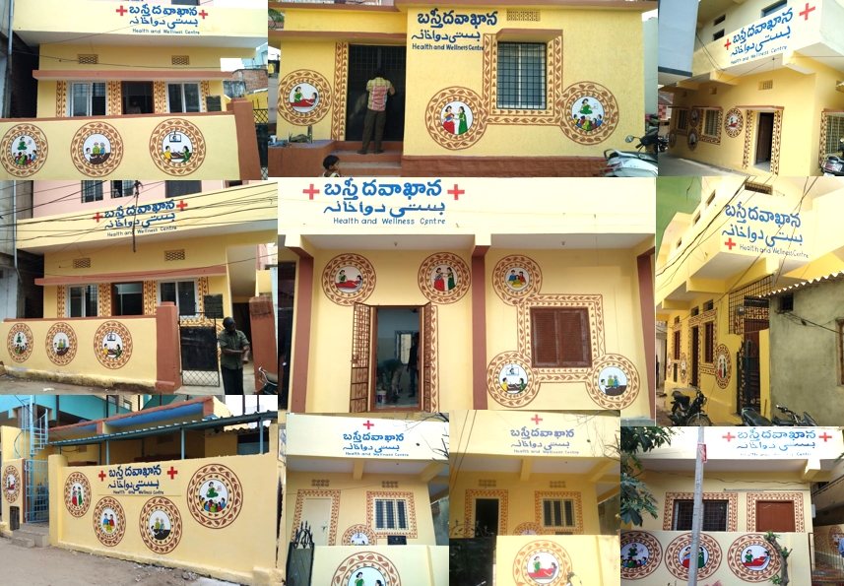

Slide 14
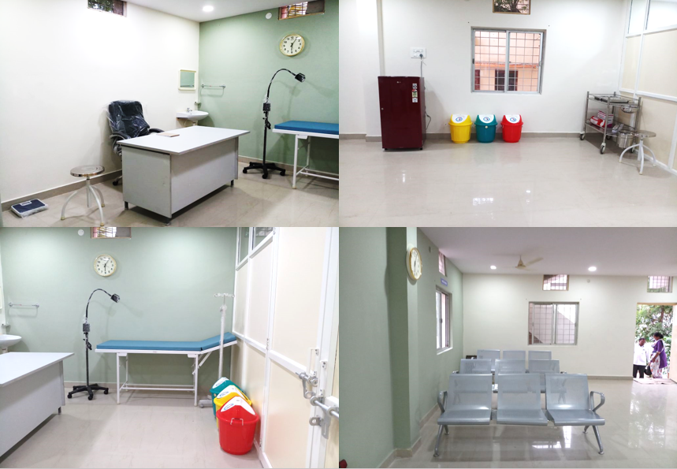
Standardization

Slide 15
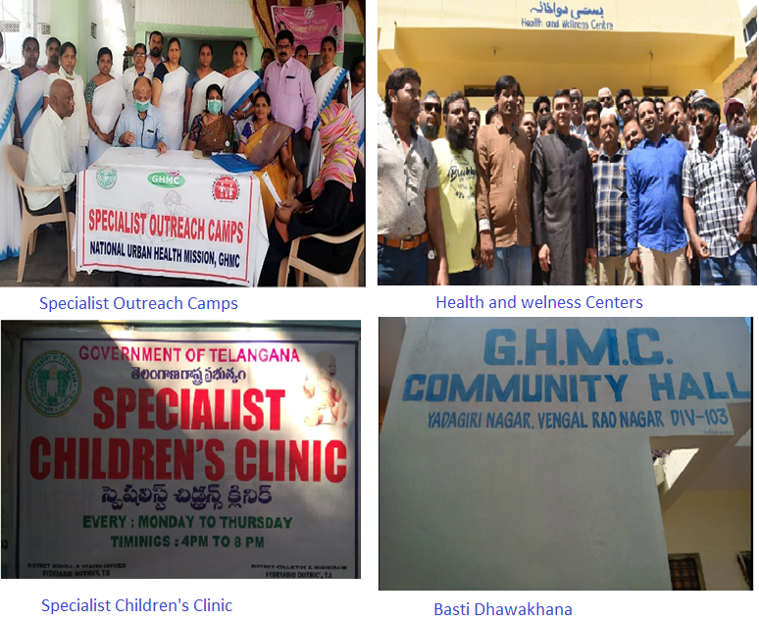

Slide 16
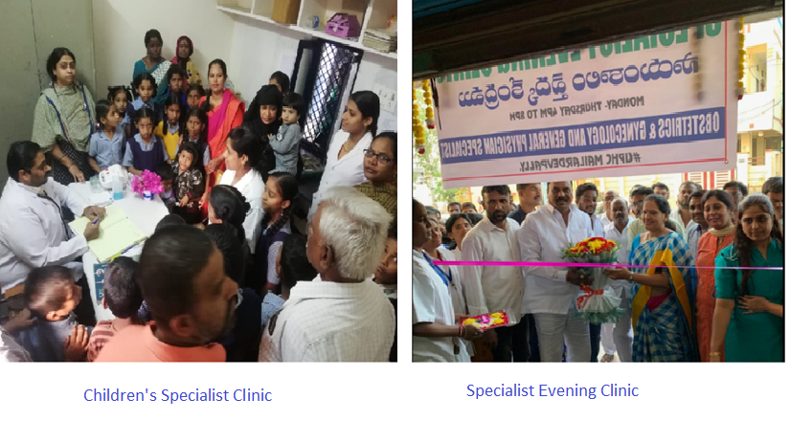

Slide 17
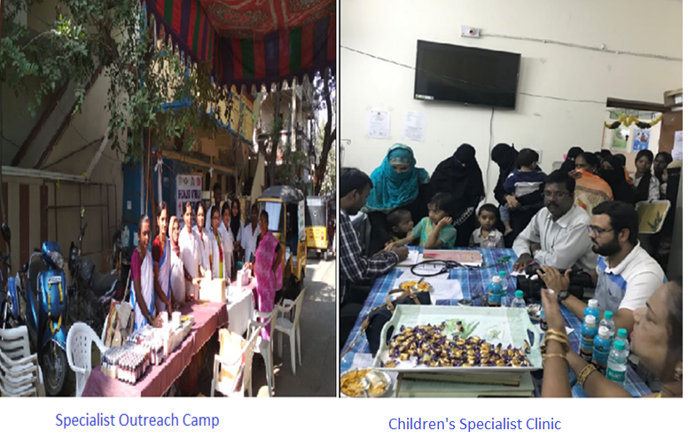

Slide 18
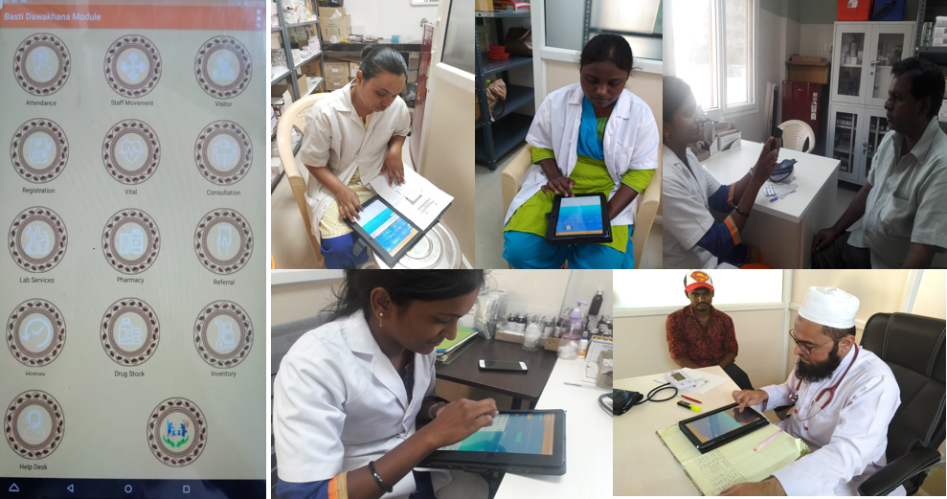
IT enabled

Slide 19


