Slide 1


NCD Screening :
Odisha Experience
Presented by:
Mission Director
NHM, Odisha

Slide 2
Mandate for the Year 2018-19
To operationalise 957 HWCs.
To initiate PBS for NCD in all HWCs.
To screen at least 15% of 30⁺ population (25 lakh) for NCD as part of Key Conditionality Framework under NHM PIP.
Update 50% of screened data in NCD App.

Slide 3
Achievement of HWC
PHC (R) : 827 (64.25 % of total PHCs)
PHC(U) : 82 (84.53% of total UPHCs)
Subcenter : 93 (1.85% of total Subcenters)

Slide 4
Achievement of NCD Screening

Slide 5

Key Challenges
Institutional Strengthening for PBS Screening at HWCs.
Capacity building of more than 20,000 ASHAs and 3,500 ANMs on NCD Screening.
Online Entry in App by Front line Service Providers with limited IT Skills.
Community mobilisation for NCD Screening.

Slide 6
Enabling Policy Decisions & Interventions
Selection of better equipped PHC/UPHC: rapid facility assessment using score card.
Infrastructure Strengthening: Customized action plans, Pooling of resources .
IT Infrastructure: Computers & ANMOL Tabs.
Lab Strengthening : Decentralised procurement of essential equipment. Engagement of LTs on per-day wages.
Human Resource: Creation of posts of SNs and LTs. Filling up of vacancies of doctors. Establishing norms for engaging yoga teachers.
Establishing Model HWC: Two per District by 15th August, for wider replication.
Continuous monitoring with Collectors.

Slide 7
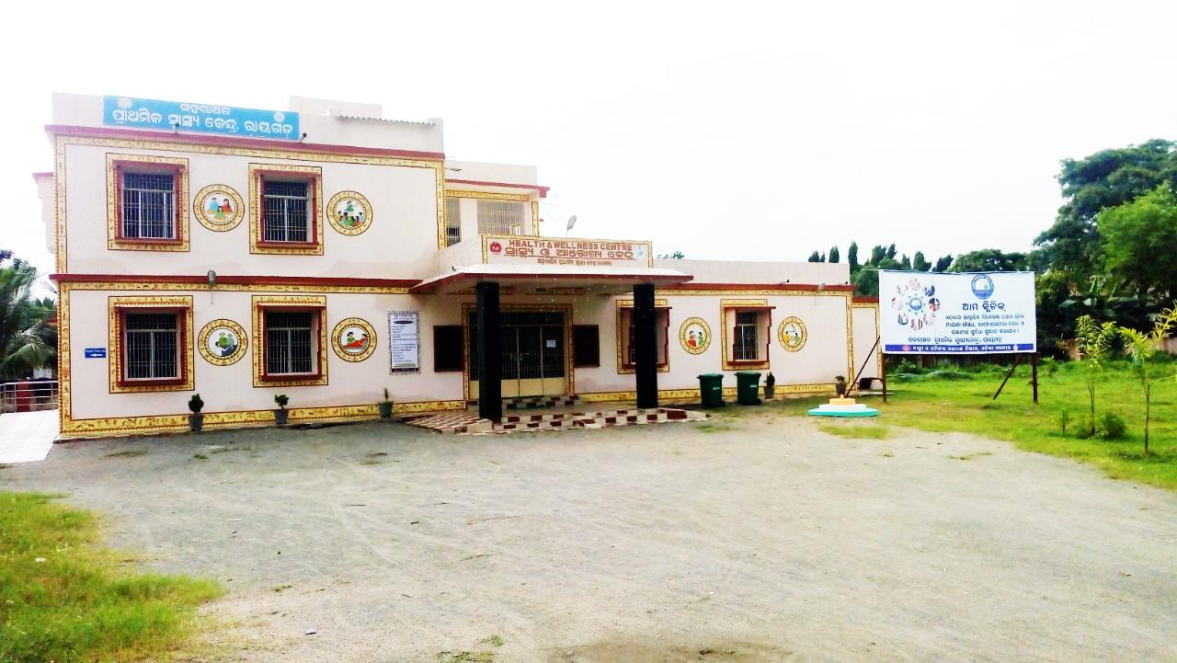
UPHC Level HWC

Slide 8
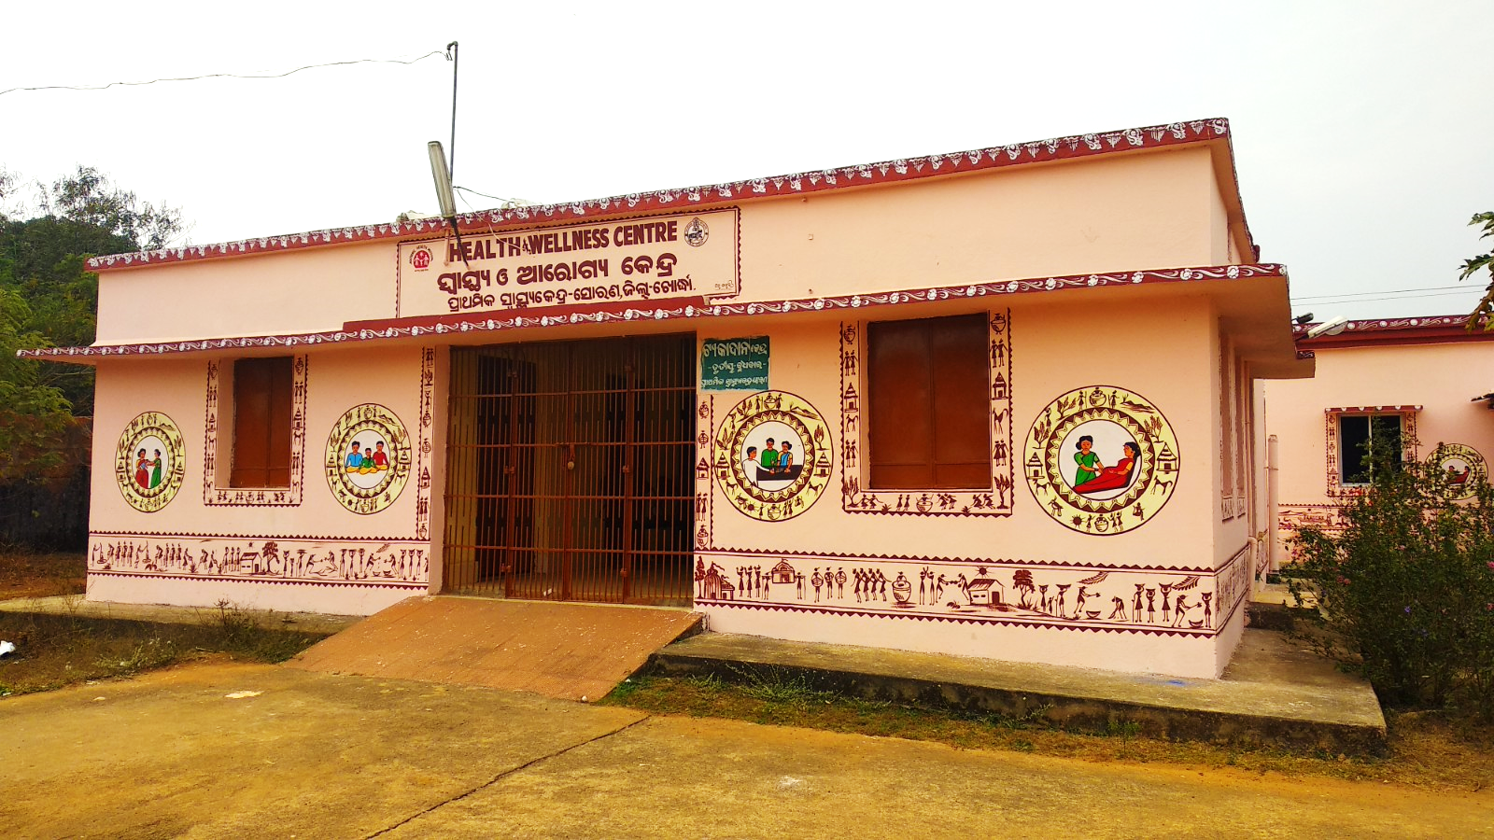
PHC Level HWC

Slide 9
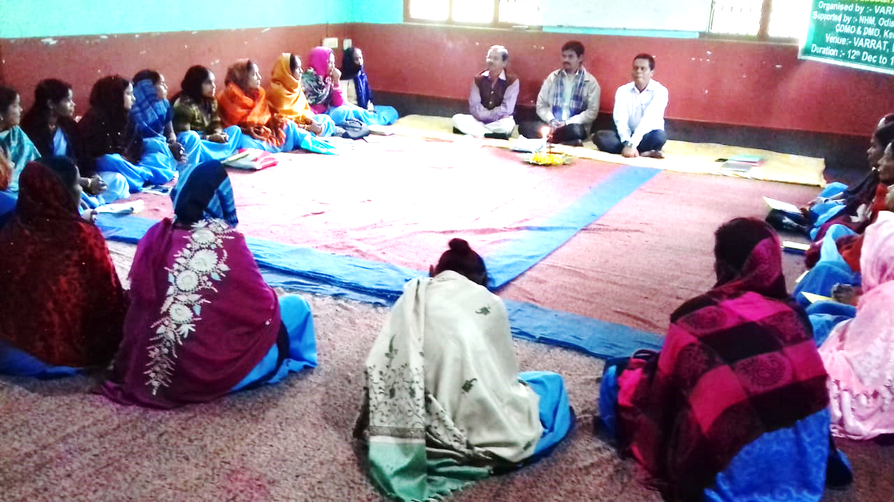
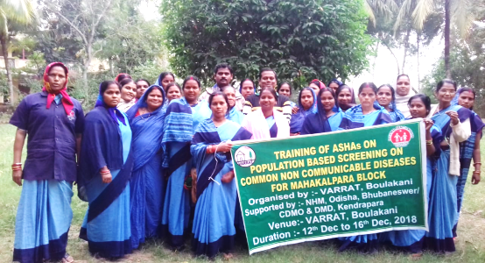
Enabling Policy Decisions & Interventions
Capacity Building:
Doctors training at State Level & other trainings on cascade model.
Utilise Freelance Trainers for ASHA Training
Training Calendar
Training quality monitoring by Development Partners (Jhpiego)
NCD Training for ASHAs

Slide 10


Enabling Policy Decisions & Interventions
Community mobilisation :
Facility Branding with indigenous theme & Citizen Charter
Focus on folk media & IPC
Facility Level
Citizen Charter focusing on 12 mandatory services for public information at Facility
Medicine Pouch containing Key message on NCD
Community Level IEC
Hoarding at GP headquarter.
Folk Shows by local troops as per script provided by State
Discussion at VHSNC
Distribution of leaflets with key messages on 5 major NCDs during population enumeration by ASHA
Performance incentive to ASHA
ASHA incentive linked with enumeration, mobilisation and ensuring attendance of eligible case for screening
Theme provided by GoI
Theme developed by Odisha

Slide 11
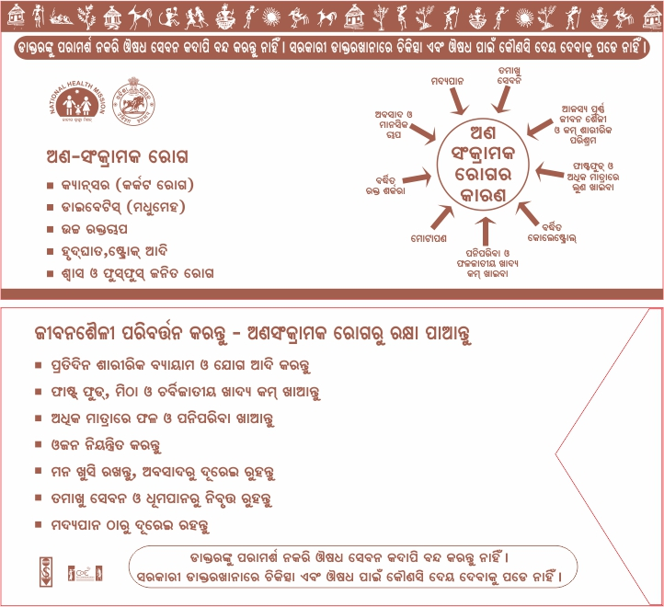
Medicine Pouch containing Key Message on NCD

Slide 12
Enabling Policy Decisions & Interventions
Achieving Screening target
We first focussed on - tablet procurement
      - trainings
      - equipment procurement
      - operationalising HWCs
      And it was already February
Decided to do NCD Screening & App Entry in Campaign Mode to create mass awareness and achieve our target within the timeline

Slide 13
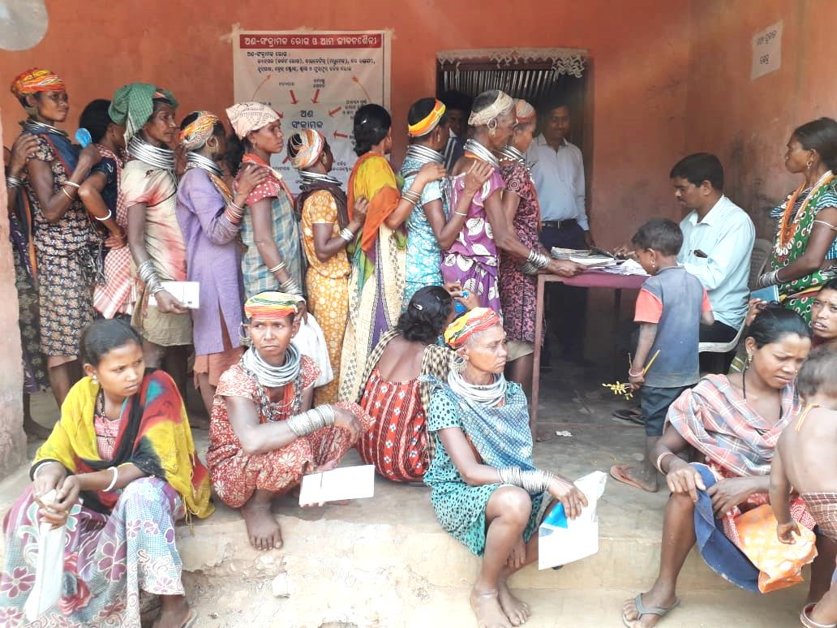
NCD Campaign (1st March-31st March 2019)
Major Features :
Sub centre wise Micro Plan.
Fixed day camp approach for screening
Mobilsation of service providers from non HWC area on screening day.
Monitors at State, District & Block level.
Daily Reporting, Weekly review at State level and VC with districts.
NCD Screening at Bonda Hills, Malkangiri district

Slide 14
Campaign Calendar
Date | Day | Activities
1 | Friday
2 | Saturday | Mobilisation -cum-Survey day
3 | Sunday | Holiday
4 | Monday | Holiday
5 | Tuesday | Holiday
6 | Wednesday | Mobilisation -cum-Survey day
7 | Thursday | Camp Day
8 | Friday | Camp day
9 | Saturday | Holiday
10 | Sunday | Holiday
11 | Monday | Reporting Day
12 | Tuesday | Mobilisation -cum-Survey day
13 | Wednesday | Mobilisation -cum-Survey day
14 | Thursday | Camp Day
15 | Friday | Camp day
Date | Day | Activities
16 | Saturday | Reporting Day
17 | Sunday | Holiday
18 | Monday
19 | Tuesday | Mobilisation -cum-Survey day
20 | Wednesday | Mobilisation -cum-Survey day
21 | Thursday | Holiday
22 | Friday | Holiday
23 | Saturday | Camp day
24 | Sunday | Holiday
25 | Monday | Reporting Day
26 | Tuesday | Mobilisation -cum-Survey day
27 | Wednesday | Mobilisation -cum-Survey day
28 | Thursday | Camp day
29 | Friday | Camp day
30 | Saturday | Reporting Day
31 | Sunday | Holiday
8 Mobilisation –cum-Survey Days & 7 Camp Days

Slide 15
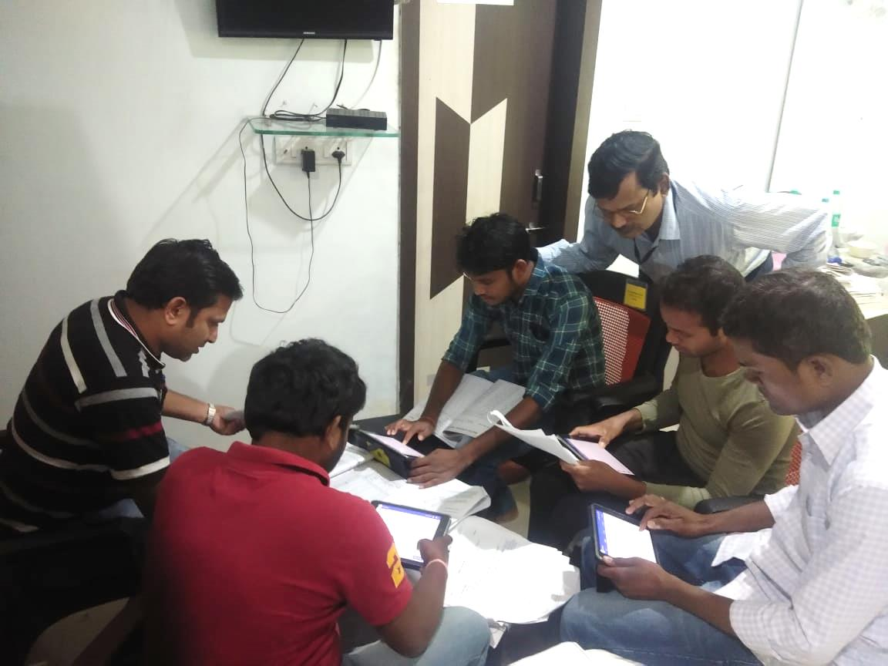
Entry in NCD App
Training
District level Master Trainers created with the support of TATA Trust
Block Data Managers trained to coordinate NCD App entry
HW- Male trained to support low performing ANMs
Entry
Simultaneous screening & entry in team approach at HWCs.
NCD App Training

Slide 16
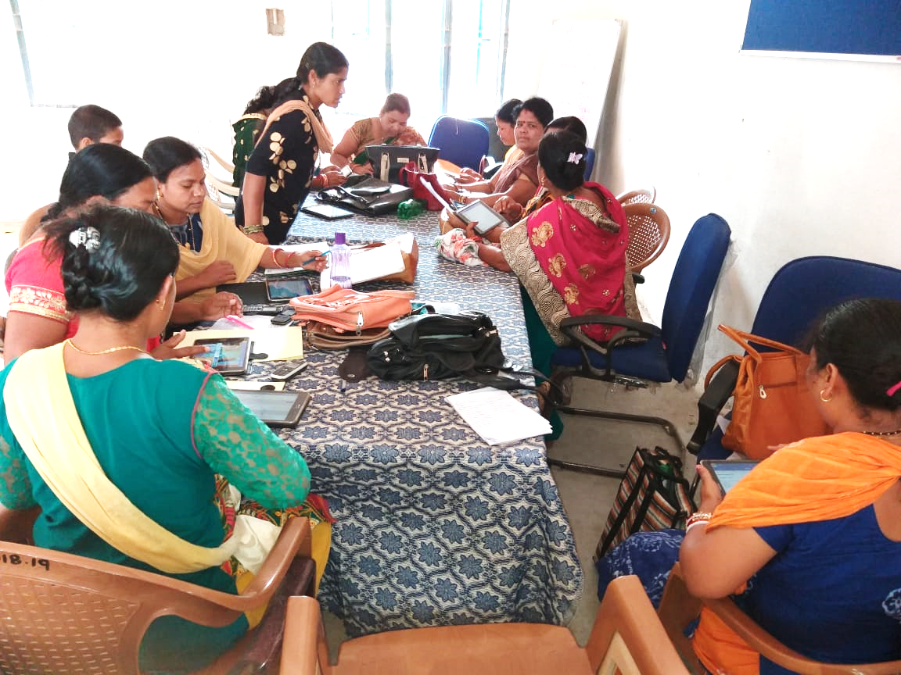
Hands-on training of ANMs at Sector PHC on NCD APP

Slide 17
Outcomes
Sl. No | Type of Cancer | Screened (As on 31st March) | Abnormality Detected
1 | Oral Cancer | 1785254 | 4776 (0.27 %)
2 | Breast Cancer | 899896 | 1716 (1.19%)
3 | Cervical Cancer | 334104 | 30021(8.99%)
4 | Diabetes | 1823124 | 87802 (4.82%)
5 | Hypertension | 1838608 | 99238 (5.40%)
Created Mass awareness on NCDs
Improved Knowledge & Skills of Services Providers

Slide 18
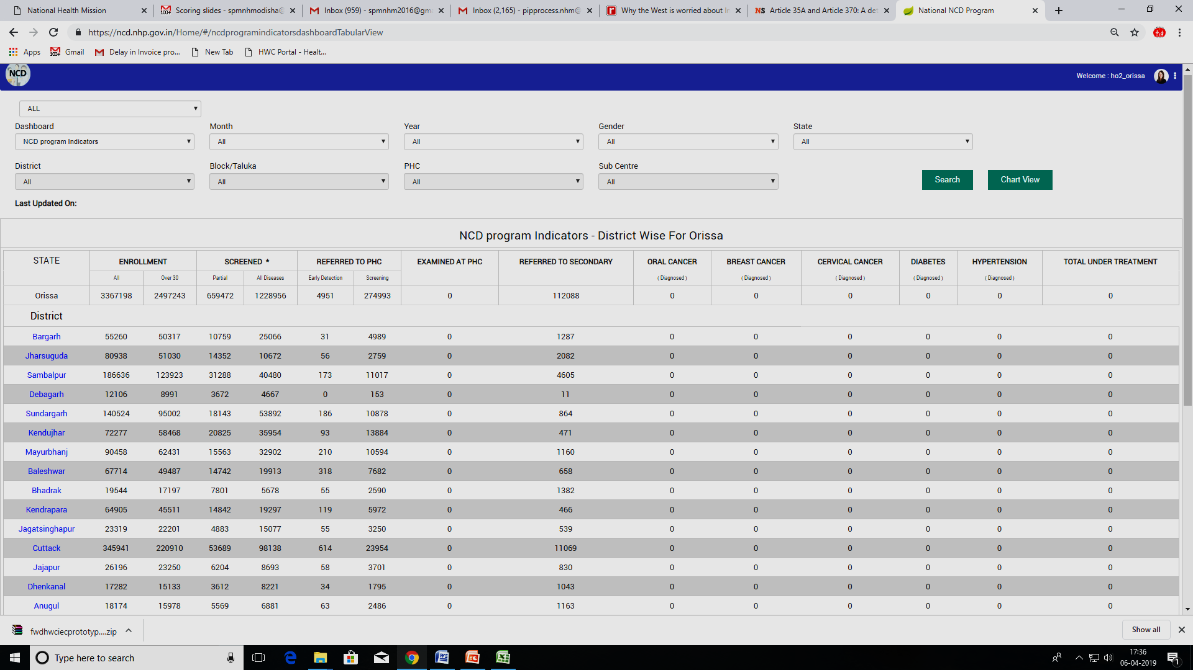

Slide 19
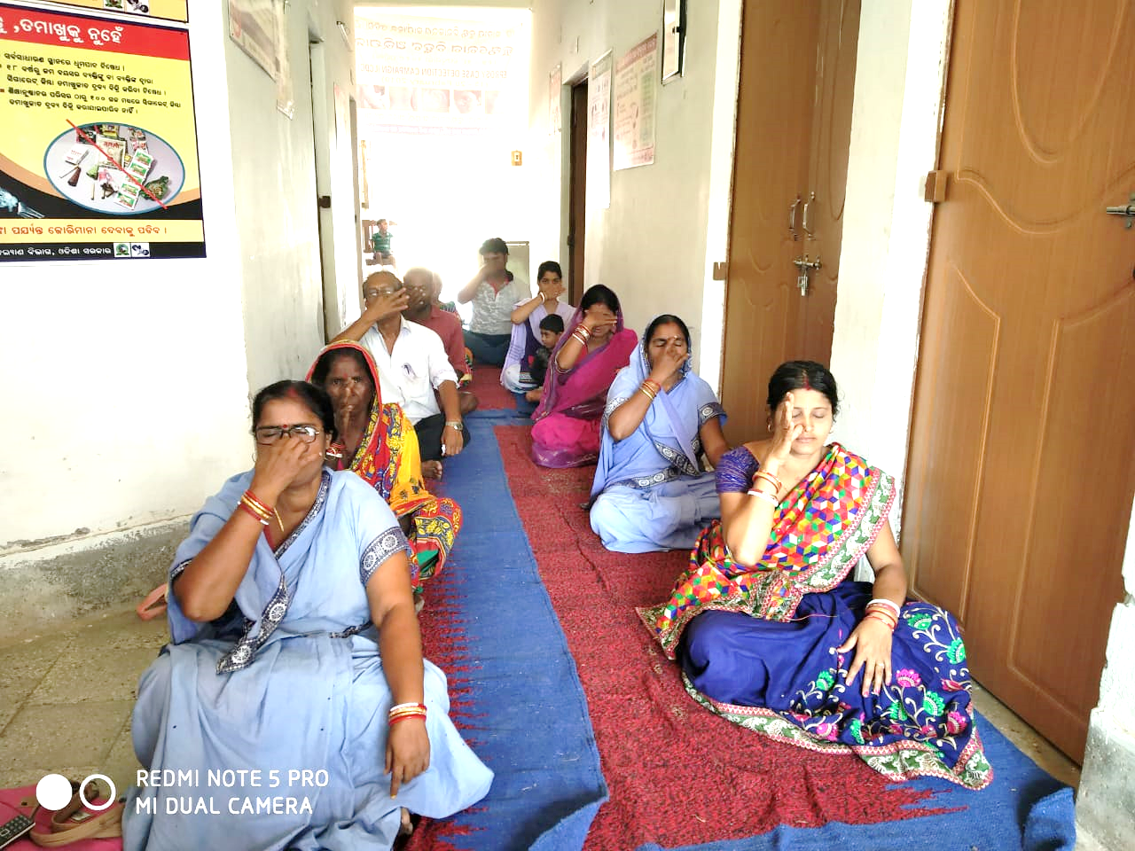
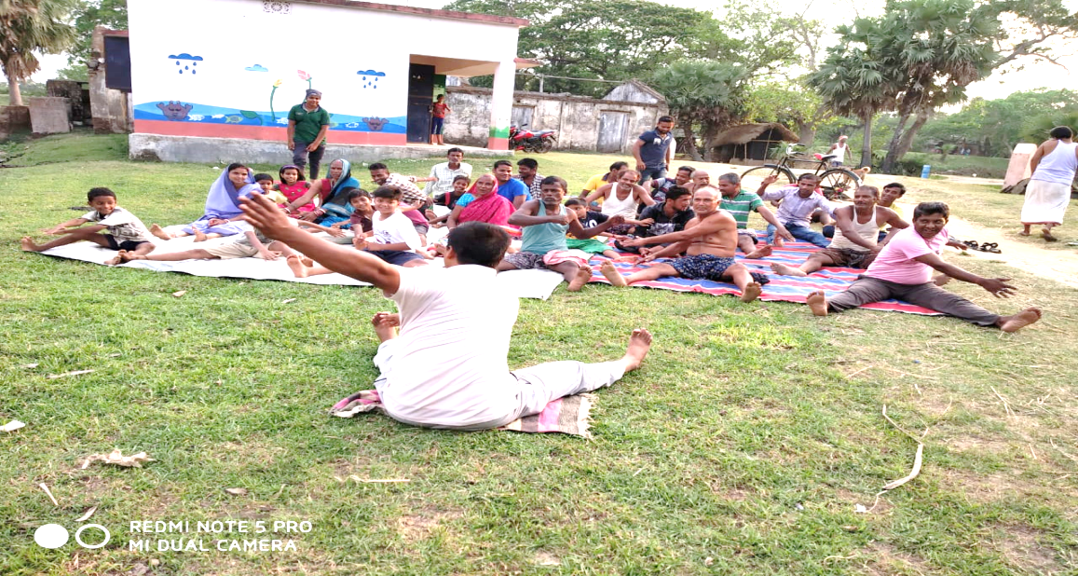
HWC In Action: Treatment/ Management of NCD Cases
Line listing & Follow-up of diagnosed cases.
Streamlining Supply of NCD Drugs to HWCs.
Free Treatment for all diagnosed cases.
Using Referral slip for referral complicated cases to DHH.
Fixed day NCD Screening- Thursday
Organising Yoga Sessions
Yoga Session at HWC

Slide 20
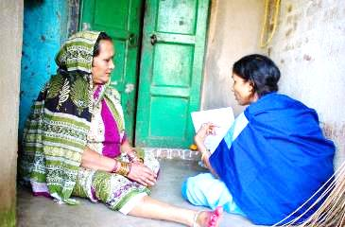
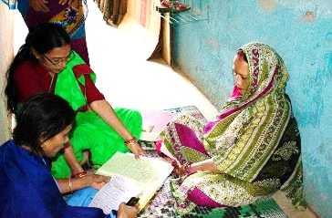
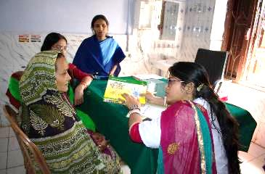
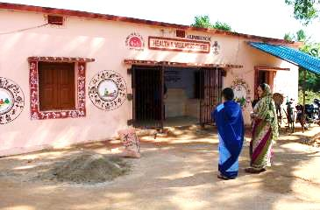
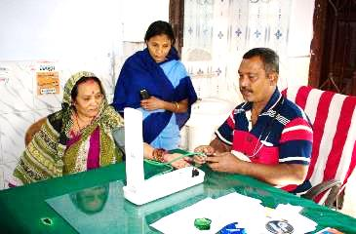
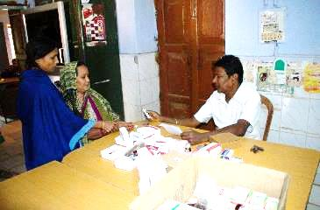
HWC in Action
1. ASHA filling the CBAC form at beneficiaries’ house
2. Community screening session at Anganwadi centre by ANM
3. CHO providing health education on NCDs
4. ASHA accompanying the beneficiary to HWC PHC
5. Confirmation of diagnosis my MO-MBBS at HWC-PHC
6. Treatment initiated: distribution of drugs for a month

Slide 21
Continuing Challenges & Way Forward
Continuing Challenges:
Improving IT skills of ANMs
Entry in MO Portal by Medical Officers
Tracking confirmed cases to ensure treatment
PBS in non-slum urban areas
E-tracking of drugs upto Sub Centre level
Way forward:
Expanding E-Niramaya to all HWCs
Outsourcing of Telemedicine setup (6 hubs & 600 Spokes in 1st phase)
Health card to track patients ?
Posting doctors in all PHCs and trained SNs in all SCs
Streamlining issues with IGNOU

Slide 22
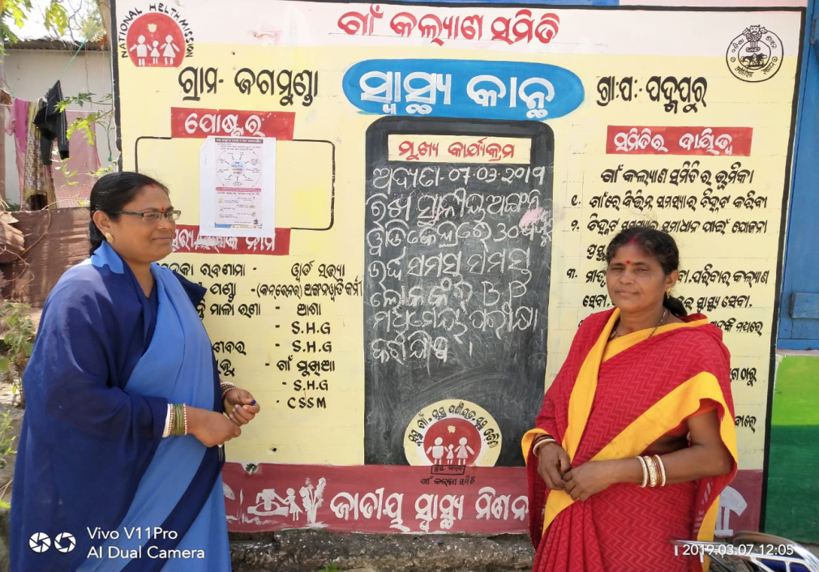
Thank you

