Slide 1

Mera Aspataal
An initiative to capture patient feedback and improve quality of services
Ministry of Health and Family Welfare
Government of India
April 08, 2019

Slide 2
Why Mera Aspataal?
To provide patient-centric care at public and empaneled private health facilities through the use of technology based patient feedback and satisfaction measurement system that facilitates this objective effectively

Slide 3
What is Mera Aspataal ?
Simple, intuitive, and multi-lingual ICT based system that captures patient feedback in a very short time on the services received from the public and empanelled private health facilities

Slide 4
Goal and Objectives of Mera Aspataal
Goal
Objectives
Evolve patient-driven, responsive and accountable healthcare
Enable patients to make informed decisions
Establish an environment of healthy competition among providers
Recognize top performing facilities, which will boost the morale of staff
Establish a mechanism to rank health facilities based on feedback
Improving patient centric care by obtaining patient feedback using technology based solutions

Slide 5

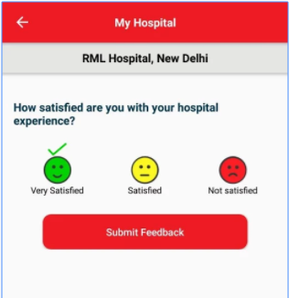
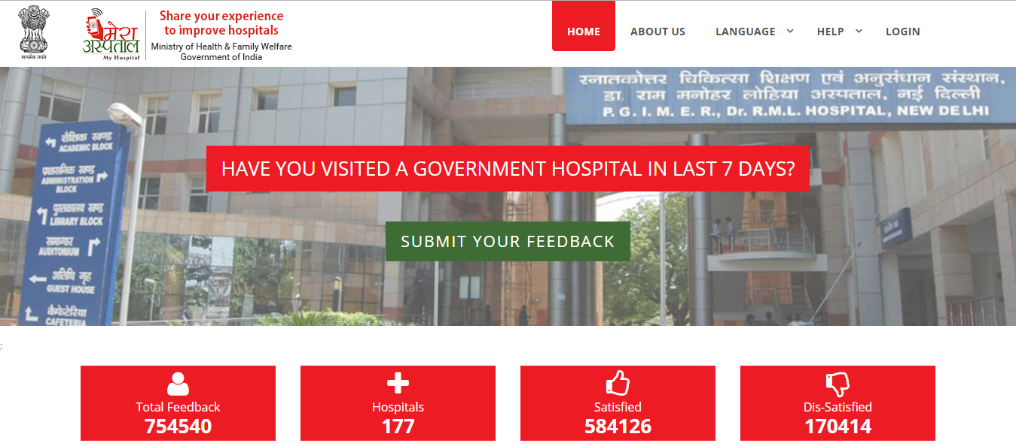
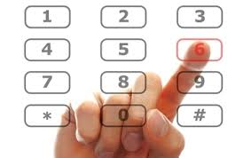
Multi-Channel Approach to Capture Patient Feedback
SMS
OBD
Mobile App
Web Portal
Average Patients Targeted Daily*
64,813
Average Responses Received Daily*
4,659
Total Mobile App Downloads**
11,850
Average Web Page Hits Monthly**
4,390
* Through SMS and OBD Channel (Average of December 18-Feb 19)
** Till Feb 2019

Slide 6










Feedback Collection Flow
Patient
Hospital
Registration Counter
Doctor Room
Patient
1. Entry
2. Exit
4b. Patient visits mobile app/web portal
3. Upload
Patient Data
7. Online Access/
Reporting
National
NIC Cloud
4a. Target Patient through SMS & OBD
State
6
District
5b. Patient Response (Mobile App & Web Portal)
Dashboard
Web Server
Facility
5a. Patient Response (OBD & SMS)

Slide 7
Patient Feedback Parameters
Doctor
Nurse
Lab/X Ray Technician
Pharmacist
Ward Assistant
Other Staff
Patient Registration and Waiting area
Patient Wards
Examination Room and Table
Toilet
Bed sheets
General Surrounding of the hospital
Cost of Medicines and Supplies
Cost of Investigations
Informal payment to the Staff
No relief in symptoms
Health condition worsened after treatment
Doctor didn’t listen to your problems carefully
Nurses were not skilled enough
Poor quality of food served during the hospital stay
Long waiting time
Inadequate information on available services and location
Lack of amenities for patients
Lack of support services for accompanying family members
Overcrowding
Others
Q2: Staff Behaviour
Q3: Cleanliness
Q4: Cost of Treatment
Q5: Quality of Treatment
Q6: Other reasons

Slide 8
MA is Functioning in 24 States and 5 UTs
Started with a mandate to integrate with CGHs and DHs
22 CGH
2634 facilities on boarded**
Out of which, 48% of the total District Hospitals* (DH) are integrated
    100% in Bihar, Goa, Odisha, Tamil Nadu, Andhra Pradesh, Karnataka, Maharashtra, Rajasthan, Tripura, Chandigarh, Dadra & Nagar Haveli, and Daman and Diu
Non-participating states/UTs:
    States-Arunachal Pradesh, Mizoram, Nagaland, Sikkim and Kerala
    Union Territory- Andaman & Nicobar, Lakshadweep
365 DH
Legends
DH Integration 68-100%
DH Integration 34-67%
DH Integration 0-33%
Non Participating
Reach of 2634 facilities across 29 states/UTs
*Data source: Rural Health Infrastructure 2018

Slide 9
MA is Functioning in 24 States and 5 UTs
Apart from district hospitals, certain states reached up to SDH, CHCs, PHCs, UPHCs, and private hospitals
Sub-district facilities are also on-boarded
  Gujarat, Andhra Pradesh, Rajasthan, Karnataka, Himachal Pradesh, Goa and Delhi
Private Facilities in Tamil Nadu
40 MCH
40 MCH
91 SDH
91 SDH
367 CHC
192 UPHC
192 UPHC
988 PHC
549 Empaneled Private Facilities
988 PHC

Slide 10
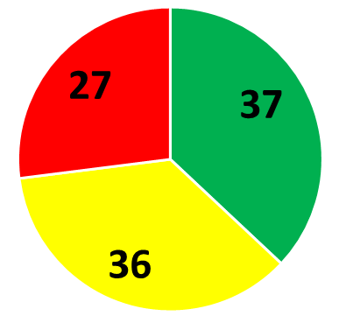
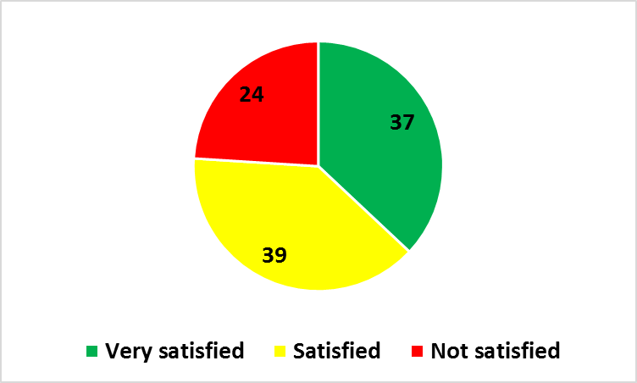
Overall Satisfaction from Health Services at DHs and SDHs (%)
District Hospitals & Sub-District Hospitals
Duration: Sept 06, 2016 – March 27, 2019

Slide 11
Overall Dis-satisfaction from Health Services at National, DHs and SDHs (%)
Reasons of Dis-Satisfaction | India | District Hospital | Sub-District Hospital
Staff Behavior | 38 | 40 | 37
Cleanliness | 12 | 15 | 16
Cost of Treatment | 16 | 16 | 18
Quality of Treatment | 2 | 1 | 0
Other Reasons (Long waiting time, lack of amenities, inadequate information etc.) | 32 | 28 | 29
India District Hospitals Sub-District Hospitals
N=7.8 lakhs N=3.2 lakhs N= 16.7 thousand
Duration: Sept 06, 2016 – March 27, 2019

Slide 12
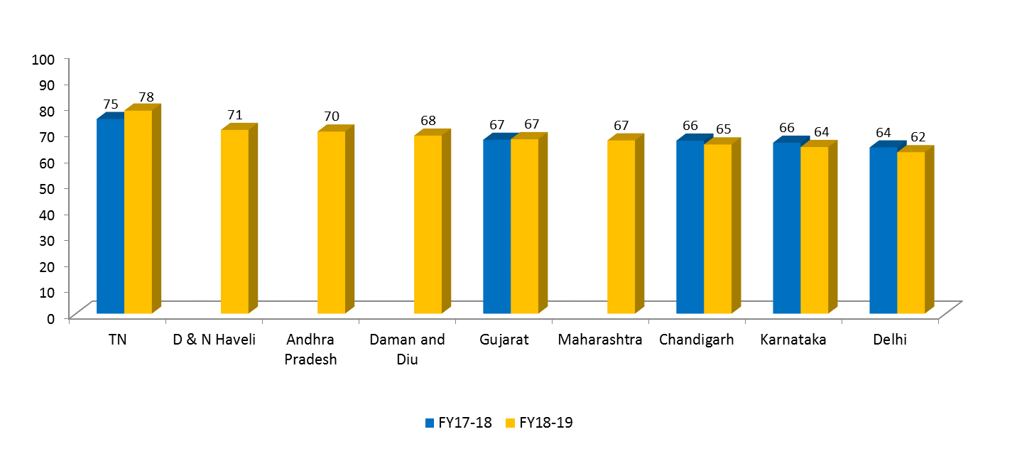
Performance (PSS) of States in FY17-18 and FY18-19
Patient Satisfaction Score

Slide 13
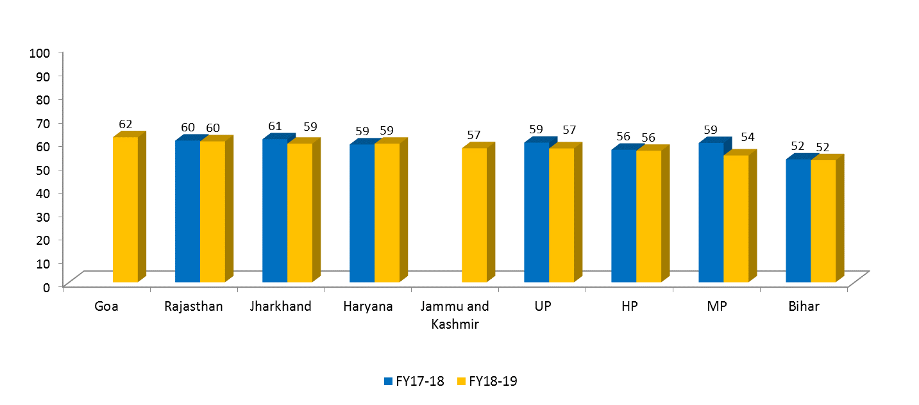
Performance (PSS) of States in FY17-18 and FY18-19
Patient Satisfaction Score

Slide 14
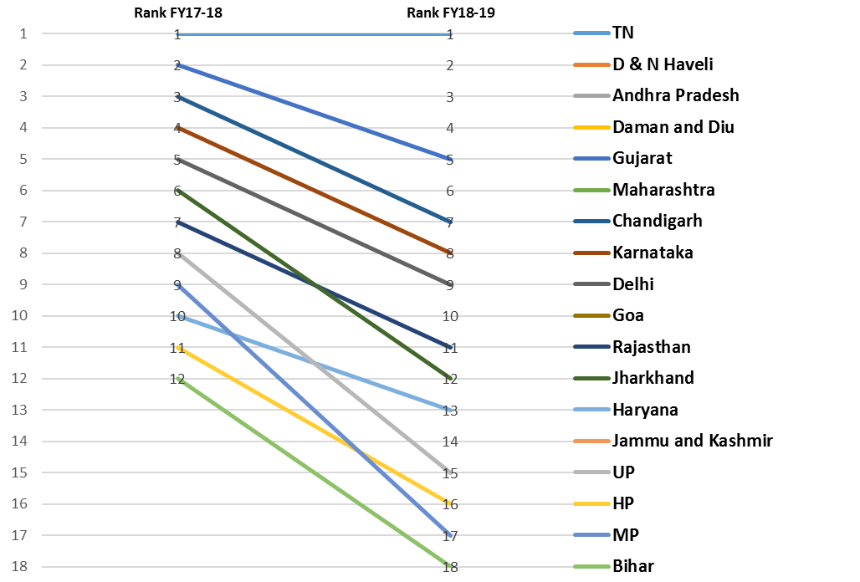
Shift in Rank of States from FY17-18 to FY18-19

Slide 15
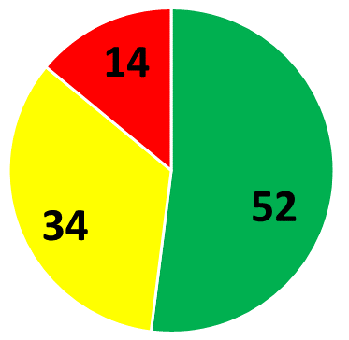
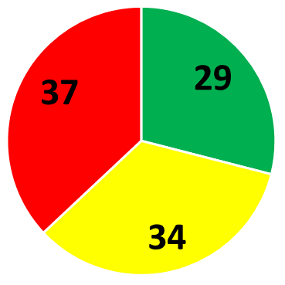
Comparison of Top and Bottom performing state based on satisfaction
Tamil Nadu
Bihar
N=49 thousand N=63 thousand
Duration: Sept 06, 2016 – March 27, 2019

Slide 16
Overall Dis-satisfaction from Health Services at National, TN and Bihar (%)
Reasons of Dis-Satisfaction | India | Tamil Nadu | Bihar
Staff Behavior | 38 | 30 | 38
Cleanliness | 12 | 14 | 15
Cost of Treatment | 16 | 13 | 19
Quality of Treatment | 2 | 2 | 0
Other Reasons (Long waiting time, lack of amenities, inadequate information etc.) | 32 | 41 | 28
India Tamil Nadu Bihar
N=7.8 lakhs N=7000 N= 23000
Duration: Sept 06, 2016 – March 27, 2019

Slide 17


Integration of Mera Aspataal with Quality Frameworks of Government of India
District hospitals* are getting ranked under District Hospital Ranking System based on PSS
Public health facilities are getting accredited under NQAS based on PSS
* Source: The Health of our Hospitals, Tracking the Performance of district hospitals, Niti Ayog

Slide 18
Challenges & Mitigation plan
S. # | Challenges | Mitigation Plan
1 | Use of data for quality improvement of facilities | Online quality improvement module can be made and used
2 | Low valid phone numbers | Awareness generation about Mera Aspataal (MA) using IEC
3 | Implementation of online registration systems can ease the process | Integration with e-hospital
4 | Lack of follow-up mechanism | Review meeting to discuss performance in Mera Aspataal
5 | Lack of accountability at facility level | Linking the performance of facility with ACR of stakeholders

Slide 19
Pending request for Integration (Statewise) in MA
Sr. No. | Name Of States/UT'S | No. Of Facilities | Type of Health Facilities | Status
1 | Gujarat | 14 | PHC – 10,UPHC – 1,CHC – 3 | Integration to be done
2 | Rajasthan | 3144 | CHC – 595,City Dispensary – 123, DH – 2, MCH – 30, Other Government Hospital – 23, PHC – 2337, Satellite Hospital – 13, Sub-Division Hospital -21 | Discussion in progress for building web service with IHMS team
3 | Delhi | 1 | DH | Facility Integrated
4 | MP | 59 | DH – 51, Civil hospital – 4, Community health center – 4 | Integration in progress

Slide 20
Thank You

Slide 21
Additional slides

Slide 22
Computation of Patient Satisfaction Score
Very Satisfied (VS): 2
Satisfied (S): 1
Dis-satisfied (DS): -1
X= Number of patients who gave feedback as VS
Y= Number of patients who gave feedback as S
Z= Number of patients who gave feedback as DS
PSS= [{{X(2)+Y(1)+Z(-1)/(X+Y+Z)}*100}+100]/3

Slide 23
Percentage of District Hospitals integrated with MA in different states
100% | Bihar, Goa, Odisha, Tamil Nadu, Tripura, Andhra Pradesh, Dadra & Nagar Haveli, Daman & Diu, Maharashtra, Chandigarh
76 - 99% | Gujarat, Haryana, Himachal Pradesh, Rajasthan
51 - 75% | Jharkhand, Karnataka, Delhi
26 - 50% | Jammu & Kashmir, Madhya Pradesh, Telangana, Uttar Pradesh
0 - 25% | Chhattisgarh, Meghalaya, Punjab
Source: Rural Health Infrastructure and Integration status data from Mera Aspataal

Slide 24
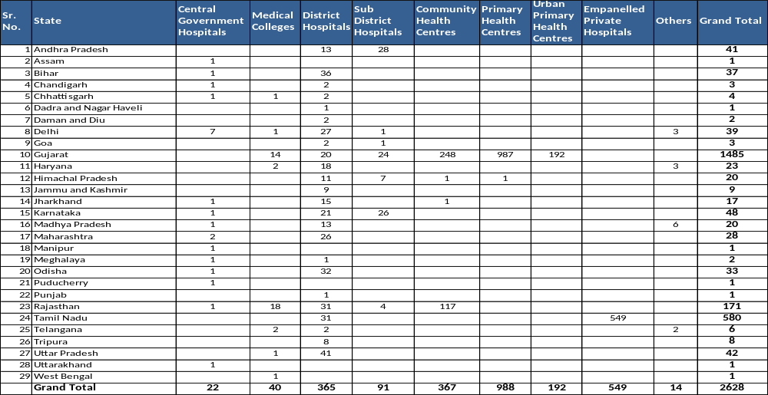
STATEWISE INTEGRATION STATUS OF MERA ASPATAAL

Slide 25
Linkage of Mera Aspataal with NQAS Certification
The patient satisfaction score collected through Mera Aspataal application is one of the criteria for certification of public health facilities as approved by Central Quality Supervisory Committee (CQSC)
Type of Facility | Facility with Mera Aspataal Application | Facility without Mera Aspataal
District Hospital | Patient Satisfaction Score of 70% in the preceding quarter or more (Satisfied & Highly Satisfied on Mera-Aspataal) | Score of 3.5 on Likert Scale
CHC/U-CHC | Patient Satisfaction Score of 65% in the preceding quarter or more | Score of 3.2 on Likert Scale
PHC/U-PHC | Patient Satisfaction Score of 60% in the preceding quarter or more (Satisfied & Highly Satisfied on Mera-Aspataal) | Score of 3.0 on Likert Scale

Slide 26
Process of Integrating Health Facility with the Mera Aspataal Application
Test URL
Production URL
Web services
Patient ID
NIN ID Mapped
Visit ID
Patient Name
Gender
Age
Mobile/Landline #
Visit Date
Visit Time
Department Name
Outpatient/ Inpatient
JSON/XML format
Facility 1
IP Whitelisting
Web based HMIS with internet connectivity
CSV file uploaded on an FTP Location
CSV Format
Facility 2
Computerized patient registration system without internet connectivity
e.g. Microsoft Excel/Access, and any third party software
Patient Information Required on Daily basis

Slide 27
Linkage of Mera Aspataal with Quality Improvement
National Level
State Level
Facility Level
Patient Satisfaction Score* calculated through Mera Aspataal linked with
  NQAS Certification System
  NITI Aayog District Hospital Ranking System
Regular formal intimation to the states and Central Govt. Hospitals from MOHFW regarding their patient feedback results.
Continuous follow up of the states and facilities’ performance during the review meetings.
Mera Aspataal dashboard integrated with Central Health Dashboard monitored by HFM.
Continuous monitoring of the patient feedback results and performance being shared with the facility in-charges e.g. Rajasthan, Haryana
Performance of facilities is being published in the local newspapers e.g. Rajasthan.
Generating competition among facilities within a state to achieve higher ranking.
Sharing of State and Facility performance during the Service Provider Training under NQAS certification.
Share, develop action plan and take appropriate steps based on Mera Aspataal patient feedback results is important agenda of Quality Assurance Committee at DH Rajkot and Erode.

Slide 28
Capturing Valid phone # is Critical
Issues
Non-mandatory at registration counter
Entering 0 or no number
Entering wrong numbers
Duplication of numbers
Unwillingness of the patient to share the phone #
Proposed Solutions
Official communication to the facilities
Training of staff to counsel patients for providing the phone #
Motivation for Data entry operator

Slide 29
Response drill down across different categories
Patient visits
17,36,81,544
Patient with valid phone #s 3,92,65,859 (23%)
Total responses received
32,47,562 (8%)
INDIA
Patient visits
3,11,91,687
Patient with valid phone #s 1,74,67,231 (56%)
Total responses received
16,50,826 (9%)
CGH
Patient visits
10,06,55,917
Patient with valid phone #s 1,63,11,351 (16%)
Total responses received
12,01,591 (7%)
DH

Slide 30
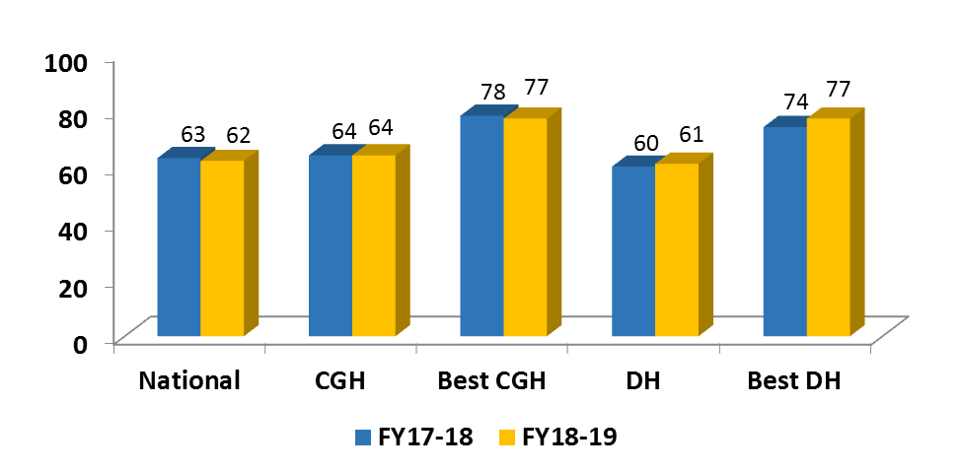
Performance of Central Government and District Hospitals in comparison to National Average
DH, Namakkal
JIPMER
Patient Satisfaction Score

