Slide 1
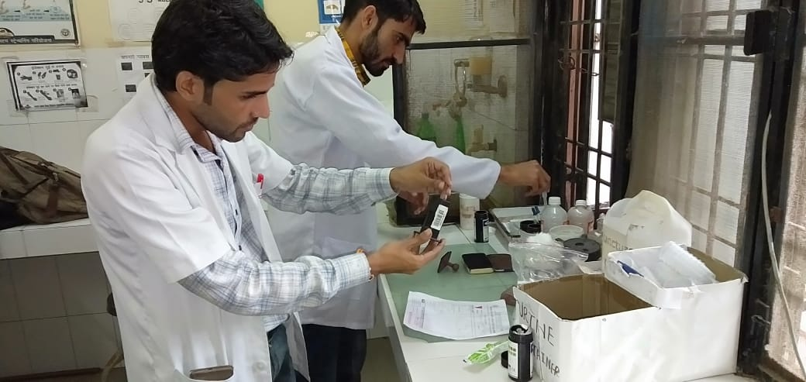
Scale-up of MLHP Training: Uttar Pradesh

Slide 2
The Task
20573 sub-centres , 3318 PHCs (PHC-2726 and UPHC-592) into Health & Wellness Centres by 2022
01
Operationalization of HWC (SHCs) would require incremental addition of trained human resource
02
52 Program Study Centres to be operationalized in a phased manner by 2019 to ensure adequate number of MLHP
03
Six‐months Certificate Course in Community Health developed by IGNOU adopted for developing the cadre of MLHP
04

Slide 3
Roadmap for operationalization
Year | Work load | Timeline | No. of existing PSCs | No. of PSCs to be added | Total no. of PSCs | Proposed Plan for MLHP training | Total no. of trained MLHPs
2017-18 | 329 | Jul-17 | 1 | - | 1 | 29 | 13
 |  | Jan-18 | 1 | 9 | 10 | 300 | 204
2018-19 | 2430 | Jul-18 | 10 | 15 | 25 | 990 | 849
 |  | Jan-19 | 25 | 8 | 33 | 1440 | 2289
2019-20 | 5130 | Jul-19 | 33 | 19 | 52 | 2565 | 4854
 |  | Jan-20 |  |  |  | 2565 | 7419
2020-21 | 5130 | Jul-20 | 52 | 0 | 52 | 2565 | 9984
 |  | Jan-21 |  |  |  | 2565 | 12549
2021-22 | 5130 | Jul-21 |  |  |  | 2565 | 15114
 |  | Jan-22 |  |  |  | 2565 | 17679
 | 2565 | Jul-22 |  |  |  | 2565 | 20244
Total |  |  |  |  | 52

Slide 4
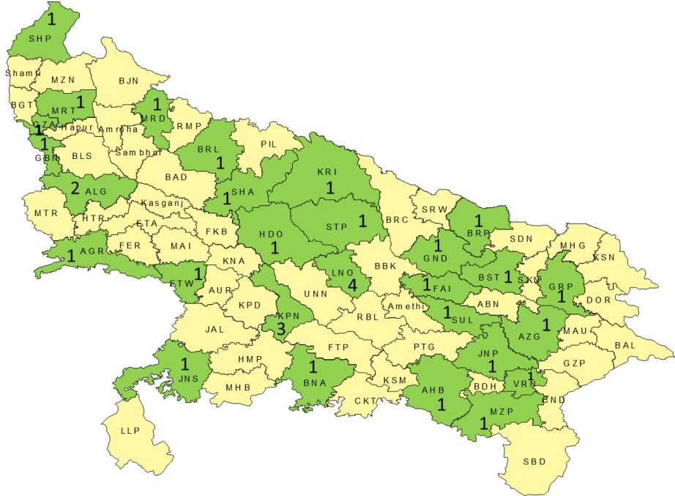
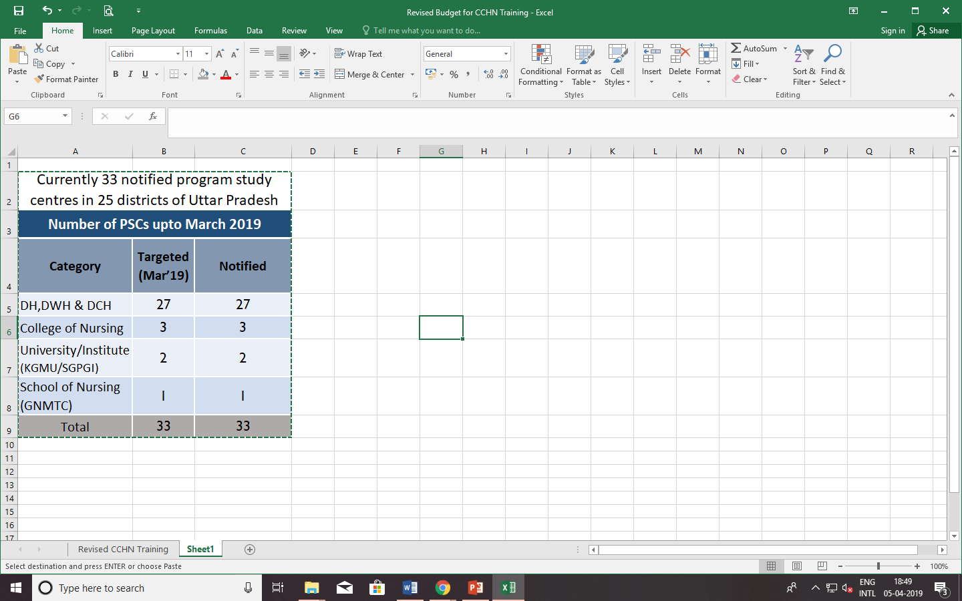
Geographical Spread and Achievements
Program Study Centres
33 PSCs notified and operational
Community Health Officers
Health & Wellness Center
717 SCs and 1290 PHCs (PHC-952 and 338 UPHC) centres are functional as of now.
3570 HWCs will be functional by Aug-19
849 MLHP passed till date
1232 candidates enrolled in Jan 19
From July’19 onwards 2500+ candidate to be enrolled in every 6 months
12 DWHs/DHs are in process
5 Not-For-Profit identified for piloting

Slide 5
Measuring Success: Term End Examination Results
191/217
648/798

Slide 6
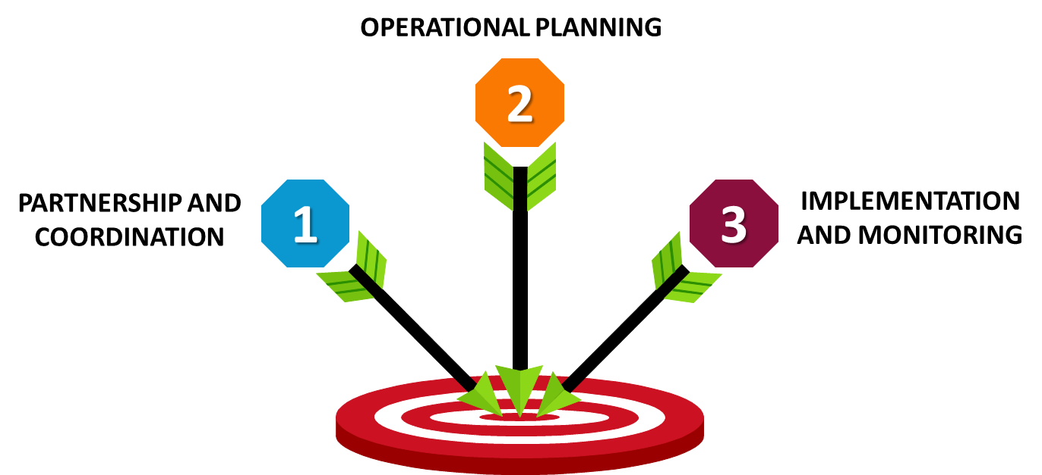
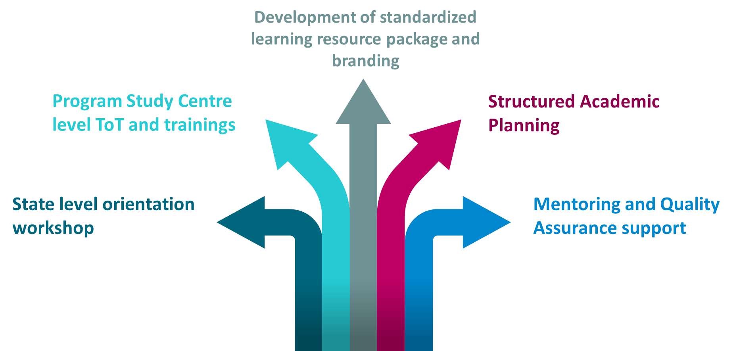
MLHP Training - Conceptual Framework and Operational Strategy
Comprehensive roll out strategy developed with technical support of Jhpiego
Notes:
© Copyright PresentationGO.com – The free PowerPoint template library

Slide 7
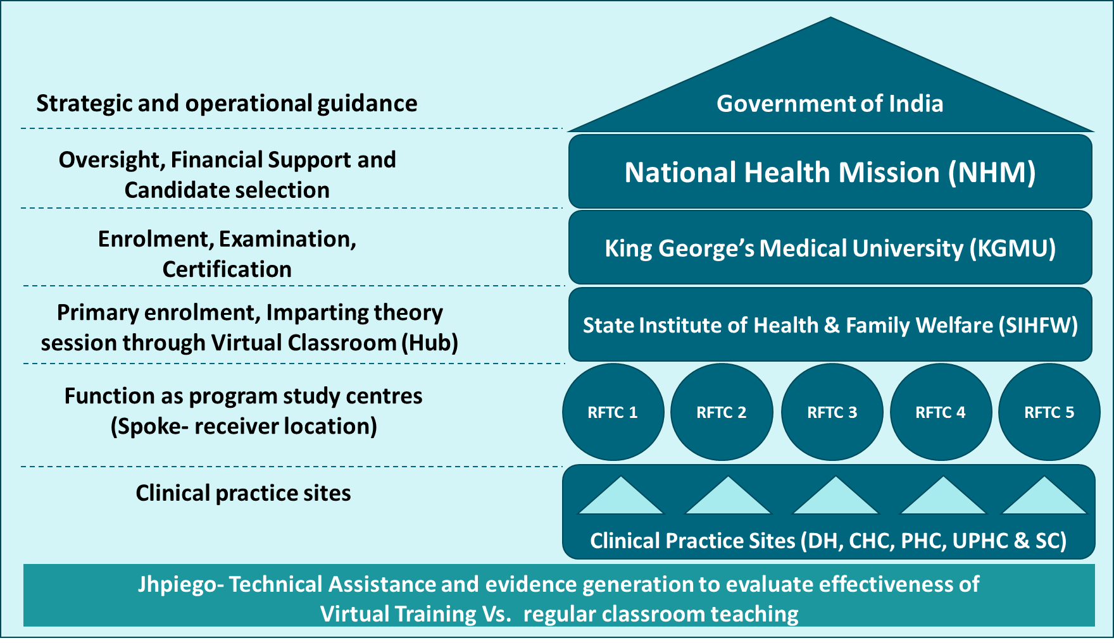
Piloting State Led Alternate Strategy To Boost MLHP Output
Pilot to start with July 2019 batch
Will initially add approx. 400 MLHPs annually
Once successful, to be scaled up to 10 RHFWTCs.

Slide 8
Strategies That Worked For Us..
MLHP Selection and Training
Open Market candidates
No domicile restrictions
Non-residential training
Training Approach & Quality Assurance
  Use of Learning Resource Package and facilitators guide developed with support of Jhpiego
  Creating pool of trainers through PSC level ToTs
  Mentoring & quality assurance visits
Counselling and retention
  Allocation of final posting prior to joining course
  Bond signing prior to joining the course

Slide 9
Persistent Challenges and Way forward
Attrition of MLHPs
Quality of MLHP trainings
Procedural Delays
Cadre creation
Improving coordination with IGNOU to increase operational efficiency and timely resolution of challenges
Mid-term examination (Mock Test)
Skill based trainings (Draft package Developed by Jhpiego, to be piloted)

Slide 10


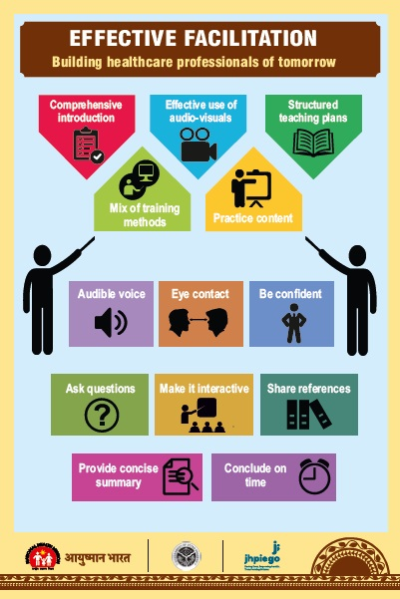

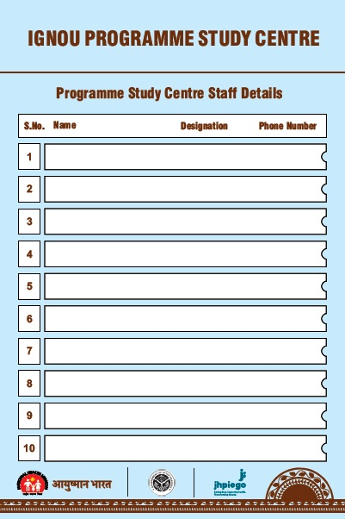
Branding of Program Study Center

Slide 11
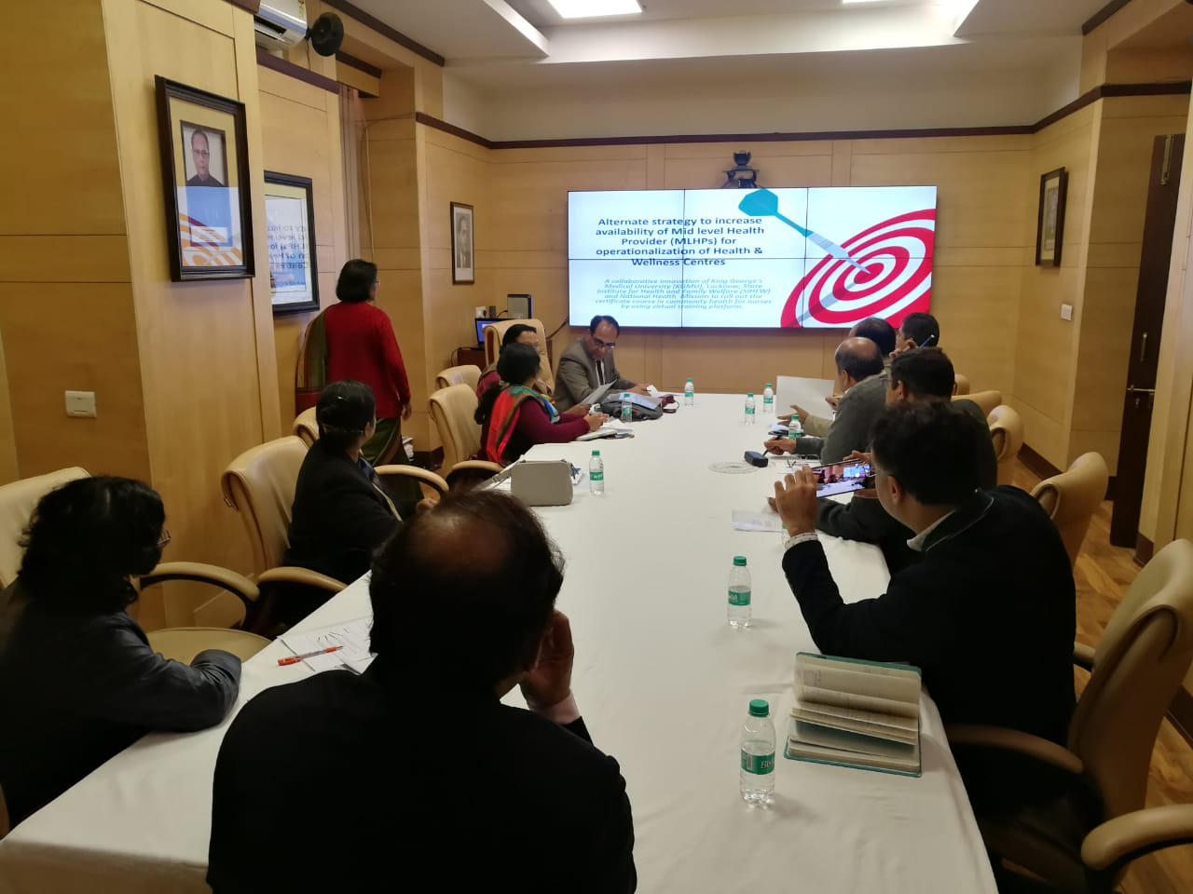
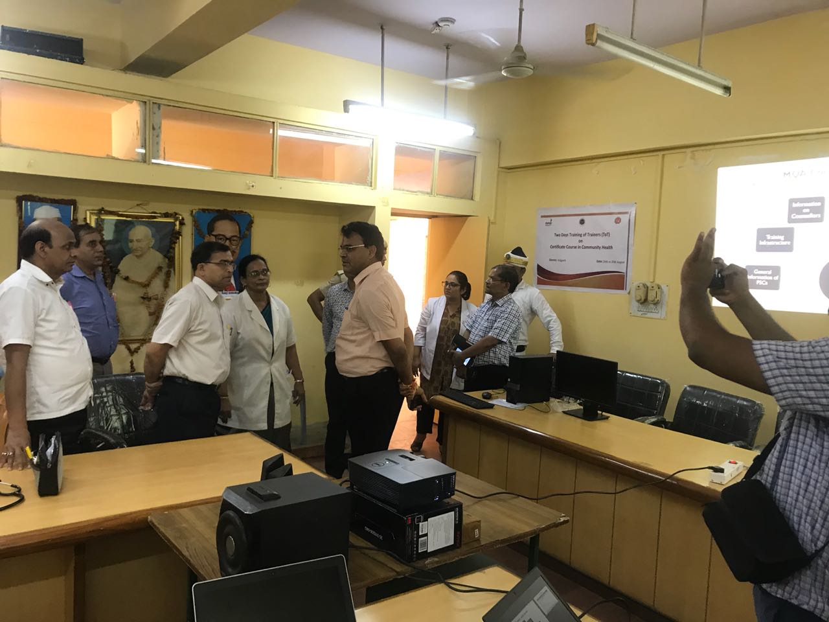
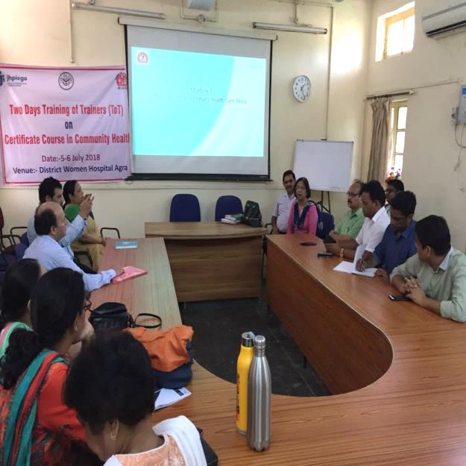
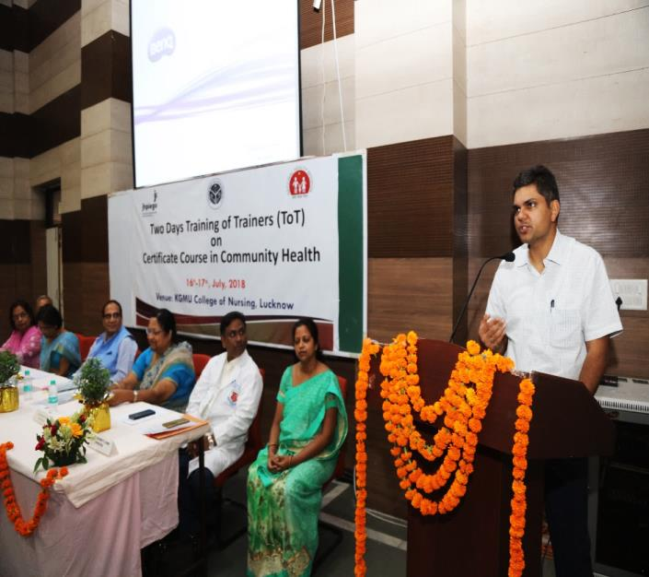
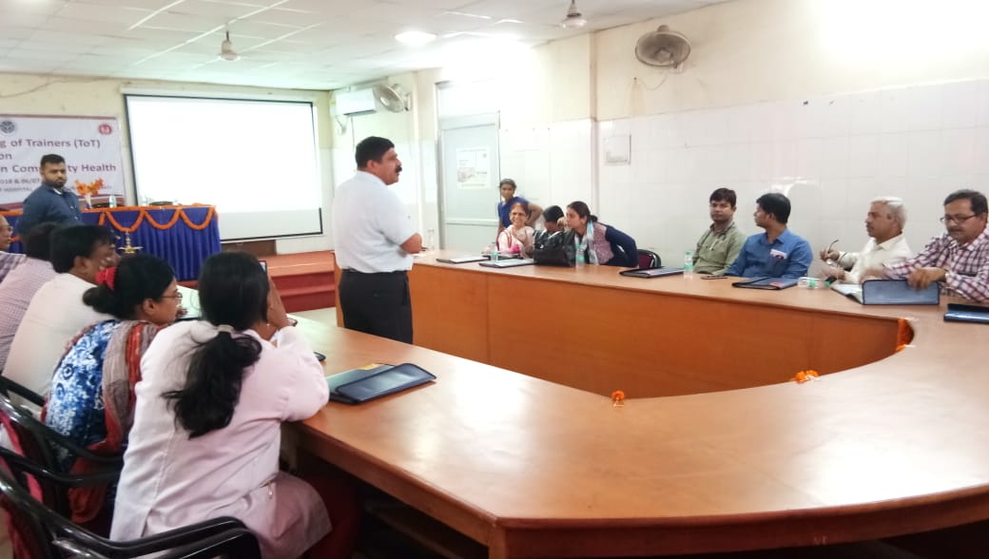
Glimpses
Discussion on Alternate Strategy with VC-KGMU
DM Aligarh visited During ToT
Dr Madhu sharma GM Planning during ToT
MD NHM at ToT KGMC
Mr. Devesh Tripathi (SNO-N) briefing guideline during ToT Varanasi

Slide 12
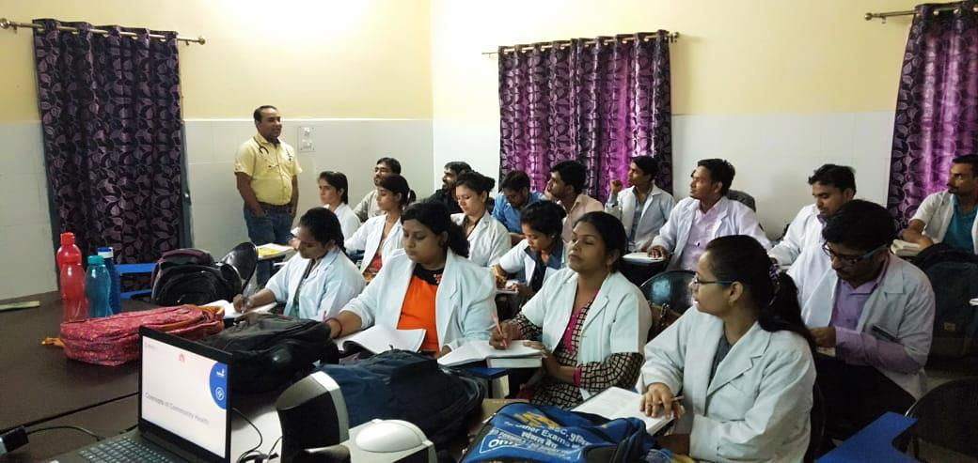
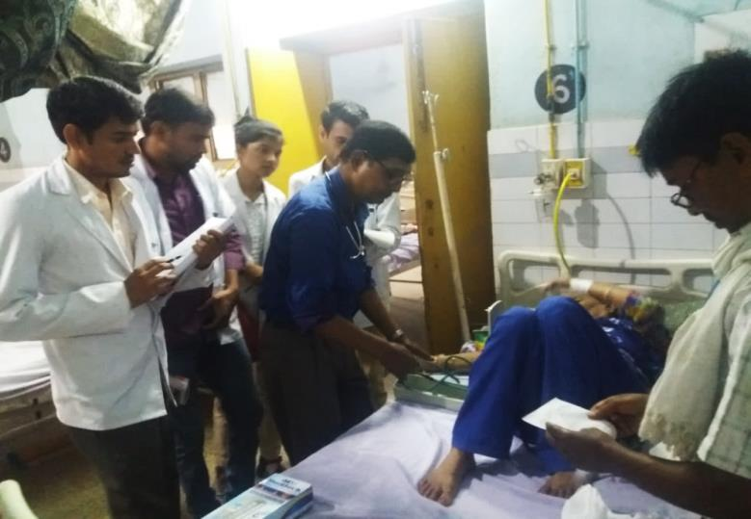
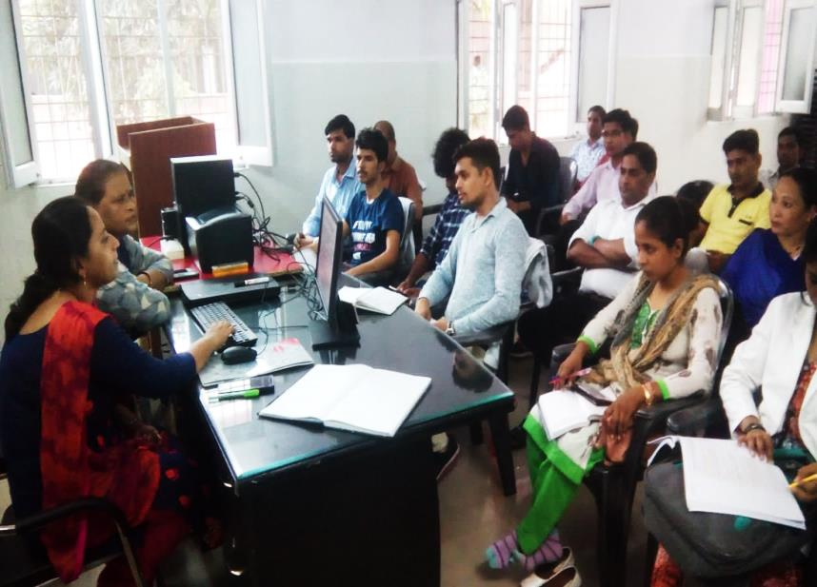
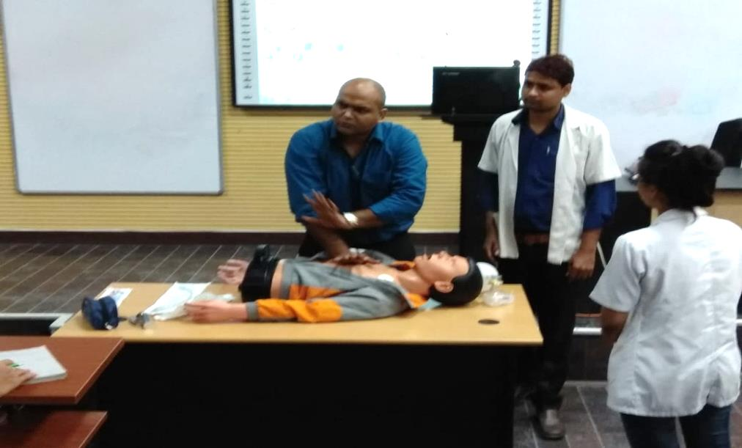
Theory and Practical Sessions at PSCs
Classroom teaching at DWH Aligarh
Clinical postings at DH Baharaich
Sexual Health Education Counseling class at DWH Kheri
Basic Life Support class at RMLIMS Lucknow

Slide 13
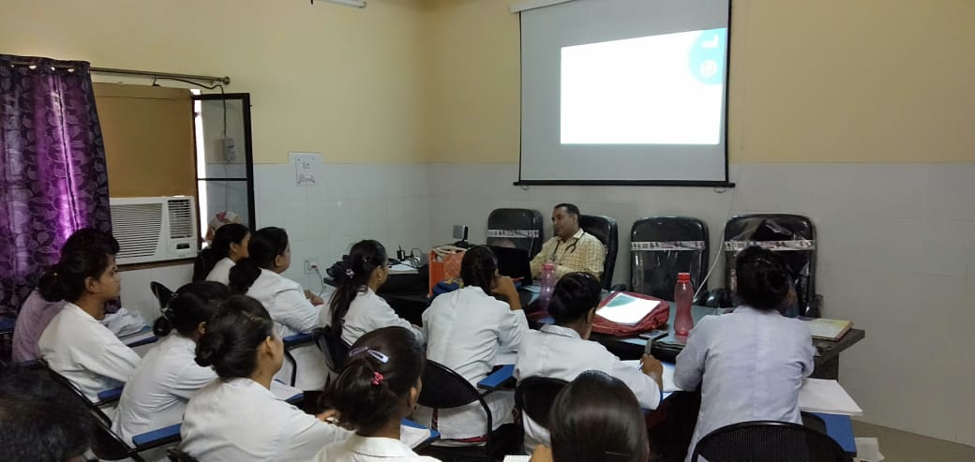
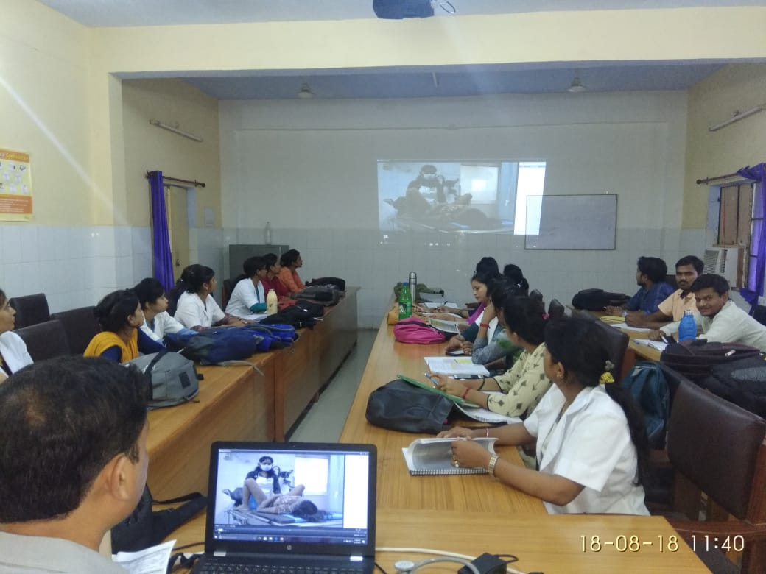
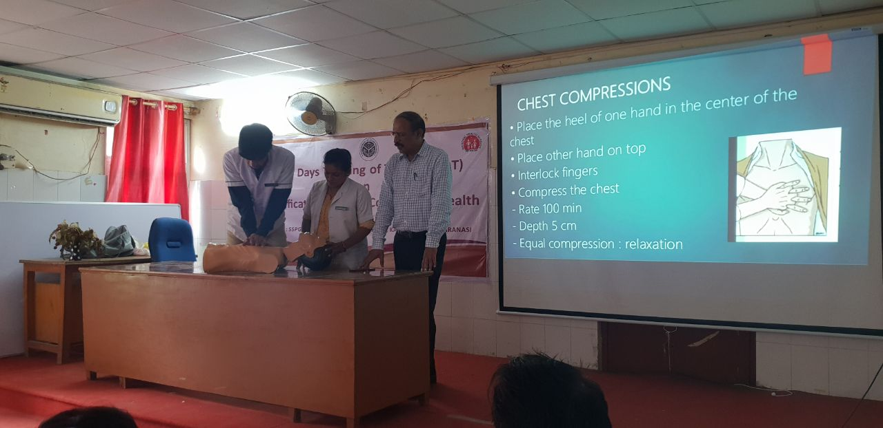
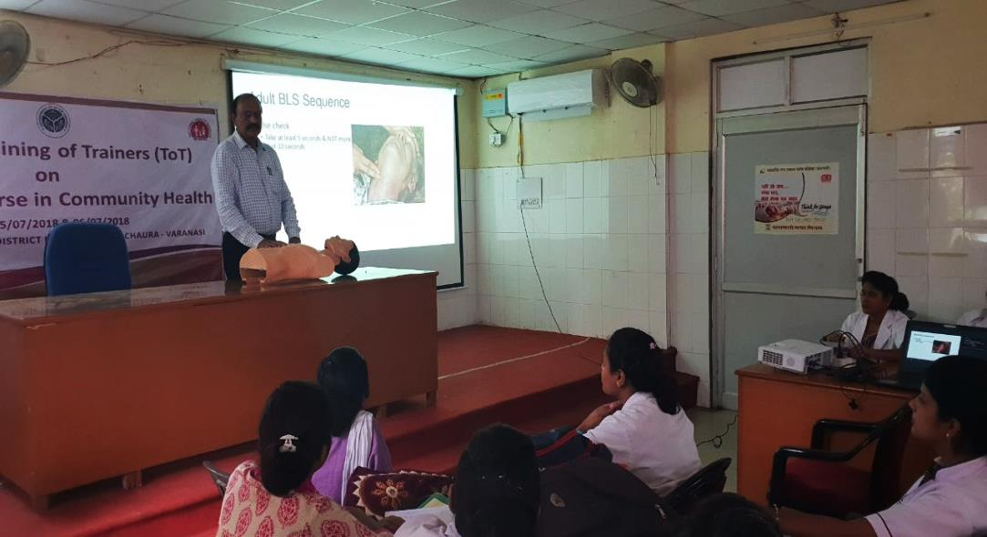
Theory Sessions using LRPs and Skills demonstration.
Theory session using Standard LRPs
Classroom teaching using AV aid at DWH Basti
Skills demonstration at PSC Varanasi

Slide 14
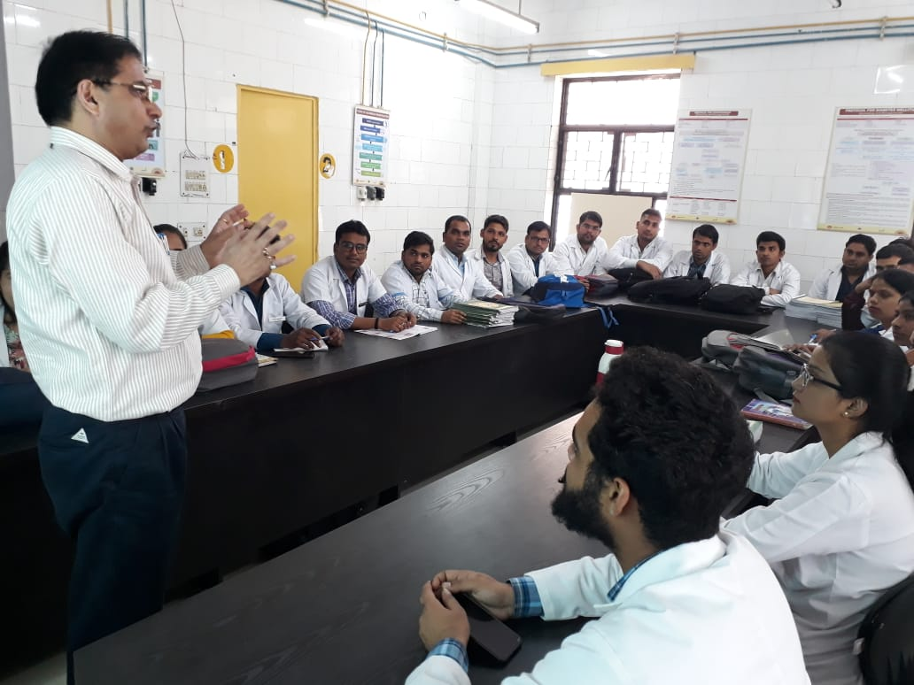
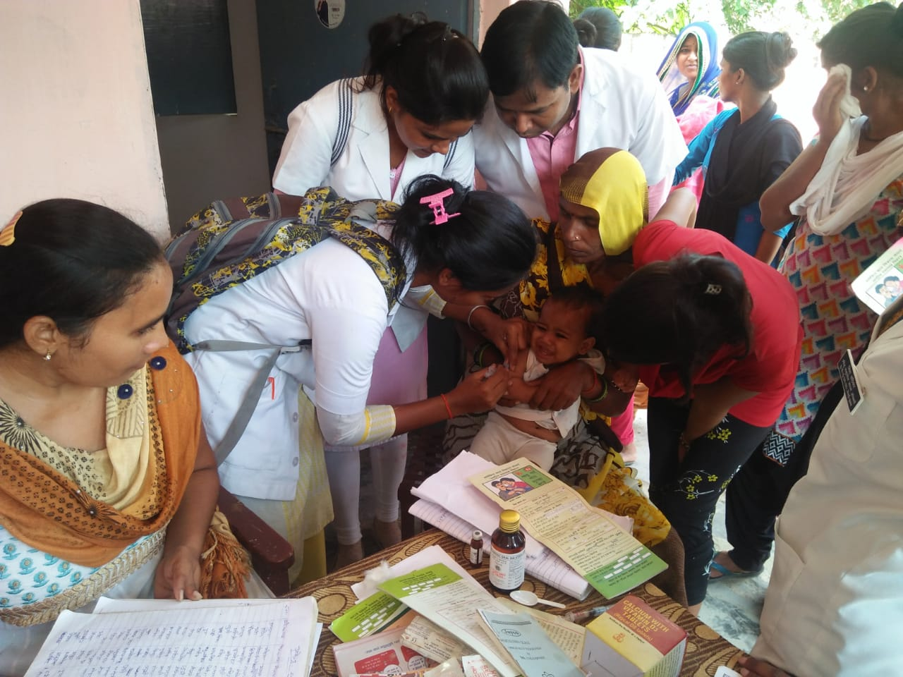
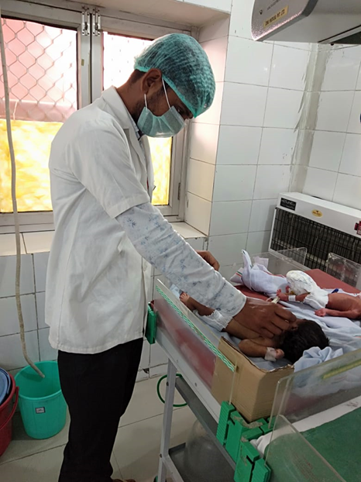
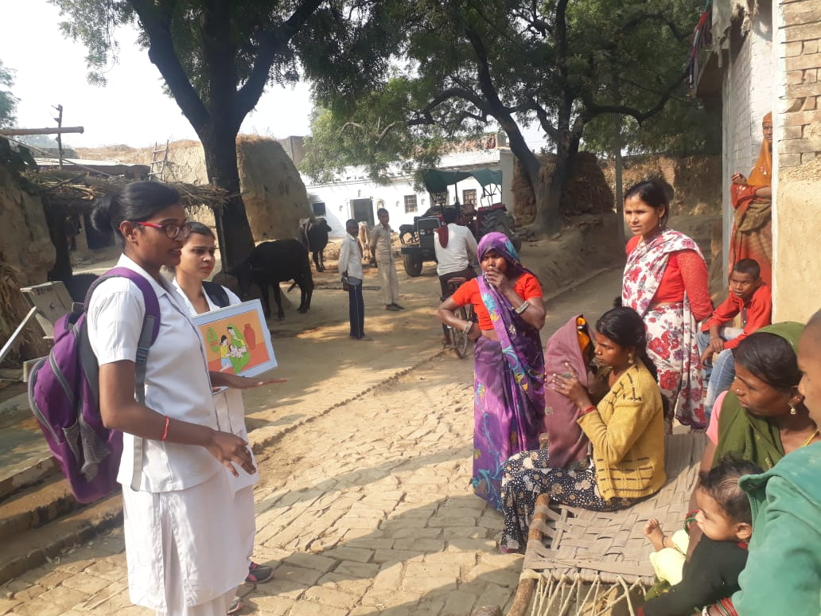
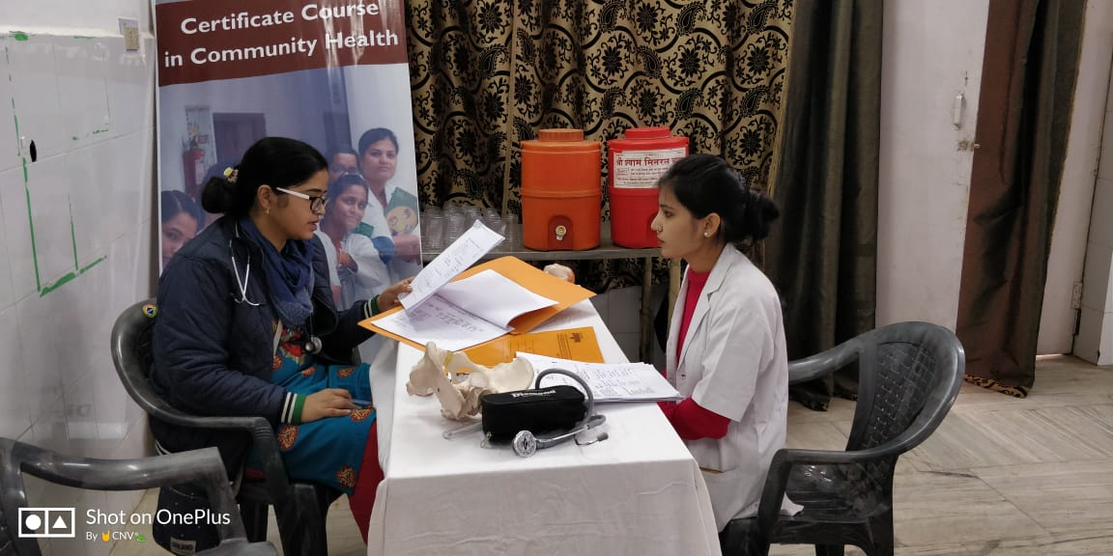

Slide 15
THANK YOU….

