Slide 1



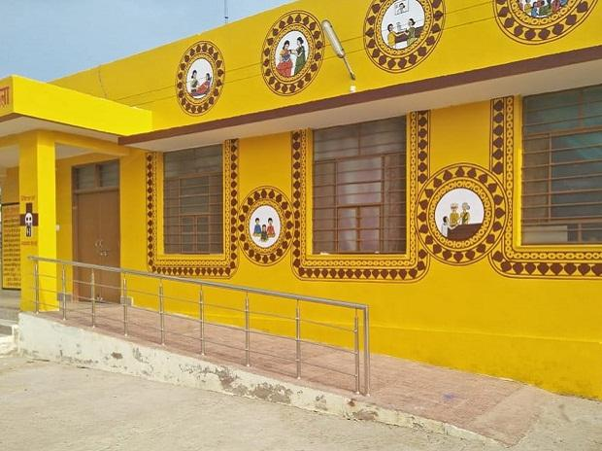
Supply and Logistics Management
Health & Wellness Center
The Rajasthan Experience
Rohit Kumar Singh
Additional Chief Secretary
Government of Rajasthan
Department of Medical, Health & Family Welfare

Slide 2

Overview
State Profile
Health Infrastructure
Health & Wellness Centers
  Measures to be adopted for logistics and supply chain management
  State Modified the list of EDL as per Operational Guidelines for CPHC
  Measures taken to enhance range of diagnostic tests at HWC-SHCs
  Strategy to prevent irrational use of Medicine
  Mechanism to ensure rational use of diagnostics at all level
Challenges
Key Learnings

Slide 3












Demographic Profile
Children
18.6 %
22.3 %
Adolescent
6.1 %
Infants
Adults
31.8 %
16.4 %
Middle
aged
4.8 %
geriatric

Slide 4

Demographic Profile
Children
18.6 %
22.3 %
Adolescent
6.1 %
Infants
7.8 Cr. Population
1.27 Cr. Households
Adults
31.8 %
16.4 %
Middle
aged
4.8 %
geriatric

Slide 5





300 (Approx)
Health complex & offices
29
Medical College Hospitals
13575
Sub Centers
130
HWC
32
District Hospitals
Health Infrastructure
2336
Primary Health Centers
20
Sub District Hospitals
595
Community Health Centers
12
Satellite Hospitals
123
Health Dispensaries

Slide 6
3D of Health Care
Qualified doctors assisted by Skilled
Para-
medical
staff
Essential Medicines, Surgical
Items &
Sutures
Basic Equipment and Diagnostics facilities
D
D
D
DOCTORS
DRUGS
DIAGNOSTICS

Slide 7
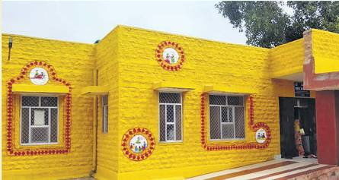
Health & Wellness Centers
PHC-HWC : 304
SHC-HWC :130
UPHC-HWC : 057

Slide 8

HWC - logistics and supply chain management
Policy to provide free drug & diagnostics
Central Procurement Agency (RMSCL) established
Essential Drug & Diagnostic list for State (RSEML) adopted
Standard Treatment Guideline (RSSTG) adopted
Drug & Therapeutic Committees constituted
Electronic Inventory Management (e-Aushadhi / e-Upkaran) being implemented.

Slide 9

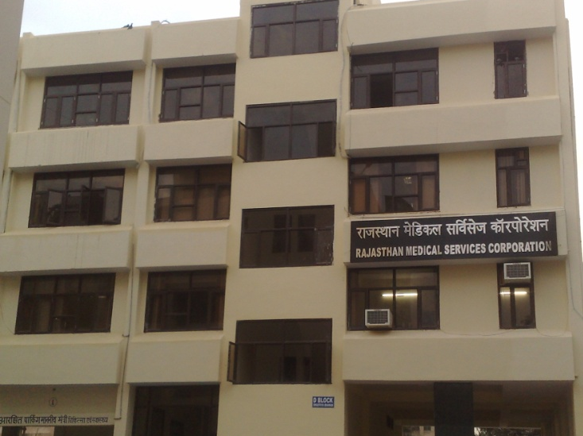
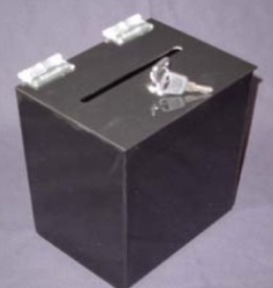
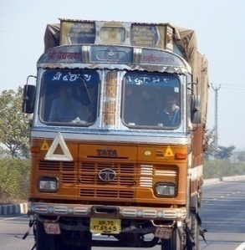
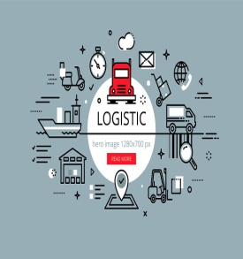



RAJASTHAN MEDICAL SERVICES CORPORATION – an autonomous centralized procurement agency
Since 2011
PROCUREMENT
SUPPLIES
LOGISTIC
QC
IT CELL
FINANCE
EQUIPMENT PROCUREMENT & MAINTENANCE CELL

Slide 10







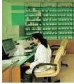
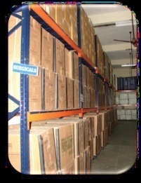

RMSC Work Flow
Annual Demand
Annual demand received from M&H Dept. /ME Dept/RUHS
Laboratory
Quality Testing & update status
Contract signed b/w Suppliers and HQ
Rate Contract
Sample sent to HQ for Quality assurance
A purchase order is generated for DDWH as consignee
Approval from HQ Laboratory
PO Generation (drug-wise)
PO Received
Drug Recieved
Challan Generation
and Drug send to DDWH
Drug is ready for Issue
Supplier

Slide 11



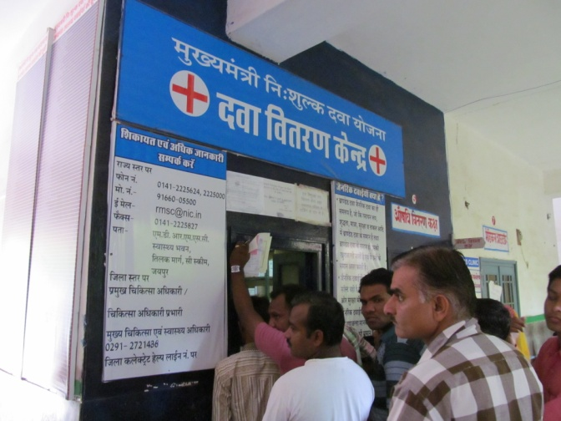
RMSC Work Flow
Indent for Issue
Sub-store
DH
SDH
CHC
PHC
Medical College
others
Receive after approval
Drugs Issued to DDC
34 District Drug Warehouses
6 Medical College Drug Warehouses
Drug distribution Centre
Drugs distributed to patients
Manpower at DDW/MCDW
Officer in-charge-DDW
2 Pharmacists
2-3 Informatics Assistants
Helpers – need based
Security person – need based
Final Consumption by Patients

Slide 12
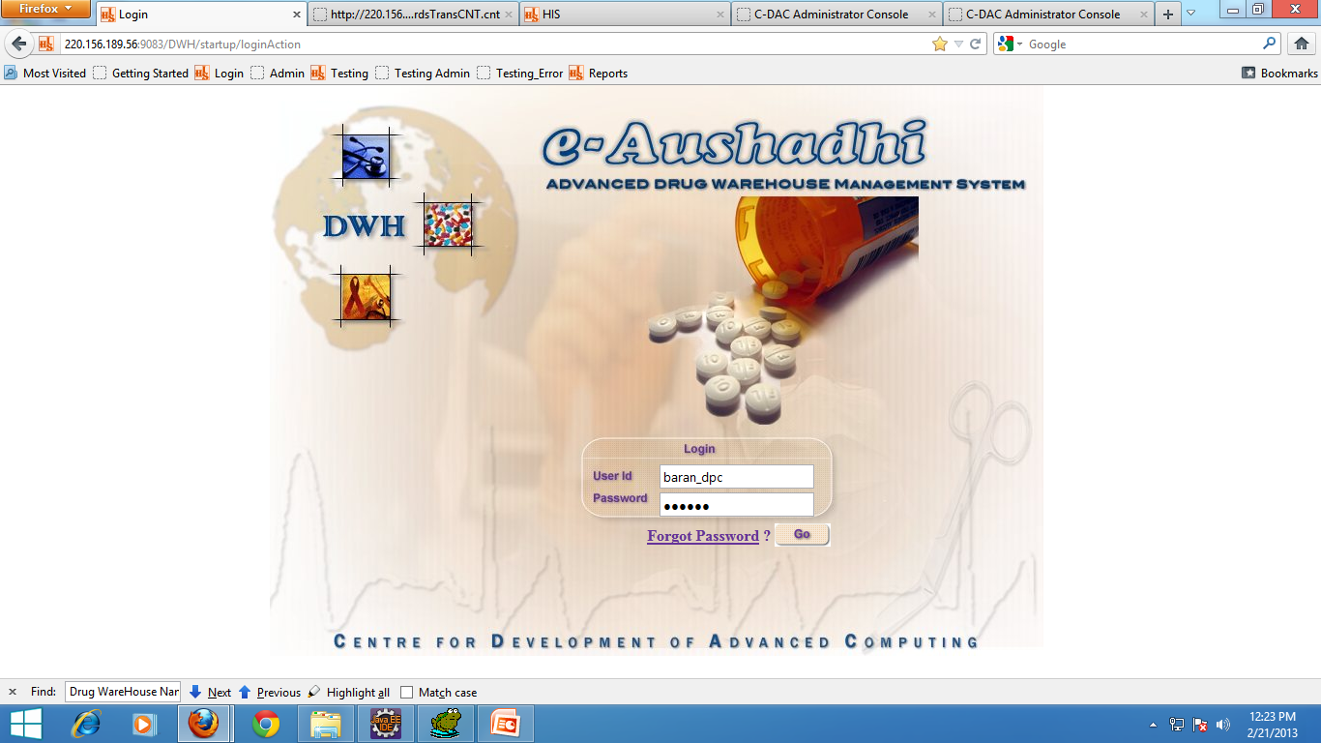
e-Aushadhi Software for Inventory management
Complete Supply Chain Management Solution for drugs, surgical items and sutures, developed by CDAC.
Provides inventory management at all DDWs and at sub stores / DDCs of Medical college hospitals, District Hospitals, CHCs and PHCs.
Implemented across 4397 locations (including DDCs) across the state.
Provides detailed information from the stage of procurement of the drug to its consumption by the end users.
Key Features of e-Aushadhi
Facilitates online annual demand submission
Online purchase order generation to suppliers
Provision to maintain expiry date/shelf life
Provides details of Quality control
Ability to track drug inventory online
Ability to generate customized reports
Facilitates inter ware house transfer of drugs
Alert generation in different colours for expired drugs, re-order level
Maintains daily stock ledger of drugs

Slide 13
e-Aushadhi Inventory management
Implemented across 4397 locations across the state.

Slide 14
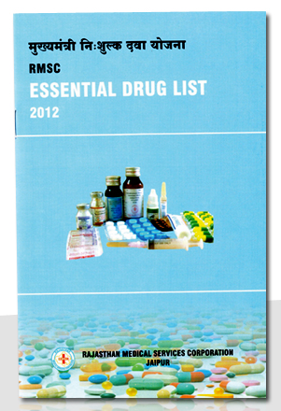
State modified the list of EDL as per operational Guidelines for CPHC
The current EDL of the state up-to PHC & HWC PHC level, already includes all the medicines specified in operational guidelines
43 medicines / Surgical items are provided at SHC and HWC-SHCs.
130 HWC-SHCs functional

Slide 15
Present Status of the EDL
Category of Healthcare Institutions | Numbers based on level of care
 | Medicines | Surgical Items | Sutures | Total
Medical College Hospitals | 608 | 147 | 77 | 832
District / Sub-dist / Satellite Hospitals | 563 | 142 | 37 | 742
CHCs | 447 | 111 | 11 | 569
PHCs /Dispensaries/ PHC-HWCs | 245 | 73 | 2 | 320
Sub Centers | 33 | 10 | 0 | 43
SHC-HWCs | 91 | 10 | 0 | 101
Notes:
Recognizing that many important factors feed into disparities in access to essential medicines, and that the “puzzle” of access will vary from country to country, it is crucial for policymakers and stakeholders to have a better understanding of where resources can be allocated most efficiently in order to optimize efforts and enable wider access to essential medicines for their populations.

Slide 16
Various Diagnostic Tests available presently
S. No | LEVEL OF CARE | NUMBER OF TESTS
1 | Medical Colleges Hospitals | 70
 | District /Sub-Divisional & Satellite Hospitals | 56
2 | Community Health Centers | 37
3 | Primary Health Centers & City Dispensaries | 15
4 | Sub Health Centre | 5

Slide 17
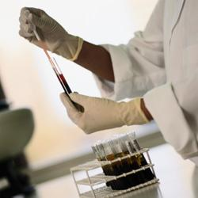
Diagnostic tests at HWC-SHCs/PHCs
At HWC-PHC and HWC-SHC state is providing tests as per operational guidelines i.e. 19 & 8 respectively
State plans to provide facility of 36 types of tests in financial year 2019-20 at all the PHC-HWCs
For this process of procurement of equipment is under process
      Semi-auto analyzer
      3 part cell counter
      ECG machine

Slide 18
List of Proposed 36 Diagnostic Tests at all PHC-HWCs
Clinical Pathology
1 | Haemoglobin Estimation (Hb)
2 | Total Leukocyte Count (TLC)
3 | Differential Leukocyte Count (DLC)
4 | MP (Slide Method)
5 | ESR
6 | Bleeding Time (BT)
7 | Clotting Time (CT)
8 | CBC
9 | Blood Group (ABO-RH typing)
10 | Total Red Blood Cell Count
11 | Platelet count by cell counter
12 | Packed cell volume (PCV)
Bio Chemistry
13 | Blood sugar
14 | Blood Urea
15 | S. Creatinine
16 | S. Bilirubin (T)
17 | S. Bilirubin (D)
18 | SGOT
19 | SGPT
20 | S. Alkaline Phosphates
21 | S. Total Protein
22 | S. Albumin
23 | S. Total Cholesterol
24 | S. Triglyceride
25 | S. VLDL
26 | S. HDL
Microbiology
27 | VDRL Rapid Test
28 | HIV Rapid Test
29 | Sputum for AFB
30 | Widal SlideTest
Urine Analysis
31 | Urine Sugar / Albumin
32 | Urine Pregnancy test (UPT)
33 | Urine Microscopy
34 | Urine Complete by strip method (Bile Salts, Bile Pigment, Ketone bodies & Occult blood, sugar, albumin, Ph, specific gravity)
Stool Analysis
35 | Stool for OVA and cyst
Cardiology
36 | ECG

Slide 19
Proposed range of Diagnostic tests at H&WC-SHCs
SN | Name of test | Available | Remark
1 | UPT | All SHCs | State is going to make it essential / available at all 13,547 SHCs.
2 | Urine Albumin/ Sugar | All SHCs
3 | Hb | All SHCs
4 | Malaria smear test | All SHCs
5 | Sputum collection | All SHCs
6 | Blood Sugar | SHC-H&WCs
7 | Malaria Rapid test | SHC-H&WCs
8 | Dengue test | SHC-H&WCs
We are going to provide facility of 36 type of tests in financial year 2019-20 at all the PHC-HWCs
Notes:
Recognizing that many important factors feed into disparities in access to essential medicines, and that the “puzzle” of access will vary from country to country, it is crucial for policymakers and stakeholders to have a better understanding of where resources can be allocated most efficiently in order to optimize efforts and enable wider access to essential medicines for their populations.

Slide 20

HWC – Rational use of diagnostics at all level
“Drugs and Therapeutic Committee” is mandated to audit the prescription as well as Test Requisition Form (TRF)
Maintaining proper record
  Stock register
  A proper record of investigations
Notes:
Recognizing that many important factors feed into disparities in access to essential medicines, and that the “puzzle” of access will vary from country to country, it is crucial for policymakers and stakeholders to have a better understanding of where resources can be allocated most efficiently in order to optimize efforts and enable wider access to essential medicines for their populations.

Slide 21

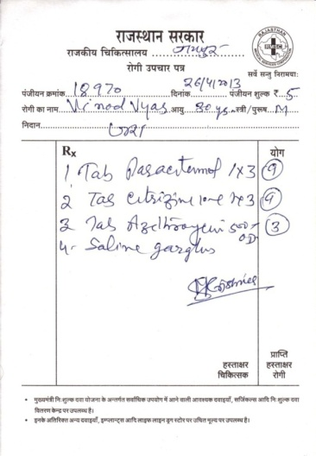
Strategy to prevent irrational use of medicine
  Prescription by Generic Name
  Prescription on Self Carbonated Slip
  Second copy is retained by pharmacists
  Use of EML
  Copy of Standard Treatment Protocols were distributed to every Medical Officer.
  Drug Therapeutic Committees at hospital level constituted
  Sensitization and Orientation of MOs
Notes:
Recognizing that many important factors feed into disparities in access to essential medicines, and that the “puzzle” of access will vary from country to country, it is crucial for policymakers and stakeholders to have a better understanding of where resources can be allocated most efficiently in order to optimize efforts and enable wider access to essential medicines for their populations.

Slide 22
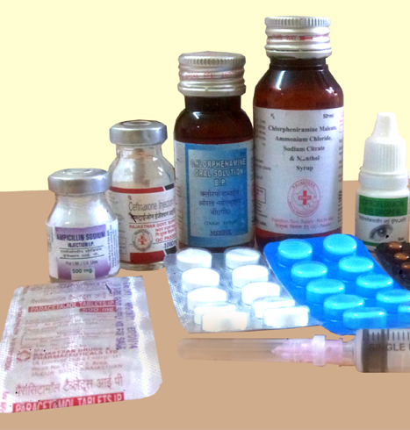
Strategy to prevent irrational use of medicine By Community Health Officers at HWC-SHCs
No authority of prescription writing.
Maintain proper record
  Stock register
  Of medicines supplied to the beneficiaries.
  Signature of the beneficiary is mandatory
  MRP is printed on packaging
  Govt. of Rajasthan Supply - Not for sale is also printed
  IEC – that medicines are available free of cost
Notes:
Recognizing that many important factors feed into disparities in access to essential medicines, and that the “puzzle” of access will vary from country to country, it is crucial for policymakers and stakeholders to have a better understanding of where resources can be allocated most efficiently in order to optimize efforts and enable wider access to essential medicines for their populations.

Slide 23

Challenges & Bottlenecks
Training & Deployment of Community Health Officer
Diverse geography– difficult logistics
Delivering drugs to SHCs is a challenge
Human Resource Management – Vacancies, Rational Deployment

Slide 24

Key Learnings
A robust supply and logistic management can help in ensuring availability of quality drugs.
Capacity/Skills/Motivation at all levels - the key.
Regular monitoring of availability of medicines and tracking mechanisms through e-AUSHADHI.
Digitisation using mobile phone can help in improving efficiency.

Slide 25
Thanks

