Slide 1








Health and Wellness Centre
Ranking
April 8th 2019

Slide 2
Functionality Criteria HWCs
Availability of HR ( i.e, Trained CHO at SHC- HWC and MBBS MO at PHC – HWC/ UPHC- HWC)
Completion of training of Primary healthcare team on NCDs
Availability of essential medicines
Availability of essential diagnostics
Infrastructure strengthening including Branding
Initiation of screening of NCDs (Hypertension, Diabetes and three cancers – Oral and Breast)
Initiation of Community Outreach (population enumeration and Community Based Assessment checklist filling) by ASHAs
Use of CPHC IT application
Wellness activity including yoga
Tele-consultation
Performance linked payment for CHO

Slide 3
Process for Ranking of HWCs
Based on-
  Data entered on HWC Portal which reflects readiness and initial service delivery at HWCs.
  Combined score determined from weightage linked with seven criteria
Done on quarterly basis
Overtime the scoring criteria will be refined to reflect service delivery ,quality and outcomes.

Slide 4
 | Criteria | Definition | Weightage
1 | % of SHCs, PHCs and UPHCs operationalized as HWCs out of total SHCs, PHCs and UPHCs in the state Source – HWC Portal | Numerator – Number of SHCs/ PHCs and UPHCs indicated as progressive on HWC portal Denominator - Number of SHCs and PHCs and UPHCs available in state | 25%
2 | % of HWC functionality criteria met against the total target functionality criteria³ – Availability of HR, Training completed, Branding Completed, Availability of Medicines, Availability of Diagnostics, Population Enumeration initiated, Screening initiated for all four NCDs (Hypertension, Diabetes, Oral and Breast Cancer) CPHC IT application is in use Tele-consultation Wellness activity including yoga Performance linked payment for CHO Source – HWC Portal | Numerator – Total number of criteria met by the HWCs Denominator – Total number of criteria estimated based on number of HWCs proposed on HWC portal Each HWC can potentially achieve a score of 11 (i.e, 1 per criterion) on meeting all 11 criteria. | 20%

Slide 5
 | Criteria | Definition | Weightage
3 | % of population enumerated (against the target population) under HWCs Source – CPHC – NCD IT application | Numerator – Number of individuals reported under population enumeration for all HWCs Denominator – Total population under the health facility | 15%
4 | % of Pregnant Women who received full ANC Source – RCH portal / ANMOL | Numerator – Number of pregnant women who received full ANC checkups (at least 4 ANC checkups) Denominator- Total number of pregnant women registered under the facility | 5%
5 | % of institutional deliveries Source – RCH portal / ANMOL | Numerator- Number of pregnant women who delivered in a health care facility (public and private both) Denominator- Total number of pregnant women reported under the health facility | 5%
6 | % of Newborns who received HBNC visits Source – RCH portal / ANMOL | Numerator- Number of newborn (0-28 days) who received HBNC visits as per the schedule (0, 3, 7, 14, 21 and 28 days). Denominator- Total number of newborn reported under the health facility | 5%

Slide 6
 | Criteria | Definition | Weightage
7 | % of Children up to 2 years of age who received full immunization Source – RCH portal / ANMOL | Numerator- Number of children up to 2 years who received full immunization (BCG, measles, and 3 doses each of polio and DPT) Denominator- Total number of children up to 2 years reported under the health facility | 5%
8 | % of Individuals over 30 screened for Hypertension against the target under HWCs Source – CPHC – NCD IT application | Numerator – Total number of individuals screened for Hypertension Denominator – Total number of individuals over 30 (estimated using 37% of the total population reported under each health facility) | 5%
9 | % of Individuals over 30 screened for Diabetes against the target under HWCs Source – CPHC – NCD IT application | Numerator – Total number of individuals screened for Diabetes Denominator – Total number of individuals over 30 (estimated using 37%⁴ of the total population reported under each health facility) | 5%

Slide 7
 | Criteria | Definition | Weightage
10 | % of Individuals over 30 screened for oral cancer against the target under HWCs Source – CPHC – NCD IT application | Numerator – Total number of individuals screened for Oral Cancer Denominator – Total number of individuals over 30 (estimated using 37%⁴ of the total population reported under each health facility) | 5%
11 | % of women over 30 screened for breast cancer against the target under HWCs Source – CPHC – NCD IT application | Numerator – Total number of women screened for Breast Cancer Denominator – Total number of women over 30 (estimated using 49% of the total population over 30) | 5%

Slide 8
State Rank
Rank | State Name
1 | Andhra Pradesh
2 | Telangana, Punjab
3 | Arunachal Pradesh, Haryana
4 | Sikkim, Tamil Nadu, Gujarat, Chhattisgarh
5 | Jharkhand, Assam, Maharashtra, Odisha
6 | Meghalaya, Uttar Pradesh, Rajasthan, Karnataka
7 | Kerala, Manipur, Tripura, Goa, Mizoram, Jammu and Kashmir
8 | Bihar
9 | Himachal Pradesh, Uttarakhand, West Bengal
10 | Madhya Pradesh
11 | Nagaland
Ranking based on first two criteria
Percentage of SHCs, PHCs and UPHCs operationalized as HWCs out of total SHCs, PHCs and UPHCs in the state
Percentage of HWC functionality criteria met against the total target functionality criteria

Slide 9
UT Rank
Ranking based on first two criteria
Percentage of SHCs, PHCs and UPHCs operationalized as HWCs out of total SHCs, PHCs and UPHCs in the state
Percentage of HWC functionality criteria met against the total target functionality criteria
Rank | UT Name
1 | Daman & Diu
2 | Chandigarh
3 | Dadra & Nagar Haveli
4 | Puducherry
5 | Andaman & Nicobar Islands

Slide 10
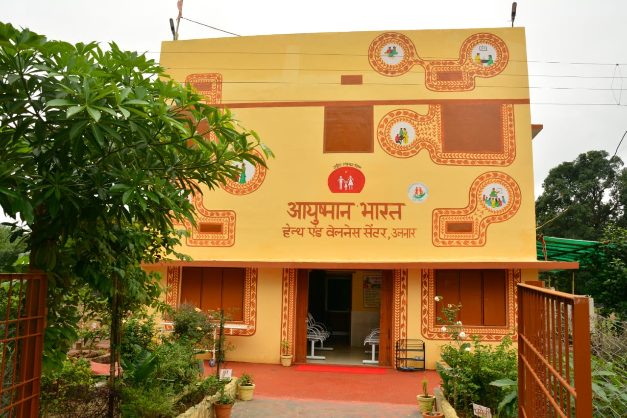
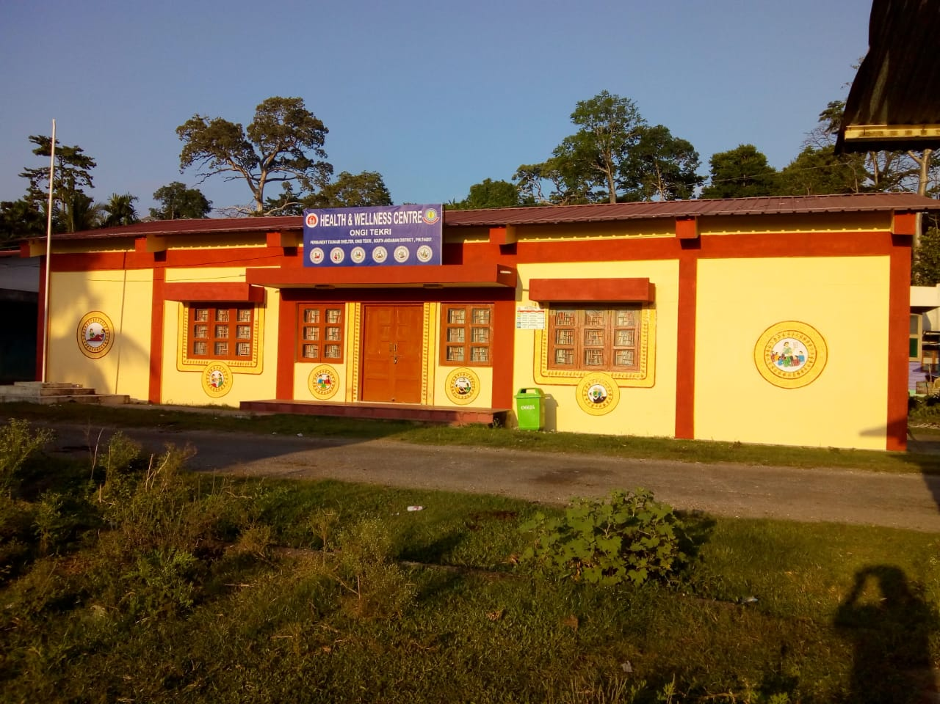
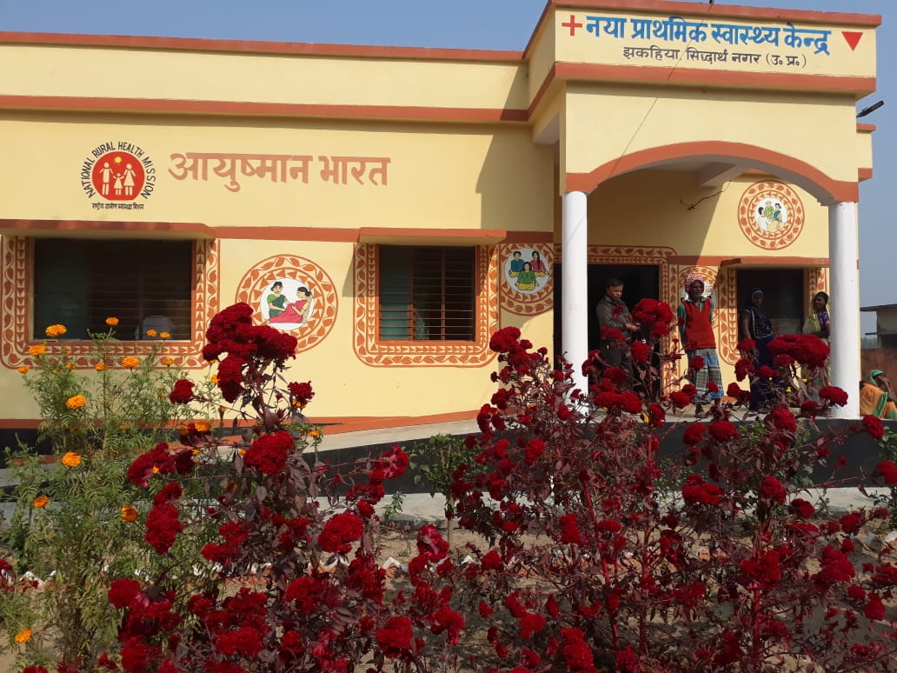
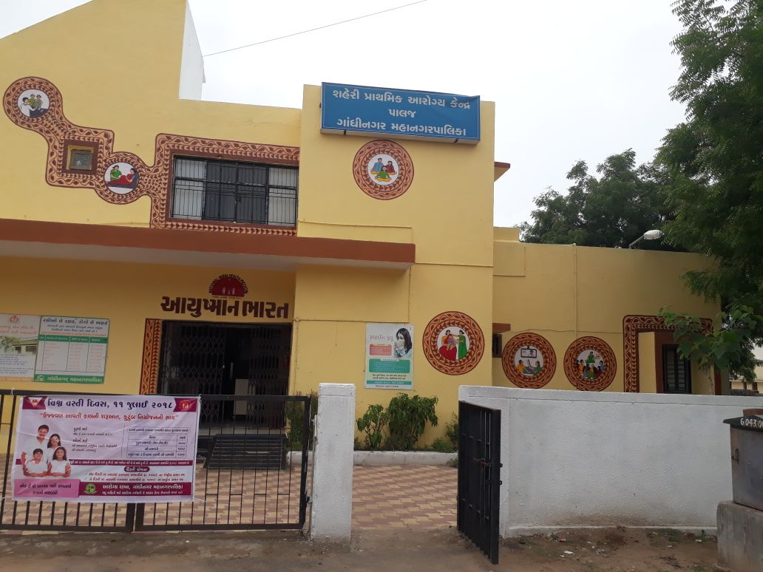
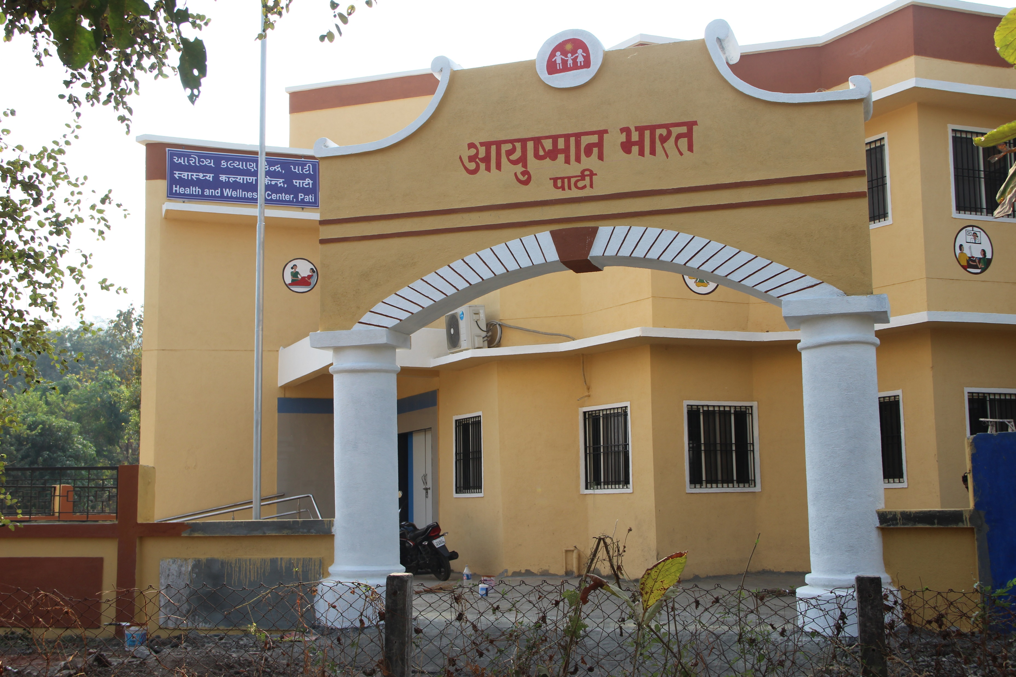
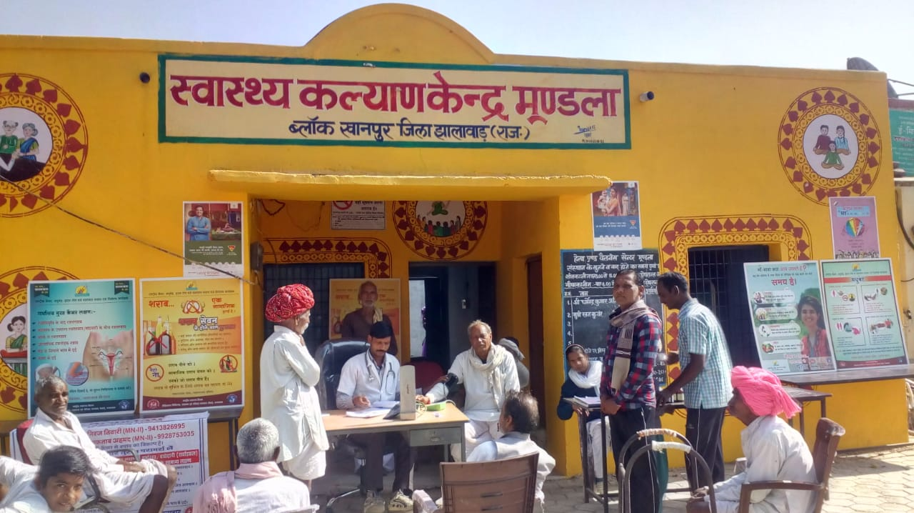
Thank You

