Slide 1






CONSTITUTING PRIMARY HEALTHCARE TEAMS: EXPERIENCE SO FAR

Slide 2
What is not right about this conceptualization? And how do we correct this understanding?
Maternal Health
Immunization
Rashtriya Bal Swasthya Karyakram
Revised National Tuberculosis Control Programme
Health & Wellness Center
Family Planning
Screening for Chronic Diseases
Child Health & Nutrition
Health Systems Strengthening

Slide 3
Human Resource Requirements for Effective Delivery of CPHC through HWCs
Service Providers at Secondary Facilities
HWC-PHC : HR as per IPHS: PHC Medical Officer as Lead of SHC-HWC cluster
HWC-SHC-: ASHAs, MPWs CHO,
TERTIARY
PMJAY
Programme Management HR at State, District and Block Level-SPMU, DPM, DCM, BPM, BCM
Programme Officers for National Health Programmes
Technical Support agency at state, district and block levels : SHSRC, SIHFW, Public Health Schools, Medical Colleges, ILCs, DPs,
SECONDARY
NHM
Referral
Preventive, Promotive, Curative, Rehabilitative & Palliative Care
PRIMARY-HWCs
Unmet need: NCDs/other Chronic Diseases
Existing services: RMNCHA
AYUSHMAN BHARAT – HWC & PMJAY

Slide 4
“The Four S Approach” for effective PHC teams
Selection- A set of transparent processes aimed at picking the “right” candidate
Skills- Build competencies and ensure that all personnel are fit for purpose
Support- Mentoring, Continuing Education, Performance Linked Payments for motivation, and enabling quality outputs
Supervision- Using standardized tools to improve efficiency, service coverage and quality

Slide 5
Selection
HWC-PHC
- 11,881 MBBS Medical Officers in position across 9376 PHC HWCs approved in FY 2018-19
- 1904 MBBS MOs in position in 1612 UPHC-HWCs approve
- 13,056 Staff Nurses in position across 9376 PHC-HWCs
- HWC-SHC (14,447 approved but Data reported from 10,521)
- 12,568 MPW(F) available across 10,521 Centres
- 7543 CHO trained and positioned against 11,202 Targeted for FY 2018-19*
- 59,749 ASHAs available across 10521 HWC-SC
- Average Population Density 1018
At least one MBBS MO/ staff nurse ensured as of now in all PHC-HWC . 66 MOs in HWC-SHC in Telengana, Goa and Chandigarh
Only Rajasthan and Uttarakhand- MPWs fewer than HWCs approved
States where Population /ASHA exceeds 1200 are Bihar, Punjab, Rajasthan, Telangana and West Bengal
Source https://ab-hwc.nhp.gov.in as reported on 31st March 2019 accessed on April 1, 2019

Slide 6
Selection of Programme Management Personnel
State Level
  CPHC Specific Programme Management HR at state/regional level one to seven consultants approved in 15 states
  Recruitment pending in most states
District Level
  District Nodal Officers for NCDs, DPM, DPMU designated as programme support for CPHC
  CPHC specific District Coordinators in Karnataka
Technical Support
  Technical Support Agencies- JHPIEGO-17 states, IIPH in Gujarat and Karnataka, WISH Foundation in MP-Urban, WHO in Chhattisgarh/Assam, Piramal and others in Assam
  SHSRC serving technical needs in three states; role of SIHFWs not yet articulated
  Innovation and Learning Centres: Gujarat, Haryana, Uttar Pradesh, Telengana, Punjab.

Slide 7
Skill Building : Training of Community Health Officers
 | Staff Nurses | Ayurveda Practitioners | BSc-Community Health
CHOs Trained | 1424 | 280 | 787
CHOs enrolled in CPCH (July 2018) | 4215 | 2115 | 146
4429 candidates completed Term End Examination July 2018 session : ( 77% pass rate lower than previous three sessions)
5214 candidates enrolled in January 2019 session
223 PSCs across the country
Programme also offered through State Public/Health Universities/Nursing Councils across five states
IGNOU Model in remaining 26 States and UTs
All basic and post-basic nursing colleges and universities have been to integrate CHO training in existing nursing curriculum
Will enable production of 1,12,546 potential candidates annually to serve as CHOs

Slide 8
CHO training - lessons
Structured lessons/powerpoint presentations for faculty improves training
Delays in selection, admission, and commencement of classes-results in reduced teaching hours and compromises skill demonstration and hands on practice
Lack of availability of course material- A challenge even for non IGNOU training programmes
Faculty and counselor inputs need strengthening-full quantum to be engaged, feedback of assignments, clinical handholding
CHO not clear on : Role clarity in HWCs, Remuneration after training, Posting in rural HWC-SHCs
Skill Testing in exam limited only to maternal and newborn care; skills for new service packages-NCD, minor injuries and trauma, eye, ENT not covered
Practical Training more observational than hands on (findings from 16 states): consequence is more severe given the quality of pre-service training of fresh candidates.
Student demands- more inputs for National health Programs; Management protocols for common conditions, maintenance of electronic health records
Source-External Observer visits across 15 Sites in FY 2018-19

Slide 9
What is being planned?
Induction training for MLHPs already trained and positioned at HWCs - on role clarity, functioning of HWCs
Supplementary Modules for Packages 1-7 to build capacities on management protocols
National Mentors being empanelled for PSC visits to monitor and improve training quality
State to identify State Mentors, joint visits with National Mentors and bi-annual meetings at national level
Guidelines for recruitment of BSc Nurses directly as CHOs to be developed in consultation with Task Force
States to explore the feasibility of conducting OSCE
Source-External Observer visits across 16 Sites in FY 2018-19
Notes:
Objective Structured Clinical Examination

Slide 10
Training of other members of Primary Health Care Team in Package 7
HWC-PHC- 9376, 1612 Urban PHC
1. MBBS MOs completed for 80-85% in urban and rural areas-5 states show training achievement 70% or below
2. Staff Nurses 62% in rural and urban areas-below 50% in 12 states
-
MPW-Fs
77% rural HWC-PHC; 68 % urban HWC-PHC
86% -HWC-SC
ASHAs-77% rural HWC-PHC and 65% urban HWC-PHC
81% -HWC-SC
Source https://ab-hwc.nhp.gov.in as reported on 31st March 2019 accessed on 1st April 2019
Notes:
MO Training Urban
<70% Himachal Pradesh Jammu & Kashmir Madhya Pradesh Meghalaya Mizoram
MO Training Rural
<70% Chhattisgarh Himachal Pradesh Jammu & Kashmir Madhya Pradesh Manipur
Staff Nurse < 50%
Andhra Pradesh Chandigarh Goa Gujarat Himachal Pradesh Jammu & Kashmir Jharkhand Madhya Pradesh Meghalaya Mizoram Tripura Uttar Pradesh

Slide 11
Lessons: Training of Primary Health Care Team
Training for ASHAs reduced to one or two days-focused on CBAC but limited sensitization of ASHAs on further steps of mobilization for screening, health promotion, follow up care
MPWs trained but ASHAs not trained that delayed the process of population enumeration and community-based risk assessment
Lack of distribution of Family Folders and CBAC to ASHAs immediately after training leading to skill attrition
Training inputs did not emphasize that process of population enumeration and CBAC is an opportunity for demand generation, health promotion and active IEC for HWCs
Source Findings Twelfth CRM 2018 and NHSRC field trip reports

Slide 12
Orientation of Programme Management Staff
One time orientation undertaken for DPMU staff but insufficient
Training related to Roles and clarifying mission of paradigm shift involved in CPHC needed
Sensitization of Programme Officers of National Health Programmes to HWC, serving primary health care component
Working with states to schedule Orientation Workshops for state and districts via zoom

Slide 13
Supervision
Quick Surveys –phone surveys
Concurrent monitoring Checklist
Planning and Preparedness of Programme Managers
Facility Based Survey to assess service delivery: coverage/quality
Community Feedback for satisfaction

Slide 14
Illustrative weekly calendar for primary health care team at HSC-HWC
 | 9-1 pm | 2-4 pm
Monday | Immunization Day
 | OPD by CHO + MPW -1 Home visits by MPW-2 | OPD by CHO + MPW-1 Home visits by MPW-2
Tuesday | ANC Day
 | OPD by CHO and MPW-2 Home visits by MPW-1 | OPD by CHO and MPW-2 Home visits by MPW-1
Wednesday | NCD screening Day
 | OPD by CHO + MPW -1 Home visits by MPW -2 | OPD by CHO + MPW -1 Home visits by MPW -2
Thursday | OPD by CHO/ MPW- 1 Two VHND by two MPWs Two VHND by MPW -1 and CHO | OPD by CHO/ MPW- 1 Home Visits by two MPWs Home Visits by MPW-1 and CHO
Friday | Outreach activities by CHO (NCD screening camp or participation in RBSK camps and school/ AWC visit etc may be planned based on roll out of new service packages and local requirements) | OPD by MPW-1 1st Friday- VHSNC meeting by CHO 2nd Friday- VHSNC meeting Patient Support Group meeting by CHO 3rd Friday- SHC monthly meeting by CHO 4th Friday- PHC Monthly meeting
Saturday | Wellness Activity – (eg-Yoga supported by two MPWs and ASHAs ) OPD by CHO | Weekly review meeting at SHC team

Slide 15
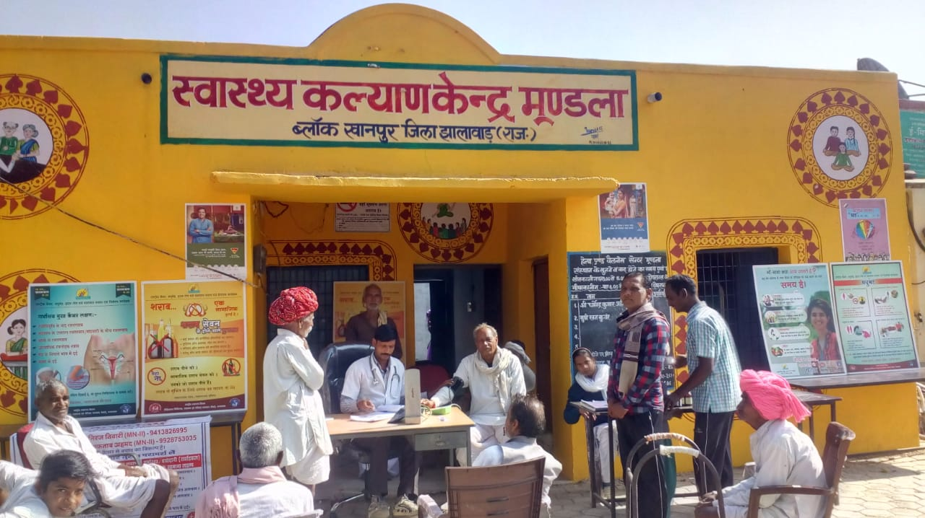






Preliminary Findings from Phone Survey with CHOs

Slide 16
States not included in phase 1 survey
States with no CHOs
Chandigarh
Delhi
Himachal Pradesh
Kerala
Lakshadweep
Andhra Pradesh
Goa
Madhya Pradesh
Mizoram
Sikkim
Tripura
Andaman and Nicobar
Daman and Diu
Puducherry

Slide 17
Status of Calls

Slide 18
State wise call status

Slide 19
Status of Upgrading of SHC to HWCs

Slide 20
Training of Primary Healthcare Team on NCDs

Slide 21
Availability of Medicines
Availability of medicines for Hypertension and Diabetes
Duration for which medicine is dispensed by CHO

Slide 22
Diagnostic services available at HWCs

Slide 23
OPD at HWCs

Slide 24
Top five conditions - OPD
Fever
Hypertension
Cold and cough
Skin diseases
Diabetes

Slide 25
Community Outreach
CBAC form filling started
Population enumeration started

Slide 26
Screening of Common NCDs

Slide 27
Support and Supervision

Slide 28
Concerns shared by CHOs
Lack of proper infrastructure (69) –
poor building condition (35), requirement for regular water (29) and electricity (15) supply, toilet facilities (2) and examination room (4)
Lack of medicines (61)
Shortage of human resource (19)
Non availability of IT tools (10)
Lack of equipment / consumables for diagnostic (8)
Salary and incentives not received (8)
Ambulance services in some areas (4)
Lack of role clarity (2)
Poor coordination with ASHAs and ANMs (2)
Requirement of security (4)
Requirement of vehicle for field visit (2)

Slide 29
Thank-you

