Slide 1
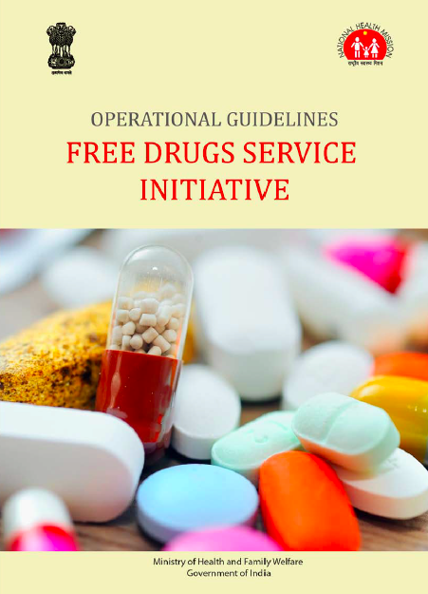
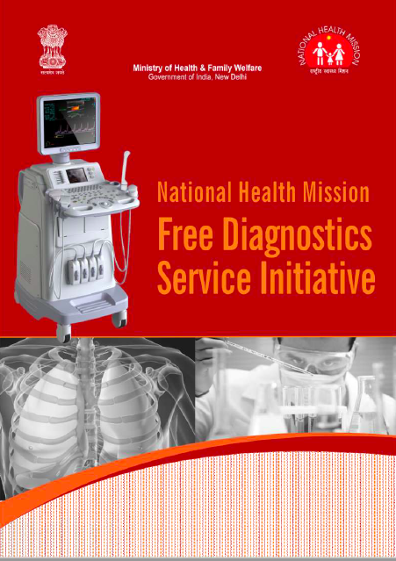
Streamlining Logistics for Medicines and Diagnostics

Slide 2
Medicines in India: A Paradox
India is one of the largest manufacturers & suppliers of generic medicines to the world
Considered ‘Pharmacy of the Global South’
18% Households faced Catastrophic Expenditure on health care.
India is amongst countries with the highest OOPE on health care . (Rank 182 / 191)
64.2 % is OOPE as a % of Total Health Expenditure (2015-16).
Further, as per NSSO (71st Round), 70% of OOPE is on Medicines and around 10% is on Diagnostics.
Notes:
*18% CHE - NSSO 71st Round : NHSRC factsheet (2014)
64.2 % is Out of Pocket Expenditure as a % of Total Health Expenditure (NHA 2015-16).

Slide 3
OOPE on medicines in public health facilities (Rural and Urban)

Slide 4
SDG 3.8 : Overarching Umbrella of SDG 3
“achieve universal health coverage, including financial risk protections, access to quality essential health care services, and access to safe, effective, quality and affordable, essential medicines and vaccines for all”.
SDG 3 : Ensuring healthy lives and promote wellbeing for all at all ages.
Notes:
SDG 3 : Ensuring healthy lives and promote wellbeing for all at all ages.

Slide 5
Rationale for Free Drugs Service Initiative
WHO study - about 65% of the Indian population lacks regular access to essential medicines.
Provision of free essential medicines in public health facilities, therefore:
-improves care
-improves footfalls
-provides substantial reduction in OOPE.
Generic medicines are priced at 1.5% to 40% of their branded counter part.
Low hanging fruit.

Slide 6
Facility wise Essential Medicine List :
Flexibility with the State / UT to increase the number of medicines in EML as per disease burden.
31 States / UTs have facility wise EML.
FDSI guidelines suggests EML to be displayed at each facility.
Type of Facility | Indicative number of Medicines / Formulations
SHC | 57
PHC | 285
CHC | 455
DH | 544

Slide 7
Number of Medicines in EML – as reported on DVDMS dashboard
Tripura & Chhattisgarh are sharing the data on Central DVDMS Dashboard
Source : Central DVDMS portal as on 6.04.2019.

Slide 8
As on today :
15 States have implemented DVDMS (CDAC)
3 States are in the process of implementing DVDMS -Sikkim, Arunachal Pradesh and Assam.
9 States and 1 UT have systems other than DVDMS.
  Tamil Nadu, Odisha, Karnataka, Haryana, Kerala, West Bengal and Goa are yet to integrate data with the Central DVDMS Dashboard.
One common application has been proposed for the remaining 6 UTs.
Only 2 States without an IT backed medicine supply chain system - Mizoram & Nagaland.

Slide 9
Status of 15 states on DVDMS
State Active User at PHCs %*
Rajasthan 91.90
Andhra Pradesh 99.34
Maharashtra 99.34
Telangana 85.39
Madhya Pradesh 60.92
Gujarat 41.54
Bihar 24.65
Himachal Pradesh 14.14
Uttarakhand 9.09
Punjab 6.12
Uttar Pradesh 0.97
Jharkhand 0.29
Meghalaya 6.4
Jammu & Kashmir 0
Manipur 0
State Active User at CHC %*
Uttar Pradesh 0.97
Jammu Kashmir Nil
Manipur Nil
Meghalaya 11.11
Bihar 12.50
Jharkhand 31.84
State Active User at DH*
Manipur 0 / 9
Meghalaya 1 / 14
Jammu Kashmir 3 / 28
Bihar 35 / 79
*Percentage of Active Users at the registered PHCs/CHCs/DH facilities on DVDMS – CDAC portal in the last 30 days. (Feb 2019)
Notes:
Rajasthan Go Live with DVDMS in Oct 2010.
Central DVDMS dashboard – percentage of active users out of total registered facilities.

Slide 10
Setting up a system for Prescription Audit
14 States / UTs have initiated the process.
“Every physician should prescribe drugs with generic names legibly and preferably in capital letters and he/she shall ensure that there is a rational prescription and use of drugs .”
  Code of (Professional Conduct, Etiquette and Ethics) Regulations 2002.
Advisory issued by MoHFW to both central Government facilities/institutions and to States/UTs for compliance.

Slide 11
Grievance Redressal System:
19 States / UTs have a mechanism in place.
Quality Assurance:
Results of National Drug Survey 2014-16 :
Not of Standard Quality (NSQ) medicines in retail outlets : 3%.
NSQ in public health facilities : 10%.
14 States with NSQ % greater than the national average.
Quality testing by NABL accredited lab is available in 28 States / UTs.

Slide 12
Free Diagnostics Service Initiative
Type of Facility | Indicative number of Tests
SHC | 7
PHC | 19
CHC | 39
DH | 56
Gujarat, Rajasthan and Andhra Pradesh are providing all tests listed in the FDI guidelines.
Andhra Pradesh (under PPP) and Telangana (in-house) have a hub and spoke model.
Rajasthan has hub and spoke outsource model for advanced tests.
In Gujarat, samples for few tests are transported to the district central laboratory from all health facilities.
Nagaland, Uttarakhand, Mizoram and Arunachal Pradesh are yet to implement Free Diagnostics Service Initiative.

Slide 13
Diagnostic Tests available : SHC
States / UTs providing tests as per indicative list at the facility | States / UTs providing less number of tests
7 States / UTs providing 7 tests or more Andhra Pradesh, Delhi, Himachal Pradesh, Maharashtra, Punjab, Odisha, Telangana | 14 States providing < 4 tests Arunachal Pradesh , Dadra & Nagar Haveli, Daman & Diu, Goa, Lakshadweep, Manipur, Meghalaya, Mizoram, Nagaland, Puducherry, Sikkim, Tamil Nadu, Tripura, Uttarakhand

Slide 14
Diagnostic Tests available : PHC
States / UTs providing tests as per indicative list at the facility | States / UTs providing less number of tests
12 States / UTs providing 19 tests or more Andaman & Nicobar Island, Assam, Gujarat, Himachal Pradesh, Sikkim, Andhra Pradesh, Delhi, Lakshadweep, Puducherry, Maharashtra, Manipur, Meghalaya. | 12 States providing < 15 tests Arunachal Pradesh, Dadra & Nagar Haveli, Daman & Diu, Goa, Jammu & Kashmir, Jharkhand, Kerala, Nagaland, Rajasthan, Tamil Nadu, Telangana, West Bengal

Slide 15
Diagnostic Tests available : DH
States / UTs providing tests as per indicative list at the facility | States / UTs providing less number of tests
10 States / UTs providing 56 tests or more Himachal Pradesh, Rajasthan, Sikkim, Andhra Pradesh, Dadra & Nagar Haveli, Delhi, Goa, Gujarat, Odisha, West Bengal | 8 States are providing < 40 tests Arunachal Pradesh, Jammu & Kashmir, Jharkhand, Nagaland, Telangana, Tripura, Uttarakhand, West Bengal

Slide 16
Way forward :
DVDMS to be used for planning and monitoring of medicine stock-out. (https://cdashboard.dcservices.in/CDDB/hissso/logoutLogin.cwh)
All States to fast-track implementation of DVDMS – upto HWC – PHC / SHC level.
Nagaland and Mizoram to implement both IT enabled Supply Chain Management System and FDSI.
Uttarakhand and Arunachal Pradesh to implement FDSI.

Slide 17
Way forward :
Expansion of facility level EML : Include medicines for expanded service packages.
  Same medicines to be made available at all levels of care (i.e. SHC-PHC-CHC-DH) to improve treatment compliance.
Ensure Point of Care Diagnostics at HWC-PHC: 50 tests and HWC-SHC:15 tests.
Ensure Rational use of medicines and diagnostics at all levels of care.

Slide 18
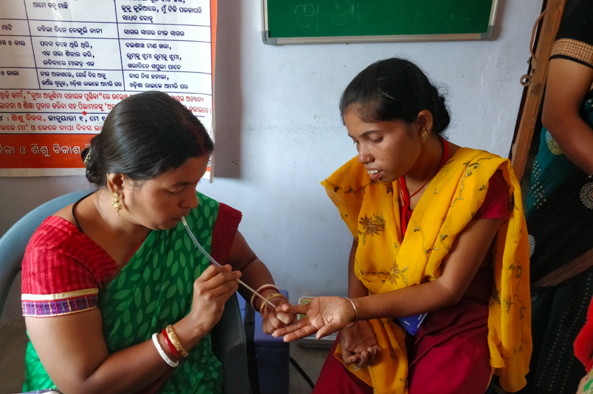
Thank-you!

Slide 19
State / UT with Facility wise EML
State / UT | State / UT
Andhra Pradesh | Madhya Pradesh
Arunachal Pradesh | Maharashtra
Assam | Meghalaya
Bihar | Mizoram
Chhattisgarh | Nagaland
D & N Haveli | Odisha
Daman & Diu | Puducherry
Delhi | Punjab
Goa | Rajasthan
Gujarat | Telangana
Haryana | Tripura
Himachal Pradesh | Uttar Pradesh
Jammu & Kashmir | Uttarakhand
Jharkhand | West Bengal
Karnataka | Tamil Nadu
Kerala

Slide 20
States on-boarded on central DVDMS dashboard
State
Andhra Pradesh
Bihar
Gujarat
Himachal Pradesh
Jammu & Kashmir
Jharkhand
Madhya Pradesh
Maharashtra
Manipur
Meghalaya
Punjab
Rajasthan
Telangana
Uttar Pradesh
Uttarakhand

Slide 21
State / UT : Grievance Redressal Mechanism
State / UT | State / UT
Andhra Pradesh | Kerala
Assam | Lakshadweep
Bihar | Madhya Pradesh
Chhattisgarh | Maharashtra
D & N Haveli | Punjab
Daman & Diu | Rajasthan
Delhi | Tamil Nadu
Himachal Pradesh | Telangana
Jharkhand | Uttarakhand
Karnataka

Slide 22
S.no | State | NSQ %
1 | Andhra Pradesh | 10.64
2 | Arunachal Pradesh | 13.46
3 | Gujarat | 10.3
4 | Jharkhand | 10.58
5 | Madhya Pradesh | 10.53
6 | Manipur | 10.14
7 | Meghalaya | 17.39
8 | Mizoram | 13.75
9 | Nagaland | 13.21
10 | Punjab | 11.39
11 | Sikkim | 33.33
12 | Telangana | 12.57
13 | Uttar Pradesh | 11.9
14 | Uttarakhand | 12.1

Slide 23
State / UTs with NABL Accredited labs
Andhra Pradesh | Madhya Pradesh
Arunachal Pradesh | Maharashtra
Assam | Mizoram
Bihar | Nagaland
Chhattisgarh | Odisha
D & N Haveli | Puducherry
Delhi | Punjab
Gujarat | Rajasthan
Haryana | Sikkim
Jammu & Kashmir | Tamil Nadu
Jharkhand | Telangana
Karnataka | Tripura
Kerala | Uttarakhand
Lakshadweep | West Bengal

Slide 24
DVDMS Implemented | Under progress
Rajasthan | Arunachal Pradesh
Maharashtra | Sikkim
Punjab | Assam
Manipur
Andhra Pradesh
Telangana
Gujarat
Madhya Pradesh
Jammu & Kashmir
Uttarakhand
Bihar
Uttar Pradesh
Jharkhand
Himachal Pradesh
Meghalaya

Slide 25
Prescription audit
States
Assam
Bihar
D & N Haveli
Delhi
Jammu & Kashmir
Lakshadweep
Mizoram
Odisha
Rajasthan
Telangana
Tripura (Under Process)
Uttarakhand
West Bengal
Tamil Nadu

Slide 26
States with their own IT enabled system
Haryana
Karnataka
Kerala
Tamil Nadu
Tripura
West Bengal
Chhattisgarh
Odisha
Goa
Dadra and Nagar Haveli

Slide 27
