Slide 1

Andhra Pradesh:Comprehensive Primary Health Care Roll Out For Telemedicine
Presented by
Smt. Dr. Poonam Malakondaiah, IAS
Special Chief Secretary
Health Medical & Family Welfare
Government of Andhra Pradesh
HM & FW Department, GoAP
Knowledge Command Center

Slide 2
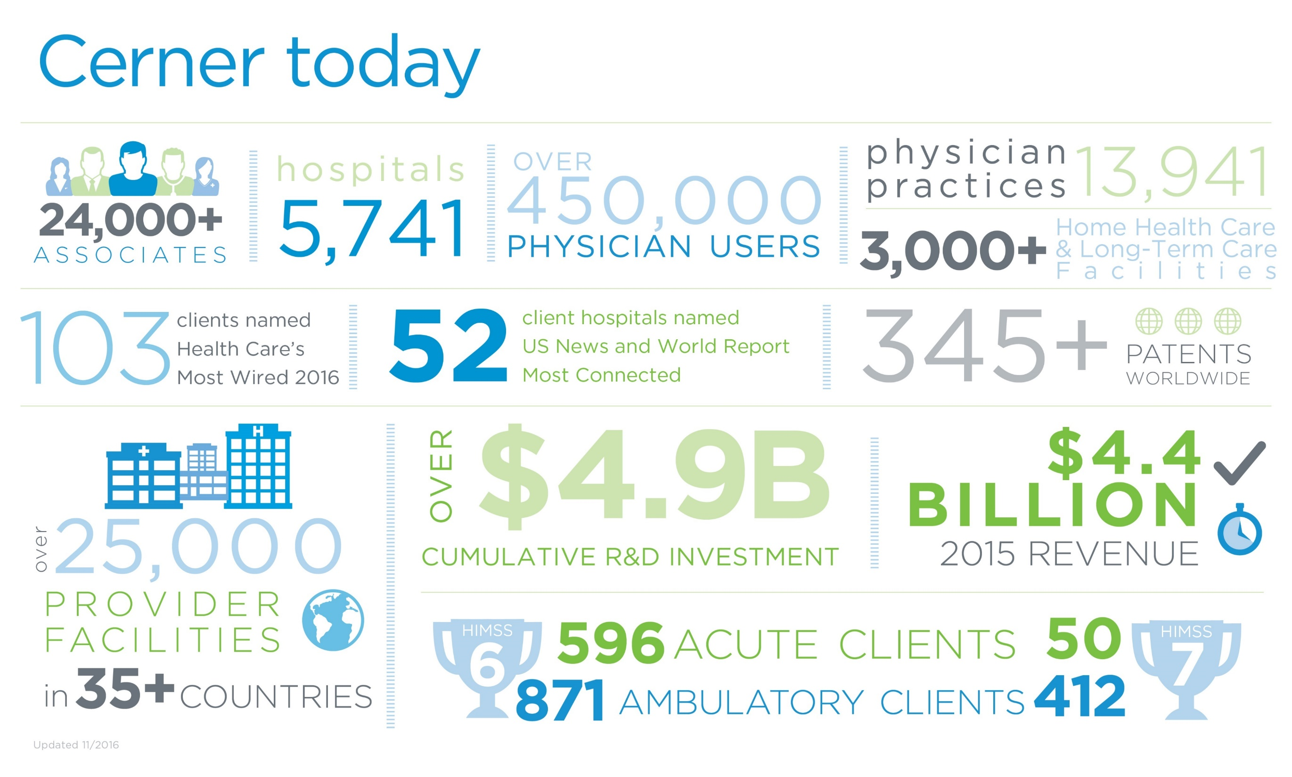

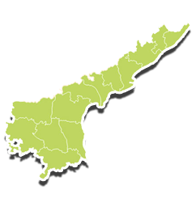



Profile of Andhra Pradesh
66.5 M
18
OUTPATIENT
Annual
Number of health programs
3.6 M
49M+
INPATIENT
Annual
P O P U L A T I O N
13
13
28
+
+
TEACHING HOSPITALS
DISTRICT HOSPITALS
AREA HOSPITALS
195
+
1157
+
7682
COMMUNITY HEALTH CENTERS
PRIMARY HEALTH CENTERS
SUB HEALTH CENTERS
242
E- UPHC
292
MOBILE MEDICAL UNITS
centers
From April 2017-Macrh 2018
Notes:
Pregnant woman – 9.8 lakh
DH 8, AH 34, 194 CHC
OP . IP

Slide 3
How Primary Care is Transforming Itself?
Key to innovation in primary care is a focus on the root causes of what makes people ill and not just treating the symptoms the patient presents with.
Holistic and not disease driven care
Each patient’s unique needs which requires that the caregivers establish a more meaningful and trusting relation with the patients.
Smart use of new care delivery venues:leveraging specialists for virtual consultations.

Slide 4
How to go the last mile?
Today virtually every other sector from books to Taxis –have been positively re invented by mobile technology.Now it is time to to reinvent community Healthcare and for this we need to build an army of digitally emowered ,community health workers .Equipped with a generation of health apps using artificial intelligence
Saving lives
Saving money
Creating jobs
Empowering women
Preventing pandemics-early detection
Strengthening health systems

Slide 5
Telehealth can get Healthcare to more people
Can reduce gaps in areas separated by distance,income and opportunity –transforming healthcare Access .
Remote patient monitoring is an emerging field that combines interconnected equipment and data analytics applications,allowinf for high quality care of patients outside typical clinical settings .

Slide 6
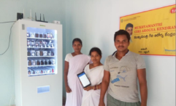
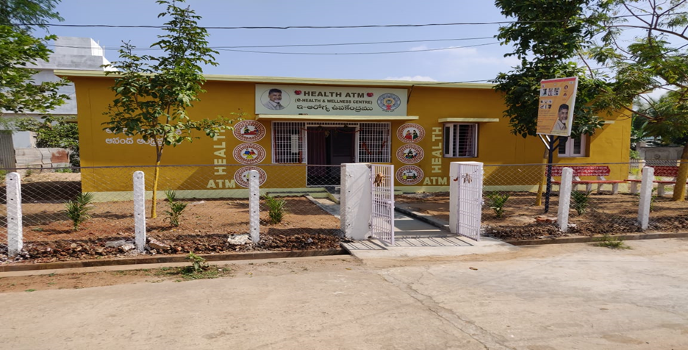
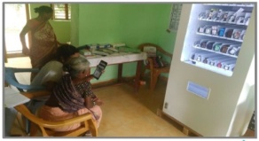
e-Heath and Wellness Sub-Center
Telemedicine (Audio & Video) – OPD consultations with Medical Officers (from Medical Hub) at Subcenters
Electronic recording of vital tests through bluetooth connected Multipara monitor machine, non-invasive Haemoglobinometer, Glucometer
Remote drug dispensing by doctors (from Medical Hub) through Automatic Drug Vending machine.
ANM training for electronic recording of patient data and teleconsultancy through IT solution
Screening services and management for NCD (Hypertension and Diabetes) of adult population
Screening facility for women above age 30 years for cervical cancer
Antenatal check-up services for pregnant women
The project of converting all 6190 Subcentres into eSubcenters is supported by the World Bank funding.
*SCs- Sub-centers | ANM-Auxiliary Nurse Midwife | NCD- Non-Communicable Disease
Notes:
Plan of launch – e Sub center

Slide 7

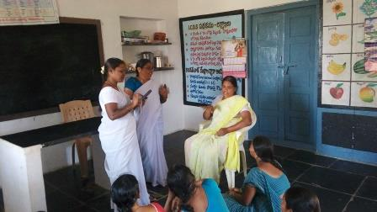
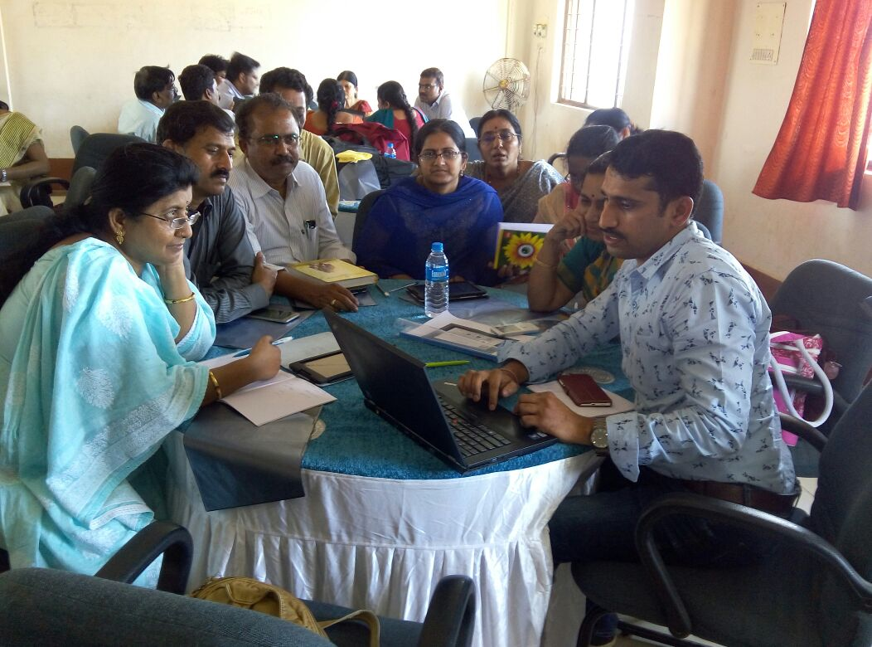
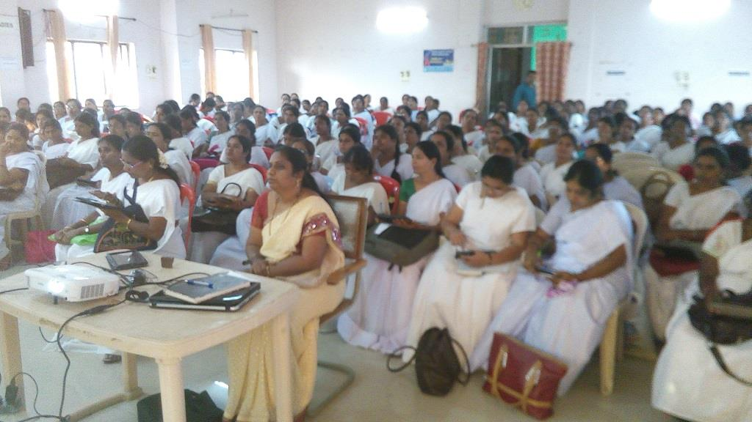
Referal Tie Up :EHR is the Key
Continuity of Care
Patient referred up
Patient referred up
1075 PHCs, 277 MMUs
7617 Subcenters
57 Secondary Hospitals
11 Tertiary Hospitals
Initial screening by ANM & MOs
10 women / week
Screening & Treatment
by Specialist Doctors
Screening & Treatment
by Specialist Doctors
citizen goes home with booklet
Follow up
Follow up
Adapt program to address ground issues
Strict program management and quality control with monthly reviews
Deployment of support team. Extensive, direct user training and re-training
7

Slide 8
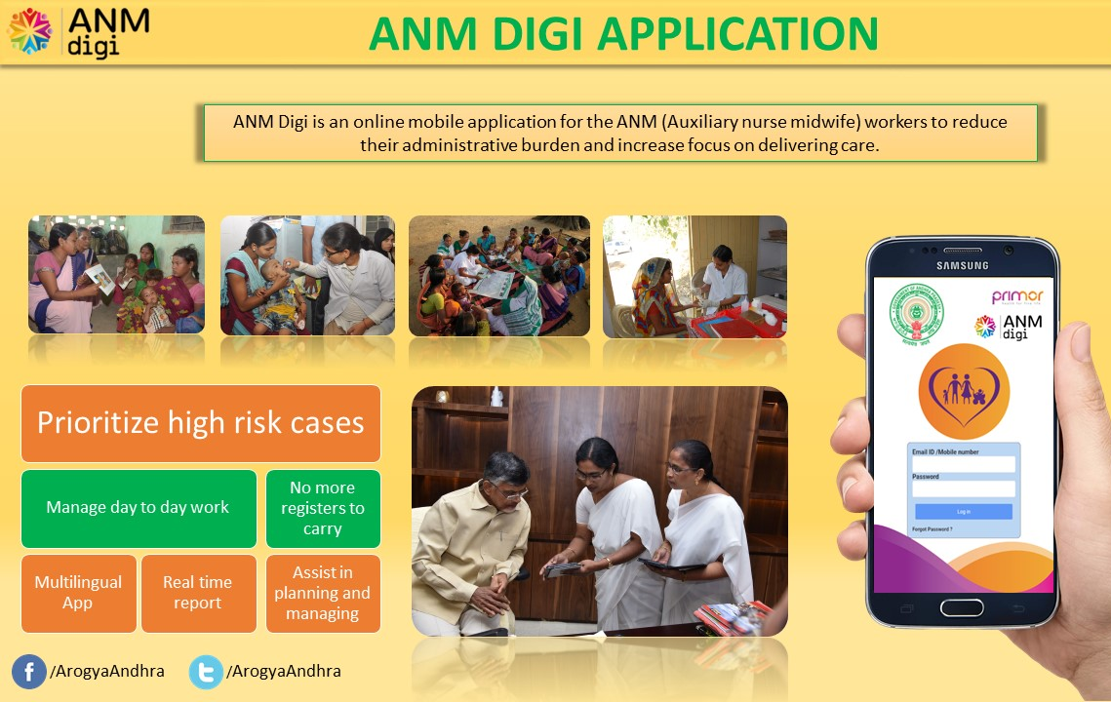
ANM Digi
A cloud based mobile/web application for ANMs
ANMs upload the electronic details through the application
A digital register for 41 manual registers (saves 40% of working time in a day)
ANM Digi covers CDs, NCDs, minor ailments, mother and child care and all other Govt. programs
Tablet PC with pre-installed ANM Digi application are provided to all the ANMs
Authentication through finger print scanner and internet connectivity
ANM Digi is integrated with Smart Pulse Survey (Praja Sadhikarika Survey), an initiative by Govt. of AP
ANM Digi is also integrated with RCH portal
The data in ANM Digi is communicated with Woman and Child Welfare Department , ICDS and Civil Suppies Department
Notes:
registers

Slide 9
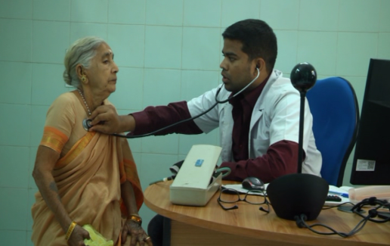


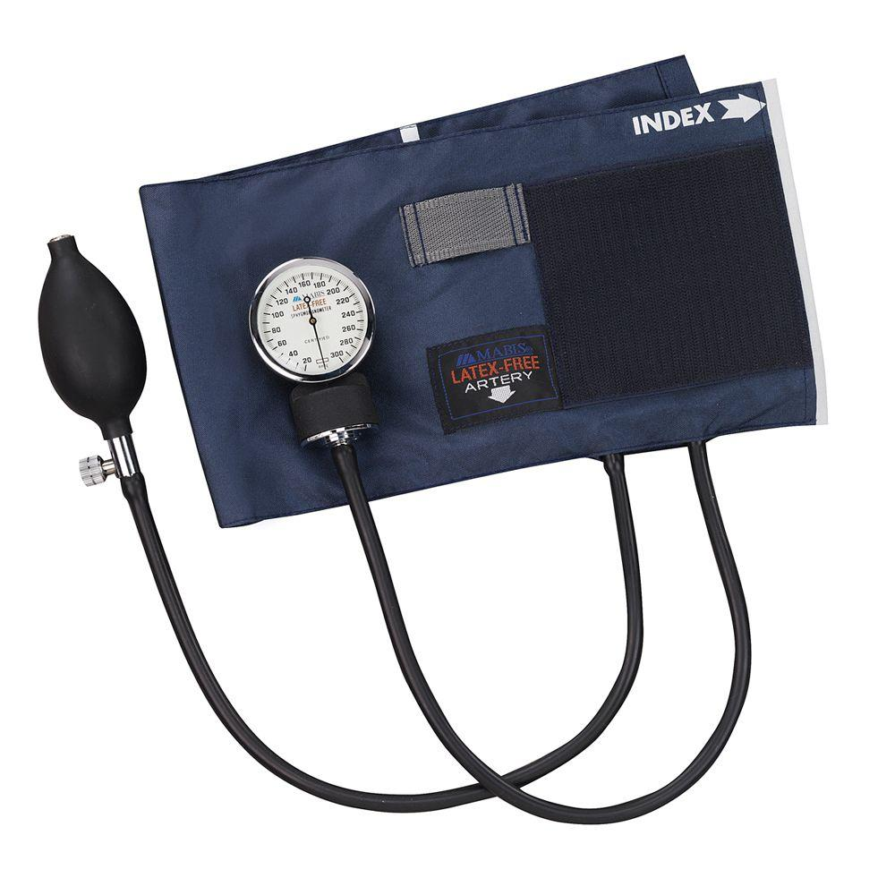




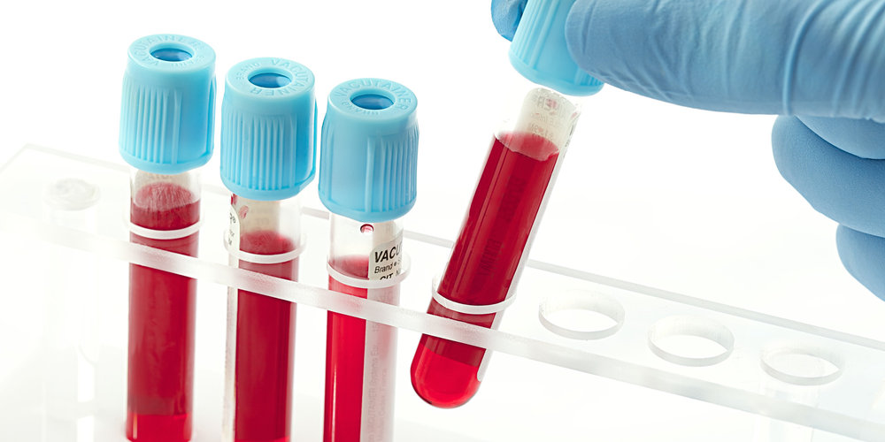
eUPHC – The Urban Super-Specialty Clinic
State-of-the-art health care services free of cost to Urban poor and Slum dwellers to reduce out of pocket expenditure
Assured full time medical officer, 30 diagnostic tests, medicines and specialist services through tele-consultancy(video).
365 days, 2 shifts
Based on complexity
Teleconsultation with specialist
Patient
Patient Registration
Patient Vitals
Drug Dispense
Prescription
Doctor Consultation
Diagnostic Tests
Follow up/exit

Slide 10
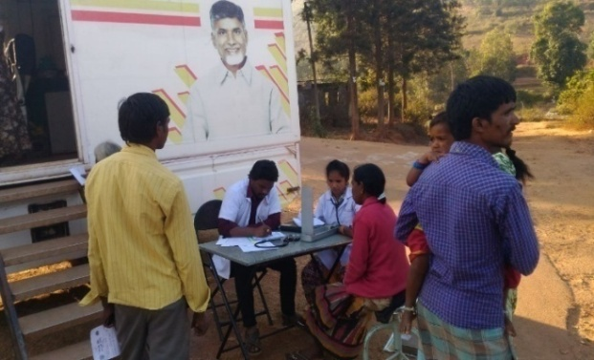
Continuum Of Care
Mobile Medical Unit
“Primary Medical Care on wheels” (289 MMUs) to reach out to the rural population that have no health facilities on fixed days every month. Diabetes, hypertension, epilepsy, and other common ailments are investigated and treated
So far, more than 10.9 million patients have benefitted from this service

Slide 11
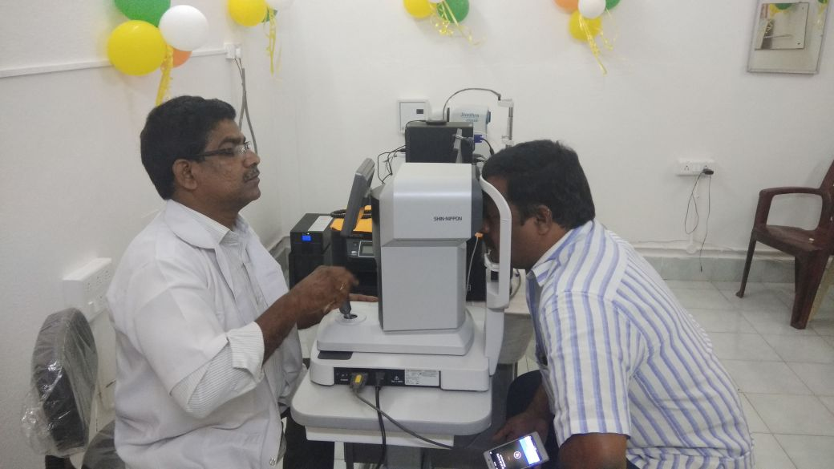
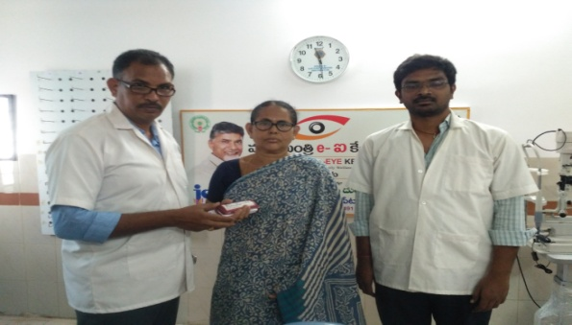
Teleophthalmology
High quality eye care through 115 e-Eye centers across the state.
The e-Eye centers are providing eye care services, mainly in the areas with needy rural population where ophthalmic care services are hardly available.
The service is delivered in a hub and spoke model and services typically delivered through these centers include checking of Fundus, retinopathy, glaucoma, refraction.
The beneficiary visits the nearest e- Eye clinic to get their eyes checked. A report is generated at the hub and treatment is initiated based on the report.
Correction glasses/ spectacles are then provided free of cost based on the report recommendations.
Screening of Anterior segment and Posterior segment disorders are provided. If any disorder is found then such case is being referred to the secondary or tertiary level Eye Hospitals as per the referral protocol network hospitals.
So far, 8,51,840 total registrations , 7,98,350 Refraction checks done, 2,00,827 Fundus check done and 6,51,999 free spectacles delivered at the centers.
Notes:
registers

Slide 12
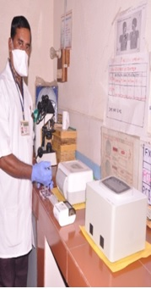
TB Detection
TRUENAT-RTPCR
225 centers with state of the art TB diagnostics testing machines TrueNat (RTPCR) for providing accurate TB detection
Battery powered portable for sample preparation and real time quantitative micro PCR system for fastest detection
80,524 tests done since inception

Slide 13
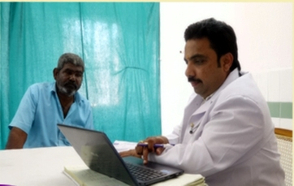
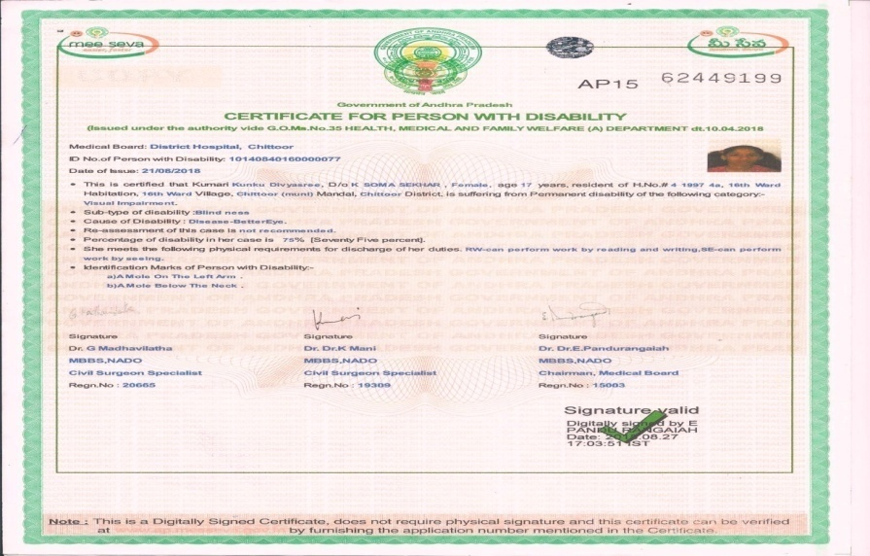
SADAREM+
The new digital initiative for assessment of disability for PWD people at Government hospitals was launched by the Government of Andhra Pradesh on 3rd August 2018.
A pool of 55 hospitals and 590 specialists from the specialities of Orthopaedics, Ophthalmology, E.N.T. and Psychiatry are involved.
The PWD can book advance slot at a MeeSeva centre of his choice and he will be given date and time of assessment.
On every Friday 2000+ slots are being issued through 1200+ MeeSeva centres. The head of the hospital on each Friday identifies the team of doctors speciality wise for assessing the cases scheduled for the day.
After assessment by three doctors and approval from the Chaiman, the digital disability certificate will be generated and transferred to MeeSeva Server.
An SMS will be communicated to the beneficiary that the certificate has been generated and it can be obtained from any MeeSeva centre.
35000+ persons were screened and issued certificates since the inception of the services so far.
Notes:
registers

Slide 14
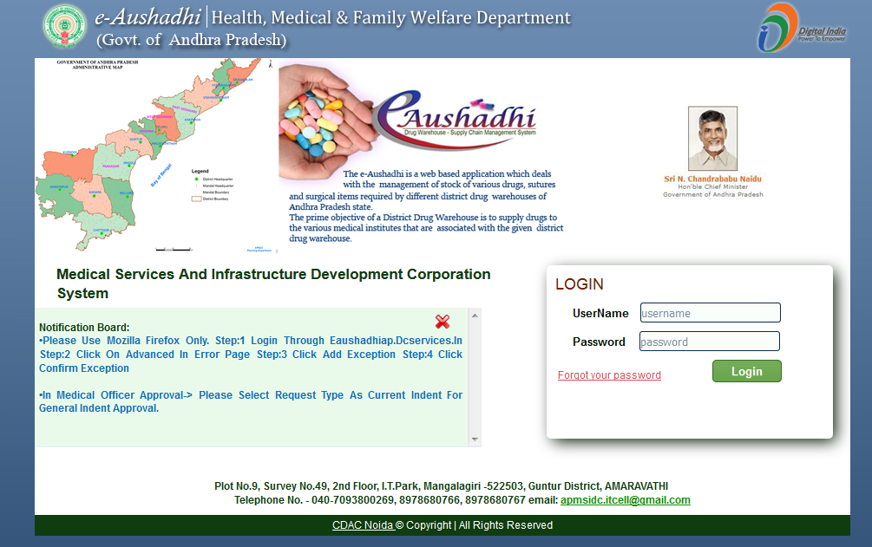
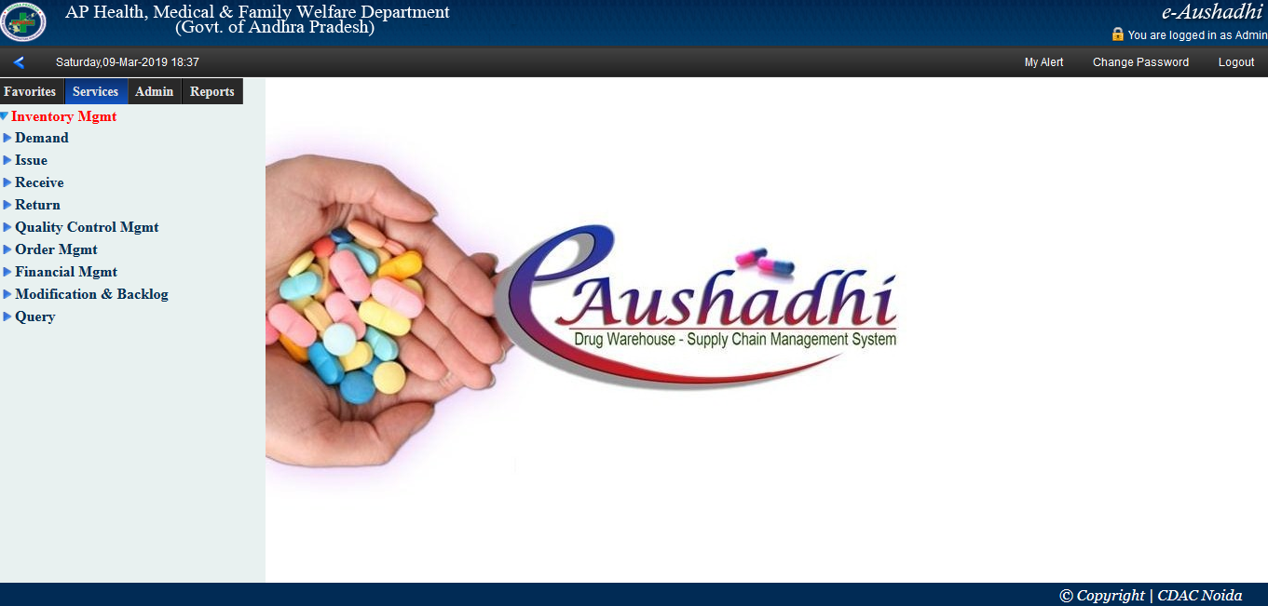
eAushadhi
A comprehensive online supply chain management software for procurement and distribution of medicines and surgical items was launched by the Government of Andhra Pradesh on 09th June 2015.
The entire process of raising demand, placing purchase orders, supply, receipt and disbursement is done on-line in a most transparent manner.
The software is implemented in 2006 institutions of the health department including Mobile Medical Units and electronic Urban Primary Health Centres.
Demands are raised and updated by the individual hospitals periodically for specific period i.e. quarterly, half yearly etc.
Purchase order wise material receipt certificate is generated immediately upon entry by the district stores and displayed in supplier logins with automatic bill processing.
Real time monitoring of stock positions at all stores i.e. from district stores to individual hospitals.
Total procurement of medicines, surgicals, CTS and AYUSH medicines worth Rs.1,06,991.36 Lakhs since inception
Notes:
registers

Slide 15
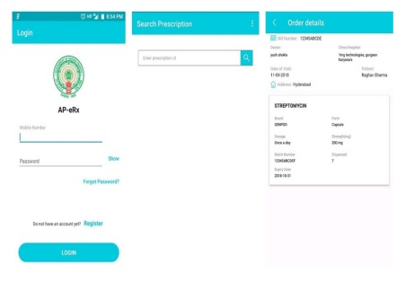
APeRX
An application for dispensing of drugs through both public and private empanelled pharmacies.
Free drugs for TB, hypertension and diabetes.
Doctors register in the application using their AP Medical Council Registration number before Prescribing the drugs from APeRx app.
A prescription ID is generated which will be shared to the patients through message. This prescription ID must be used by Pharmacists for Dispensation of Drugs
The Pharmacists register in the application using their Registration number before Dispensing the drugs from APeRx app.
13,000+ listed pharmacies with more than 6000 prescriptions generated since inception.
Notes:
registers

Slide 16




Use of Data Analytics: Knowledge Command Center
Government of Andhra Pradesh is leveraging the power of data and analytics through Knowledge Command Center to improve healthcare delivery through focused and timely action
Knowledge Command Center: An Introduction
Knowledge command center (KCC) is the analytics wing for the Health, Medical and Family Welfare department, Government of Andhra Pradesh
Data from public health facilities and PPP programs are captured using IT system and the same is used
  To identify communicable disease incidence and non communicable disease prevalence
  To calculate the effectiveness, efficiency and quality of government health programs
  To monitor progress of districts and state on various health indicators and identifying areas that need additional focus
The data analysis then serves as an input to the government to make appropriate policy or administrative interventions
Knowledge Command Center
Government
Public Health Facilities

Slide 17

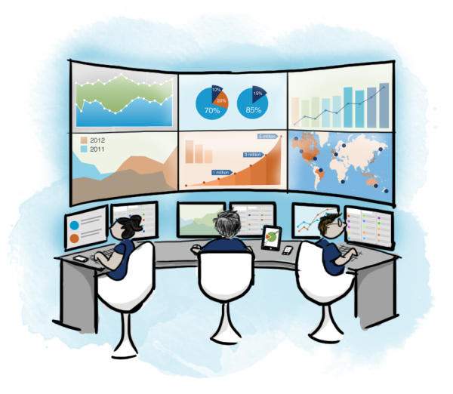
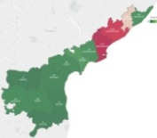









KCC: Program Flow
Health Department, GoAP
Processed data from KCC is used by the government to make necessary interventions. For example,
Knowledge Command Center
Communicable Disease Hotspots (Predicted & Actual): Govt. uses this data to ensure adequate supply of necessary drugs in the health facilities
Data of beneficiaries availing services from public health facilities
Non Communicable Disease Heatmaps:
Govt. uses this data to identify areas that need additional focus.
Program Efficiency Maps:
Govt. uses this data to identify areas that need additional focus from the service providers and government for better implementation of PPP health programs
Report Card on State Health Indicators:
Govt. uses this report card to monitor the overall progress of the state and districts on identified indicators and to identify gaps
Hospital Development Society (Rogi Kalayaan Samiti): Govt uses this analysis for close monitoring of the hospital conducting monthly HDS meetings
Data of beneficiaries availing services from health programs
Data is processed to provide meaningful inputs for the government to act on
Village/District and State Health Bulletin: Govt releases a monthly bulletin covering health initiatives, seasonal diseases in the respective geography

Slide 18
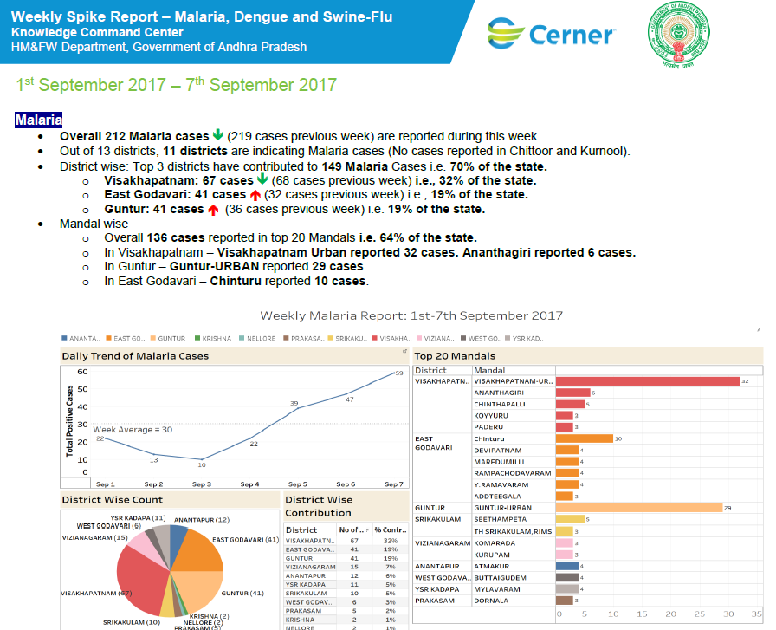

Disease Management – Communicable Diseases
Communicable Disease Spike Reports
Daily & weekly reports showing incidence of vector borne diseases – Malaria & Dengue
SOS reports showing weekly trends in the incidence of communicable diseases
Predictive report showing the possible incidence of communicable diseases based on historical incidence data
These reports are shared through Kaizala so as to ensure that the concerned authorities are better equipped to handle the situation
Analytic reports showing hotspots for water borne diseases (ADD and Typhoid) are computed at Mandal level
Predictive Model
A predictive model for the incidence of malaria and dengue was developed using historic incidence data
Analytics models including – Holt Winters, Neural Networks and ARIMA was used for building the predictive model
The predicted trendlines matched the actual incidence of cases

Slide 19
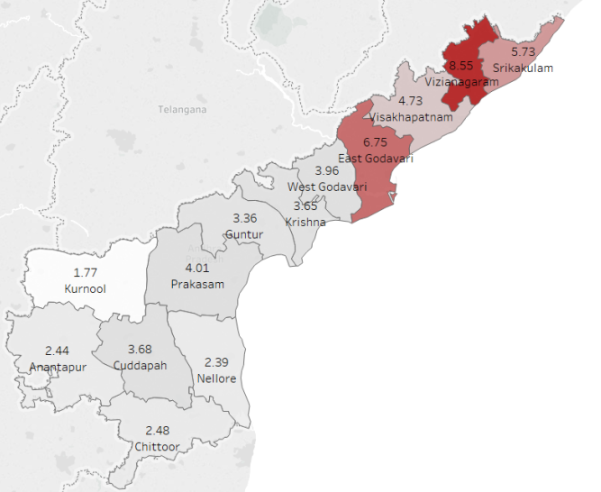
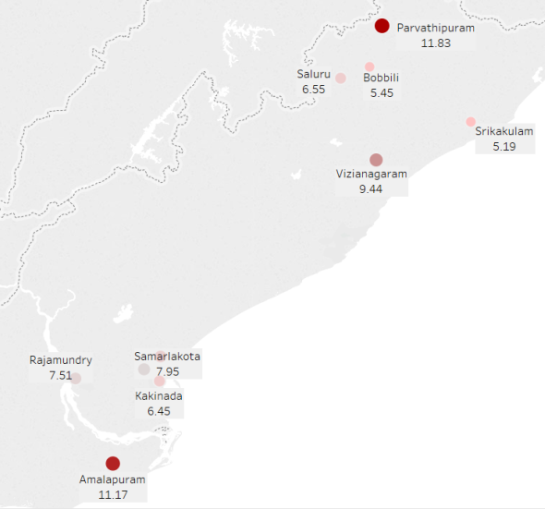
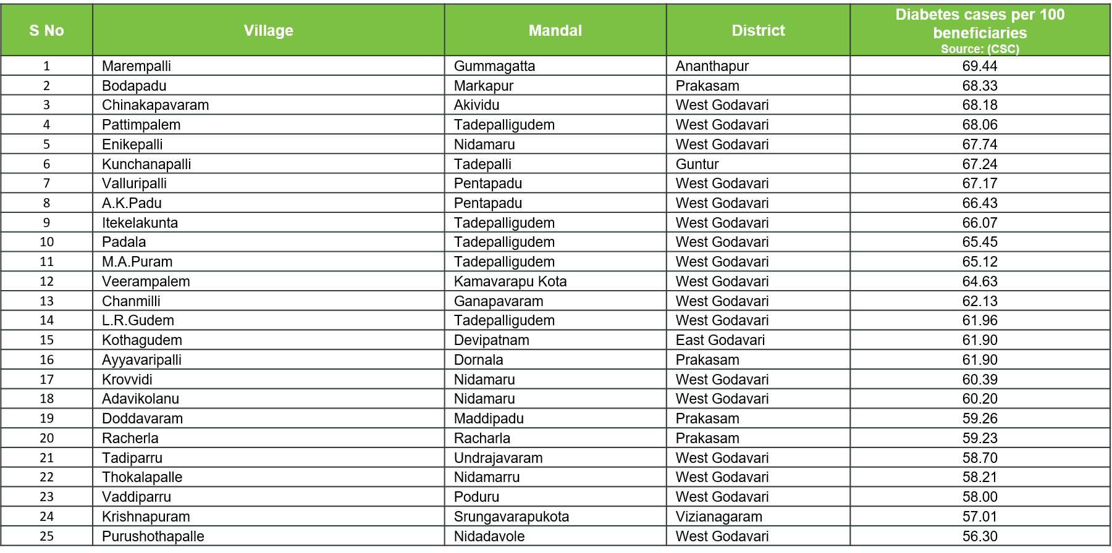
Disease Management – Non Communicable Diseases
Diseases in focus: Diabetes, Hypertension, Cardiovascular Disease, Arthritis, Asthma and Cancer
Prevalence of the above mentioned disease is calculated based on confirmed diagnosis recorded in various government health programs such as Chandranna Sanchara Chikitsa, Mukhyamantri Arogya Kendralu, NTR Vaidya Seva, NTR Vaidya Pariksha, MMHC
Districts, mandals and villages with highest prevalence of the mentioned diseases are identified for policy and administrative interventions
High risk districts, mandals and villages are also identified based on marker tests which helps the government take precautionary measures
Reported at district, Mandal, village/ municipality levels
District level maps
Mandal level maps
High Risk Villages/Wards
Incidence are across the districts is computed
Top 25 mandals across the state with highest prevalence are considered for Mandal level intervention
Top 50 villages with highest risk of disease prevalence across the state are considered for Village level intervention
Notes:
Slide 5
5a – diabetes
5b – htn

Slide 20
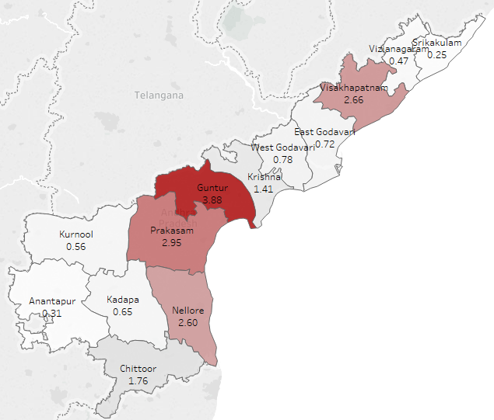
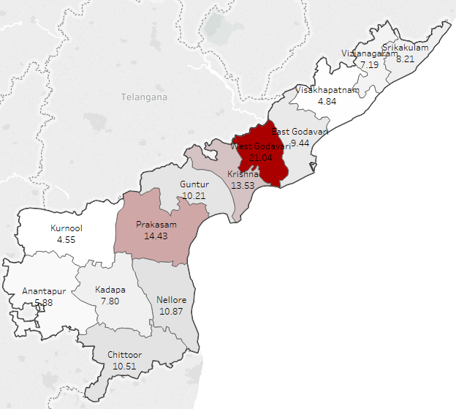
Disease Management – Non Communicable Diseases (Diabetes: State Profile)
Diabetes Profile Episodic (District Wise)*
Source: NTR VP
Diabetes Profile Longitudinal (District Wise)*
Source: CSC, eUPHC, MMHC
Guntur has the highest number of episodic cases followed by Prakasam and Visakhapatnam
West Godavari has registered the highest number of longitudinal diabetic cases with more than 21 cases per 100 beneficiaries, followed by Prakasam and Krishna
The above maps are for representation purpose only
*Number of cases per 100 beneficiaries who utilized respective programs is taken

Slide 21
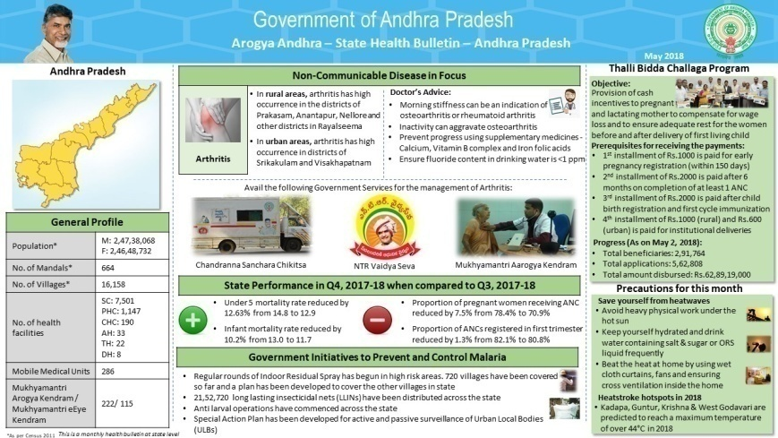
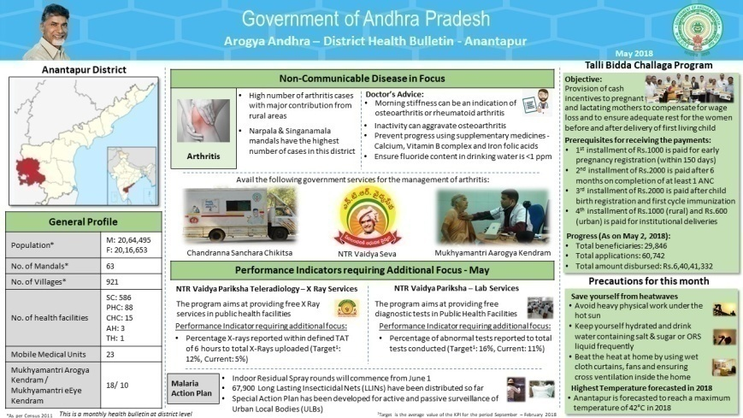
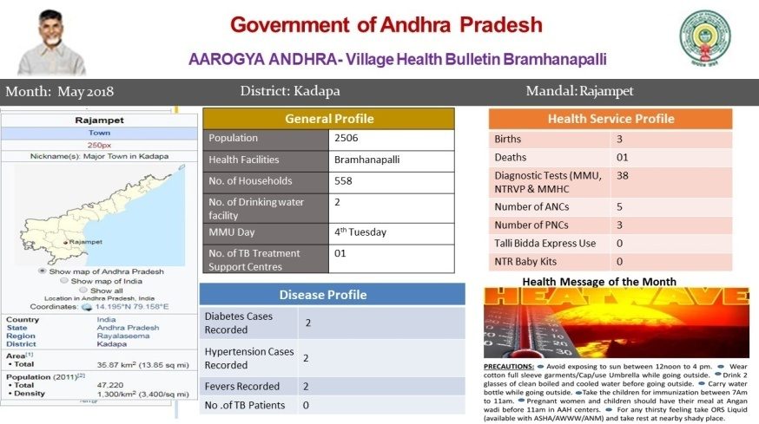
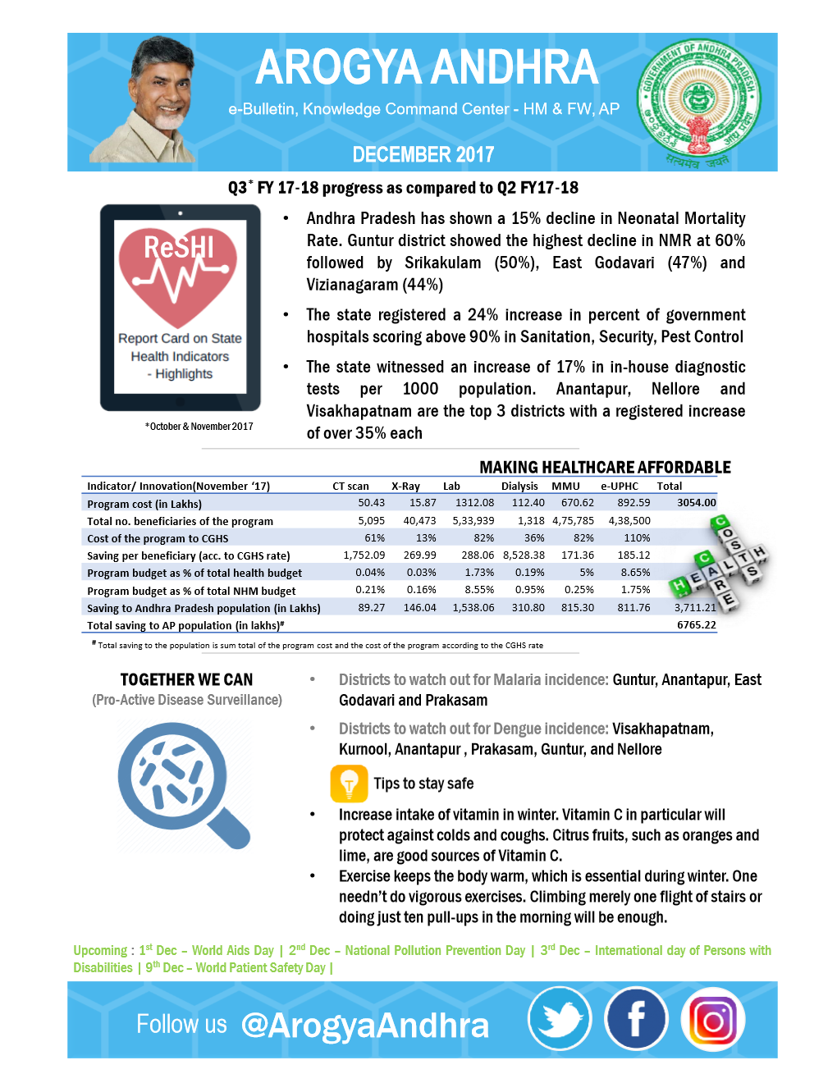
Driving Public Health Awareness
The health initiatives by the Department are published using social media through @ArogaAndhra
The Department releases a monthly health bulletin till village level on 7th of every month.
State Health Bulletin
District Health Bulletin
Village Health Bulletin
Major sections of State Health Bulletin
Preventive and healthcare management measures of leading non-communicable disease in the state
Top 2 and Bottom 2 performing health care indicators in the state are identified
Details on various government initiatives / schemes launched to improve the health of the state are made available to public
Health tips on prevention of seasonal diseases
Major sections of District Health Bulletin
District Collectors release the bulletin to inform people about various government initiatives / schemes launched in the state
Health programs that need additional focus are monitored by the concerned authorities( DM&HOs) at district level
Information on health tips on prevention of seasonal diseases are disseminated to public
Major sections of Village Health Bulletin
The information on health facilities / centers and services available in the village is communicated to village people by Mobile Medical Units on VHND days
Disease profile of the village (Name of diseases and number of cases for each disease) is highlighted
Preventive measures (health tips) of seasonal disease are conveyed

Slide 22
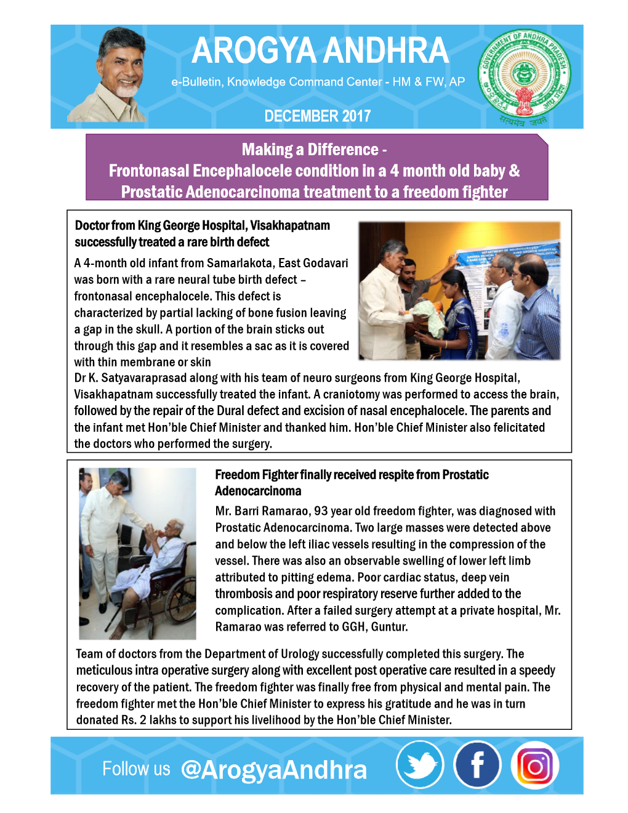
Monthly e-Bulletins
In addition to the health bulletins, the department also releases monthly e-Bulletins.
e-Bulletins are used to create awareness of government healthcare programs and to provide health tips to the population
An e-Bulletin is released and published in social media every month
Topics covered in eBulletin includes:
  General Health Indicators progress for the month
  Disease prevalence scenario in a non-panic language for the public
  Economic benefits of the program on society
  Major health days of the coming month
  Few touching case studies of good work of the department.
Notes:
14
15,16 Benefits, Challenges

Slide 23
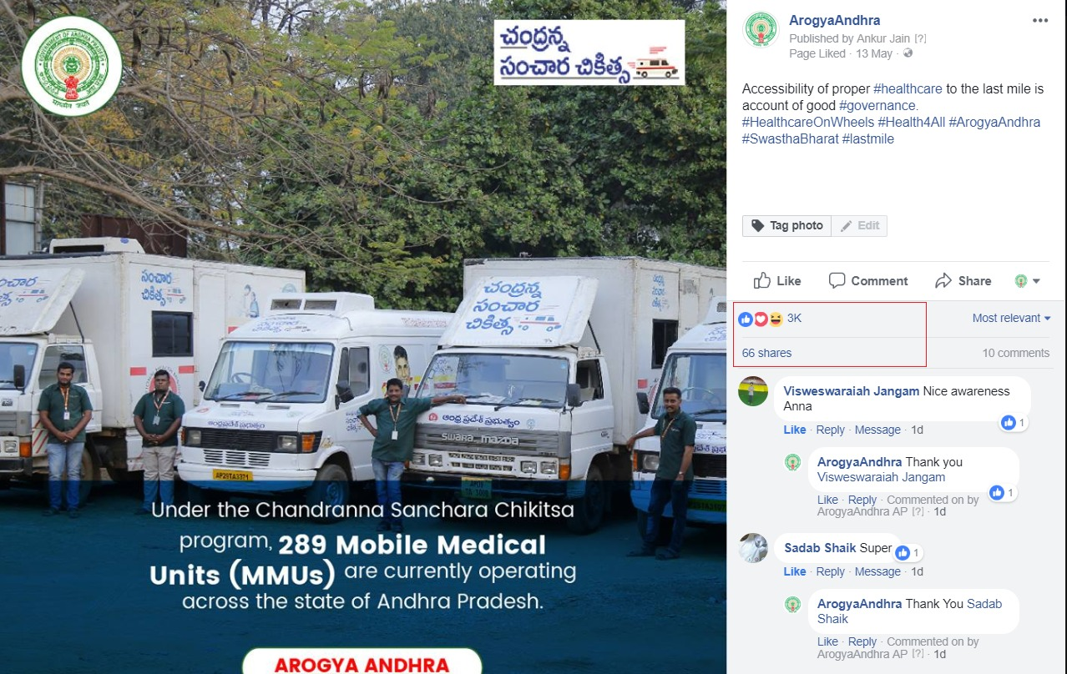
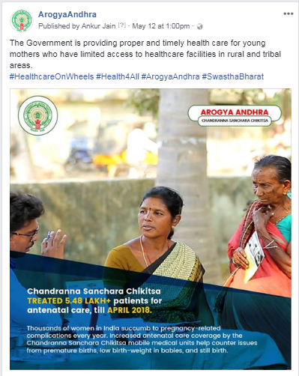
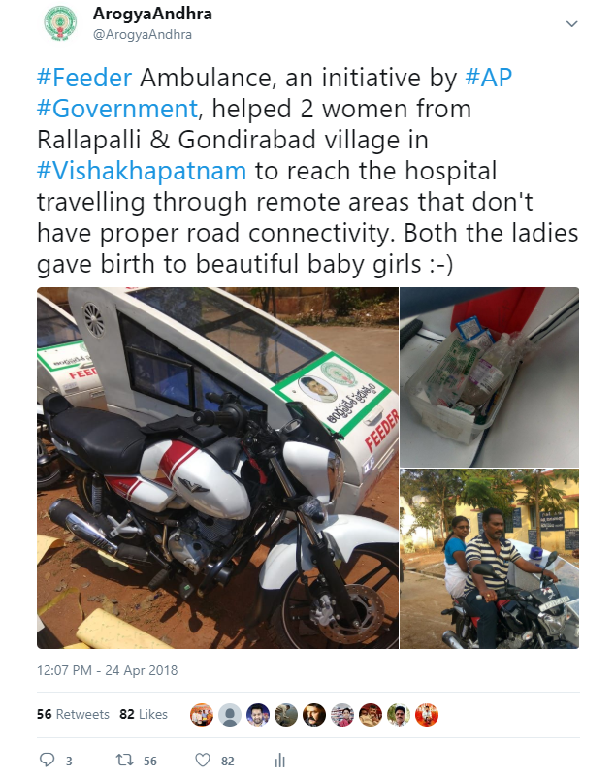


Public Outreach: Social Media
Twitter & Facebook handles of the health department called Arogya Andhra is managed by Knowledge Command Center (KCC).
Social Media is used to create awareness of government healthcare programs and to provide health tips to the population.
Leverage social media as interaction medium between the citizens and the Government for a faster resolution for grievances
e-Bulletin are released and published in social media every month. Topics covered in e-Bulletin includes:
  General Health Indicators progress for the month
  Disease prevalence scenario in a non-panic language for the public
  Economic benefits of the program on society
  Major health days of the coming month
  Few touching case studies of good work of the department.
Trending Posts
/ArogyaAndhra
/ArogyaAndhra

Slide 24
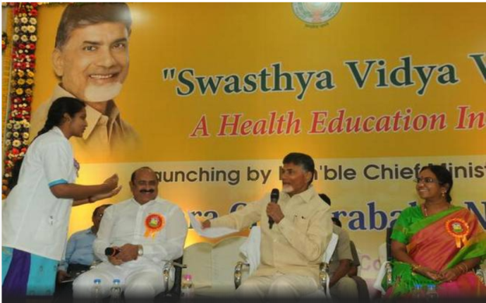
Swaasthya Vidya Vaahini
Swasthya Vidya Vahini
One of the world’s largest public health education initiative that has been rolled out
12,000 students of medicine, nursing, psychology and home science camping at villages on a daily basis to prepare the disease profile of villages

Slide 25
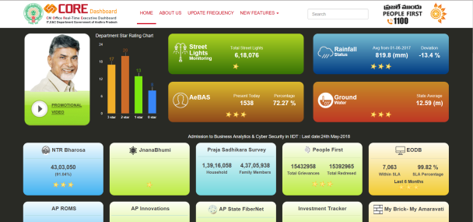
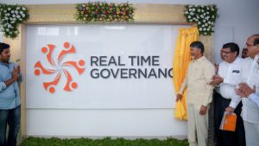
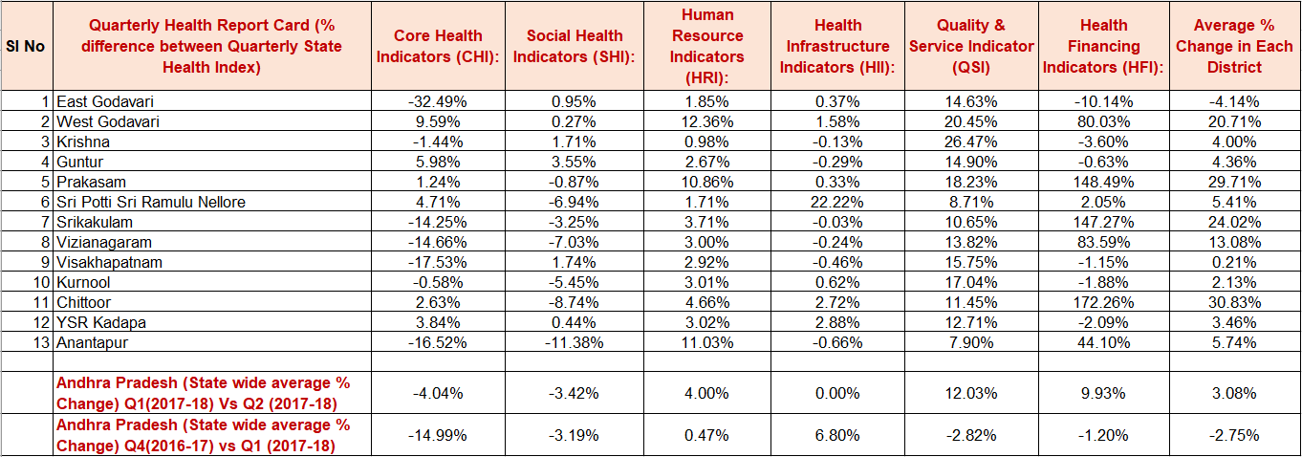
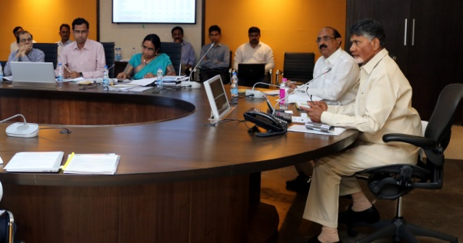
Monitoring Mechanisms
HM&FW has ways to monitor the implementation of each of the programs discussed above:
Process
Output
Core Dashboard
(Programs monitoring)
Real Time Governance System
(Citizen Satisfaction Survey)
GRACE
(Quality and Accountability)
ReSHI
A comprehensive real time monitoring of each of the health programs monitored by the Chief Minister’s office
A detailed monitoring of each of the program is available at macro and micro level
The GoAP has established a Real Time Governance system
Beneficiary details of each of these programs are collected on a real time basis
A feedback on the services received by the beneficiaries is continuously taken and acted upon as and when necessary
GRACE stands for (Governance Roadmap for Accountability, Convergence & Excellence)
Every program has
  Service provider to implement the program
  A nodal officer from government to monitor the program
  Knowledge partner, for an external audit, constant hand holding support & knowledge transfer
A district wise and state wide QoQ comparison on 100 identified health indicators across 6 baskets – Core Health, Social Health, Health Infrastructure, Human Resource, Quality Service and Health Financing Indicators
Top 2 and bottom 2 KPIs for each district is identified and shared with the concerned district collector for him/ her to take action
To view more details follow this link: https://core.ap.gov.in/CMDashBoard/Index.aspx

Slide 26
Program Efficiency Mapping
Objective
To measure the effectiveness of healthcare delivery through PPP programs of the health department every month
Methodology
Programs Covered
A set of 201 KPIs were identified across 21 programs post discussion with nodal officers
KPIs were designed based on 4 parameters: Coverage, Efficiency, Quality of Service and Cross Program Correlations
KPIs are calculated district wise and the districts are classified into 3 groups
Program & Cross Program Aggregate scores are calculated and used for ranking of districts
The following programs are evaluated through program efficiency:
108 Services
Bio Medical Equipment Maintenance Service
Mobile Medical Units
CHC Sanitation
eUPHC
Free Dialysis Program
HSMS
Master health check up
NTR Vaidya Seva
SNCU mini
Baby Kit
Approach
Coverage
Efficiency
Quality
Cross program correlations
Free Laboratory Services
Free Teleradiology (CT Scan) Program
Free Teleradiology (X Ray) Program
RCH
Talli Bidda Express
Linen and Laundry Services
Mahaprasthanam
Tele Ophthalmology Program
RBSK
Feeder Ambulance
Notes:
Slide 6a – Ashwin
6b - current
6c –
6d –

Slide 27



Progress using Data Analytics
Better preparedness
Government is now able to take necessary precautions based on the data available which has in turn helped in better management of diseases especially malaria, dengue, swine-flu and other non communicable diseases
Driving efficiency
Monthly monitoring of PPP through KCC has helped the government to measure the performance of programs on efficiency, effectiveness and quality which in turn helps the service providers and administrators to make interventions.
Evaluating the service providers through service standard indicators has laid a strong focus in improving the standard of healthcare delivery in the state
Continuous Improvement
A set of 100 key indicators are monitored on a quarterly basis and areas that need additional focus are identified at the state and district levels with the help of data
The above analysis has helped to identify the key focus areas to take necessary administrative steps to improve the performance of the lagging indicators

Slide 28
Arogya Andhra
Quality Efficiency Accountability
Thank You

