Slide 1



BASTI DAWAKHANA
AN URBAN HEALTH INITIAVE OF TELANGANA
Dr.Yogita Rana
Mission Director, NHM, Telangana

Slide 2
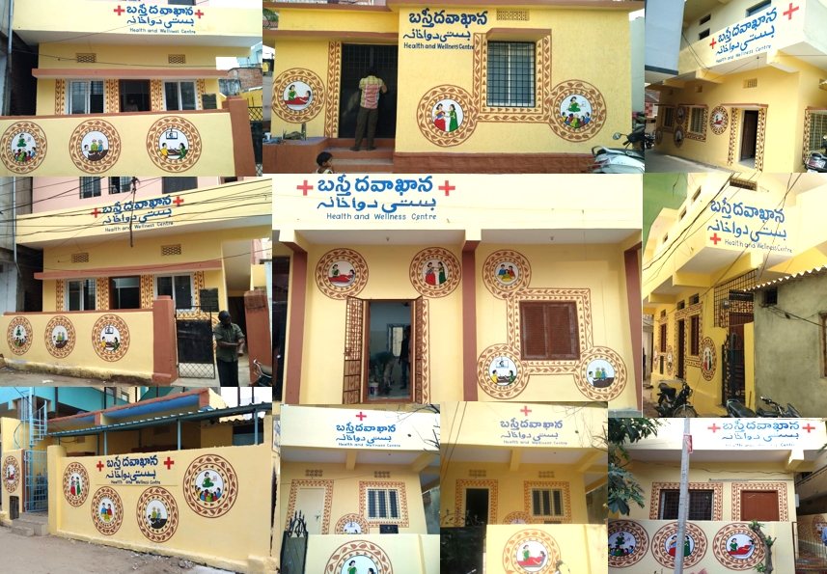

Slide 3
BACK GROUND
Hyderabad – 5th largest metro in the country with a population of about 10 million
2/3/4/5 - Annual population growth rate/Improved life expectancy/Increased burden of NCDs
Significant percentage of urban population is daily wagers ; migrant workers etc.,
Existing UPHCs (149 nos) are too few to cater to a population of 10 million.
UPHCs are located far from most of the slums and habitations of poor.
Poor visit private service providers and incur significant out of pocket expenditure.

Slide 4
Concept
  One Basti Dawakhana per 5000-10000 population; Located in slums
  Health care facility closer to the people who need it the most
  ONE STOP SERVICE
  3 Ds-Doctor, Diagnostics and Drugs
  Traveling / Waiting time reduced drastically
  Reduced out of pocket expenditure
  Reduced burden on secondary /tertiary facilities
  Platform to converge other National Health programmes in urban areas

Slide 5
Convergence
Municipal corporation (GHMC)
Rent free buildings
Electricity and water connection
Daily house keeping – cleaning ,waste disposal
Repairs etc
Urban SHGs / MAS
Awareness and mobilisation – platform
Health Department
Positioning of medical and para medical staff
Consumables ,medicines, diagnostics etc
Day to day running of the facilities

Slide 6
Roll Out
  Daily OPD services -
  Diagnostics in hub & spoke model
  Outreach services – ANC, Immunization, STI/RTI, Family planning, Adolescent clinics, NCD screening, Palliative care, elderly care etc.
  Wellness programme…yoga, counselling on lifestyle ,nutrition
Number of BDK Sanctioned | Number of BDK functional | Number of BDK to be inaugurated this month
247 | 104 | 46

Slide 7
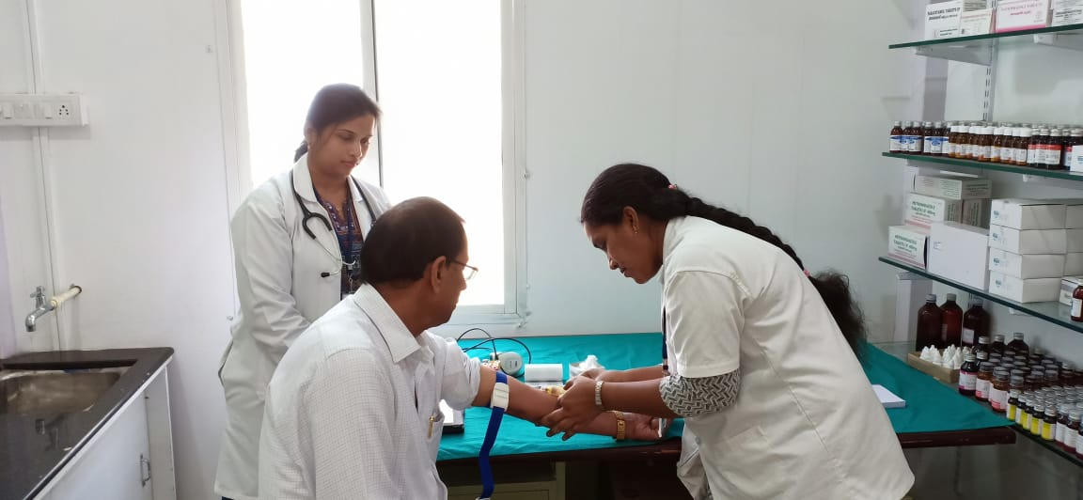
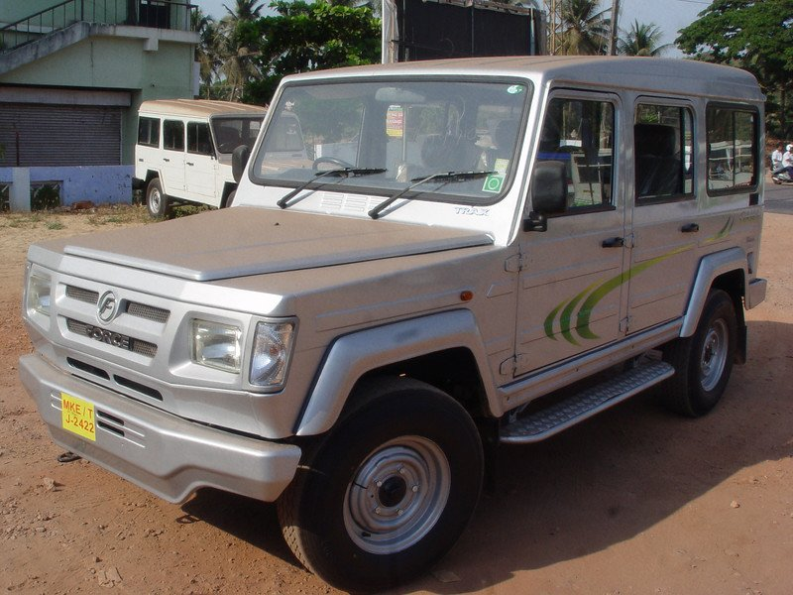
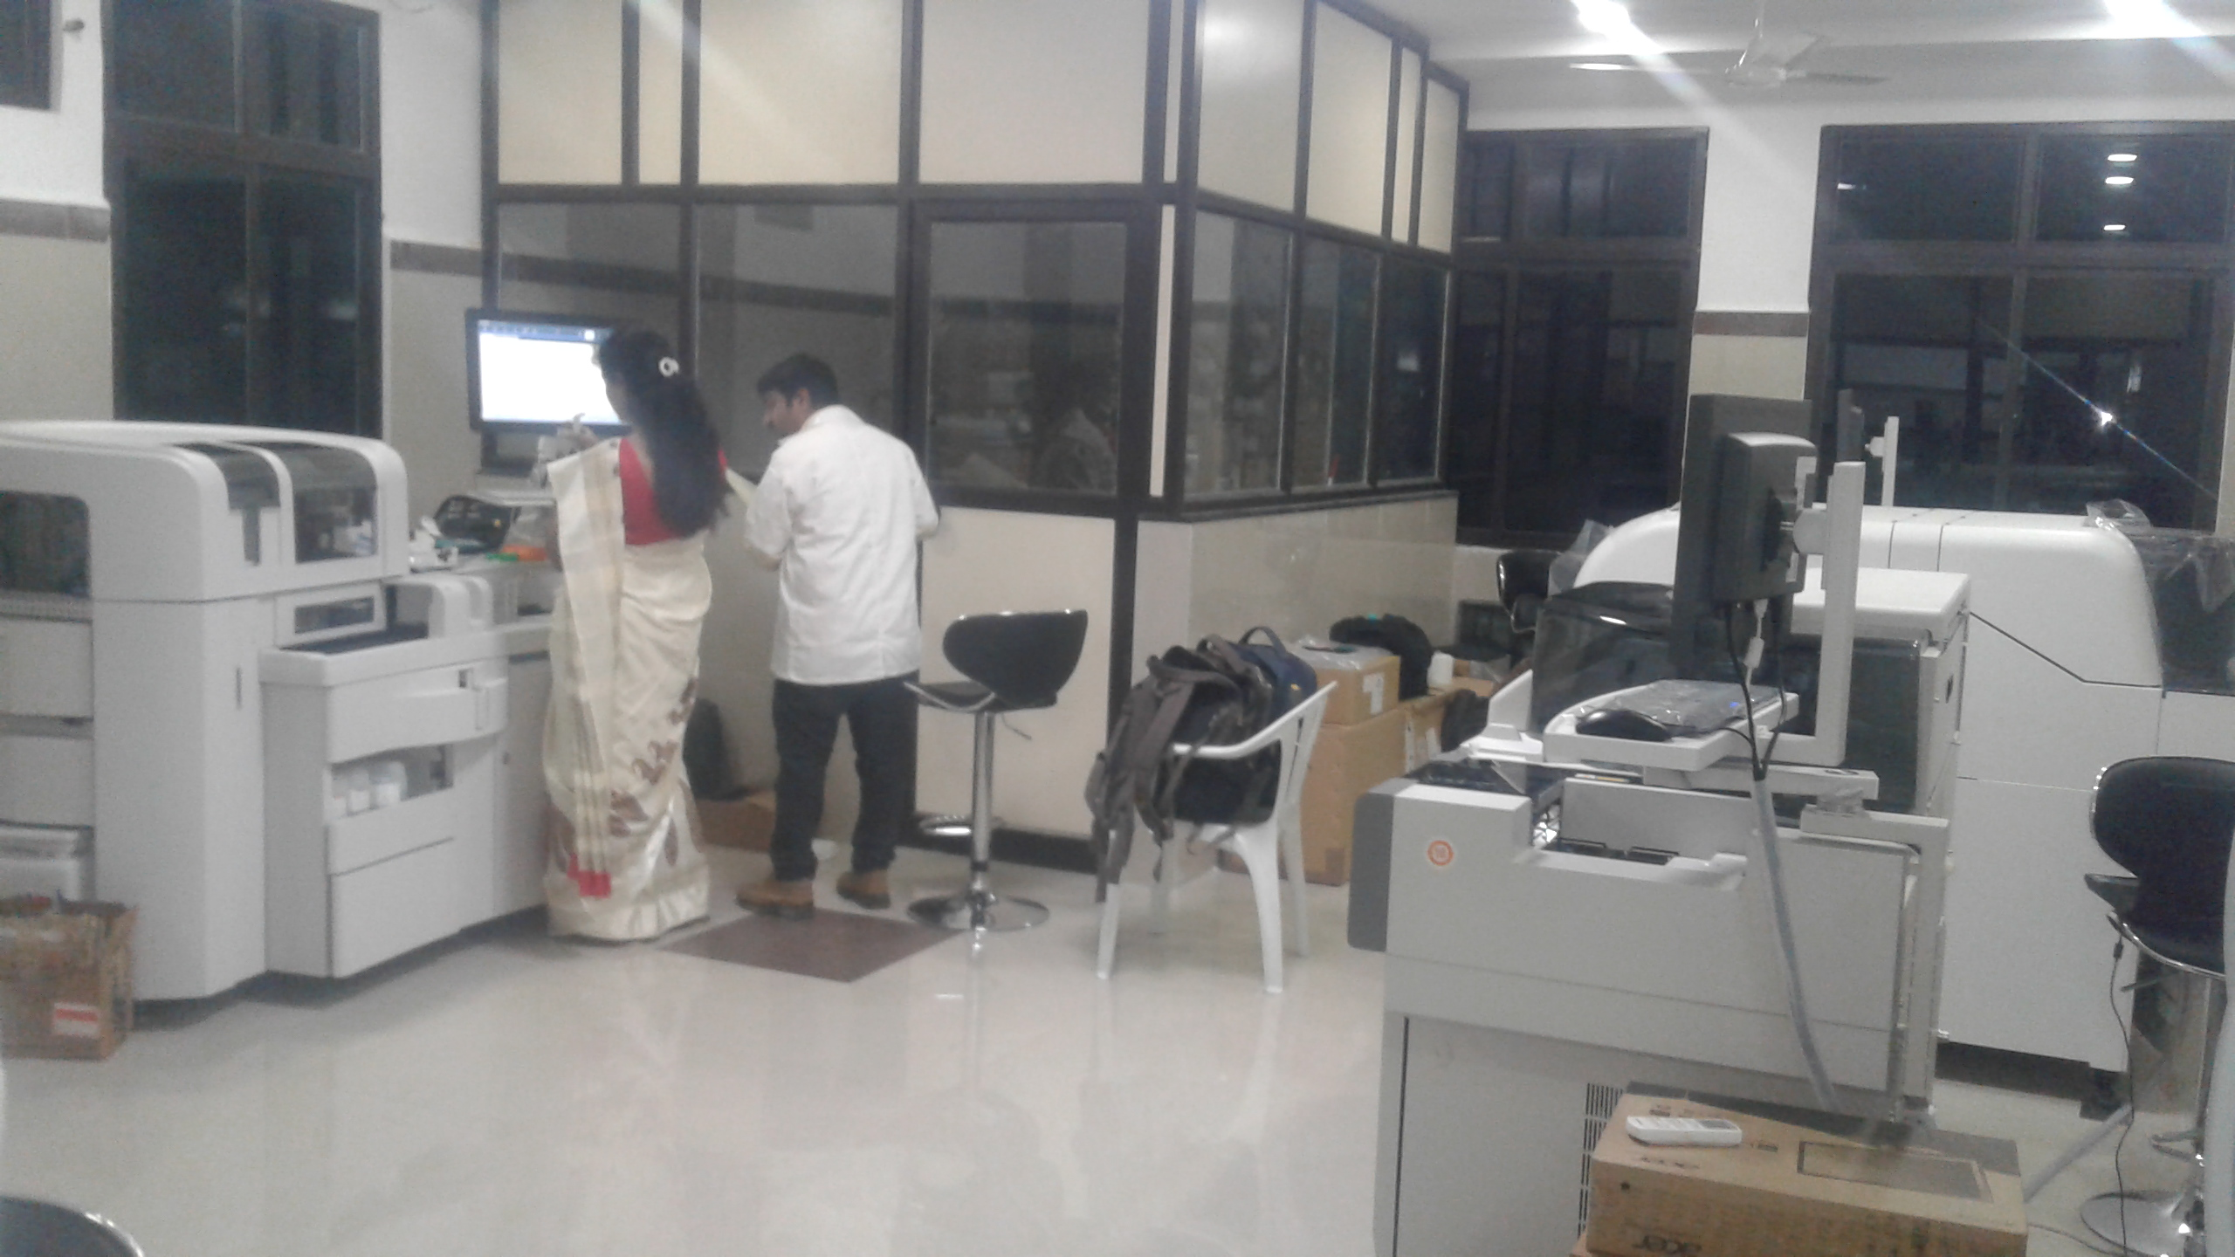
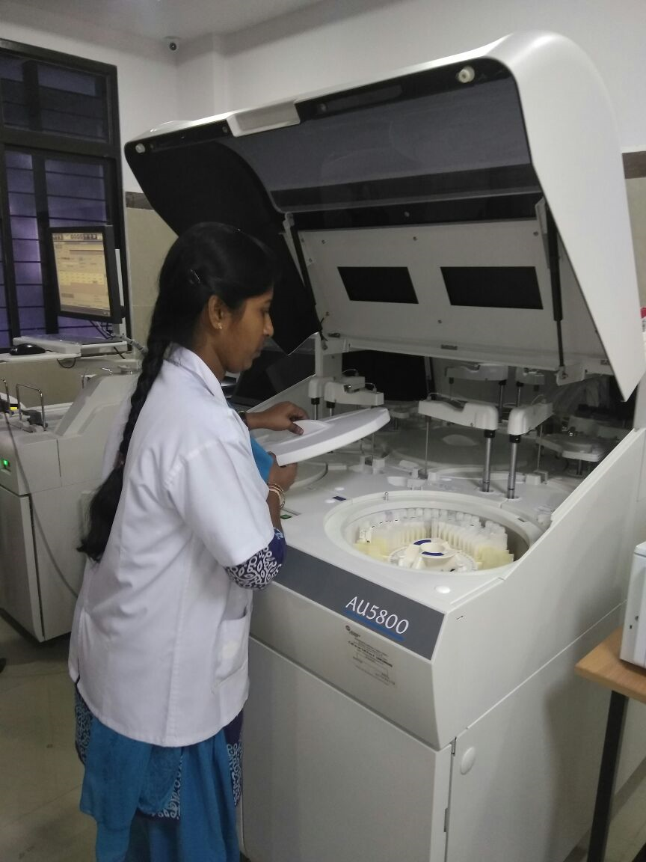
Diagnostics in Hub & Spoke model…
Sample collection at BDK-SPOKE( bar coded )
Samples Transported to Collection point(25)- HUB
Sample Testing at the Hub laboratory
Results transmitted ONLINE

Slide 8
Referral Linkage…
Basti Dawakhana
Specialist Evening Clinics in UPHCs
Teaching Hospitals
UCHCs, Area Hospitals, District Hospital

Slide 9
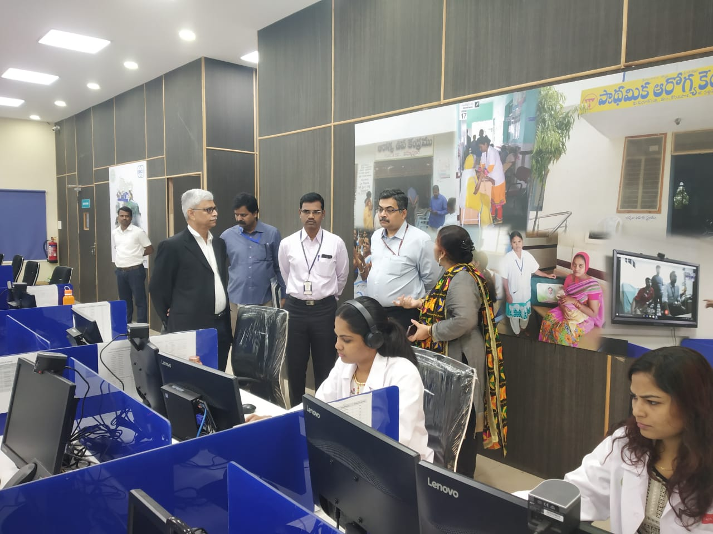
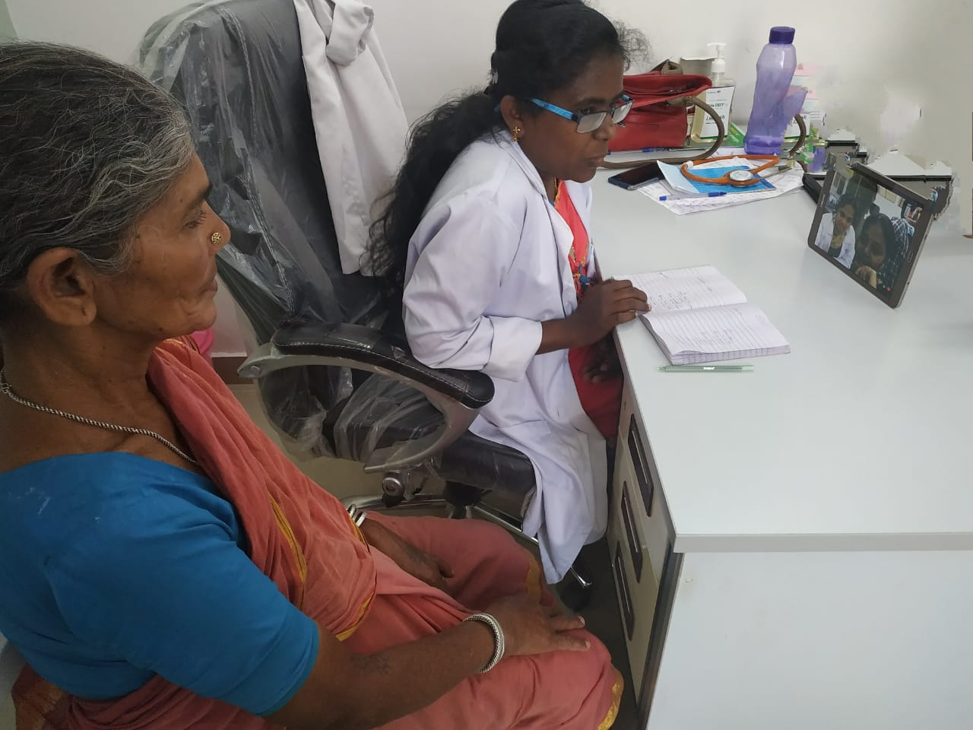
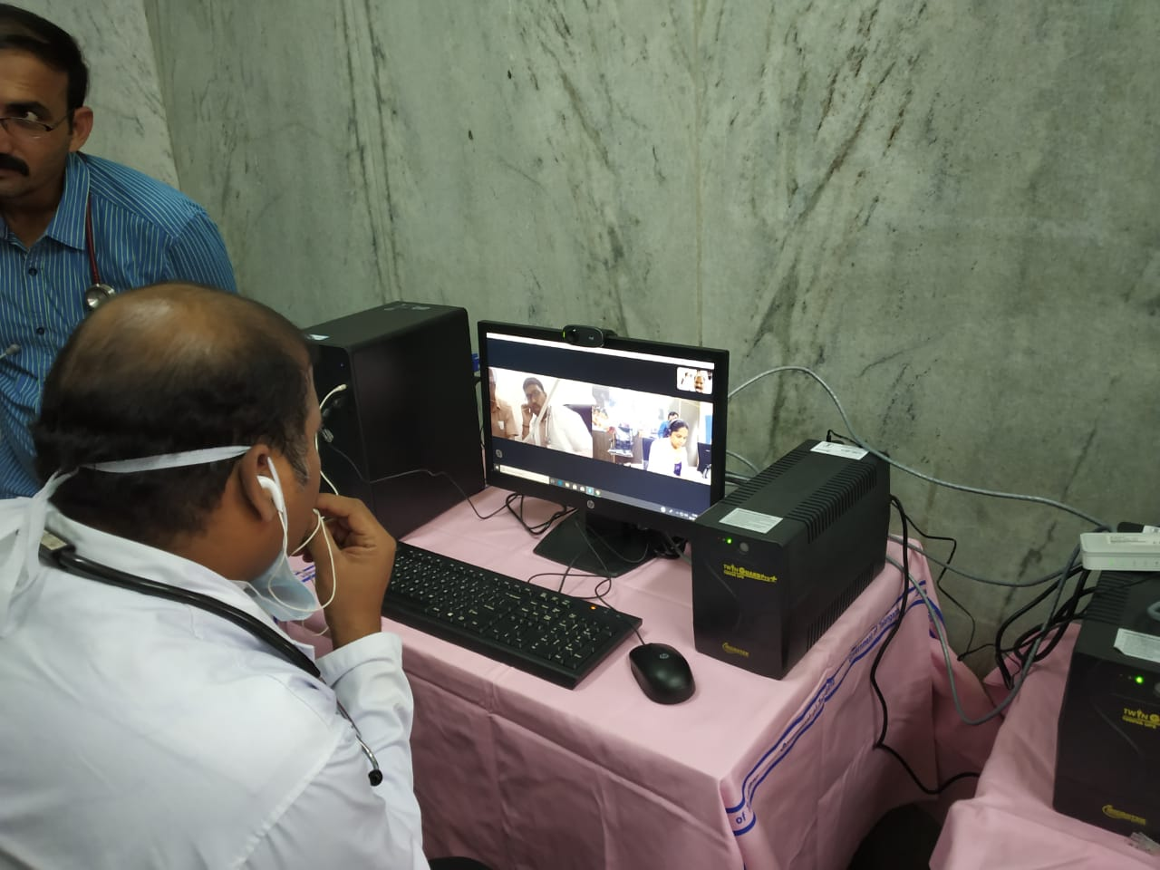
Telemedicine
Linked to Osmania General Hospital through the Digital Nerve Centre.
Specialists provide teleconsultation on fixed timings
Digital Nerve Centre
Osmania General Hospital
Bastidawakhana

Slide 10
OPD and lab tests
Performance from April 2019 to July 2019
Total OPD | Average OPD per day per BD | Total Lab Tests | Average Lab Tests per day per BD
6,05,569 | 64 | 155239 | 19

Slide 11
Increasing OPD

Slide 13
OTHER URBAN INITIATIVES…
Specialist Evening Clinics: Specialists are providing consultation in the evening in 30 UPHCs from 4.00 pm to 8.00 pm
Evening Clinics: Part time doctors are providing evening services in 40 UPHCS

Slide 14
Sl.No | Facility Name | Functional | Avg OPD/Day | HR | HR Cost per Month | Total HR cost
1 | Basti Dhawakana | 104 | 72 | 1.M.O 2.Staff Nurse 3.Helper | 1) 45,000 2) 21,000 3) 10,000 | Rs.76000
2 | SEC (4pm to 8 pm) UPHC | 30 | 50 | 1) Specialist M.O 2) Staff Nurse 3) Helper | 1) 62500 2) 21000 3) 8000 | 91500
3 | Evening Clinics (Part Time) (4-8pm) UPHC | 40 | 50 | 1)M.O 2)ANM 3) Helper | 1) 22000 2) 10,500 3) 8000 | 40500

Slide 15
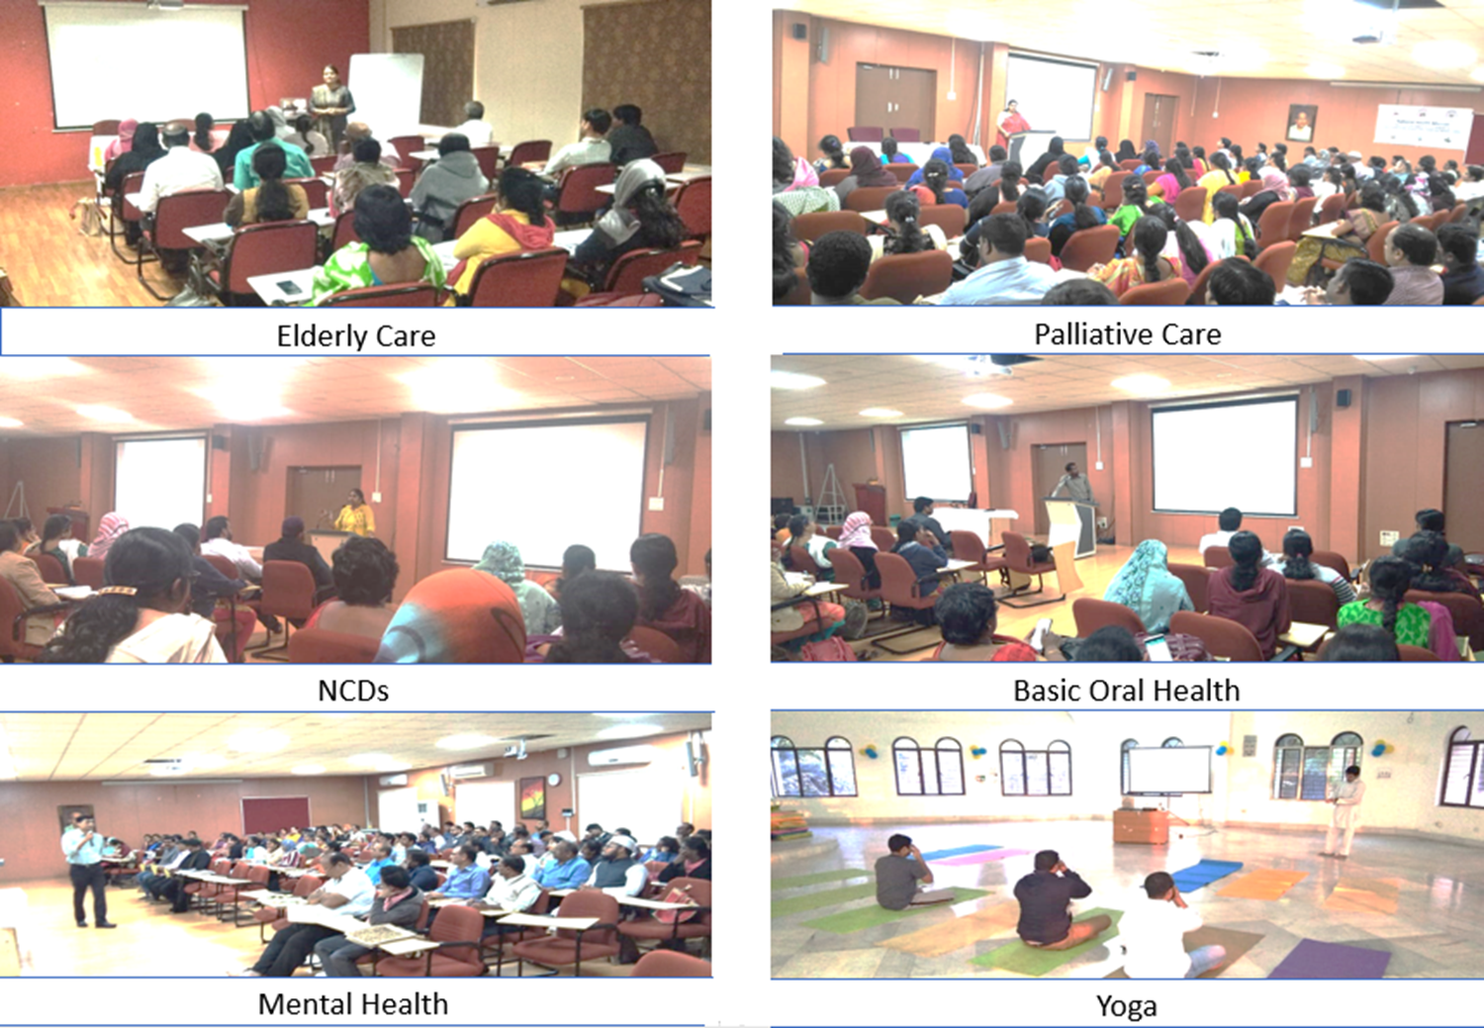
Capacity building…

Slide 16
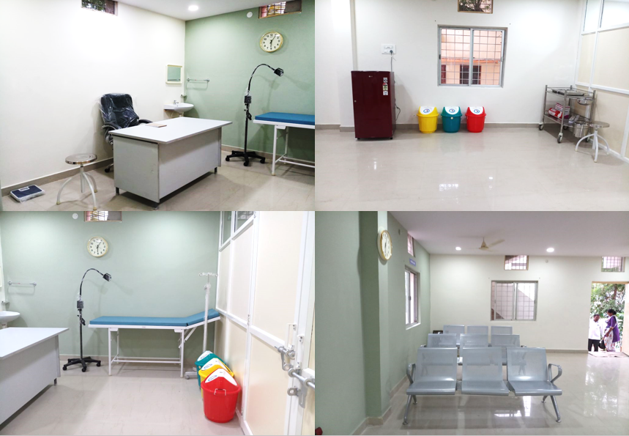
Standardisation…

Slide 17
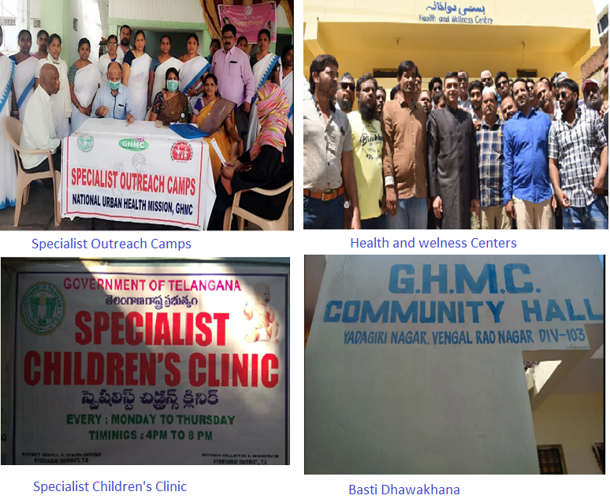
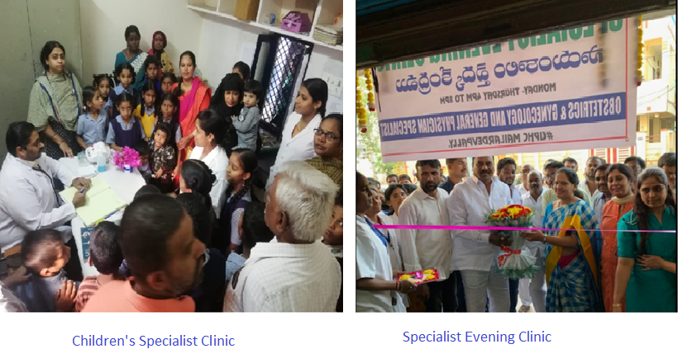
Involvement of Public Representatives…

Slide 18
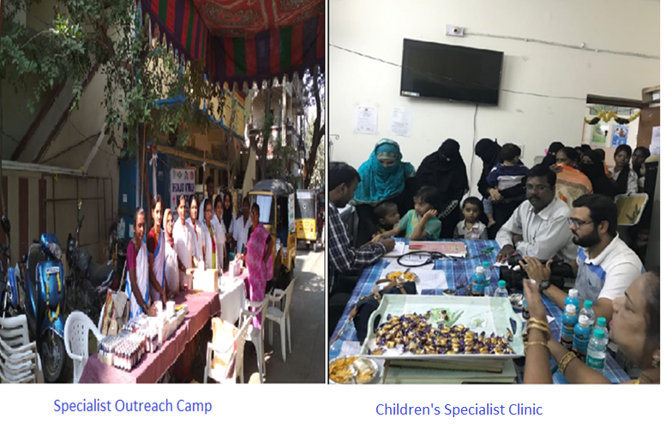

Slide 19
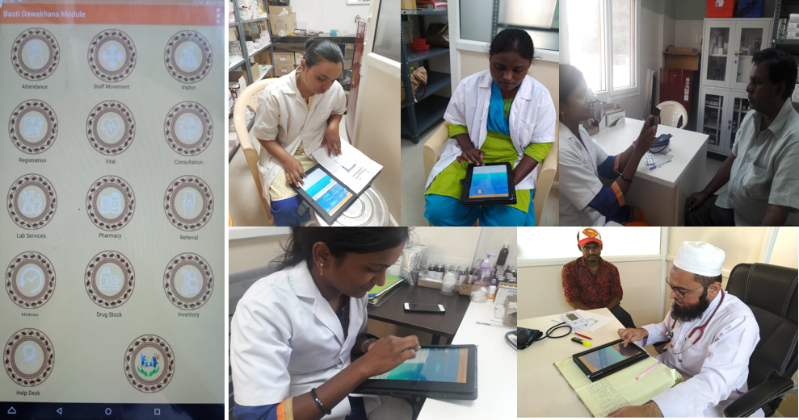
IT Enabled

Slide 20


