Slide 1



Universal Health Coverage (UHC)
Health and Wellness Centre (HWC)
Service Delivery at UHC HSCs & UHC PHCs
07.08.2019
Hyderabad

Slide 2


Slide 3
Vision 2023: Ensuring universal access to healthcare
Transformation of
716 PHCs,
214 Urban PHCs & 985 HSCs into HWCs
UHC Pilot
in 3 Blocks
67 HSCs
June 2013
May 2017
Nov 2017
June 2018
April 2019
UHC
Scoping
Study
Upscaling
to 39 Blocks
Transformation of
all Rural & Urban PHCs into HWCs
Vision 2023 envisages Tamil Nadu to become not only the numero uno State in India in terms of social indicators, but also reach the levels attained by developed countries in human development by ensuring universal access to healthcare

Slide 4
Conceptualization of UHC in Tamil Nadu
Building UHC within the public health architecture without altering the existing State policies
Public Healthcare Team, Training, Infrastructure including branding, Drugs and Diagnostics, IT Systems tailor made for State Public Health Systems
Intact continuum of care with forward and backward linkages from community to tertiary health facility supported by Master Registry
Patient centric convergence of all existing health and related activities at block level
Health Sub Centre strengthening is cornerstone of UHC implementation and differential services provided at differential level of Health Systems
Expanded Service delivery with focus on NCD services without compromising MCH services & communicable disease management

Slide 5
Functional Health and Wellness Centres
 | HSC | Addl. PHC | Urban PHC | Total
Roll out plan in 2018-19 (Hon’ CM announcement) | 985 | 716 | 214 | 1915
Roll out plan in 2019-20 (Hon’ CM announcement) | 0 | 705 | 246 | 951
Total HWCs Proposed | 985 | 1421 | 460 | 2866
Status as on 03.08.2019 (as per TN) | 758* | 1096 | 218 | 2072
Status as on 03.08.2019 (as per GoI) | 293 | 1096 | 218 | 1607
* 700 ANM and 58 GNM as MLHP

Slide 6
Overview of Service Delivery under UHC
Whom? | Members of Families mapped to UHC HSCs
Who? | Government Departments
What? | Free drugs and diagnostics. Differential Primary Healthcare services at different levels
How? | IT enabled coordination from Community (PBS) to Tertiary care centre
Notes:
Mentoring by BHS, FSO, AYUSH
Whom? Members of Families mapped to UHC HSCs
Who? Government Departments
What? Free drugs and diagnostics.
Differential Primary Healthcare services at different levels
How? IT enabled coordination from Community (PBS) to Tertiary care centre

Slide 7
Whom to Cover?
Every Health Facility should clearly identify population to be covered, fixing the denominator for service is vital for our services to be called universal.
Population enumeration is always at HSC level, but even PHCs should have a clear idea so the medical officers are universal care providers for continuum of care. This strategic shifting is necessary for real universality. The aggregation and fixing responsibility is critical for success of UHC/AB
Along with line item budgeting , capitation model for population covered should be implemented for fixing responsibility for universality.

Slide 8
How we arrived the denominator of UHC service delivery? i.e. family folders
Step1: Identified the data source
  Electronic Public Distribution System (ePDS) data in Local Language “Tamil”
  Electronic data of families enumerated by ICDS
  Electronic data of Eligible couple under PICME (MCTS)
  Electronic data of Births & Deaths registered under CRS
Step2: Transliteration from Tamil to English using open source tools
Step3: Health Facility Mapping
  2,30,126 geographical units are mapped to 13,894 health facilities
Notes:
Mentoring by BHS, FSO, AYUSH
Whom? Members of Families mapped to UHC HSCs
Who? Government Departments
What? Free drugs and diagnostics.
Differential Primary Healthcare services at different levels
How? IT enabled coordination from Community (PBS) to Tertiary care centre

Slide 9
How we arrived the denominator of UHC service delivery? i.e. family folders
Step4: Service Area Mapping
  Rural habitations are mapped to Rural HSCs
  Urban streets are mapped to Urban Health Sectors
Step5: Unique Health ID to Family and members are assigned and shared from common place called “Master Registry”
Step6: Shared to all Health and related application for integration
  Aadhaar verified 6.6 crore members and 2.05 families are mapped
  UHC application is using the dataset as denominator
Notes:
Mentoring by BHS, FSO, AYUSH
Whom? Members of Families mapped to UHC HSCs
Who? Government Departments
What? Free drugs and diagnostics.
Differential Primary Healthcare services at different levels
How? IT enabled coordination from Community (PBS) to Tertiary care centre

Slide 10
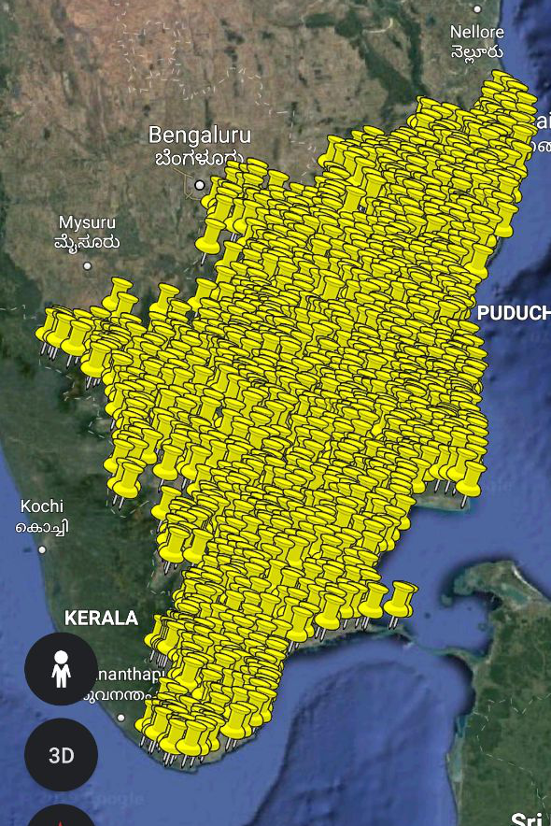
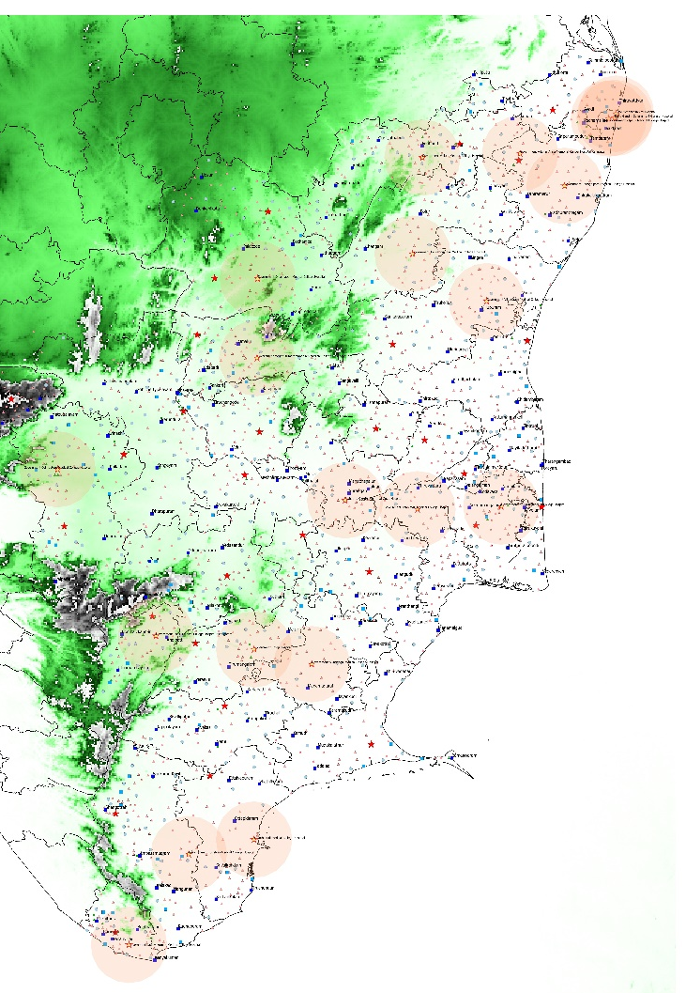
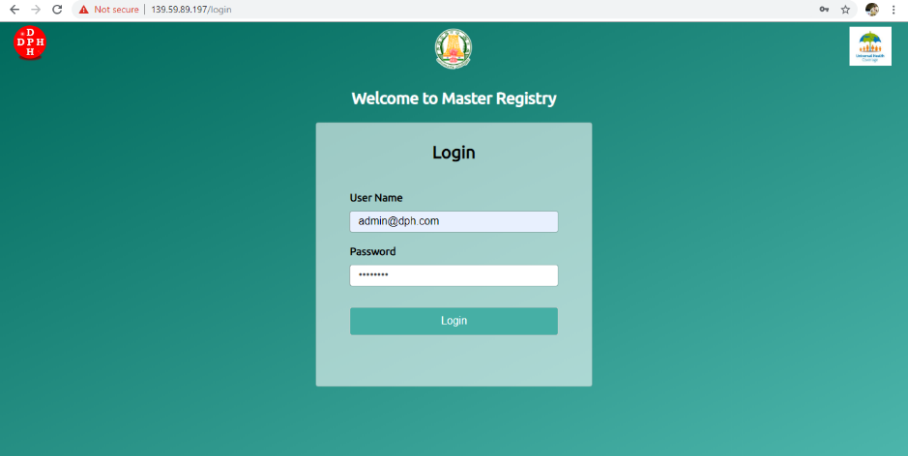
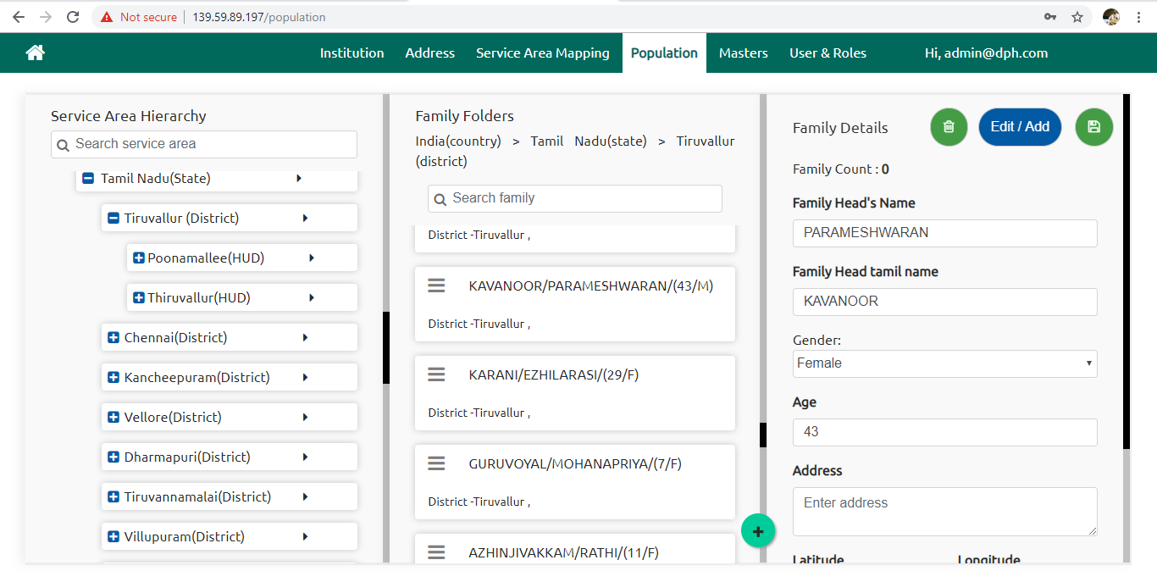
Service Area Mapping of Family Folders
Health Facility Mapping
Service Area Mapping
Master Registry Application

Slide 11




Data linkages for improved referral & follow-up services
(Single database updated from multiple service delivery points)
PBS
MR
Data added to record
Risk Assessment
Blood Pressure
Blood Sugar
Screening
Create Beneficiary Record
Name, Age, Gender, Address
Referral based on Residential Village mapped to the PHC
Data added to record
Diagnosed
Lab investigations
Medications
Advice
Data added to record
Follow up details
Medication details
HWC
Based on HWC mapped to the Residential Village
HWC HSC
HWC PHC

Slide 12
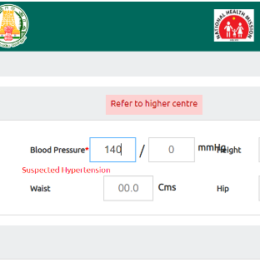
IT enabled service delivery for continuum of care
Gap analysis of IT systems like Device and Internet
Hands-on training given to Master Trainers (6 batches)
Block Level Training given to VHN & SN (47 batches)
Electronic Public Health Record across all levels
  Minimum dataset collected with decision support
  Patients records will be viewed by both referral out and referral in facilities
1,40,996 footfalls were reported under UHC Portal during July 2019.
  27% of all OP entries are fetched from Master Registry
  Offline and Elastic Search are the solutions on progress
Notes:
Mentoring by BHS, FSO, AYUSH

Slide 13
What to Cover ?
Entry point to the community
Emergency care, Poisoning, Mental Health, Palliative and Geriatric Home based care, Suicide Counselling.
Continuum of Care : Telemedicine as an alternative? only where accessibility and availability of doctors are an issue.
Tamil Nadu has focused on Essential Diagnostics List (270 crore), sanctioned under PIP 2019-20 with a hub and spoke model as an integral part of Universal Health care.
Linking community needs for high end care.

Slide 14
Analysis of Congenital Heart Disease Surgeries Performed under CMCHIS- Avg. Cases / Month
Effective Linkage between RBSK and CMCHIS since 2016
Year | 2012 | 2013 | 2014 | 2015 | 2016 | 2017 | 2018 | 2019 (Upto Mar’19)
Total cases | 3276 | 3532 | 3283 | 3310 | 4840 | 5390 | 5416 | 1161

Slide 15
Criteria for a functional UHC HSC, PHC & Block
Notes:
All HWCs aim for Quality accreditation in a phased manner

Slide 16
Criteria for a functional UHC HSC, PHC & Block
Input |  | HSC (24x7) | PHC (4pm-9am) | Block (24x7)
1 | Primary Healthcare Team | 1 Addl. VHN/GNM + 1 Regular VHN + WHV | 3 Staff Nurses+ MO+ Pharmacist + LT | 3 Lab Technicians
2 | Capacity Building | Certificate Course in CHC through TNMGR + UHC-IT training (2 days) +Tele mentoring | Certificate course in CPHC (1 month)+ UHC-IT training (2 days) + Tele mentoring | Training on UHC Operationalization + UHC-IT training(2 days) +Tele mentoring
3 | Infra Structure* | Own HSC building, Branding, Water supply, Alternate power backup, Toilets | Branding, Dedicated Lab space, Water supply, Alternate power backup, Toilets | Block Public Health Lab building, Multipurpose Hall, Water supply, Alternate power backup
*All HWCs aim for Quality accreditation in a phased manner
Notes:
All HWCs aim for Quality accreditation in a phased manner

Slide 17
Criteria for a functional UHC HSC, PHC & Block
Input |  | HSC (24x7) | PHC (4pm-9am) | Block (24x7)
4 | IT Systems (Hardware) | 1Tablet + Internet | 1Tablet + 1Desktop (lab) +Internet | 1Desktop (lab) + Internet
 | (Software) | Family folder + UHC app PBS App+ NCD App + Drug Inventory+ LIMS (Report) | Family folder + UHC app+ NCD App + Drug Inventory + LIMS | Family folder + UHC app NCD App + Drug Inventory + LIMS
5 | Drugs | Kit A (12), Kit B drugs(4), UHC Kit (12), NCD drugs (15), Family Welfare Kit (5) Dispensed as per STG | Insulin injection, Antibiotic injection Dispensed as per MO Prescription | As per Essential Drug List Dispensed as per MO Prescription

Slide 18
Criteria for a functional UHC HSC, PHC & Block
Input |  | HSC (24x7) | PHC (4pm-9am) | Block (24x7)
6 | Diagnostics | 6 tests + Sputum collection | 20 tests @ PHC+ 20 tests thro’ LIMS+ ECG + Sample collection | 25 tests @ Block+ 15 tests thro’ LIMS+ ECG + Sample collection USG + X-ray (9am-4pm)
7 | Service Delivery | Minor ailment treatment + Referral & Follow up of all 12 CPHC services + NCD services + Wellness activities including Yoga + IEC+ Tele consultation | Minor ailment treatment + Referral & Follow up of all 12 CPHC services + NCD services + Wellness activities including Yoga + IEC+ Tele consultation | All 12 CPHC services by Medical Officers+ Managing referral in from UHC HSCs & PHCs+ IEC+ Tele consultation
*Tele consultation as per the need in UHC HSC, PHC and Block PHC

Slide 19
Criteria for a functional UHC HSC, PHC & Block
Input |  | HSC (24x7) | PHC (4pm-9am) | Block (24x7)
8 | Outreach Services | MCH outreach+ Population Based Screening + Patient Support Group | Medical Camp by MO @ HSC | Community palliative care services+ HoWP + RBSK
9 | Reporting | Daily reporting of Line list of beneficiaries + Weekly HWC implementation status | Daily reporting of Line list of beneficiaries + Weekly HWC implementation status | Sharing of beneficiary Line list to all levels+ Weekly LIMS implementation status
10 | Mentoring & Supervision* | Fortnightly visit by MO, DMCHO | Mentor Staff Nurse, DMCHO | District Microbiologist (LIMS), Adoption of UHC block by Regional Training Institutes (RTIs)
*Community Action for Health will be integrated with UHC
Notes:
Mentoring by BHS, FSO, AYUSH

Slide 20
Service Delivery under UHC
Notes:
Mentoring by BHS, FSO, AYUSH

Slide 21
Service Delivery under UHC
CPHC |  | Existing services | Current focus under UHC
1 | MCH activities + Family Planning | CEmONC+ PICME + CRS+ HOB blocks+ 102 call centre | PIH+ Anaemia+ Child & Mother nutrition + NRC
2 | Adolescent Health | RBSK+ Menstrual Hygiene+ Linkage with insurance | NCD screening extended to adolescent age + Adolescent clinic
3 | Communicable Disease | Surveillance & Response+ Vertical Programmes | Integrating data sources for surveillance like UHC & HMIS+ TB Prevalence survey
4 | NCD (HT, DM, Cancers) + Dental | Institutional services | Population Based Screening, Patient Support Group, Drug & testing at HSC, Intact linkage
5 | ENT+ Ophthal | Cochlear implantation+ Spectacles+ Cataract surgeries | Tele V care centre
Notes:
Mentoring by BHS, FSO, AYUSH

Slide 22
Service Delivery under UHC
CPHC |  | Existing services | Current focus under UHC
6 | Mental | 104 call centre, Linkage with NGO | Suicidal Prevention Helpline, Emergency Care and Recovery Centre (ECRC)
7 | Geriatric | Institutional service | Geriatric friendly clinic
8 | Palliative Care | Institutional service | Community Palliative care, Care Giver Training
9 | Emergency care | 108, TAEI | Emergency Care Centre
10 | Occupational Health | MMU Camp | Community follow-up of identified cases
11 | Wellness Activities | Water testing, Iodine testing kit | Yoga & Naturopathy, Eat Right Campaign, Open Gym, Pebble path, Sanitation Demonstration Park, Food Adulteration Testing, Health Ambassadors
12 | Equity services | Tribal MMU | Transgender Speciality Clinic, Guideline for Intersex Surgeries
Notes:
Mentoring by BHS, FSO, AYUSH

Slide 23
Linkage of NCD services under UHC
Screening
Door to Door screening by 2,053 WHV
11 Lakh families enumerated 2018-19
Confirmation
NCD SN facilitate consultation with PHC MO
New 24,376 HT, 18565 DM & 5,302 HT&DM, 1030 VIA, 428 CBE, 121 Oral Cancers
Follow up
HSC, WHV, Patient Support Group, MMU and special medical camps
Output
Community level follow up status of NCD patients made available under UHC
Women Health Volunteer (WHV)
Line list of NCDs confirmed shared to WHVs by VHN
2nd VHN
@ UHC HSC
Line list of NCDs confirmed at UHC PHC to UHC HSCs during Weekly review
Referring to PHC for confirmation
NCD Staff Nurse
@ UHC PHC
Notes:
Mentoring by BHS, FSO, AYUSH

Slide 24
Strategies adopted for Improved Service Delivery
Standard Treatment Guideline (STG) for VHN and SN providing the Primary Healthcare Services
Hands-on training at Block level for IT systems, Standard Treatment Guideline (STG), Linkages of CPHC services
Clear job responsibility of Public Healthcare Team (Addl. VHN, Regular VHN, Women Health Volunteer, Health Inspector)
Drug indenting from the level of Sub centre
Hub and Spoke Model to maximize the lab support to HWCs
Building Mentoring Teams at Block Level for Clinical Audit
Notes:
Mentoring by BHS, FSO, AYUSH

Slide 25
Documents developed by Tamil Nadu Public Health Department to support service delivery
https://drive.google.com/folderview?id=1C_m4MXgZpz-2Kw8nF0317wwq5Y8wEKdx
Strategic Plan for implementing UHC programme in Tamil Nadu
Standard Treatment Guideline (STG) for VHN
Maternal Child Health (MCH) Toolkit for MLHP
Health IT Standards for integrating Health and related applications
Training Manual for participating in Tele-Mentoring session
Training Manual on UHC IT
UHC Case Study: Job Oriented training for MLHP
Operational Guideline for Laboratory Strengthening under UHC
Notes:
Mentoring by BHS, FSO, AYUSH

Slide 26
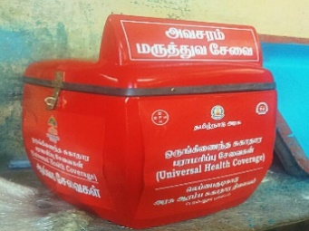
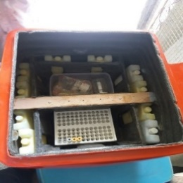
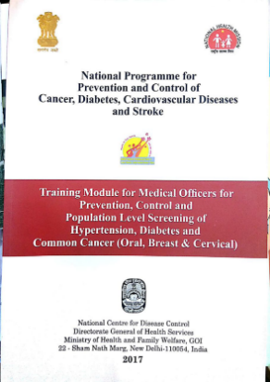
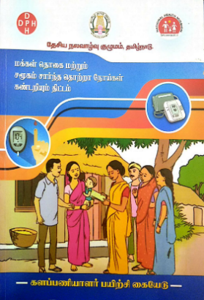
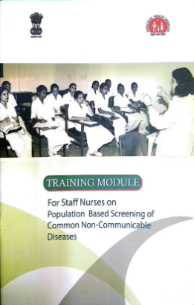

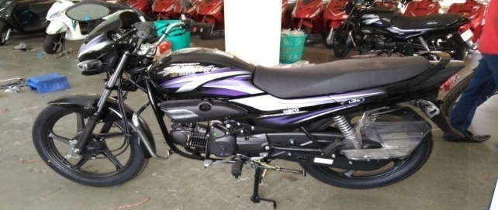
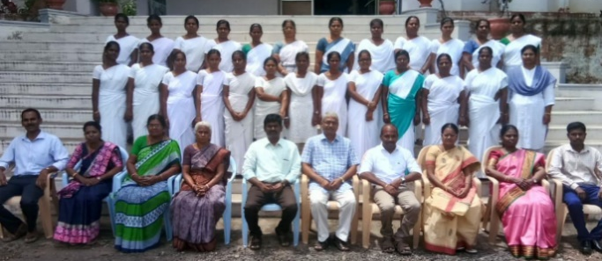
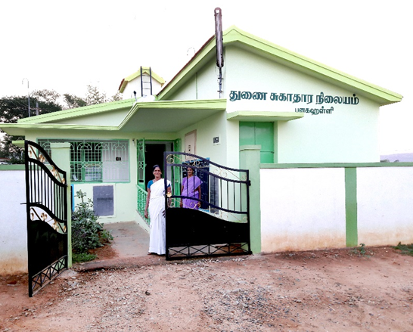

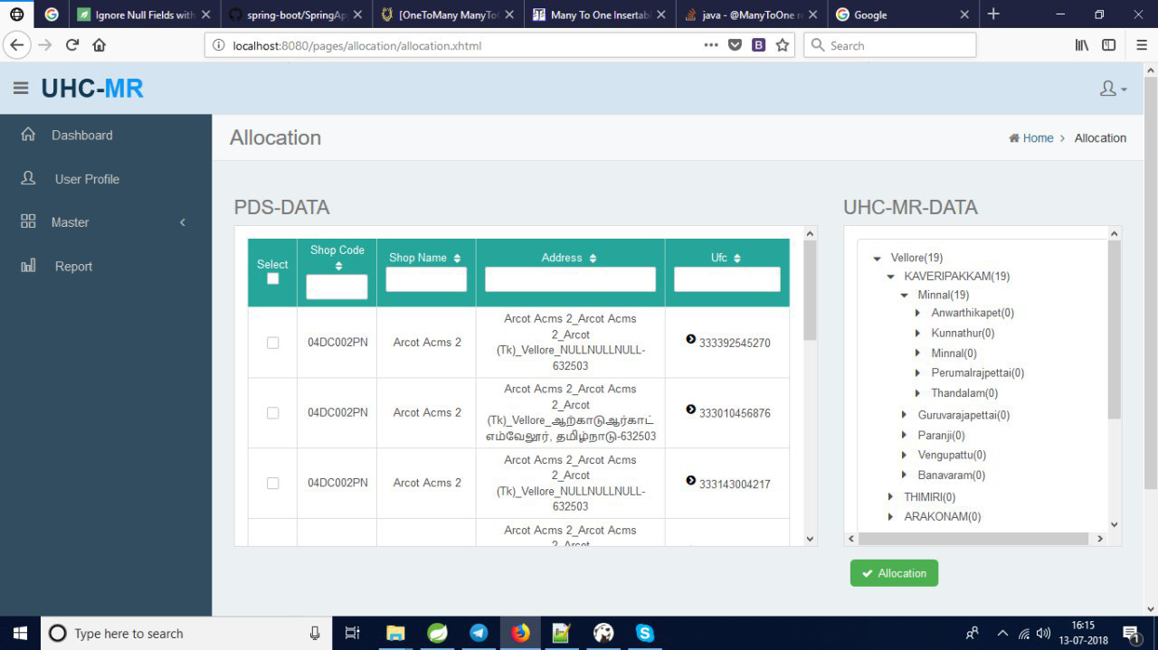
Thanks
Population Based Screening Training
Hub and Spoke
Lab Model
MLHP Training
Display board of HWC
Painting (Branding) of HWC
Software of HWC

