Slide 1


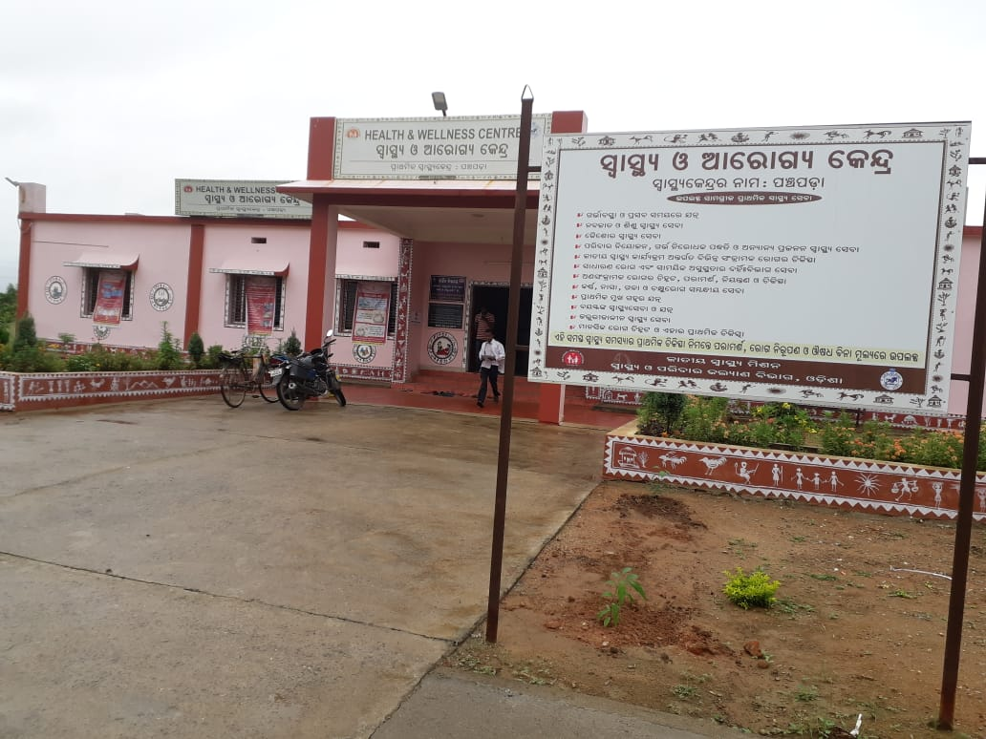
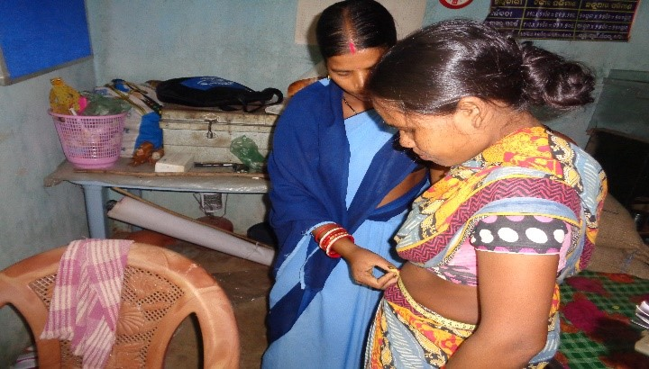
NCD Screening :
Odisha Experience
Presented by:
Mission Director
NHM, Odisha

Slide 2
Mandate for the Year 2018-19
To operationalise 957 HWCs.
PBS for at least 15% of 30⁺ population (25 lakh) for NCD as part of Key Conditionality Framework under NHM PIP.
Update 50% of screened data in NCD App.

Slide 3
Achievement of HWC
PHC (R) : 827 (64.25 % of total PHCs)
PHC(U) : 82 (84.53% of total UPHCs)
Subcenter : 93 (1.85% of total Subcenters)

Slide 4
Achievement of NCD Screening

Slide 5
Key Interventions
Selection of better equipped PHC/UPHC: rapid facility assessment using score card.
Infrastructure Strengthening: Customized action plans, Pooling of resources .
IT Infrastructure: Computers & ANMOL Tabs.
Lab Strengthening : Decentralised procurement of essential equipment. Engagement of LTs on per-day wages.
Human Resource: Creation of posts of SNs and LTs. Filling up of vacancies of doctors. Establishing norms for engaging yoga teachers.
Establishing Model HWC: Two per District by 15th August, for wider replication.
Continuous monitoring with Collectors.

Slide 6
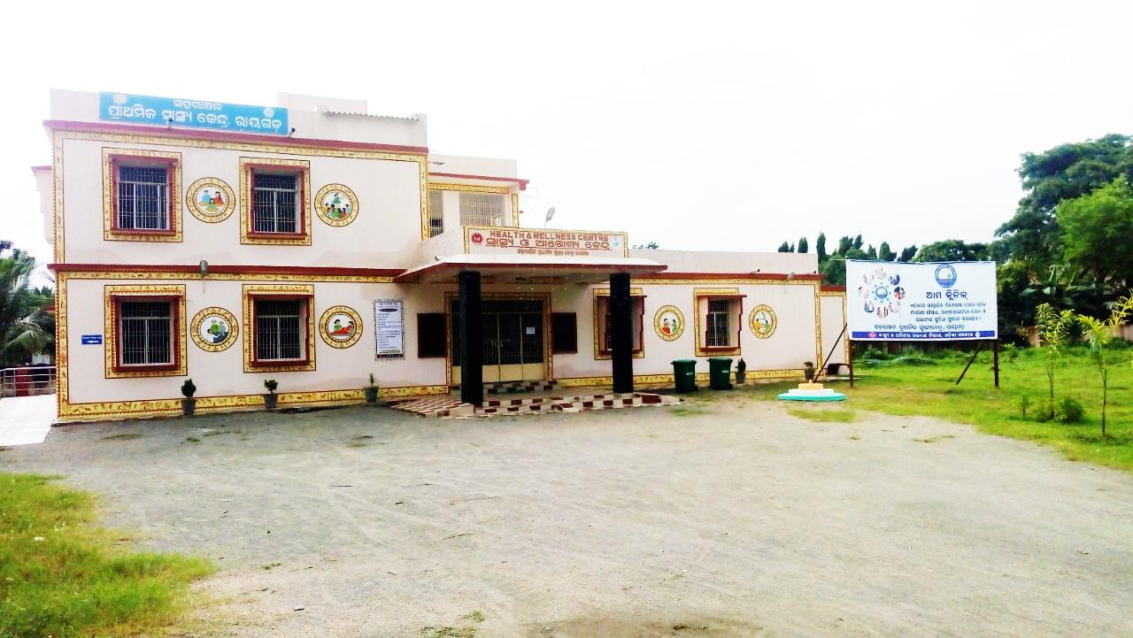
UPHC Level HWC

Slide 7
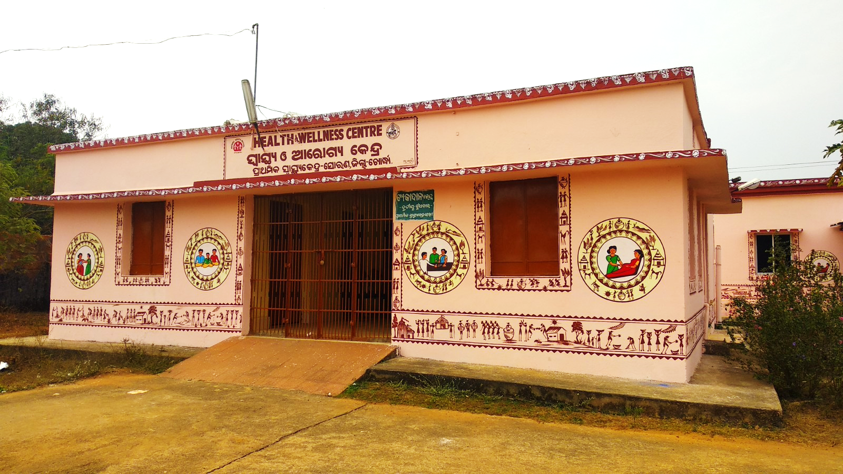
PHC Level HWC

Slide 8
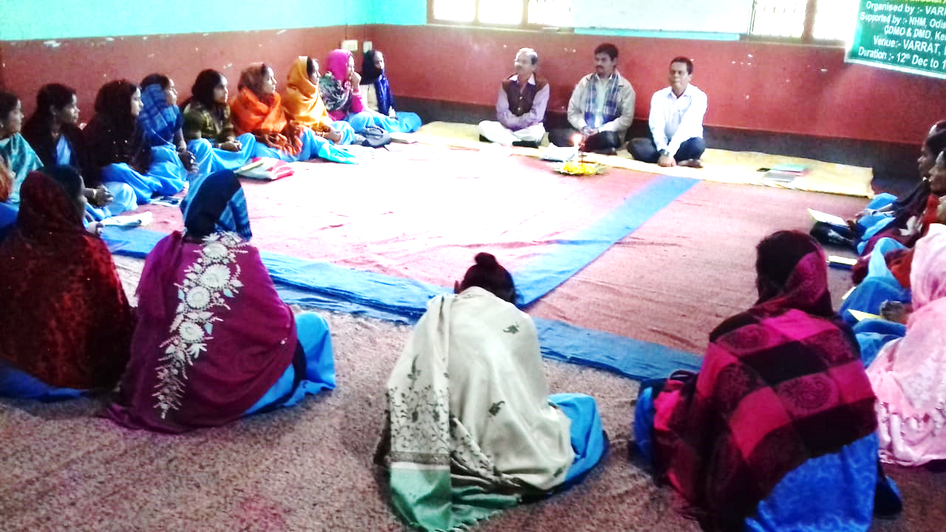
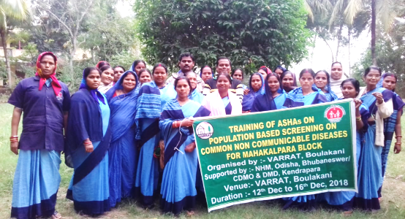
Enabling Policy Decisions & Interventions
Capacity Building:
Utilise Freelance Trainers for ASHA Training
Training quality monitoring by Development Partners (Jhpiego)
NCD Training for ASHAs

Slide 9


Enabling Policy Decisions & Interventions
Community mobilisation :
Facility Branding with indigenous theme & Citizen Charter
Focus on folk media & IPC
Facility Level
Common branding and display of Citizen Charter
Medicine Pouch containing Key message on NCD
Community Level IEC
Hoardings, Folk shows, distribution of leaflets etc.
Performance incentive to ASHA
ASHA incentive linked with enumeration, mobilisation and ensuring attendance of all cases for screening
NCD Screening & App Entry in Campaign Mode
Theme provided by GoI
Theme developed by Odisha

Slide 10
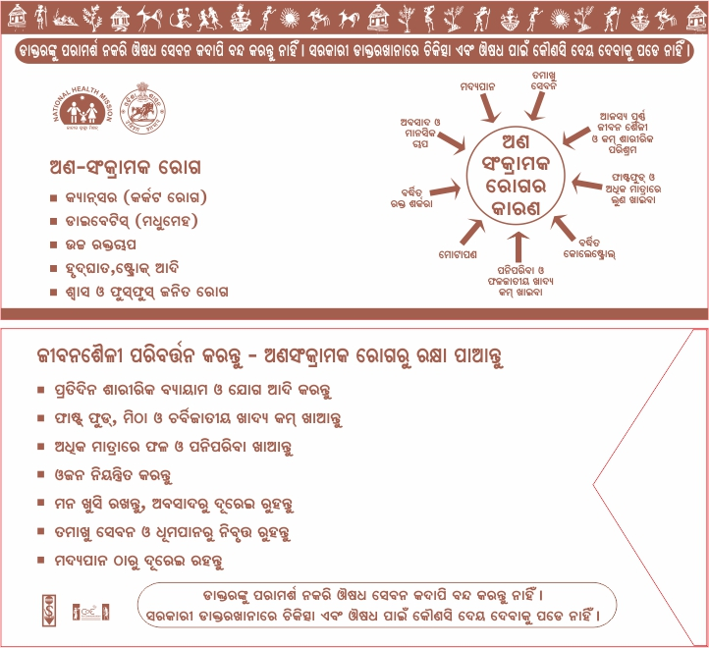
Medicine Pouch containing Key Message on NCD

Slide 11
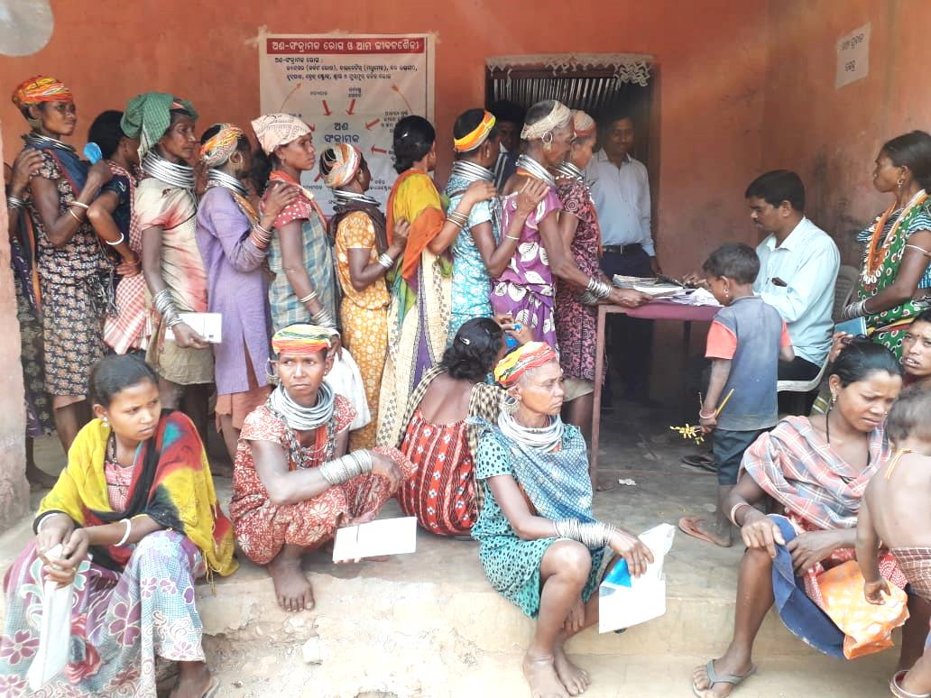
NCD Campaign (1st March-31st March 2019)
Major Features :
Sub centre wise Micro Plan.
Fixed day camp approach for screening
Mobilsation of service providers from non HWC area on screening day.
Monitors at State, District & Block level.
Daily Reporting, Weekly review at State level and VC with districts.
NCD Screening at Bonda Hills, Malkangiri district

Slide 12
Campaign Calendar
Date | Day | Activities
1 | Friday
2 | Saturday | Mobilisation -cum-Survey day
3 | Sunday | Holiday
4 | Monday | Holiday
5 | Tuesday | Holiday
6 | Wednesday | Mobilisation -cum-Survey day
7 | Thursday | Camp Day
8 | Friday | Camp day
9 | Saturday | Holiday
10 | Sunday | Holiday
11 | Monday | Reporting Day
12 | Tuesday | Mobilisation -cum-Survey day
13 | Wednesday | Mobilisation -cum-Survey day
14 | Thursday | Camp Day
15 | Friday | Camp day
Date | Day | Activities
16 | Saturday | Reporting Day
17 | Sunday | Holiday
18 | Monday
19 | Tuesday | Mobilisation -cum-Survey day
20 | Wednesday | Mobilisation -cum-Survey day
21 | Thursday | Holiday
22 | Friday | Holiday
23 | Saturday | Camp day
24 | Sunday | Holiday
25 | Monday | Reporting Day
26 | Tuesday | Mobilisation -cum-Survey day
27 | Wednesday | Mobilisation -cum-Survey day
28 | Thursday | Camp day
29 | Friday | Camp day
30 | Saturday | Reporting Day
31 | Sunday | Holiday
8 Mobilisation –cum-Survey Days & 7 Camp Days

Slide 13
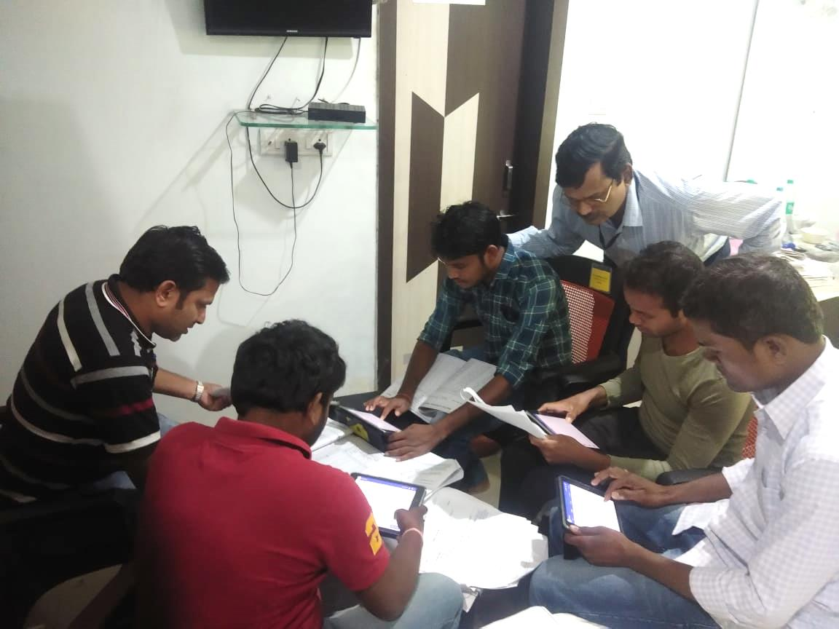
Entry in NCD App
Training
District level Master Trainers created with the support of TATA Trust
Block Data Managers trained to coordinate NCD App entry
HW- Male trained to support low performing ANMs
Entry
Simultaneous screening & entry in team approach at HWCs.
NCD App Training

Slide 14
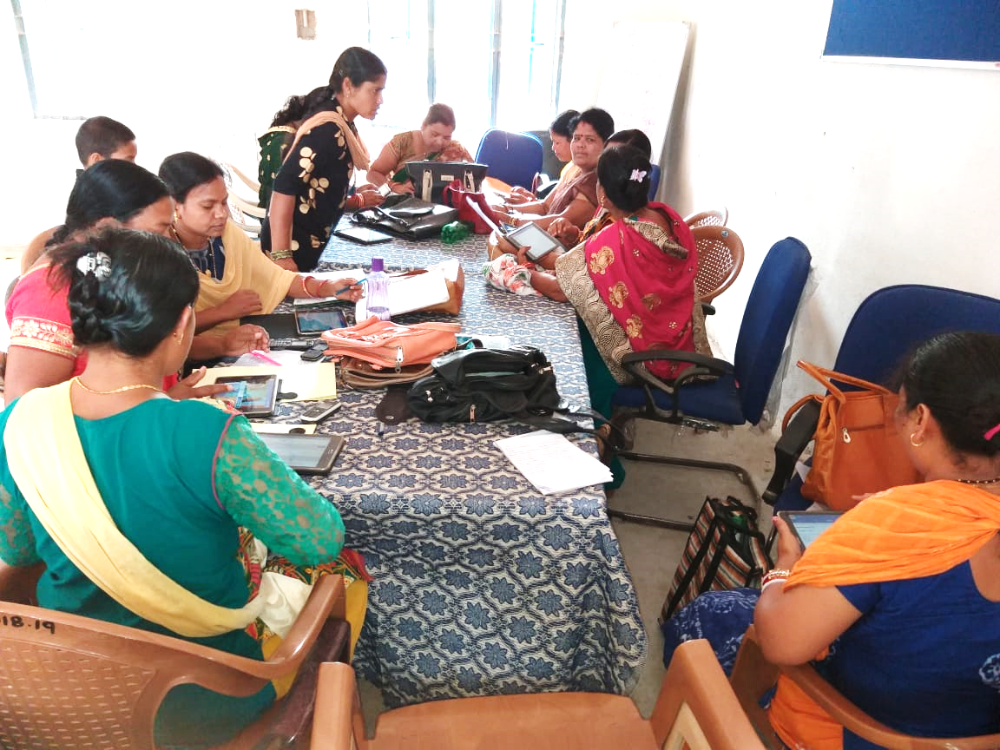
Hands-on training of ANMs at Sector PHC on NCD APP

Slide 15
Outcomes
Sl. No | Type of Cancer | Screened (As on 31st July) | Abnormality Detected
1 | Oral Cancer | 2092747 | 5371 (0.26%)
2 | Breast Cancer | 1051428 | 1833 (0.17%)
3 | Cervical Cancer | 403244 | 33919 (8.41%)
4 | Diabetes | 2139526 | 98910 (4.62%)
5 | Hypertension | 2158069 | 117313 (5.44%)
Created Mass awareness on NCDs
Improved Knowledge & Skills of Services Providers

Slide 16
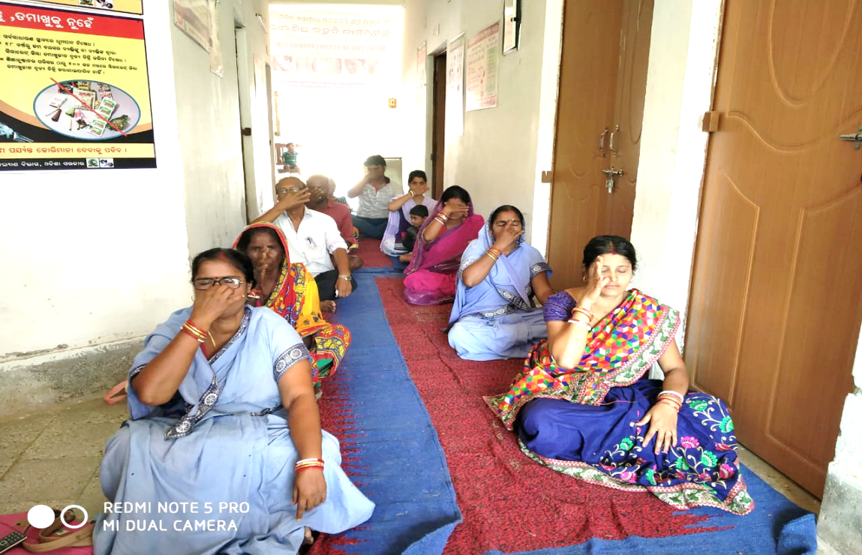
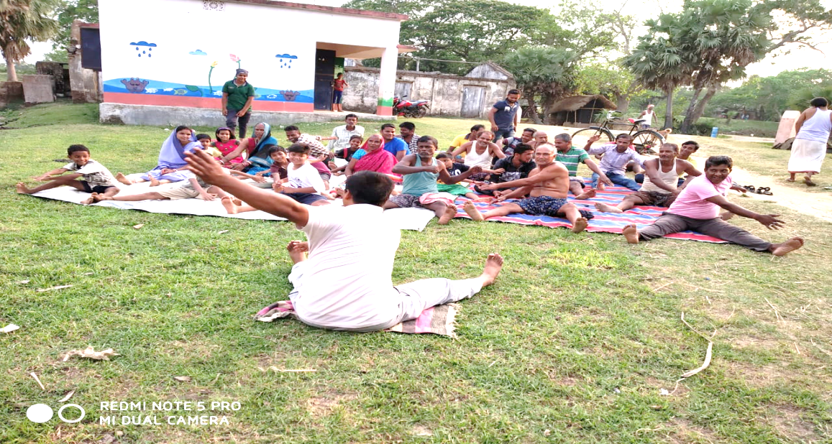
HWC In Action: Treatment/ Management of NCD Cases
Line listing & Follow-up of diagnosed cases.
Streamlining Supply of NCD Drugs to HWCs.
Free Treatment for all diagnosed cases.
Using Referral slip for referral complicated cases to DHH.
Fixed day NCD Screening- Thursday
Organising Yoga Sessions
Yoga Session at HWC

Slide 17
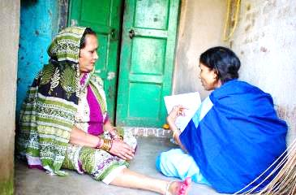
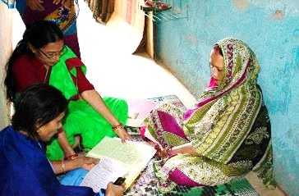
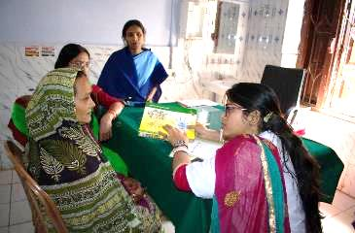
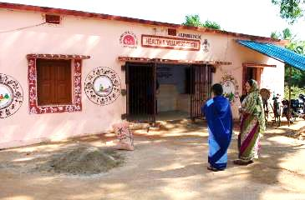
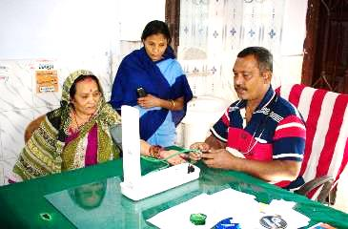
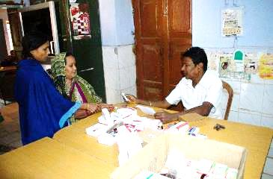
HWC in Action
1. ASHA filling the CBAC form at beneficiaries’ house
2. Community screening session at Anganwadi centre by ANM
3. CHO providing health education on NCDs
4. ASHA accompanying the beneficiary to HWC PHC
5. Confirmation of diagnosis my MO-MBBS at HWC-PHC
6. Treatment initiated: distribution of drugs for a month

Slide 18
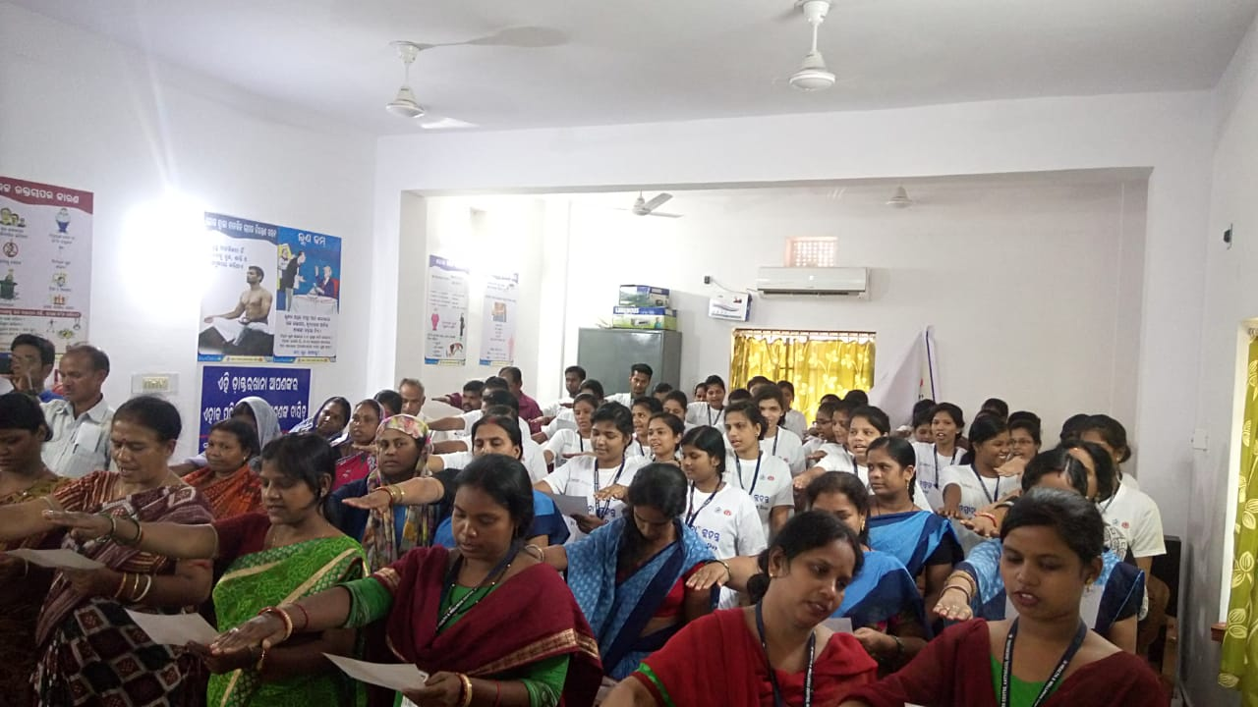
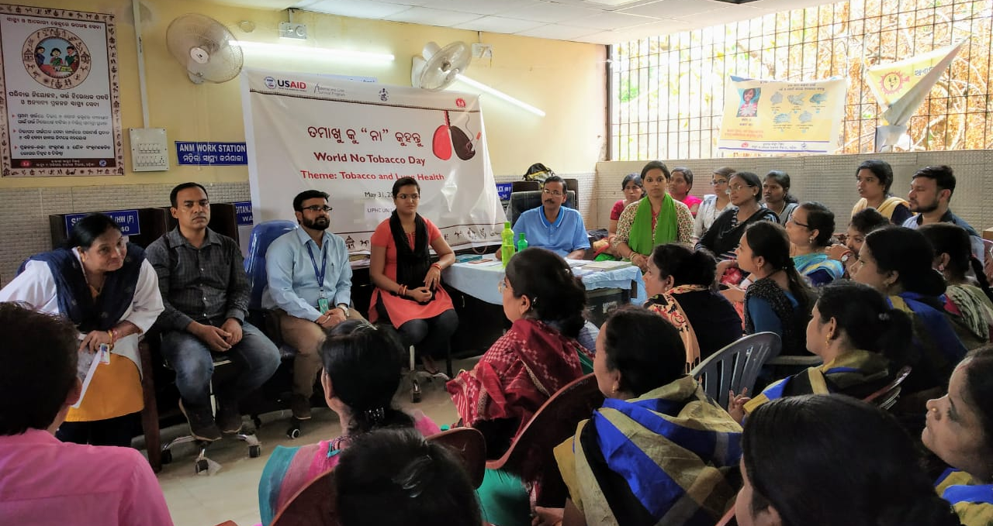
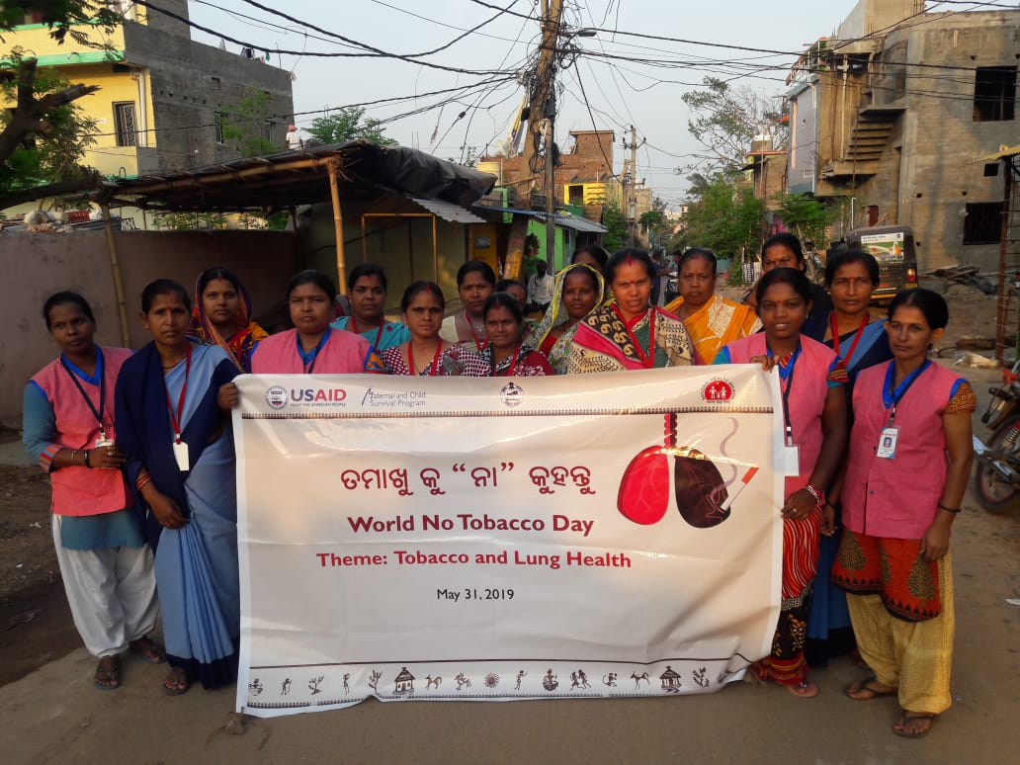
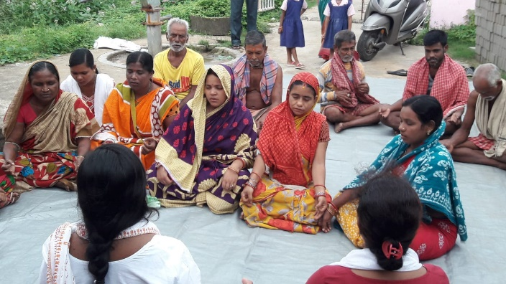
Community Process Initiatives
Oath taking & Rally for “No Use of Tobacco”
Sensitization and health talk at HWC & Village level

Slide 19
Continuing Challenges & Way Forward
Continuing Challenges:
Improving IT skills of ANMs
Entry in MO Portal by Medical Officers
Tracking confirmed cases to ensure treatment
PBS in non-slum urban areas
E-tracking of drugs upto Sub Centre level
Inadequate number of MO, Staff nurse and LT at PHCs
Way forward:
Expanding E-Niramaya to all HWCs
Outsourcing of Telemedicine setup (6 hubs & 600 Spokes in 1st phase)
Health card to track patients ?
Creation of posts of SN and LT and posting of doctors

Slide 20

Digital Dispensary
in Difficult Areas

Slide 21

Digital Dispensary in Difficult areas
One Stop Solution for Consultation, Diagnosis and Drugs
Digital Dispensary operates as an OPD in the selected difficult areas.
Medical consultation, basic tests and medication dispensing
Criteria for Selection of location - No PHC within 10 Km distance or isolated due to geographical barriers while covering 5000 population.
Doctors

Slide 22
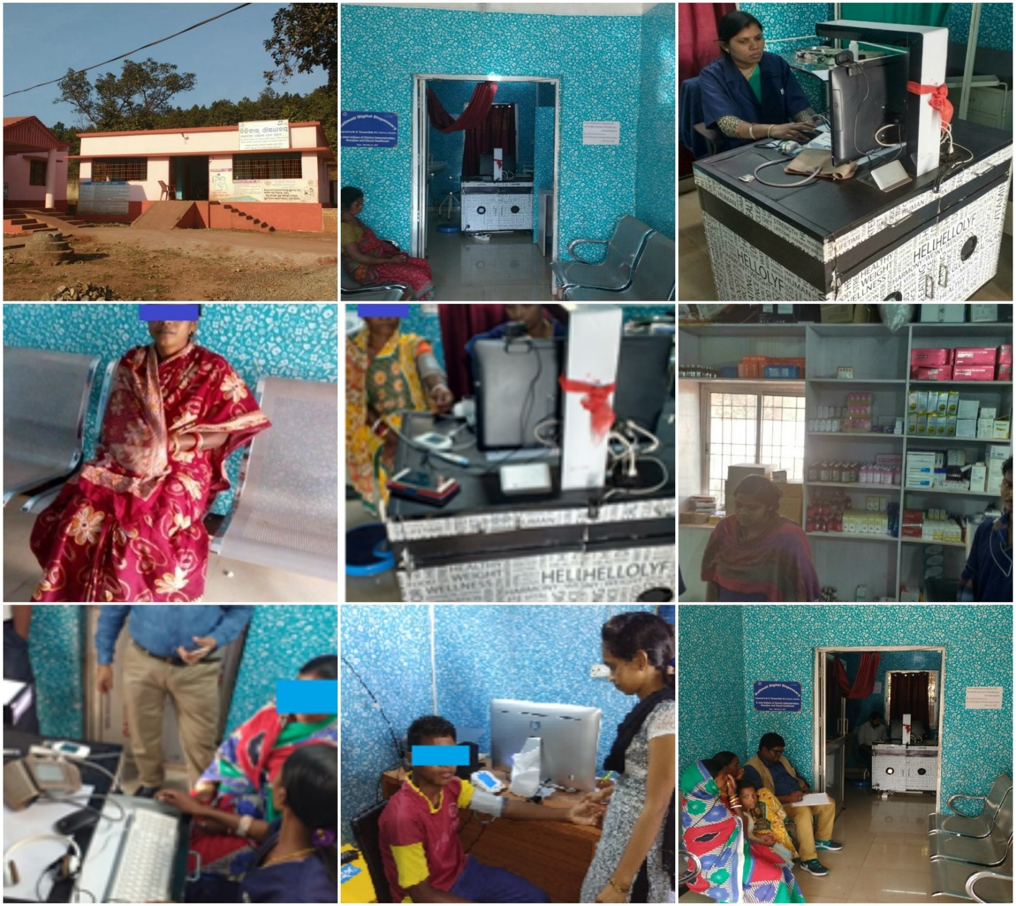
Major Features
Model | Located in Government building Operated through PPP Mode Doctors consultancy/ Manpower (one trained Nurse for the Telemedicine side, one Pharmacist, one Laboratory Assistant and one Support staff) and Medicines provided by PPP Partner
Location | Sub Centre Community Building Any other Govt. building within the catchment area
No of Digital Dispensary | 1st Phase- 30 2nd Phase -102 (63 under functional HWC area)
Financial Implications | Capex- Rs.12.29 Lakhs per Dispensary Opex-Rs.225 /-per patient per consultation

Slide 23
Service Deliverables of Digital Dispensaries
To manage and operate the digital dispensary centers which will function as an OPD with virtual consultation with doctor (through video consultation) to deliver Primary Health Care.
Management & Operation of the centers on a 8 hours / day basis in all days of a week.
Registration of Patients
Consultations with Doctors through Video Conferencing using Internet Broadband Connectivity (Minimum 2 MBPS)
e-Prescription
Basic Laboratory Tests (Malaria, Dengue, Haemoglobin, Pregnancy, Blood Sugar & Urine) with Reports
Dispensing of Medicine as per e-Prescription
Online data Report of daily transactions (Consultation) - Center wise
Generation of Electronic Medical Record (EMR) online with video consultation file
Web-based real time dashboard for monitoring of service delivery of all digital dispensary centers.

Slide 24







Patients Walk Through a Digital Dispensary
1
2
3
Online consultation with vitals check-up, rapid investigation tests
Booking at the desk
Waiting in Queue
6
5
4
Happy Patient !
Patient receives medicine
Patient receives prescription

Slide 25
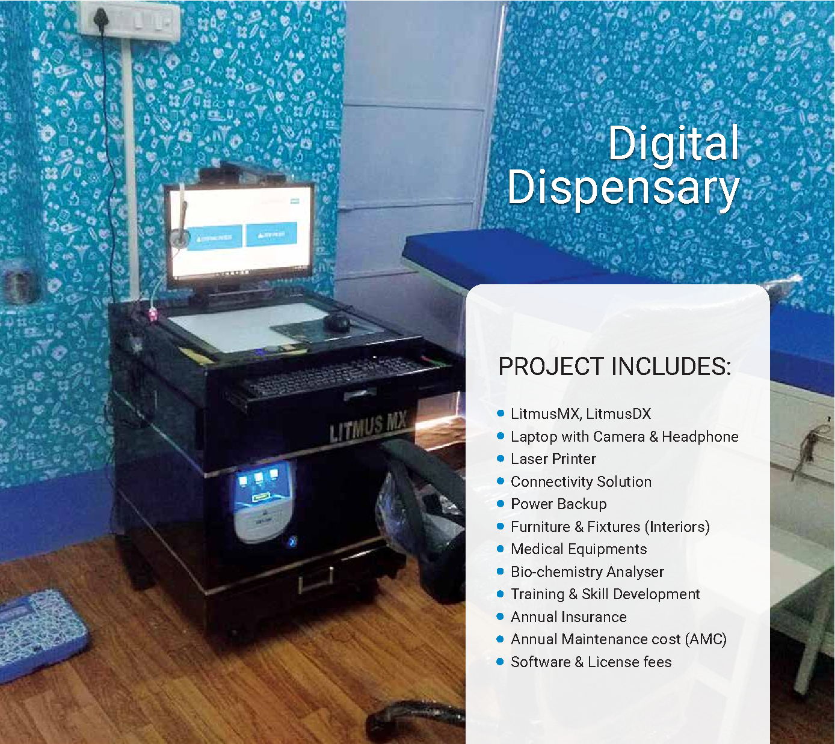

Slide 26
Outcome
Total Operational Digital Dispensary: 48
Last two months total consultation | Avg. OPD per Day | Highest OPD per day | Name of the Centre | Lowest OPD per Day | Name of the Centre
27,281 | 11 | 105 | Tangriapal, Keonjhar | 4 | Badakumari, Nabarangpur

Slide 27
Thank you

Slide 28

Key Challenges
Institutional Strengthening for PBS Screening at HWCs.
Capacity building of more than 20,000 ASHAs and 3,500 ANMs on NCD Screening.
Online Entry in App by Front line Service Providers with limited IT Skills.
Community mobilisation for NCD Screening.

Slide 29
