Slide 1
Ensuring Continuum of Care
Keshvendra Kumar, IAS
Mission Director, NHM Kerala

Slide 2
Declaration of Alma Ata
Defined Primary Healthcare as
“... first level of contact of individuals, the family and community with the national health system…”
Stressed on health promotion, disease prevention, appropriate treatment of common diseases and public health measures for controlling infectious diseases

Slide 3

SDG3
Ensure healthy lives and promote wellbeing for all at all ages

Slide 4
Subcentre HWC
Family Health Centre
(PHC)
Comprehensive Primary Healthcare
(CPHC)
Minimum package of services
Community Health Officer
Community based services through community teams of ASHA, ANM and CHO
Curative
Preventive & Promotive care
Palliative & Rehabilitative care
Fixed day specialty services
Diagnosis & treatment initiation
Referral and back-referral
Health as a human right
Assured package of services
Universal access
Zero cost to user
Community based health activities
Institution based
Comprehensive Primary Healthcare in Kerala

Slide 5
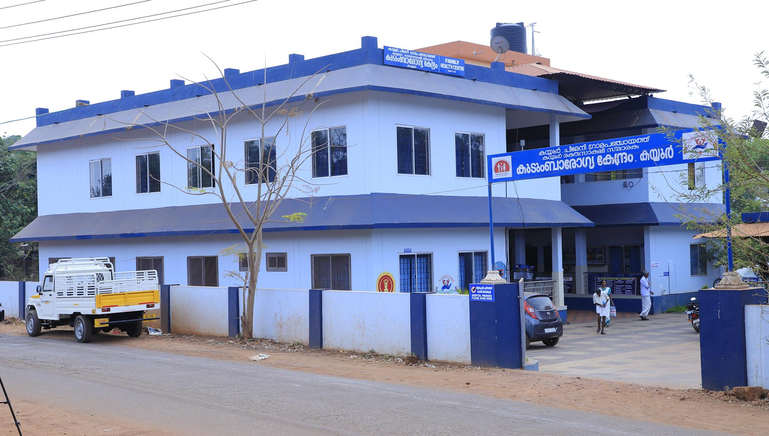
Family Health Centres

Slide 6
Family Health Centres
Caters to a population of 20000 to 30000
Provides curative care, preventive and promotive care, rehabilitative and palliative care to its beneficiaries
Hub for coordination of all public health activities in an LSG area
Reinvigoration of “Family Doctor” concept
Supervision & support of spokes (Subcentres) in a Hub & Spoke model

Slide 7
Life cycle approach to care
Pregnancy to child birth
Quality child survival
Early childhood development to adolescence
Adulthood to geriatric care
Early diagnosis & management of chronic diseases including NCDs
Palliative care
Well defined wellness concept

Slide 8
Pregnancy & Child Birth
Preconceptional folic acid supplementation to married couple
Early antenatal registration at subcentres
Diagnosis of high risk pregnancies at PHC level
Follow-up & management of complications at SDH level
NST at Family Health Centres using portable USGs
Free drugs, diagnostics
Free nuchal translucency scan @ 13 weeks; anomaly scan @ 20 weeks
Free referral transport mechanism: Mathruyaanam

Slide 9
Pregnancy & Child birth (contd.)
Ensuring 100% institutional deliveries
Specialist delivery services in all subdistrict level insititutions & above
12 point quality standards for ensuring quality delivery services
Implementation of LaQshya standards in delivery points
Birth companionship in institutions where LaQshya standards have been implemented

Slide 10
Quality Child Survival
Comprehensive Newborn Screening with RBSK support
  Visible birth defect screening through RBSK within 24 hours
  Pulse oximetry screening after 24 hours for critical congenital heart diseases according to “Hridyam” guidelines
  Oto Acoustic Emission Screening for hearing after 48 hours (supported by Social Justice Department
  Metabolic Screening for congenital hypothyroidism, G6PD deficiency, Phenyl Ketonuria, CAH ,Galactosemia using blood spot analysis
  ROP screening of high risk newborn, especially SNCU admit babies

Slide 11
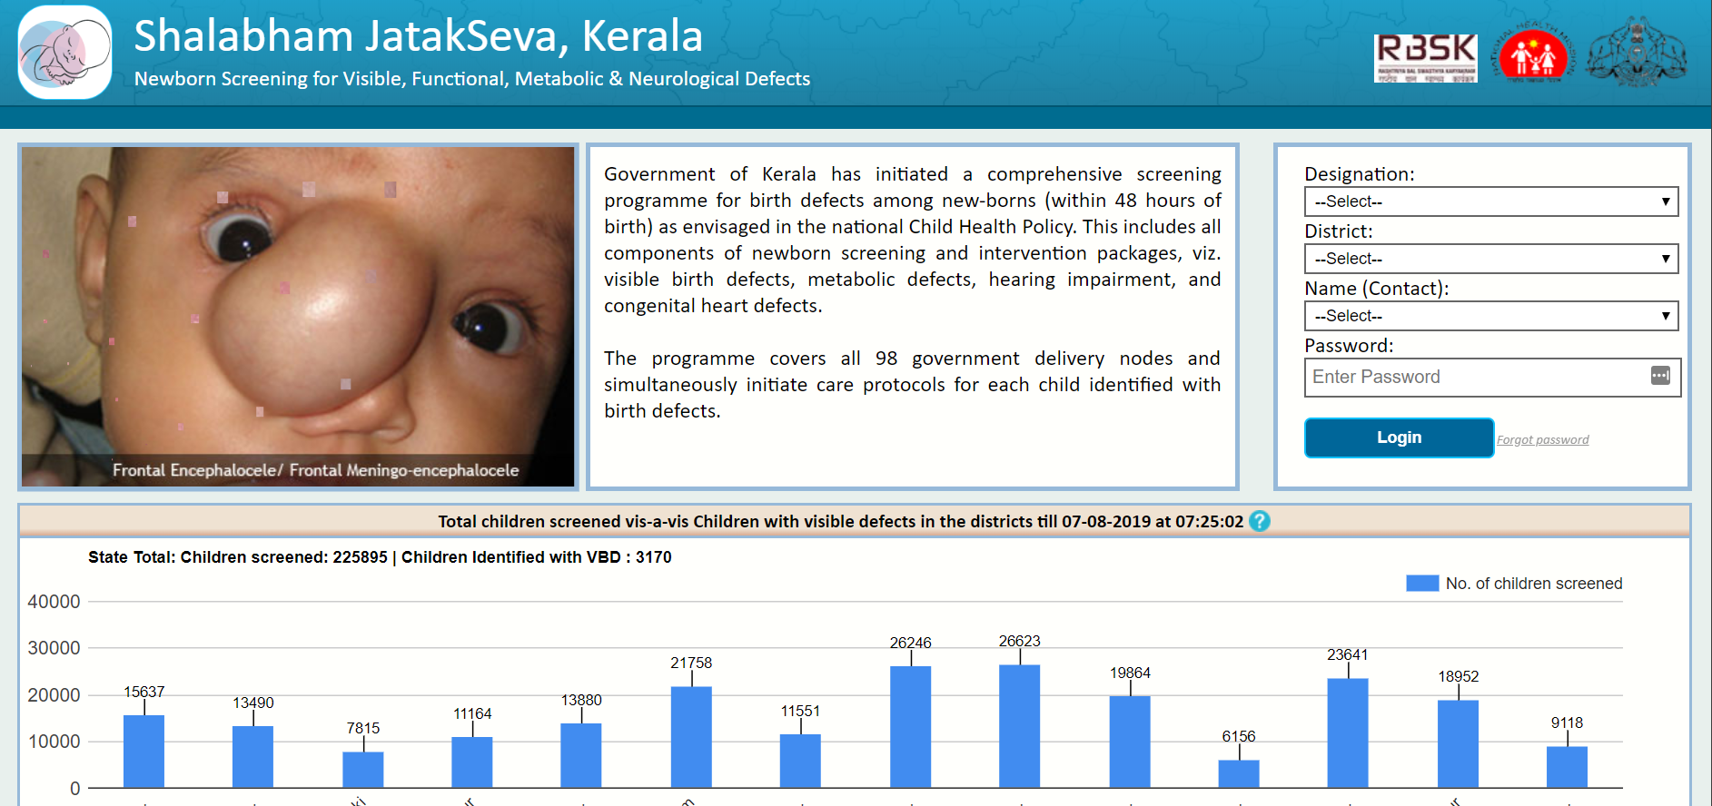
Closing the loop for child health: 4Ds - Shalabham Portal

Slide 12

Hridyam portal
Tracking of PO positive cases
Consultation with specialist facilitated through portal
Curative treatment
Strategic purchasing from private sector
Appointments based on priority algorithm
Screening at delivery points
Pulse Oximetry
Visible birth defects
OAE screening
Metabolic screening
Realtime registration in Shalabham-Jatakseva portal
Color coding of positive cases
Community based follow-up
ASHAs
RBSK nurses
Closing the loop for management of 4Ds among children

Slide 13
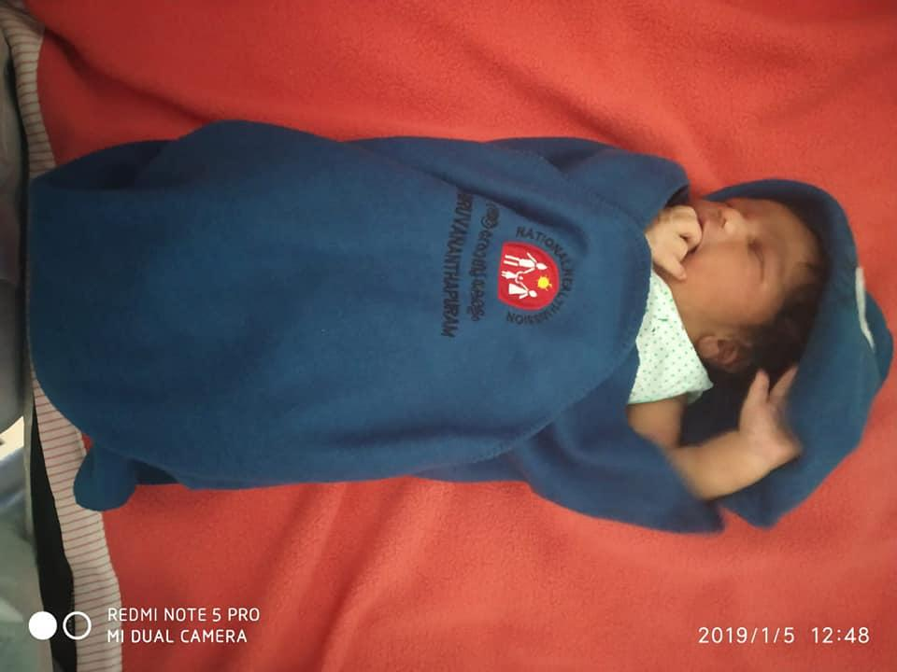

Slide 14
Quality Child Survival
Screening for 4Ds by trained RBSK nurses & mobile health teams in all LSG areas through anganwadis, play schools, immunisation points etc
Referral to DEIC for diagnosis and initial management
Follow-up support through Mobile Intervention Unit (Social Justice Dept.) - Anuyatra, a state funded program
Free congenital heart disease management through “Hridyam” - online platform with empanelled hospitals
Field level follow-up through ASHAs, RBSK nurses, child health crisis management team

Slide 15
Child nutrition & Early childhood development
Linkage with Child Development Centre for training of service delivery personnel
Growth monitoring through MCP cards & AWs
Early childhood development assessment by RBSK nurses
Team based intervention through DEIC & MIU (Anuyatra)
Community based follow-up through RBSK nurses using “Shalabham” web-portal

Slide 16
“Arogyakiranam”: An addon to RBSK
State funded program
Provides free secondary & tertiary care to children with non-RBSK conditions
Covers all children <18 years except children of tax payers & govt. employees
Drugs, diagnostics & referral transport covered

Slide 17
Adolescent Health
Creation of a cadre of “Student Doctors” in the age group 11-18 years
Mentoring of Student Doctors through school-based & community based adolescent mobilisation
Student initiative in palliative care
Convergence with “Souhrida” Clubs of Education Department
Yellow line campaign for awareness reg. Tobacco
VIBGYOR: College Health Program

Slide 18
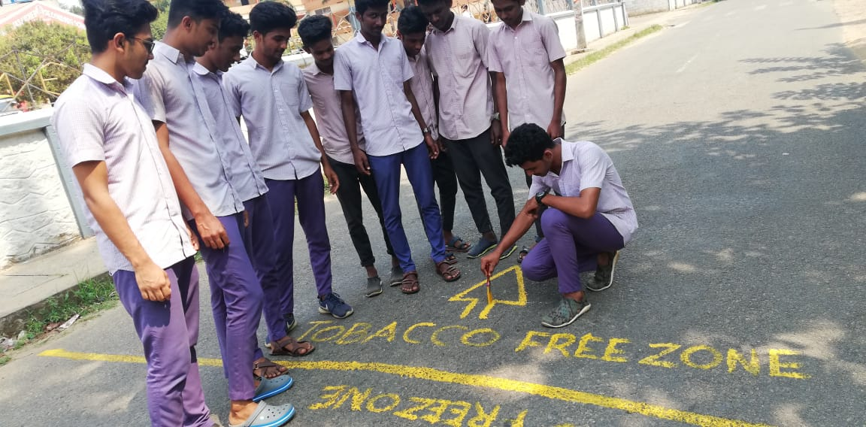
Yellow line campaign for Tobacco awareness

Slide 19
Management of NCDs
Workplace NCD screening through PHCs & subcentres
Universal population based NCD screening through subcentres & PHCs
  Risk assessment by ASHA using Customised forms & e-Health NCD application
  Neighbourhood NCD camps by ANM & Male HW once per month. ASHA to support
  Diagnosis & Management through PHCs/CHCs
Tracking of diagnosed patients through patient cards & patient books
  Tickler box system as part of India Hypertension Management Initiative
Screening for Diabetic Retinopathy (Nayanamritham)
  Teleconsultation with Regional Institute of Ophthalmology using non-mydriatic fundus camera

Slide 20
Management of NCDs
Screening for microalbuminuria
  Urine dipstick test for microalbuminuria in all FHCs
HbA1c analysers in all FHCs to assess control of diabetes
Ensuring control of diabetes & hypertension through community mobilization and patient groups at subcentre level
Standard treatment protocols across multiple disciplines
Regular availability of necessary drugs from FHC level onwards including insulin
Vision centres in all FHCs

Slide 21
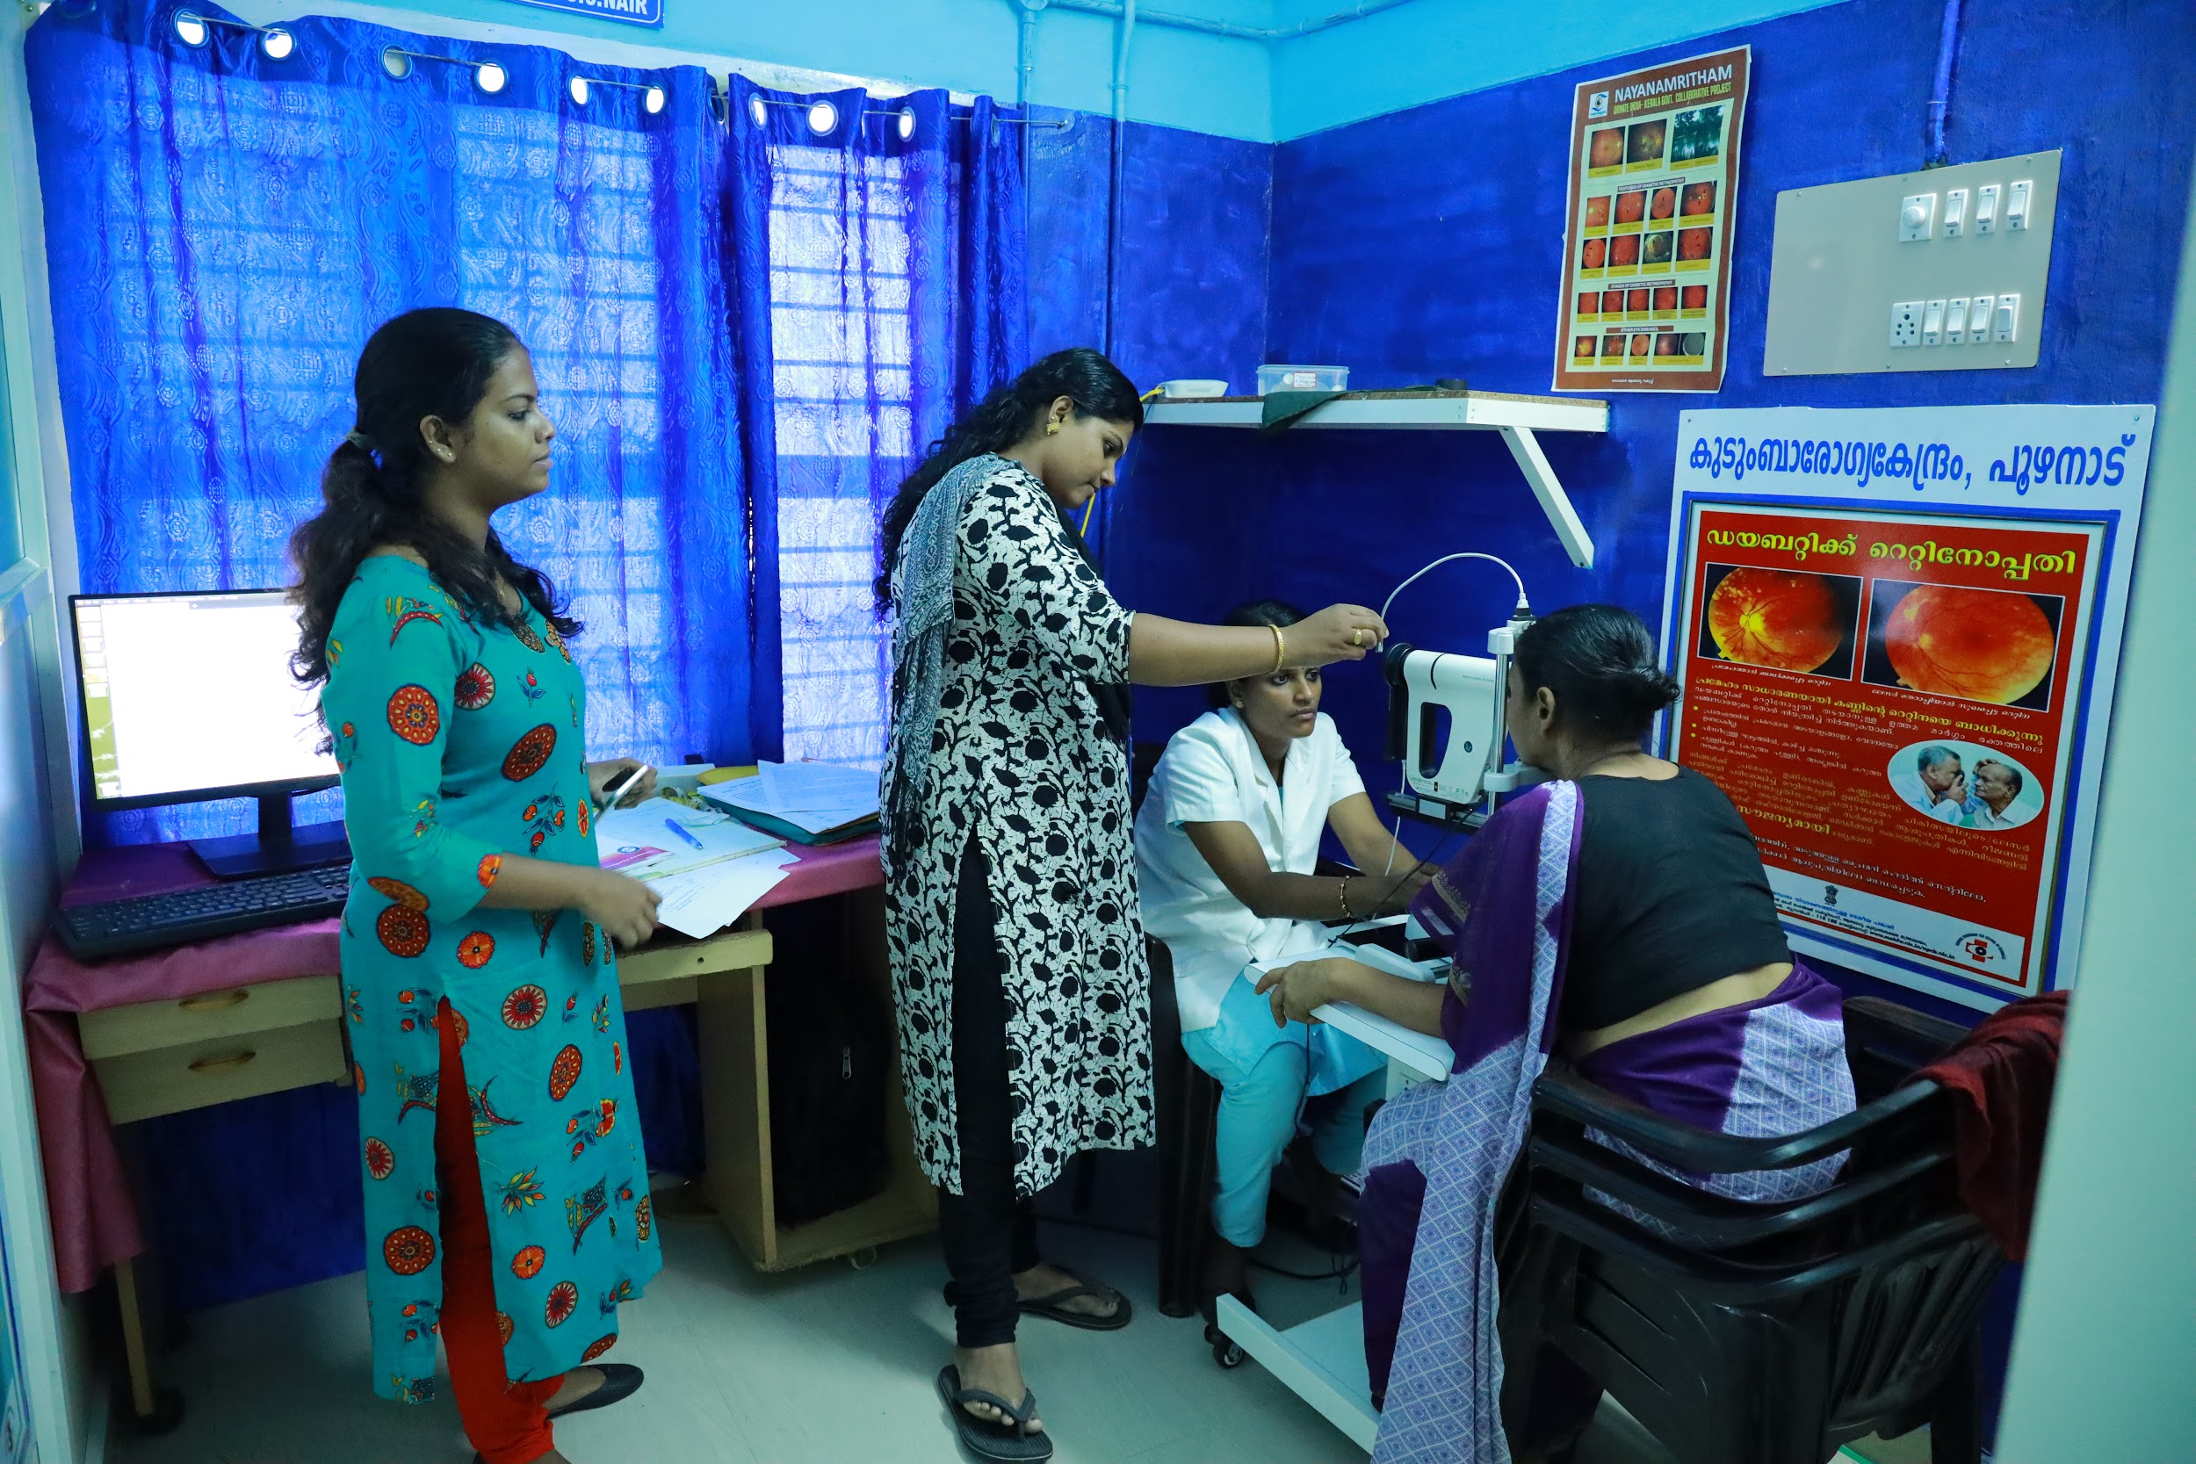
Nayanamritam: Screening for Diabetic Retinopathy at an FHC

Slide 22

Screening at FHC level
Non-mydriatic cameras at FHC level
Trained staff nurses
Scheduled screening of all diabetics & hypertensives
Regional Institute of Ophthalmology
Evaluation of retinal images for retinopathy
Online reporting
Reports within 48 hours at FHC
Referral to higher centre for care
Continuum of care for Diabetic Retinopathy

Slide 23

Cancers
Screening for cancers through neighbourhood screening camps organised in association with LSGs
  Mobile cancer detection units run through District Cancer Centres
  Pap smear test, Oral visual examination, Clinical Breast Examination
Referral & back referral system with 3 Regional Cancer Centres established
Day care chemotherapy centres at District level
Standardised treatment policy for Cancers

Slide 24

Mental Health
Sampoorna Manasikarogyam - Population survey using PHQ9 questionnnaire to identify those in high risk of depression
  Conducted by ASHA (using Malayalam questionnaire)
  Confirmation of diagnosis through fixed day mental health clinics at FHCs (DMHP teams)
  Follow up care through FHCs, Subcentres
Aswaas clinics - fixed day depression clinics at FHCs
  Manned by trained MPW
Amma Manass - Identification of post-partum depression & maternal mental health issues through trained ANMs
School Mental Health Program - Identification of children in need of support

Slide 25
Community based management of communicable diseases
Arogya Jagratha Campaign
Community mobilisation for mosquito source reduction
Water source chlorination
Waste management & Environment management
Promoting environment consciousness
Cadre of non-remunerated community health volunteers: Arogya Sena

Slide 26
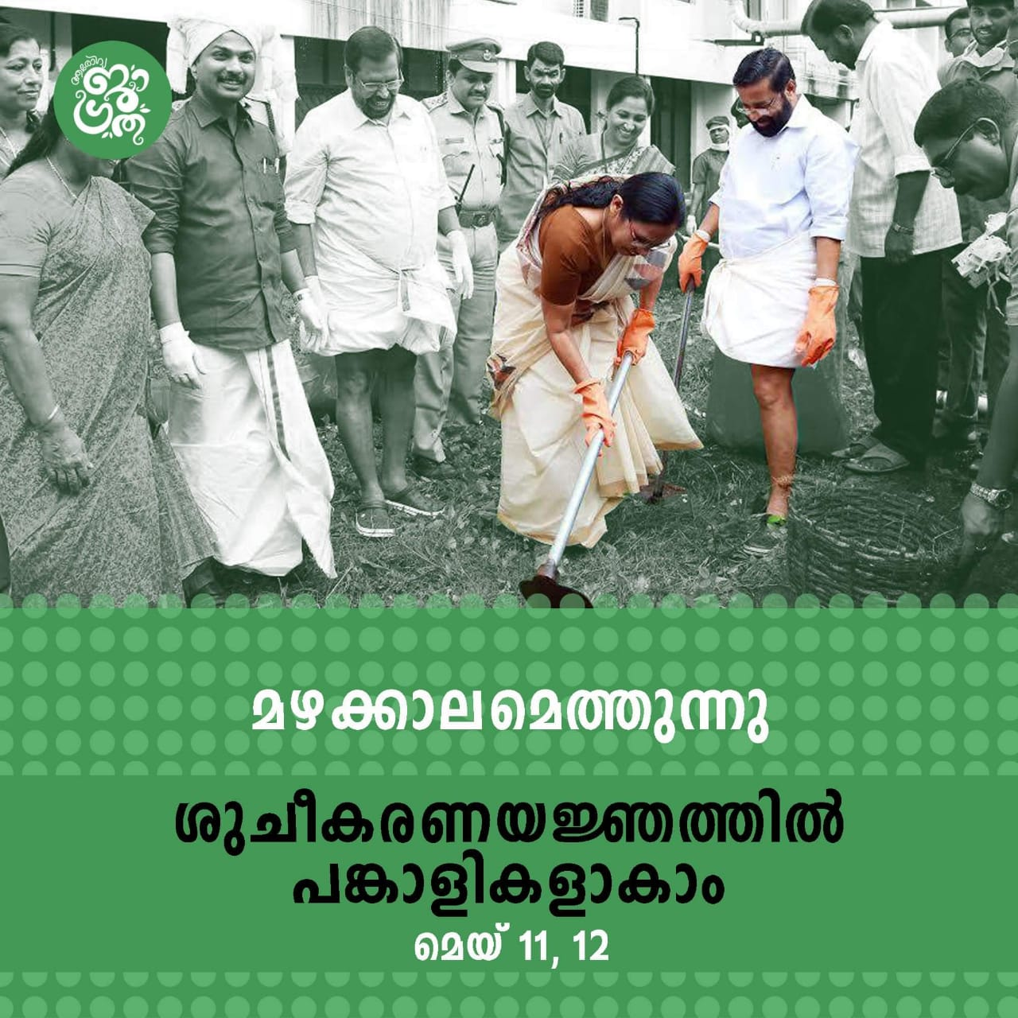
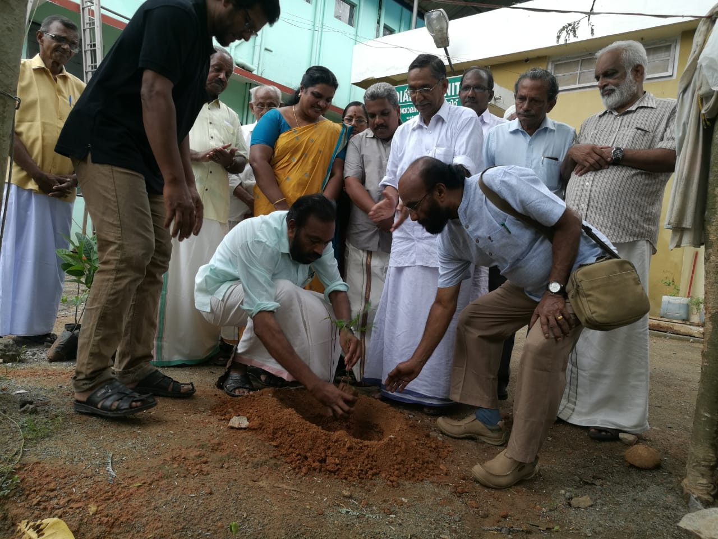

Slide 27

Wellness
Play areas at workplaces
Yoga training
Cycling tracks & walkways around FHCs
Junk food Junglee campaign in association with Food Safety Department to promote healthy eating habits
Imposition of Fat tax - 14.5% for junk food
Wellness activity integrated with days of importance

Slide 28
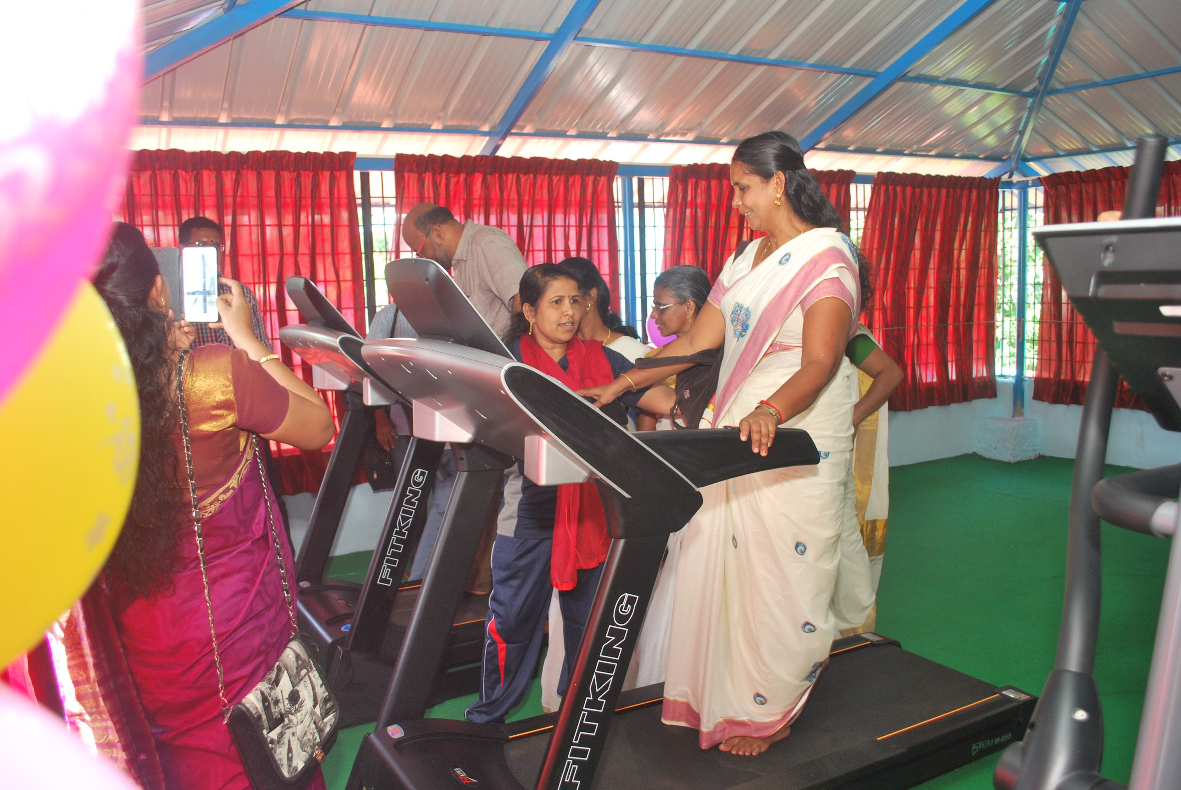
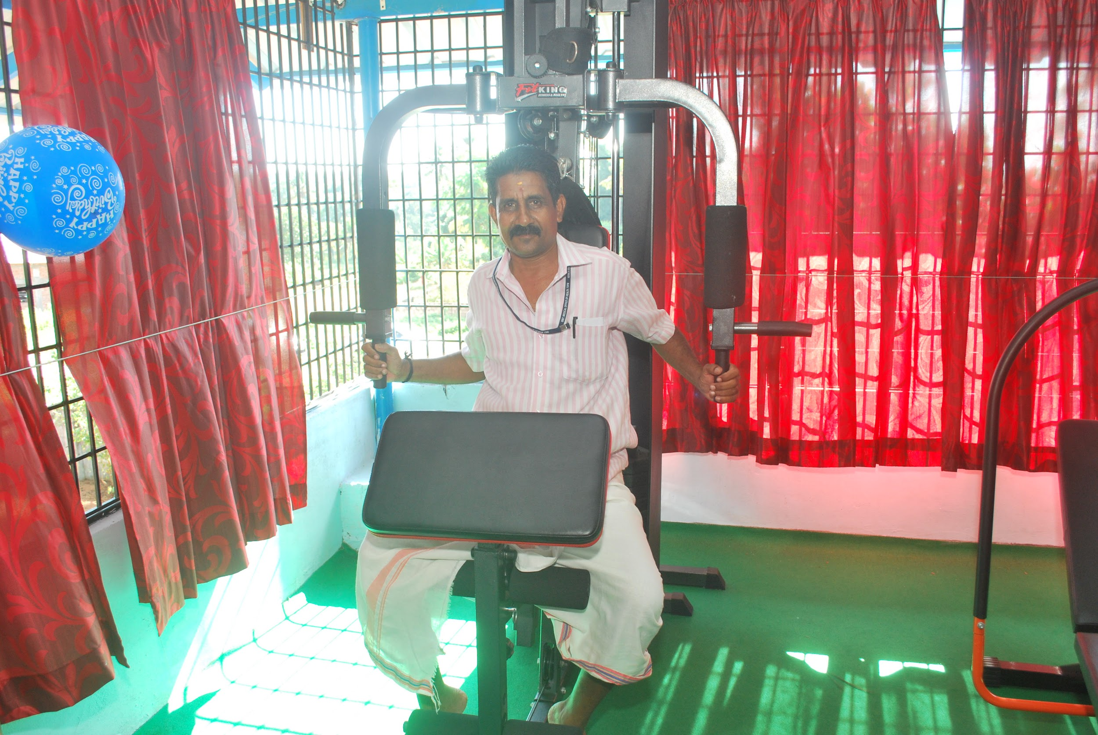
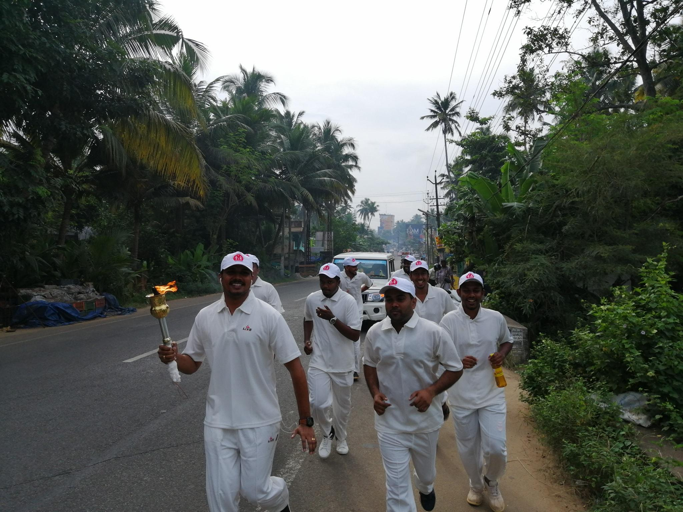
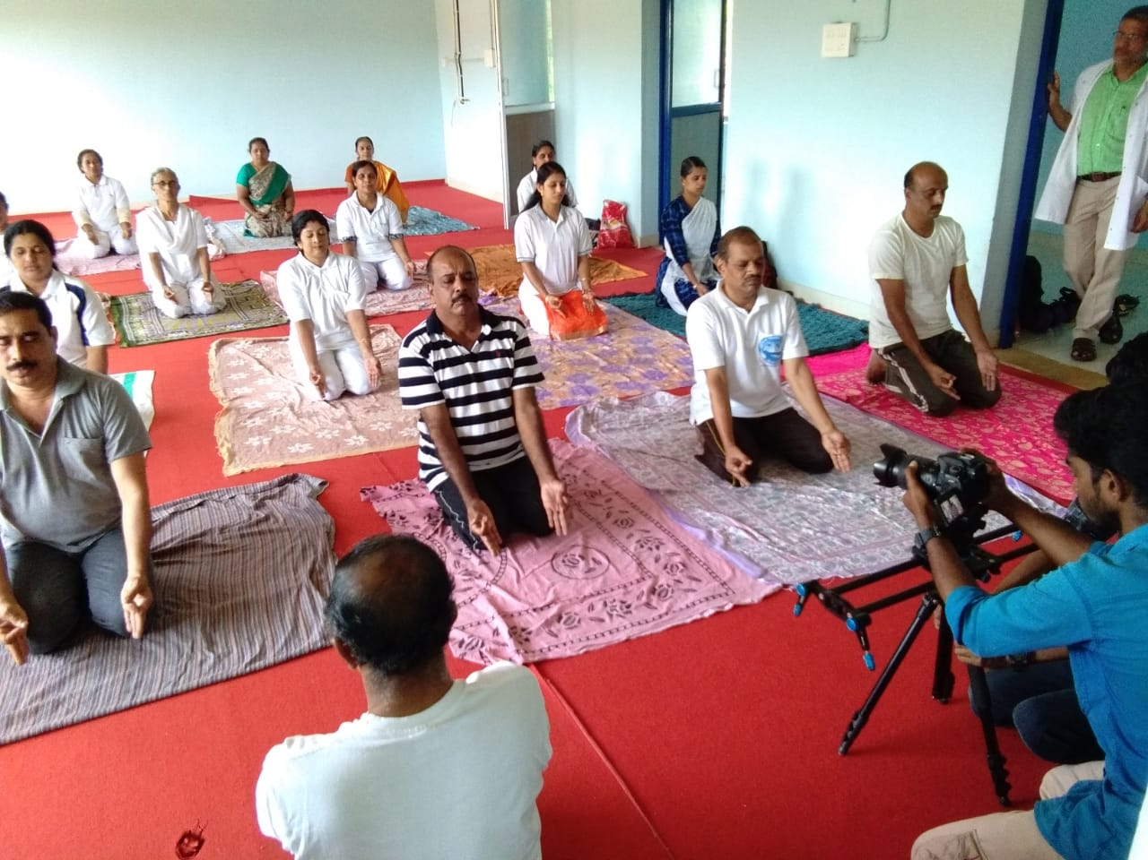
Wellness activities in various FHCs

Slide 29
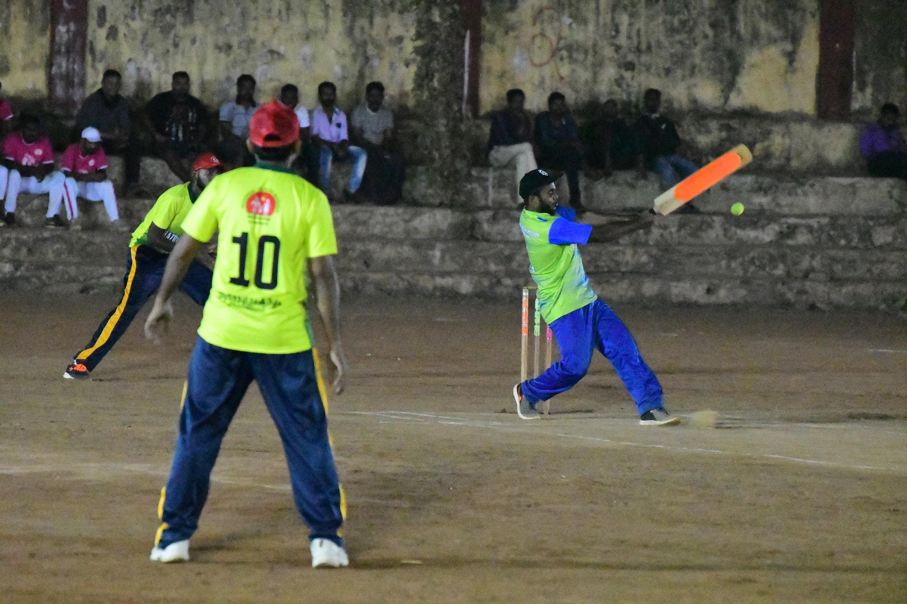
Cricket championship as part of Wellness activity in College Health Program VIBGYOR

Slide 30
Skating competition for kids

Slide 31
Palliative Care
Project owned by LSG
Implemented through MO in charge of health institution
Trained ANMs (3 months training) in every PHC/panchayat
Home based palliative care for 16 days in a month
Remaining are OP days
Provision for consumables (incl catheters, colostomy bags, ryles tube etc), drugs, mobility support & honorarium
Training of Arogya Sena volunteers & self help groups for community assistance in palliative care
Community patient support for non-medical needs

Slide 32
Palliative Care
Secondary Palliative Care in all CHCs
  Staff Nurse + Physiotherapist
  Home based expert care for patients
IP facility for patients requiring long-term care at CHCs
Morphine for pain management at CHC level wherever trained MO is available
Specialist care through palliative units at sub-district hospitals
District Palliative Training Resource Centre at DH level
  BCCPM & BCCPN courses for MOs & Staff Nurses (45 days)
  BCCPAN course for ANMs (3 months)

Slide 33

Rehabilitation
Tobacco Cessation Clinics at District level
Vimukti - Deaddiction Centres at District level
Pakalveedu - Day care centres for mentally challenged - separate for males and females
  Occupational rehabilitation - inmates of pakalveedu engage in economically productive activities - soap making, pen making, medicine cover manufacturing

Slide 34
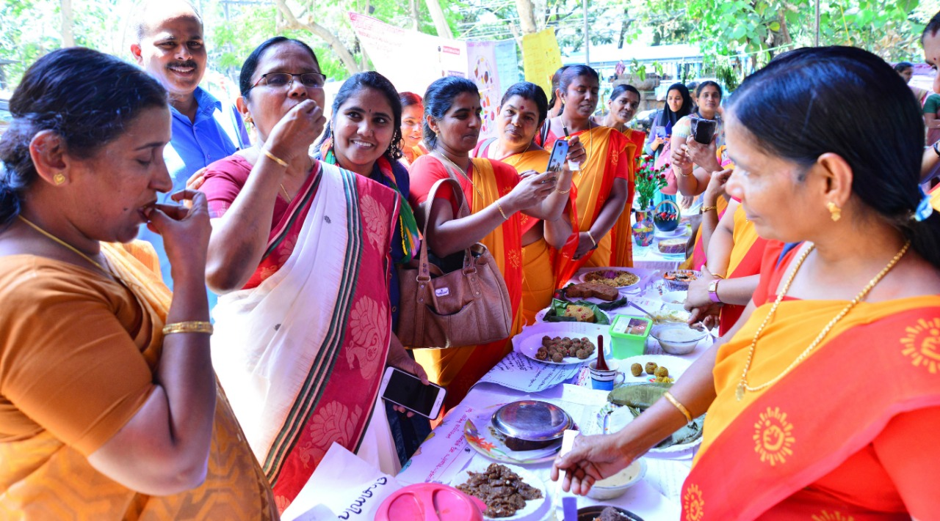
Continuum of care across levels

Slide 35
Superspecialty services at Tertiary level
3 assured super-specialty services
Training resource centre
1
Specialty services at Secondary level
8 assured specialities
Complication management
2
Comprehensive Primary Healthcare
FHCs
Subcentres
ASHA, ANM, CHO
1
Ensuring continuum of care

Slide 36
Sub-district Hospitals
8 assured specialities in all Taluk Hospitals - Medicine, Surgery, ENT, O&G, Anaesthesia, Ophthalmology, Paediatrics, Dental
Dialysis units in all taluk hospitals run by trained MOs (3 months training)
Secondary Palliative care unit for specialist IP care
Audiology & speech therapy services at Taluk level

Slide 37
District Hospitals
3 assured superspeciality disciplines - Cardiology, Neurology, Nephrology
Functional Cath lab with CCU
Stroke Stabilisation Unit with thrombolysis facility
Day care Chemotherapy Centre at DH level
Palliative Care Training Resource Centre
360 degree metabolic centre - for comprehensive NCD management

Slide 38
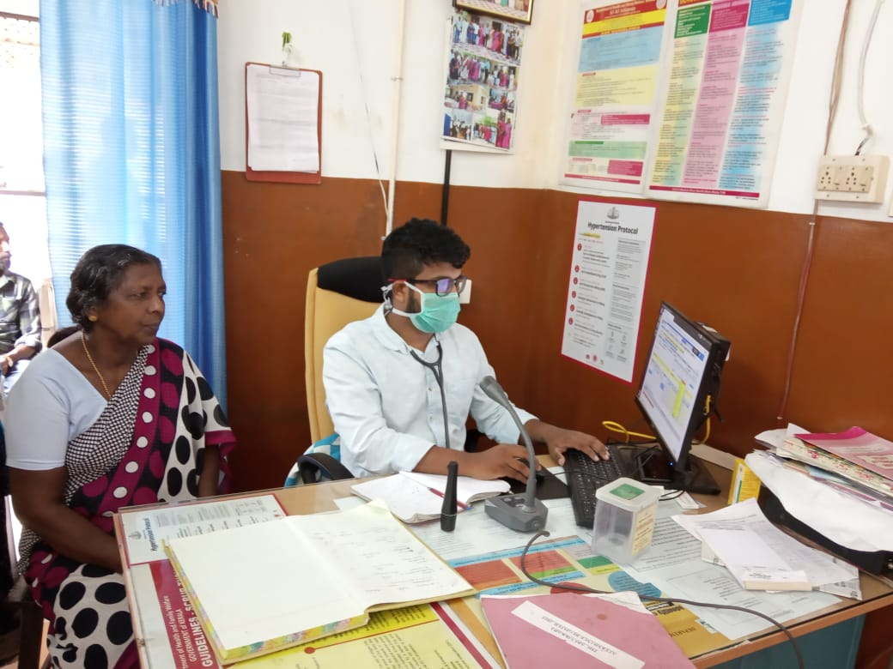
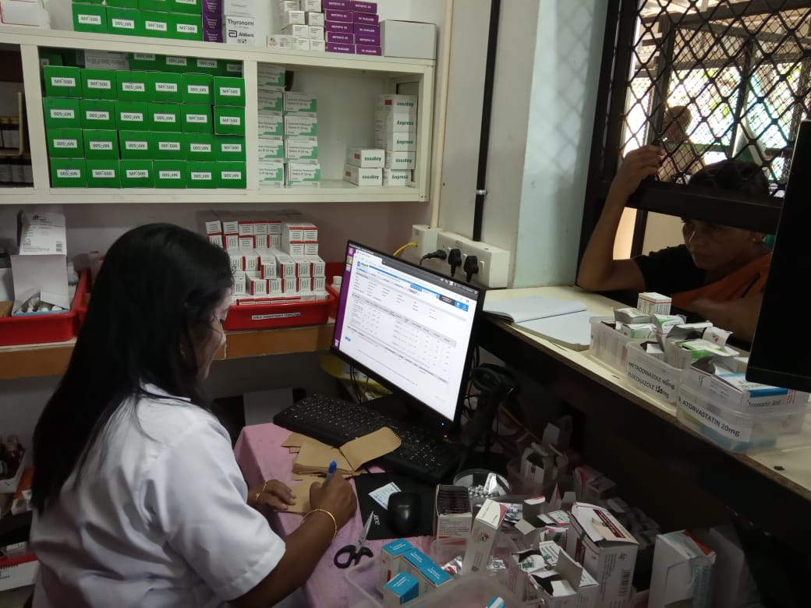
e-Health Implementation in Kerala - OPD and pharmacy

Slide 39
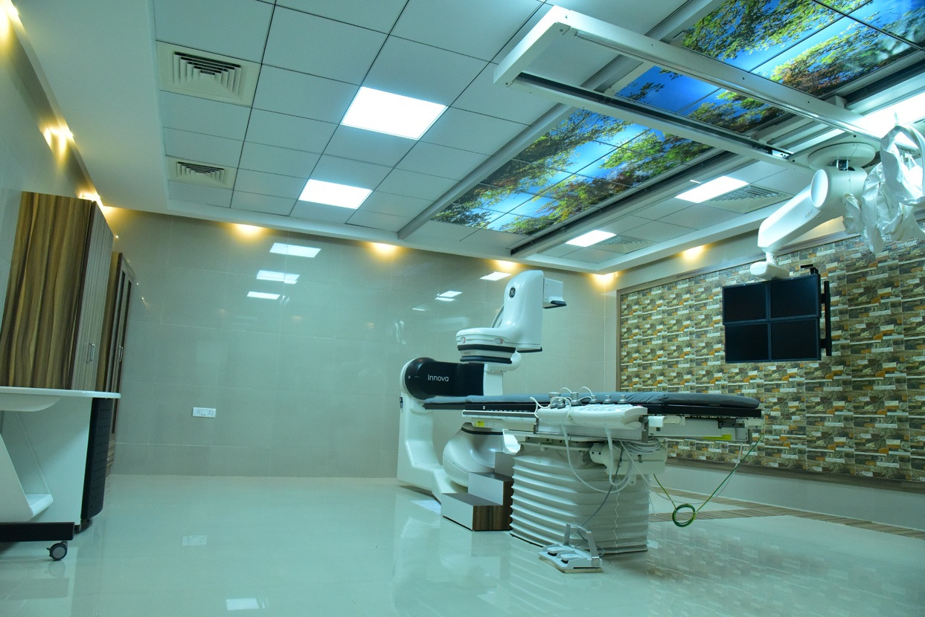
CATH labs in District Hospitals

Slide 40
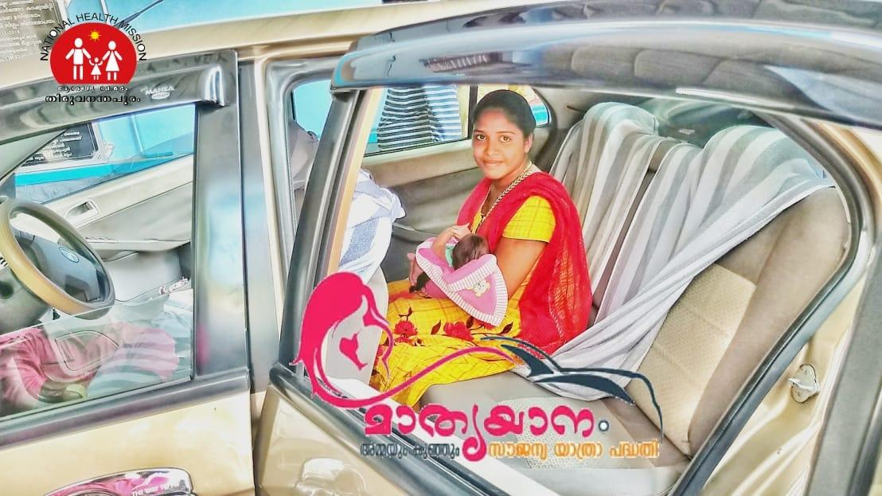
Mathruyaanam: Home drop-back after delivery

Slide 41
e-Health in Kerala
Public Health Module
  Operational across the state
  Population enumeration - Unique Health ID for each person
  Virtual family folders
  Tracking of communicable diseases with geolocation
  e-Health NCD module for population based screening (data sharing with national app)
Hospital Module
  Currently in Pilot phase
  Patient registration
  Online appointments
  Queue management
  Paper-less prescription and drug dispensation
  Facilitates referral & back-referral

Slide 42
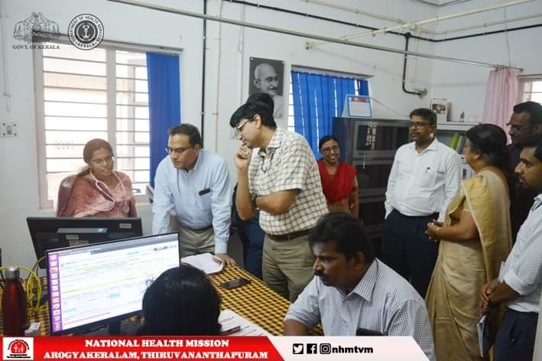
Ensuring access & affordability

Slide 43
Client Friendly Hospitals
Renewed commitment to client friendly services in hospitals
  Adequate waiting area with amenities
  Token system
  Secondary waiting area with patient care coordinators for fast-tracking
  Online appointment system

Slide 44
Demand generation with PRI involvement
PRIs actively involve in the functioning of FHCs
Service delivery & Infrastructure augmented with PRI support
Ward Health Review
  Ward level health review by PRI member, ANM, ASHA and ArogyaSena Volunteers
  Monthly meeting
Panchayat Health Review
  Institutional mechanism for interdepartmental coordination
  Once per month
  ASHAs, PRI members, Medical Officers of all cadres
  Other allied departments

Slide 45
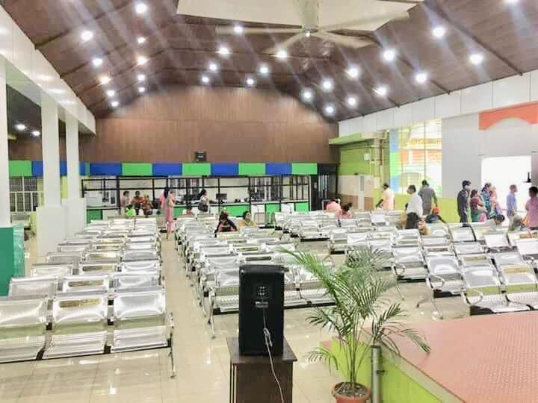
Patient waiting area with amenities at Chalakkudy SDH

Slide 46
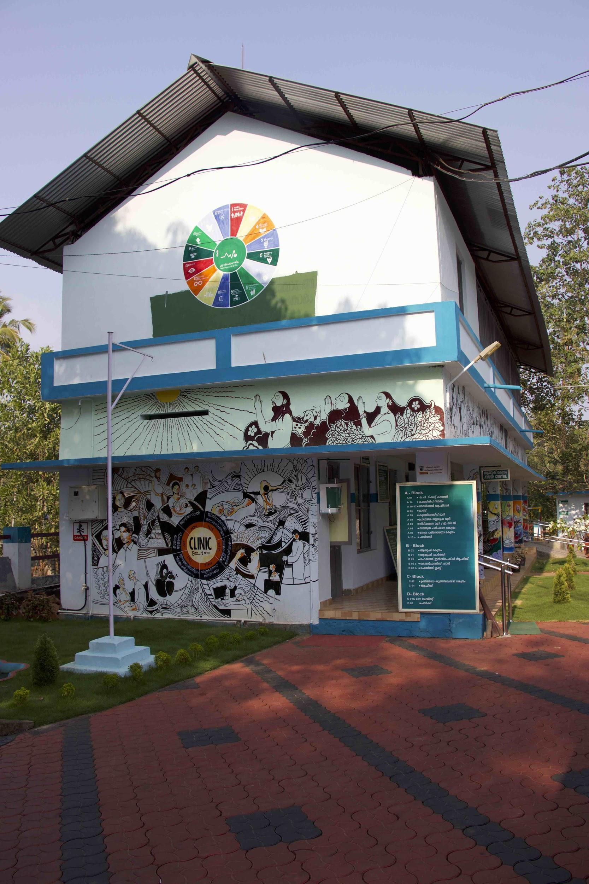
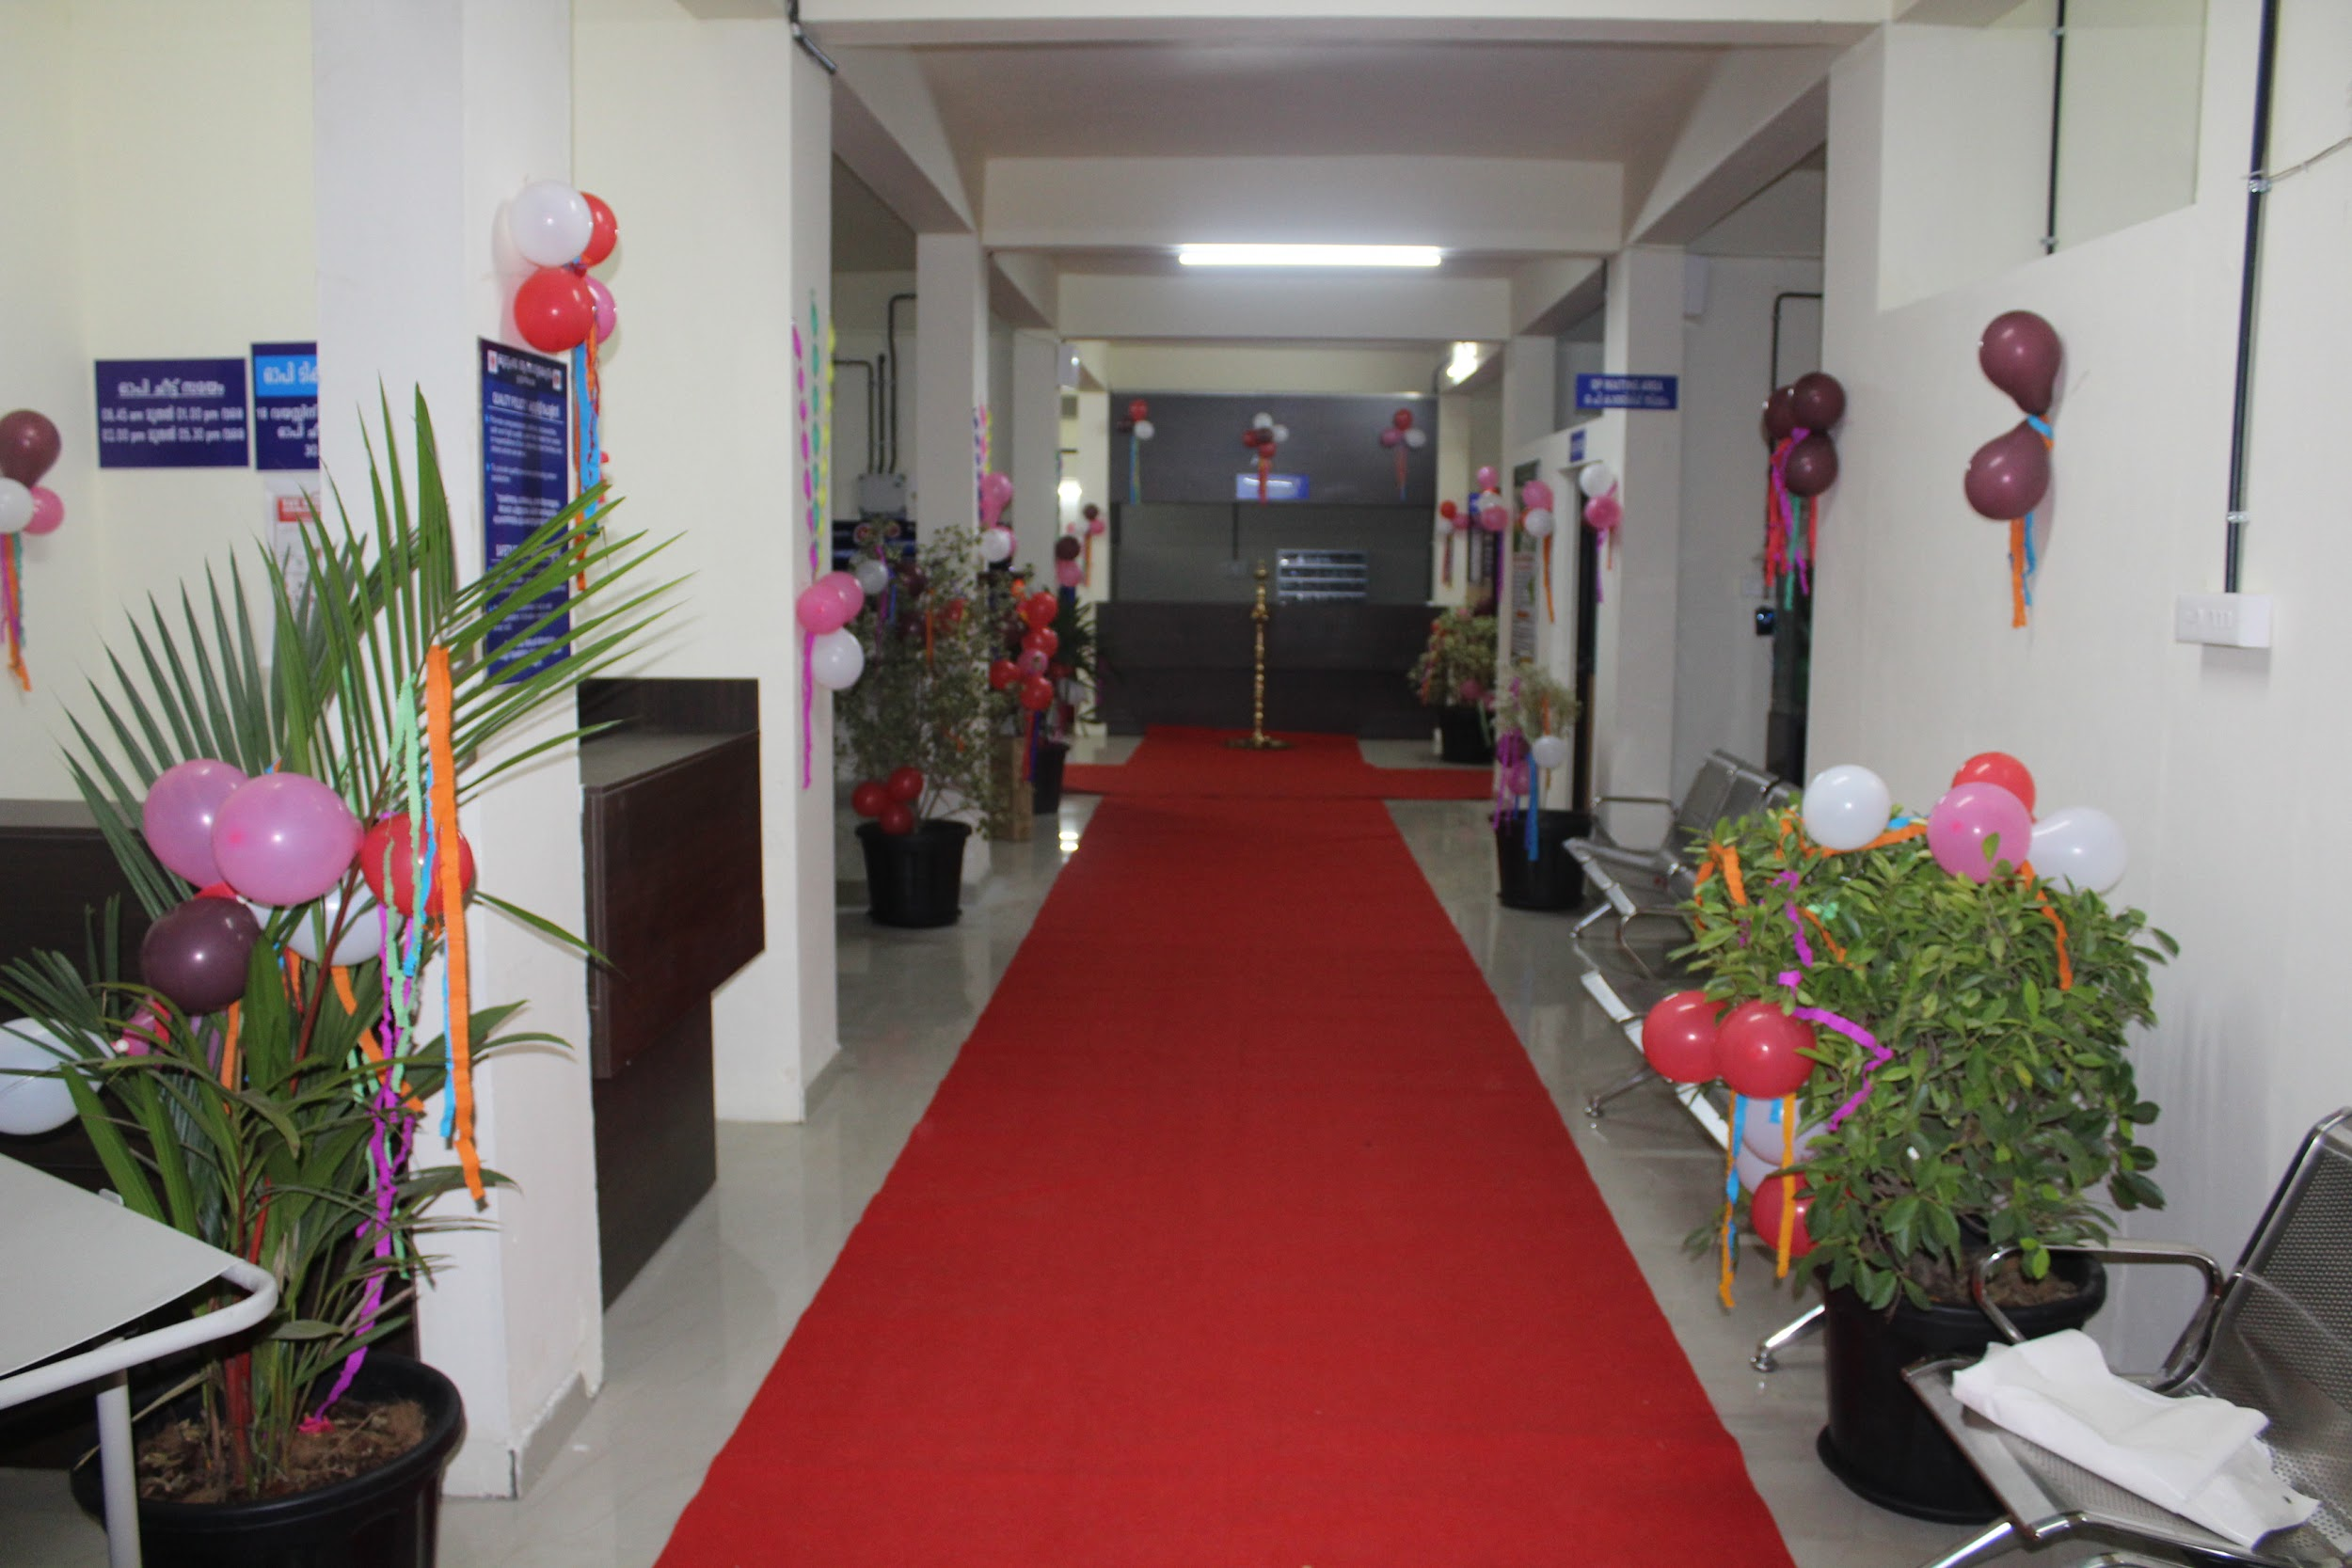
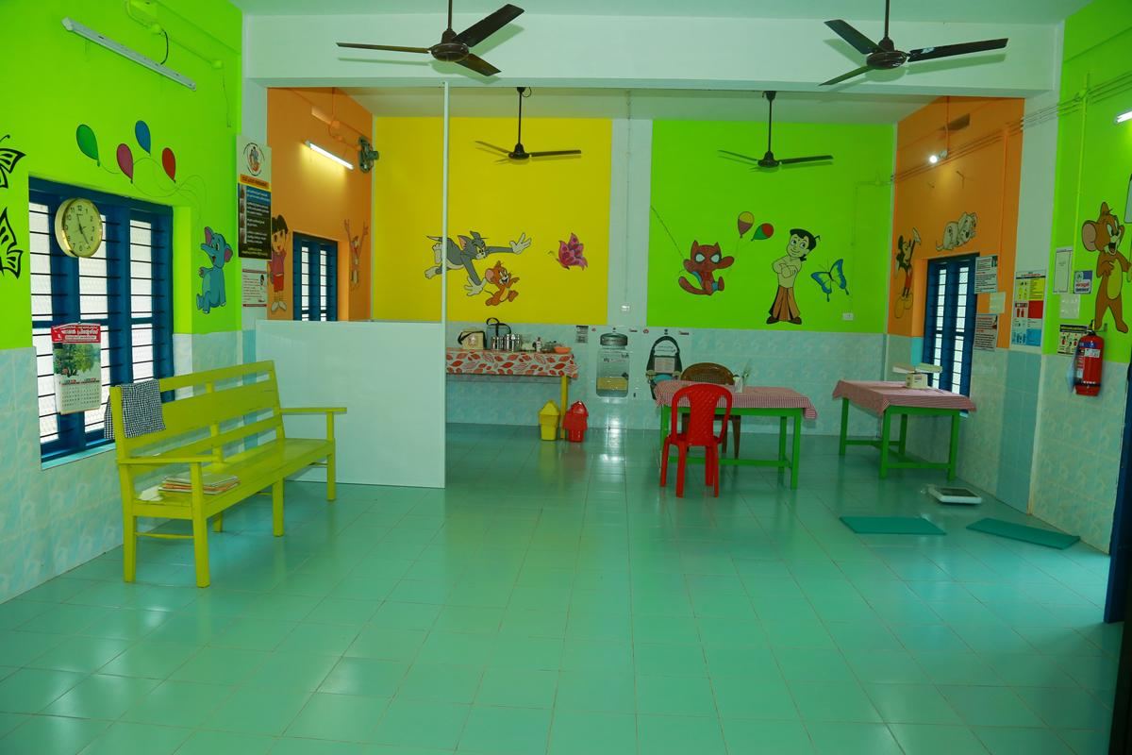
FHCs of Kerala

Slide 47
Karunya Arogya Suraksha Padhati (KASP)
Insurance based care
41 lakh families covered for in-patient care
  19.5 lakh families through AB-PMJAY
  20.5 lakh families through Comprehensive Health Insurance Scheme of Kerala
Convergence with Ayushman Bharat - PMJAY
Rs. 5 lakhs per family
Karunya Benevolent Fund - Additional 3 lakhs benefit for critical illnesses
Strategic purchasing of services from private sector to augment public capacity

Slide 48
Medisep
State funded health insurance for state government employees and pensioners
IP care covered
All government hospitals and empanelled private providers

Slide 49
‘We Care’
Crowd funding platform for health & social security needs
Operated by Kerala Social Security Mission

Slide 50
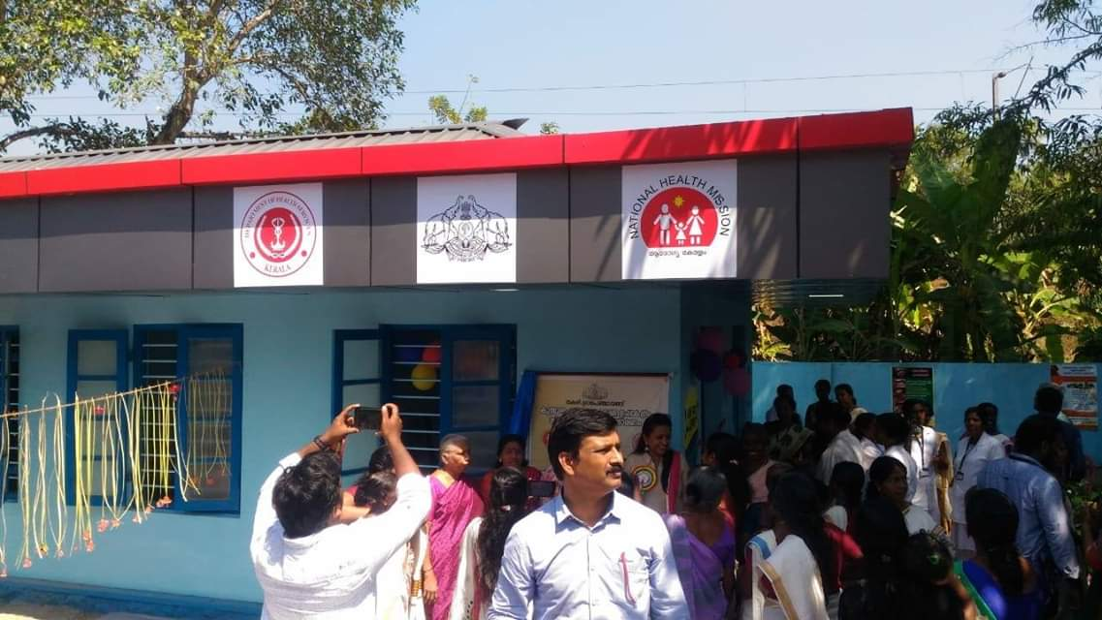
Way forward:
Subcentre as HWC

Slide 51
Planned HR at SC-HWC
4-5 ASHAs
1 ANM (JPHN)
1 Male Health Worker (JHI)
1 CHO (Trained staff nurse)
CHO to be trained at District Training Centres with customised curriculum developed by SHSRC

Slide 52
Weekly Workplan of Staff Nurse CHO
Monday | Woman Wellness Clinic
Tuesday | Field visit of priority households
Wednesday | Screening of children <5 years for 4Ds; follow-up of children w/ 4Ds
Thursday | Chronic diseases clinic - Patient groups & peer support
Friday | School visit: Adolescent outreach clinic
Saturday | FHC Duty - Precheck & patient care; restocking of consumables
Sunday | Weekly Off
Help organise NCD screening camp along w/ JPHN, JHI and ASHA once/month/ward

Slide 53
Mondays: Woman Wellness Clinic
Screening for oral, breast and cervical cancers
  OVE, CBE, VIA/VILI
First contact for Dysfunctional Uterine Bleeding
Anemia screening
RTI/STI screening
Screening for depression & other mental health issues
Woman NCD screening & support
Diet advise
Any other health issues

Slide 54
Tuesdays: Priority households
Chronic epileptics
Persons with psychiatric illness
Accident survivors
Cancer survivors not bedridden
COPD patients
CVA patients not bedridden
Recently discharged antenatal - episiotomy care
Recently discharged SNCU admit baby
Recently discharged ICU admit person
Any person requiring intermittent expert care
Persons on peritoneal dialysis (CAPD)

Slide 55
Wednesdays: Screening of children with 4Ds
Defects at birth
Developmental delays
Deficiencies
Diseases of childhood
Protocol based screening using RBSK screening checklist
Screening of all under five children at least once per year
Periodic followup of children already diagnosed with 4Ds
Counseling of parents of children with 4Ds

Slide 56
Thursdays: Chronic diseases clinic
Follow-up clinical examinations
Patient group activities
Peer support mechanisms
Lifestyle modification advice
Drug compliance monitoring
Care provider counseling
Organised as subcentre activity or as neighbourhood clinic
Patients of a particular disease group taken on rotation basis for clinics

Slide 57
Fridays: Adolescent Health
Visit schools in the area and address adolescents with physical, emotional and mental issues
Counseling and group activities
Menstrual hygiene counseling and support
Early identification and referral of adolescent health issues

Slide 58
Saturdays: FHC Duty
Pre-check and patient counseling in OPD
Nursing care in OPD
Brief MO on activities of the previous week and plan for the coming week
Restocking of consumables for HWC

Slide 59



Financial Risk Mitigation
RBSK
Arogyakiranam
JSSK
Karunya Arogya Suraksha Padhati
Karunya Arogya Suraksha Padhati
Karunya Benevolent Fund
CHIS/CHIS-plus

Slide 60
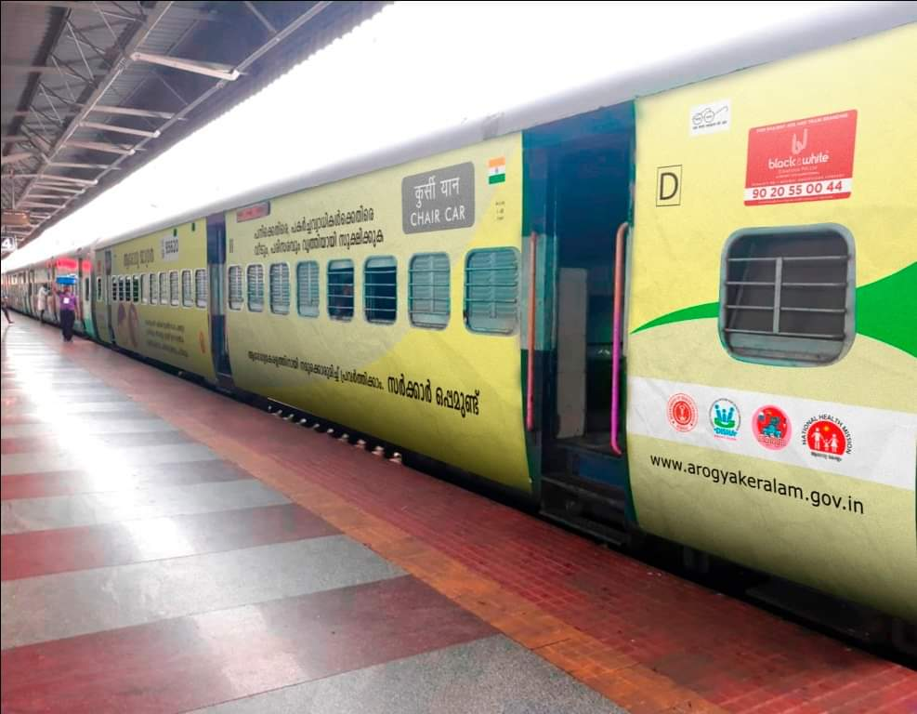
Closing the loop

Slide 61
Local Self Government Support
ASHA
ANM
CHO
Arogyasena
Subcentre
Family Health Centre
Community Health Centre
Sub-district Hospital
District Hospital
Field health outpost providing outreach services.
Coordination of all public health activities. Comprehensive Primary Care with fixed day speciality services
Add on specialty services
Assured specialty services with management of complications
Training resource centre with superspecialty services
1
2
3
4
5
e-Health connectivity across levels to ensure continuum of care
Ensuring continuum of care

Slide 62
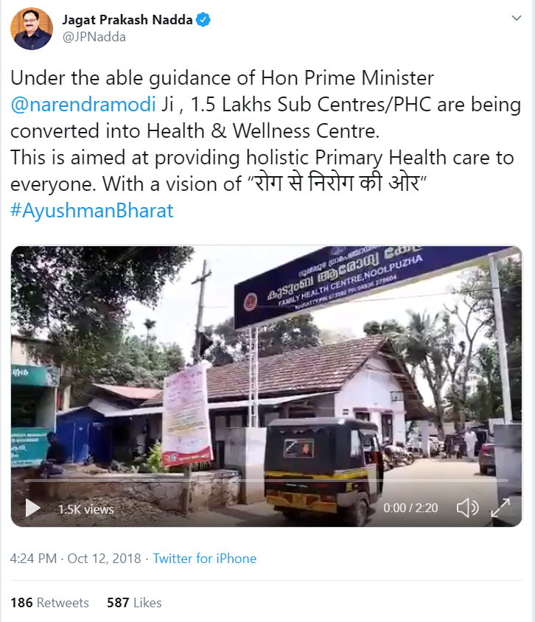
Former Union Minister of Health & Family Welfare tweeting about FHCs in Kerala

Slide 63
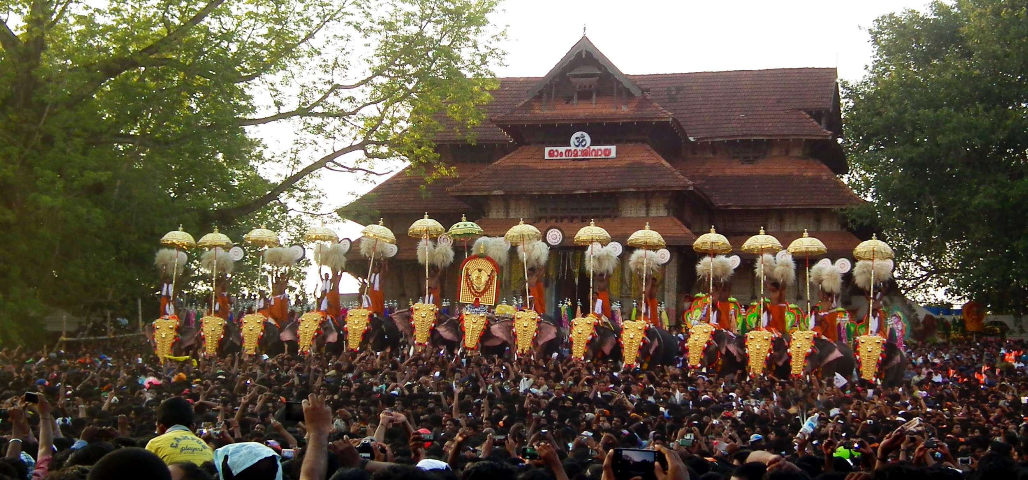
Thank You

