Slide 1







Ayushman Bharat- Arogya Karnataka-
Health and Wellness Centres
National Health Mission
Department of Health and Family Welfare, Government of Karnataka

Slide 2
State’s Initiative towards Cadre of MLHP
Mid-Level Healthcare Provider (MLHP) were recruited
  as announced by Honorable CM of Karnataka in Budget Speech of FY 2017-18.
All Activities to be implemented under Ayushman Bharat-Arogya Karnataka- through HWCs at SC/PHC/UHC
  as Policy decision taken with Cabinet approval.
State to involve only BSc Nursing as MLHPs at SC-HWCs - Karnataka is one of the front-runner in having highest number of Nurses.

Slide 3
Selection process of MLHPs
Karnataka till FY 2019-20 has been accorded 1842 MLHP approvals; 889 are currently working (530 existing + 359 newly trained).
Preferred Nomenclature -Mid-Level Healthcare Provider;
  Based on the experiences from the field by TILC team.
De-Centralized selection- district level appointment to minimize attrition rate.
Entrance exam conducted online through digital partner KEONICs to ensure transparency for 766 posts in July’19 batch.
Strict adherence to timelines for selection - one month from advertisement to selection & filling of IGNOU admission forms

Slide 4
Process adopted for selection (>1 month from date of Notification)
-Identification of Technical partner
-development of software.
- Dissemination to District teams
(01-13TH OF JUNE)
- Invited application through Online process
- Candidates to update details with relevant document scan copy.
* Fee to be paid online
(13-06-19 to 07-7-19)
- Scrutiny of applications by district teams
- online approvals by districts based on validation of documents
(07-7-19 to 15-7-19)
- Generation of District specific IDs with Hall tickets.
- Conducted online examinations ( objective type) – on 21-07-19
- 80 questions 90 minutes & 100 marks (include skill based questions)
(16-7-19 to 21-7-19)
- Results declared immediately.
- Merit lists with candidates details were shared to districts for selection (21-7-19 to 23-7-19)
- selection process done on roaster cum merit basis by districts.
(24-7-19 to 31-7-19)
- Issued appointment order with deputation to IGNOU
(31-07-2019)
E

Slide 5
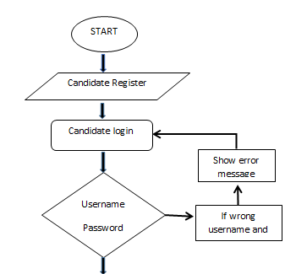
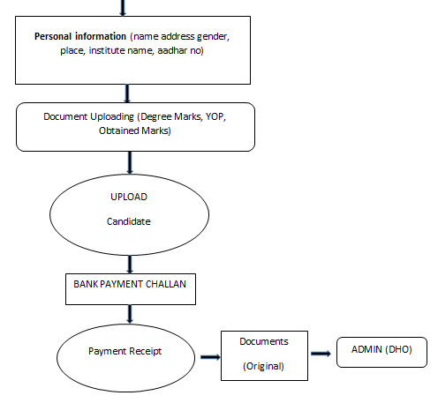
Registration Flow chart
Registration
Uploading documents

Slide 6
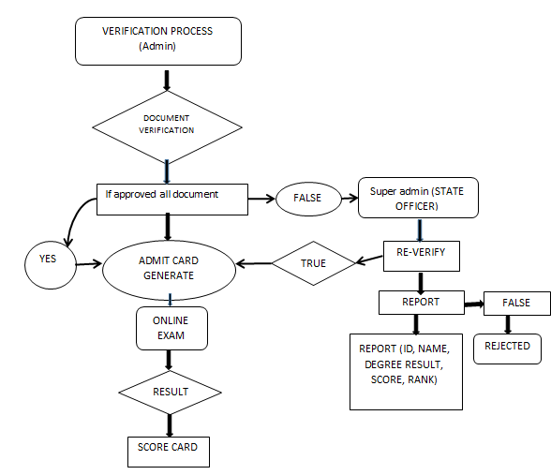
Admin Process Flow Diagram

Slide 7
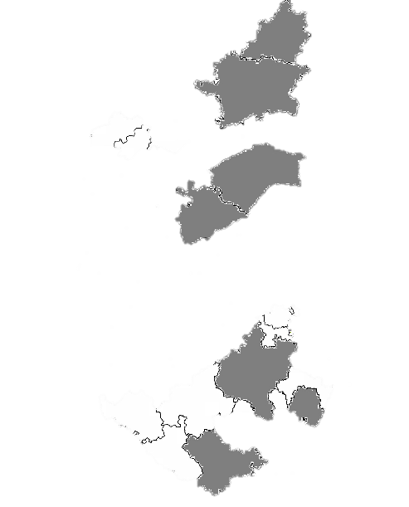
Preparations for Certificate Course in Community Health
Karnataka: The foremost state to harness Medical Colleges as Centre of Excellence in trainings as Programme Study Centres (PSCs) for Certificate Programme
Bidar Institute of Medical Sciences
Gulbarga Institute of Medical Sciences
Raichur Institute of Medical Sciences
Koppal Institute of Medical Sciences
District Hospital, Tumkur
KC General Hospital, Bangalore
General Hospital, Jayanagar, Bangalore
Mysore Institute of Medical Sciences
Deviation from MoHFW Guidelines
which specify using only > 100 bedded District Hospitals
In addition to the IGNOU Curriculum, State has designed Practical Skill tests- reinforcing the skill sets required at the Health & Wellness Centers
Five additional Program Study Centers identified to cater the increased number of candidates in July 2019 batch.

Slide 8
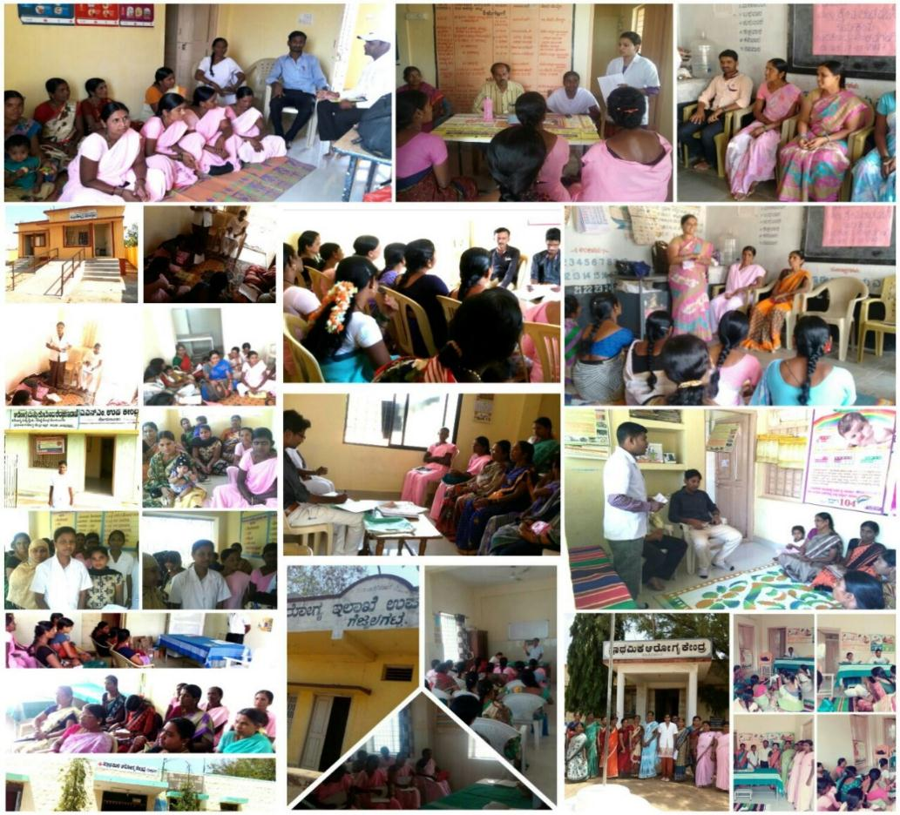
Role of MLHP in field : A-Team Leader
Team Building, Orientation Session with ASHAs, ANMs and Gram Panchayat Members on
Roles and Responsibilities of Front line Health workers
Concept of Certificate Course in Community Healthcare
Functions of the Team
Targeted Community immersion & acceptance by existing field functionaries, VHSNC & GP members

Slide 9
MLHP- Weekly Schedule
DAY | 09:00 AM TO 01:00 PM | 02:00PM TO 05:00PM
MONDAY | OPD Clinic | OPD Clinic
TUESDAY | NCD Clinic-9-12 pm | HOME VISIT-12-1 pm OPD Clinic 2-5 pm
WEDNESDAY | NCD CAMP
THURSDAY | IMMUNIZATION CAMP OPD Clinic & mobilization for Immunization In afternoon – Home visit for High risk pregnancy case care
FRIDAY | OPD clinic & SCHOOL VISIT in lunch hour | Review meeting- MO
SATURDAY | Yoga day monitoring-9-10 am OPD Clinic 10-1:00 pm VHSNC/ VHND & ANGANWADI Visit | OPD Clinic 1-5 pm

Slide 10
MLHP: Service Delivery
Response to non-conventional packages was reported to be increased e.g NCD, Elderly care, ENT, Trauma, Oral health etc.
Average daily footfalls- increased from 2-5 patients/day (Nov-December 2017) to 20 patients/day in FY 2019
Injections withdrawn from all the HWCs except for the regular supply of immunization.
TILC along- with state has introduced Google drive to capture micro-picture of MLHP working
  Functionality criteria assessment (Gap analysis)

Slide 11
Variables Captured in Google Drive
Base information- List of HWCs linked through their PHCS, with details of corresponding MLHPs, Population, phase of implementation, type of building, Infrastructure repair work status, branding and details on parliamentary constituencies.
Details of MLHPs- Details on date of joining, contract details, contact details, training details etc
HR details- HWC wise availability of ASHAs, JHWs, MO with contact information
Availability of equipments- HWC wise availability of equipment (as per the required list)
Monitoring Indicators- Service delivery information in each of the 12 service areas of CPHC with information on referrals and follow up on each of the service areas, Trends in OPD,

Slide 12
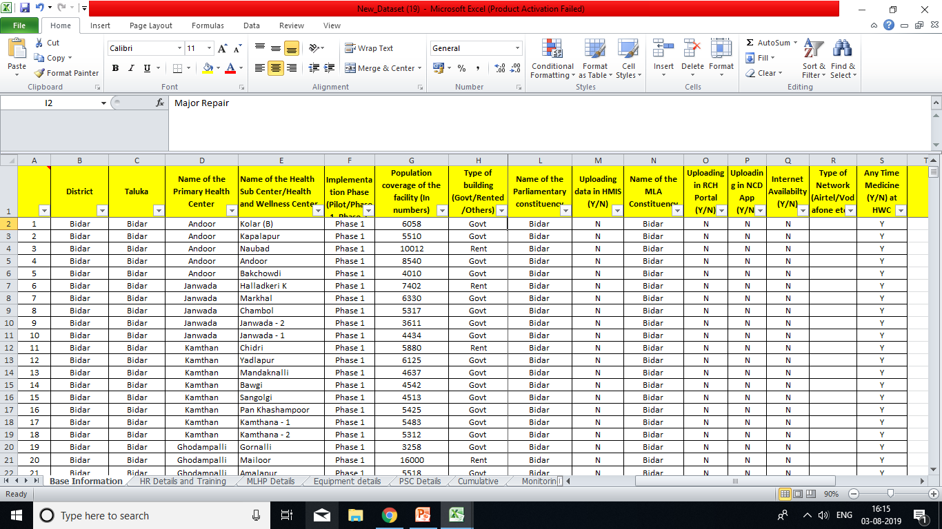
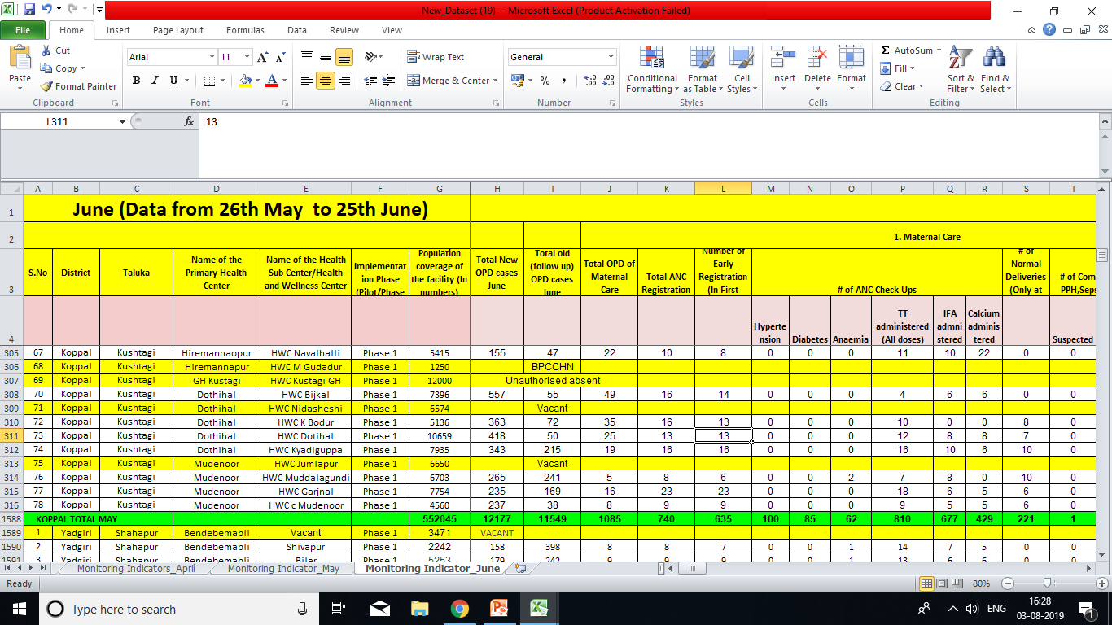
Screenshots of Google drive
https://docs.google.com/spreadsheets/d/1fhke9J2Qv6uYZTZhv78HcQRsOlMLPNzYQAyjoSdoyS0/edit?usp=sharing

Slide 13
Performance- Average OPD per centre per day- last quarter (Google drive)

Slide 14
Taluk Wise Daily OPD seen as on 1-8-19 (HWC Portal)

Slide 15
% of case load in each of the 12 Service packages of HWC –Google drive

Slide 16
% of referrals in the last Quarter (April to June 2019)

Slide 17
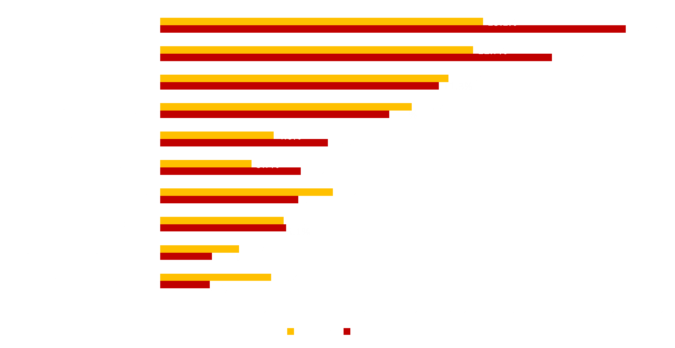
Top 10 Causes (diseases) of out-patient attendees in HWCs

Slide 18
IIPH PHFI Bengaluru Independent Monitoring: provisional findings*
72% beneficiaries are aware about MLHPs at HWC
92% beneficiaries availing services at HWCs rate quality of services by MLHPs as good/satisfactory
Common services availed from MLHPs at HWCs- Consultation (50%), medicines (35%), investigations (15%)
MLHPs perceived role in NCD care by community- measuring BP/ blood sugar, dispensing drugs & mobilizing people for screening
54% perceive improvement in HWCs as compared to previous visits
* Subject to change, process underway

Slide 19
Perception about MLHP: Beneficiary, ASHA, ANM, PHC MO
Patients- MLHPs are Village level “Community Doctor” – cares for patient
ASHAs-MLHP commonly referred to as “UHC Doctor” and are responsible for the overall functioning of SC-HWC
ANM- On being probed about how MLHPs has reduced your work they reported that
  “earlier due to workload stipulated number of ANC and PNC visits could not be completed. With MLHPs in place, ANMs can complete these activities”
PHC MO- Satisfactory knowledge about the programme and expected roles and responsibilities of HWC team and their work distribution

Slide 20
Career Progression for MLHPs – Envisaged by State
( In coordination with NHSRC Team)
Career Progression for MLHP proposal as shown below-
SHC level MLHP
HWC
0-12 years
Public Health Nurse (Grade II)
Taluk Hospital / CHC
>12 years
Senior Public Health Nurse (Grade II)
Block level
>15 years
Public Health Nurse Grade I
District Hospital
> 18 years
Senior Public Health Nurse Grade I
District Health Office
>22 years

Slide 21
Roles and Responsibilities of MLHPs at Taluk level
MLHPs:- Team leader at SHC-HWC – will provide Preventive, curative, rehabilitative & palliative services (Limited)
PHN Grade-2 :- Along with Public Health Manager of CHC/TH – will execute
  Facility (CHC/Taluk) based out reach activities to community,
  coordinate and facilitate NCD, RMNCH+A as well as disease control activities implementation in the Hospitals.
Senior PHN Grade 2 :- Along with Block Health Officer (THOs)– will accomplish
  Provide supportive supervision for implementation of National Health programmes in Taluk level also provide inputs to cover the needs of HWCs.
  Coordinate for proper functioning of Acute emergency & Referral chain management between PHC & Specialty centres for- RCH, CD, NCD cases.
  Will coordinate & Part of disaster management, out break investigation team at Taluk level.
  Will assist Taluk teams along with THO & BPM in preparing evidence based planning/ Gap assessment for MLHP programme of NHM.
  Will be nodal person for MLHP specific grievance redressal with counseling to prevent attrition

Slide 22
Roles and Responsibilities of MLHPs at District level
PHN Grade-1 :- Along with Public Health Manager at District Hospitals/ Medical colleges– will execute
  Facility (Hospital) based out reach activities to community.
  coordinate and facilitate NCD, RMNCH+A as well as disease control activities implementation in the Hospitals.
& Senior PHN Grade 1 :- Along with DHOs– will accomplish
  Provide supportive supervision for implementation of National Health programmes in District level also provide inputs to cover the needs of HWCs.
  Coordinate for proper functioning of Acute emergency & Referral chain management between PHC & Specialty centres for- RCH, CD, NCD cases.
  Will coordinate & Part of disaster management, out break investigation team at Taluk & District level.
  Will assist District teams along with DHWC coordinators in evidence based planning/ Gap assessment for MLHP programme of NHM.
  Will be nodal person for MLHP specific grievance redressal with counseling to prevent attrition

Slide 23
Way forward
The Cadre for MLHPs will be finalized soon and will be projected along with Public Health Cadre in state.
MLHPs will have IT devices for assessing their work performance using appropriate soft wares.
They will also have to submit annual performance report (personalized copy ) for evaluation of their individual performance.
Grievance redressal system will be established at District and sub district level to prevent the attrition of MLHPs

Slide 24
Other Key Initiatives done by state
Decentralized local procurement of drugs at MO PHC level
  using KDLWS- EDL package
THO & Engineering division to make plan for SC-HWC / PHC- HWC repair and up gradation for wellness area .
  Planning done for adoption of exclusive Wellness are- for Yoga and community based awareness and health promotion activity – 15x20 sqft area.
MLHPs payment through PFMS including Performance based and team based incentives
  Performance parameters derived as per GOI norms
Utilization of NCD application for Continuum of Care (decided at IT meeting of state)
  State has adopted NCD application as dynamic software for NCD and Minor ailment care atr HWCs – patient wise records-for dispensing of drugs, follow-up care and performance of MLHPs

Slide 25
Thank You

