Slide 1






Ayushman bharat – health and wellness centres
Regional Workshop , Hyderabad - 7th August 2019

Slide 2
National Health Policy 2017
To attain the highest possible level of health and well-being for all, at all ages, through a Preventive and Promotive healthcare orientation in all developmental policies and universal access to good quality healthcare services without anyone having to face financial hardship as a consequence.

Slide 3
Roll out Plan of Health and Wellness Centres
20,081 as on
7th August 2019
Notes:
Last year against the target of 15,000 about 22,380 were approved and 17,149 became operational, and states have made substantial effort.
This year about 30,323 were approved, and with the accelerated pace about 52,703 are likely to be operational, and the target of 40,000 for this FY met.

Slide 4
AB-HWC Conditionality 2019-2020
State/UT | Total Facilities in the State/ UT | ROP approvals | Target for 25% Functional HWCs | Total Functional as on 06.08.2019
A & N Islands | 128 | 85 | 32 | 30
Andhra Pradesh | 7680 | 3616 | 1920 | 2166
Puducherry | 59 | 121 | 15 | 18
Tamil Nadu | 9132 | 2866 | 2283 | 1617
Telangana | 4991 | 1705 | 1247 | 1174
Kerala | 5463 | 1308 | 1365 | 671*
Karnataka | 9807 | 2740 | 2451 | 708
Orissa | 6781 | 2057 | 1695 | 1003
Lakshadweep | 14 | 3 | 4 | 0
*Till date, no Sub Health Centers (SHCs) have been upgraded as Health & Wellness Centres (728 SHCs approved in FY 2019-20) . State to expedite the process for selection of SHCs, recruitment of additional HR (CHOs) etc.

Slide 5
Functionality Criteria
Following are the essential criteria for Functional HWCs:
Availability of HR ( i.e, Trained CHO at SHC- HWC and MBBS MO at PHC – HWC/ UPHC- HWC)
Completion of training of Primary healthcare team on NCDs
Availability of essential medicines
Availability of essential diagnostics
Infrastructure strengthening including Branding
Initiation of screening of NCDs (Hypertension, Diabetes and three cancers – Oral and Breast)
Initiation of Community Outreach (population enumeration and Community Based Assessment checklist filling) by ASHAs
Use of CPHC IT application
Wellness activity including yoga
Tele-consultation
Performance linked payment for CHO
Expanded service package comprising of Basic Oral healthcare, Geriatric care, Palliative care, Eye and ENT care and Emergency Services
  *Functionality criteria shall be upgraded with time.

Slide 6
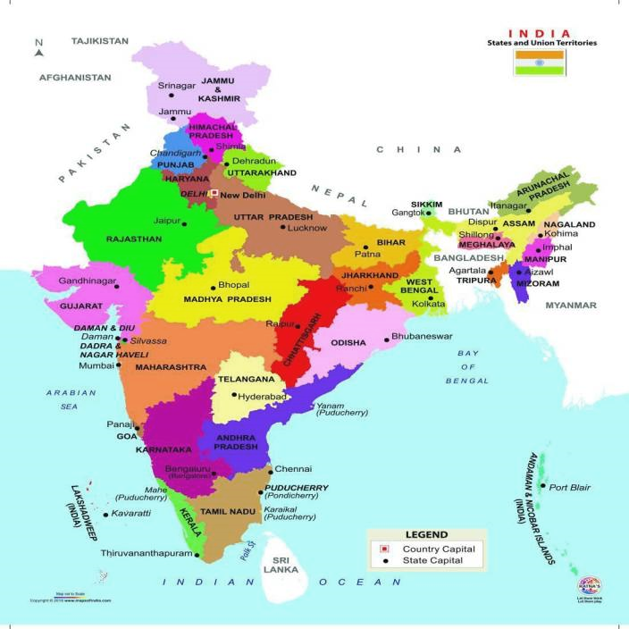
HWC Field Visit Teams
Total 27 Members
Mandar Ranadive
Dr. Adil Shafie
Sunita Kalita
Nishitha Dash
Shraddha Masih
Shailey Gokhale
Dr. Ravikumar AV
Shahid Ali Warsi
Sudipta Basa
Harsha Joshi
Rapungna Pairson
Nadeem Shaikh
Dr. N. Yuvaraj
Dr. Rakshita Khanijou
Dr. Abhishek Gupta
Dr. Meena Chavan
Dr. Apurva Pawar
Dr. Honey Arora
Seema Pati
Dr. Sanjay Tripathi
Dr. Sneha Mutreja
Nisha
Dr. Ajay Patle
Prashant janjal
Bhanupriya Sharma
Dr. Shreeporna Bhattacharya

Slide 7
Good and Replicable Practices
Andhra Pradesh :
  Tele consultation at e-UPHC ; paperless
  e-health record accessible throughout the State
  Safe Delivery Calendar at the facility Level
Karnataka :
  CHO / MLHP
Kerala :
  Continuum of care
  PRI Involvement
  Arogya Sena / Health Ambassadors
Notes:
Strong involvement of Panchayat (Local Self Governance) in planning, management and operationalization of FHCs. Earmarked financial provisions made through PRIs.
Community Level Health Volunteers (like Retired School Teachers etc.) specially formed to perform various activities related to community mobilization, awareness and health promotion

Slide 8
Good and Replicable Practices
Odisha :
  PBS – Campaign mode
  Mahila Aarogya Samitis (Self Help Groups) are actively involved for in house profiling, IEC and health promotional activities
  Yoga and Mediation
Pudducherry :
  Range of Wellness activities at AB-HWC
Tamil Nadu :
  24*7 functional AB-HWCs
  3 months of buffer stock for medicines are available
  SHC – PHC linkages, Yoga and Mediation
Telangana :
  Basti Dawa Khana
  State run diagnostic hub ; streamlined collection of samples and reporting
Notes:
Strong involvement of Panchayat (Local Self Governance) in planning, management and operationalization of FHCs. Earmarked financial provisions made through PRIs.
Community Level Health Volunteers (like Retired School Teachers etc.) specially formed to perform various activities related to community mobilization, awareness and health promotion

Slide 9
Key Elements of Ayushman Bharat – Health and Wellness Centres
Continuum of Care – Telehealth /Referral
Infrastructure
Expanded Service Delivery
Community Mobilisation and Health Promotion
Financing/
Provider Payment Reforms
Robust IT System
CPHC
through
HWC
Medicines & Expanding Diagnostics
Expanding HR - MLHP & Multiskilling
Partnership for Knowledge & Implementation

Slide 10
Expanding HR and Multiskilling :
Planning for CHO / MLHPs & PSCs – as per SHC approvals and ASHAs in Urban areas.
Nursing candidates – direct recruitment – after Dec 2020
CHO / MLHP – home district posting / preference posting
Retention of trained CHO – ensure PLP
Monitoring of the quality of training of CHOs / skill based assessment of CHOs
Quality and duration of training should be adhered– all AB-HWC team
VIA training lag in all states

Slide 11
Expanding HR and Multiskilling :
Andhra Pradesh, Telangana and Karnataka – yet to start July 2019 batch
Karnataka : Vacant positions of District HWC coordinators at both the visited districts
Kerala : Staff nurses are trained for multi-tasking activities such as they are working as Ophthalmic Assistant, ECG technician, HWC data entry, Counselling for Common Mental Health disorders etc.
Odisha : All MOs were trained in Mental Health, SBA, NCD, RNTCP, PPIUCD, BEMOC etc. Lab Technicians are currently either are on deputation or vacant in HWC, Staff Nurse are not present in all PHCs
Puducherry : VIA training- 1 day training to ANM – quality of training to be improved
Tamil Nadu : Due to non availability of dedicated community health volunteer like ASHAs, community services and linkages are affected.
Telangana : Training of Primary Health Care Team on Universal Screening for NCDs has been done for only 1 day.

Slide 12
Medicines and Expanding diagnostics
All State EML has been updated as per CPHC Guidelines – availability of all facility based EML at AB-SHC is to be ensured
IT enabled drug inventory management system to be made available till AB-SHC
Expanded range of POC diagnostics at AB-HWCs : Hub and Spoke
RDT kits ; ensure availability of refrigerator for maintaining optimum temperature

Slide 13
Medicines and Expanding diagnostics
Andhra Pradesh : Irregular indenting at SHC level. Drugs and consumables availability is affected.
Karnataka : Part-time AYUSH MO at both UPHCs prescribing allopathic medicines
Odisha : Drug indenting procedures are not streamlined
Tamil Nadu : Sample transportation through DMLT. Laboratory Information Management System
Telangana : Calibration of equipment happening regularly through PPP mode- Mahbubnagar.
Notes:
In the districts visited , drug indenting for SHC was being done at PHC and CHC.

Slide 14
Community Mobilisation and Health Promotion
Universal screening, prevention and management of NCDs- initiated in all states except Kerala. Fixed day camp approach also followed.
Population enumeration- initiated in all states. Family folders not maintained in Andhra Pradesh
States to initiate structured wellness activities (Health Calendar) / Eat Right related activities in both rural and urban facilities.
Screening on NCDs for ANMs/ ASHAs / MAS members to be ensured.

Slide 15
Community Mobilisation and Health Promotion
Andhra Pradesh : Family folder – not being used
Karnataka : Incomplete CBAC form sets (without annexure 2 and 3)
Kerala : CBAC forms yet to be rolled out in the State.
Odisha : Peer supporting group for NCD diagnosed patients
Puducherry : Wellness activities in forms of yoga, laughter therapy, music therapy and clap therapy through partnership with an NGO at the functional AB-HWC-SHC visited.
Tamil Nadu : State has modified the CBAC format to include screening for 10 conditions. Universal Screening through CBAC for Age group 18-29 years and mandatory screening above 30 years, by Women Health Volunteer , Yoga and meditation sessions are conducted daily at HWC-SHC, Peer support groups for NCD care, Nutrition counselling
Telangana : Meditation sessions conducted for pregnant women every Monday at SC-HWCs in Mahbubnagar and VHND sessions

Slide 16
Robust IT System
Procurement and use of Tablets / Laptops – ANM / NCD / Telemedicine
Procurement - Smart phone for ASHA
Daily reporting – not yet started
Verification of AB-HWC portal data – to be reviewed by PS / MD regularly
Facilitate use of NCD application - MO portal use
State application data - compatible with GOI application/s

Slide 17
Robust IT System
Andhra Pradesh : NCD application is not being used – PPP run model
Karnataka : Tablets are not available with MLHP.
Odisha : Data entry is not done in HWC portal at facility level.
Puducherry : No training on NCD application, HWC portal.
Tamil Nadu : Colour coding was available in the NCD portal for follow up cases. Alert and Messages are send to patient and VHN.(State owned application – offline mode also)

Slide 18
Infrastructure
Ensure gap analysis and infrastructure upgradation – including adequate basic amenities (separate toilet, handwashing area and drainage) including BMW.
Water and electricity – regular supply at all AB-HWCs
Space availability at AB-HWCs including
  RMNCHA+N,
  laboratory,
  waiting areas,
  staff quarters,
  wellness activities

Slide 19
Infrastructure
Andhra Pradesh : New infrastructure – quality / incomplete finishing
Kerala : Rain water Harvesting provision in the facilities visited (also Odisha). UPHCs to be considered as Family Health Centres.

Slide 20
Partnership for Knowledge & Implementation
Development Partners – Technical support
Medical Colleges to adopt 10 AB-HWCs
Self Help Groups / MAS – Urban
ECHO based trainings with National/State institutes
Involvement of Not for profit organization – secondary / tertiary care
Odisha : Specialized health care services at UPHC-HWC through “AMA Clinic” which almost covers 12 package of services as per CPHC.

Slide 21
Financing/Provider Payment Reforms
Performance Linked Payments to be ensured monthly
State can add indicators as per State disease burden
CSR funds / MPLAD / MLALAD fund for AB-HWCs
ASHA payments
Andhra Pradesh & Karnataka : ASHAs not receiving incentive for CBAC filling and community mobilization for screening

Slide 22
Expanded Service Delivery
Ensure wellness activities including Yoga, laughing clubs, patient support groups
State to share models / experiences for remaining packages
Ensure adequate multi-skill training, referral linkages , continued care at the community and follow up.

Slide 23
Expanded Service Delivery
Karnataka :
  Ophthalmic assistant conducting weekly twice OPD at PHC in Gulbarga district
  Clinic for adolescents, called ‘Sneha Clinic’ with one counsellor operational at PHC in Gulbarga district
Tamil Nadu :
  Mental health counselling services are available at the facility along with care /
  counselling through toll free number 104.
  Geriatric and Palliative Care – The Home based Palliative care has been implemented through dedicated Palliative Care Nurse.
  Polyclinic – Fixed day specialized services (Ophthalmic, ENT, Dentistry, Ortho & Physiotherapy, Psychiatry, Obs & Gynae, Dermatology, Paediatric, General medicine) are provided in PPP mode in UPHCs
  Trauma and Emergency care - Immediate first aid care is provided at HWC.
Telangana :
  Palliative care programme being implemented in Siddipet through Tata Trusts and PRPCS
  Weekly geriatric clinics are being conducted at SHCs, PHCs and Basti Dawakhana

Slide 24
Continuum of Care – Telehealth /Referral
Referral according to the HR / Services available at the facility (link referral pathways with HRMIS / services provided)
Ensure infrastructure, human resource and hub-identification
Telemedicine services at all AB-HWC facilities
Medical Colleges – specialist tele-consultations
Telangana : Monthly follow up is being done by the AHSAs and MPWs to ensure treatment compliance for patients diagnosed during screening.
Loss to follow up, except in Kerala and Tamil Nadu, and even in the urban areas.

Slide 25

Thank-you!
HUMAN RESOURCE
RMNCHA+N
MEDICINES
DIAGNOSTICS
TRAINING
INFRASTRUCTURE
WELLNESS

Slide 26
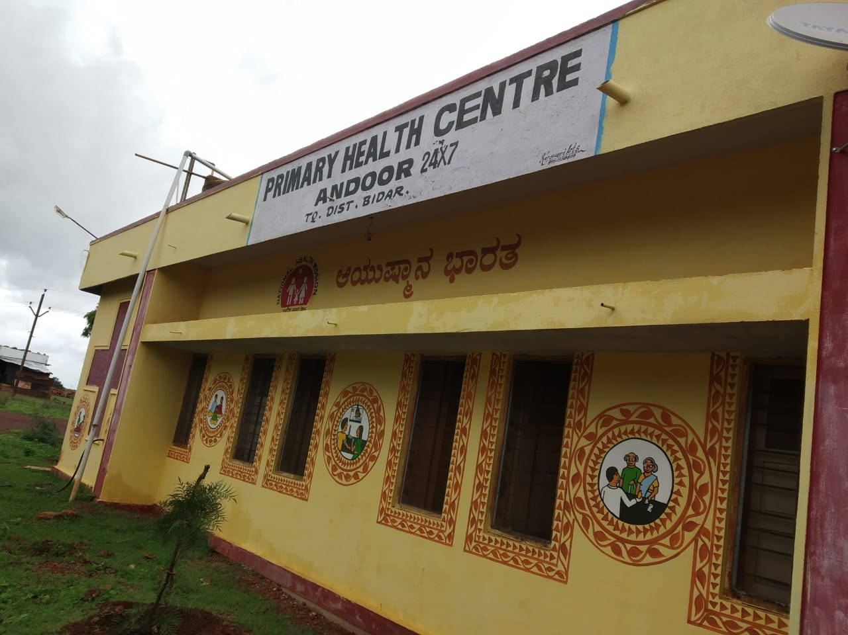
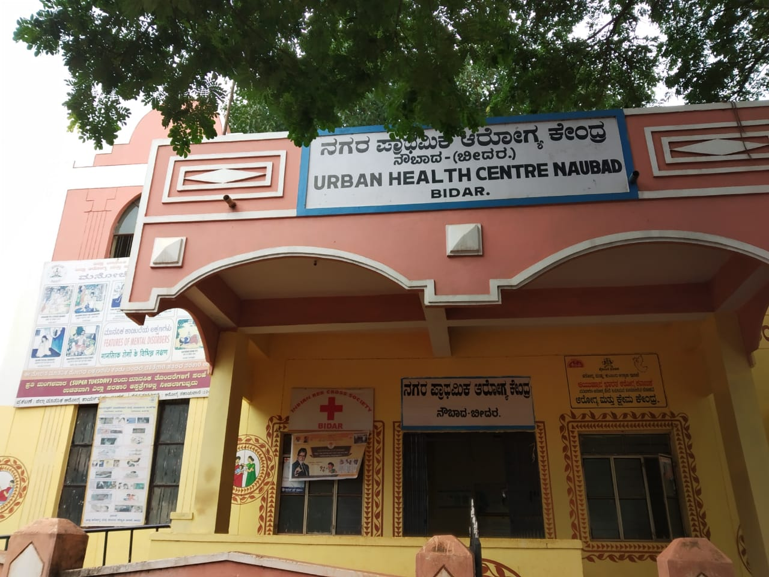

Slide 27
