Slide 1


Regional Workshop on Operationalization of Ayushman Bharat
Health and Wellness Centres – Focus on Telemedicine (AP)
7.8.2019
Hyderabad, Telangana

Slide 2
Health and Wellness Centres – Status of AP
2,167 Health and Wellness centres are functioning in A.P.
Primary Health Centres : 1,145
e-UPHCs : 243
Sub centres : 779 (Tele Medicine operational in 450)
Time line for conversion of remaining 6,880 locations to HWCs : 31st March 2021
Planned for CHO / MLMPs. Recruitment / Training calendar has been prepared
NCD training being focussed upon. Better quality vernacular IEC under prep.
Notes:
Plan of launch – e Sub center

Slide 3
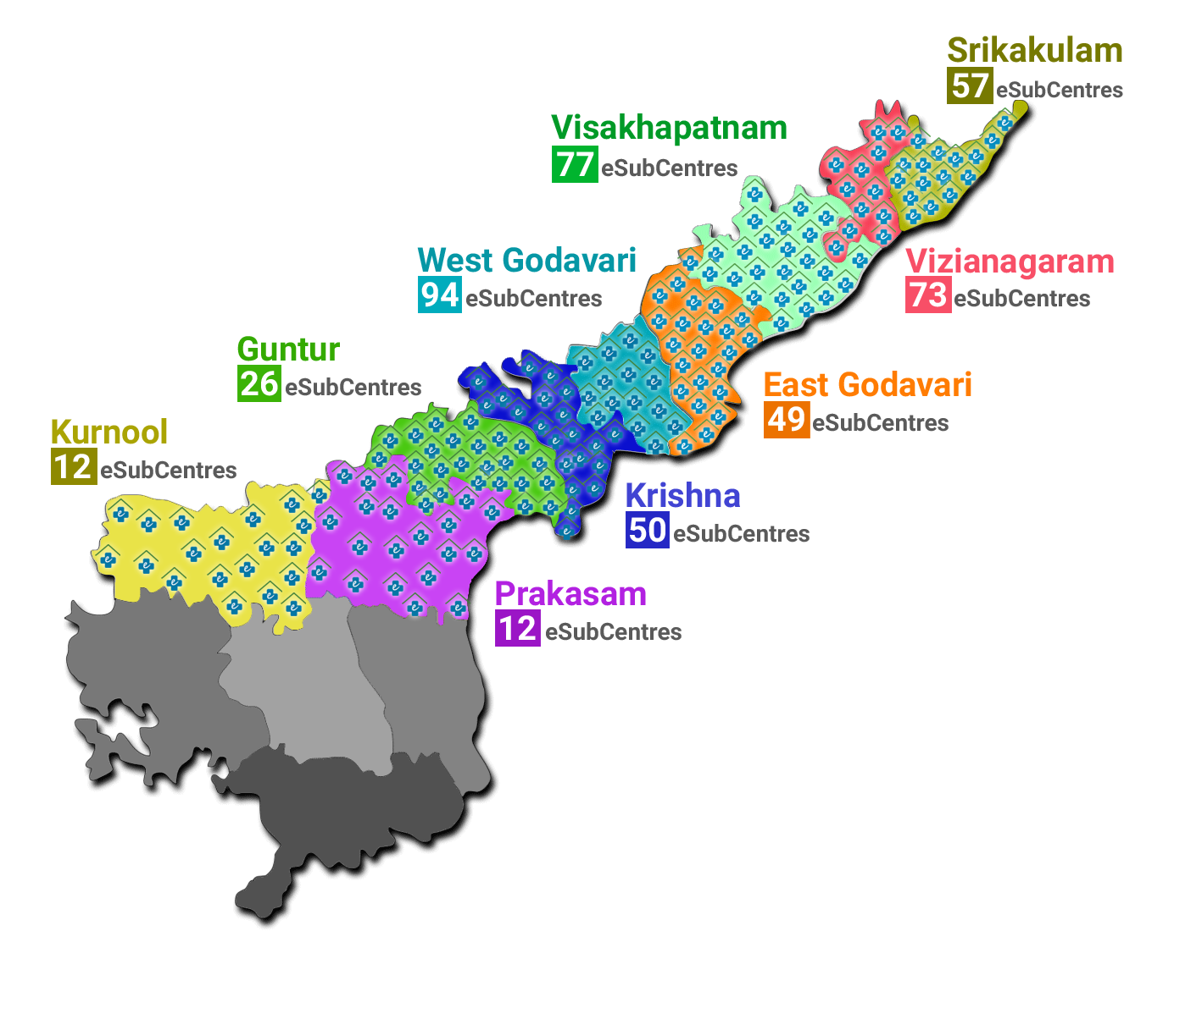
Telemedicine Footprint in Andhra Pradesh
District | No. of live H&WCs
Srikakulam | 57
Vizianagaram | 73
Visakhapatnam | 77
East Godavari | 49
West Godavari | 94
Guntur | 26
Krishna | 50
Kurnool | 12
Prakasam | 12
Total | 450
Roll out planned by Dec 2019

Slide 4
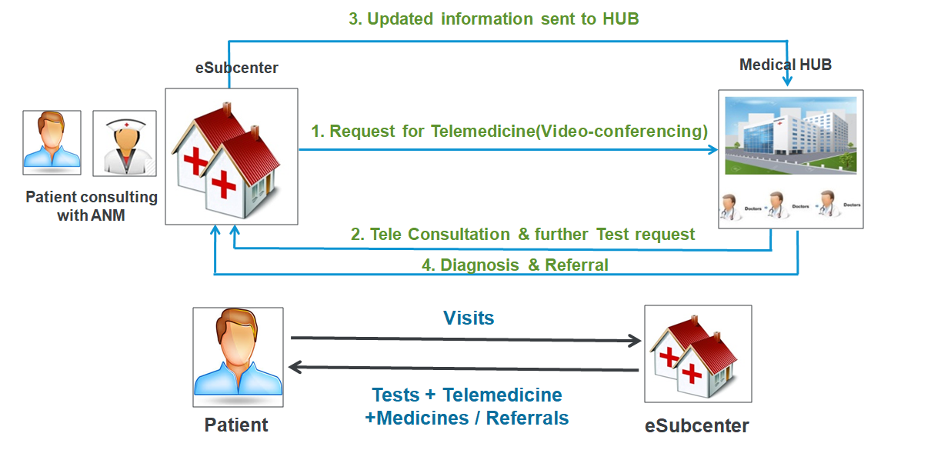
Schematic Representation of Telemedicine

Slide 5
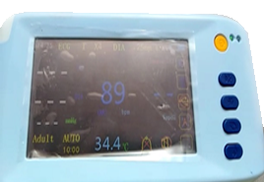
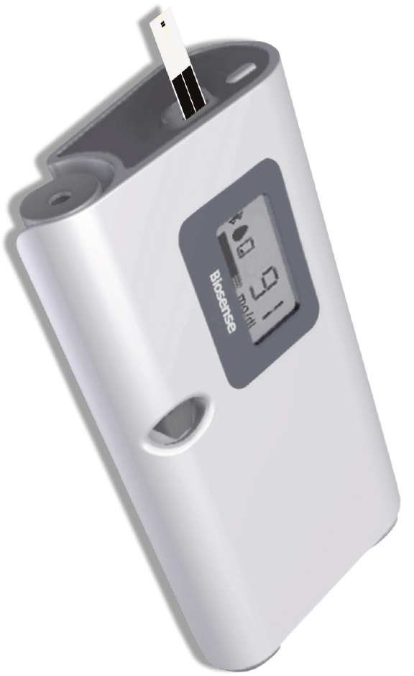
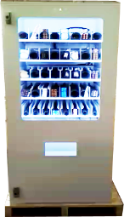
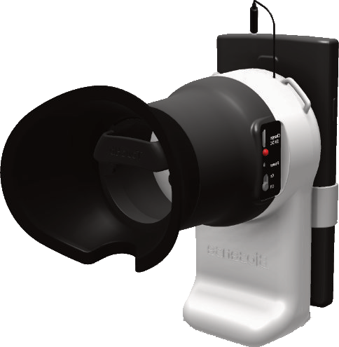
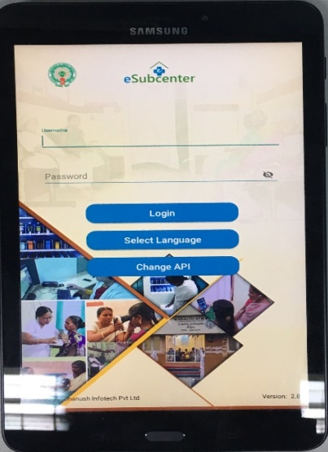
IT/Medical Devices Deployed
Multi para monitor
Glucometer
Drug Vending Machine
Non Invasive Haemoglobin meter
Tablet

Slide 6
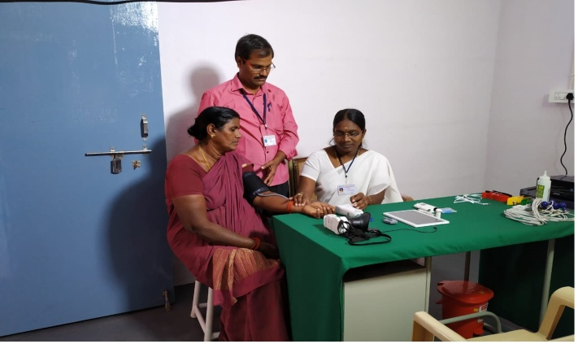
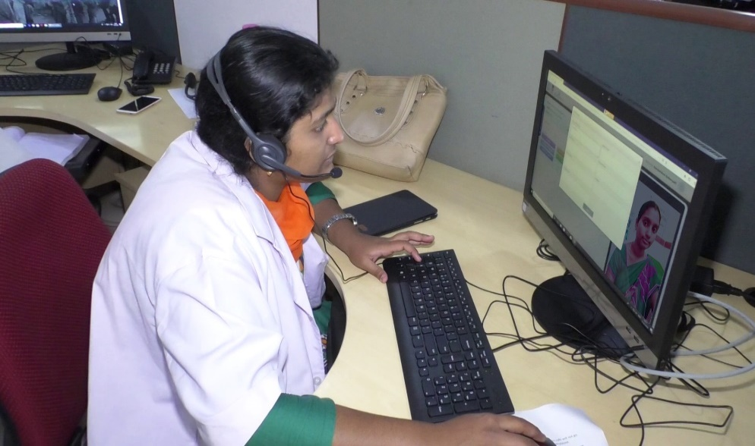
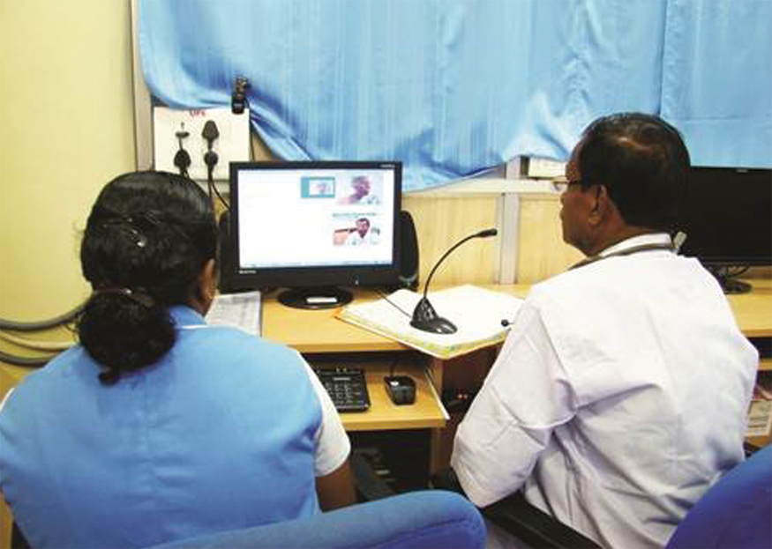
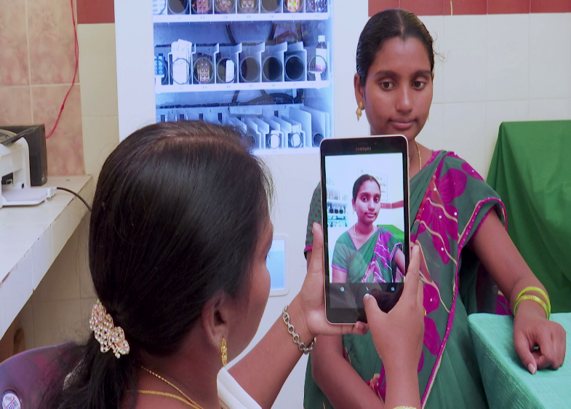
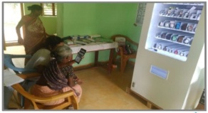

Slide 7
Change in Quality of Services Delivery
Before Conversion
After Conversion
  When Patient arrives at sub-centre ANM collects demographic details.
  Manual entries done in physical registers.
  The ANM records vitals like Blood Pressure, Temperature, Anthropometric data etc., which takes lot of time.
  The ANM prescribes basic drugs (13 drugs) for minor ailments
  For major ailments refers the patient to PHC or Community Health centre for further treatment. No Doctor available at Sub Centres.
  Patient demographic details, history & complaints entered digitally by CHO in vendor application.
  Multipara device is available to record temperature, SPO2, Blood Pressure, Heart rate & details stored digitally and shared electronically with specialists at Medical hubs – Vizag, Rajmundry, Hyderabad (8 specialists / 10 MBBS doctors).
  CHO connects patient to the doctor through telemedicine (Video Conference) IT solution for virtual consultation
  Conduct further tests as instructed by doctor like ECG (multiparamonitor).
  After test reports drugs are prescribed remotely from the 36 drugs available in the Drug Vending Machine

Slide 8
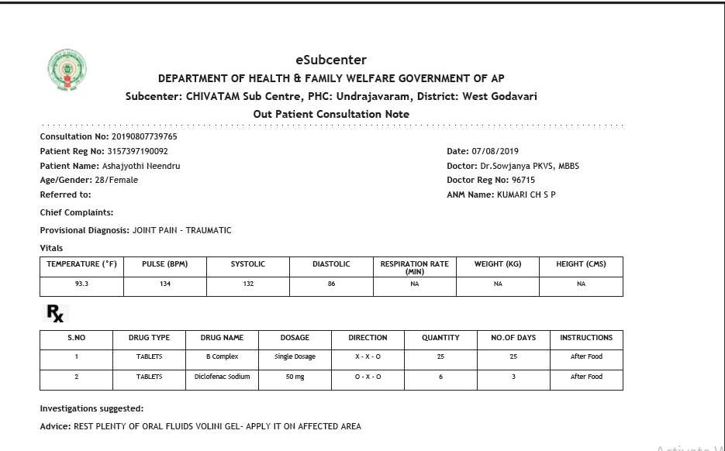
e Prescription

Slide 9
Tele Medicine (eSub Centre) Status
Reporting Parameters (as on 31st July 2019) | Total Count
Total Number of Active Facilities with Telemedicine Services | 450
Total Number of Patients Registrations | 33,339
Total Number of Tele Consultations | 33,696
Total Number of Referrals at Subcentres | 4660
Average Patients per day at SC | 5-6

Slide 10
Safe Delivery Calendar
Identification of all Antenatal cases in PHC catchment area – ANMs report data from all SCs
High Risk ANC is marked in red and referred to secondary / tertiary hospital for early evaluation
Each one catch one – supervisory staff of PHC
Mother is given option of institution for delivery – same is marked in SDC
High Risk case details shared with 108
Name of tagged doctor is also marked on SDC with phone number
All red marked cases are evaluated one week before delivery

Slide 11
